Slide 1
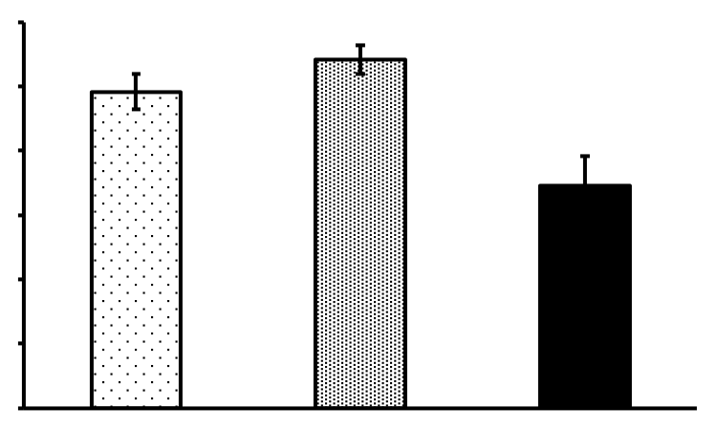
160
150
140
Immobility counts
130
120
110
100
0
1
10
Ketamine (mg/kg)

