Slide 1
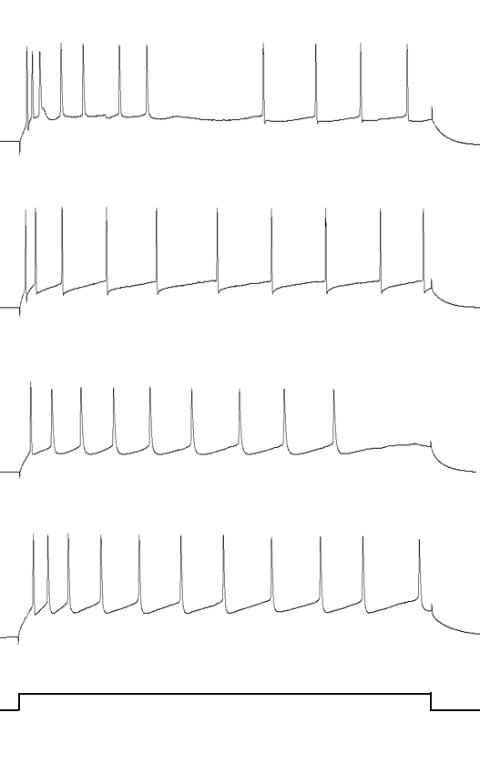
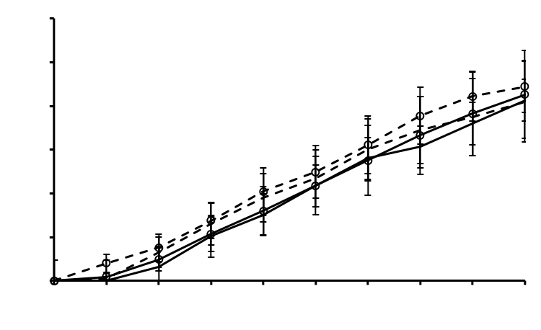
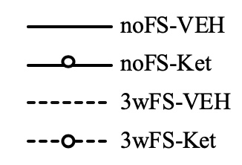
B
C
noFS-VEH
120
100
A
80
Membrane resistance (MΩ)
noFS-Ket
60
30
40
25
20
0
20
noFS-VEH
noFS-Ket
3wFS-VEH
3wFS-Ket
3wFS-VEH
Firing frequency (Hz)
15
D
10
noFS-VEH
noFS-Ket
3wFS-VEH
3wFS-Ket
0
5
3wFS-KEt
-
0
20
0.05
0.1
0.15
0.2
0.25
0.3
0.35
0.4
0.45
0.5
RMP (mV)
-
40
Injection
current (nA)
-
60
20 mV
-
80
0.5
nA
0.05 s

