Slide 1
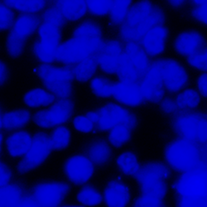
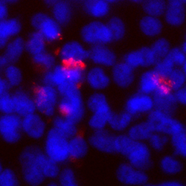
Fig. 1
A
C
WNV genome
prM
E
NS1
2A 2B
3
4A 4B
5
SP6
promoter
XbaI site
DsRed
pWNrep-DsRed
189
2380
CMV
promoter
HDV ribozyme
polyA
pCMV-WNrep-DsRed
(DNA-based replicon)
Homologous
sequences
C
prM
E
pCXSN-NY99CME or
pCXSN-Eg101CME
B
Mock
pCMV-WNrep-DsRed
C
XhoI site
NotI site
C
prM
E
pCXSN-NY99CME or
pCXSN-Eg101CME
primers
PCR or
restriction enzyme
DNA fragment for
structural proteins
pCMV-WNrep-DsRed
Transfection
293T cells
Infectious WNV
Homologous
recombination

Slide 2
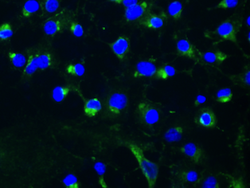
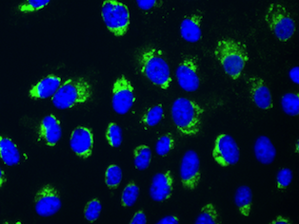
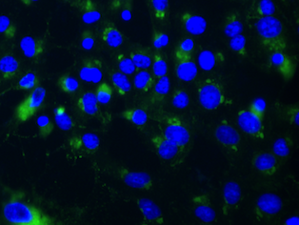
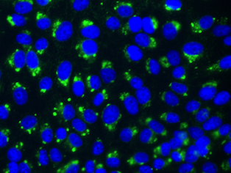
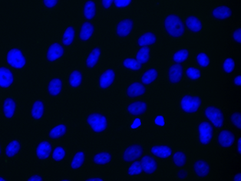
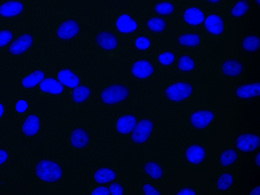
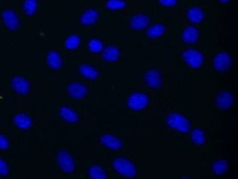
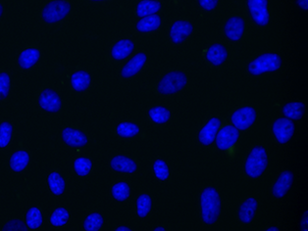
Fig. 2
A
D
Pfu / ml
Pfu / ml
N. D.
N. D.
B
E
PCR product
+ Replicon
RE fragment
+ Replicon
Parental NY99
Parental NY99
PCR product
Replicon
RE fragment
Replicon
C
Parental NY99
PCR product
+ Replicon
PCR product
Marker
Replicon
3000
2000
1500
1000
(bp)

Slide 3
Fig. 3
Pfu / ml
4666.7
1366.7
195.0
5.0
full length
(90)
60
30
15
Length of overlap nucleotide

Slide 4
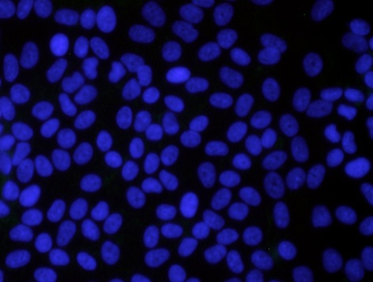
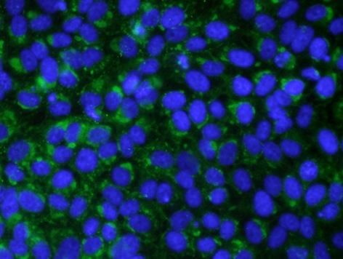
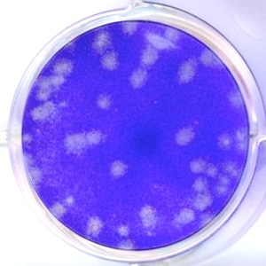
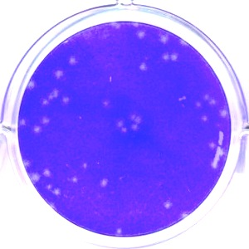
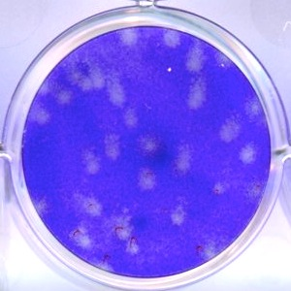
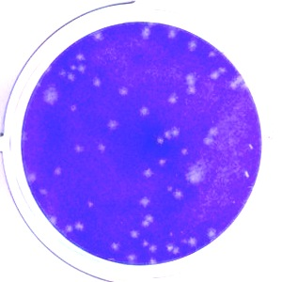
Fig. 4
A
PCR product (CME-Eg)
+ Replicon
PCR product (CME-Eg)
B
C
NY99
Eg101
Parental
log₁₀ (Pfu / ml)
NY99-HR
NY99-CMEEg101
Time post-infection (h)
Recombinant
Parental NY99
Parental Eg101
NY99-HR
NY99-CMEEg101

