Slide 1
On-demand Guidance
on Northern Campus Library’s Services
How to search Google Scholar
(and Web of Science Core Collection) for articles
Hokkaido University Northern Campus Library
April 2018

Slide 2
How to search Google Scholar
(and Web of Science Core Collection) for articles
Google Scholar
What is Google Scholar?
Settings and Screen
Link to Web of Science
Link to Hokkaido University Library Full text navigator
Google Scholar Button
Web of Science Core Collection
Remote Access Service
* I suppose that you access them on-campus for now.

Slide 3
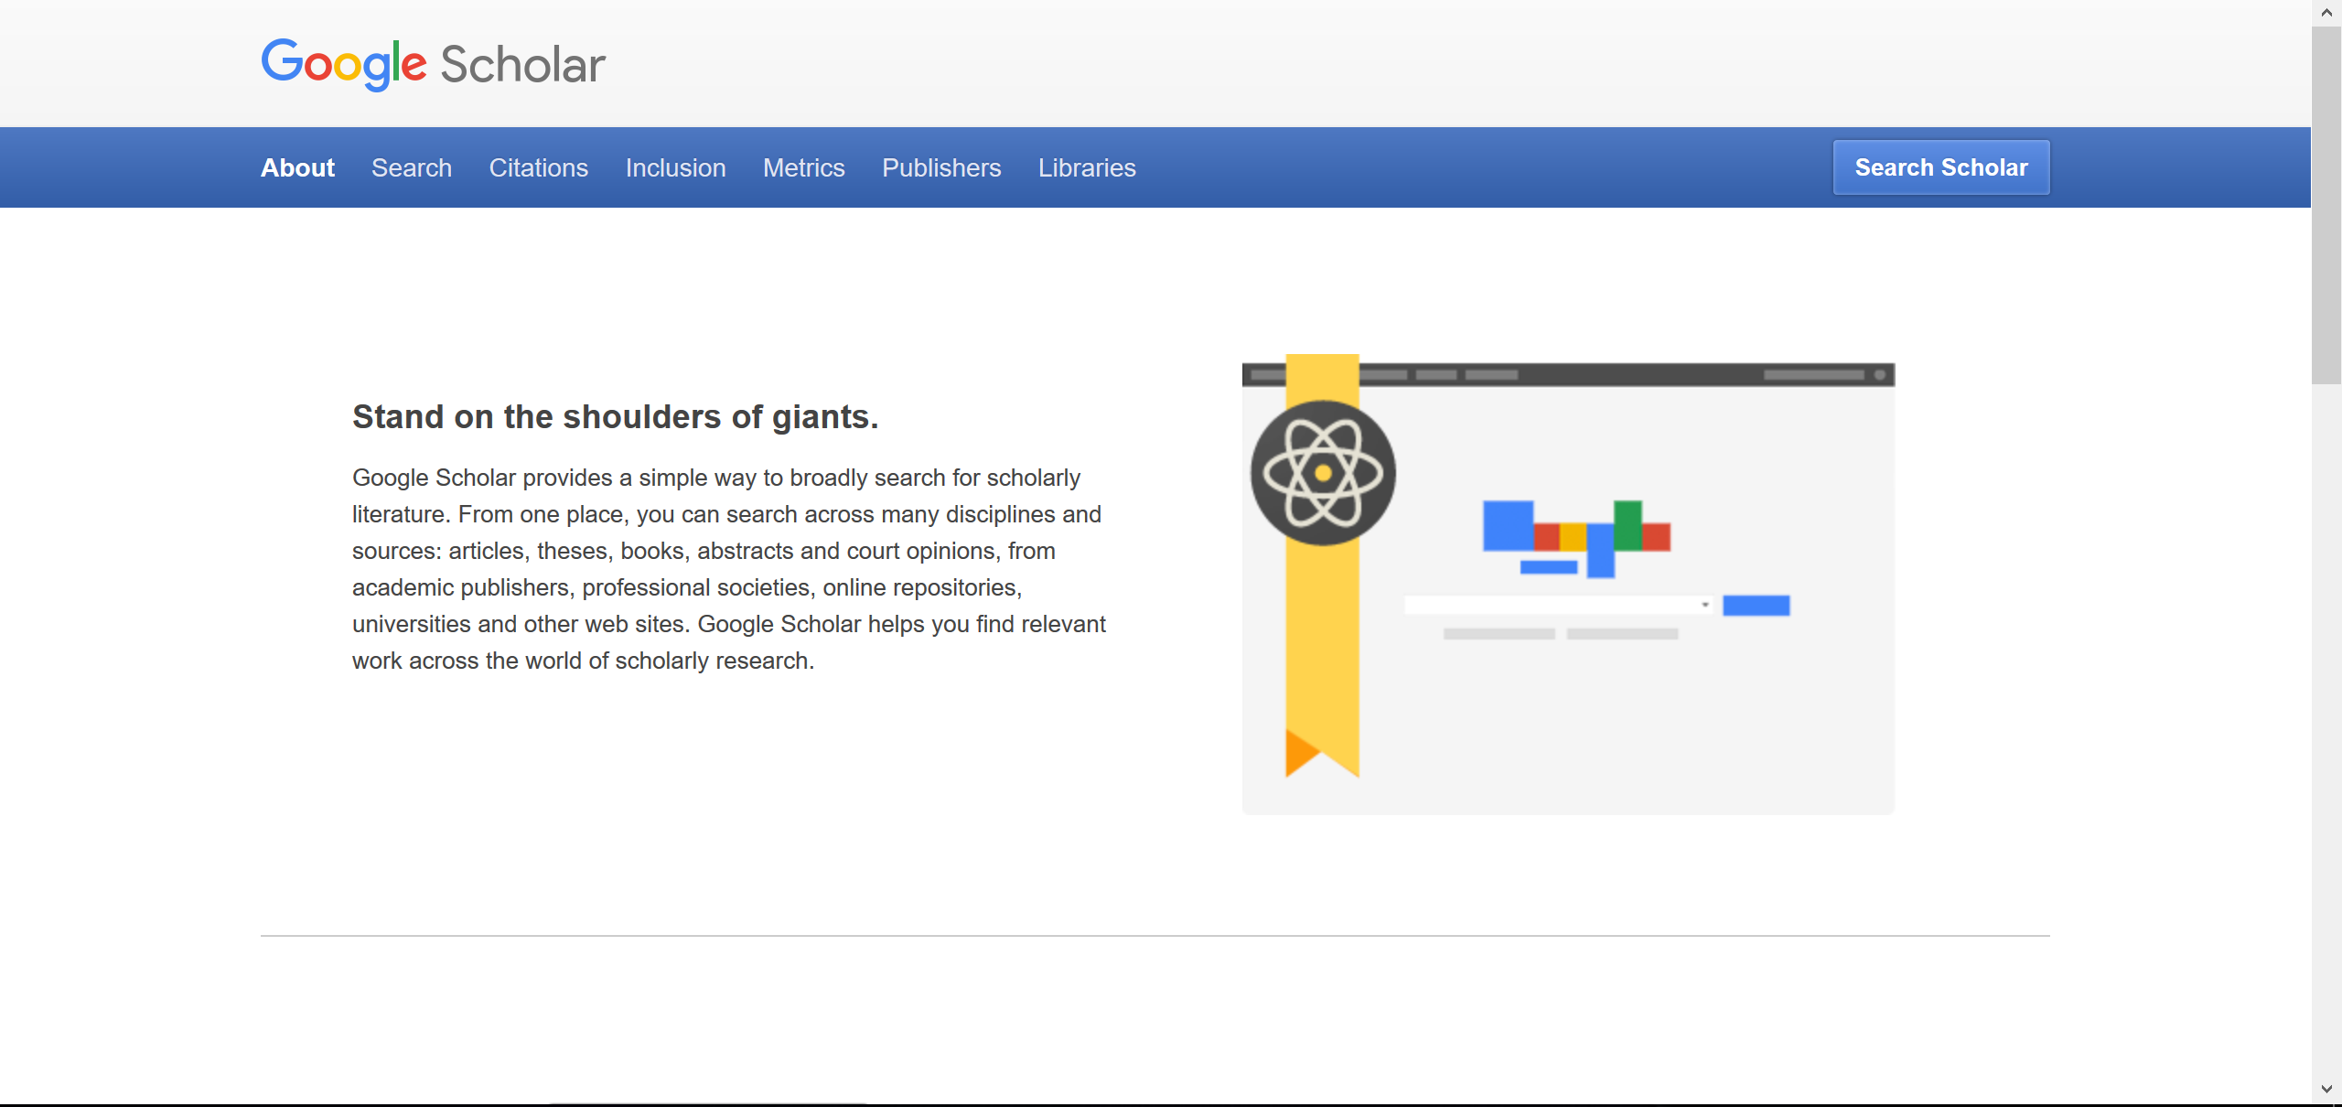
What is Google Scholar?
https://scholar.google.com/intl/en/scholar/about.html

Slide 4
What is Google Scholar?
The Surface Web
Outside of the Web
crawls and indexes information
Open-access articles
Crawlable databases
Print products
such as CiNii
Paywall articles
Bibliographic information
The Deep Web
Stand-alone databases
Full text
Commercial databases
such as Web of Science,
Scopus, SciFinder, and...

Slide 5
What is Google Scholar?
Advantages
Disadvantages
Google Scholar seems to cover
a huge number of articles.
Bibliographic information on the surface Web
But it does not cover the all.
Uncrawlable pages
Paywall articles’ full text
Commercial databases
Print-only information
But several services work together with Google Scholar to enhance its function.
Hokkaido University Library Full text navigator
Web of Science
Google’s account service
Google Scholar is less functional than other commercial databases in indexing and cataloging.
Google Scholar makes you search quickly for articles while browsing the Web.
Google Scholar Button

Slide 6
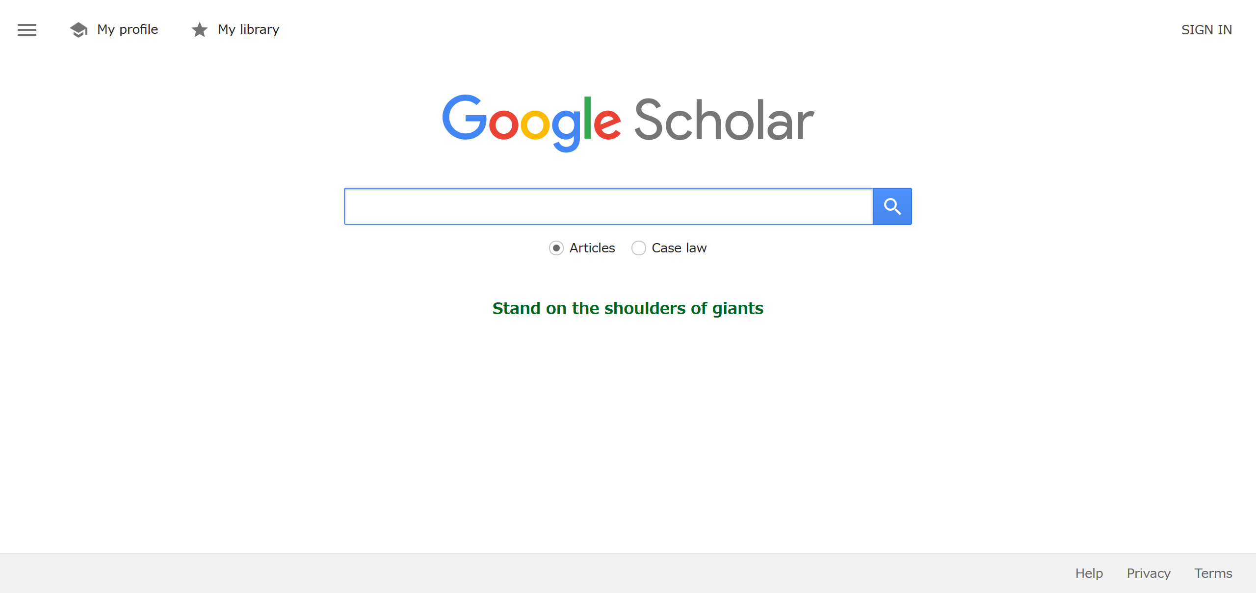
Settings and Screens
https://scholar.google.com

Slide 7
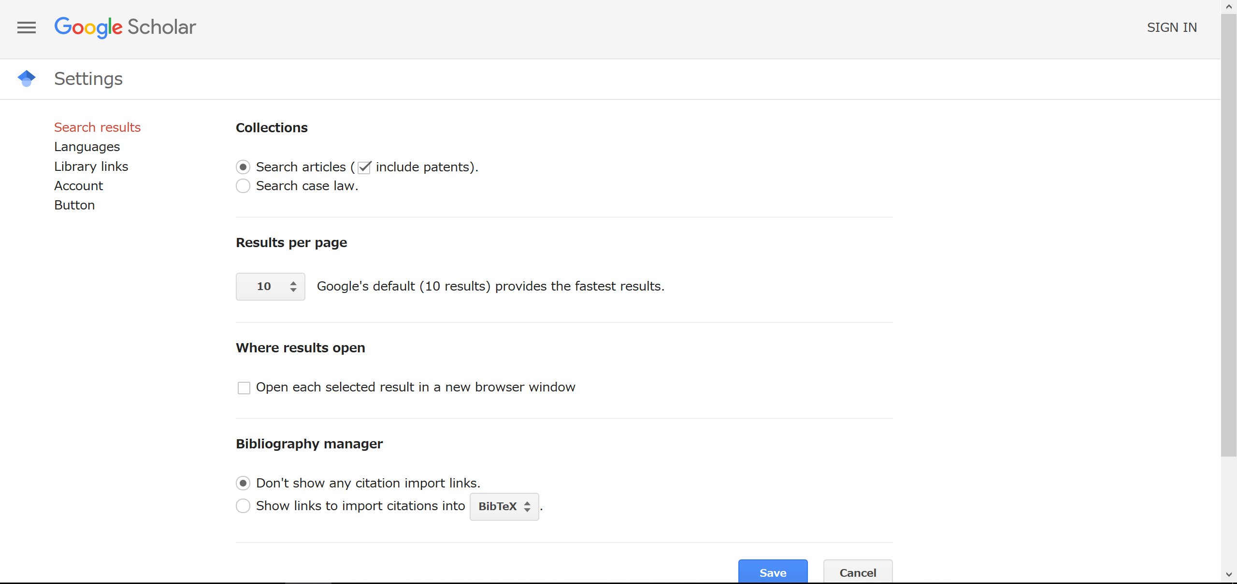
Setting 1 : Search results
https://scholar.google.com

Slide 8
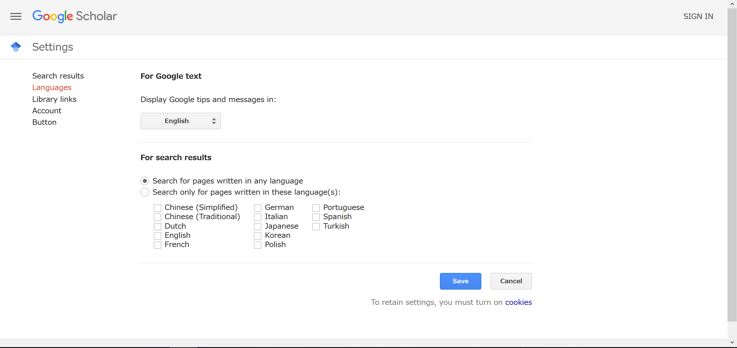
Setting 2 : Languages
https://scholar.google.com
choose languages
whose pages Google Scholar searches
In Japanese version,
Google Scholar searches only pages
written in Japanese and English by default.

Slide 9
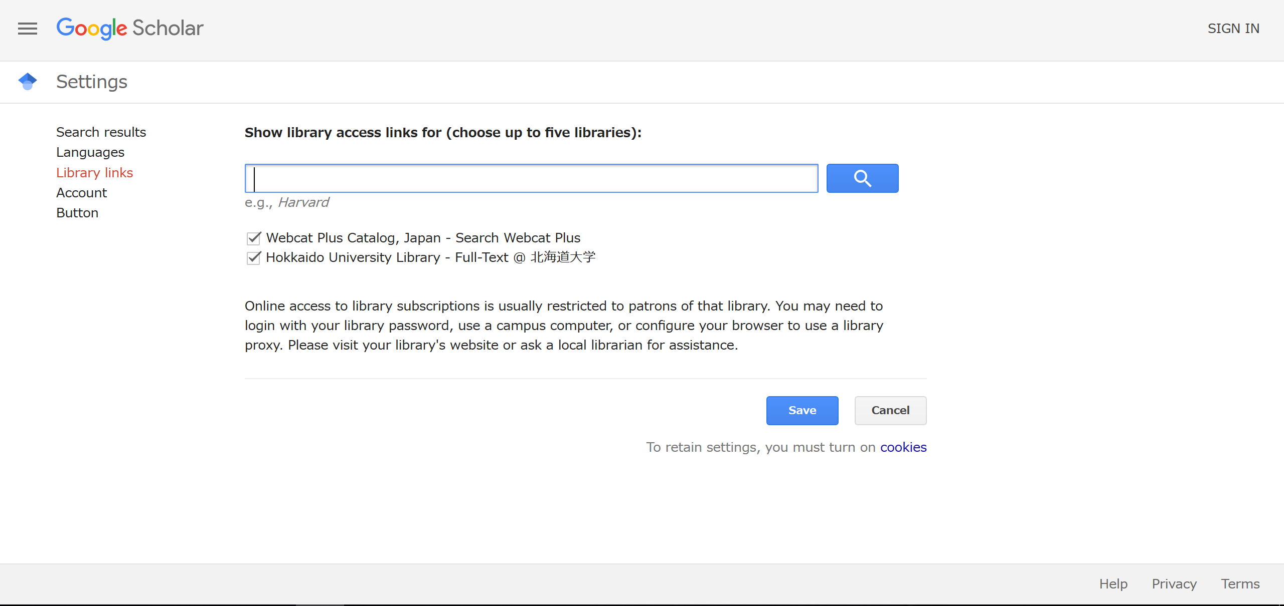
Setting 3 : Library Links
https://scholar.google.com
I highly recommend to choose
“Hokkaido University Library
- Full-Text @ 北海道大学”
I will explain this advantage later!

Slide 10
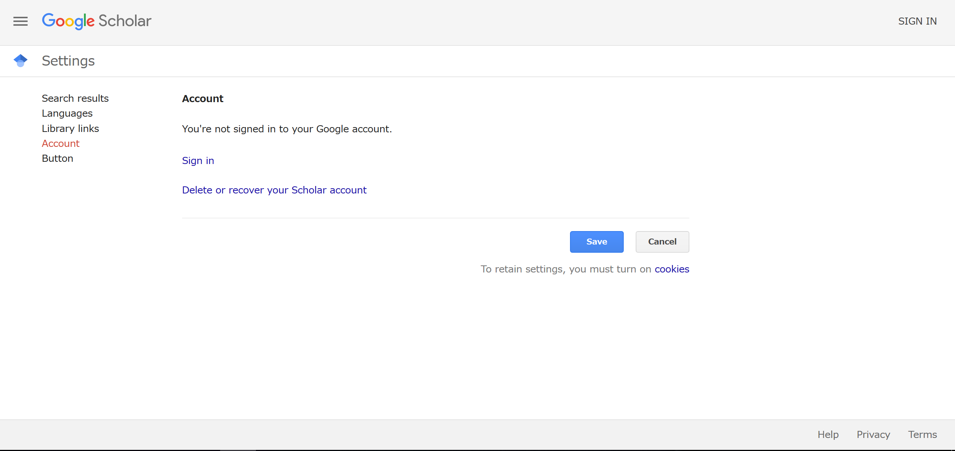
Setting 4 : Account
https://scholar.google.com
If you sign in,
you can save the results in My library and read them later.
I will explain “Button” later.

Slide 11
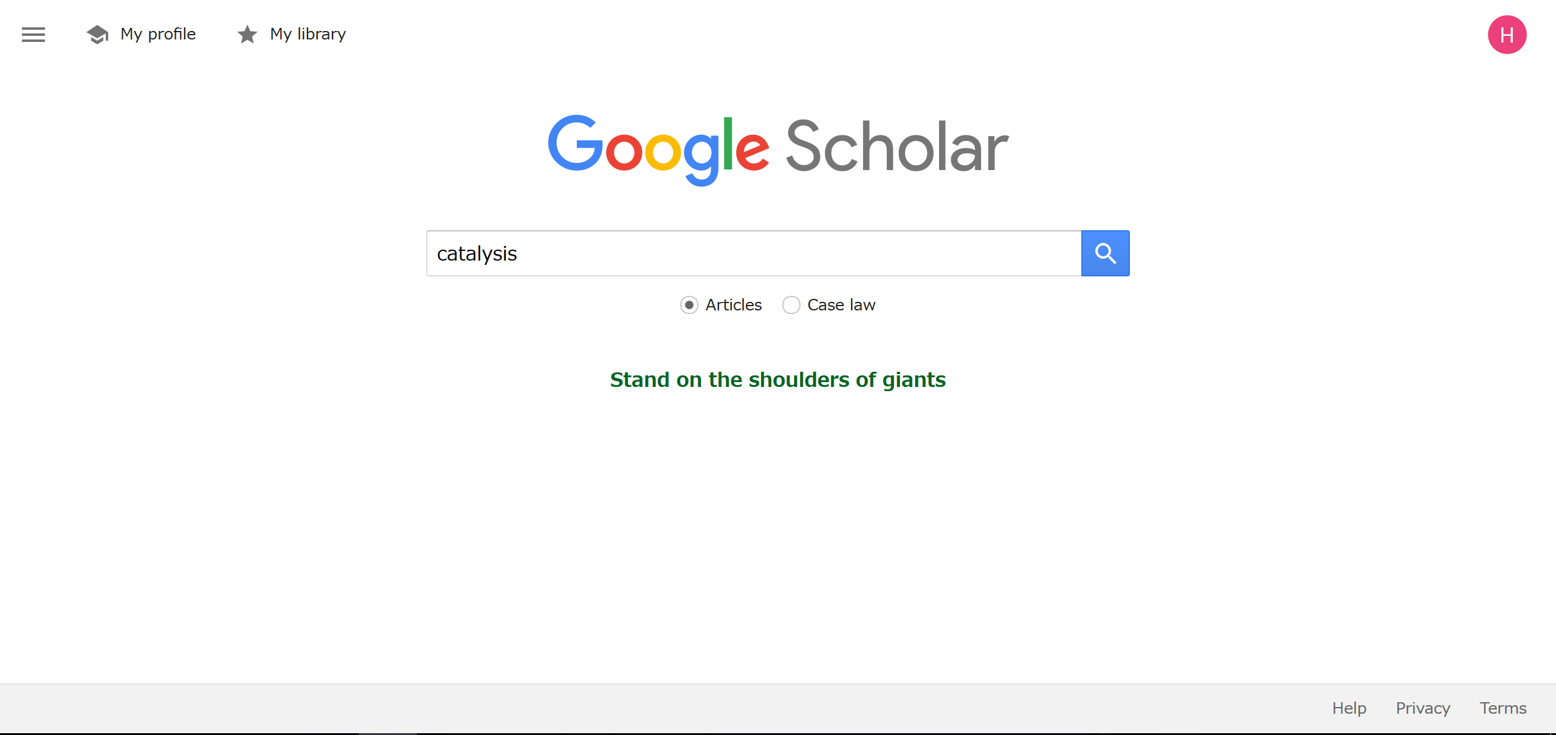
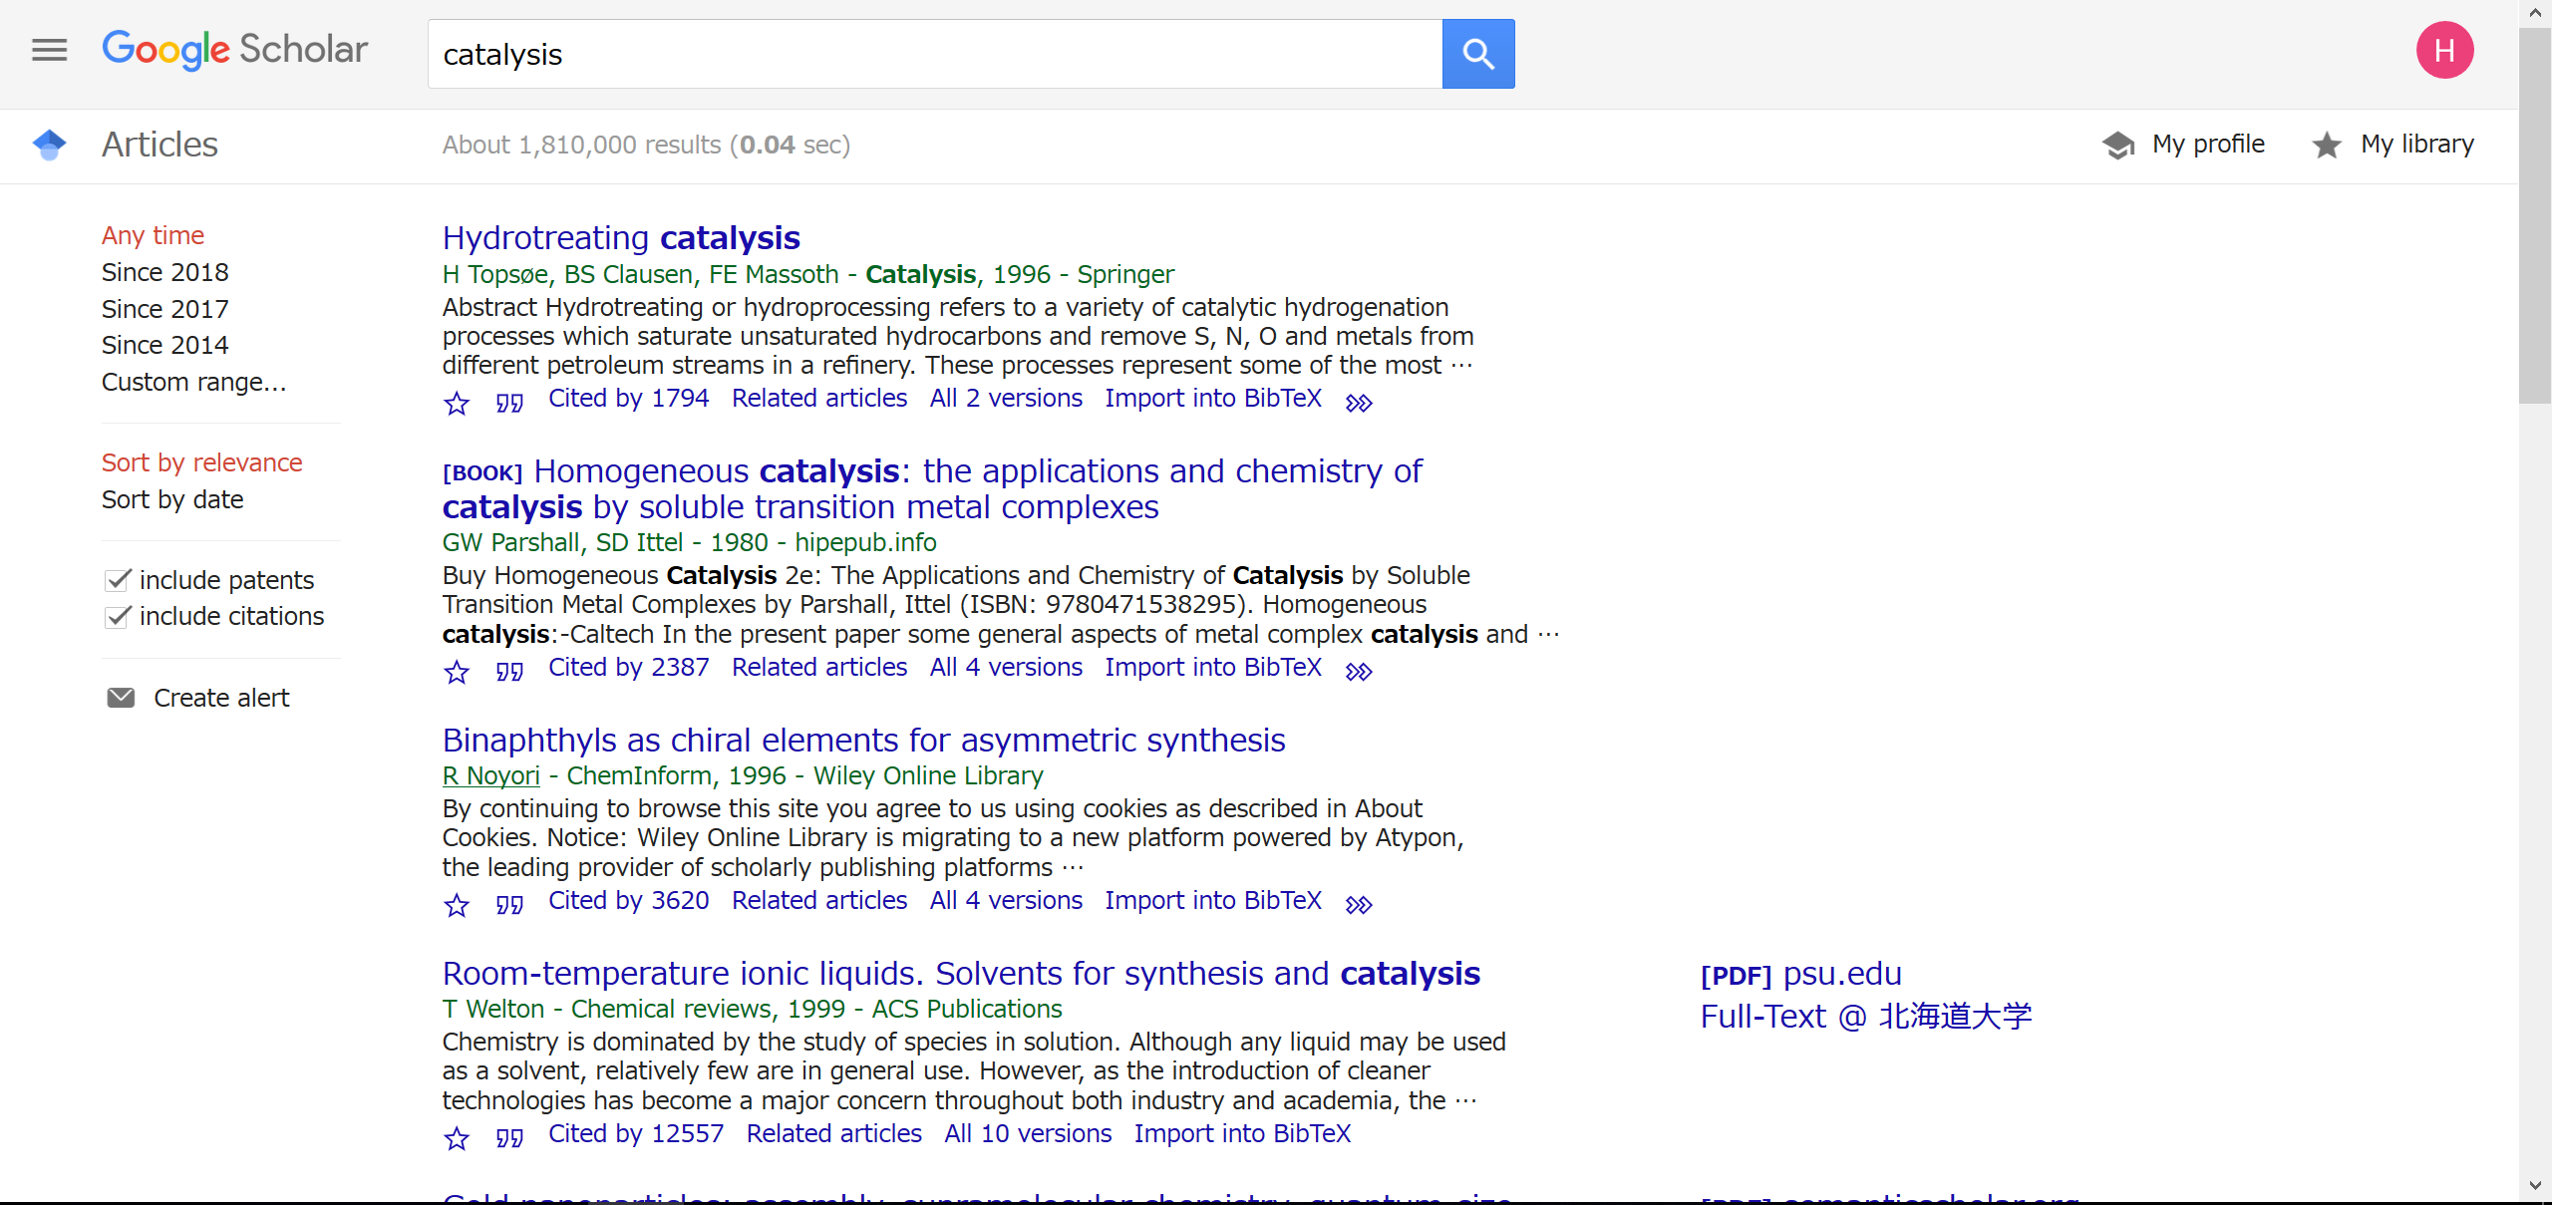
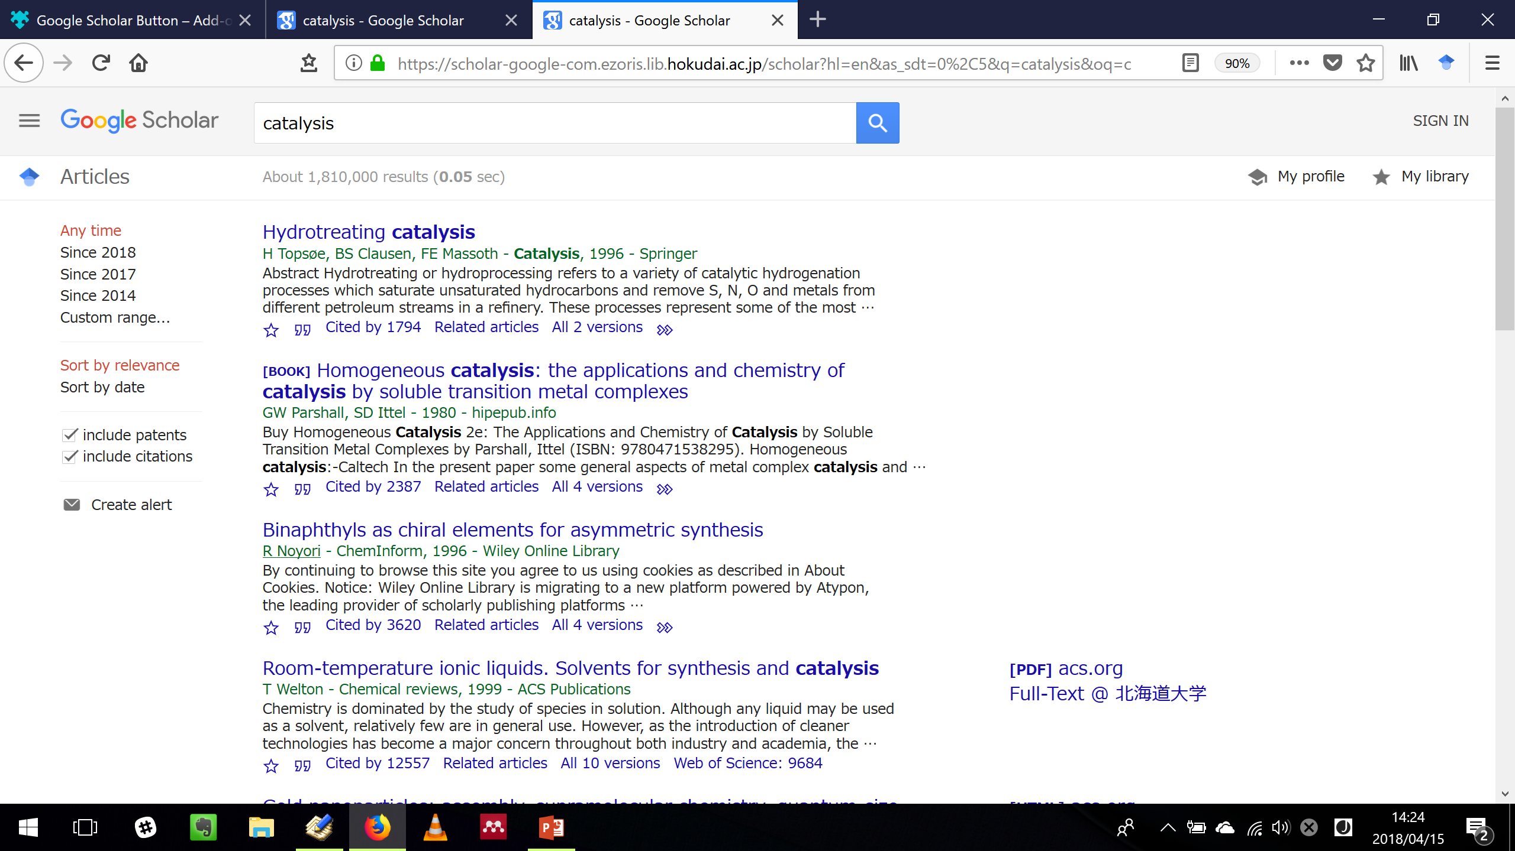
Search screen
https://scholar.google.com
If needed

Slide 12
Search result screen
https://scholar.google.com
The results are listed.
Each result is displayed:
Title
Author – Publication, Year – Source
Abstract
Links
- narrow down the results by the publication year
- change the sorting order
- include or exclude patents and citations
- receive an email when the articles that match the search criteria are published

Slide 13
Links below each result
https://scholar.google.com
save this result in My library
* need to sign in with a Google account
export the citation of this article
display the articles which cite this article in Google Scholar
display the articles which relate with this article in Google Scholar
display other versions of this article,
i.e. other source’s version, author’s version (manuscript), and so on

Slide 14
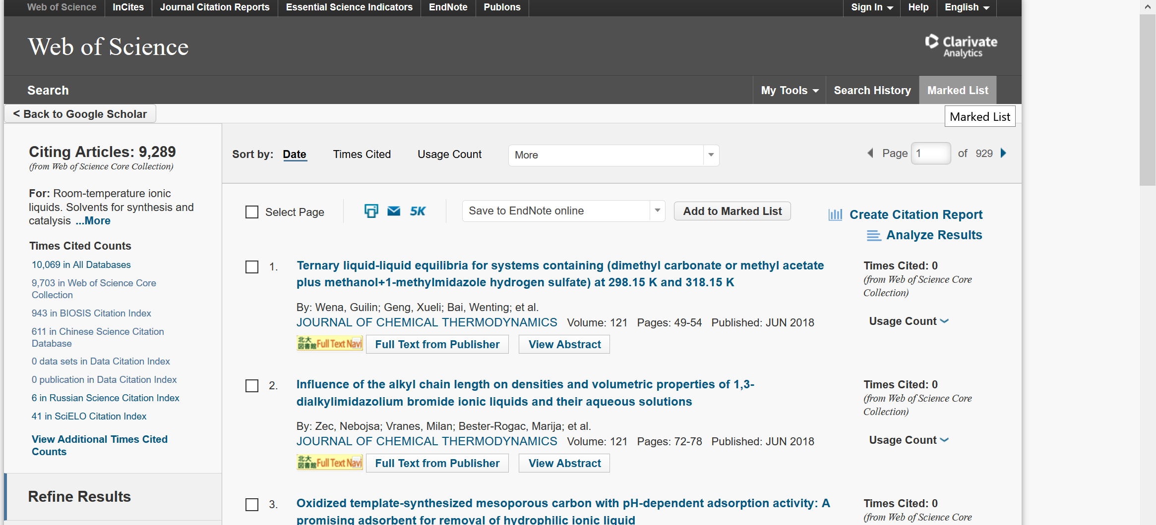
Link to Web of Science
https://scholar.google.com
display the articles which cite this article in Web of Science Core Collection
Hokkaido University does not subscribe the whole of the collection.
So only 9289 articles are displayed in Web of Science.

Slide 15
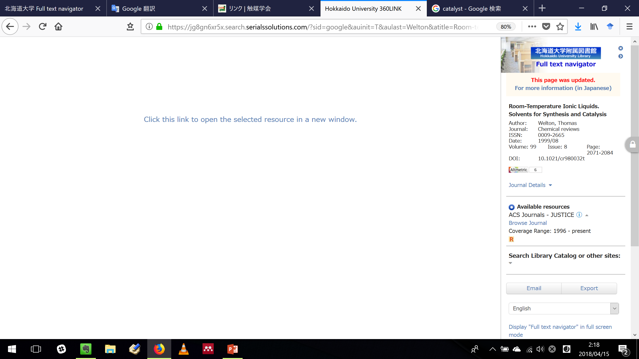
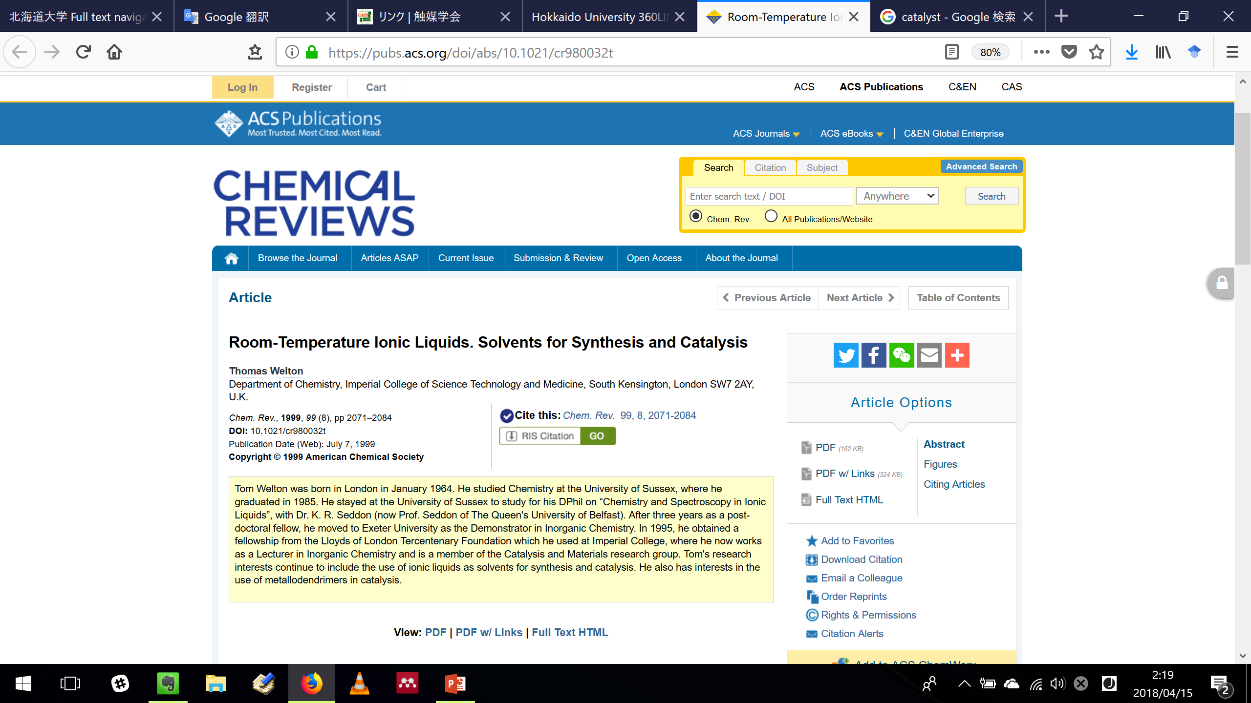
Link to Hokkaido University Library Full text navigator
Full-Text @ 北海道大学
https://scholar.google.com
switch language
If you find “Full-Text @ 北海道大学”
you can access the full text with a few clicks.

Slide 16
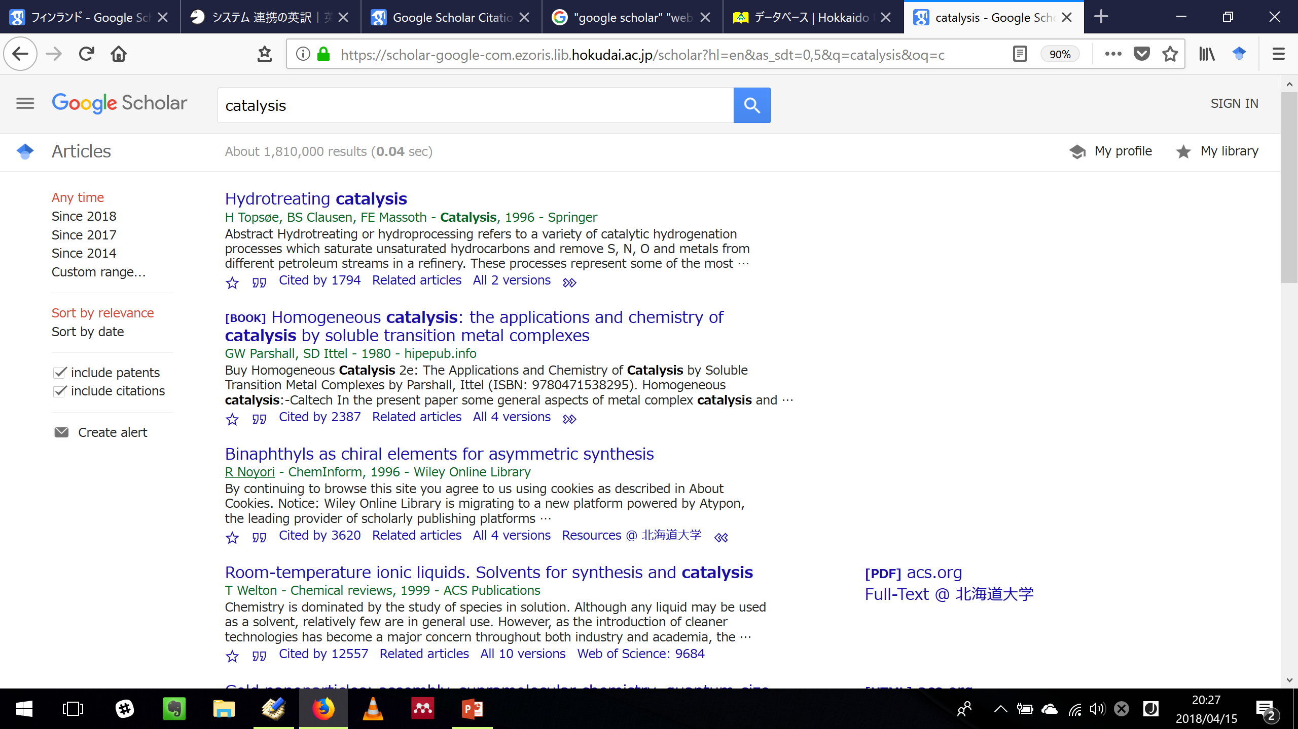
Link to Hokkaido University Library Full text navigator
Resources @ 北海道大学
https://scholar.google.com
If you do not find “Full-Text @ 北海道大学”
you may not access the full text immediately.
click the right edge of the links’ line, and you find “Resources @ 北海道大学”
*“Resources @ 北海道大学” is not displayed,
- when “Full-Text @ 北海道大学” is already displayed
- when the result’s title is started from [BOOK] or [CITATION]

Slide 17
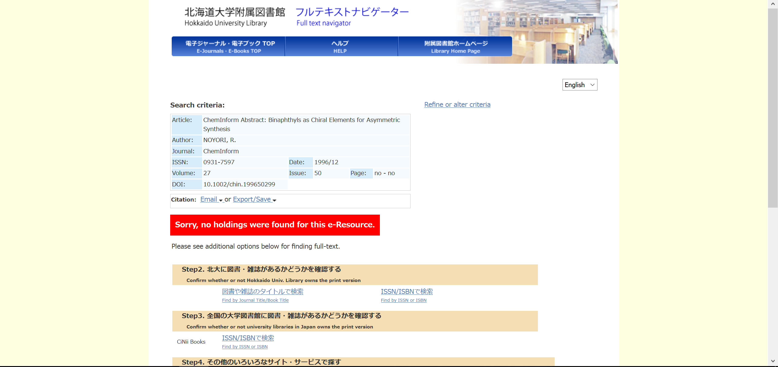
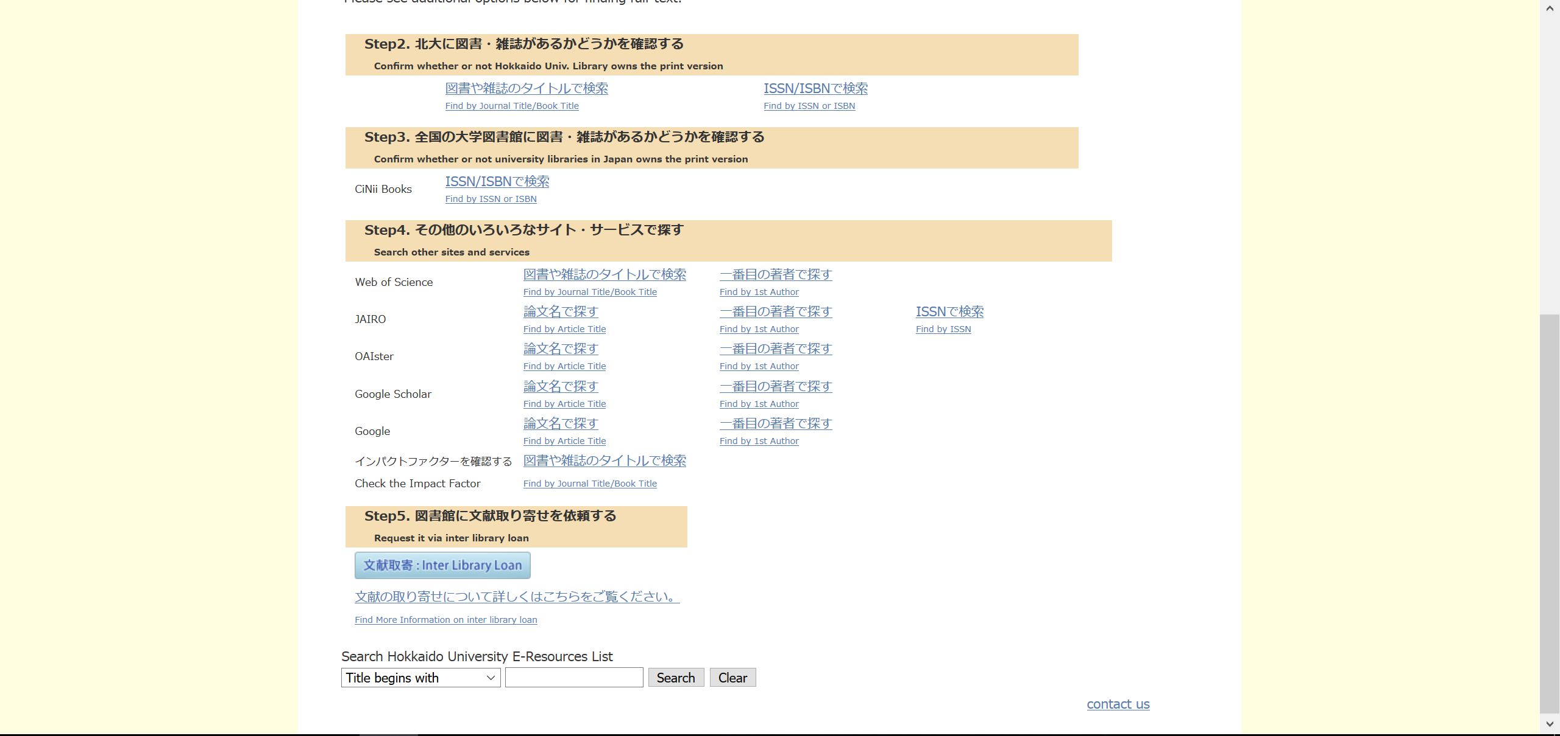
Link to Hokkaido University Library Full text navigator
Resources @ 北海道大学
switch language
“Resources @ 北海道大学” offers you some option for finding the full text
- search for the print version in Hokkaido University and other universities
- search other websites
- request a photocopy via interlibrary loan (a fee-based service)
You can try them with a few clicks (without typing the bibliographic information).

Slide 18
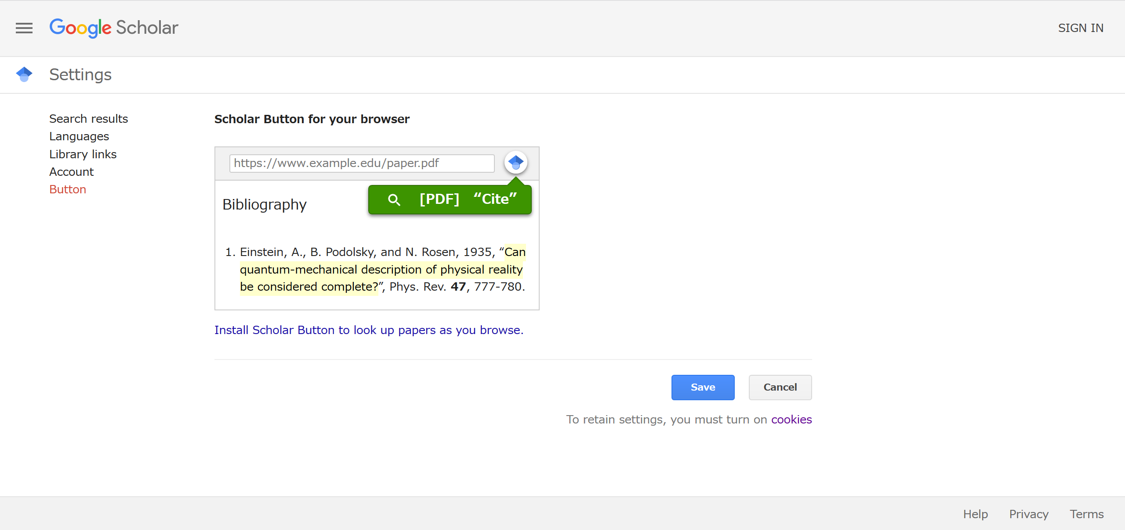
Google Scholar Button
https://scholar.google.com
If you install “Google Scholar Button” on your browser,
you can search quickly for articles while browsing the Web.

Slide 19
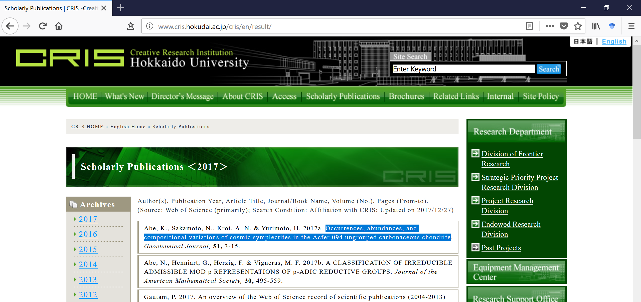
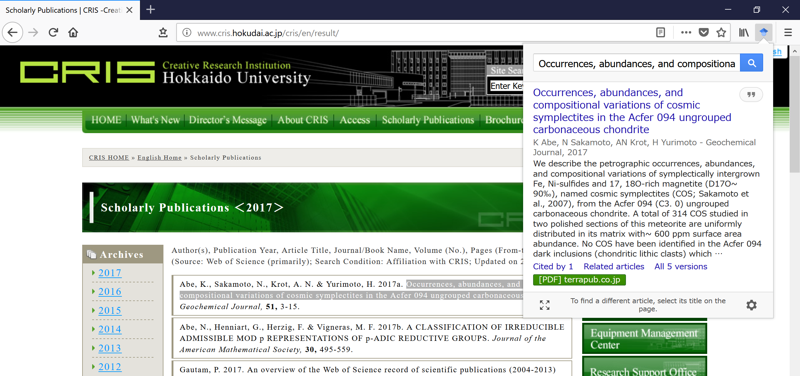
Google Scholar Button
Google Scholar Button installed on the browser
When you select the letters and click Google Scholar Button,
Google Scholar starts to search for articles.
You can check all the search results.

Slide 20
Google Scholar vs. Web of Science Core Collection
Too many to find?
Google Scholar
When you already have bibliographic information, the search will go well.
When you have only keywords or subjects,
It may be hard to find the articles you should read
from the search results.
Web of Science Core Collection
articles published
in the top journals
Its records are from the top journals(, conference proceedings, and books).
You can find only high-quality articles.
* Hokkaido University subscribes only the indexes of the journals.
We cannot search for conference papers or parts of books.
Each record has several types of metadata.
You can narrow down the search results in various respects.
Each record is connected to the citation (citing/cited) network.
You can find one article after another.

Slide 21
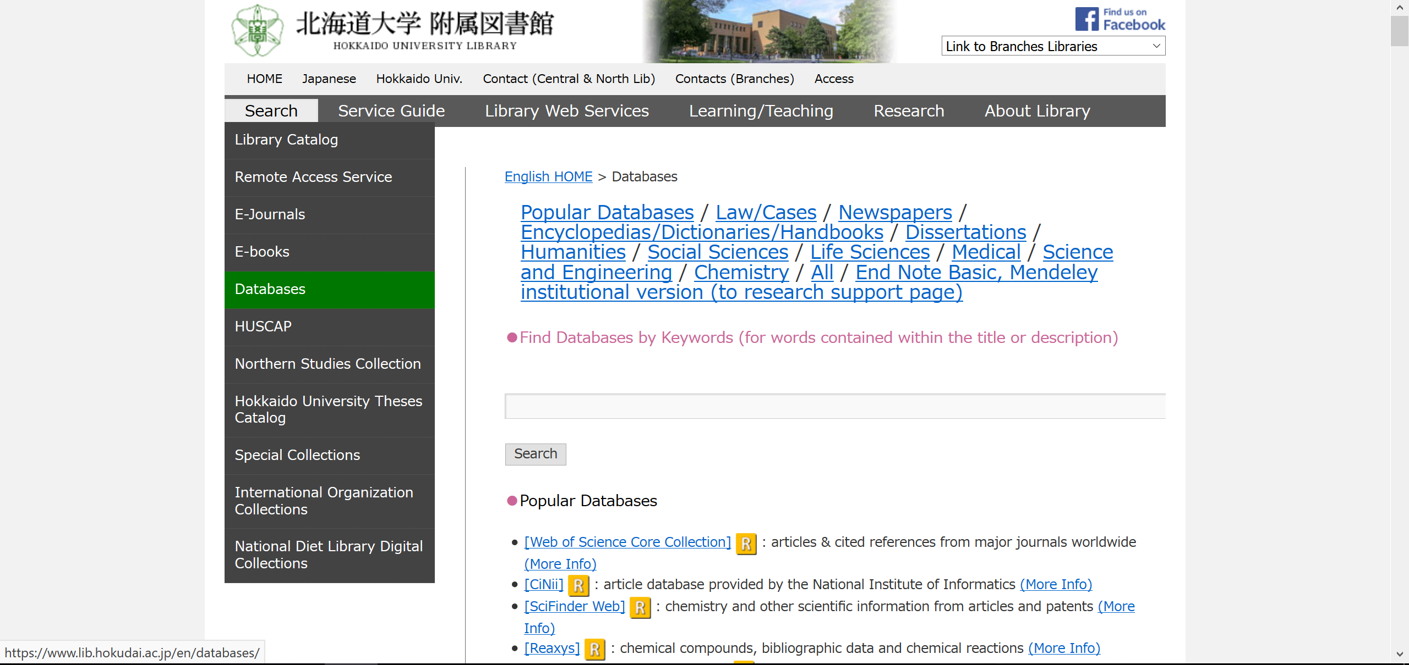
How to access Web of Science Core Collection
and other useful databases
https://www.lib.hokudai.ac.jp/en/databases/
I recommend that you also check the databases in these categories.

Slide 22
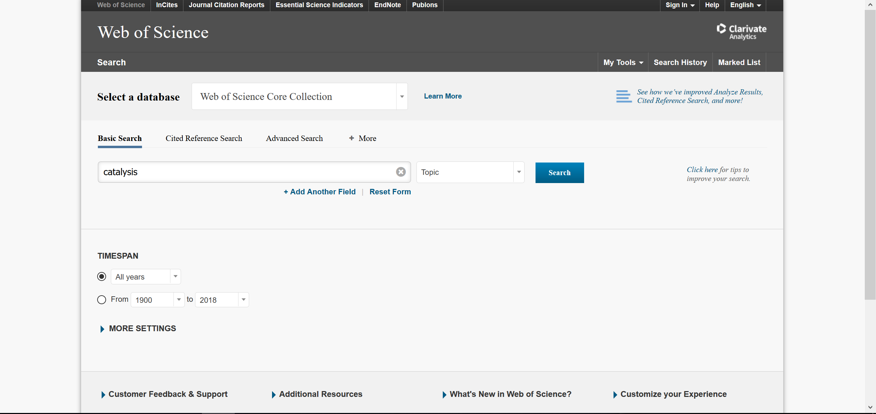
How to use Web of Science Core Collection
Search screen
search by not only Topic but also Title, Author, Language, Document Type, Finding Agency and so on
multiply these search criteria

Slide 23
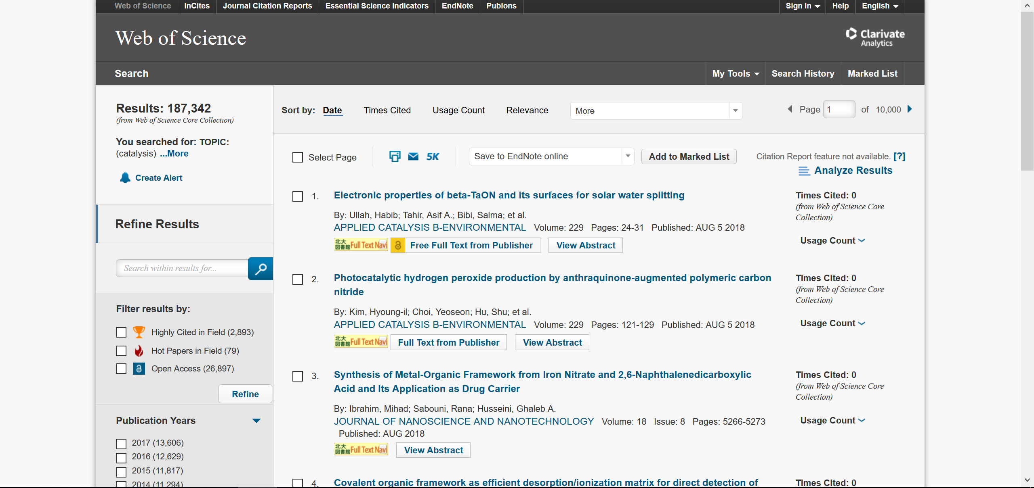
How to use Web of Science Core Collection
Search result screen
change the sorting order
find the top papers
View abstracts in one screen

Slide 24
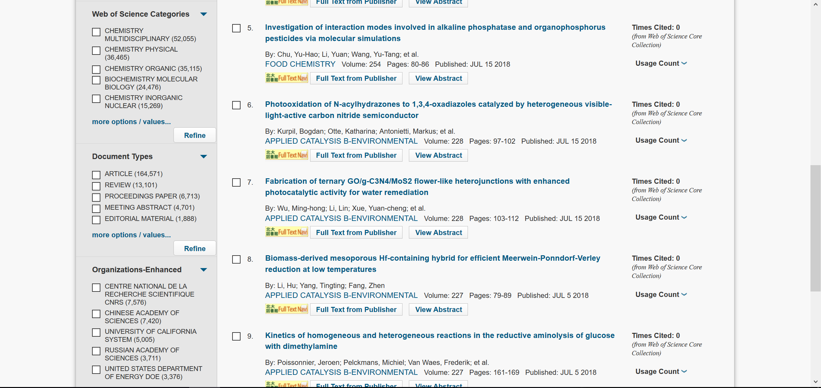
How to use Web of Science Core Collection
Search result screen
filter the results by the research fields
filter the results by the document types
If you just begin to research a new field,
I recommend reading REVIEWs.
filter the organization which authors belong to

Slide 25
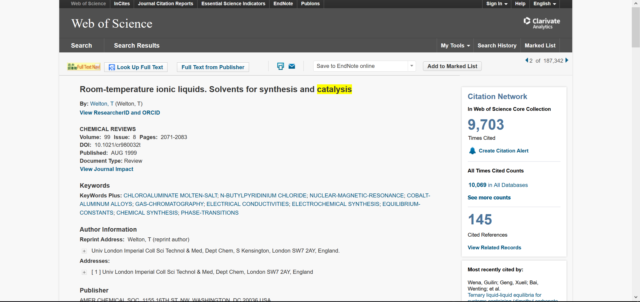
How to use Web of Science Core Collection
Detailed information (displayed after clicking a title in the search result screen)
Link to Hokkaido University Library Full text navigator
search by a keyword again
find one article after another through the citation network
which is the feature and strength of Web of Science Core Collection

Slide 26
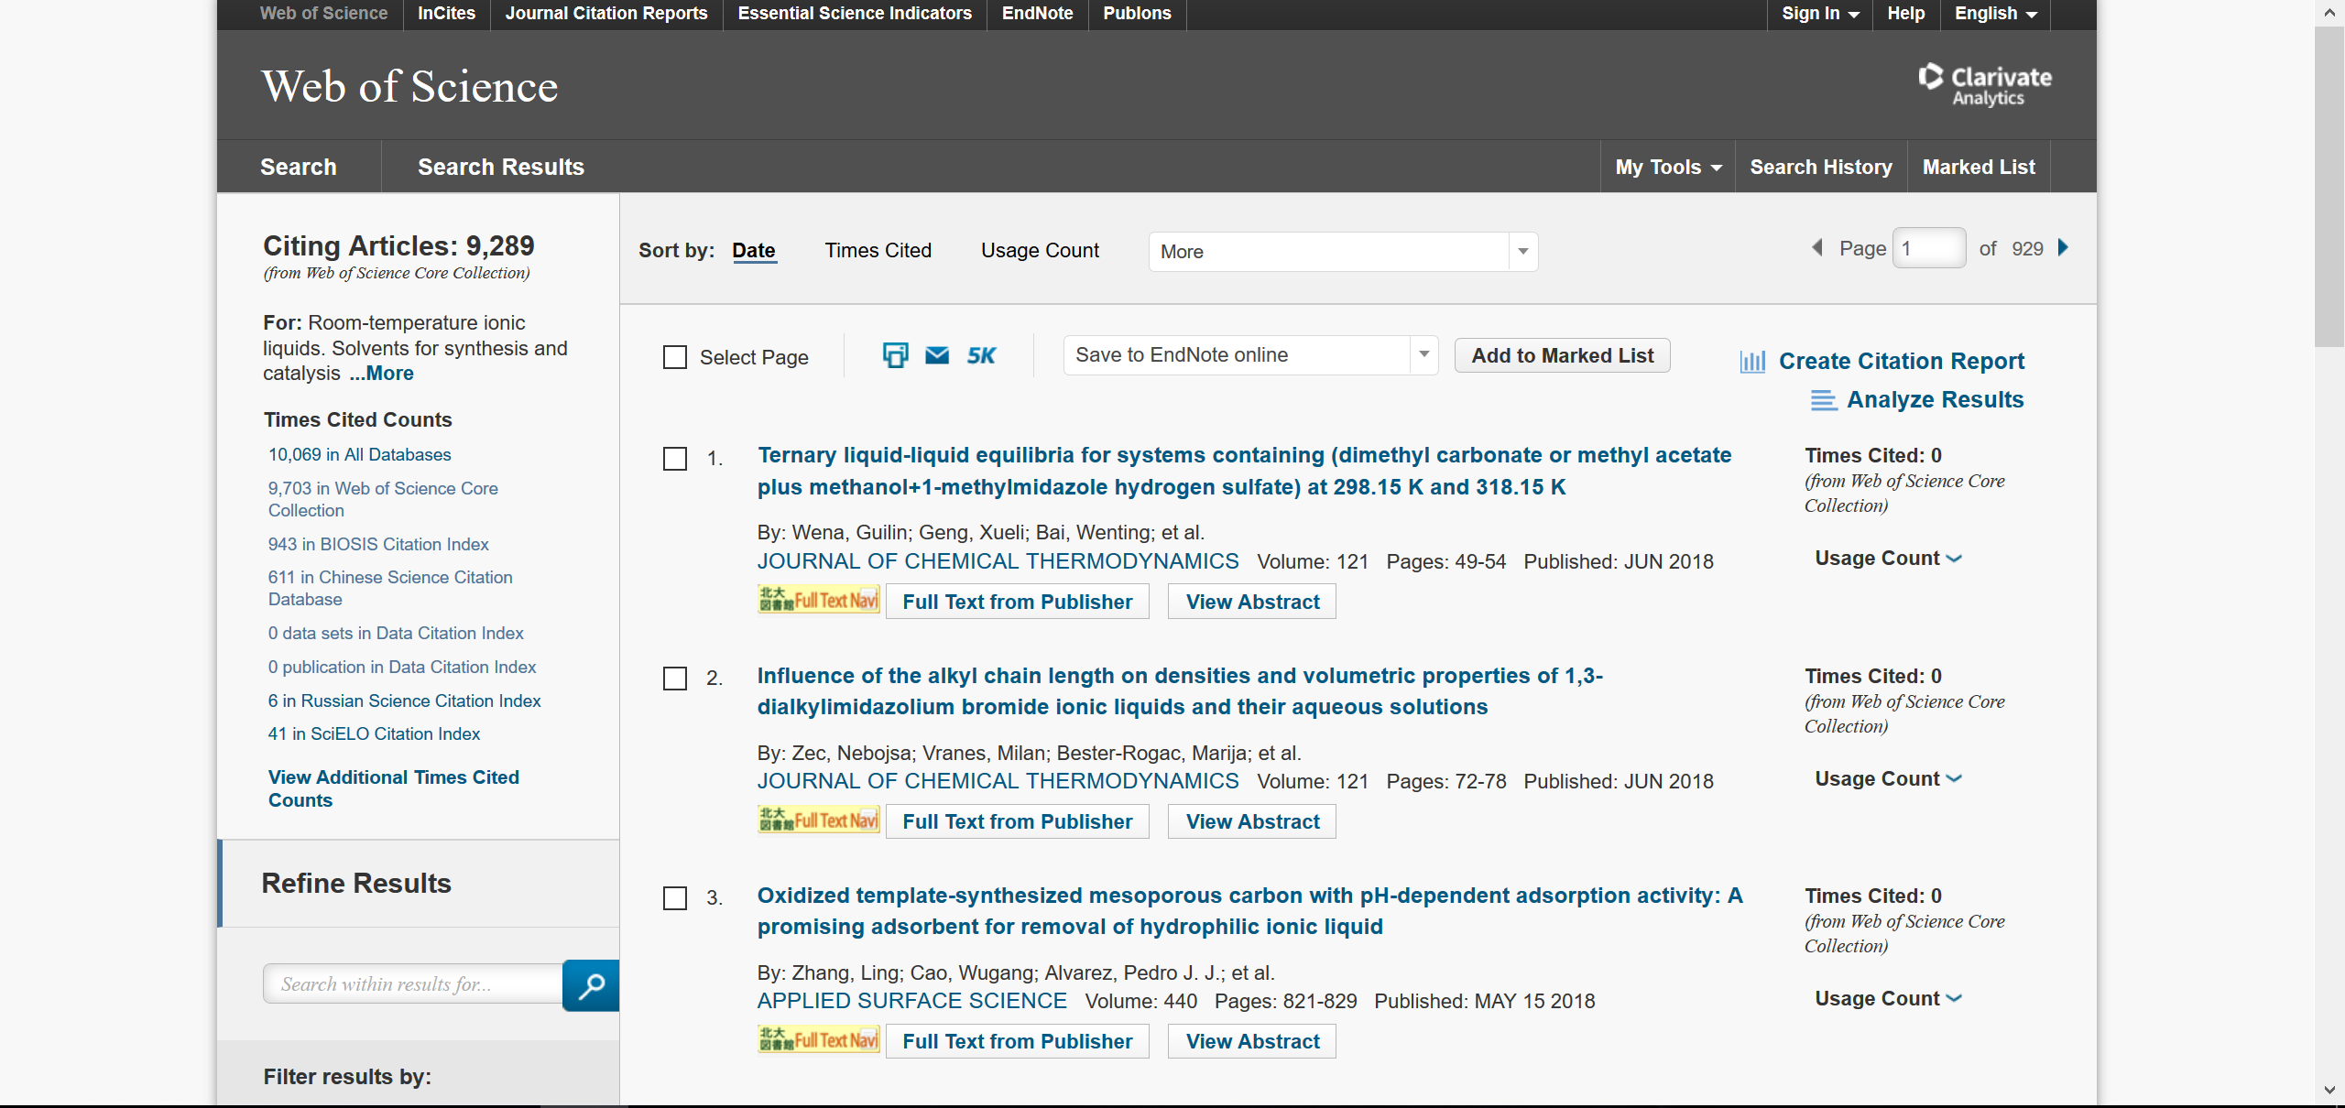
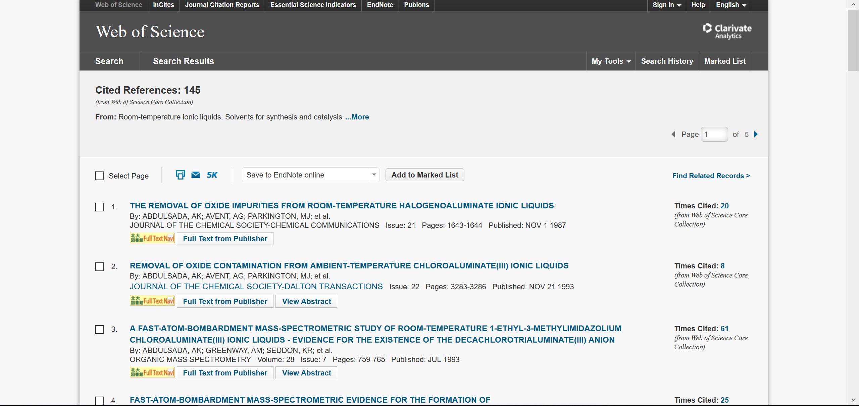
How to use Web of Science Core Collection
What articles cite this article? / What articles are cited by this article?
The articles cite this article
The articles were cited by this article

Slide 27
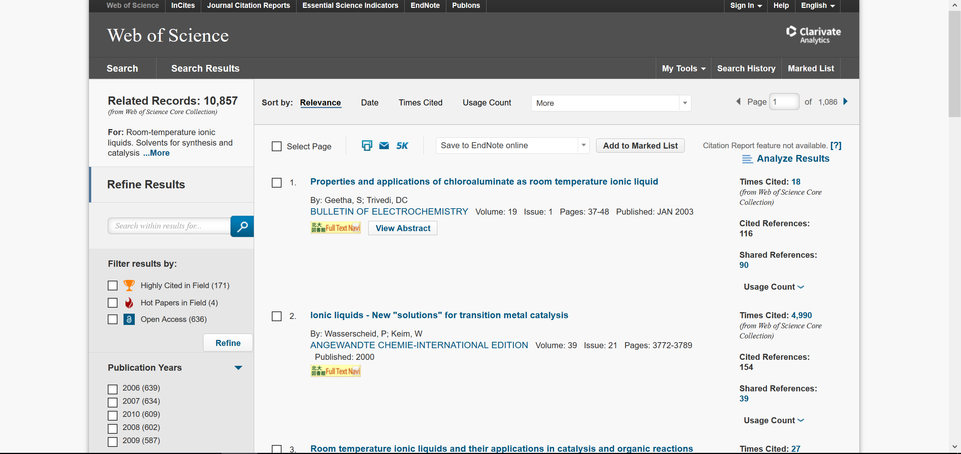
How to use Web of Science Core Collection
What articles have references common to this article?
The articles have references common to this article

Slide 28
Remote Access Service
The Surface Web
access only the surface Web
Free databases
Open-access articles
Off-campus
such as CiNii
Paywall articles
unsubscribed
by university
Paywall articles
subscribed
by university
such as home
Bibliographic
information
Bibliographic
information
Remote Access Service
The Deep Web
Full text
Full text
On-campus
Commercial databases
unsubscribed by university
Commercial databases
subscribed by university
such as Scopus
such as Web of Science,
SciFinder, and...
Some e-journals and databases are not available under Remote Access Service.

Slide 29
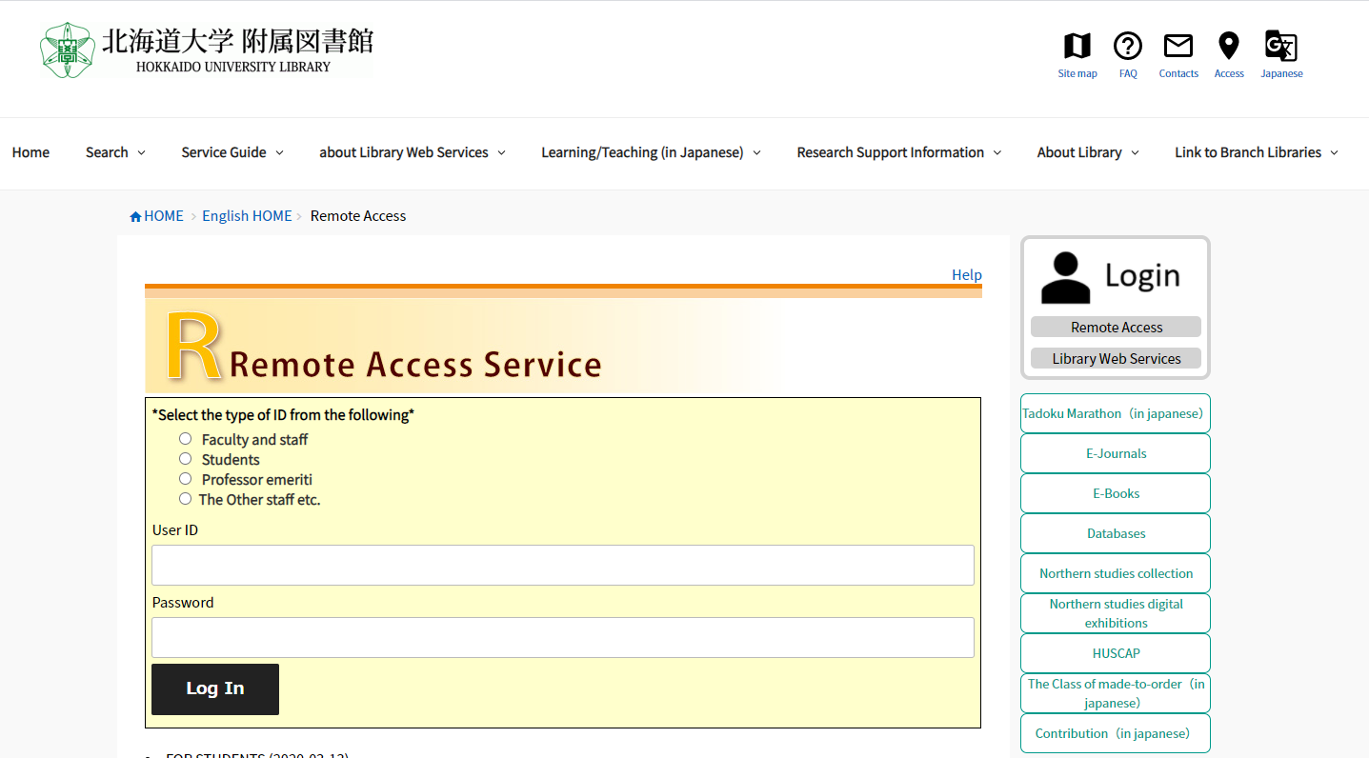
Remote Access Service
https://www.lib.hokudai.ac.jp/en/remote-access/

Slide 30
TRY
LATER
AND
ASK
ME
ANYTIME:
kitacam@lib.hokudai.ac.jp

