Slide 1
On-Demand Guidance on Northern Campus Library’s Service
Managing references : EndNote basic, Mendeley, and Zotero
Hokkaido University
Northern Campus Library
April 2019

Slide 2
Managing references
1) Reference Management Software
2) EndNote basic
3) Mendeley
4) Zotero
5) Sources and cautionary points

Slide 3
1) Reference Management Software
3 Main Functions
IMPORT
Import bibliographic data including full-text (PDF)
MANAGE
Save bibliographic data
and share them in groups
OUTPUT
Generate a reference list
in your manuscript
This guidance introduces as representative software
EndNote basic, Mendeley, and Zotero

Slide 4
1) Reference Management Software
 | EndNote basic | Mendeley | Zotero
Provider (Developer) | Clarivate Analytics | Elsevier | Roy Rosenzweig Center for History and New Media (George Mason University)
Versions | Browser [Not Free] Desktop | Browser Desktop Mobile | Browser Desktop
Import of PDFs | Upload later one by one | Directly / Upload with folder | Directly
Manageable Disk Space | 2GB | 100GB (Private) 100GB（Private Group） | 300MB [Not Free] 2G, 6G, Unlimited * External storage available
Outputtable Styles | < 4,000 | > 7,000 | > 9,000
Other features | - Data linkage with Web of Science - Recommendation of which journals to post to | - Recommendation of related papers - Annotation and sharing of PDF - Many related services | - Various extensions available for open source
EndNote basic and Mendeley are enhanced for students and faculty of Hokkaido University
Each time you access from inside the campus, you can use the enhanced function for a year

Slide 5
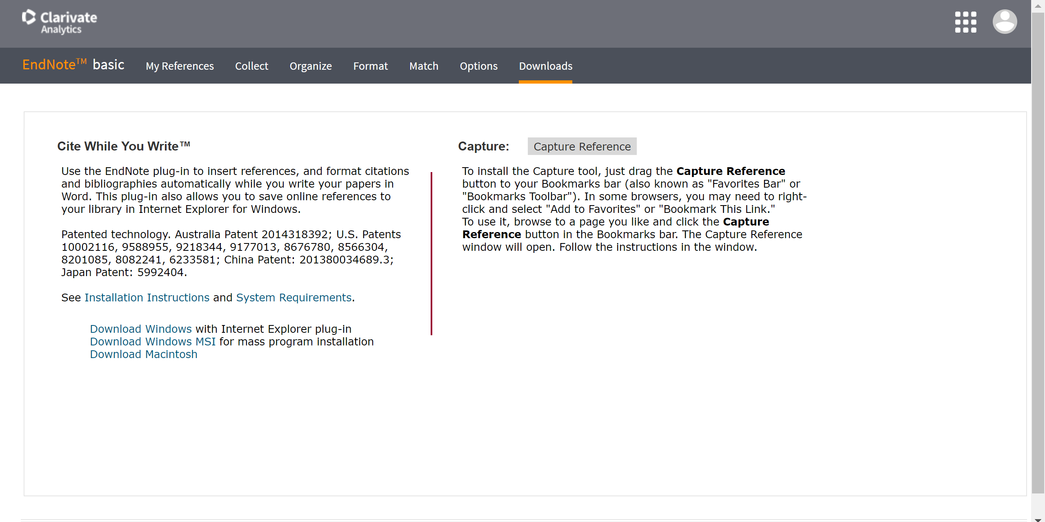
2) EndNote basic
Output Tool
Import Tool
* Drag and drop to Bookmark bar
Account of Web of Science,
or create new
http://my.endnote.com

Slide 6
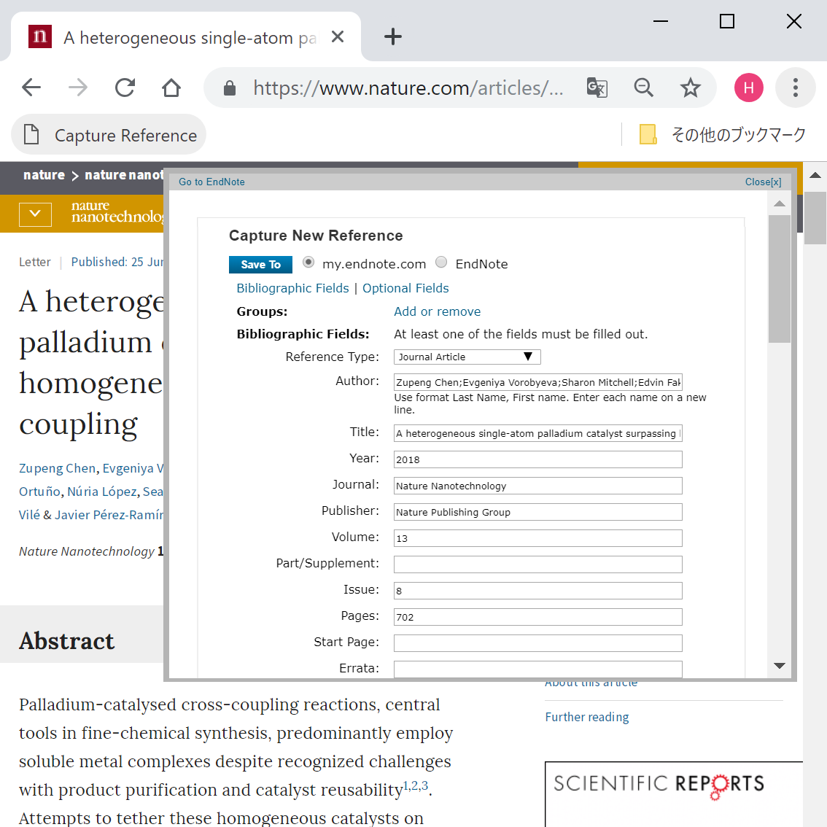
2) EndNote basic
Click “Capture Reference” on the website of papers, and import bibliographic data one by one
From Web of Science
import multiple bibliographic data directly

Slide 7
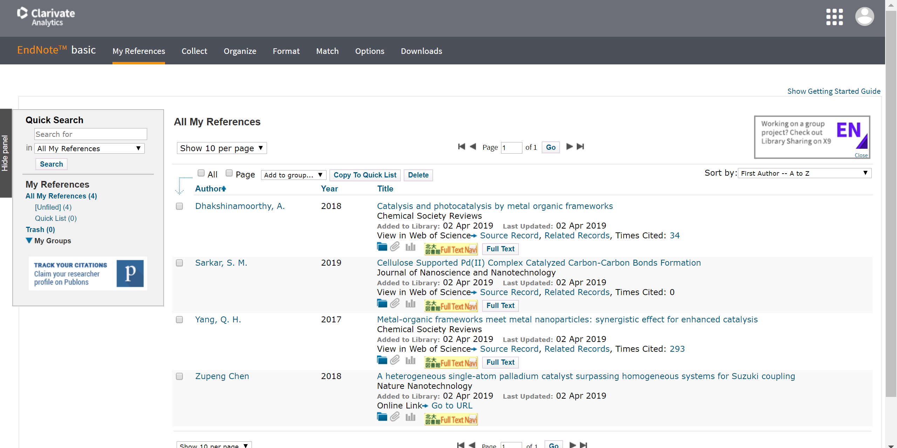
2) EndNote basic
Import bibliographic data in RIS format etc.
Bibliographic data imported from Web of Science
show links to it and times cited
Organize bibliographic data in folders
and share them in groups
Upload PDF if you have
* PDF cannot be shared in groups

Slide 8
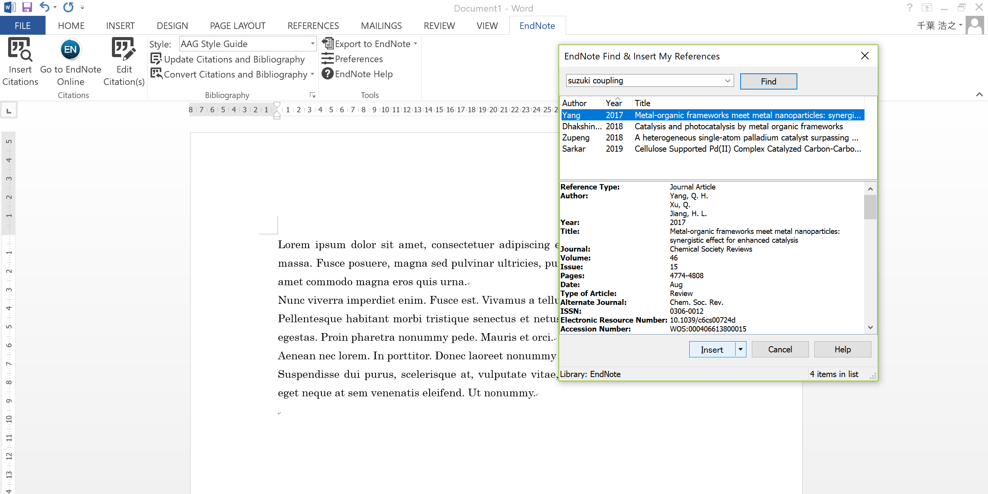
2) EndNote basic
Open the "EndNote" tab in Word on which the Output Tool is installed,
click "Insert Citations" at the place where you want to insert a citation,
and search for the paper you want to insert from EndNote basic

Slide 9
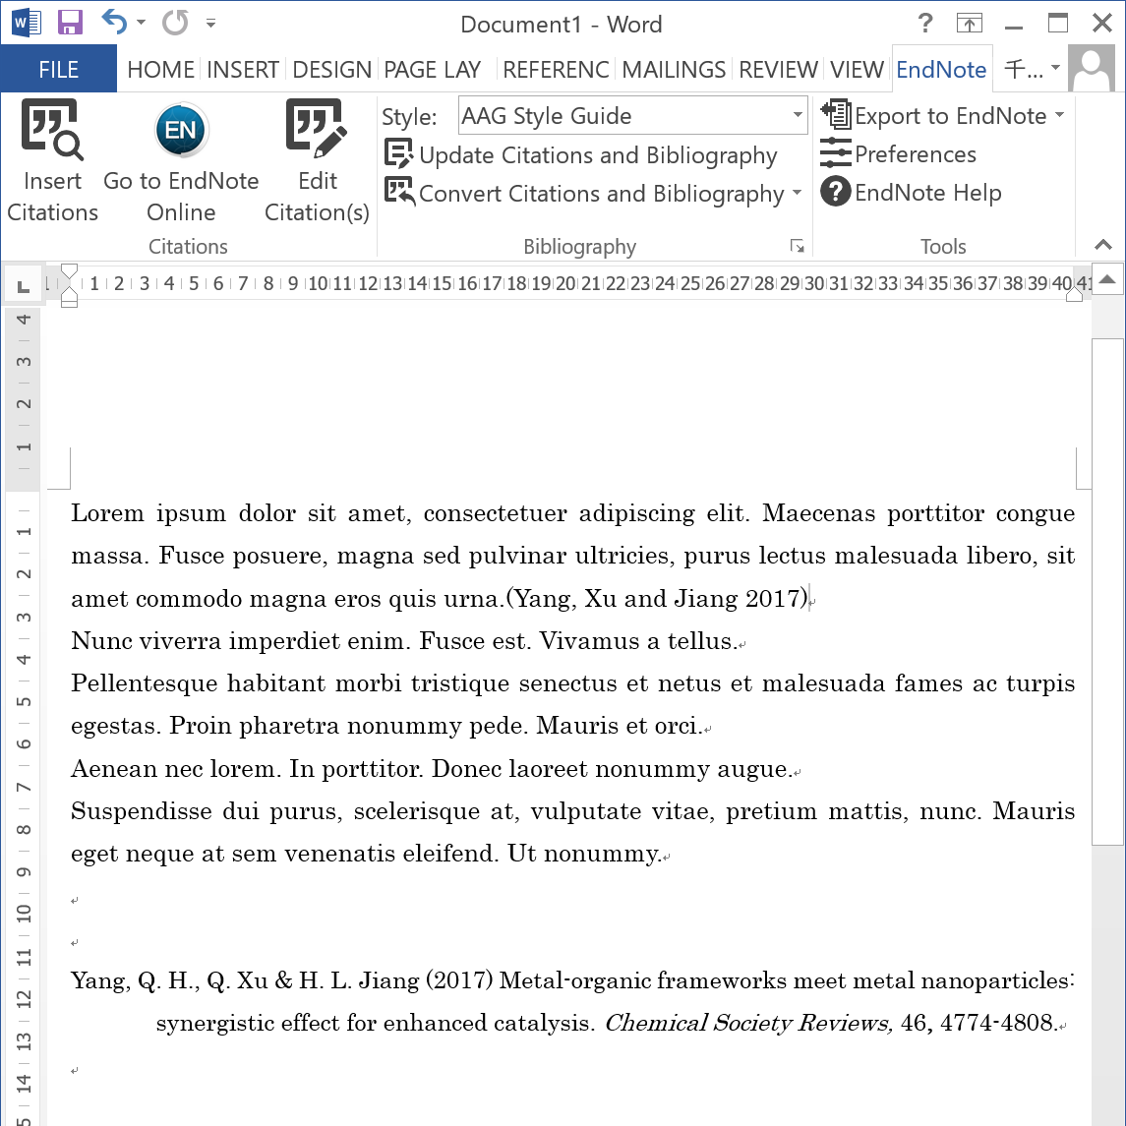
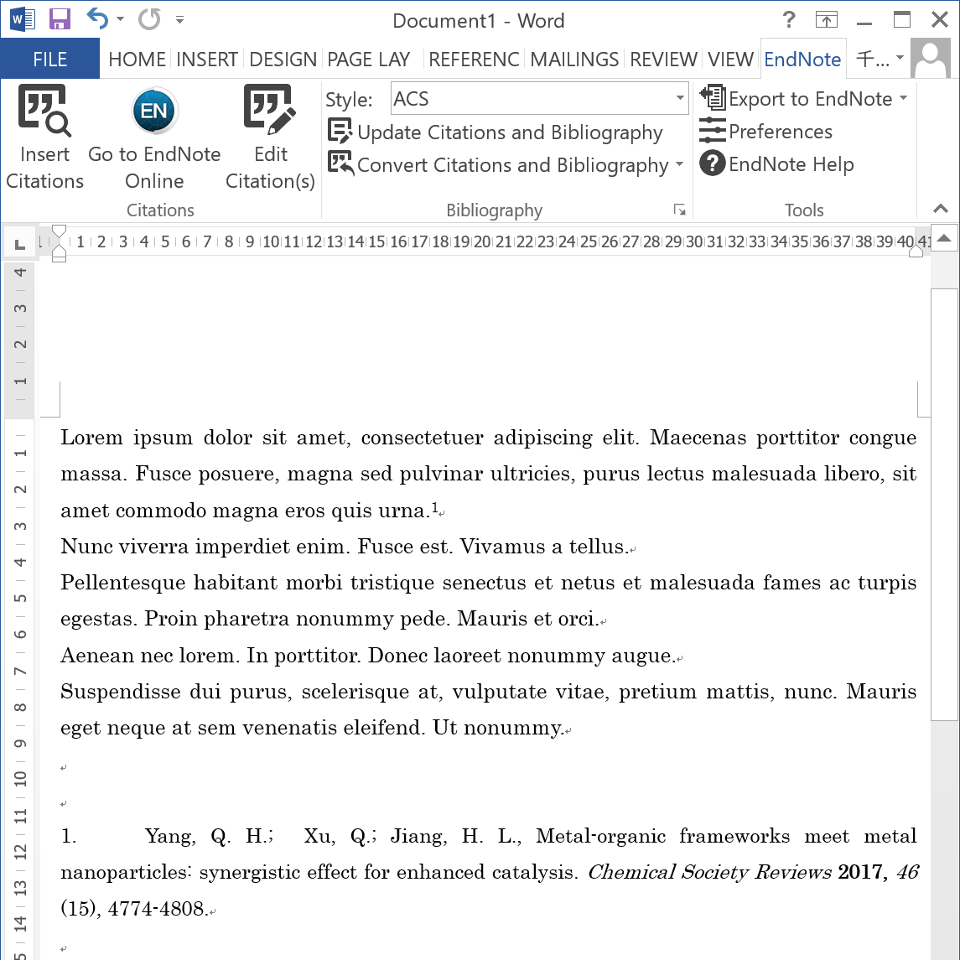
2) EndNote basic
A reference sign is inserted in the sentence,
and a reference list is below
Change citation style at “Style”

Slide 10
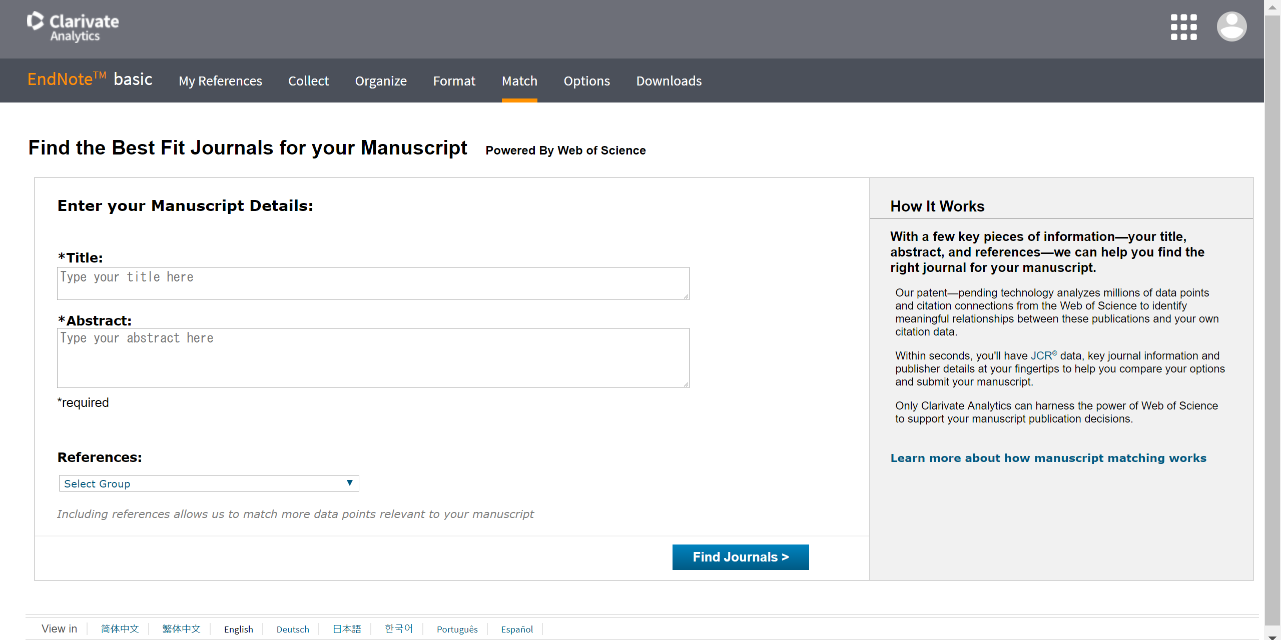
2) EndNote basic
"Match" connects
the title, abstract, and bibliographic data of your manuscript
with data of the Web of Science,
and suggests the best fit journals for your manuscript

Slide 11
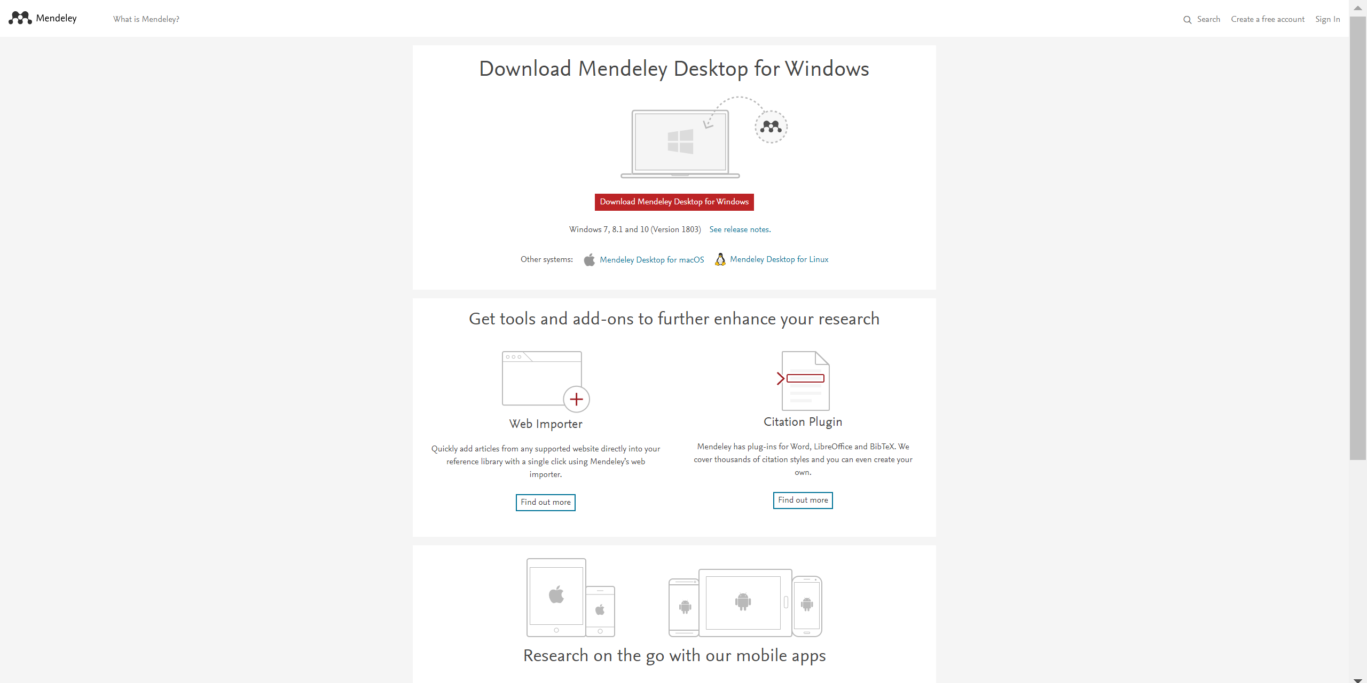
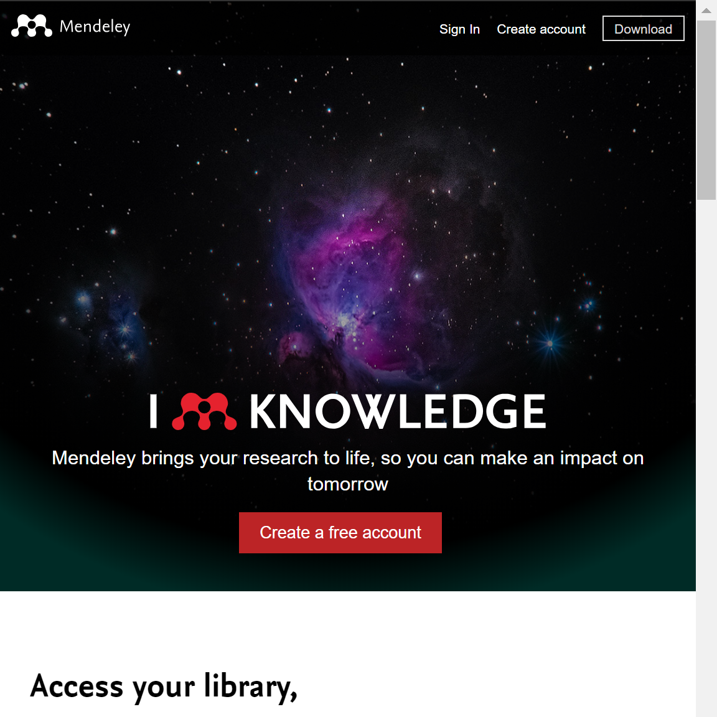
3) Mendeley
Desktop Version
Create account
Import Tool
Output Tool
Mobile Version
https://www.mendeley.com

Slide 12
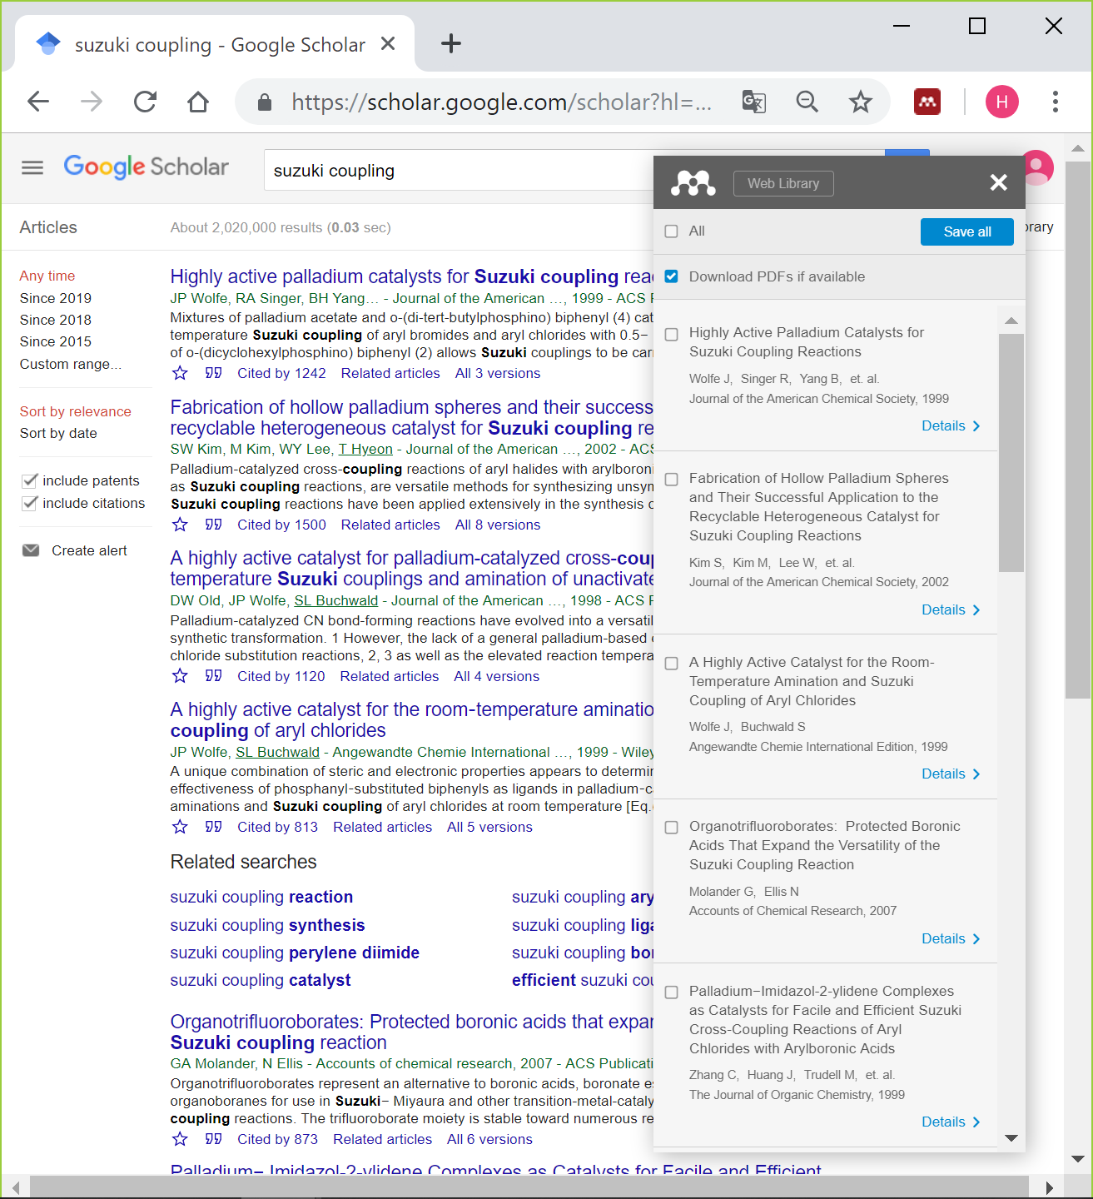
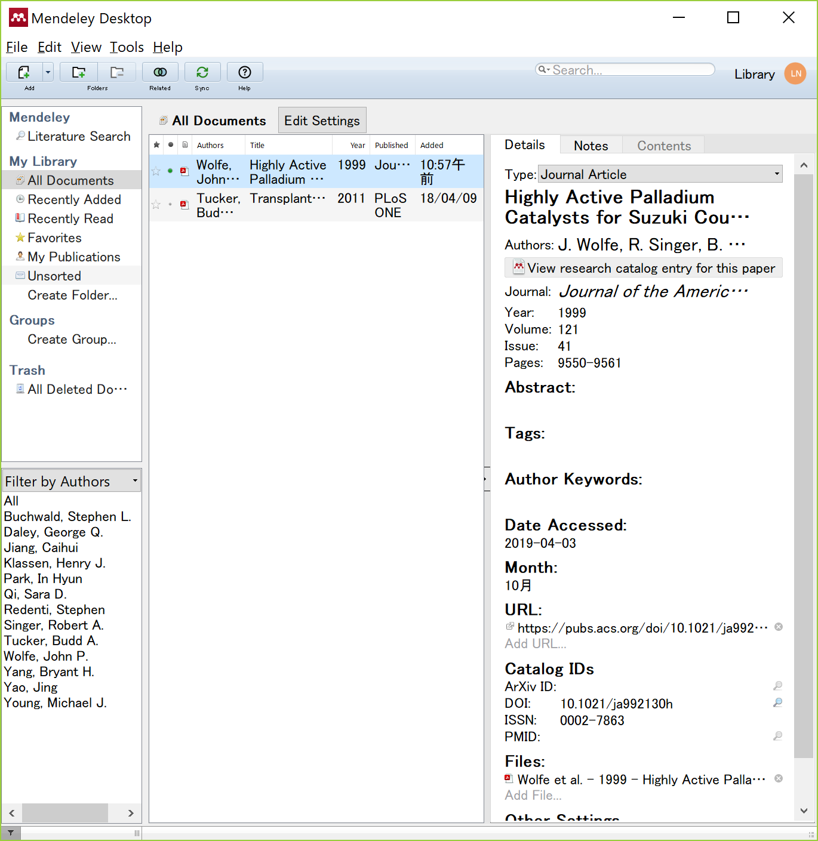
3) Mendeley
With the Import Tool,
import directly multiple bibliographic data
and PDFs (if you can access) at the same time
In Desktop version,
import bibliographic data and PDFs
by dragging and dropping
the entire folder containing PDFs as well as PDFs

Slide 13
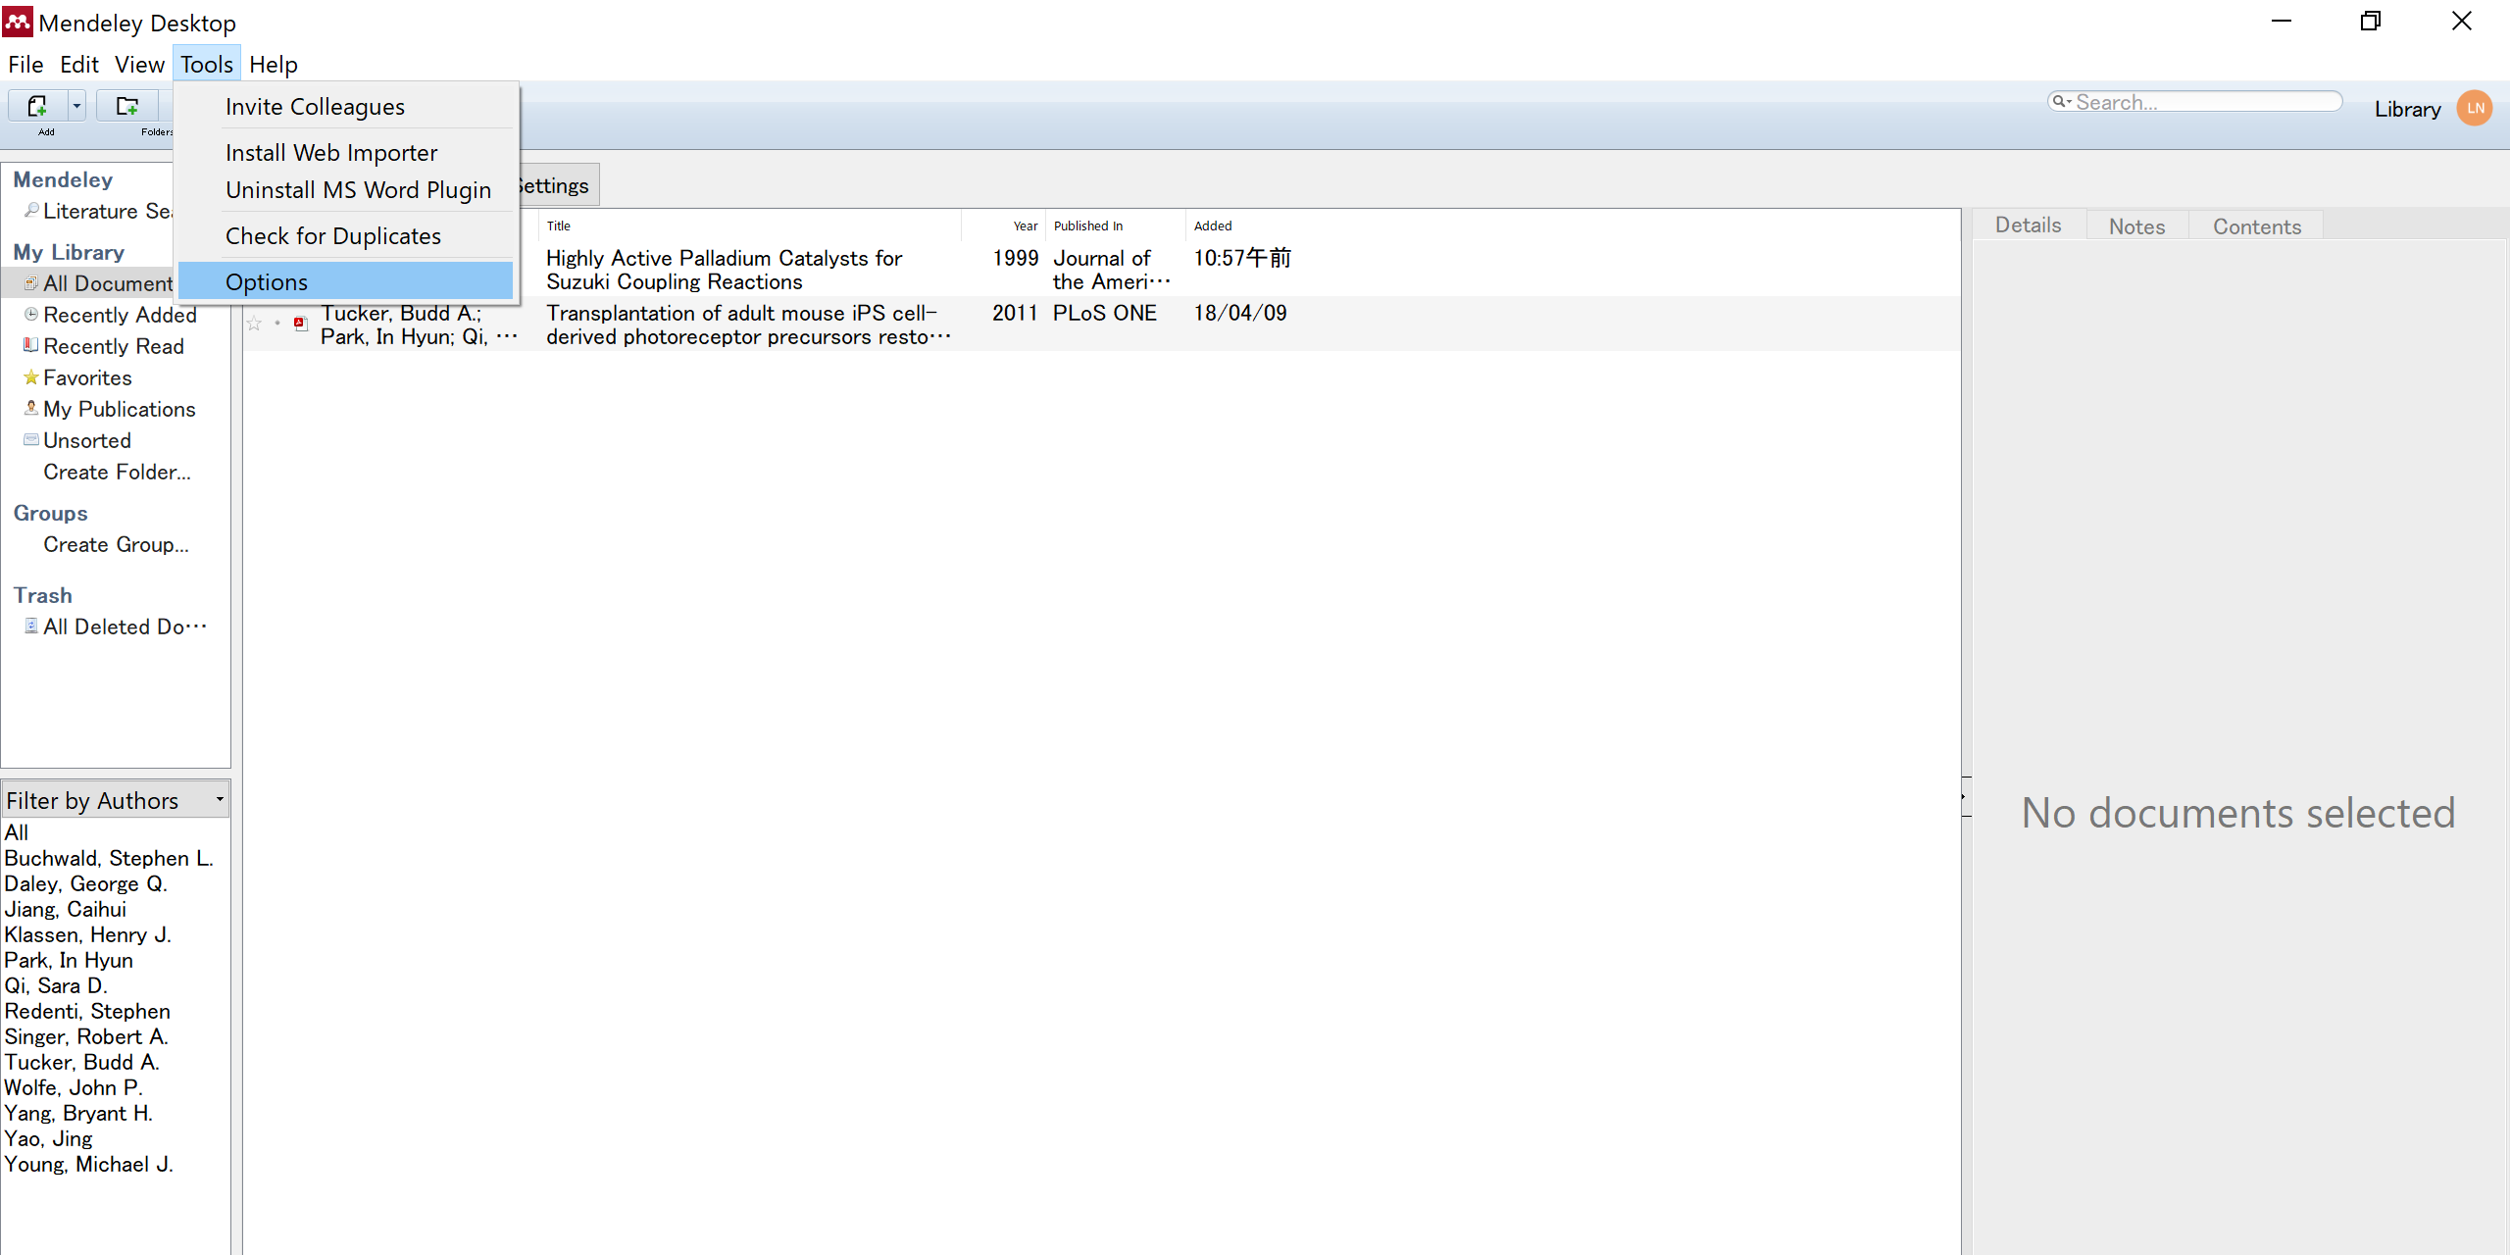
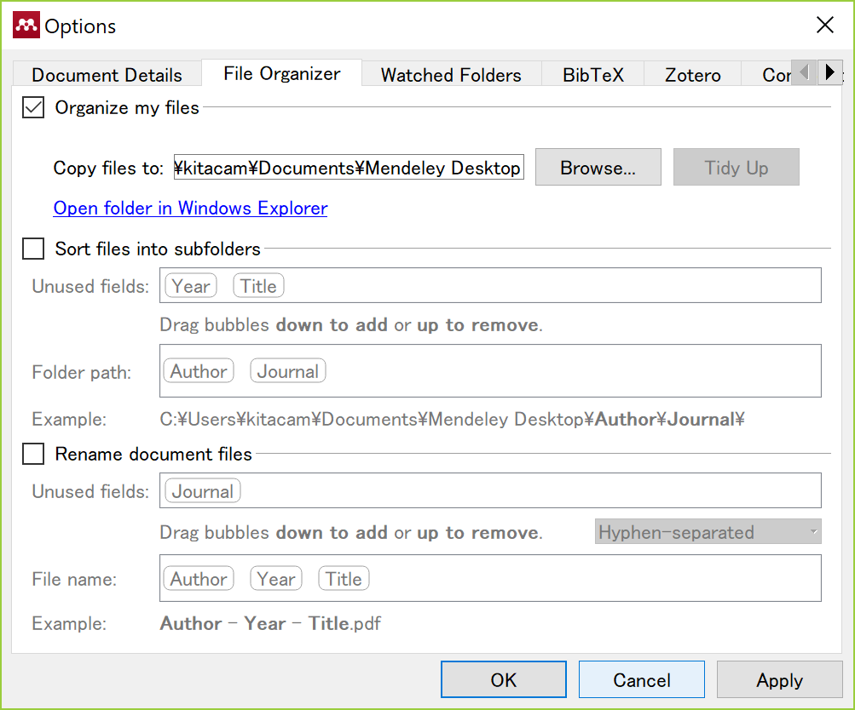
3) Mendeley
Save PDFs to your computer
* If you delete bibliographic data in Mendeley,
their PDFs are also deleted there
Import bibliographic data
in RIS format etc.

Slide 14
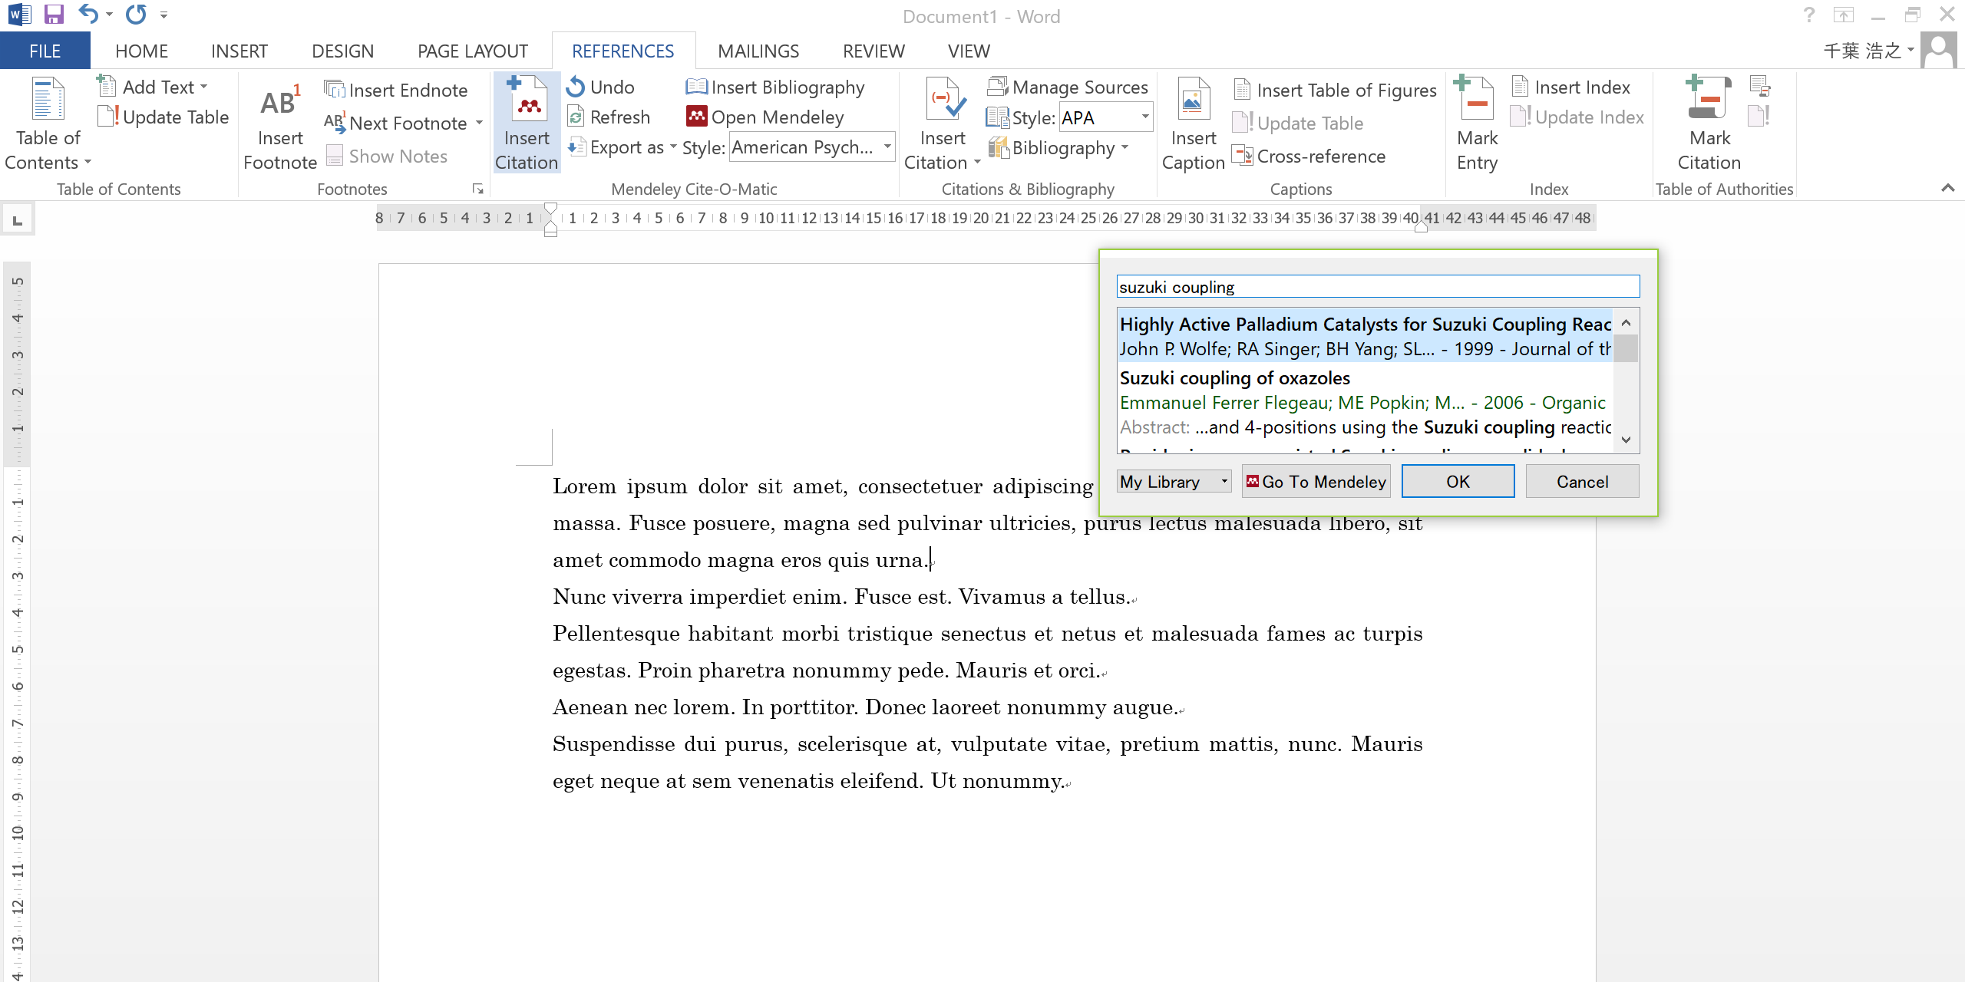
3) Mendeley
Open the “REFERENCES" tab in Word on which the Output Tool is installed,
click "Insert Citation" at the place where you want to insert a citation,
and search for the paper you want to insert from Mendeley

Slide 15
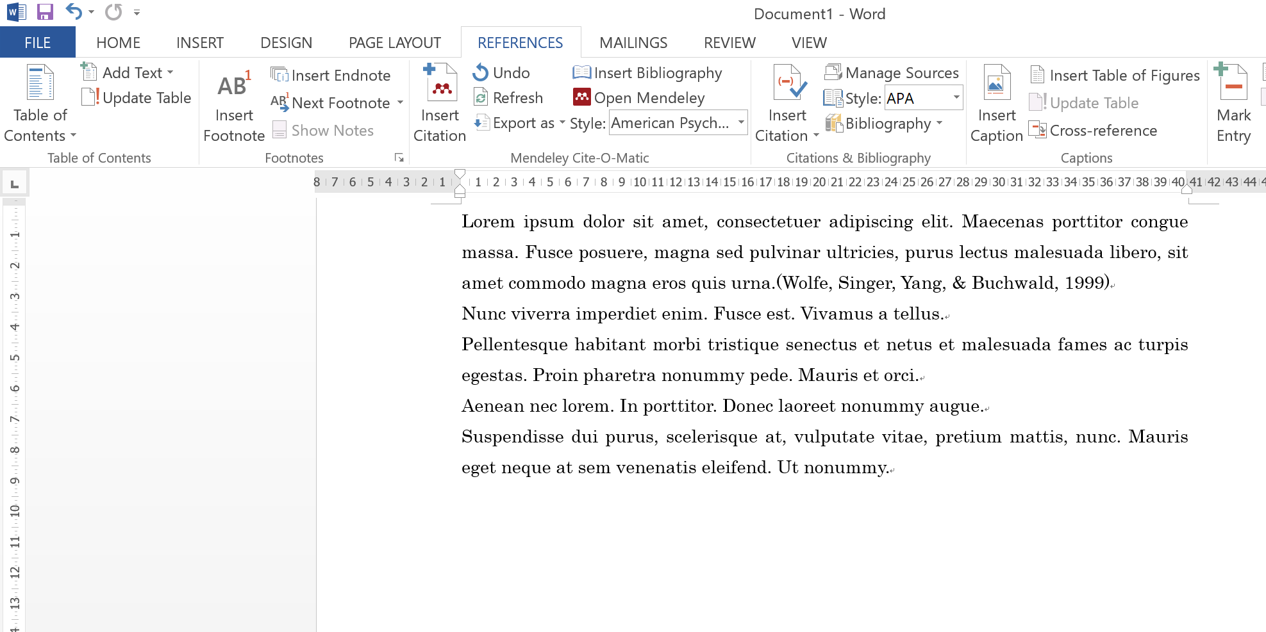
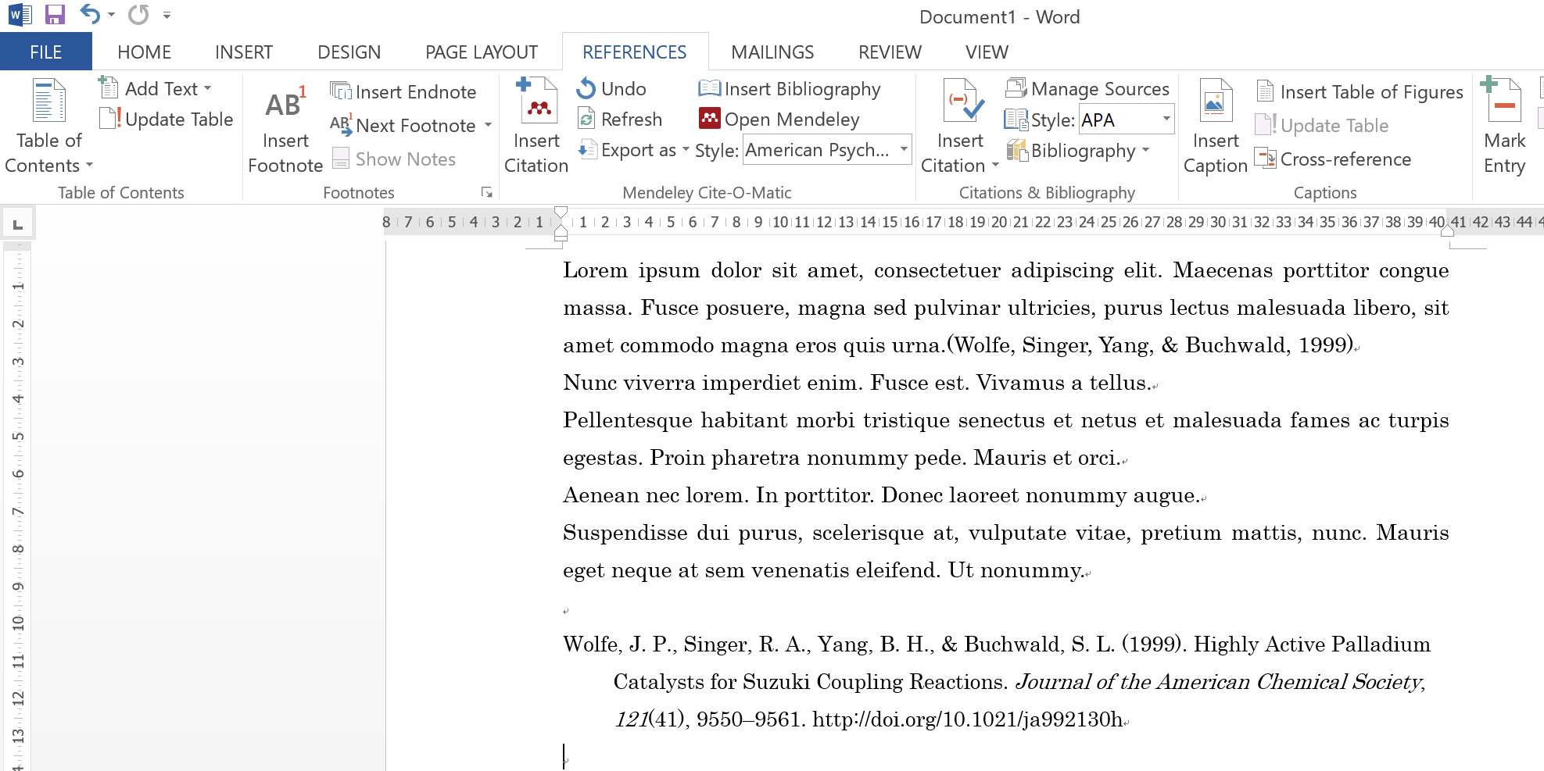
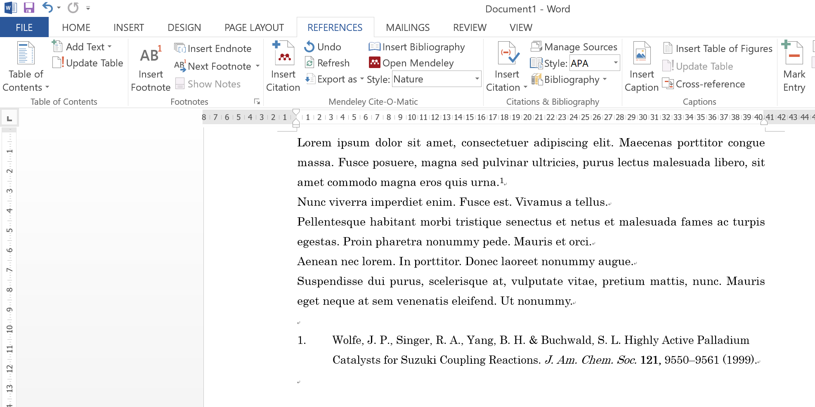
3) Mendeley
A reference sign is inserted in the sentence
Click “Insert Bibliography” to insert a reference list
Change citation style at “Style”

Slide 16
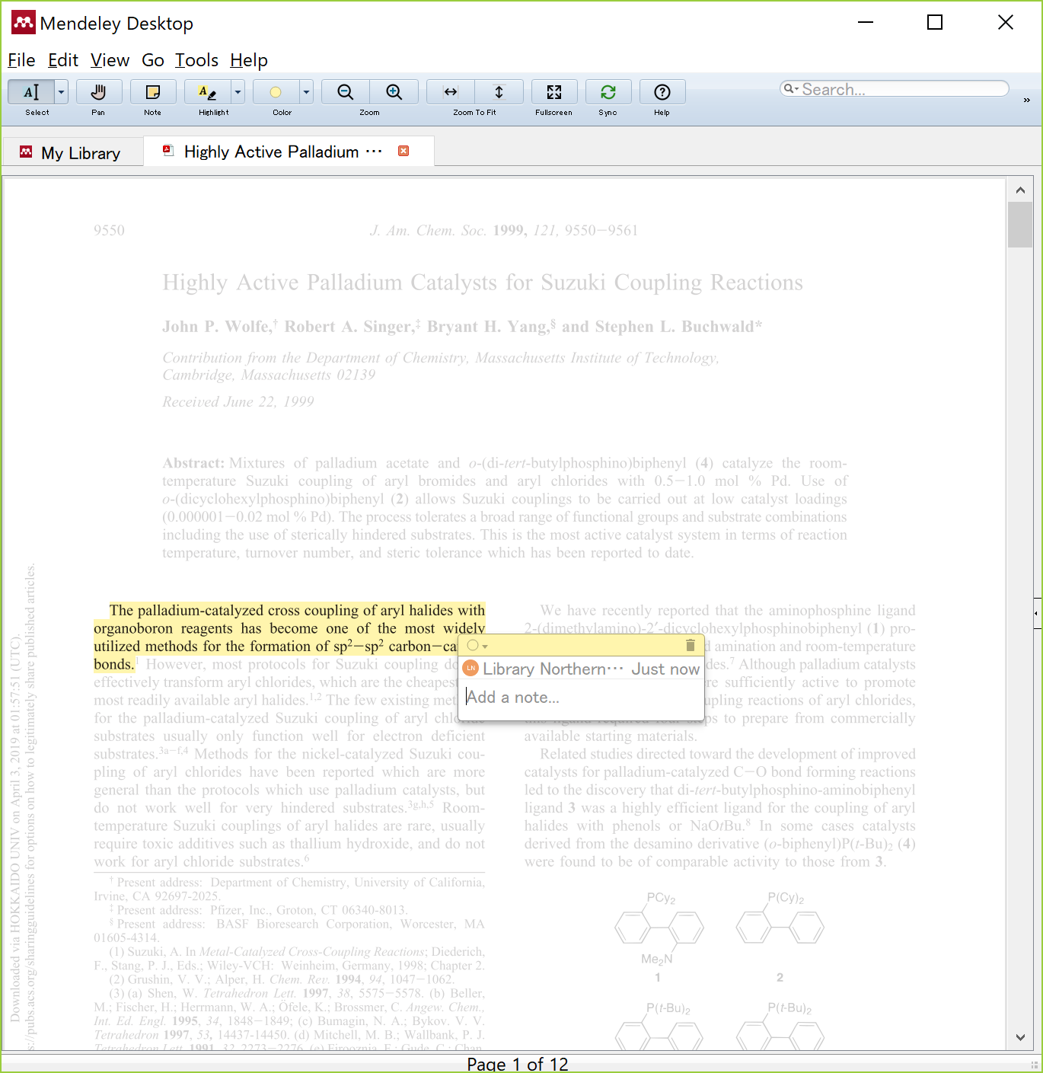
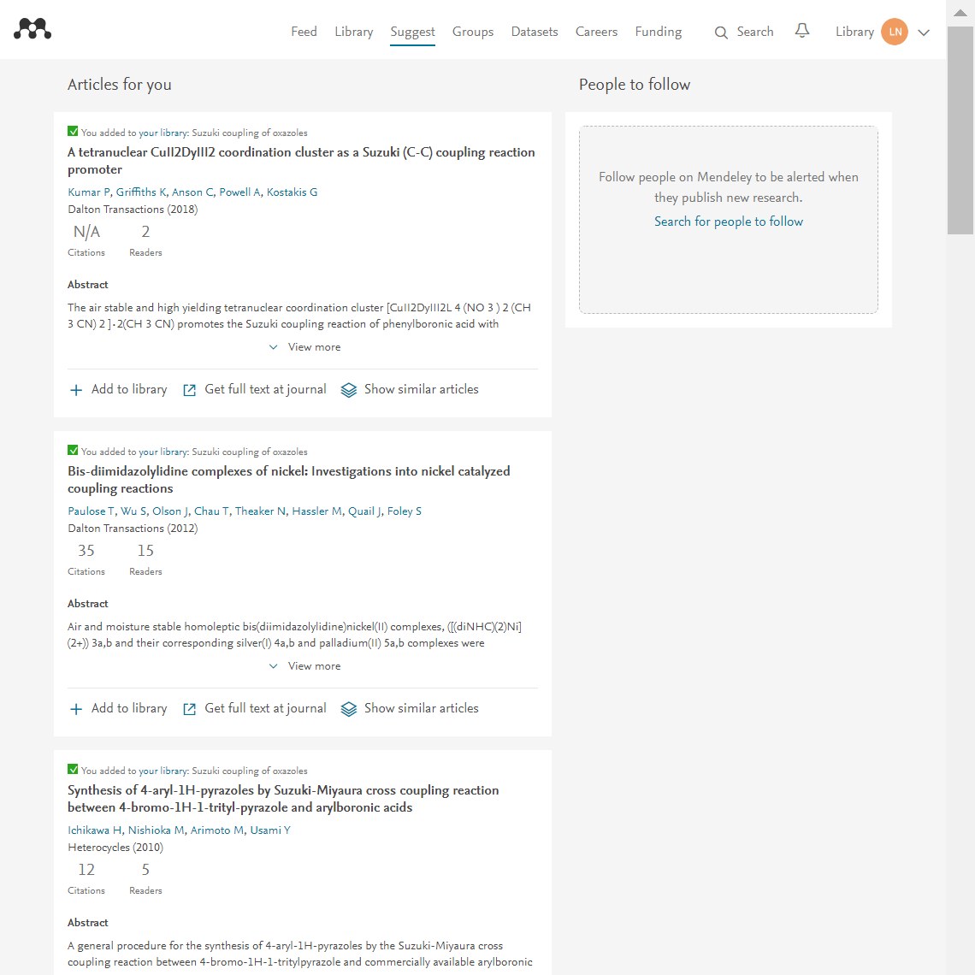
3) Mendeley
Follow other users
In response to
bibliographic data imported,
suggest papers to read
Read and annotate PDF,
and share it in groups
Other various services

Slide 17
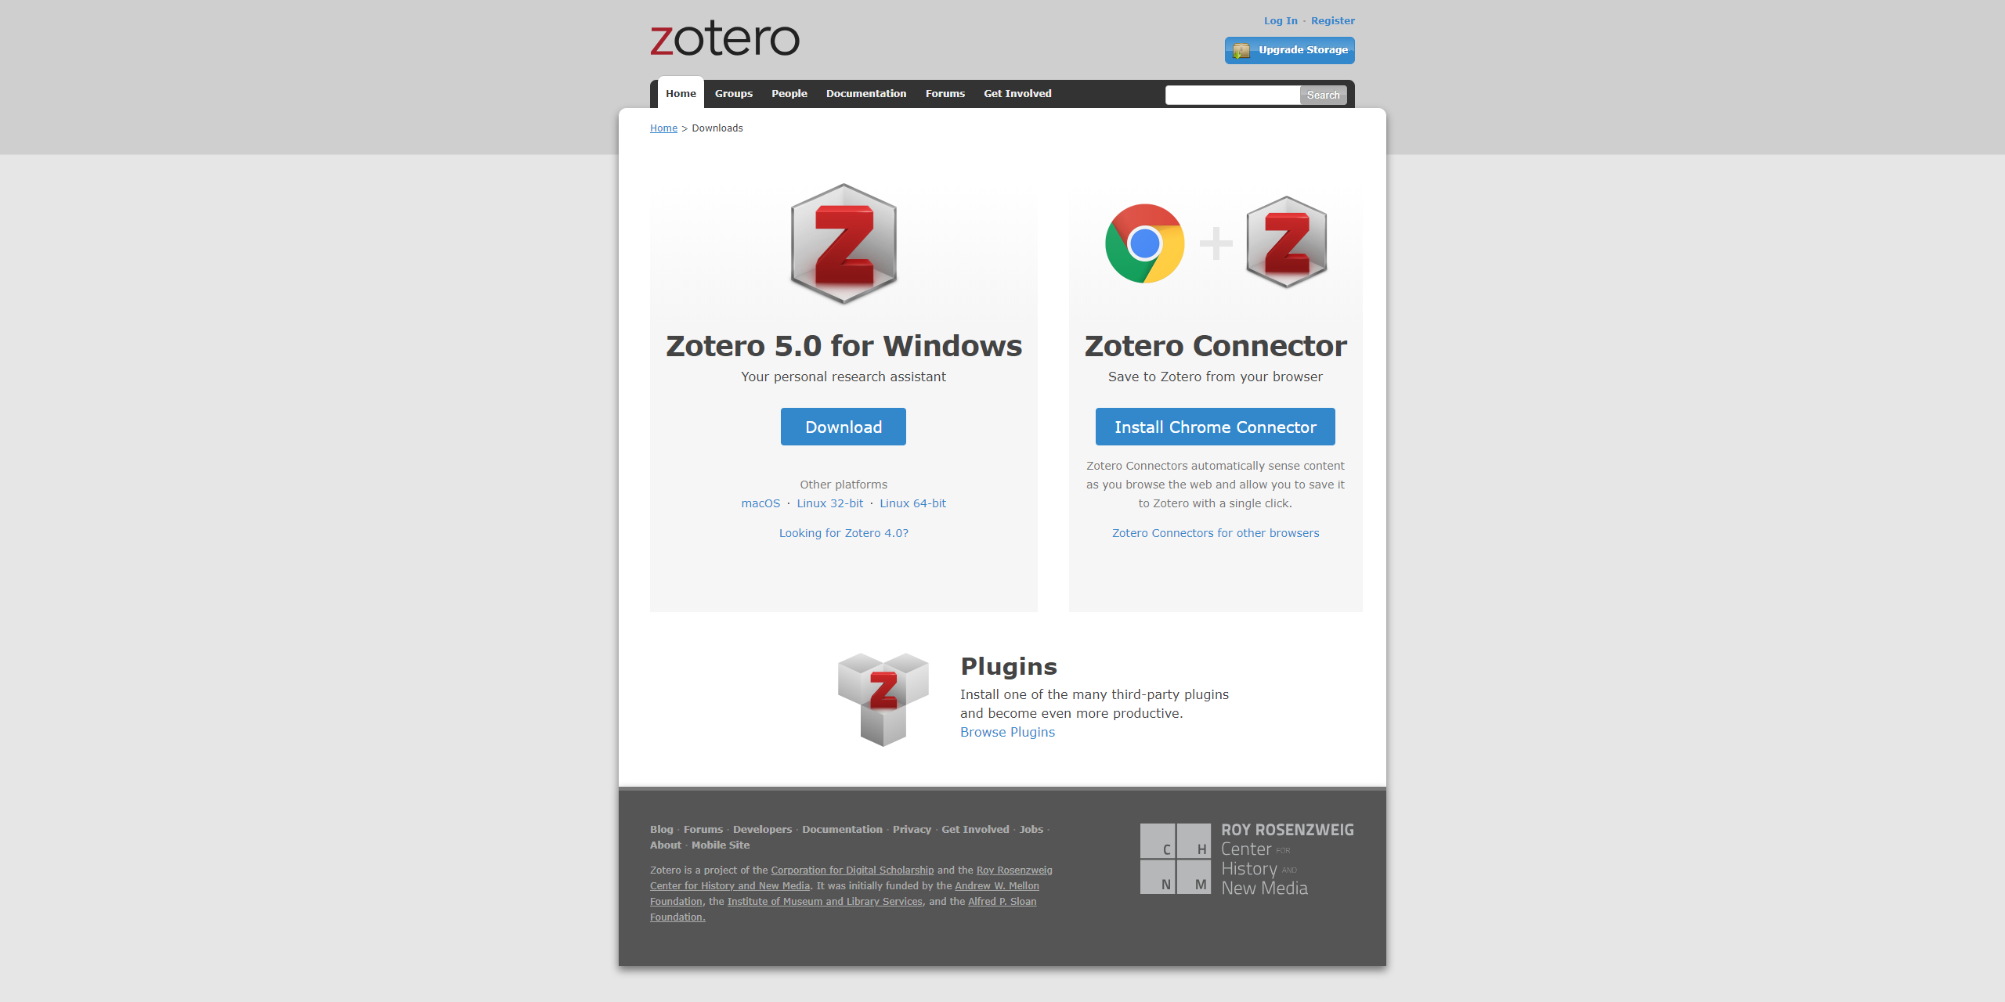
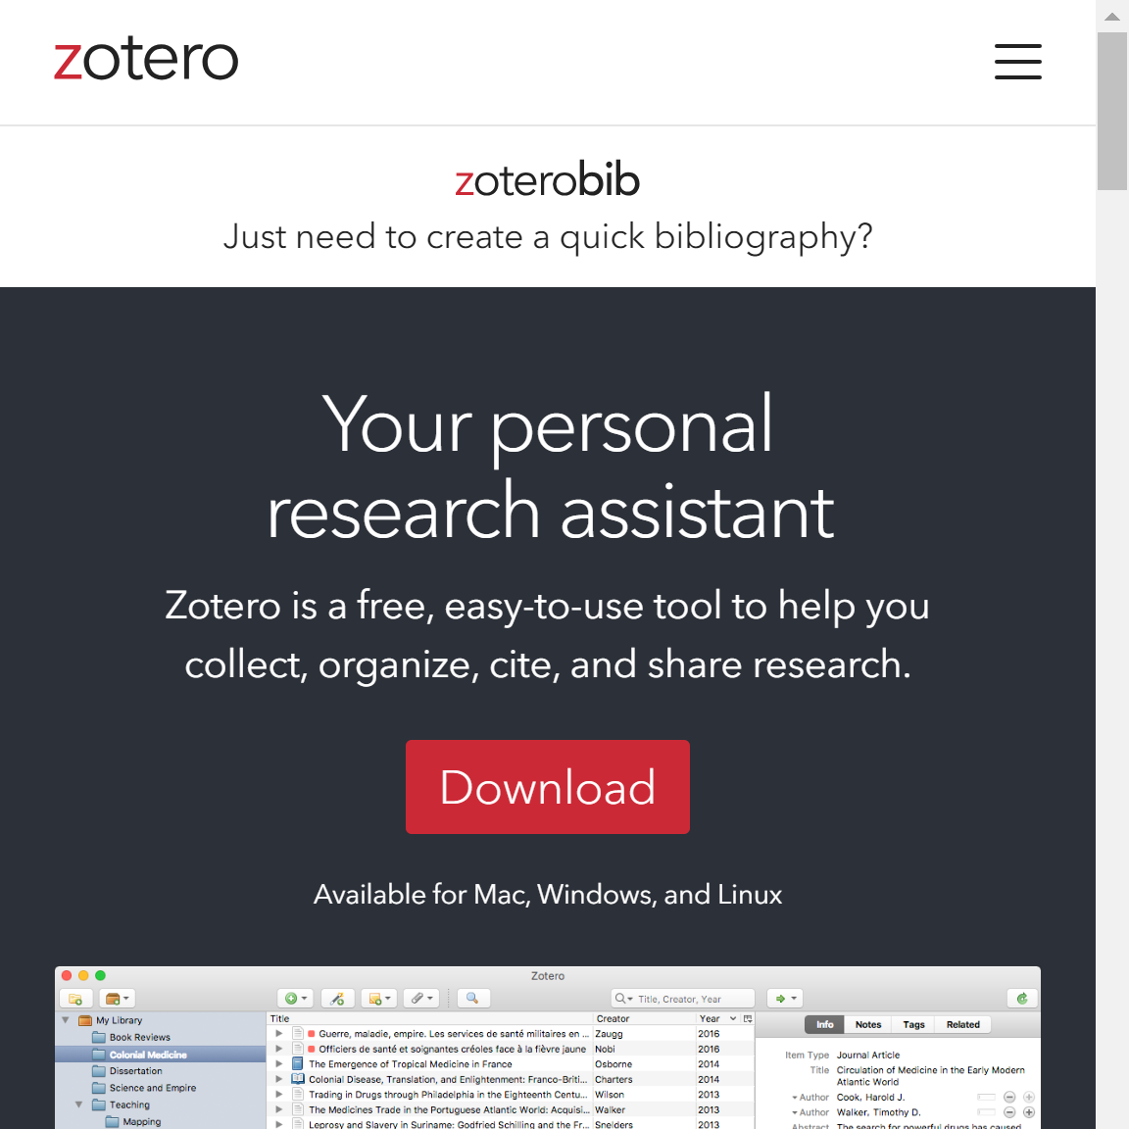
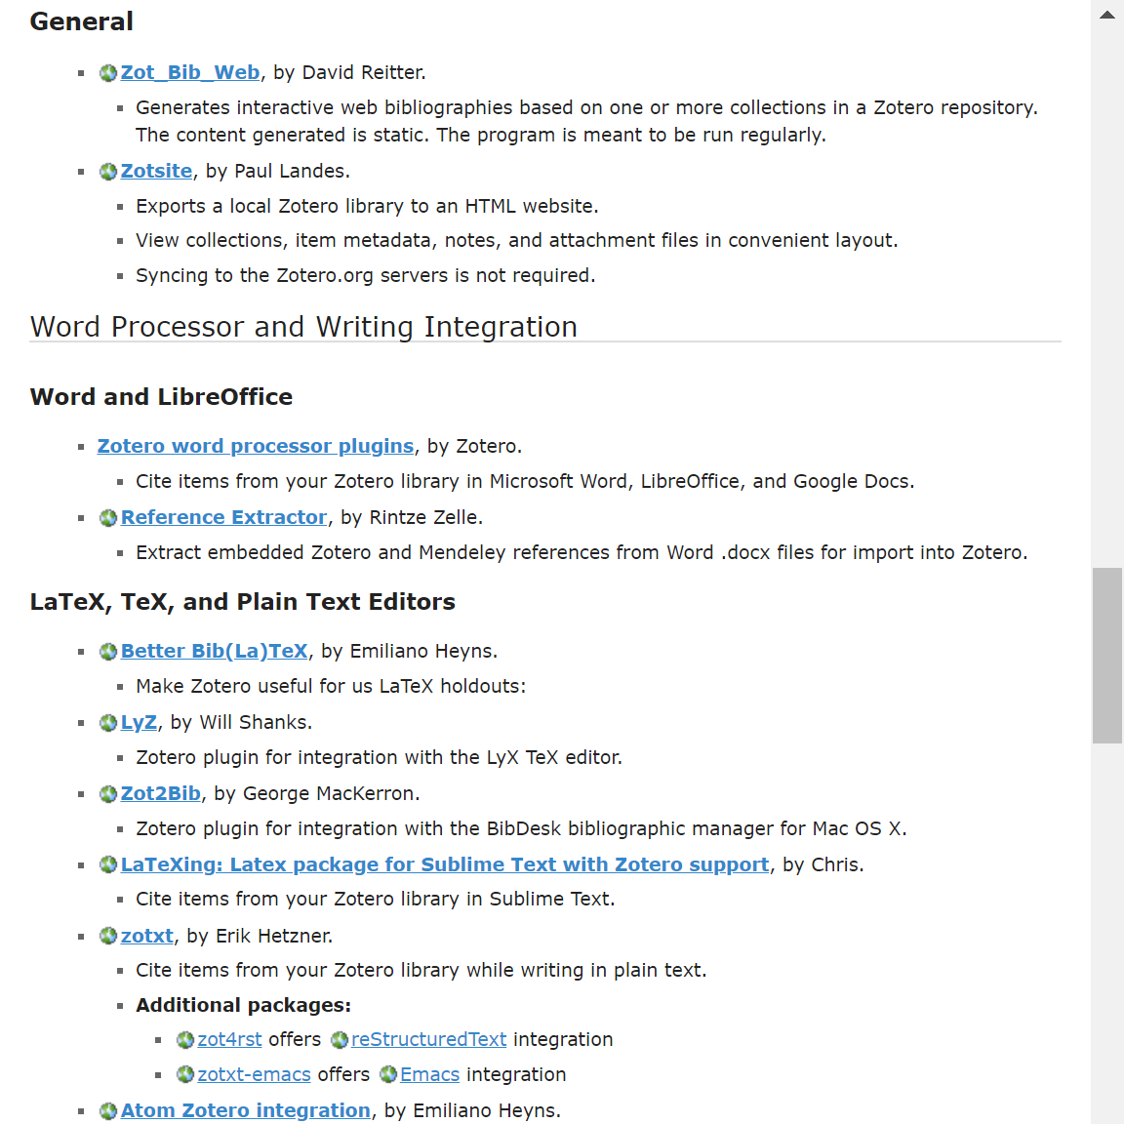
4) Zotero
Desktop Version
Import Tool
Output Tool
https://www.zotero.org

Slide 18
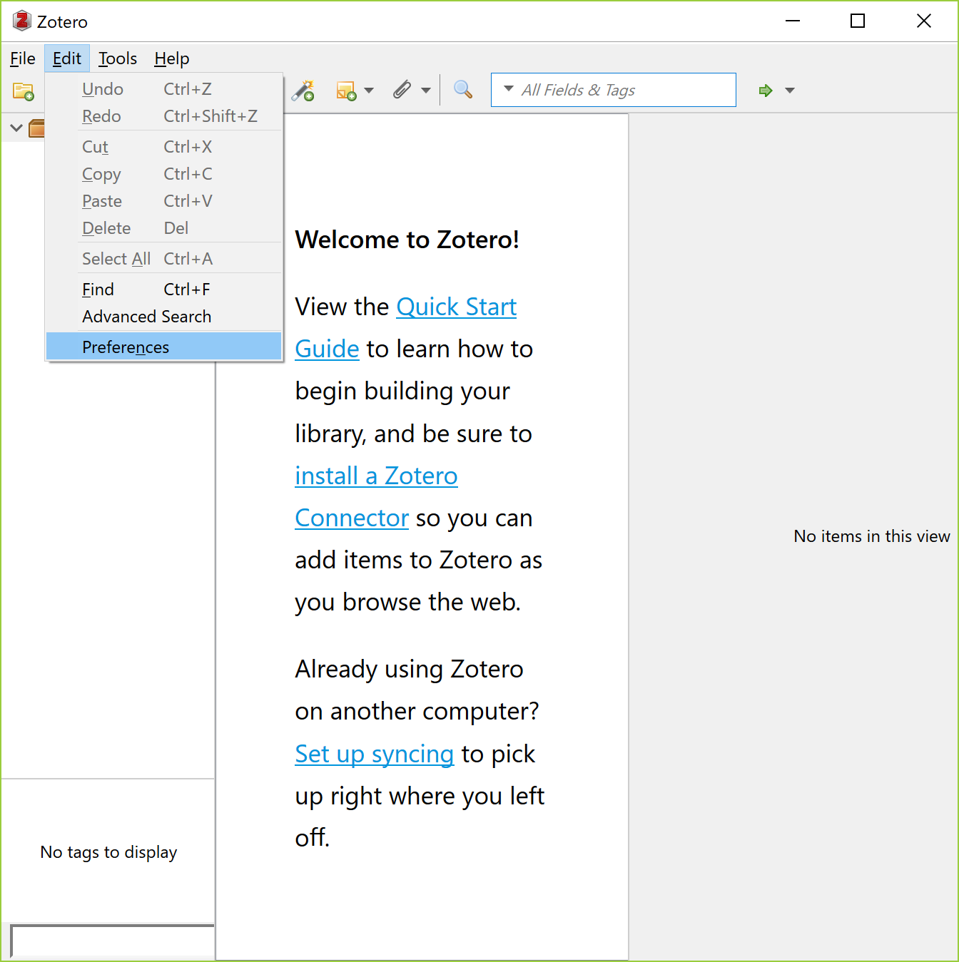
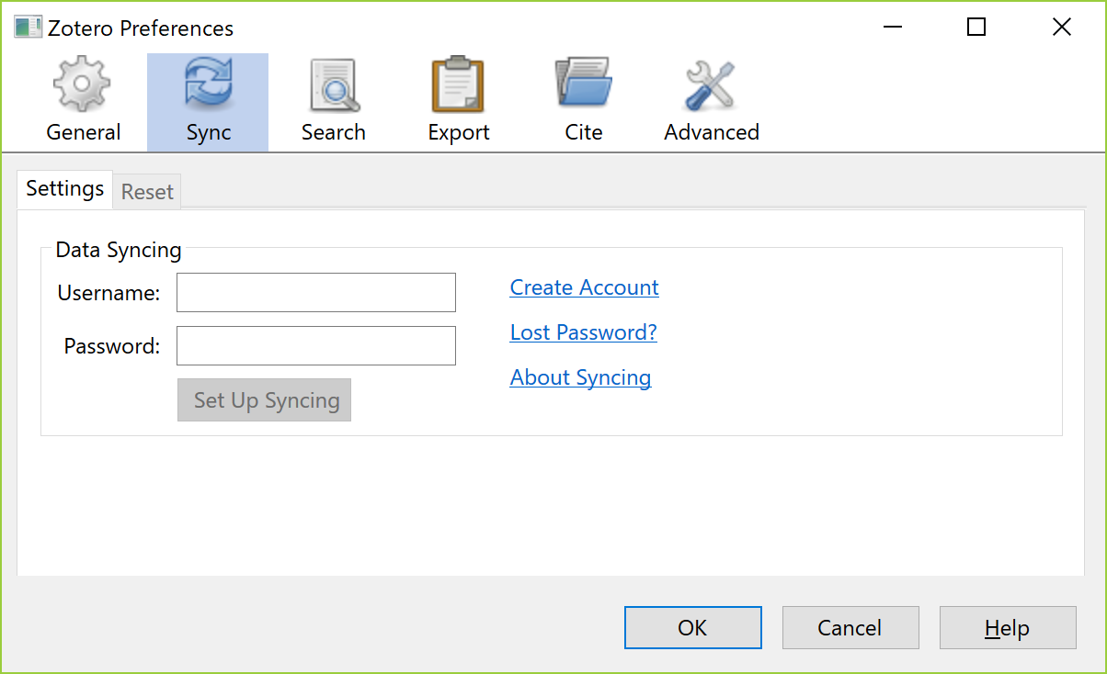
4) Zotero
Set the account created
to Desktop Version
Create account
https://www.zotero.org/user/register

Slide 19
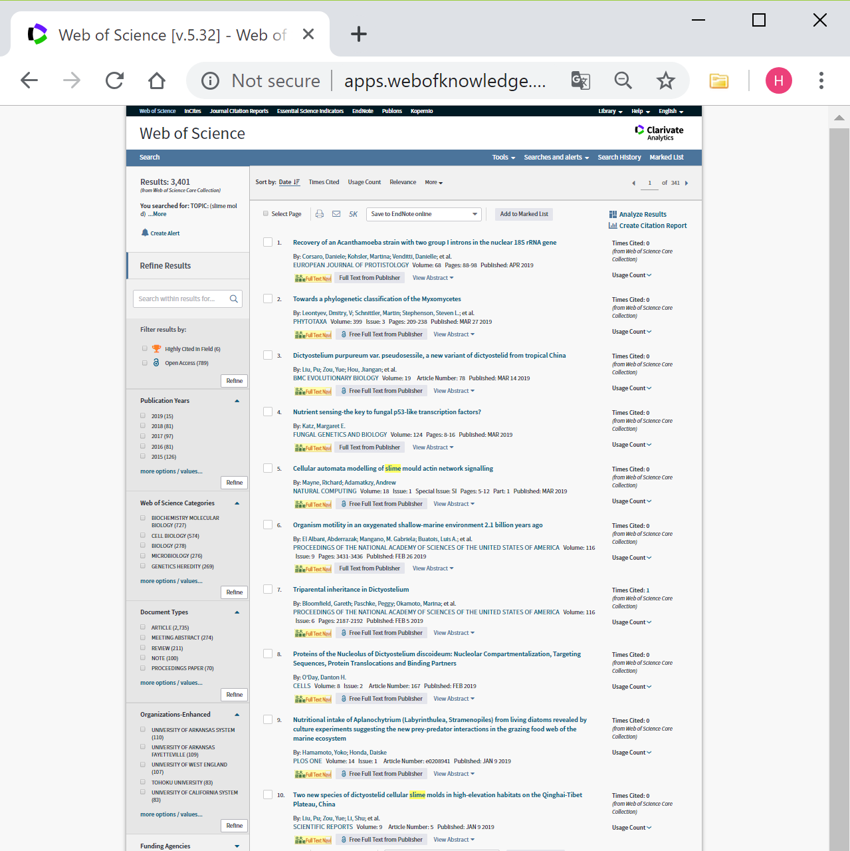
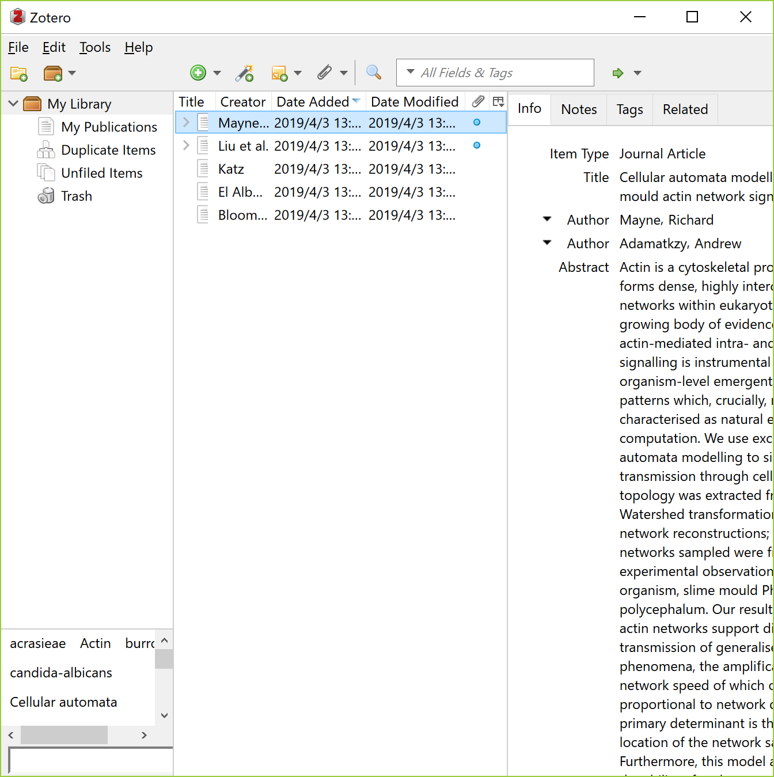
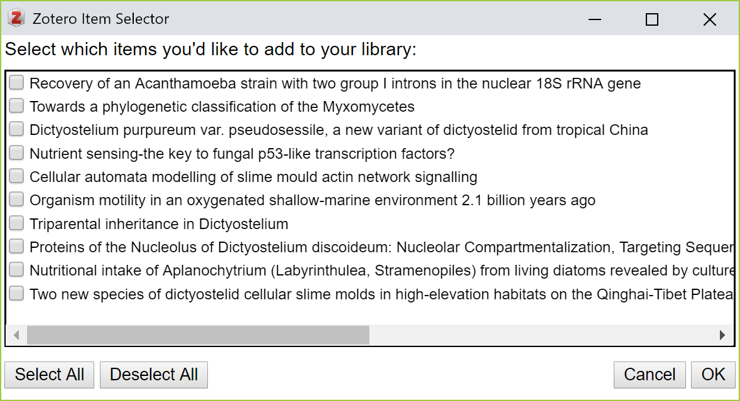
4) Zotero
With the Import Tool,
import directly multiple bibliographic data
and PDFs (if you can access) at the same time
In Desktop version,
import bibliographic data and PDFs
by dragging and dropping PDFs

Slide 20
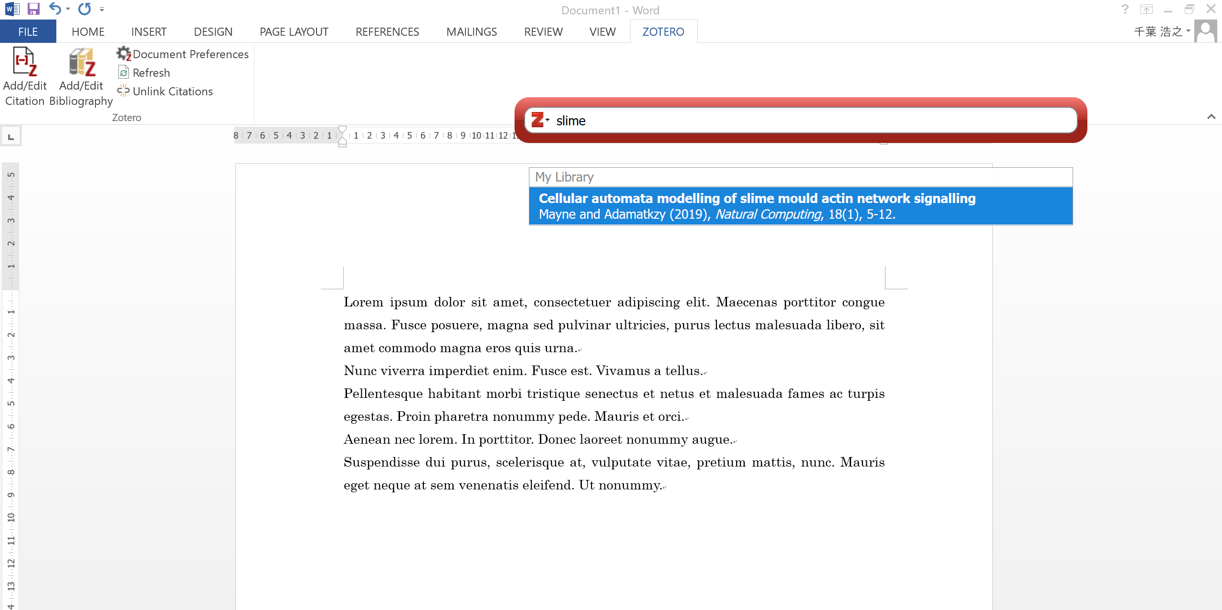
4) Zotero
Open the “ZOTERO" tab in Word on which the Output Tool is installed,
click “Add/Edit Citation" at the place where you want to insert a citation,
and search for the paper you want to insert from Zotero

Slide 21
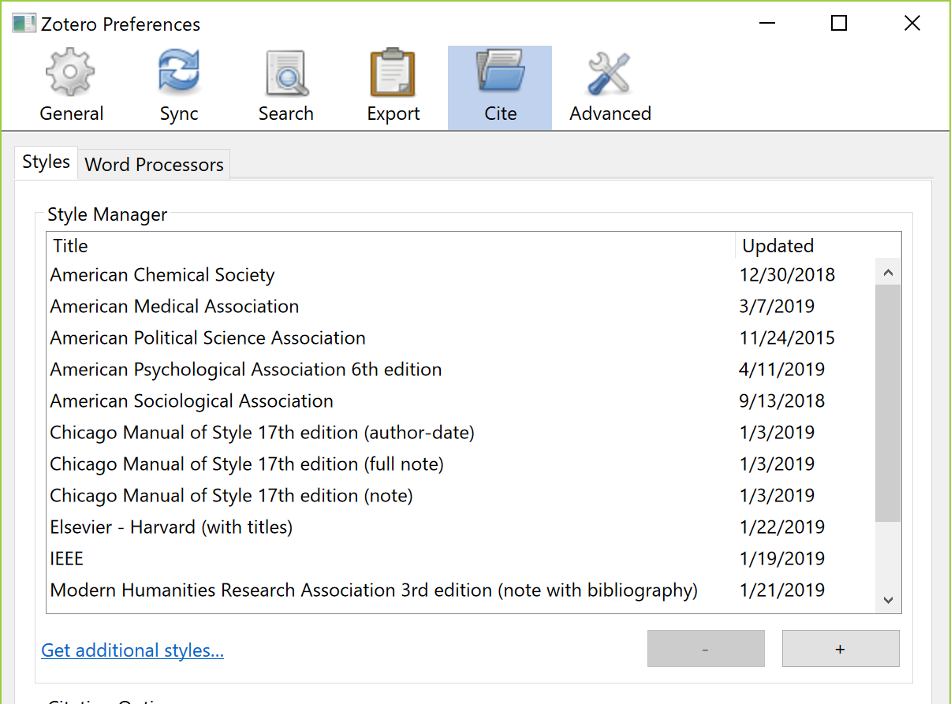
4) Zotero
Click “Add/Edit Bibliography”
to insert a reference list
A reference sign is inserted in the sentence
Change citation style
at “Document Preferences”

Slide 22
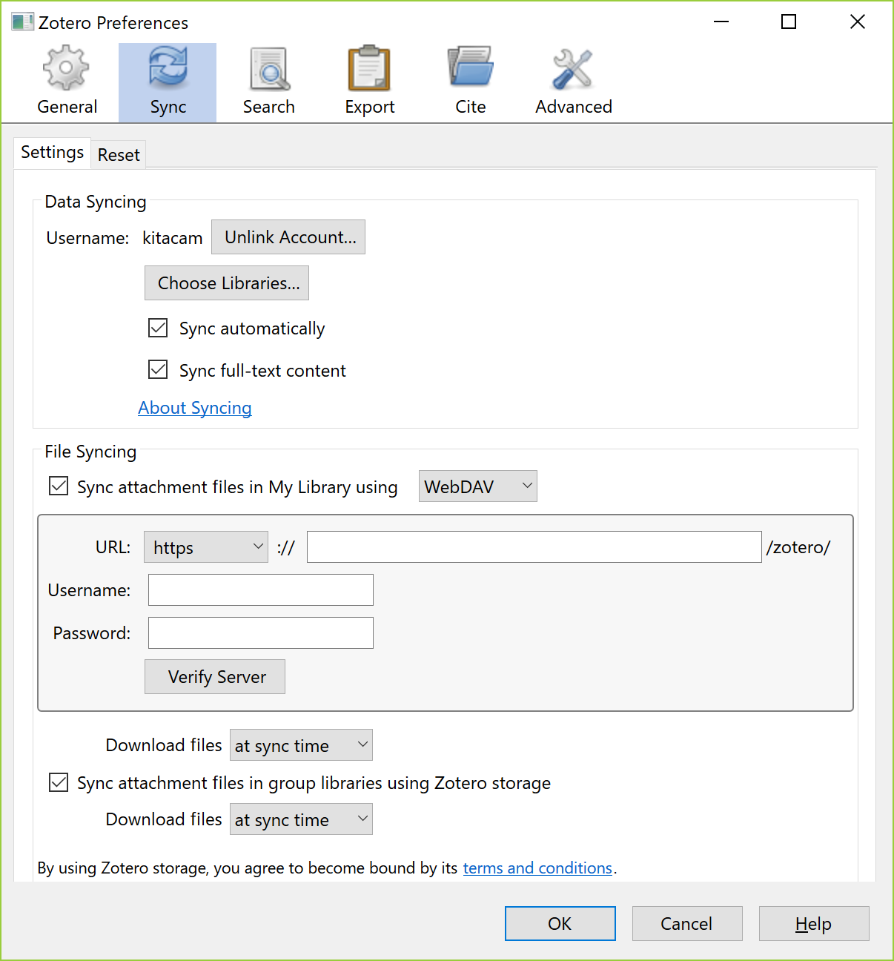
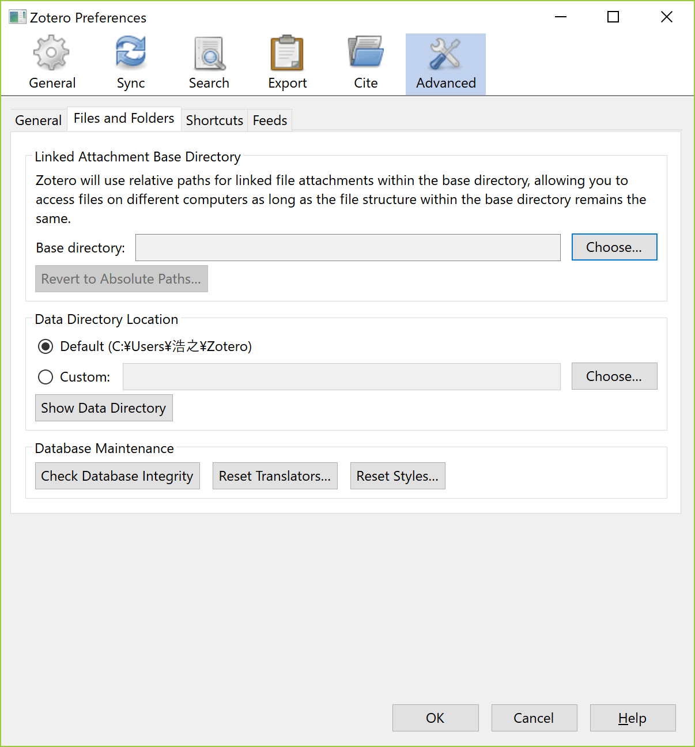
4) Zotero
Save bibliographic data and PDFs
to WebDAV storage without using Zotero’s storage (up to 300 MB for free)
* Desktop Version - Edit - Preferences - Sync
Where in your computer
the bibliographic data and PDFs synchronized are
* Desktop Version - Edit - Preferences - Advanced

Slide 23
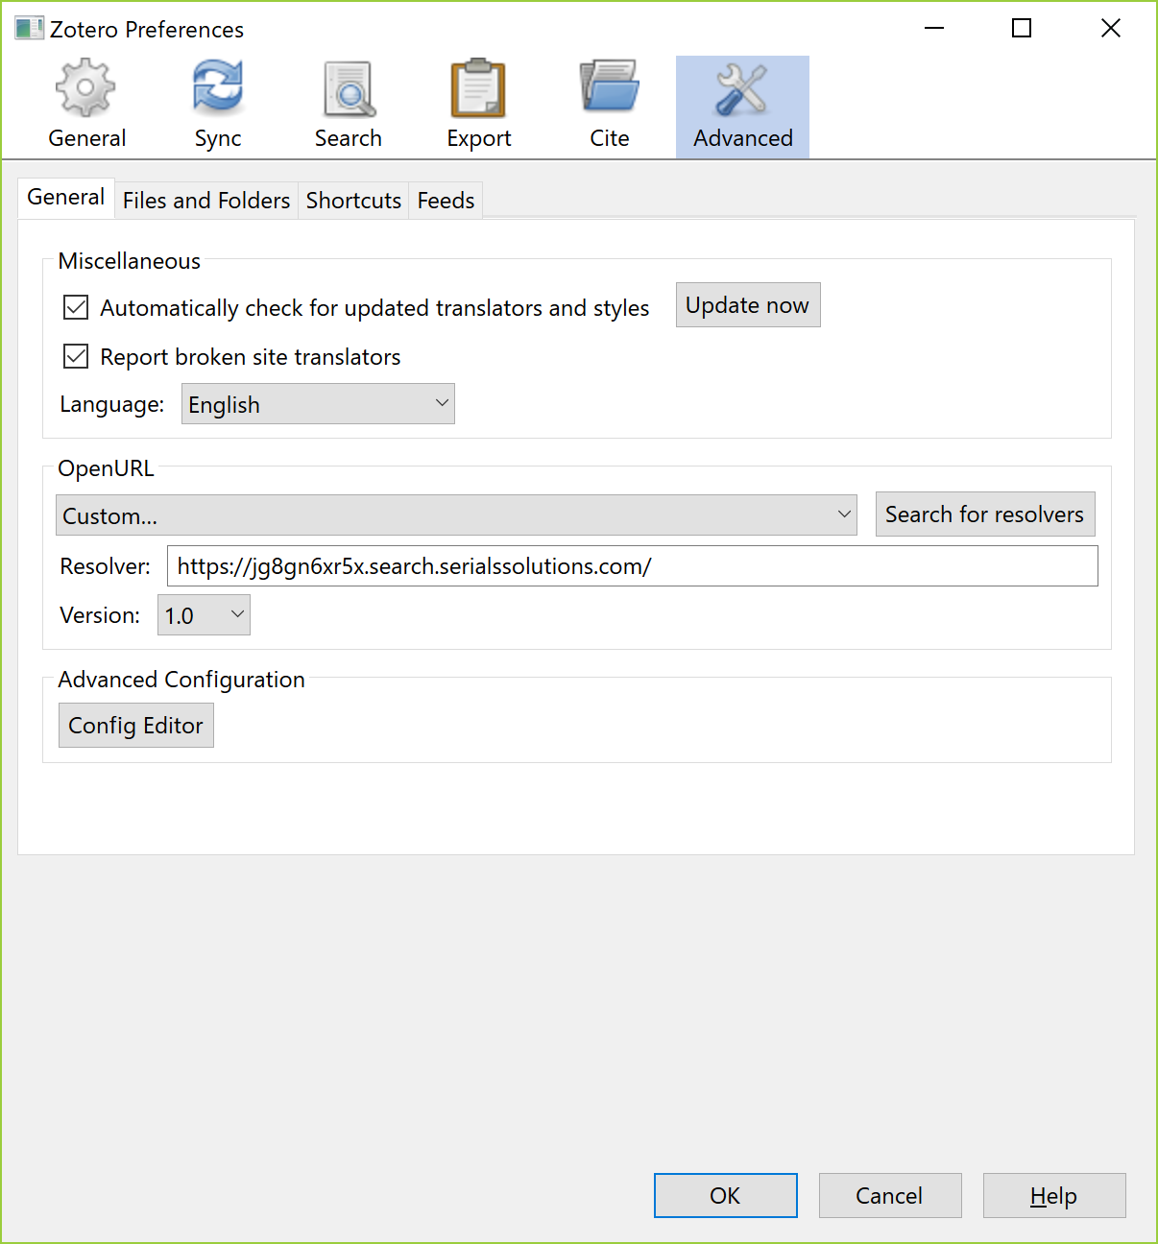
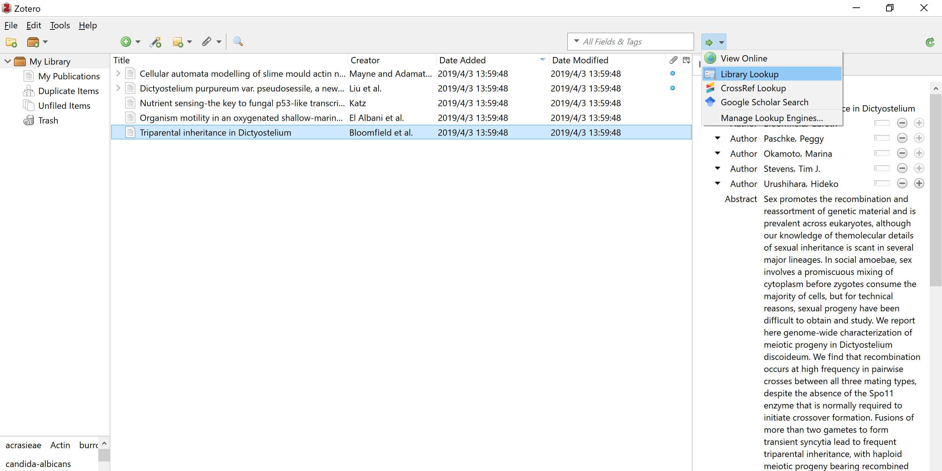
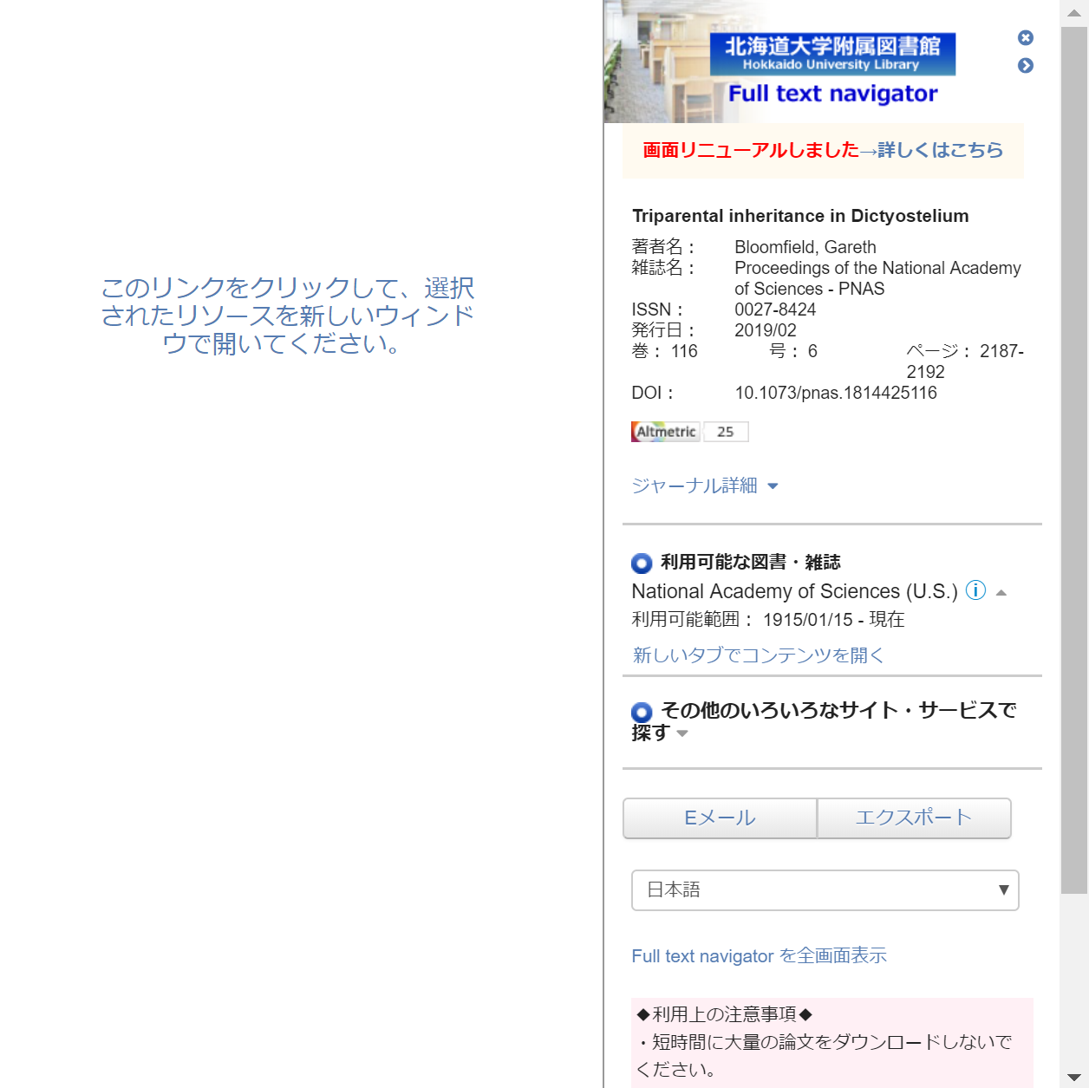
4) Zotero
If you set the link resolver of Hokkaido University ( https://jg8gn6xr5x.search.serialssolutions.com/ ),
"Library Lookup" navigate you to PDF,
or suggest alternatives to access full-text by DOI etc. of the bibliographic data
* Desktop Version - Edit - Preferences - Advanced

Slide 24
5) Sources and cautionary points
EndNote basic
https://clarivate.jp/wp-content/uploads/2017/10/enw_qrc_jp.pdf [Japanese PDF]
https://clarivate.libguides.com/endnote_training/endnote_online [English]
Mendeley
https://www.mendeley.com/guides [English]
Zotero
https://www.zotero.org/support/start [English]
Check where to have saved PDFs when changing the software used

Slide 25
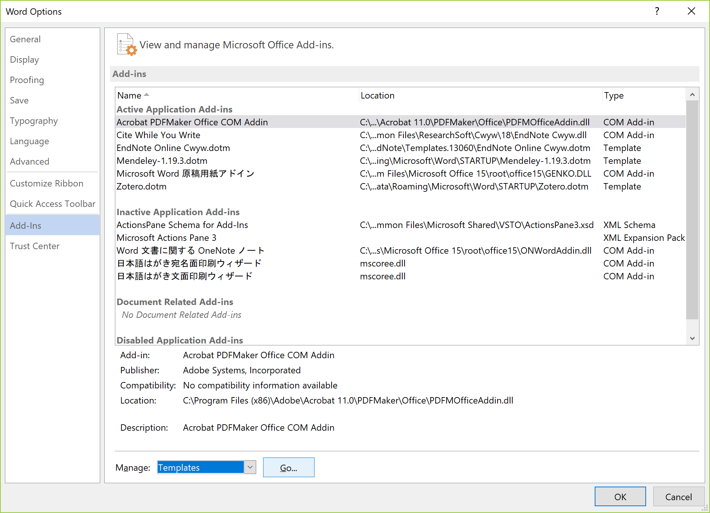
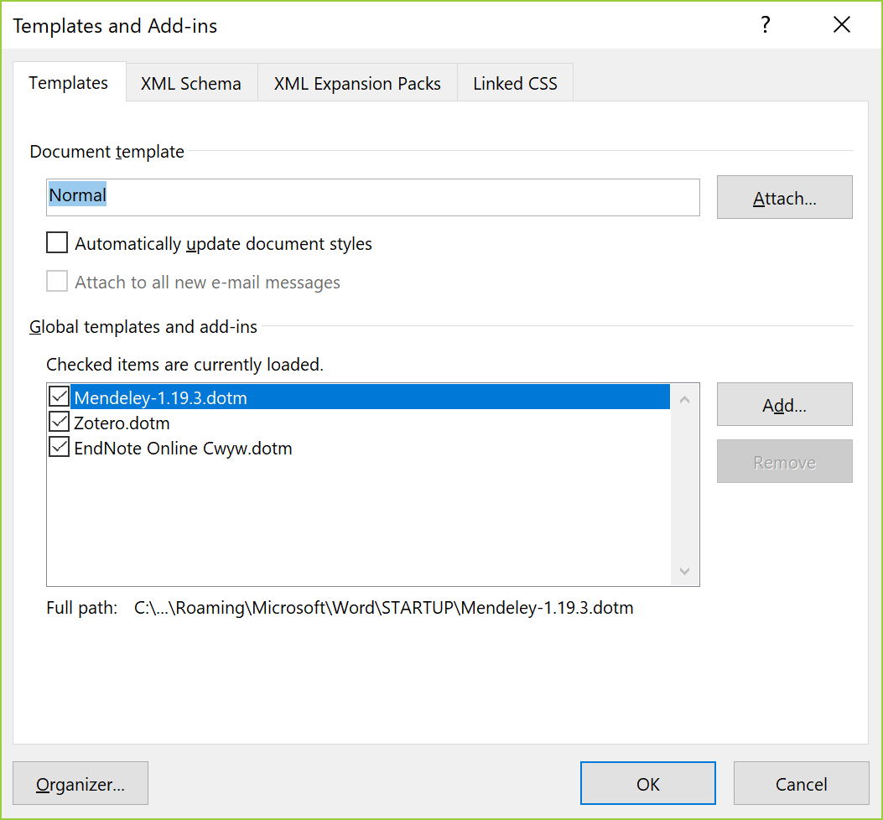
5) Sources and cautionary points
If you have installed multiple Output Tools on Word, they may conflict, so deactivate those you do not use
* Word - File - Options

Slide 26
TRY
LATER
AND
ASK
ME
ANYTIME:
kitacam@lib.hokudai.ac.jp

