Slide 1
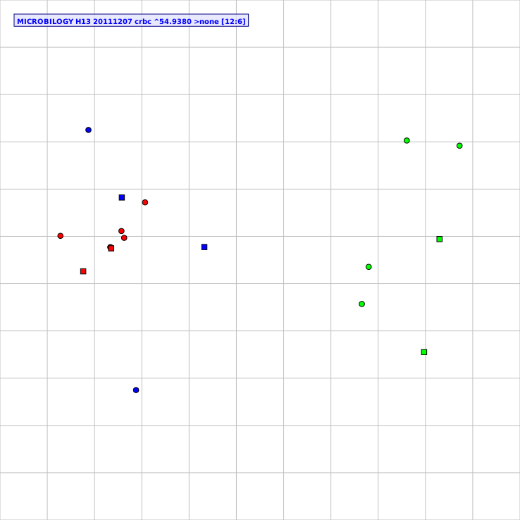
Supplementary Fig. 1.
Wang et al.,
Virus Group I
Antisera Group I
Virus Group II
Antisera Group II
Virus Group III
Antisera Group III
A/red knot/Delaware Bay/424/2007 (H13N9)
A/sanderling/Delaware Bay/221/2006 (H13N9)
A/sanderling/Delaware Bay/224/2006 (H13N9)
Red knot/424
A/whistling swan/Shimane/1343/1981 (H13N6)
A/duck/Hokkaido/WZ68/2012 (H13N2)
A/duck/Siberia/272PF/1998 (H13N6)
Sanderling/224
A/duck/Hokkaido/W186/2006 (H13N6)
A/gull/Maryland/704/1977 (H13N6)
A/duck/Hokkaido/W189/2006 (H13N6)
Duck/WZ68
Gull/2838
Gull/Maryland
A/duck/Hokkaido/W345/2012 (H13N2)
A/mallard/Korea/SH38-45/2010 (H13N2)
Duck/W345
A/laughing gull/Delaware Bay/2838/1987 (H13N2)

