Slide 1
International Open Access Week 2019 Program
at Northern Campus Library, Hokkaido University, Japan
Afternoon Talk
Looking over / for / out of Open Access
Hokkaido University Northern Campus Library
kitacam@lib.hokudai.ac.jp
October 2019
Except where otherwise noted,
content of this material is licensed under a Creative Commons Attribution 4.0 International license

Slide 2
Looking over / for / out of Open Access
Open Access (OA)
To publish research works on the Internet
and make them available for free by everyone
Looking over the ways and recent trends of OA
Looking for OA papers faster
Looking out of predatory OA journals / publishers

Slide 3
Looking over Open Access

Slide 4
Looking over Open Access
Percentage of OA papers by Publication Year
The whole world
Hokkaido University
expected to be OA
These graphs are made by searching SCI-E, SSCI and A&HCI of Web of Science under the following conditions:
Year Published = 2009-2018, Document Type = Article, Review, Organization-Enhanced = Hokkaido University
and refining the results by the option "Open Access" (accessed 2019-10-18)

Slide 5
Looking over Open Access
One of the background of OA movement: Serials Crisis (goes on…)
■ Japanese ■ Foreign
If price increase of 5% continues every year…
Numbers of e-journal titles
provided by Hokkaido University Library
EBSCO announces serials price projections every year:
2020: price increase of 5-6% for packages, 4-5% price increase for individual titles
2019: price increase of 5-6%
2018: price increase of 5-6%
2017: price increase of 5-6%
2016: price increase of 4-6%
2015: price increase of 5-7%
EBSCO’s announcements are available online:
2020, 2019 (PDF), 2018 (PDF), 2017 (PDF), 2016 (PDF), 2015 (PDF) (accessed 2019-10-28)
Numbers of e-journal titles provided by Hokkaido University Library are calculated from “Hokkaido University Library Annual Report” 2014-2019 (in Japanese)
https://www.lib.hokudai.ac.jp/about/publications/#href_nenpo (accessed 2019-10-23)

Slide 6
Looking over Open Access
Ways of OA
Green OA
Subscription Journal
Subscription
Fee
Self-archiving into Institutional Repository
Author Manuscript
Gold OA
Hybrid OA Journal
Over 70% of the 4 major publishers’ journals
and 45% of all journals are of this type
Full OA Journal
Article
Processing
Charge
(APC)
Our institutional repository is Hokkaido University Collection of Scholarly and Academic Papers (HUSCAP)
https://eprints.lib.hokudai.ac.jp (accessed 2019-10-25)
Hokkaido University Library provides information on discounts of APC on the following website (in Japanese):
https://www.lib.hokudai.ac.jp/support/apc (accessed 2019-10-25)

Slide 7
Looking over Open Access
Ways of OA
Green OA
Subscription Journal
Subscription
Fee
Self-archiving into Institutional Repository
Author Manuscript
Gold OA
Hybrid OA Journal
Over 70% of the 4 major publishers’ journals
and 45% of all journals are of this type
Full OA Journal
Article
Processing
Charge
(APC)
Our institutional repository is Hokkaido University Collection of Scholarly and Academic Papers (HUSCAP)
https://eprints.lib.hokudai.ac.jp (accessed 2019-10-25)
Hokkaido University Library provides information on discounts of APC on the following website (in Japanese):
https://www.lib.hokudai.ac.jp/support/apc (accessed 2019-10-25)

Slide 8
Looking over Open Access
Attempts of transformation from subscription to OA publishing
Offsetting Agreement
OA2020 https://oa2020.org
aims to transform to OA publishing based not only on transfer from subscription fee, but also on the situation of countries or institutions
Calculation of Max Planck Digital Library
The whole world: Subscription Fee > APC
DE, UK, FR, US: transformable
Survey of Japan Alliance of University Library Consortia for E-Resources (JUSTICE)
JPN: Subscription Fee > Necessary Expenses for OA
Article
Processing
Charge
(APC)
Subscription
Fee
Read and Publish Agreement
Refer to the following documents for details * The former is Japanese
Sawako KOJIN, Keiko YANO. Towards transformation from journal subscription to open access publishing. Journal of College and University Libraries. 2018, vol. 109, 2015, doi:10.20722/jcul.2015. https://www.jstage.jst.go.jp/article/jcul/109/0/109_2015/_article/-char/en, (accessed 2019-10-23).
SCHIMMER Ralf, GESCHUHN Kai Karin, VOGLER Andreas. Disrupting the subscription journals’ business model for the necessary large-scale transformation to open access. 2015, doi:10.17617/1.3. http://hdl.handle.net/11858/00-001M-0000-0026-C274-7, (accessed 2019-10-30).

Slide 9
Looking over Open Access
OA policies of research funder / institution
Japan Society for the Promotion of Science (JSPS) OA of papers supported by KAKENHI is recommended https://www.jsps.go.jp/data/Open_access.pdf (in Japanese)
Japan Science and Technology Agency (JST) JST Policy on Open Access to Research Publications and Research Data Management, and its Implementation Guidelines (2017-04-01) Green OA is recommended, Gold OA can be selected https://www.jst.go.jp/EN/about/strategy.html
Hokkaido University Hokkaido University Open Access Policy (2019-06-25) OA as a general rule (Author may choose methods for OA) https://eprints.lib.hokudai.ac.jp/oa-policy_en.pdf

Slide 10
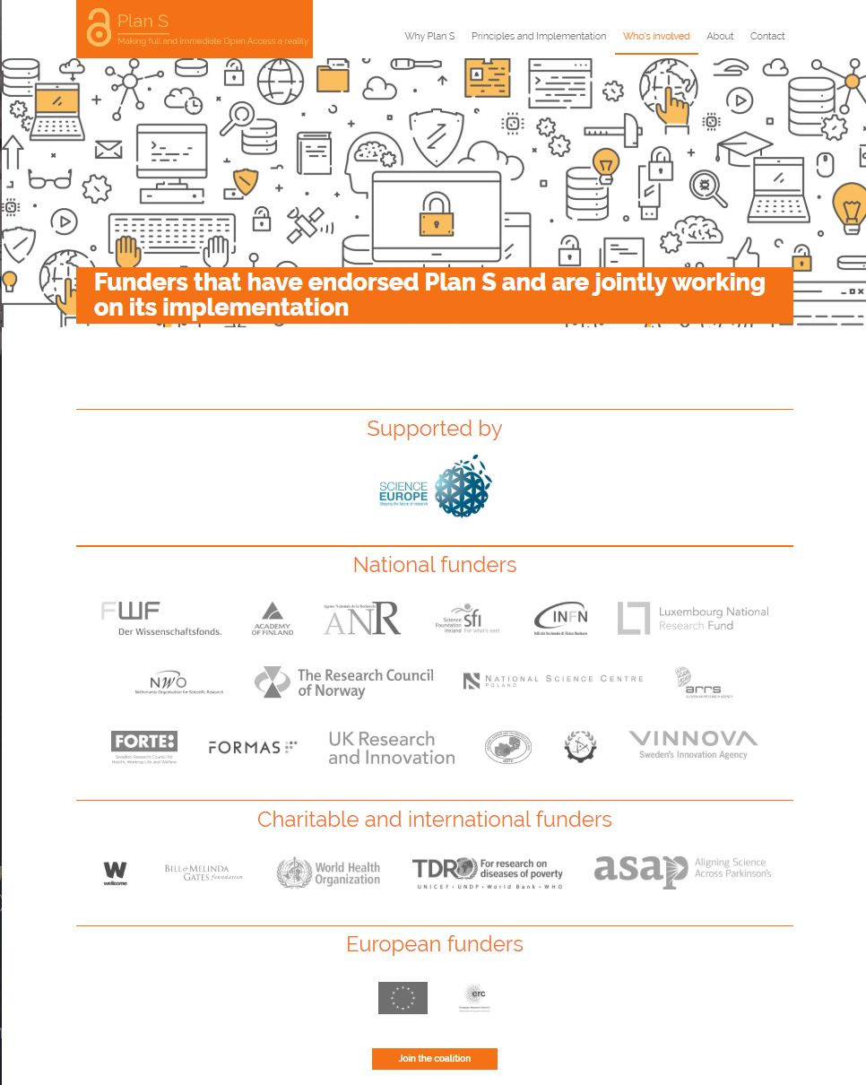
Looking over Open Access
Plan S https://www.coalition-s.org
An initiative set by cOAlition S, a consortium of European funders
requires that from 2021 the subsidized research results be immediately set OA
2-3% of Hokkaido University papers seem to have been subsidized by Plan S signing funders
There may be no immediate response, but the impact is expected to spread
https://www.coalition-s.org/funders (accessed 2019-10-22)
Copyright © 2019 Science Europe
Refer to the following documents for details * The both are written in Japanese
Yutaka HAYASHI. Plan S: Principles and Implementation. The Journal of Information Science and Technology Association. 2019, vol. 69, issue 2, p. 89–93, doi:10.18919/jkg.69.2_89. https://www.jstage.jst.go.jp/article/jkg/69/2/69_89/_article/-char/en, (accessed 2019-10-23).
Miho FUNAMORI. Plan S revised—Its impact and possible measures in Japan. The Journal of Information Science and Technology Association. 2019, vol. 69, issue 8, p. 390–396, doi:10.18919/jkg.69.8_390. https://www.jstage.jst.go.jp/article/jkg/69/8/69_390/_article/-char/en, (accessed 2019-10-23).

Slide 11
Looking for Open Access

Slide 12
Looking for Open Access
Open but hard to find?
Click repeatedly
to PDF
Where is
the button to PDF?
Author Manuscripts are often overlooked

Slide 13
Looking for Open Access
Examples of tools for finding OA papers
Unpaywall (extension for Chrome and Firefox) if OA is available, displays a green button to PDF if OA is unavailable, displays a gray button https://unpaywall.org
Open Access Button (extension for Chrome and Firefox) if OA is available, downloads PDF if OA is unavailable, requests the author to self-archive https://openaccessbutton.org
Google Scholar if PDF is available, displays the link to PDF on the right of the screen https://scholar.google.com

Slide 14
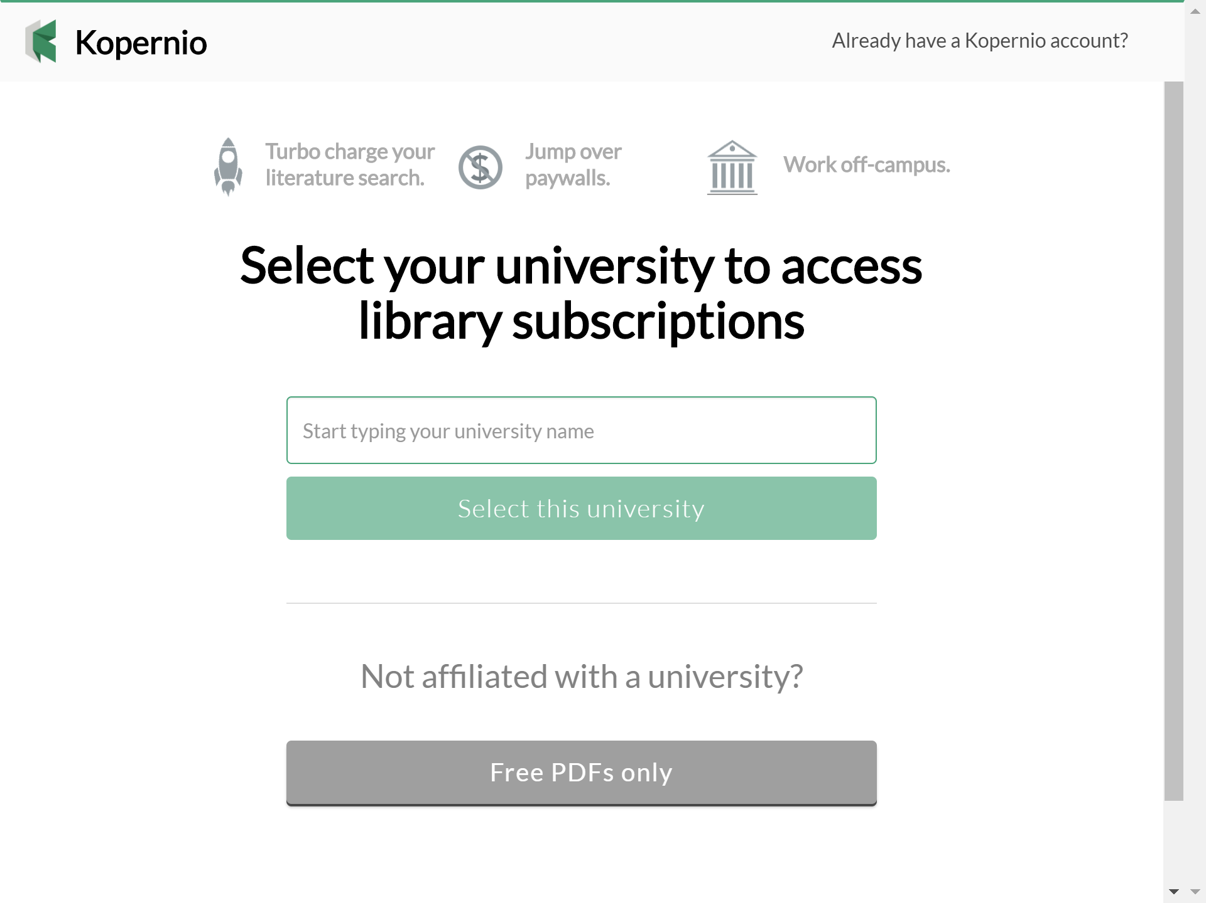
Looking for Open Access
Kopernio (Extension for Chrome and Firefox)
https://kopernio.com
With one click you can get the subscribed paper and the OA version of the unsubscribed paper
Once you log in to Remote Access, you can always access the subscribed papers from outside the university network
When creating an account,
enter and select “Hokkaido University”

Slide 15
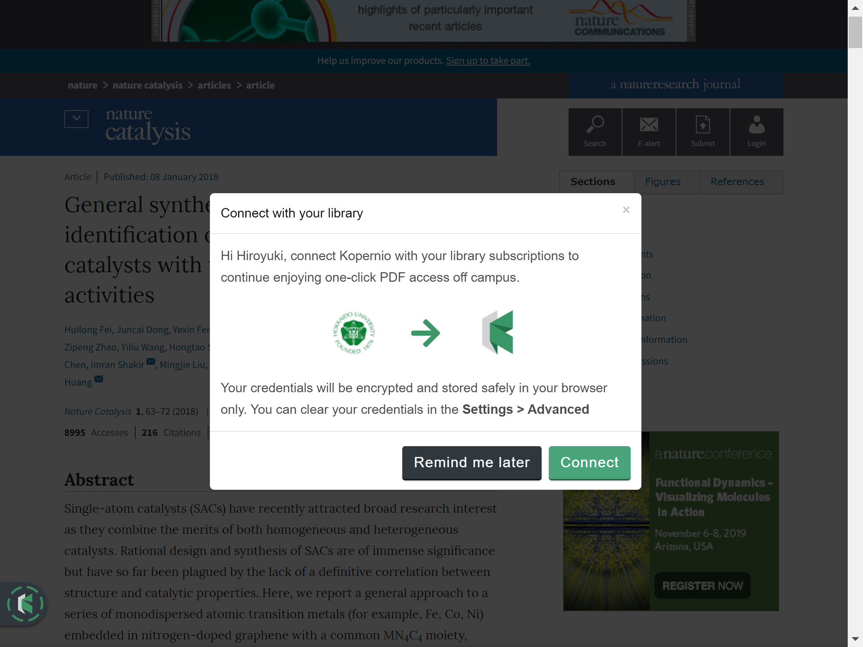
Looking for Open Access
Setting of Remote Access with Kopernio
© 2019 Springer Nature Limited
© 2019 Springer Nature Limited
The first time you try to get a paper,
Kopernio asks you whether to log in to Remote Access

Slide 16
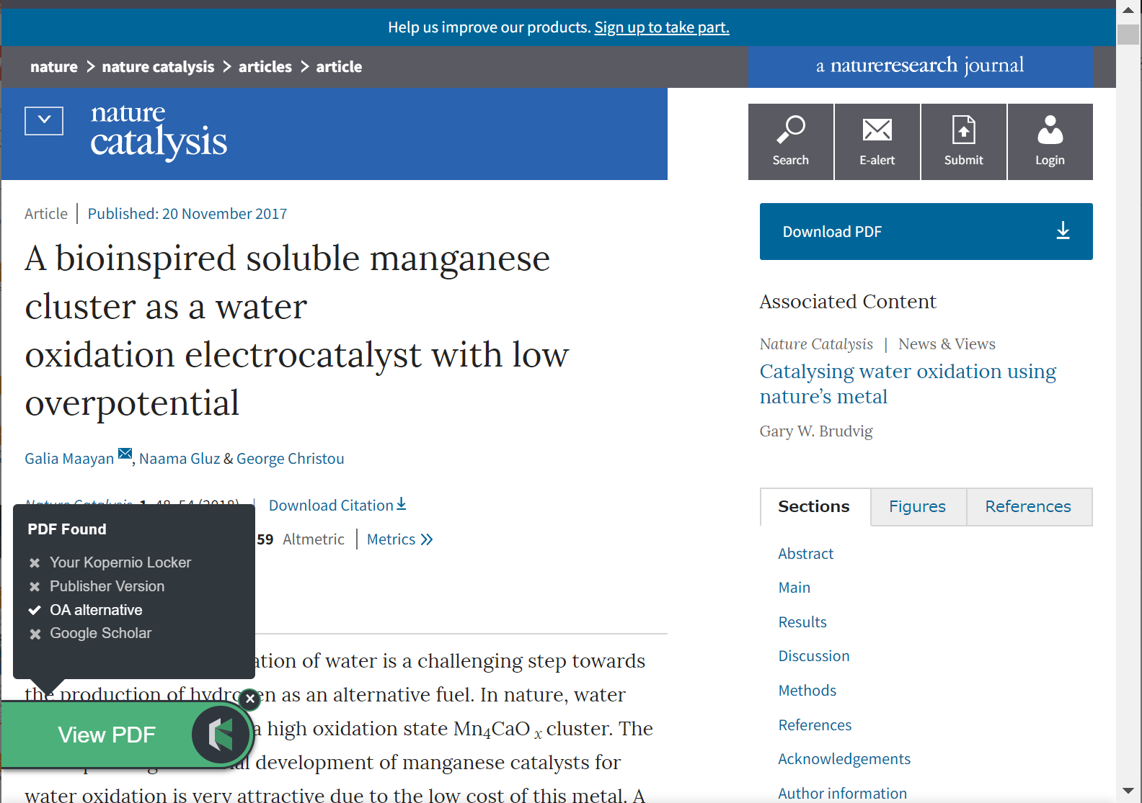
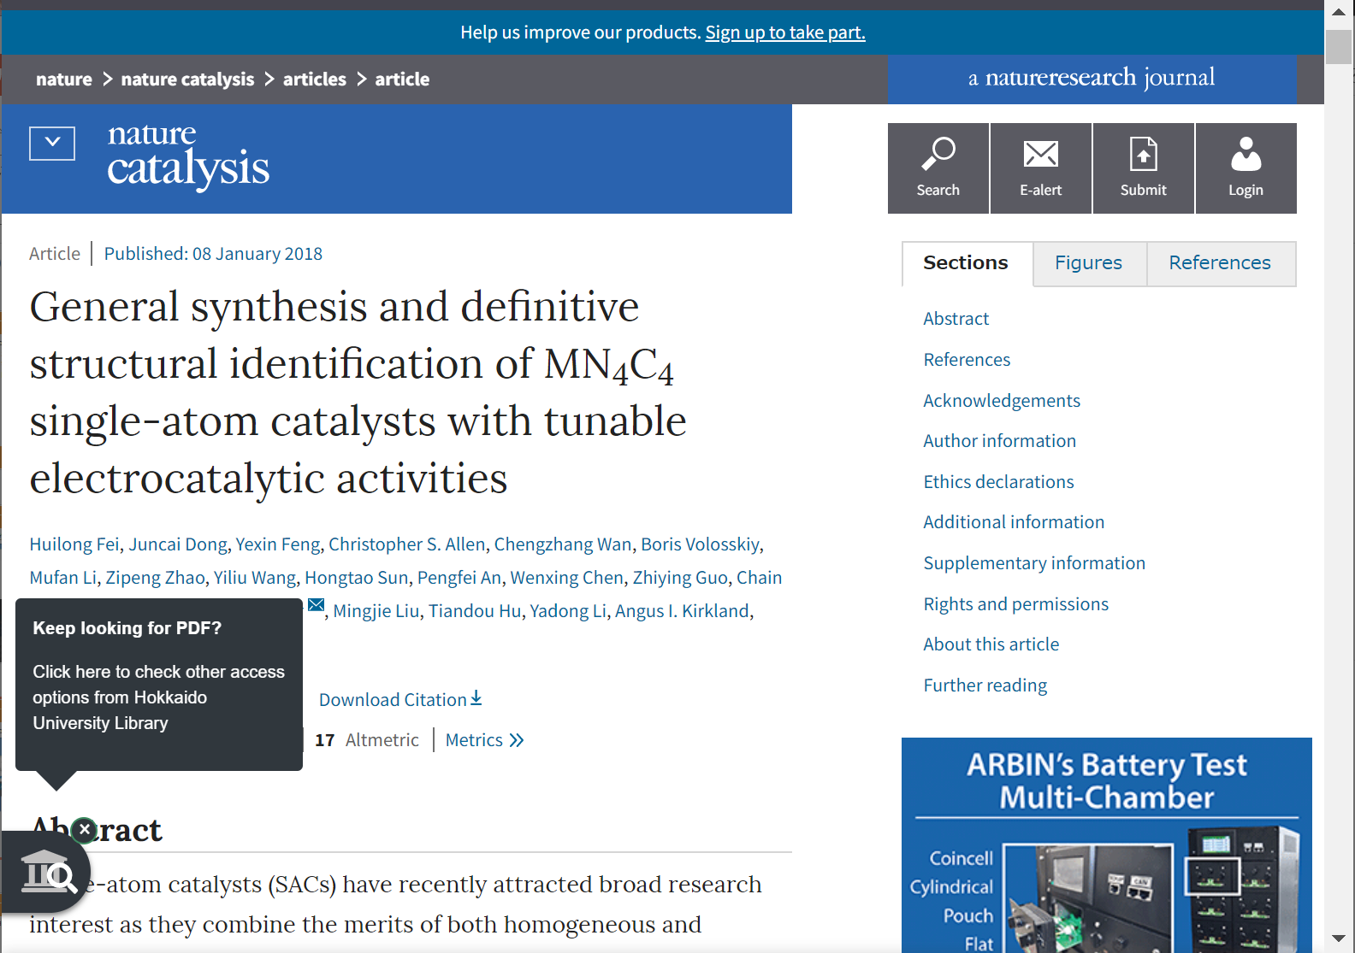
Looking for Open Access
How Kopernio works
© 2019 Springer Nature Limited
© 2019 Springer Nature Limited
Kopernio automatically seeks PDF in the following order:
in your Locker (personal folder on the cloud)
publisher version
OA version
in Google Scholar
When PDF is not found in 1-4 on the left,
Kopernio leads you
to the screen providing alternatives
In the case the screen does not works please take alternatives yourself

Slide 17
Looking for Open Access
Reference 1: Basics of getting papers
* All the papers cannot be always got
Unknown papers (searching by keywords)
Known papers (in the reference list)
Library > Databases
Bibliography
Search
Publication
Search
Bibliographic Database (such as Web of Science)
Library Catalog
e-journal
print journal
shows whether to be able to access or not
Consider
alternatives
Select alternatives
Library
+ Ask a librarian
+ Ask
a librarian
Get PDF
Get a photocopy
Get PDF
Read / Take a photocopy

Slide 18
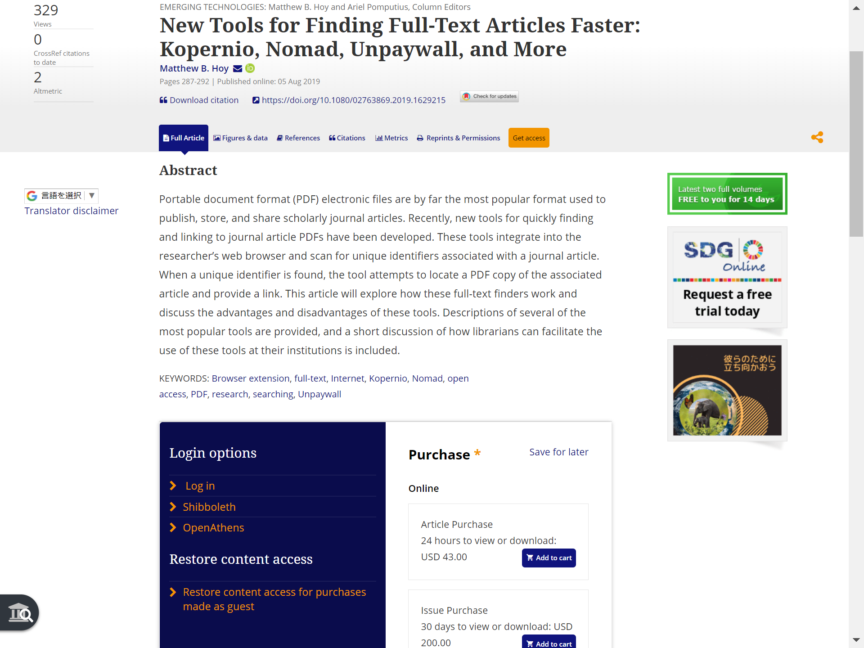
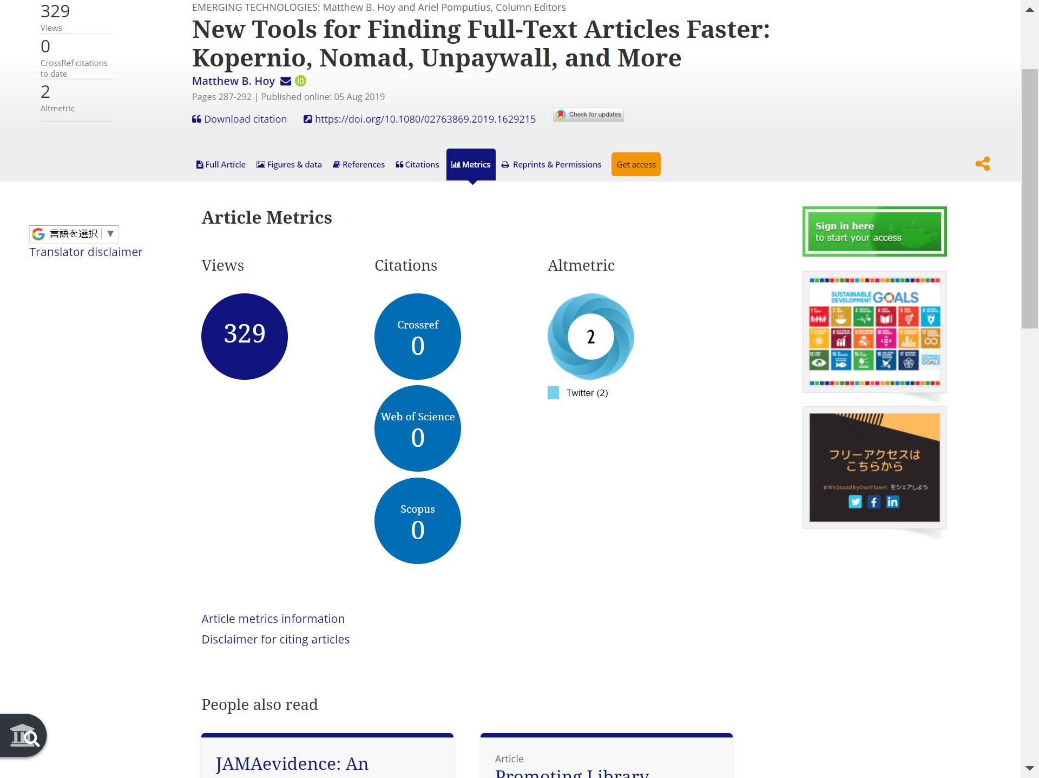
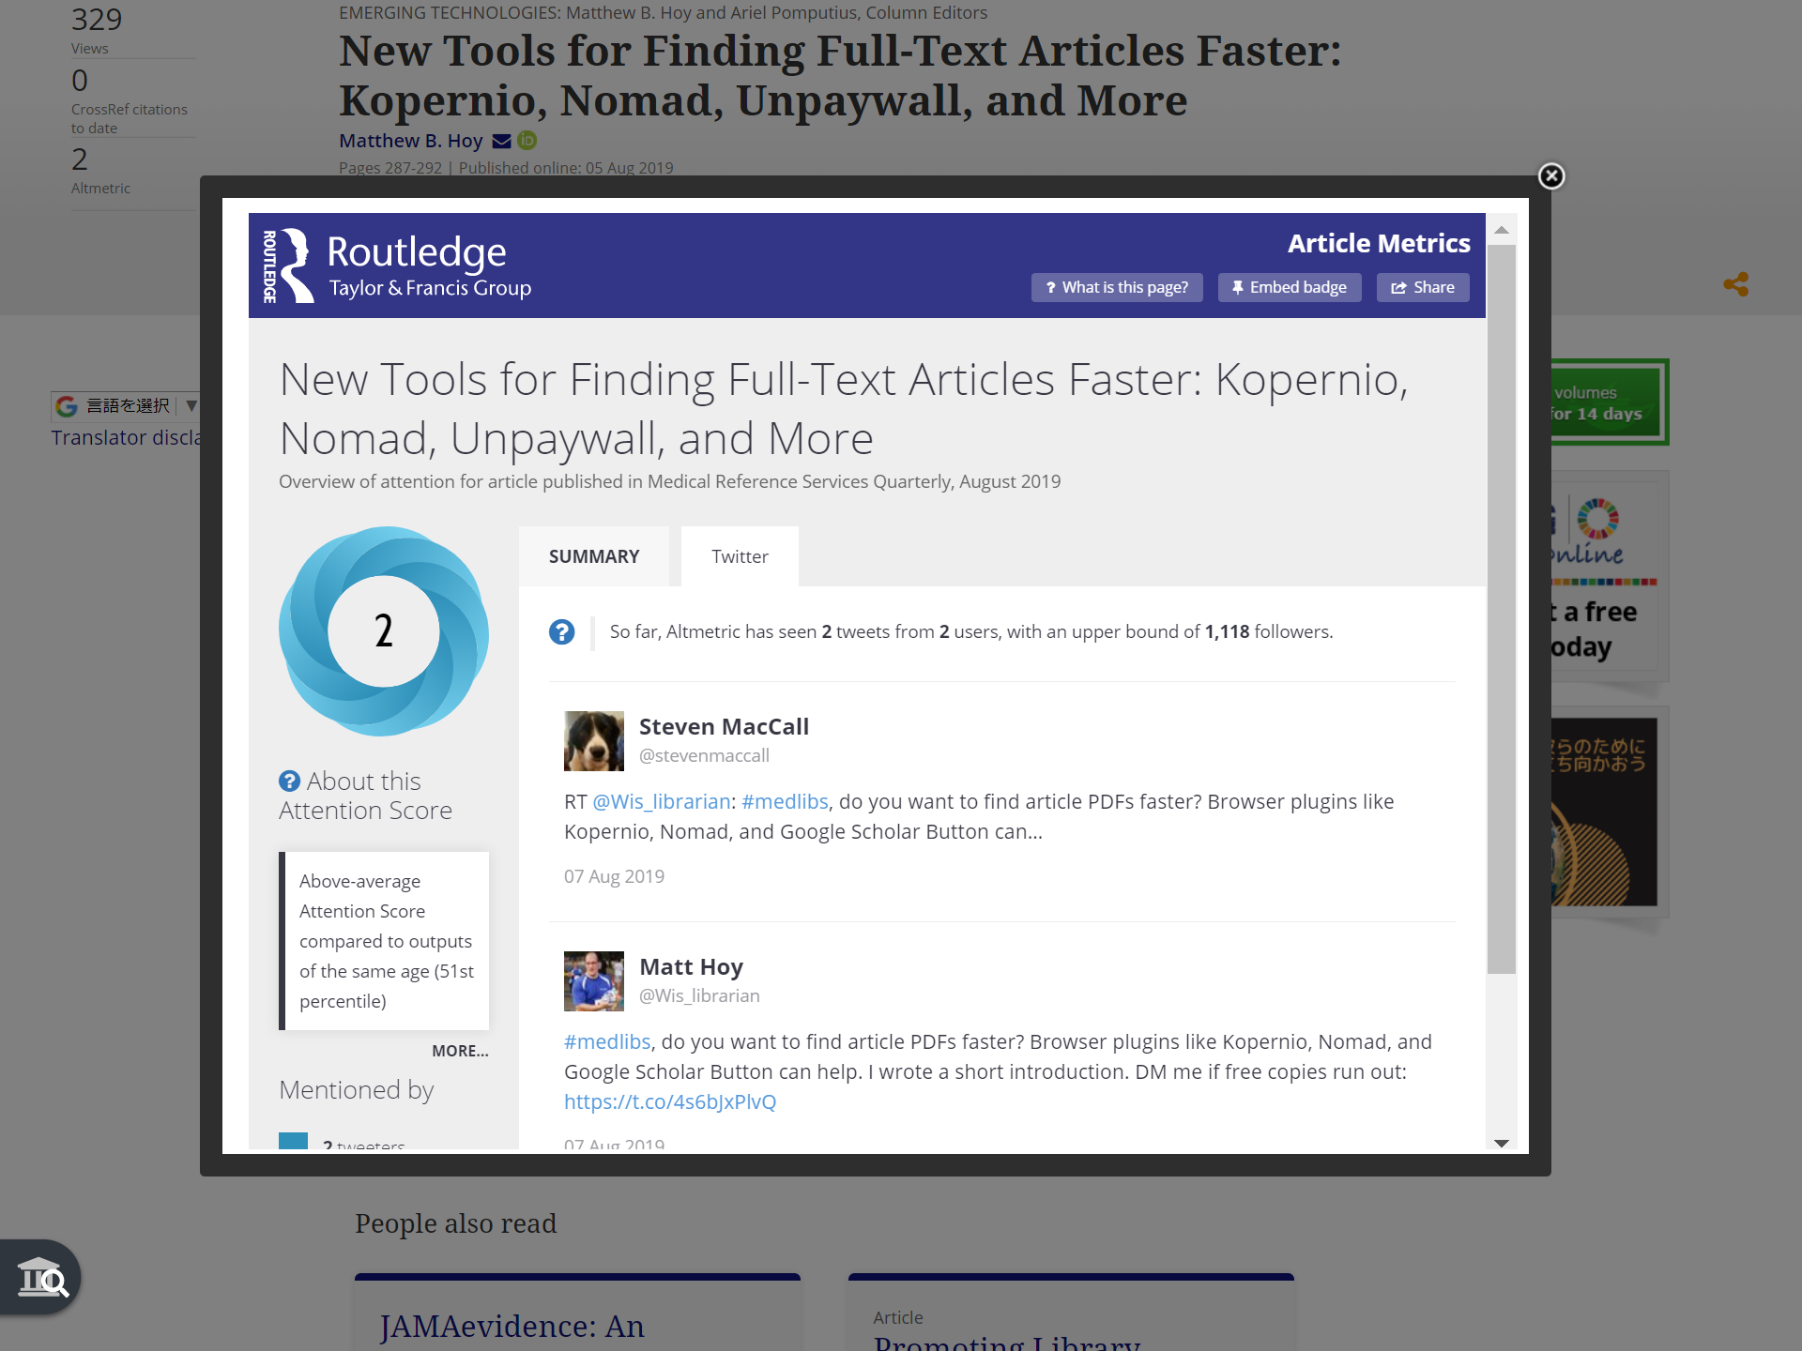
Looking for Open Access
Reference 2: Sharing papers and Altmetric
Publishers may allow authors to share papers as a service However, usually we can access shareable papers only a limited numbers of times, or cannot print or save them
You can find mentions to a paper on SNS and blogs through its Altmetric The author may have written a link for her/his shareable paper
Copyright © 2019 Informa UK Limited
Copyright © 2019 Informa UK Limited
Copyright © 2019 Informa UK Limited

Slide 19
Looking out of Open Access

Slide 20
Looking over Open Access
Ways of OA
Green OA
Subscription Journal
Subscription
Fee
Self-archiving into Institutional Repository
Author Manuscript
Gold OA
Hybrid OA Journal
Over 70% of the 4 major publishers’ journals
and 45% of all journals are of this type
Full OA Journal
Article
Processing
Charge
(APC)
Our institutional repository is Hokkaido University Collection of Scholarly and Academic Papers (HUSCAP)
https://eprints.lib.hokudai.ac.jp (accessed 2019-10-25)
Hokkaido University Library provides information on discounts of APC on the following website (in Japanese):
https://www.lib.hokudai.ac.jp/support/apc (accessed 2019-10-25)

Slide 21
Looking out of Open Access
Predatory Journals
Suspicious academic journals that publish papers with inappropriate or no peer-review only for making money (profit from APC)
The actual situation is unclear, but there are damage reports and legal cases
Problems
Money trouble such as too expensive APC charges
Decreasing trust in research results due to insufficient peer-review
If the publisher abandons cost of maintaining OA, the research achievement may disappear
Social criticism (when lost APC is public fund)
Spread of insufficiently checked papers
From here on, the following Japanese document has been translated, restructured and rewritten
Hiroyuki CHIBA. Problems of Predatory Journals : from the Perspective of University Librarians. Current Awareness. 2019, no. 341, p. 12–14, doi:10.11501/11359093. https://current.ndl.go.jp/ca1960, (accessed 2019-10-23).
This document is licensed under a Creative Commons Attribution 4.0 International license
https://creativecommons.org/licenses/by/4.0

Slide 22
Looking out of Open Access
Major features of Predatory Journals
They often
call for papers by mass e-mails
guarantee quick peer-review and/or publication in a short period
does not show APC and publication process
have the rough and poor website
display the indicators misleading as if they were top journals
plan to cheat many researchers in many other ways (handle a too wide range of research fields, use a name similar to a famous journal, and so on)

Slide 23
Looking out of Open Access
Ways to find out if a journal or a publisher is predatory
Does it have the features described previously?
Visit Think. Check. Submit. https://thinkchecksubmit.org
What can be grounds for soundness
A publisher belongs to COPE and OASPA
A journal is indexed in DOAJ and paid database (such as Web of Science, Scopus)
- The basis for doubting soundness?
- Beall’s List
Anonymous volunteer has taken over the list, which a librarian created and deleted later
・[In my opinion] Can you explain the reason for submitting to the journal?

Slide 24
Looking out of Open Access
The indicator to watch out for: Journal Impact Factor (JIF)
What is the official name? Global Impact Factor or Scientific Impact Factor is another indicator
What is the data source and provider? Web of Science provided by Clarivate Analytics
What year is the version of JIF? The latest version is 2018 JIF released in June 2019 (The previous year’s JIF is released in every June) The version remain old? The journal might have caused some problem and may be now being excluded from Web of Science
Visit Journal Citation Reports and check JIF there https://jcr.clarivate.com

Slide 25
Think about Open Access

