Slide 1
330 patients with physician diagnosed COPD were enrolled
30 patients were excluded during run-in period due to ineligibility or withdrawal of consent
300 patients started follow-up study
21 patients were excluded for not meeting the GOLD criteria for spirometric data for first three visit.
279 patients were eligible for subsequent follow-up
158 patients underwent CT examination at each site.
121 patients underwent CT examination at Hokkaido university hospital
The scans of 30 patients was not preserved properly for 3D-analysis as DICOM data.
91 patients had CT data on V1
No analyzable CT data (different kernel, giant bullae or pleural thickening) (N=21)
70 patients had analyzable CT data on V1
Other 26 patients had analyzable CT data on V3
Enrolled for the present study (N=96, 70 patients with V1 data and 26 patients with V3 data)
Notes:
Figure E1

Slide 2
Figure E2.
154 male patients were investigated
1 had lobectomy
5 had malignancy within 5 years
148 underwent
baseline evaluations
18 were excluded for the following reasons:
4 had interstitial pneumonia
2 had current asthma
1 had bronchiectasis
11 had abnormal shadows on chest CT
130 patients met the inclusion/exclusion criteria
Notes:
Figure E2

Slide 3
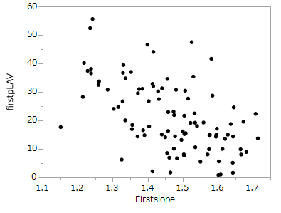
Figure E3.
(%)
Rho=-0.54
P<0.01
%LAV
Fractal D
Notes:
baseline %LAV& baseline D N=96

Slide 4
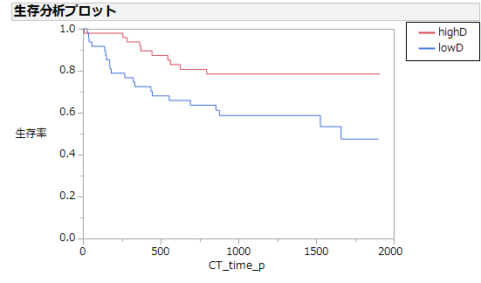
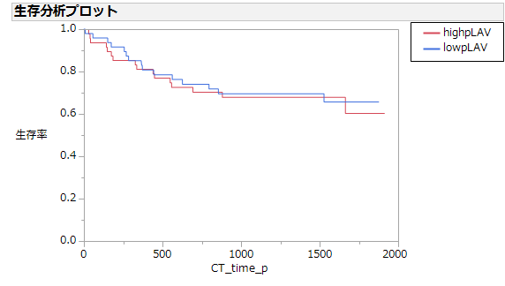
Figure E4.
High D
Low D
Exacerbation (prescription)
Low pLAV
High pLAV
Exacerbation (prescription)
P=0.01
(logrank)
P=0.75
(logrank)
Follow-up days
(days)
(days)
Follow-up days

Slide 5
Figure E5.
%FEV₁ (%)

Slide 6
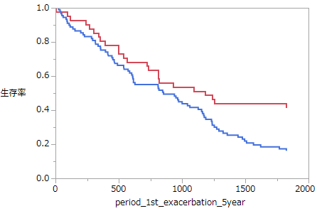
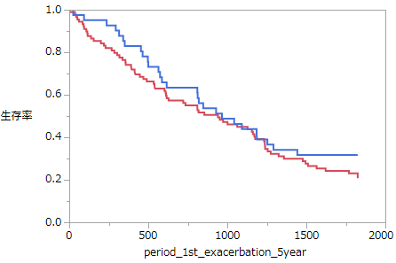
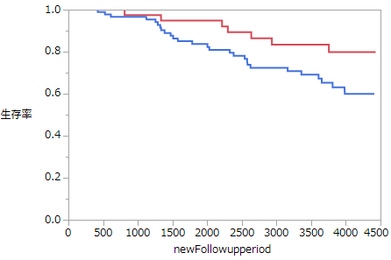
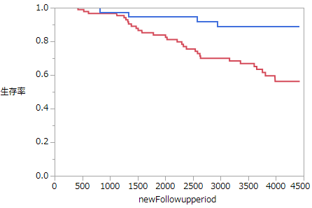
Figure E6.
Exacerbation
Exacerbation
High D
Low D
Low pLAV
High pLAV
Exacerbation
増悪
P=0.015
(logrank)
P=0.27
(logrank)
Follow-up days
Follow-up days
High D
Low D
Low pLAV
High pLAV
Mortality
Mortality
生存
P=0.055
(logrank)
P<0.01
(logrank)
Follow-up days
Follow-up days

Slide 7
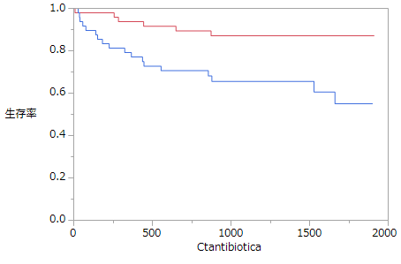
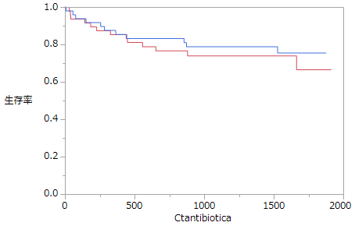
Exacerbation
Exacerbation
Low pLAV
High pLAV
Exacerbation
Exacerbation
High D
Low D
P<0.01 (logrank)
P=0.51 (logrank)
Follow-up days
(days)
Follow-up days
(days)

