Slide 1
Table S1. Effect of WSCA concentrations on fiber morphology and diameter.
WSCA concentration wt.% | Fiber morphology | Average diameter (µm)
1 | only beads | -
3 | only beads | -
5 | only beads | -
7 | fibers with beads | 0.54
9 | fibers with beads | 1.02
11 | uniform fibers | 1.20
13 | uniform fibers | 1.99
15 | uniform fibers | 2.34
17 | uniform fibers | 3.57
Table explanation:
The lower WSCA concentration [1-5 wt.%] yielded only beads. The solutions at 7 and 9 wt.% yielded fibers and beads. The solutions at 11 wt.% and more concentrations gave uniform fibers. In the concentration range of 11 – 17 wt.%, the fiber diameter was increased with an increase in WSCA concentration.

Slide 2
Table S2. Average diameter and surface roughness of saponification of WSCA At 11 wt.% and CDA 9 wt.%
Saponified fibers | Average diameter (µm) | Surface roughness (µm)
 |  | Ra | Rp + Rv | Rz
WSCA at 11% (w/w) | 1.16 | 7.40 | 129 | 129
CDA at 9% (w/w) | 1.73 | 7.26 | 245 | 237
Ra: Arithmetic average roughness Rp: Maximum peak height in the assessed profile obtained from 3-D microscopic observation Rv: Maximum depth in the assessed profile obtained from 3-D microscopic observation Rz: 10-point average roughness The detailed explanation is available at http://www.iso.org/obp/ui/#iso:std:iso:4287:ed-1:vl:fr
Table explanation;
Ra value of both saponified fibers was almost identical, while the Rp+Rv and Rz of saponified WSCA fibers were much smaller than those of CDA fibers. Therefore, smaller fiber diameter give smaller roughness or more flat surface.

Slide 3
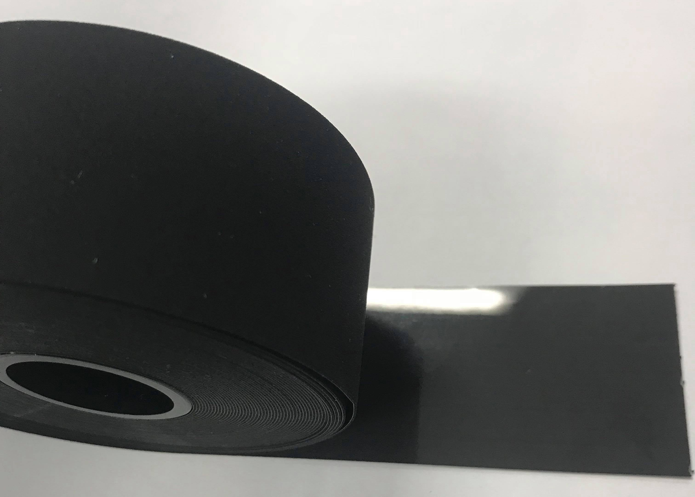
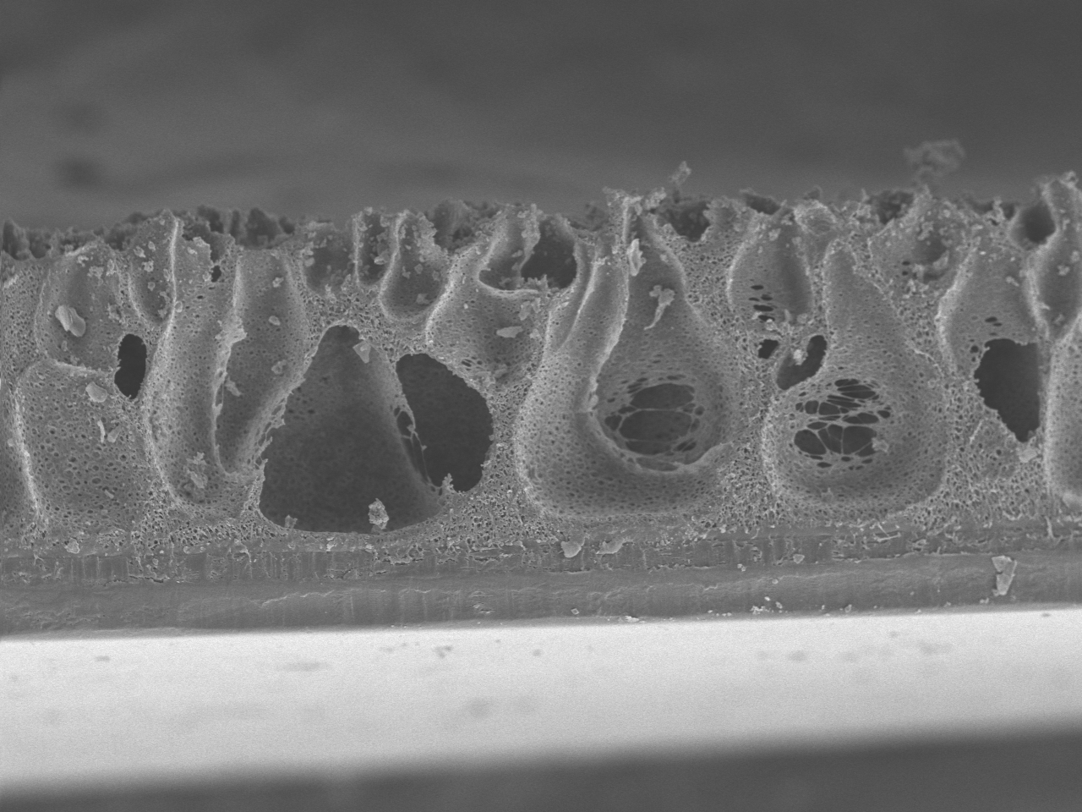
Embossed PU sheet with rough surface
(b)
(a)
(c)
(a)
(a)
100 µm
PET sheet
Fig. S1. Appearance of PU sheet (a), hand writing image of PU sheet structure (b), and cross section (c).
Figure explanation:
PU sheet was attached and supported by PET sheet, and then embossing was used on the PU sheet to give rough surface.

Slide 4
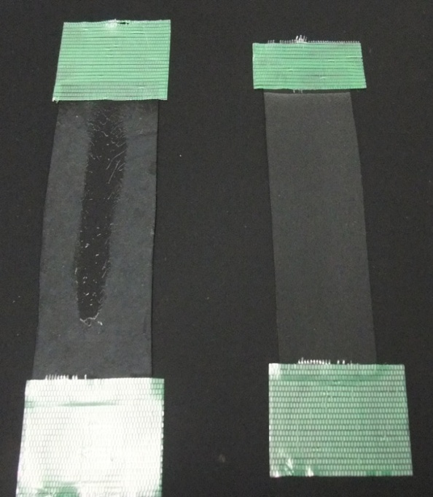
(a)
(b)
Fig. S2. Peeling-off test by rubbing CA electrospun fibers-deposited PU sheet with a finger before (a) and after (b) the fixation treatment with DMF/ethanol solution.

Slide 5
(a)
(1)
(2)
(3)
(4)
(b)
Fig. S3. Fiber adhesion strength roughly estimated with tribology test machine before (a) and after (b) the fixation treatment with DMF/ethanol solution.
(a – 1, 2, 3 and 4), rubbing test under 5 gf load at one-time scan (reciprocating), at three-time scans, at six-time scans and at twelve-time scans, respectively.
(b), rubbing test under 150 gf loading at twenty-time scans.
Figure explanation:
Rubbing test for the fixed sample was carried out at least four replicates under 150 gf loading in Figure (b). However, no peeling-off was observed for any replicates.

Slide 6
(a)
(b)
(c)
(d)
Fig. S4. Electrospun fiber morphology of CDA at 17 wt.% concentration fixed with 90% (a), 80% (b), 60 % (c) and 50 wt.% (d) DMF solution spray, respectively. Arrows show the dissolving part of fibers and PU sheet.

