Slide 1
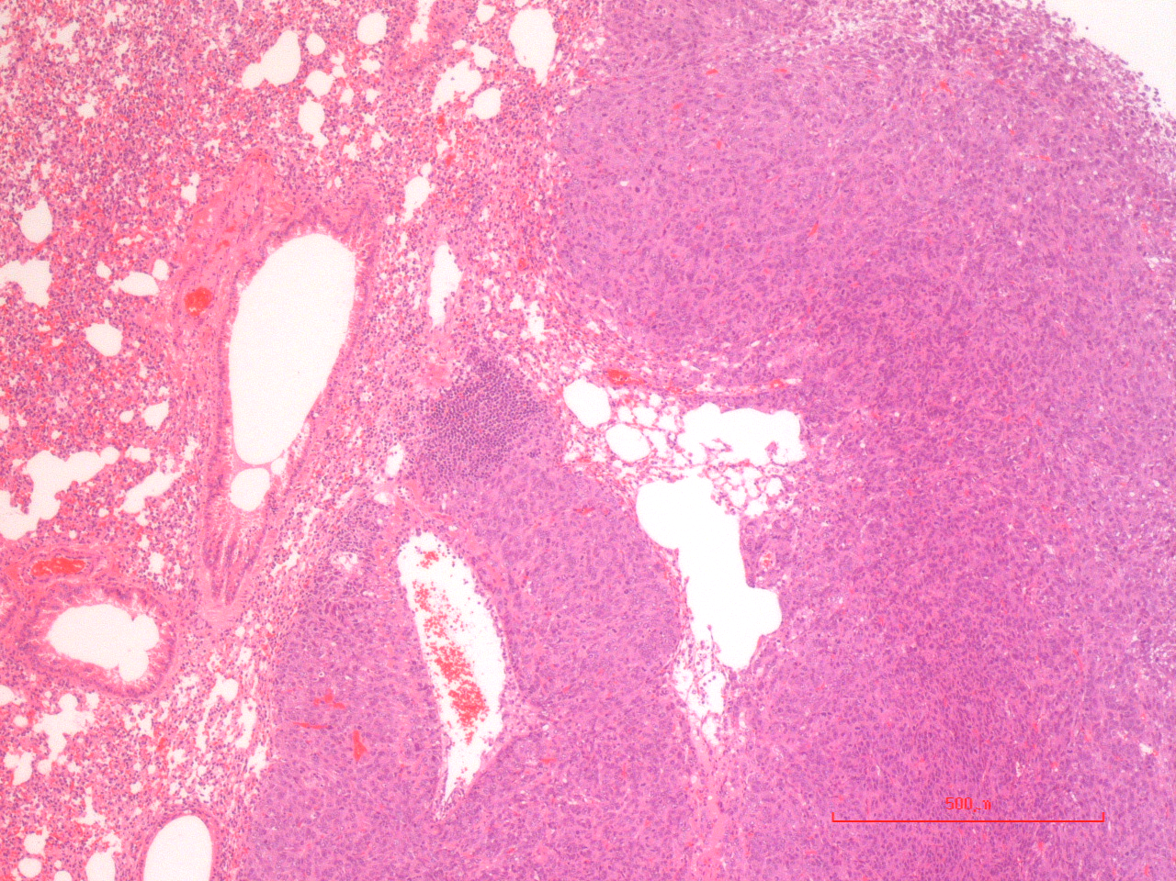
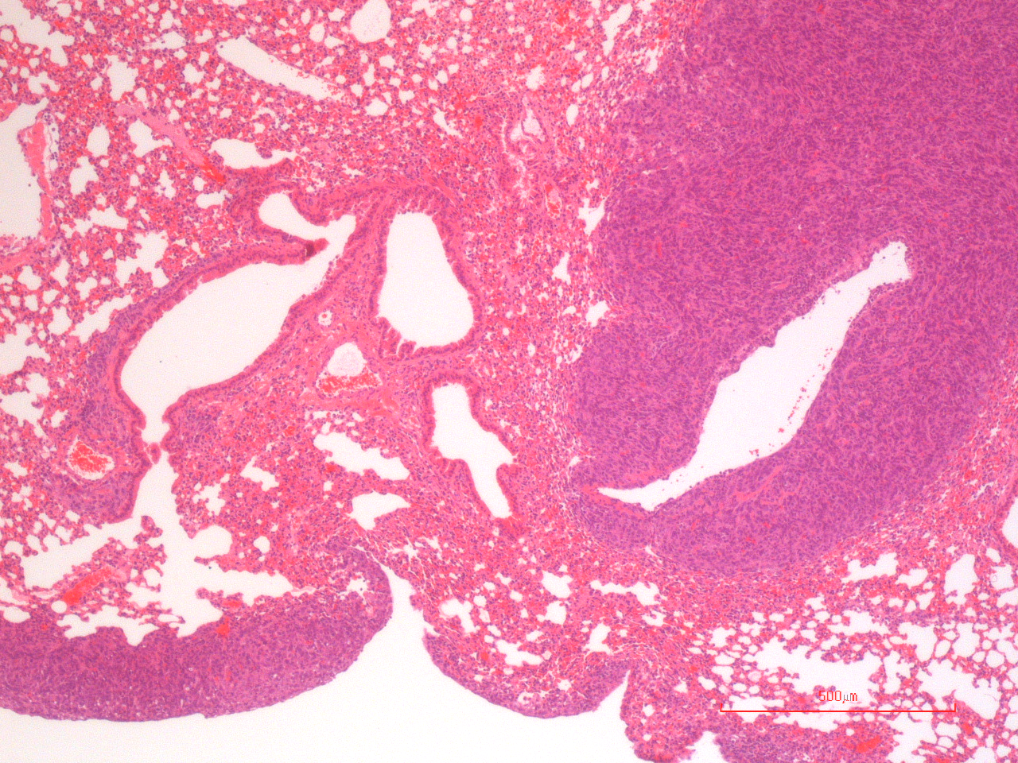
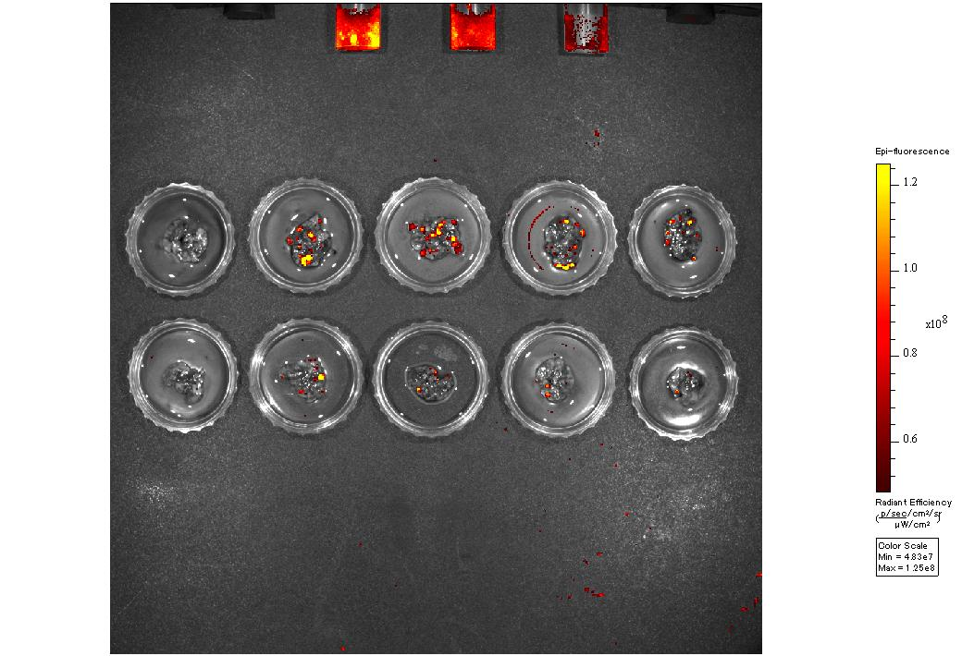
Supplementary Figure S1. Toyoshima et al.
A
B
Il6^{+/+}
Tumor area / Total tissue area
*
Il6^{-/-}
Il6^{+/+}
Il6^{-/-}
C
D
No tumor
CT26-inoculated lung
Il6^{+/+}
Photon flux ratio
*
Il6^{-/-}
Il6^{+/+}
Il6^{-/-}
E
Log rank test *P=0.0263
Survival (%)
n=15
Il6^{+/+}
n=15
Il6^{-/-}
Days after inoculation

Slide 2
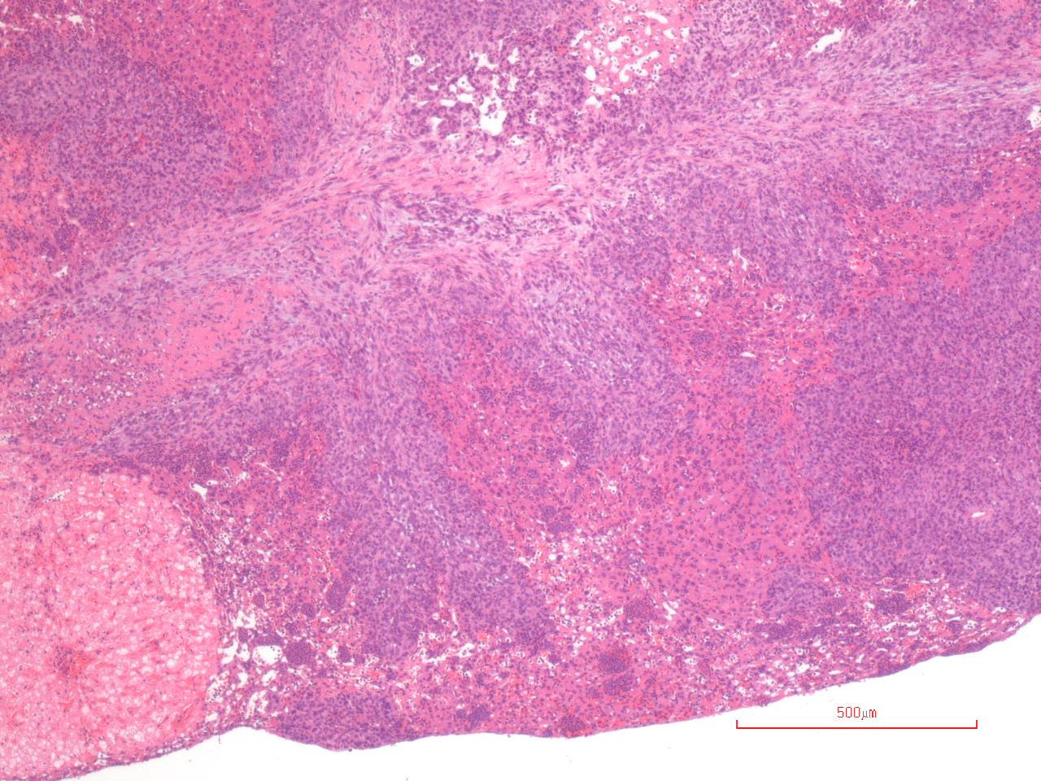
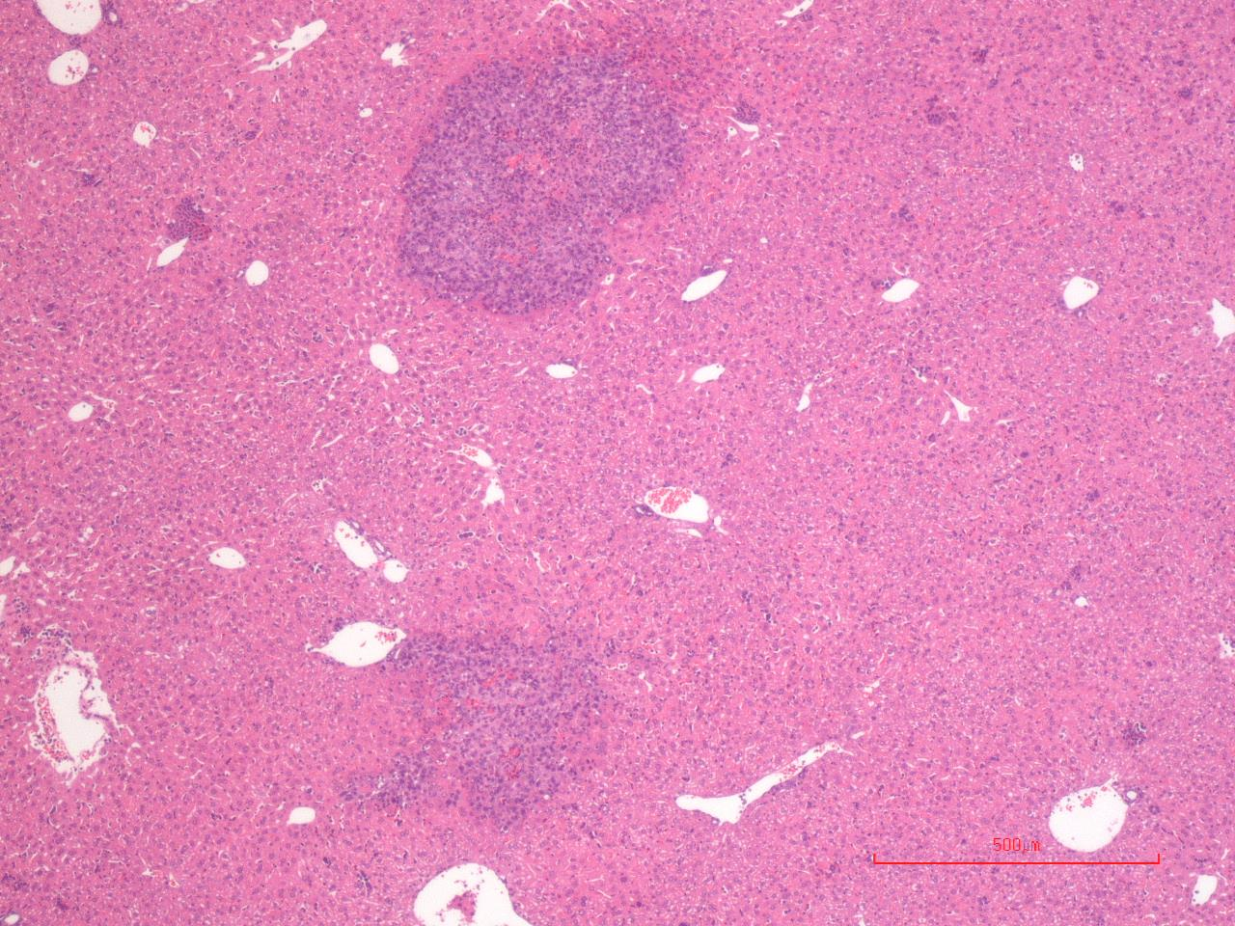
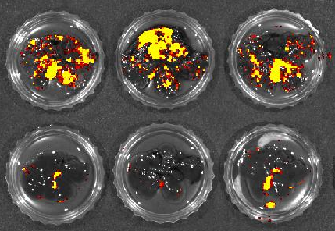
Supplementary Fig. S2. Toyoshima et al.
A
B
4T1-inoculated
Il6^{+/+}
Tumor area / Total tissue area
Il6^{-/-}
*
Il6^{-/-}
Il6^{+/+}
C
D
4T1-inoculated
Il6^{+/+}
Photon flux ratio
*
Il6^{-/-}
Il6^{-/-}
Il6^{+/+}
E
Log rank test *P=0.0037
Survival (%)
n=22
Il6^{+/+}
n=20
Il6^{-/-}
Days after inoculation

Slide 3
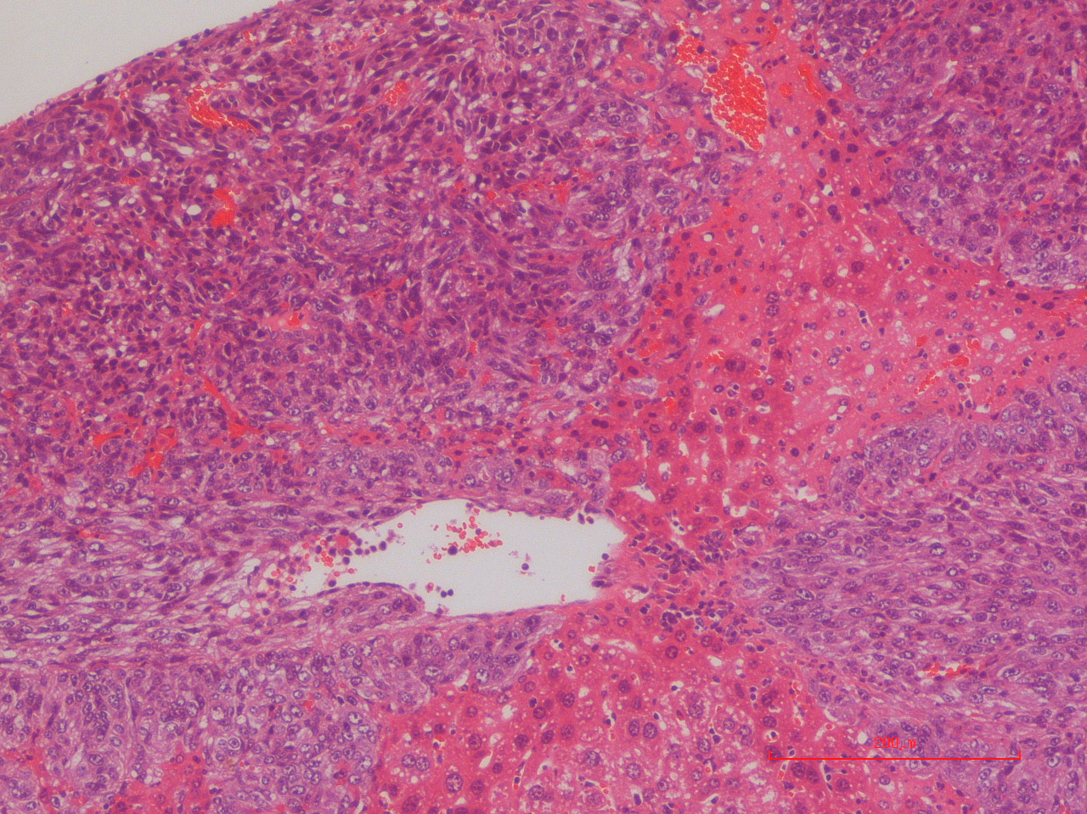
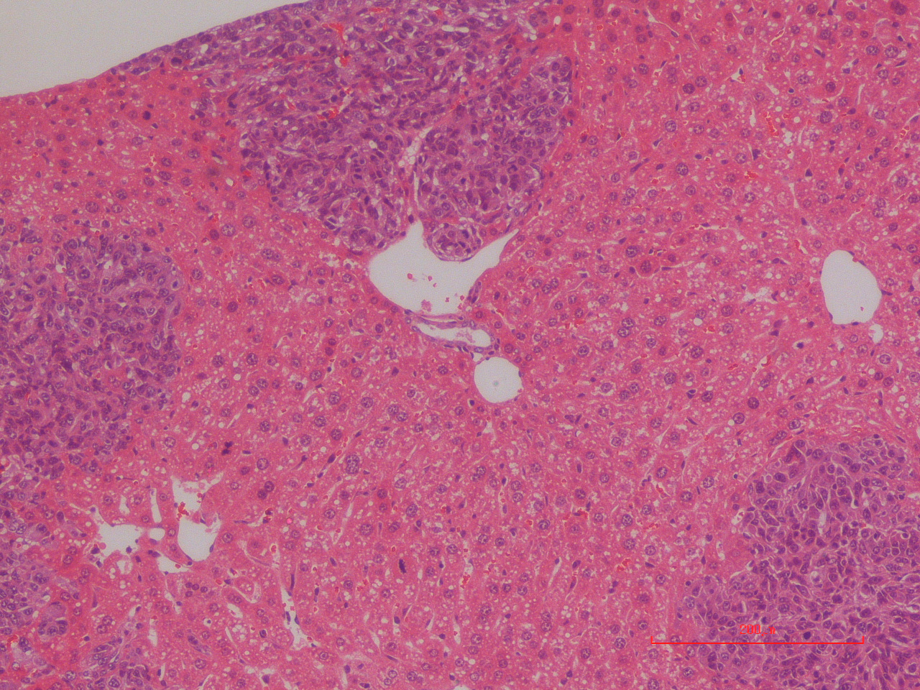
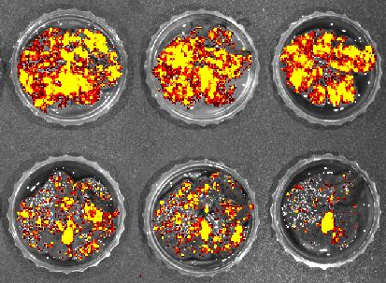
Supplementary Figure S3. Toyoshima et al.
A
B
Control
IgG
Tumor area / Total tissue area
*
Anti-IL6 mAb
Anti-IL6 mAb
Control IgG
C
D
Il6^{+/+}
Control
IgG
*
Photon flux ratio
Anti-IL6 mAb
Anti-IL6 mAb
Control IgG
E
Log rank test *P=0.0100
n=15
Survival (%)
n=16
Control IgG
Anti-IL6 mAb
Days after inoculation

Slide 4
Supplementary Figure S4. Toyoshima et al.
*
*
*
*
*
Normalized IL-6 gene expression level
Il6^{+/+}
Il6^{-/-}
Il6^{+/+}
Il6^{-/-}
Total hepatic cell populations
Isolated CT26 cells

Slide 5
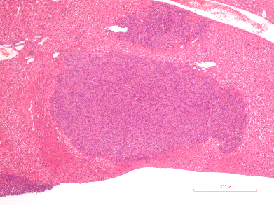
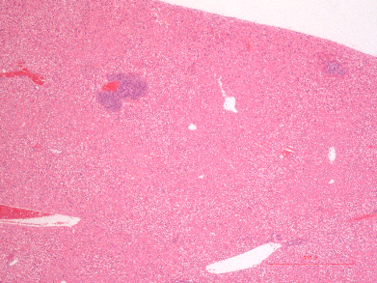
Supplementary Figure S5. Toyoshima et al.
A
B
CT26-mock
*
CT26-IL6KO
Relative IL6 gene expression level
O.D. 450 nm
*
*
Mock
0h
24h
48h
IL6KO
C
Il6^{+/+} mice
D
CT26-mock-inoculated
Tumor area / Total tissue area
CT26-IL6KO-inoculated
*
CT26-mock
CT26-IL6KO

Slide 6
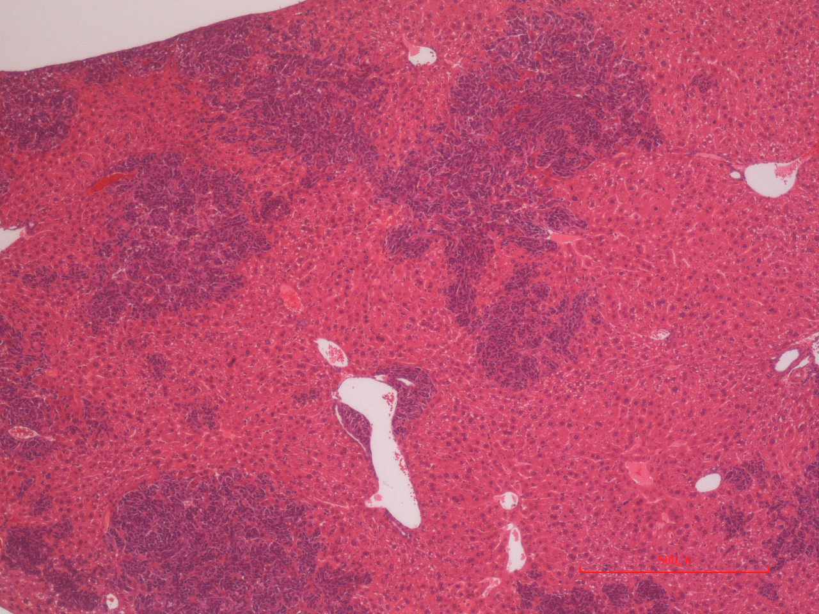
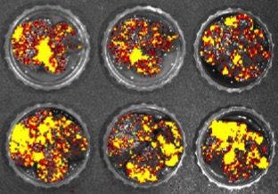
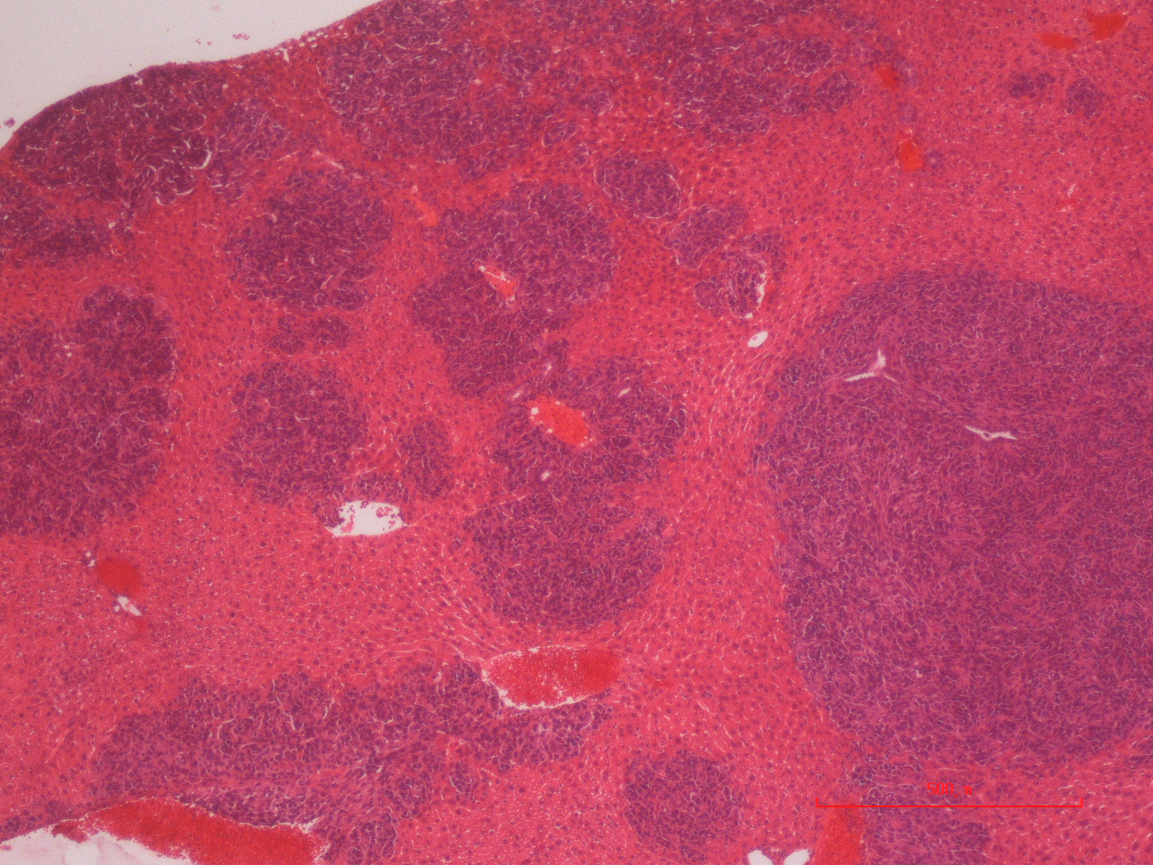
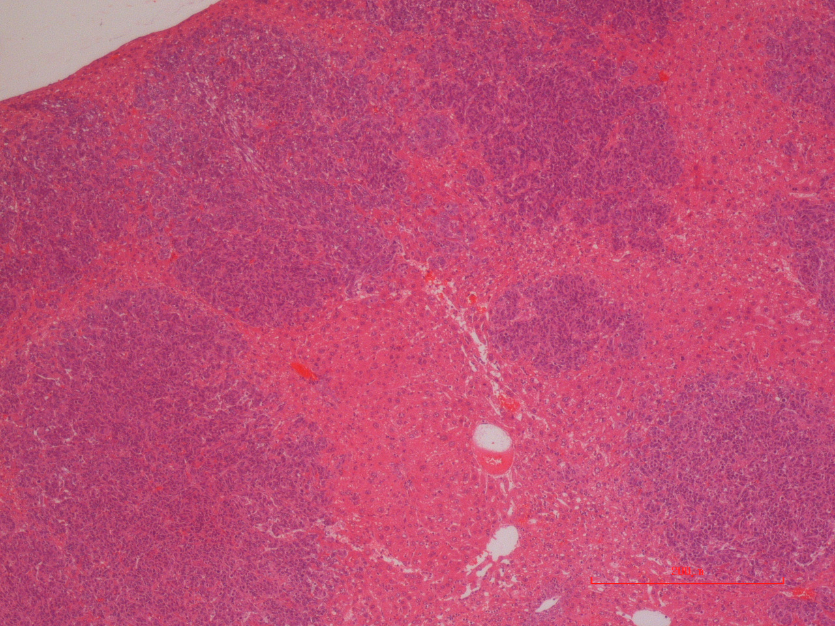
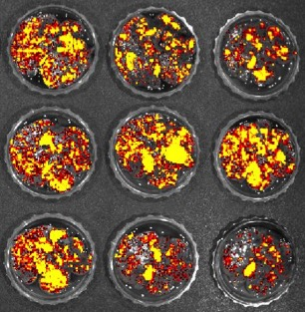
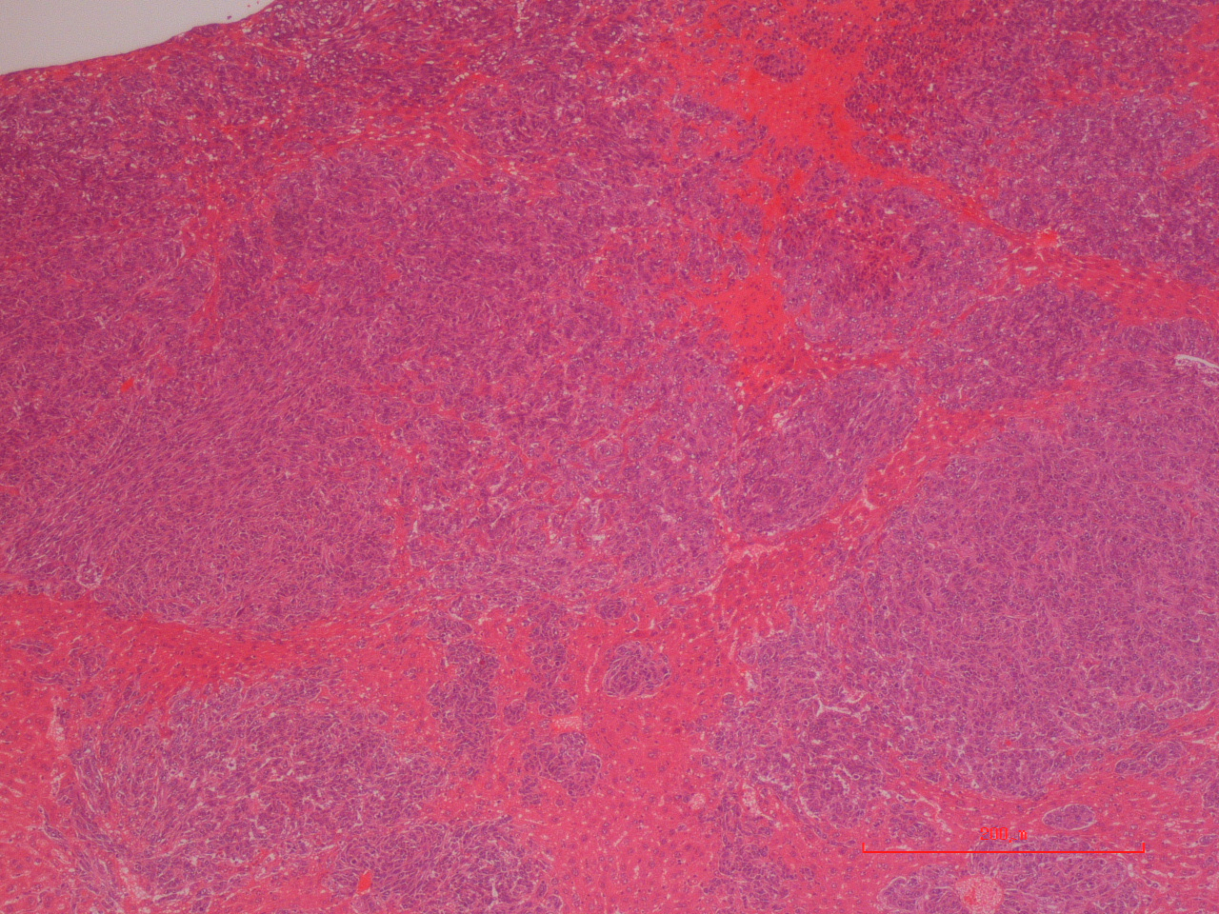
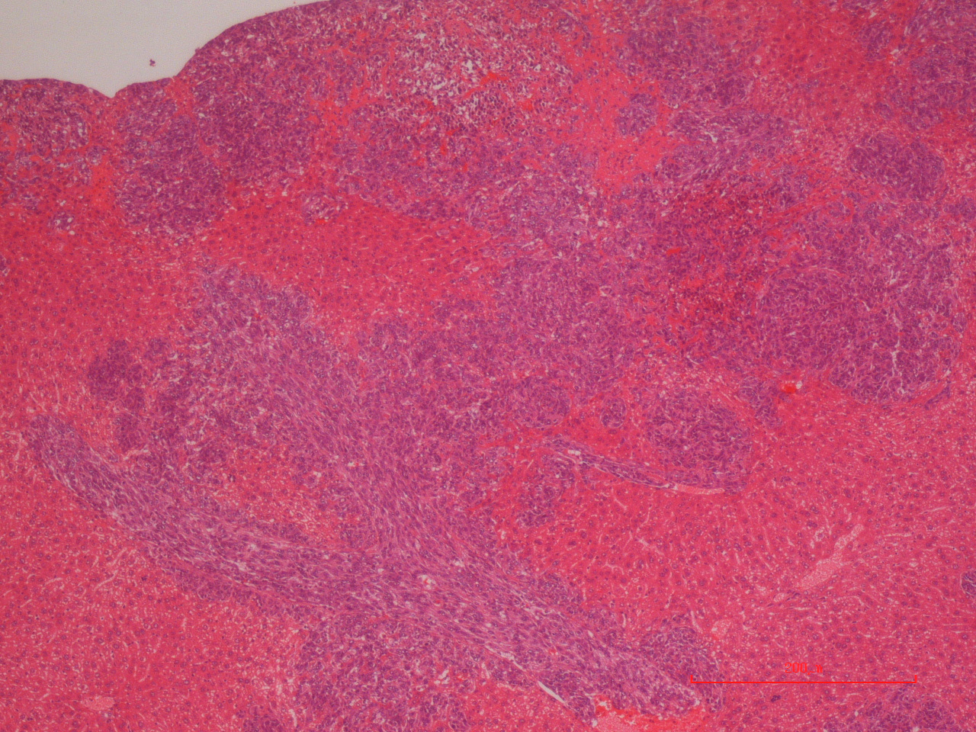
Supplementary Figure S6. Toyoshima et al.
A
B
Il6^{+/+}
C
Il6^{+/+}
Control Liposome
Control Liposome
*
Photon flux ratio
Clodronate Liposome
Clodronate Liposome
Control Liposome
Clodronate Liposome
D
E
Il6^{+/+}
F
Il6^{+/+}
Control IgG
Control
IgG
Photon flux ratio
Anti-CD8 mAb
Anti-CD8 mAb
Anti-IL12 mAb
Anti-IL12 mAb
Anti-CD8 mAb
Control IgG
Anti-IL12 mAb

Slide 7
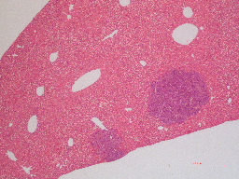
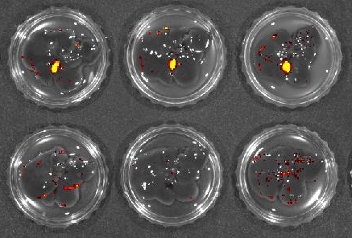
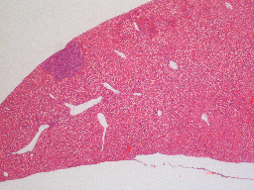
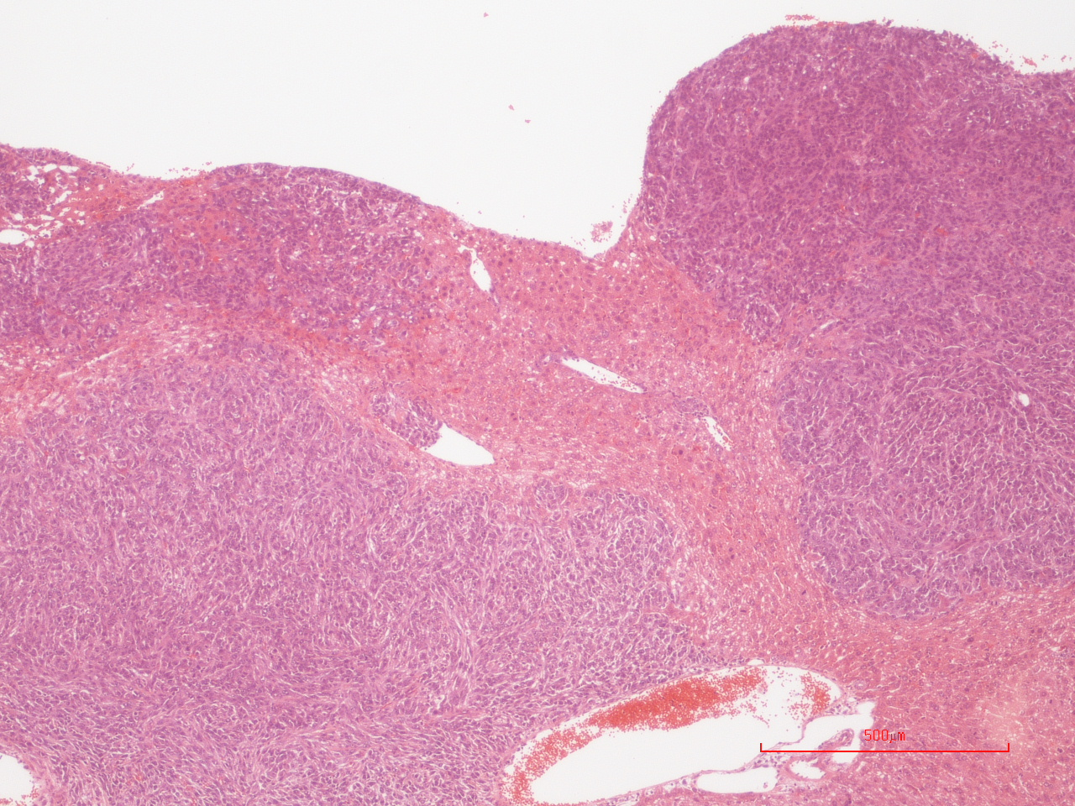
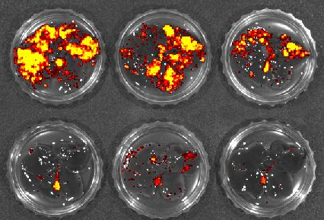
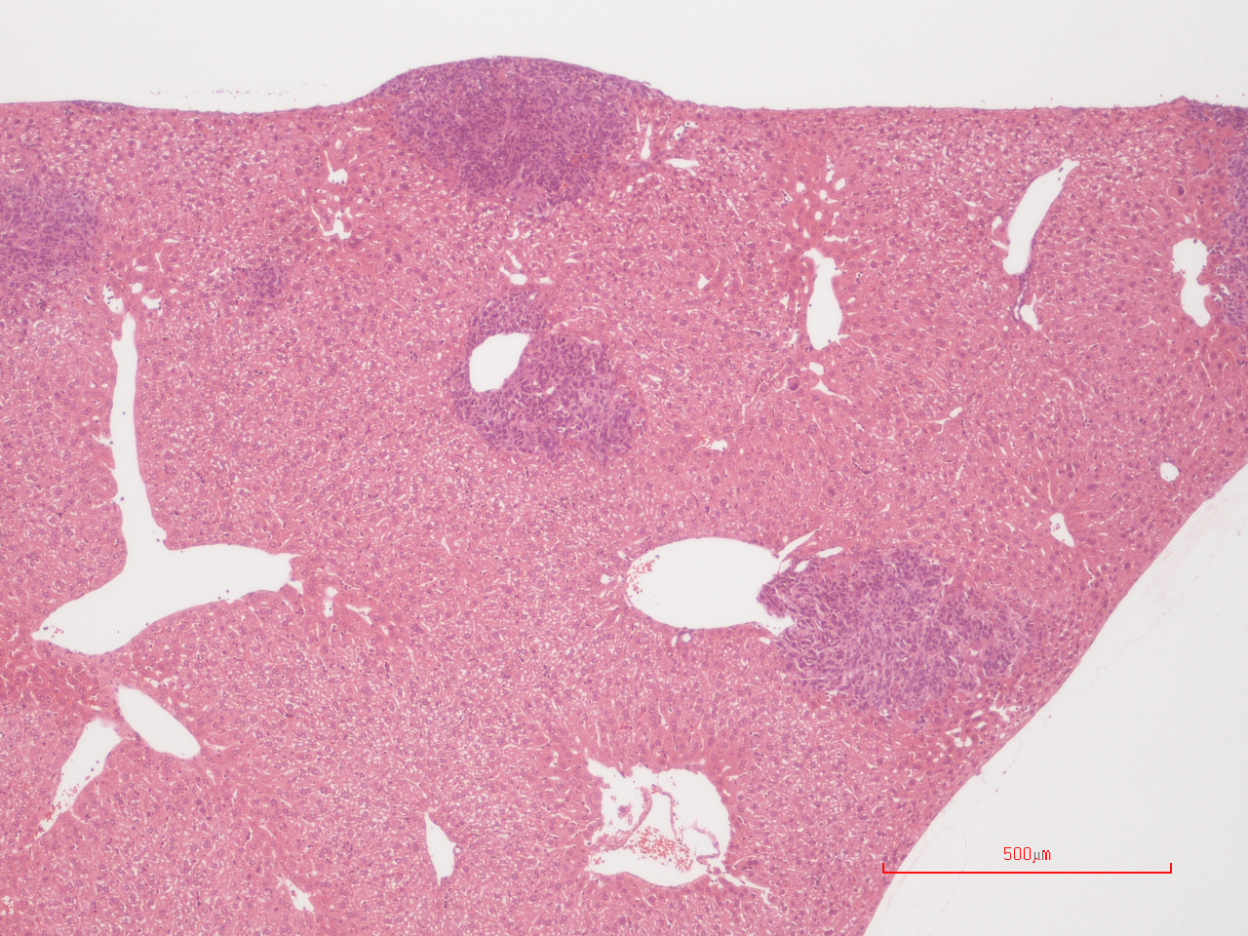
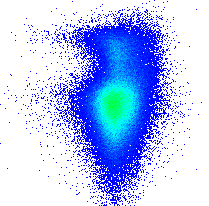
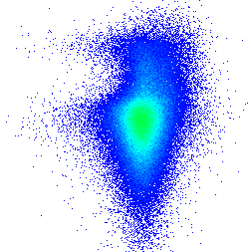
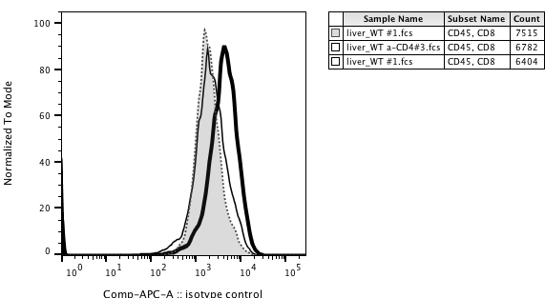
Supplementary Figure S7. Toyoshima et al.
A
Il6^{-/-}
B
Il6^{-/-}
C
Control IgG
Control IgG
*
Photon flux ratio
Anti-CD4 mAb
Anti-CD4 mAb
Anti-CD4 mAb
Control IgG
D
Il6^{+/+}
E
Il6^{+/+}
F
Control IgG
Control IgG
Photon flux ratio
*
Anti-CD4 mAb
Anti-CD4 mAb
Anti-CD4 mAb
Control IgG
G
0.07
10⁵
10⁵
CD11c
*
CD44
46.5
Control IgG
10⁴
10⁴
*
10³
10³
10²
10²
10¹
I-Ad^{hi}CD11c^{hi} cells (%)
10¹
CD44^{hi}CD62L⁻CD8⁺ cells (%)
10⁰
10⁰
10⁰
10¹
10²
10³
10⁴
10⁵
10⁰
10¹
10²
10³
0.19
10⁵
84.0
10⁴
10⁵
10⁵
10⁴
Anti-CD4 mAb
10⁴
10³
10³
10²
10²
10¹
10¹
Anti-CD4 mAb
Anti-CD4 mAb
10⁰
Control IgG
10⁰
Control IgG
10⁰
10¹
10²
10³
10⁴
10⁵
10⁰
10¹
10²
10³
10⁴
10⁵
I-Ad
CD62L
H
Control IgG
*
Anti-CD4 mAb
100
Perforin expression level in CD8 ⁺ cells (ΔMFI)
80
60
% of MAX
40
20
0
10²
10³
10⁴
10⁵
0
10¹
Perforin
Anti-CD4 mAb
Control IgG

