Slide 1
Supplementary Table1
Gene | Sequence
human GAPDH | 5’-GAGTCAACGGATTTGGTCGT-3’ 5’-CGCTCCTGGAAGATGGTG-3’
human IL-6 | 5’- GGTACATCCTCGACGGCATCT-3’ 5’-GTGCCTCTTTGCTGCTTTCAC-3’
human Ccl20 | 5’-TGCTGTACCAAGAGTTTGCTC-3’ 5’- CGCACACAGACAACTTTTTCTTT-3’
human Ccl2 | 5’- CAGCCAGATGCAATCAATGCC-3’ 5’- TGGAATCCTGAACCCACTTCT-3’
human ORM1 | 5’-CAACTGGGAGAGTTCTACGAAGC-3’ 5’- CTTCTCCAGTGGCTCACACTTATC-3’

Slide 2
Supplementary Fig 1
A
IL-6
B
CCL2
**
**
*
*
*
***
Relative expressions
Relative expressions

Slide 3
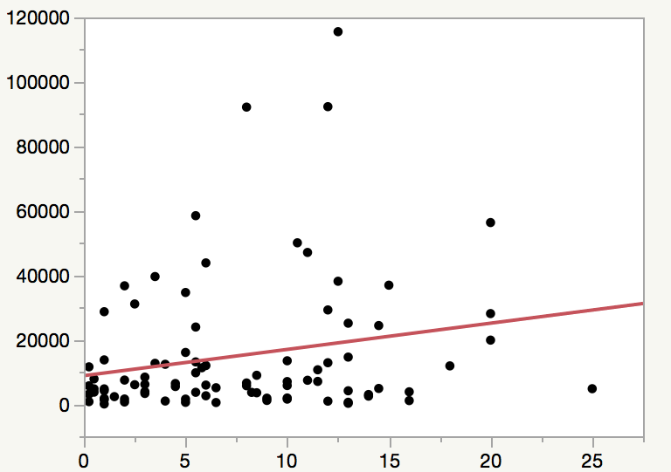
Supplementary Fig 2
Urinary ORM1 (ng/mgCre)
Post transplantation period (year)

Slide 4
Supplementary Fig 3
A
B
***
***
***
ORM1 (pg/ml)
ORM1 (ng/ml)

Slide 5
Supplementary Fig 4
A
CCL2
B
IL-6
ns
ns
**
**
Relative expressions
Relative expressions
ORM1
(μg/ml)
0
0
0.1
0.3
1
3
1
ORM1
(μg/ml)
0
0
0.1
0.3
1
3
1
Heat
Heat
None
IL-6
None
IL-6

Slide 6
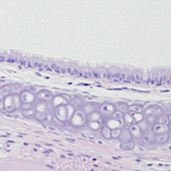
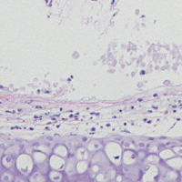
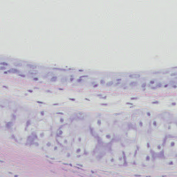
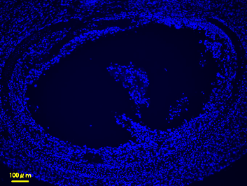
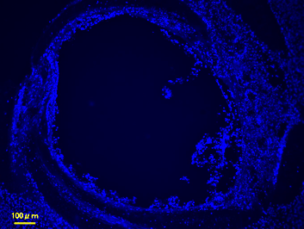
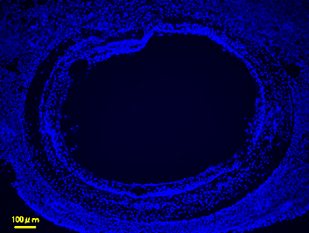
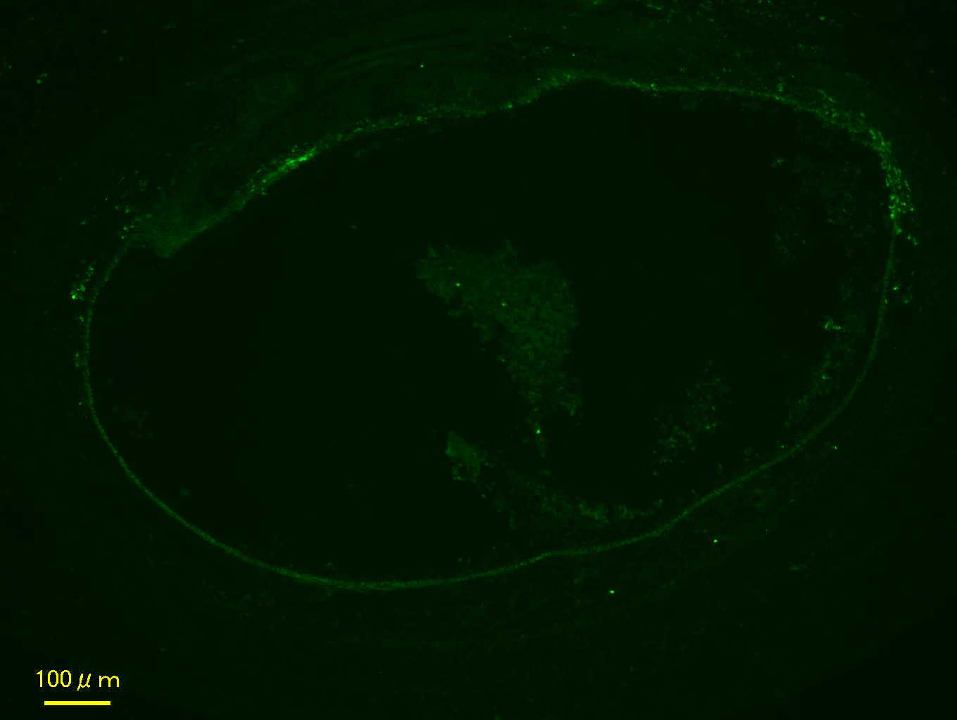
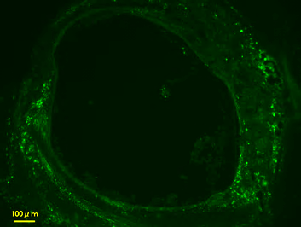
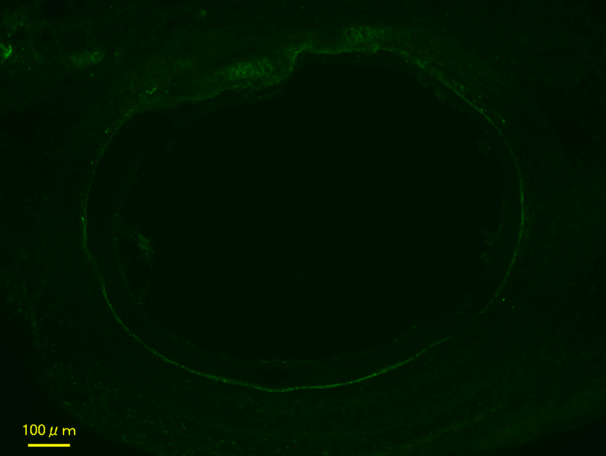
Supplementary Fig 5
A
B6 → B6
C3H → B6
Control siRNA
Control siRNA
ORM1 siRNA
B
B6 → B6
C3H → B6
Control siRNA
Control siRNA
ORM1 siRNA
Nucleus
(Hoechst33342)
CD4
C
**
**
CD4⁺ T cells/section
Control
siRNA
Control
siRNA
ORM1
siRNA
B6 → B6
C3H → B6

Slide 7
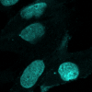
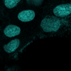
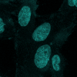
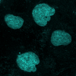
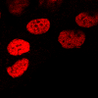


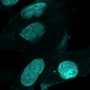
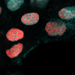
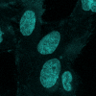
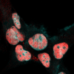
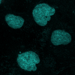
Supplementary Fig 6
A
none
IL-6
ORM1
IL-6+ORM1
TNFα
Hoechst
pSTAT3
Merge
B
ns
***
%

Slide 8
Supplementary Fig 7
A
R²=0.61
P<0.001
B
C
**
ns
*
*

