Slide 1
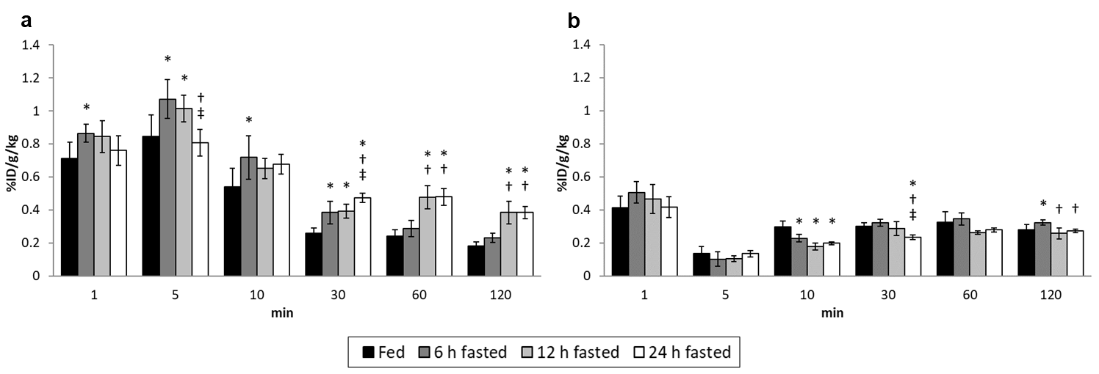
Supplemental Figure 1. Radioactivity in liver (a) and blood (b) in each group
Data represent mean ± SD (%ID/g/kg, n = 5–15/time point for each group). Two-way factorial ANOVA showed significant changes in hepatic radioactivity with feeding condition (F = 52.63; p < .0001) and each time point (F = 293.42; p < .0001). Interaction between the effects of the feeding condition and the time point was observed (F =6.18; p < .0001). Significant changes in radioactivity in the blood were also observed with the feeding condition (F = 11.63; p < .0001), each time point (F = 174.42; p < .0001), and the interactions of their effects (F = 4.61; p < .0001). When an interaction was confirmed, significant changes were evaluated at each time point. *, vs. fed group; †, vs. 6 h fasted group; ‡, vs. 12 h fasted group. These graphs were reconstructed using the data published in our previous report (6).

Slide 2
Supplemental Table 1. Myocardial accumulation of [¹²⁵I]BMIPP in each group
 |  |  | Time after the injection (min)
 | Group | 1 |  | 5 |  | 10 |  | 30 |  | 60 |  | 120
Heart | Fed |  | 0.93±0.09 |  | 1.05±0.16 |  | 1.03±0.18 |  | 0.85±0.12 |  | 0.65±0.12 |  | 0.60±0.12
 | 6 h Fasted |  | 1.07±0.12 |  | 1.14±0.09 |  | 1.03±0.17 |  | 0.79±0.12 |  | 0.76±0.14 |  | 0.55±0.04
 | 12 h Fasted |  | 0.75±0.16*† |  | 0.97±0.08 |  | 0.73±0.05*† |  | 0.69±0.08* |  | 0.63±0.07 |  | 0.60±0.04
 | 24 h Fasted |  | 0.70±0.09*† |  | 0.71±0.13*†‡ |  | 0.61±0.06*† |  | 0.60±0.03*† |  | 0.55±0.08† |  | 0.56±0.07
Data represent mean ± SD (%ID/g/kg, n = 5–15/time point for each group). Two-way factorial ANOVA showed significant changes in myocardial accumulation of [¹²⁵I]BMIPP with the feeding condition (F = 42.36; p < 0.0001) and each time point (F = 39.77; p < 0.0001). Interaction between the effects of the feeding condition and the time point was observed (F =3.67; p < 0.0001). When an interaction was confirmed, significant changes were evaluated at each time point. *, vs. fed group; †, vs. 6 h fasted group; ‡, vs. 12 h fasted group.

Slide 3
Supplemental Table 2. Heart-to-liver (H/L) and heart-to-blood (H/B) ratios of [¹²⁵I]BMIPP accumulation in each group
 |  |  | Time after the injection (min)
 | Group | 1 |  | 5 |  | 10 |  | 30 |  | 60 |  | 120
H/L | Fed |  | 1.33±0.22 |  | 1.26±0.24 |  | 1.92±0.22 |  | 3.30±0.62 |  | 2.72±0.38 |  | 3.38±0.78
 | 6 h Fasted |  | 1.25±0.18 |  | 1.08±0.17 |  | 1.45±0.13* |  | 2.09±0.35* |  | 2.69±0.57 |  | 2.40±0.39*
 | 12 h Fasted |  | 0.88±0.12*† |  | 0.96±0.13* |  | 1.12±0.14* |  | 1.79±0.34* |  | 1.34±0.21*† |  | 1.58±0.20*
 | 24 h Fasted |  | 0.92±0.12*† |  | 0.88±0.16* |  | 0.91±0.15*† |  | 1.27±0.06* |  | 1.14±0.14*† |  | 1.48±0.30*
H/B | Fed |  | 2.31±0.33 |  | 8.47±2.75 |  | 3.50±0.72 |  | 2.83±0.44 |  | 2.02±0.28 |  | 2.15±0.45
 | 6 h Fasted |  | 2.13±0.27 |  | 12.62±4.50* |  | 4.51±0.38* |  | 2.45±0.36 |  | 2.24±0.54 |  | 1.70±0.13
 | 12 h Fasted |  | 1.69±0.64* |  | 9.55±1.94 |  | 4.12±0.39 |  | 2.44±0.34 |  | 2.41±0.22 |  | 2.34±0.20
 | 24 h Fasted |  | 1.71±0.34* |  | 5.39±1.38*†‡ |  | 3.09±0.24† |  | 2.57±0.14 |  | 1.96±0.26 |  | 2.07±0.26
Data represent mean ± SD (n = 5–15/time point for each group). Two-way factorial ANOVA showed significant changes in H/L and H/B ratios with the feeding condition (F = 123.20; p < 0.0001, F = 8.81; p < 0.0001) and each time point (F = 54.15; p < 0.0001, F = 146.48; p < 0.0001). Interaction between the effects of the feeding condition and the time point was observed (F =8.93; p < 0.0001, F =6.71; p < 0.0001). When an interaction was confirmed, significant changes were evaluated at each time point. *, vs. fed group; †, vs. 6 h fasted group; ‡, vs. 12 h fasted group.

