Slide 1
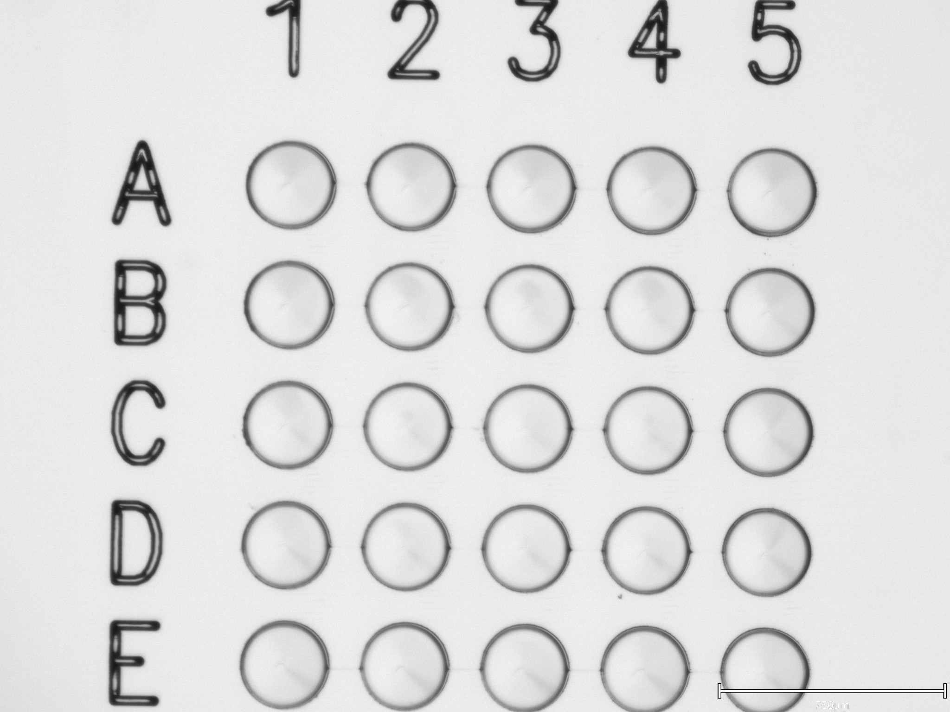
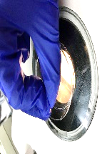
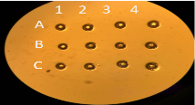
Suppl Fig (Fan et al)
Oocyte collection
Culture
2-cell
Zona Removal
blastocyst
…………
Culture
Acid Tyrode’s Solution
Culture
In vitro fertilization
①
Microdroplet culture
(flat)
②
WOW
③
Customized WOW

