Slide 1
Fig. S1. Incidence of blossom-end rot (%) in IL8-3 and M82 grown in the field in 2016, 2017, and 2018.

Slide 2
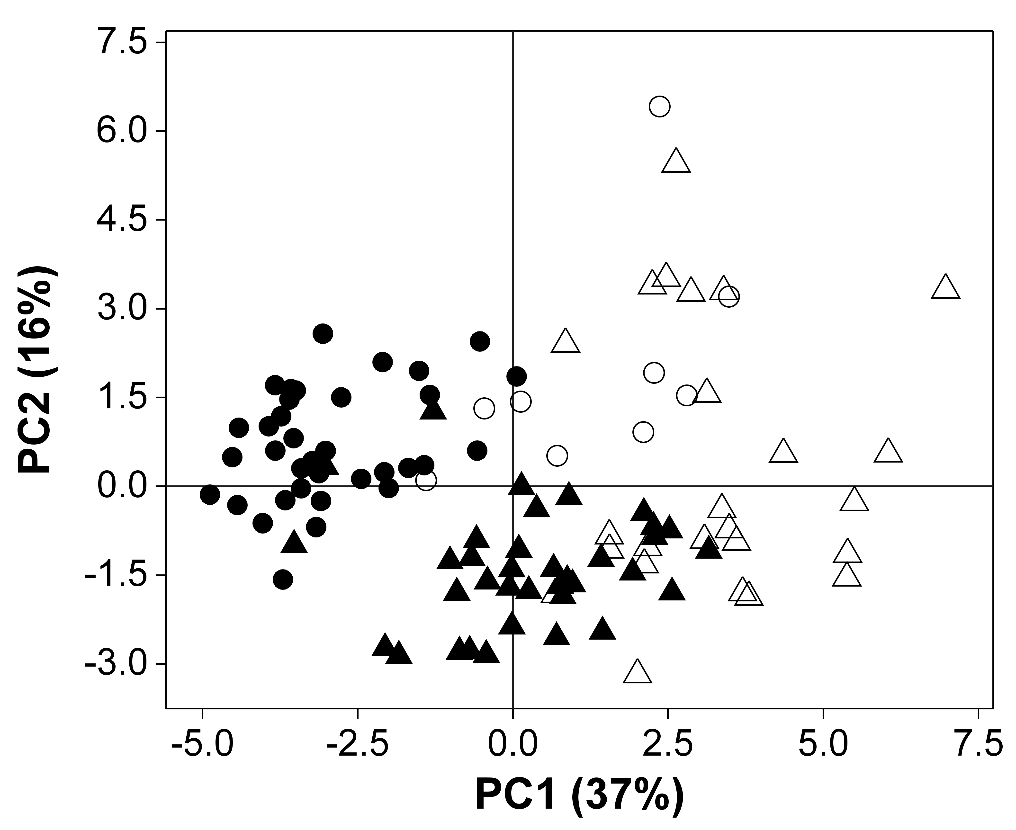
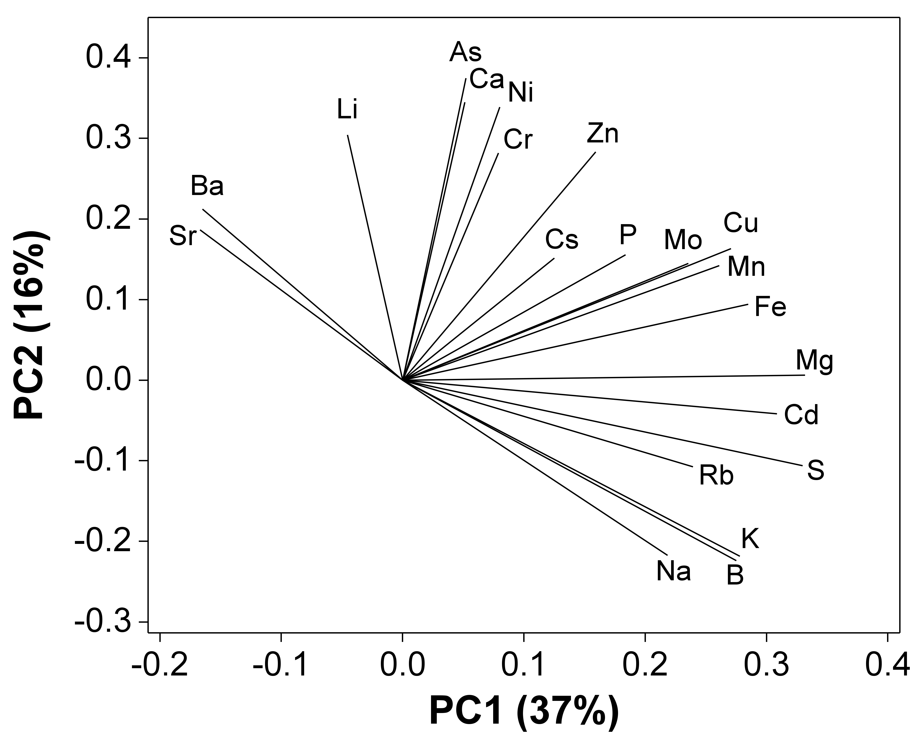
A
non-BER
B
BER
Fig. S2. Principal component analysis (PCA) of elements in the distal part of non-BER and BER fruits in two tomato lines. For the PCA analysis, values of the concentration data for each element were used after standardization of the variables to mean of zero and variance of one. Scores on PC1 and PC2 were plotted to indicate different lines and with or without BER incidence (A). The loading plot was also shown (B).

Slide 3
Fig. S3. Heat map analysis showing difference in elemental concentrations between the distal part of non-BER (unrotten) and BER (rotten) fruits in M82 and IL8-3.

