Slide 1
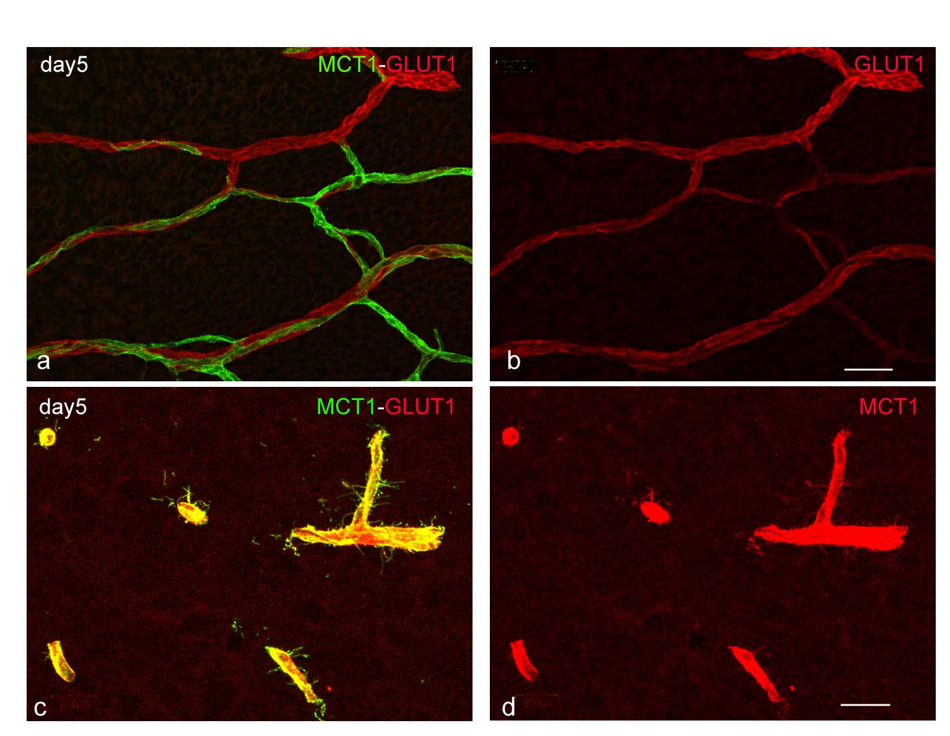
Supporting Figure 1
Fig. 1. Double staining of MCT1 and GLUT1 shows a mosaic expression pattern of two transporters in the VHP at postnatal day 5 (a, b). Another double staining of the brain (c, d) detects fine radicular projections; their number and density peak around the mid-stage of the suckling period around postnatal days 5–15 but almost disappear by day 35. Bars 50 μm (a, b), 20 μm (c, d)

Slide 2
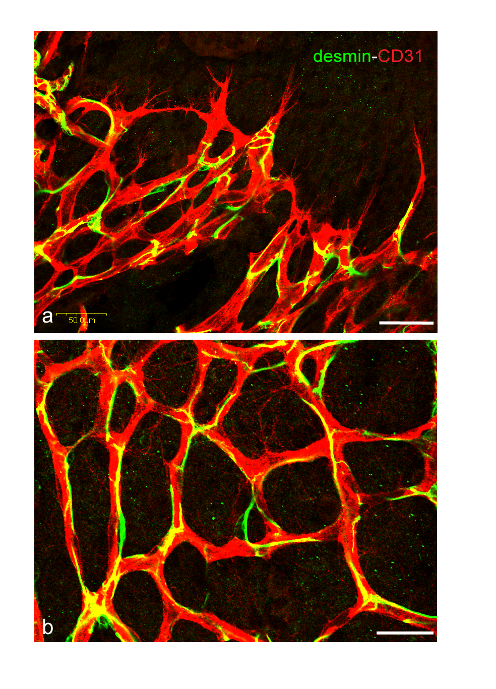
Supporting Figure 2
Fig. 2. Double staining of desmin and CD31 shows distribution of desmin-expressing
pericytes in the sprouting area (a, angiogenic front) and mature capillary plexus
(b, central plexus). Pericytes are associated with both sprouting vessels (a) and mature
capillary (b), but not with the radicular projections (arrow in b). Bars 50 μm (a, b)

Slide 3
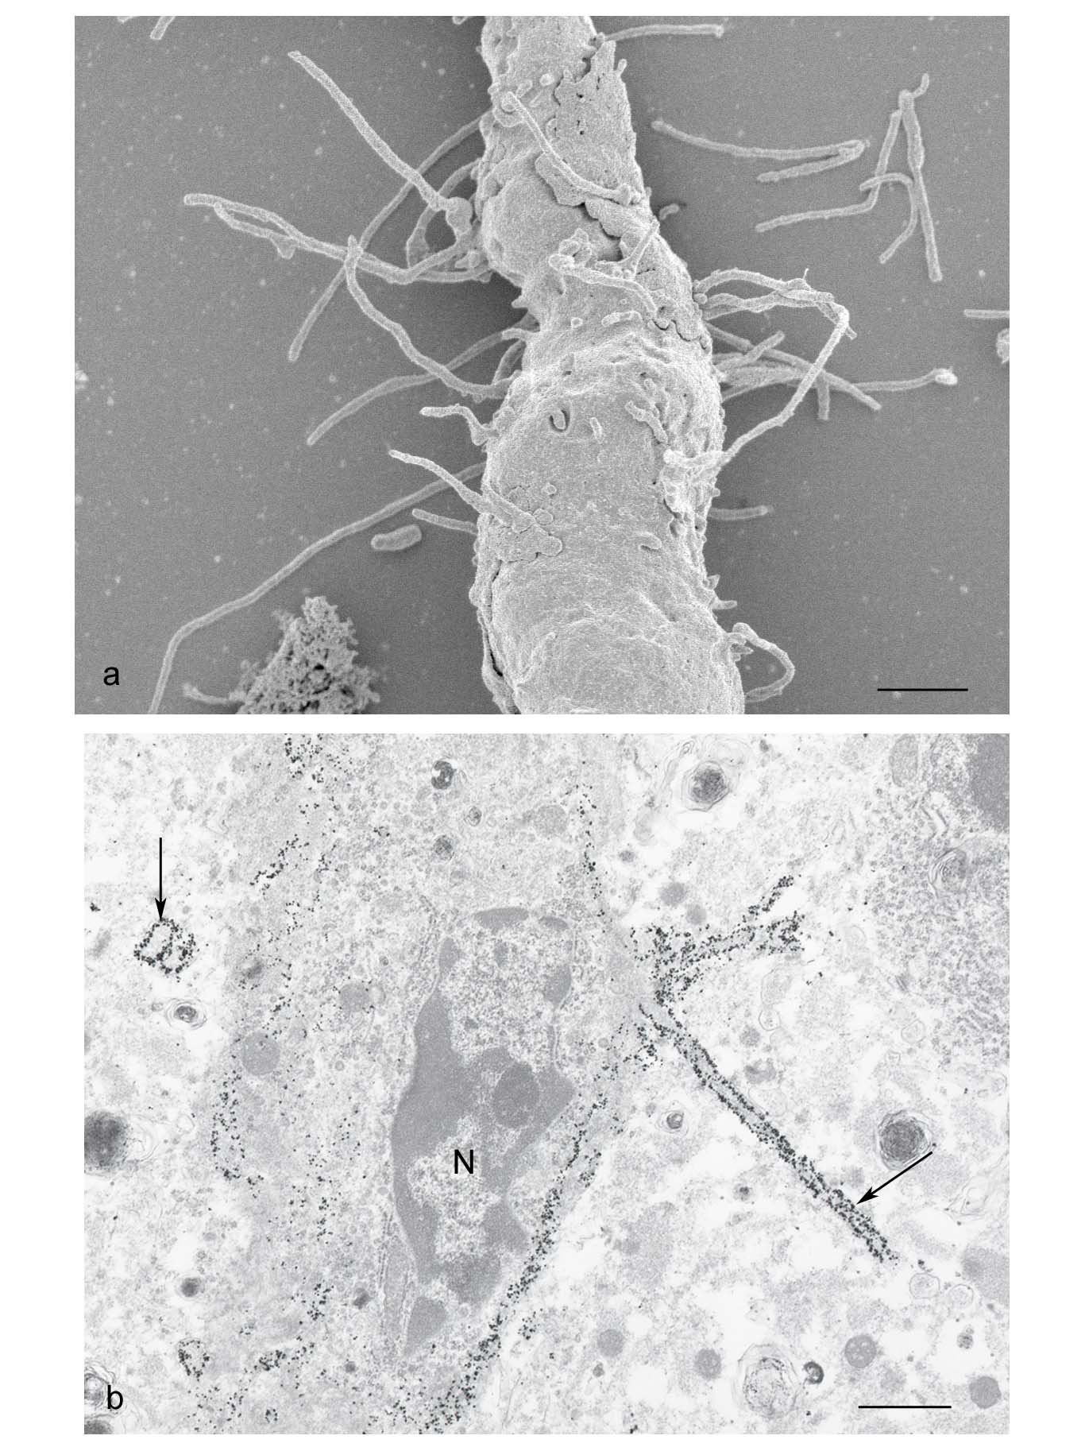
Supporting Figure 3
Fig. 3. Electron micrographs of capillary vessel in the brain at postnatal day 7. In SEM observation (a), the extracellular matrix has been thoroughly removed by alkaline maceration. Many long radicles project from the outer surface of endothelial cells. In Fig. 2b stained with the immunogold method, gold particles showing the existence of MCT1 label long radicles (arrows) extending from the endothelial cells. N: nucleus Bars 1 μm

