Slide 1
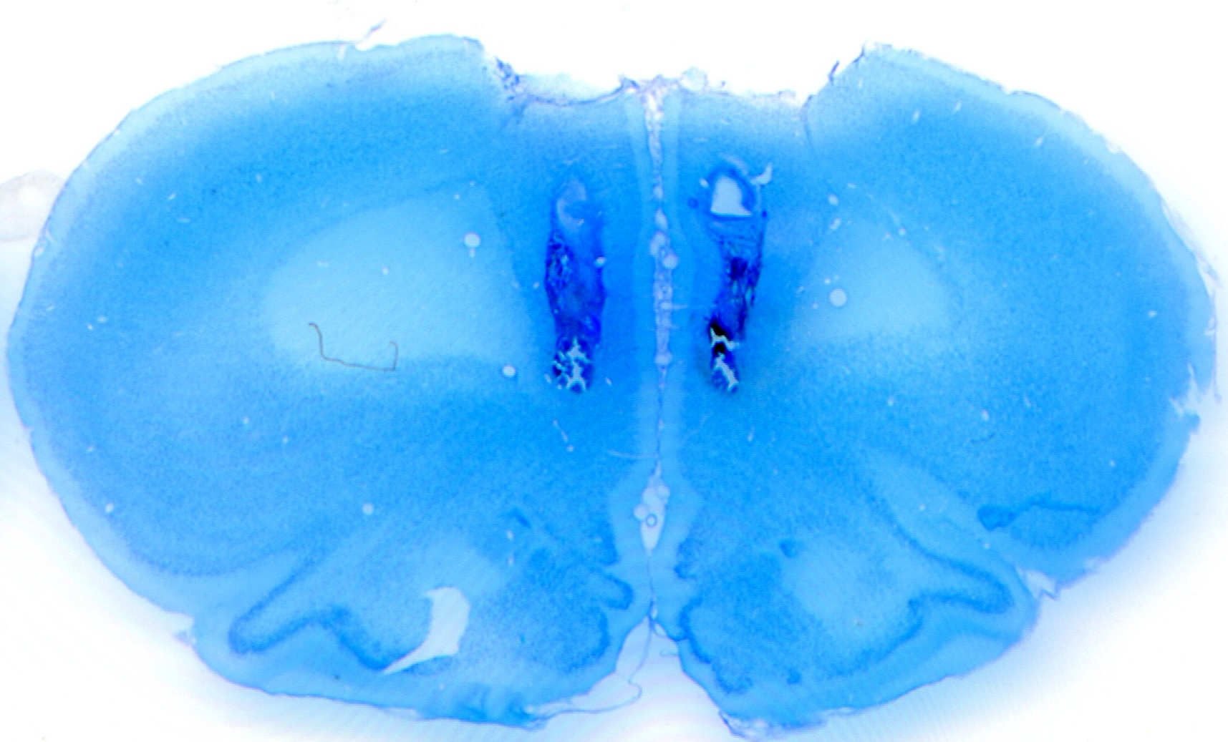
Supplementary Figure S1. Cannula placements in the infralimbic cortex (Experiments 2).
A representative photomicrograph shows the coronal section of a typical site of injection cannulae.

Slide 2
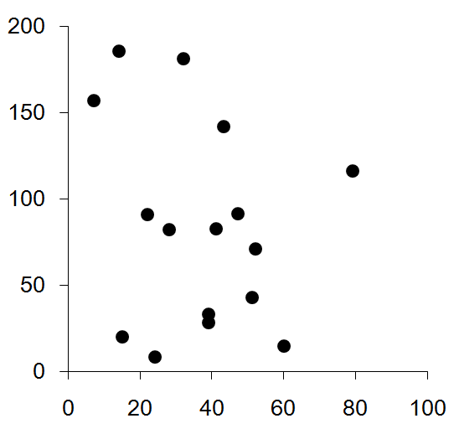
r = - 0.21
Increase rate of premature responses (%) by varenicline 0.075 mg/kg
The number of premature responses at vehicle
Supplementary Figure S2. Scatter plot of the number of premature responses at vehicle and the increase rate of premature responses by varenicline (0.075 mg/kg) administration (Experiments 1 and 2). Each increase rate was calculated by (premature responses at 0.075mg/kg of varenicline / premature responses at vehicle - 1) x 100.

Slide 3
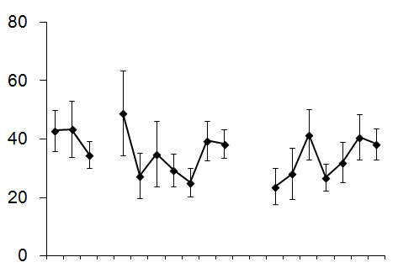
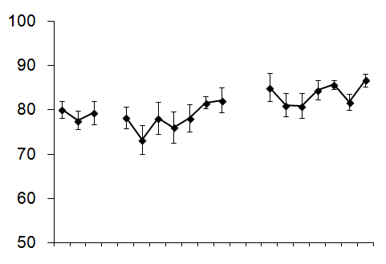
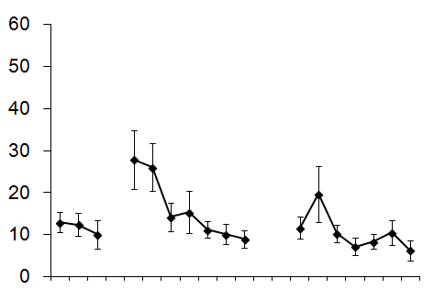
Varenicline
(0.075 mg/kg, p.o.)
Premature responses
Accuracy (%)
Nicotine Pump
13
14
16
15
17
4
5
6
10
18
1
7
8
9
2
3
12
Day
Omissions
13
14
16
15
17
4
5
6
10
18
1
7
8
9
2
3
12
Day
Supplementary Figure S3. Time course of main parameters in the 3-CSRTT during Experiment 5.

Slide 4
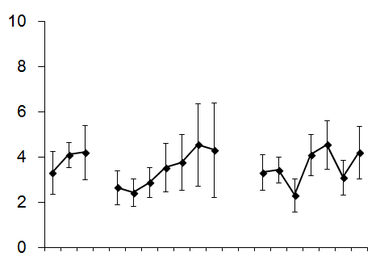
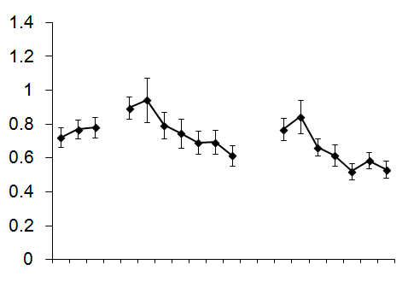
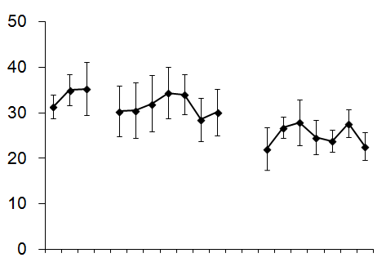
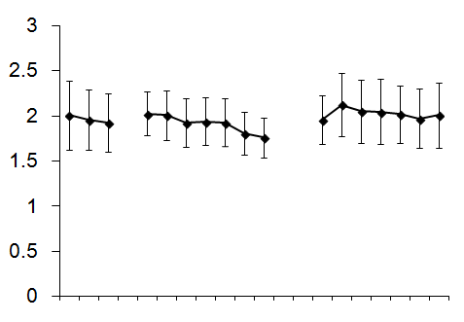
Varenicline
(0.075 mg/kg, p.o.)
Perseverative responses
Correct response latency (s)
Nicotine Pump
Responses during time-out
Reward latency (s)
13
14
16
15
17
4
5
6
10
18
1
7
8
9
2
13
3
12
14
16
15
17
4
5
6
10
18
1
7
8
9
2
3
12
Day
Day
Supplementary Figure S4. Time course of other parameters in the 3-CSRTT during Experiment 5.

Slide 5
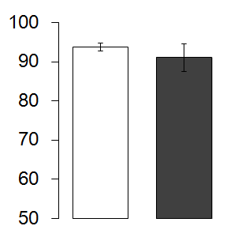
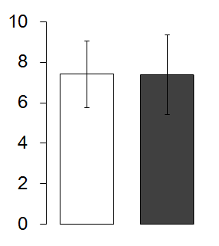
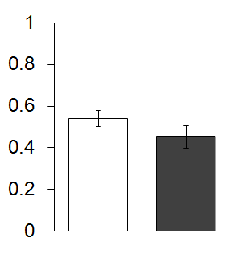
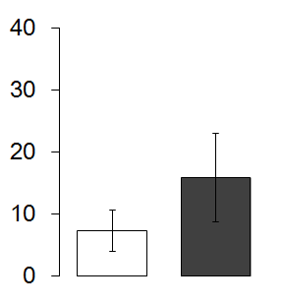
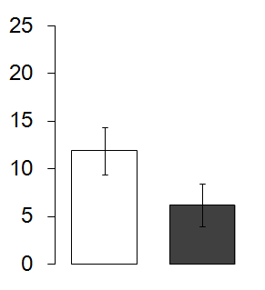
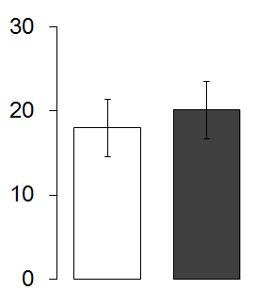
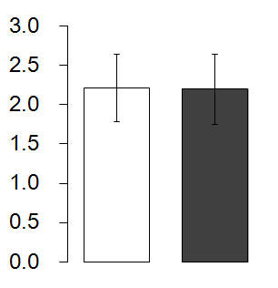
Varenicline (0.075 mg/kg, p.o.)
pump in
pump out
Water (3 ml/kg, p.o.)
day
1
2
3
4
5
6
7
8
9
10
11
12
13
14
15
16
17
18
19
Nicotine infusion
withdrawal
*
*
Accuracy (%)
Perseverative responses
Correct response latency (s)
Premature responses
*
Omissions
Responses during time-out
Reward latency (s)
Water
Varenicline
Water
Varenicline
Water
Varenicline
Water
Varenicline
Supplementary Figure S5. the effects of varenicline on performance in the 3-CSRTT after discontinuing nicotine infusion (n=5). The average performances during the period surrounded by dotted lines were used for the comparison. * p < 0.05.

