Slide 1
On-demand Guidance
on Northern Campus Library’s Services
How to use Northern Campus Library
and the other libraries of Hokkaido University
Hokkaido University Northern Campus Library
April 2018

Slide 2
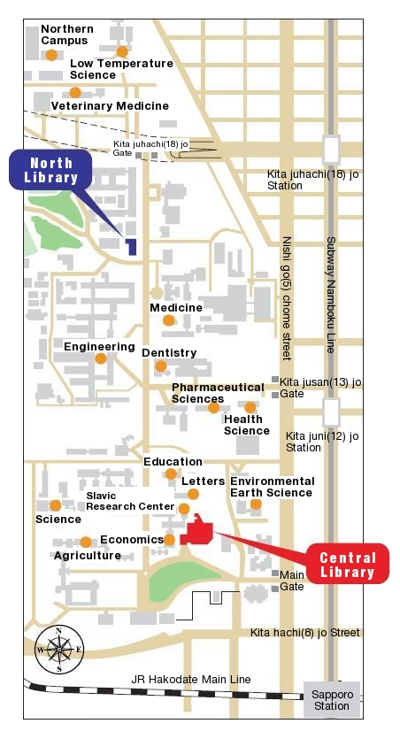
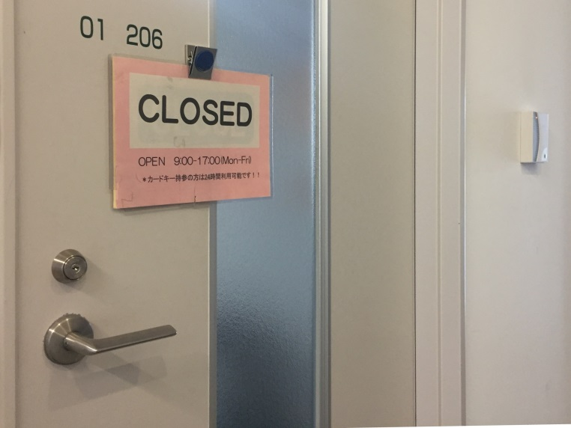
Use Northern Campus Library
Northern Campus Library is here!
open from 9 a.m. to 5 p.m. on weekdays
* rarely closed until 1 p.m.
Even if being closed,
if your laboratory is located in
Northern Campus Sousei Building or
Northern Campus Building No.5 (this building)
and you have a student / staff card,
you can use it and enter the library.

Slide 3
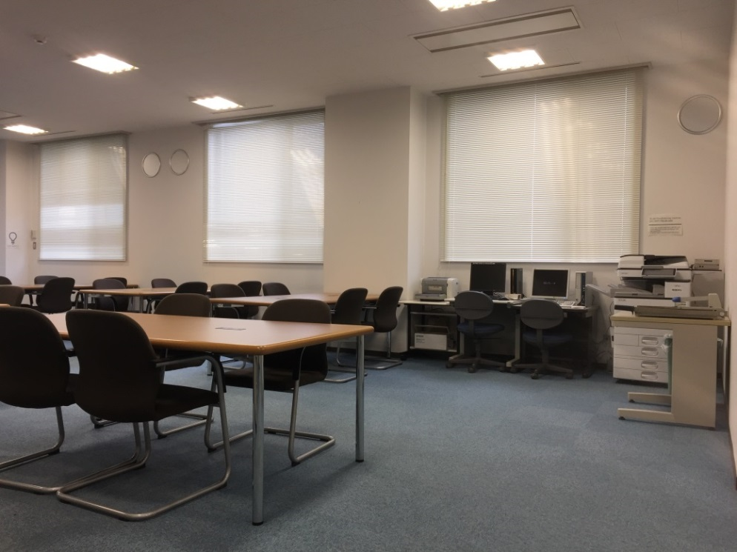
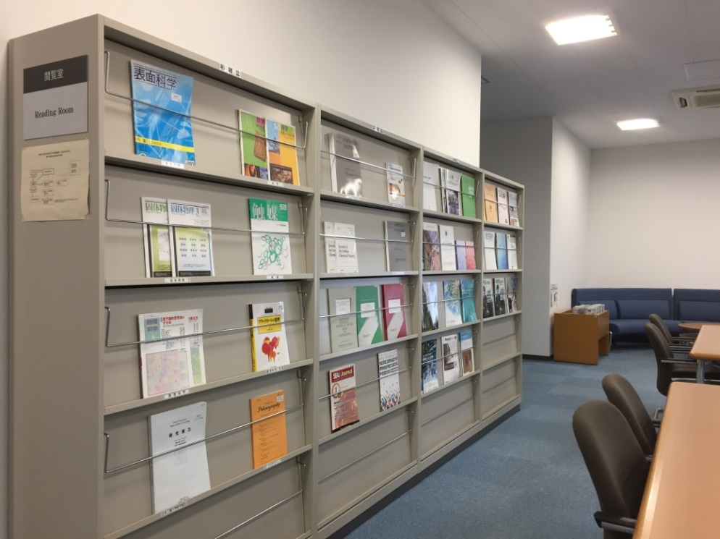
Use Northern Campus Library
Reading Room (on your left through the door)
From left
A computer linked to the Internet + a printer
* need your own ID and password
A computer linked to
Hokkaido University Library Catalog only
* available freely
A photocopy machine
* need a RICOH card
Current Journals
5 Japanese newspapers
- Hokkaido Shimbun
- Asahi Shimbun
- Nihon Keizai Shimbun
- Nikkan Kogyo Shimbun
- Japan Agriculture Times
20 seats and some sofas
This library does not have Wi-Fi.

Slide 4
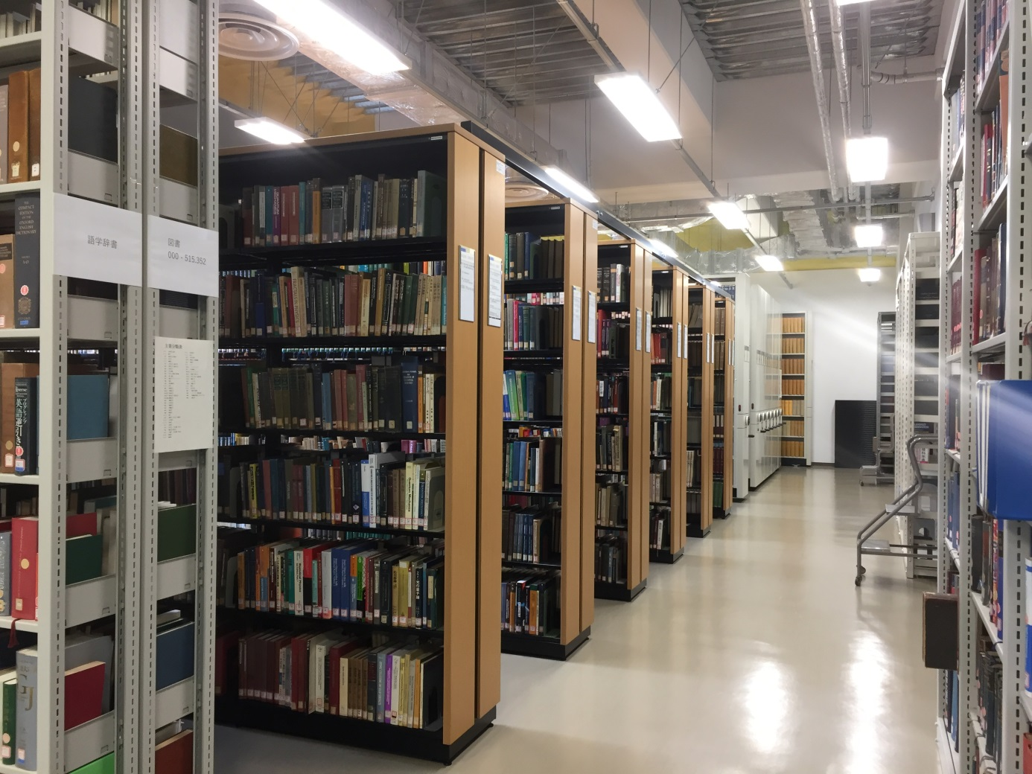
Use Northern Campus Library
Library (on your right through the door), which has 21,000 materials
Russian
journals
А→Я
Japanese
journals
A→Z
Books
in order of “Call No.”
000→999
Foregin
journals
A→Z
Dictionaries
Reference books
These materials, current journals, and newspapers are available only in the library or for temporary take-out.

Slide 5
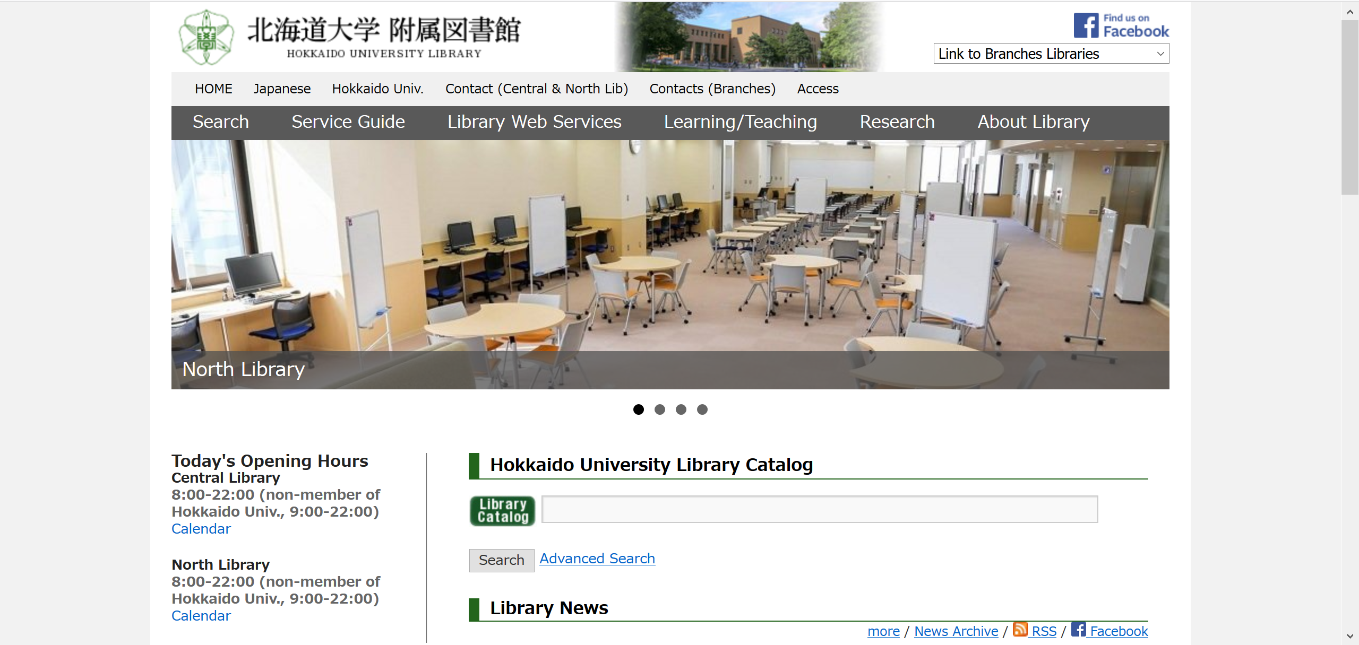
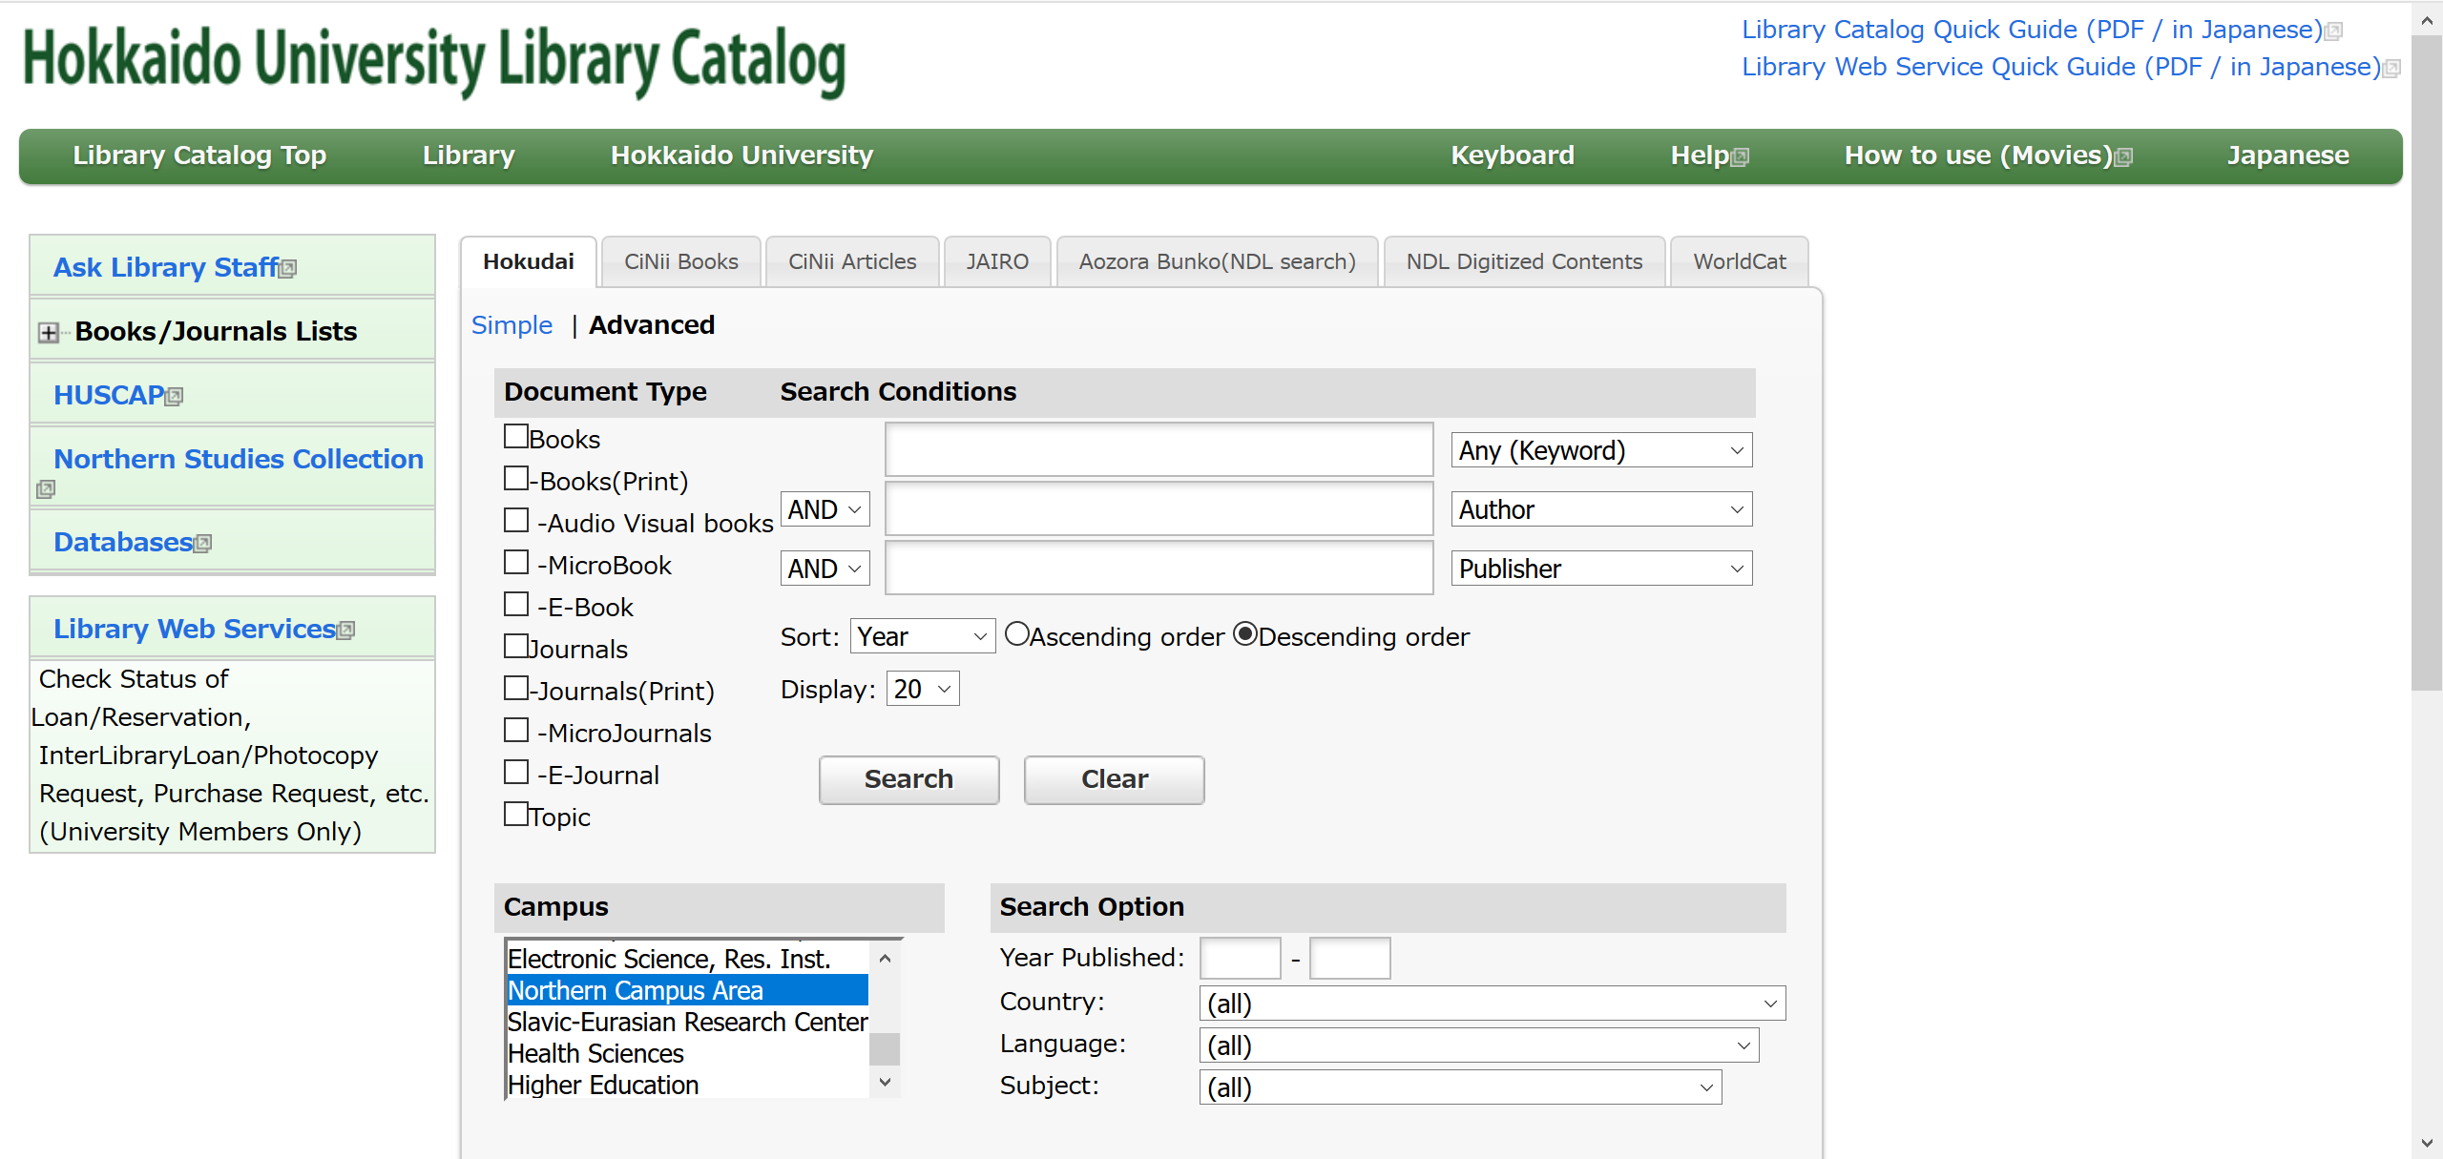
Use Northern Campus Library’s materials
https://www.lib.hokudai.ac.jp/en

Slide 6
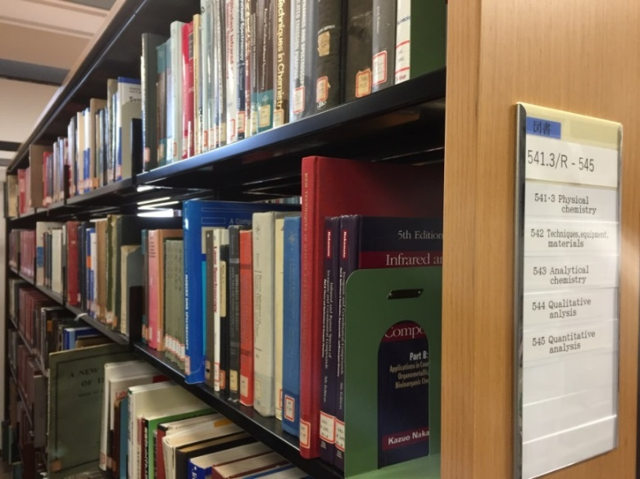
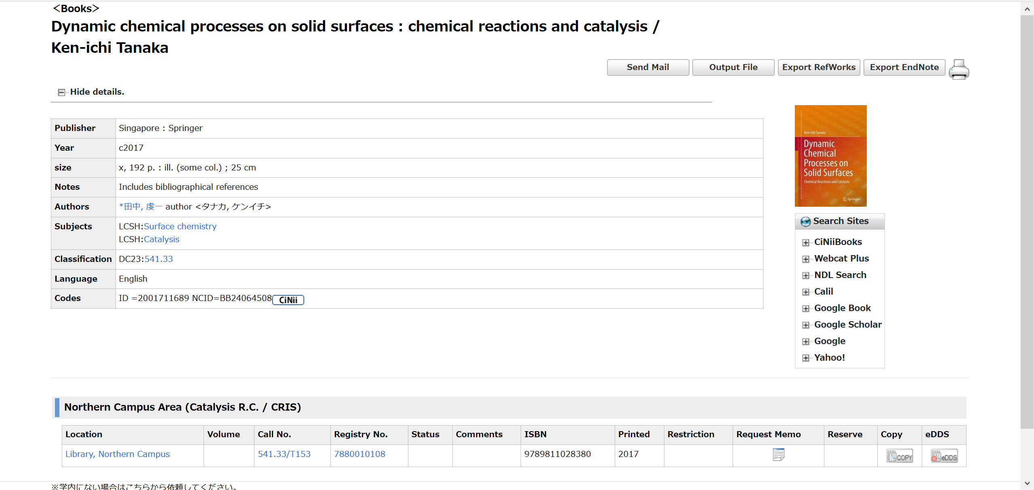
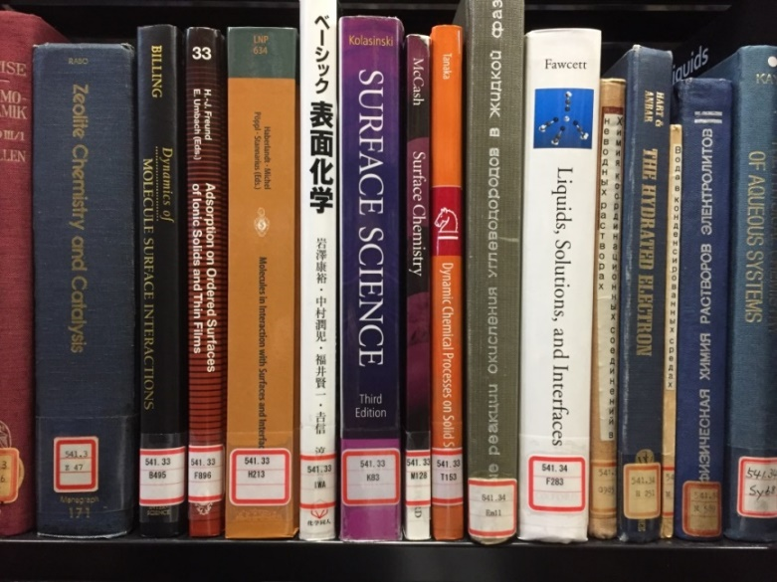
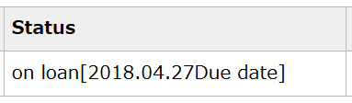
Use Northern Campus Library’s materials
Detailed information of the selected material
Books are arranged in order “Call No.”
“Call No.” is also displayed here.
This indicates that the material has already borrowed by someone.

Slide 7
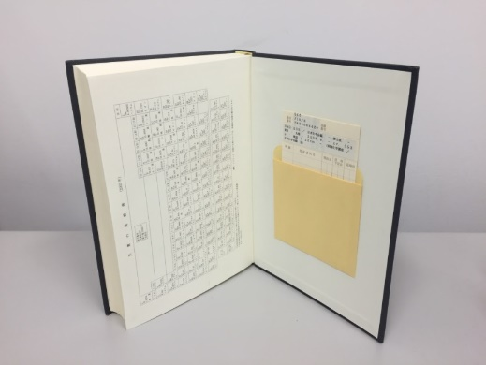
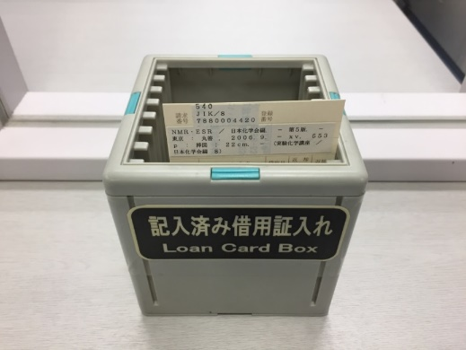
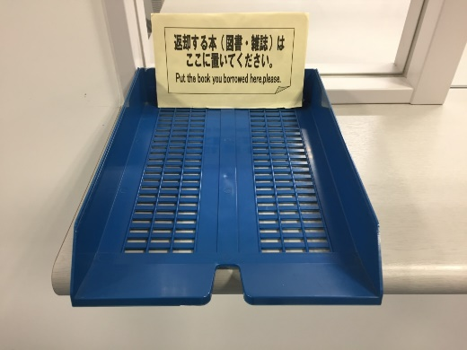
Use Northern Campus Library’s materials
Borrow and return materials
Hokkaido University members can borrow up to 3 materials for 3 weeks.
When staff is present, please bring materials to her/him.
When staff is absent, please do as follows:
Borrow materials
1. Pull “Loan card” from the book pocket
2. Fill in the card with
your department
your name
the borrowing date
Return materials
Put them into the blue tray on the counter
3. Put it into “Loan Card Box” on the counter

Slide 8
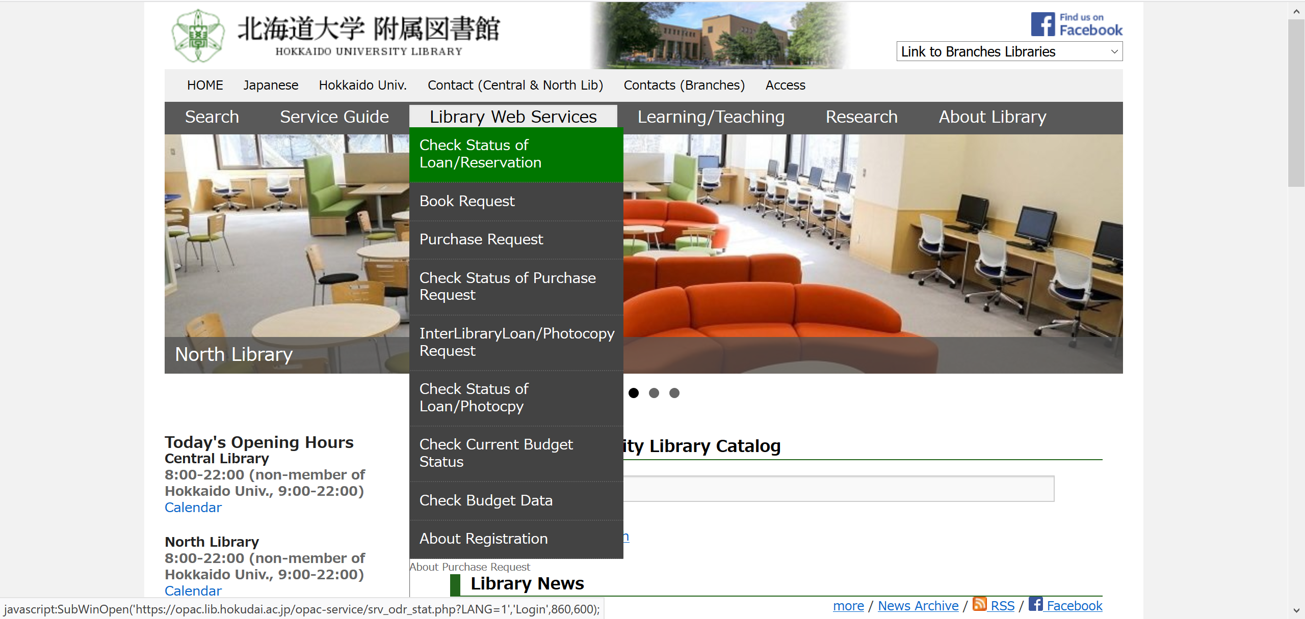
Use Northern Campus Library’s materials
Extend the loan period of the materials
You can extend the loan period on Hokkaido University Library’s website.

Slide 9
Use the other libraries of Hokkaido University
You can use the other libraries of Hokkaido University by bringing your own student / staff / library card.
The loan limit is separately set by each library.
So you can borrow
3 books from Northern Campus Library and
8 books from North Library at the same time.
You can not return the materials borrowed from Northern Campus Library to the other libraries.
If you need the material in Hakodate Campus,
which has the fisheries science library,
you can order the book loan service for free.
In that case, please let staff know.
Sapporo Campus

Slide 10
TRY
LATER
AND
ASK
ME
ANYTIME:
kitacam@lib.hokudai.ac.jp

