Slide 1
On-demand Guidance
on Northern Campus Library’s Services
How to manage references
with EndNote basic / Mendeley
Hokkaido University Northern Campus Library
April 2018

Slide 2
How to manage references
with EndNote basic / Mendeley
What is Reference Management Software?
EndNote basic
Resister
Import references
Organize and Share references
Generate citations / a reference list
Mendeley
Resister
Import references
Organize and Share references
Generate citations / a reference list
Other functions

Slide 3





What is Reference Management Software?
Basic functions of Reference Management Software
Import references
of the collected articles
organize them in folders
share them
with other researchers
generate citations
/ a reference list
from them in your paper

Slide 4
What is Reference Management Software?
Reference Management Software
- Citavi
- EndNote
- EndNote basic
- F1000Workspace
- Mendeley
- Papers
- Refworks
- Zotero ...
You can use these for free
AND
Hokkaido University memebers can use
additional functions for free

Slide 5
EndNote basic
Hokkaido University subscribes Web of Science Core Collection.
So we can
use nearly 4,000 styles of citations / the reference list
display Times Cited counts and other Web of Science data and links
of the records imported from Web of Science.
How to use these additional functions
You need to resister from the campus network.
Then each time you log in from campus network,
you can use them off-campus for one year.
I recommend this to those who:
often search Web of Science Core Collection for articles
want to manage her/his own articles
recorded in Web of Science Core Collection
(want to know how many times and by whom they are cited)
use EndNote (desktop version), which is paid software

Slide 6
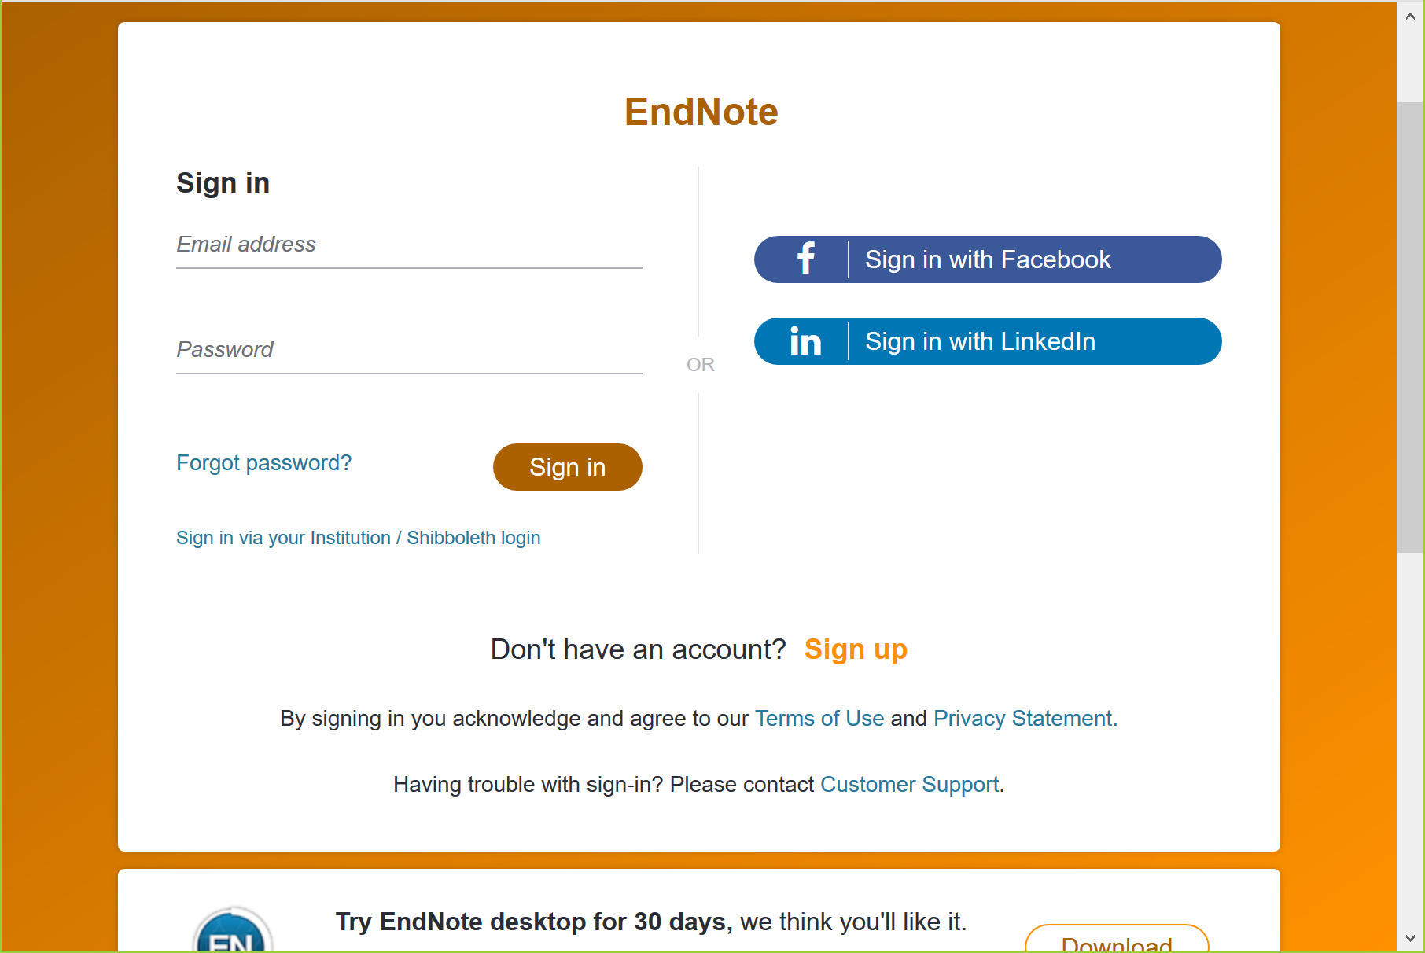
Resister with EndNote basic
https://www.myendnoteweb.com

Slide 7
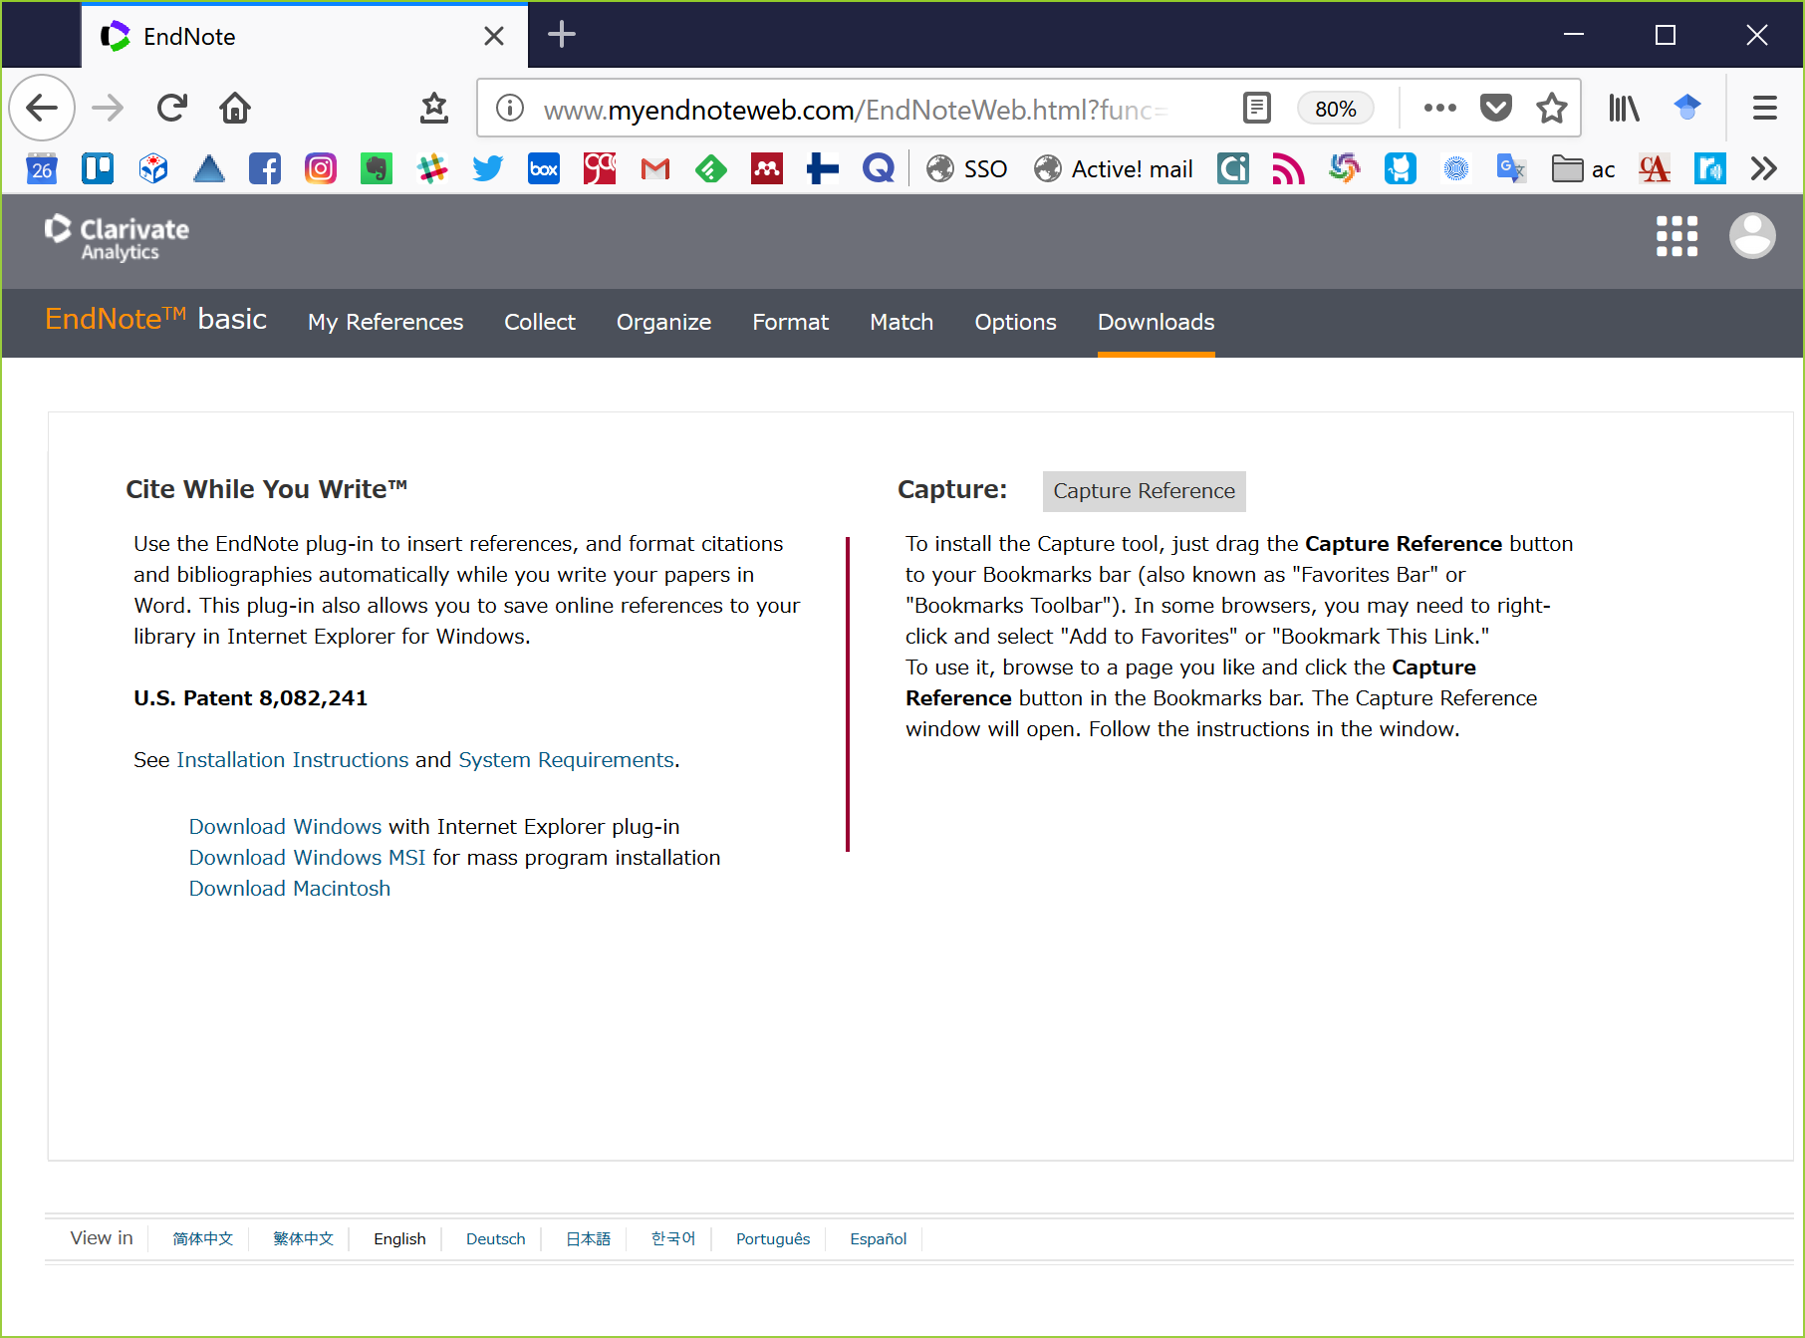
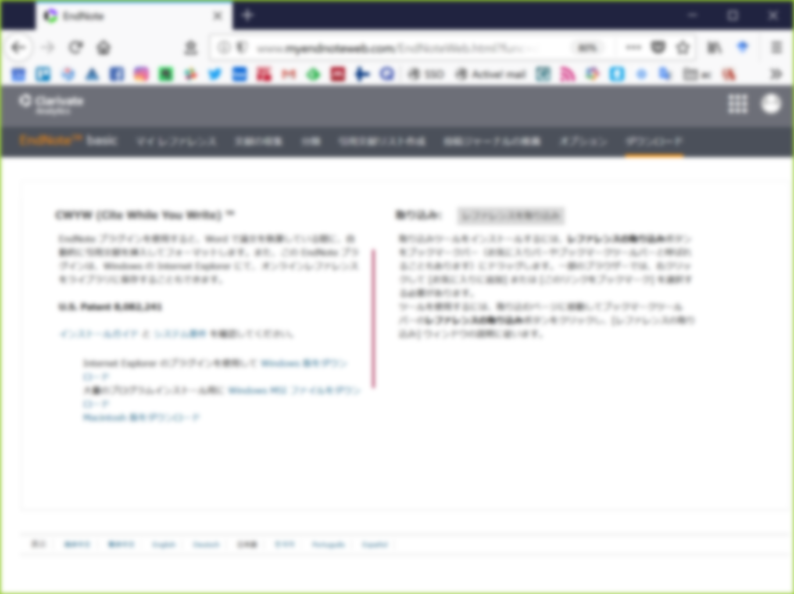
Useful tools of EndNote basic
Click “Downloads” tab
Install this tool (just drag this button to the bookmarks bar on the browser)
and you can import references from a web page to EndNote basic.
This plug-in makes you insert references while writing a paper in Word.

Slide 8
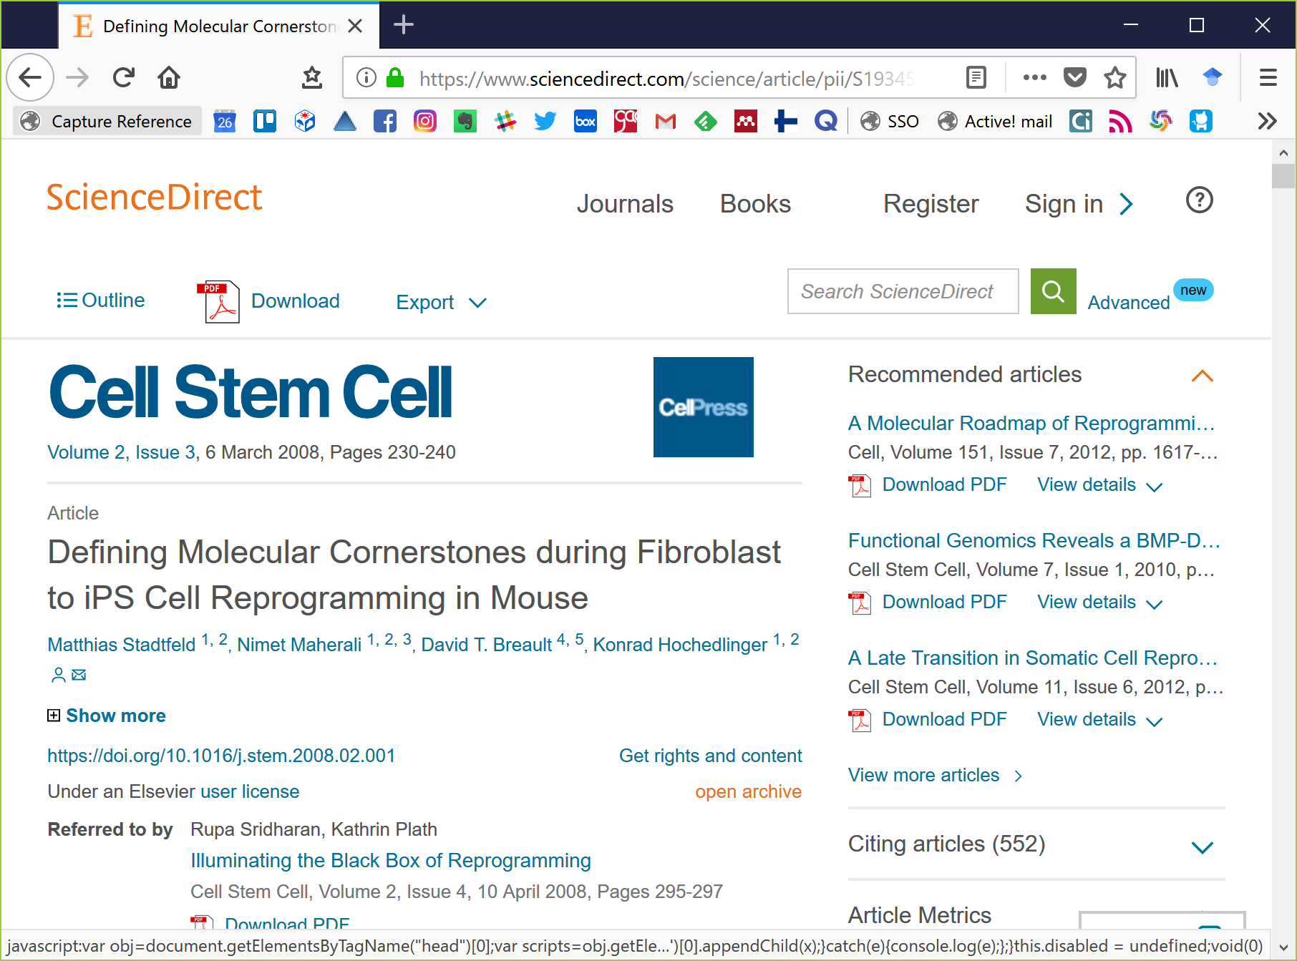
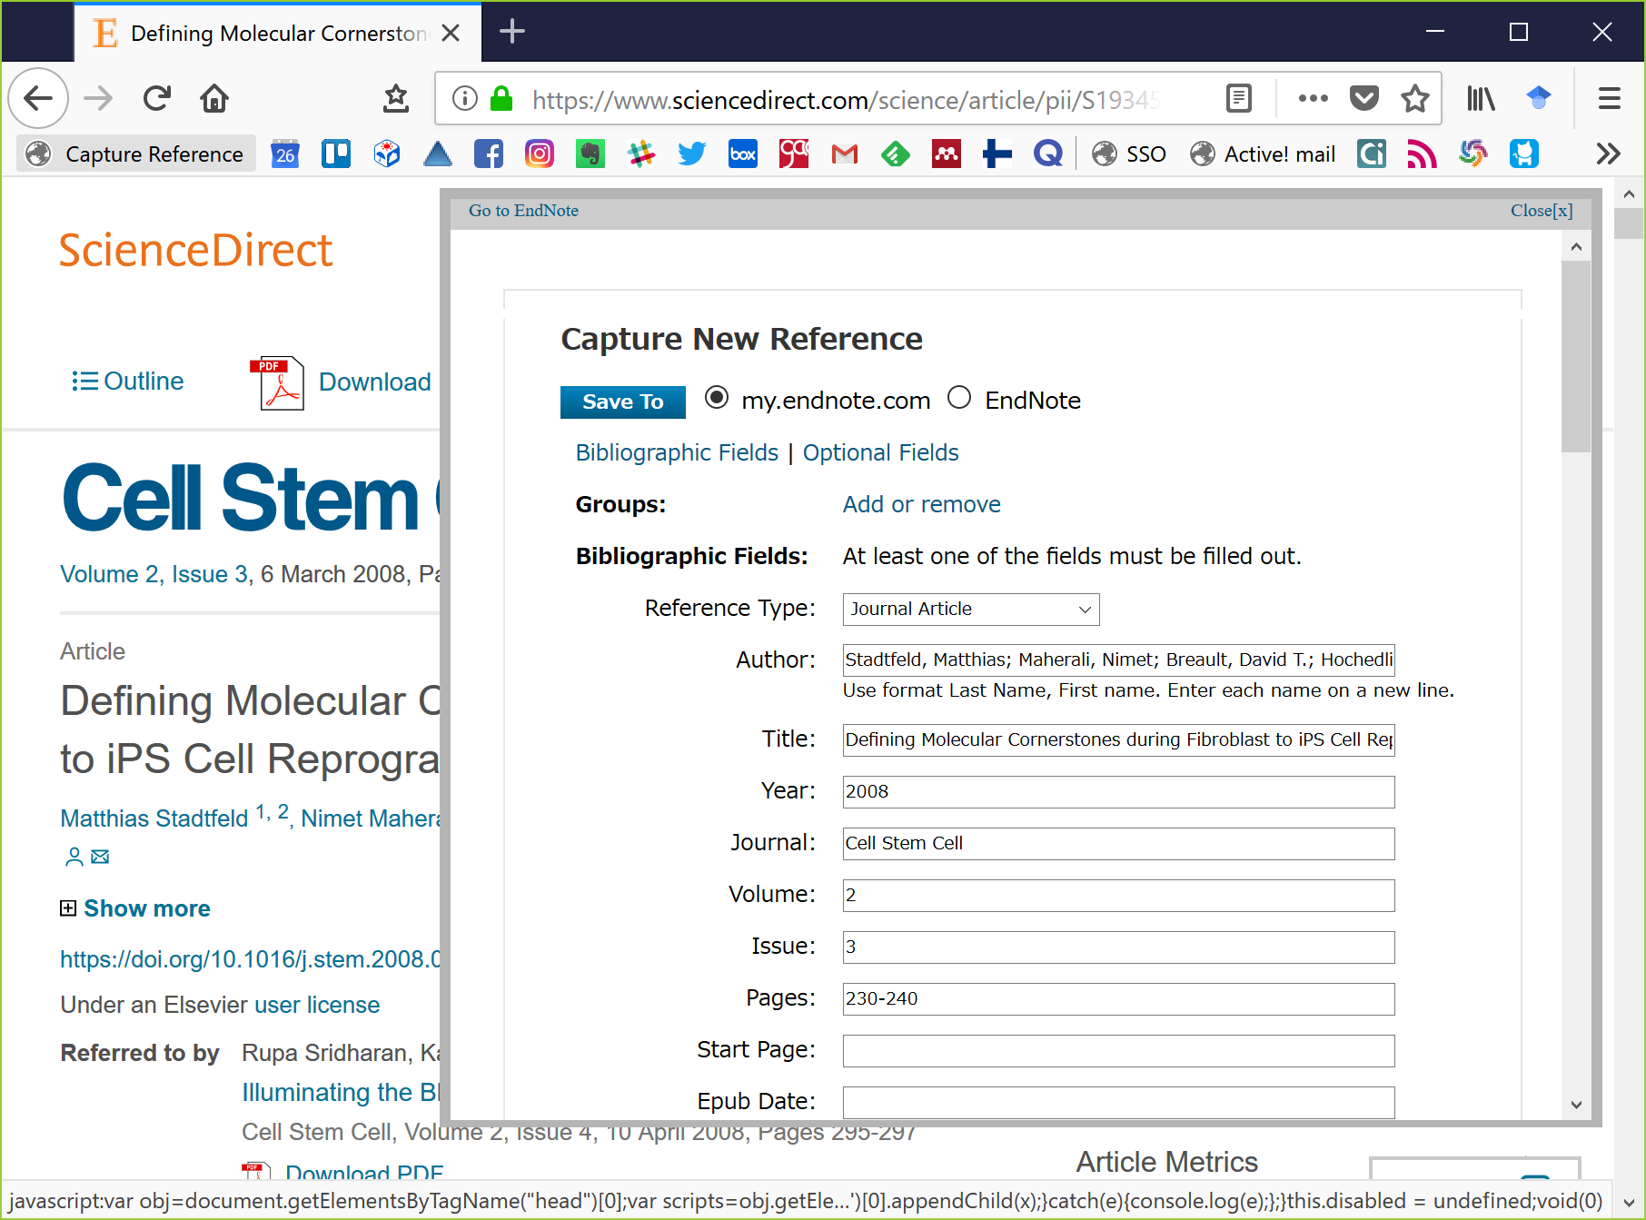
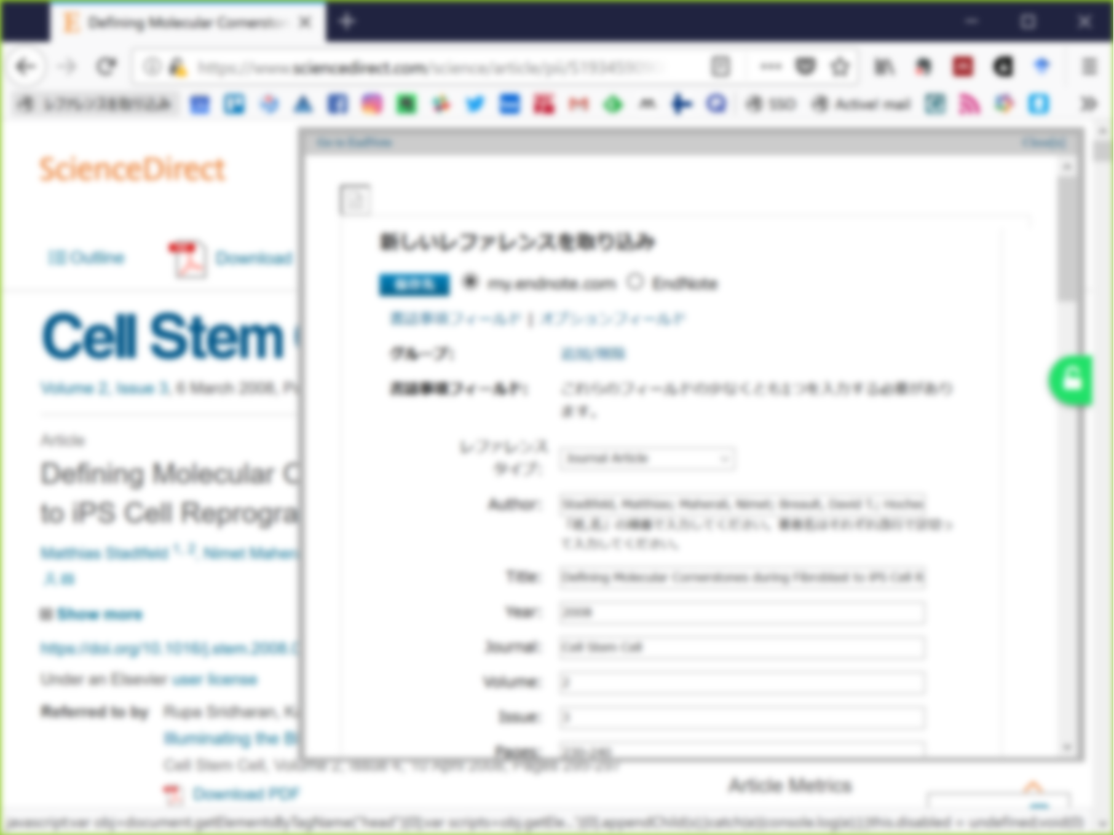
Import references to EndNote basic
From “Capture Reference” button in your bookmarks bar directly
Just click “Capture Reference” button on your browser and you import references from a web page to EndNote basic.

Slide 9
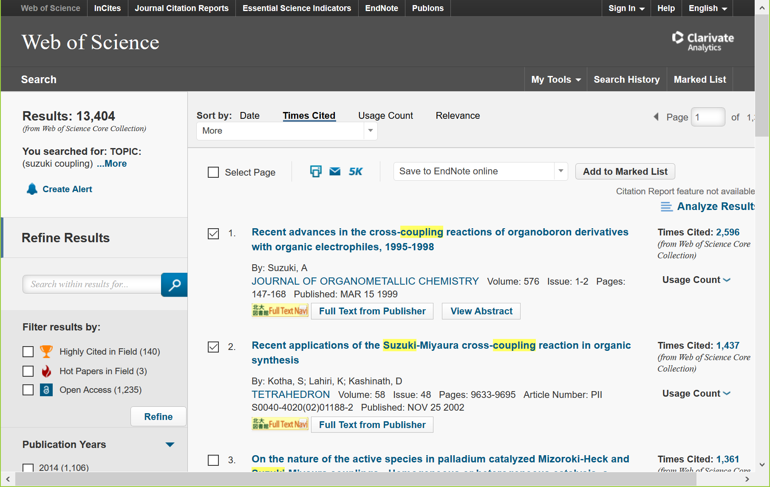
Import references to EndNote basic
From Web of Science directly

Slide 10
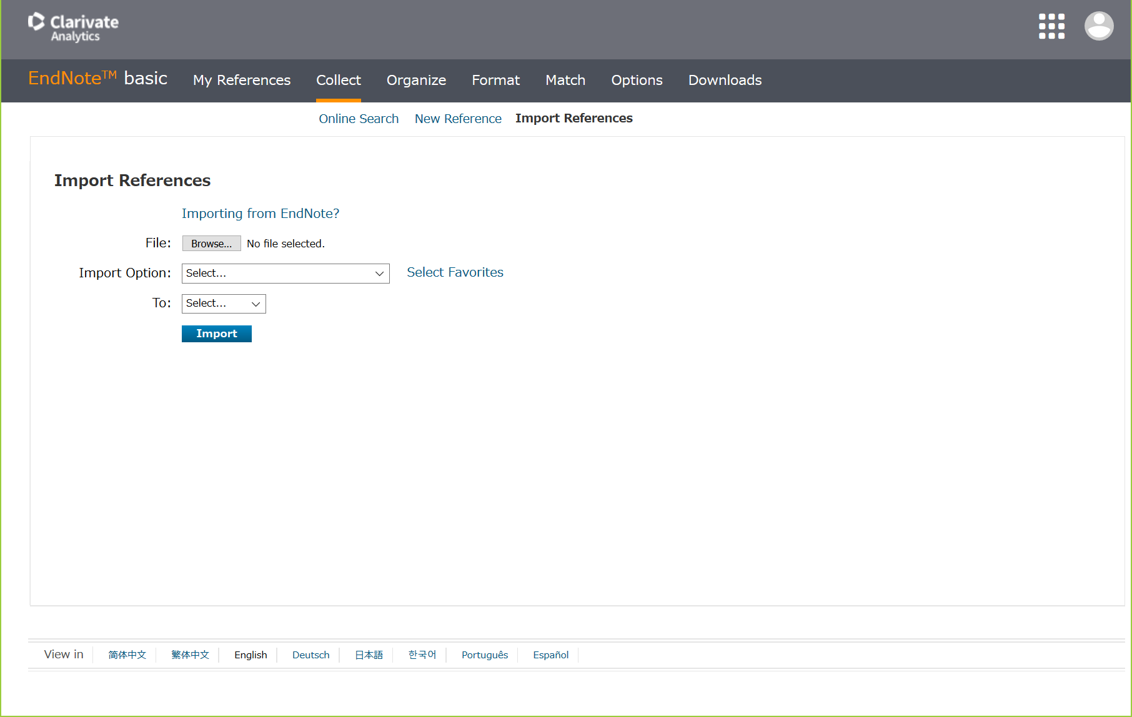
Import references to EndNote basic
Upload files (such as RIS files) from “Collect” tab in EndNote basic

Slide 11
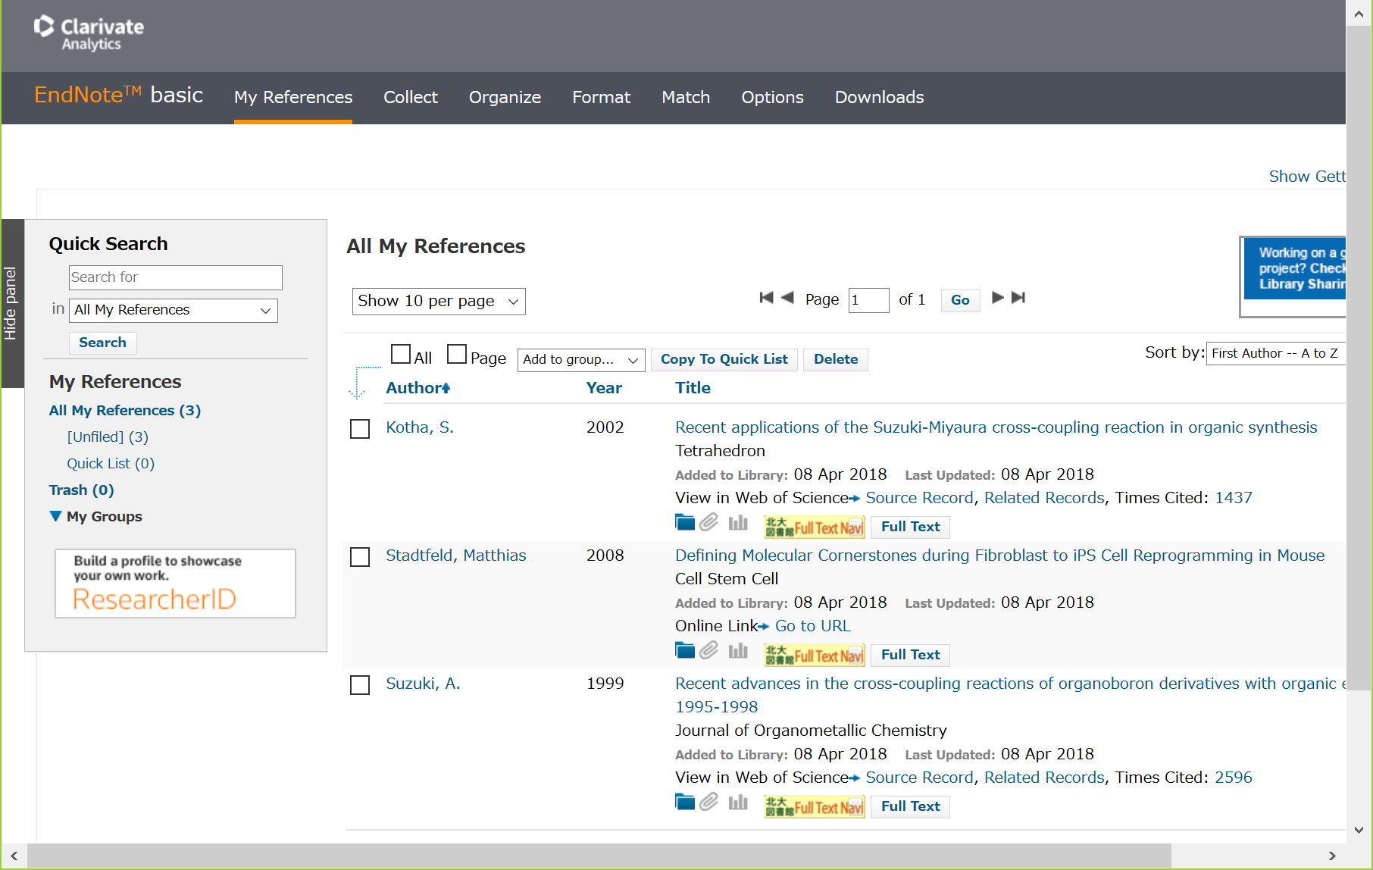
Organize and Share references
Main screen (“My References”)
References imported from Web of Science have
links to Web of Science and Times Cited.
organize references in folders and
share them with group members here
attach PDF files here if you have
(up to 2GB per user)
*share only references, but not PDF files

Slide 12
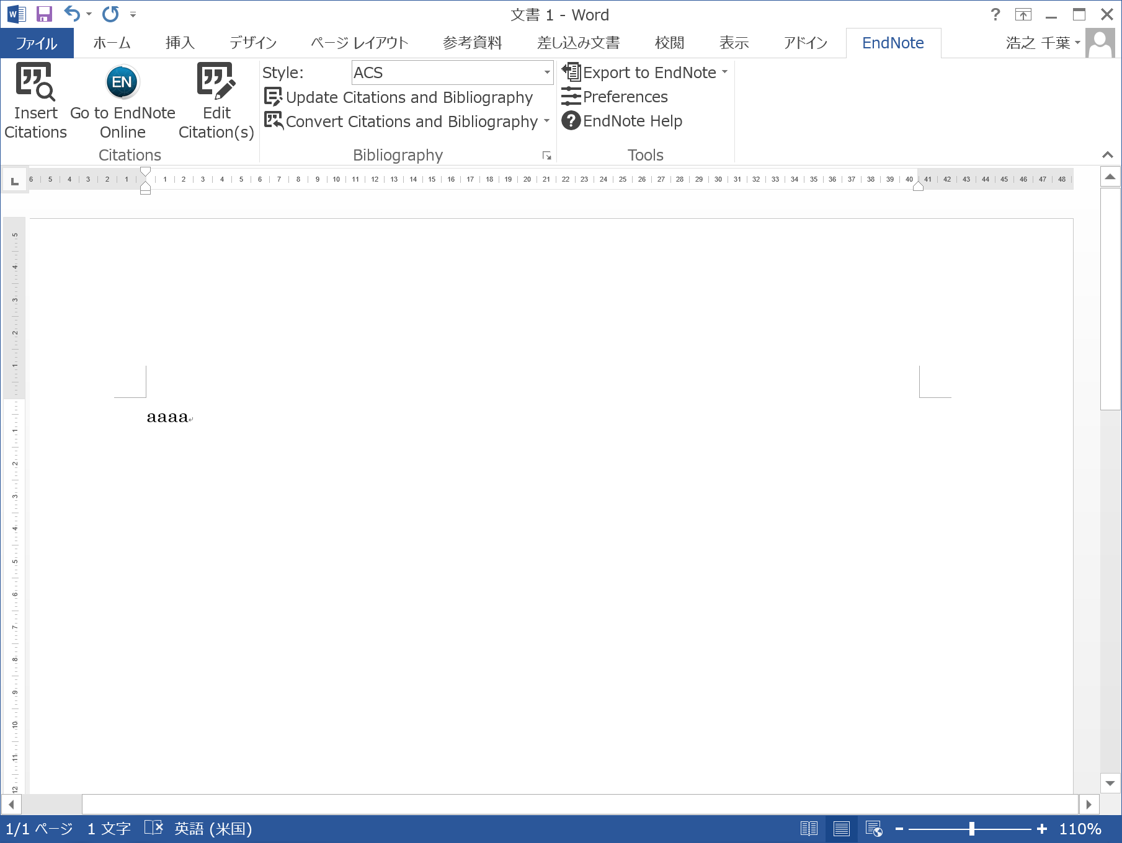
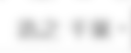
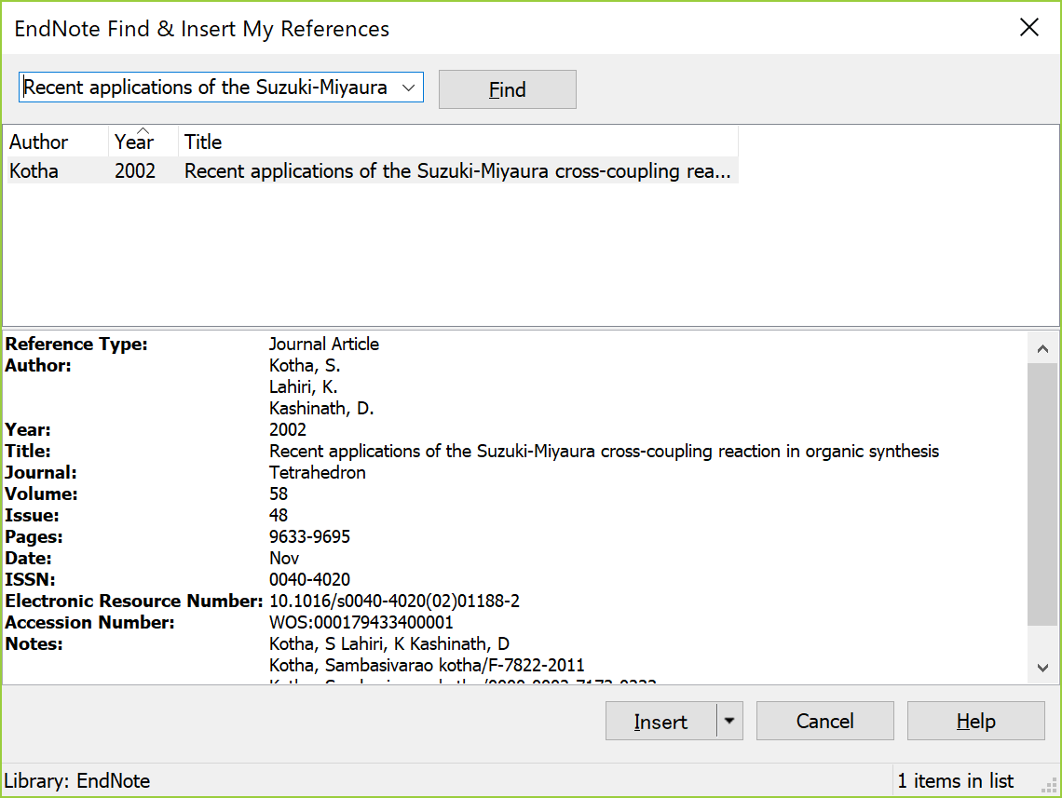
Generate citations / a reference list in Word
Screen of Word installed CWYW plug-in

Slide 13
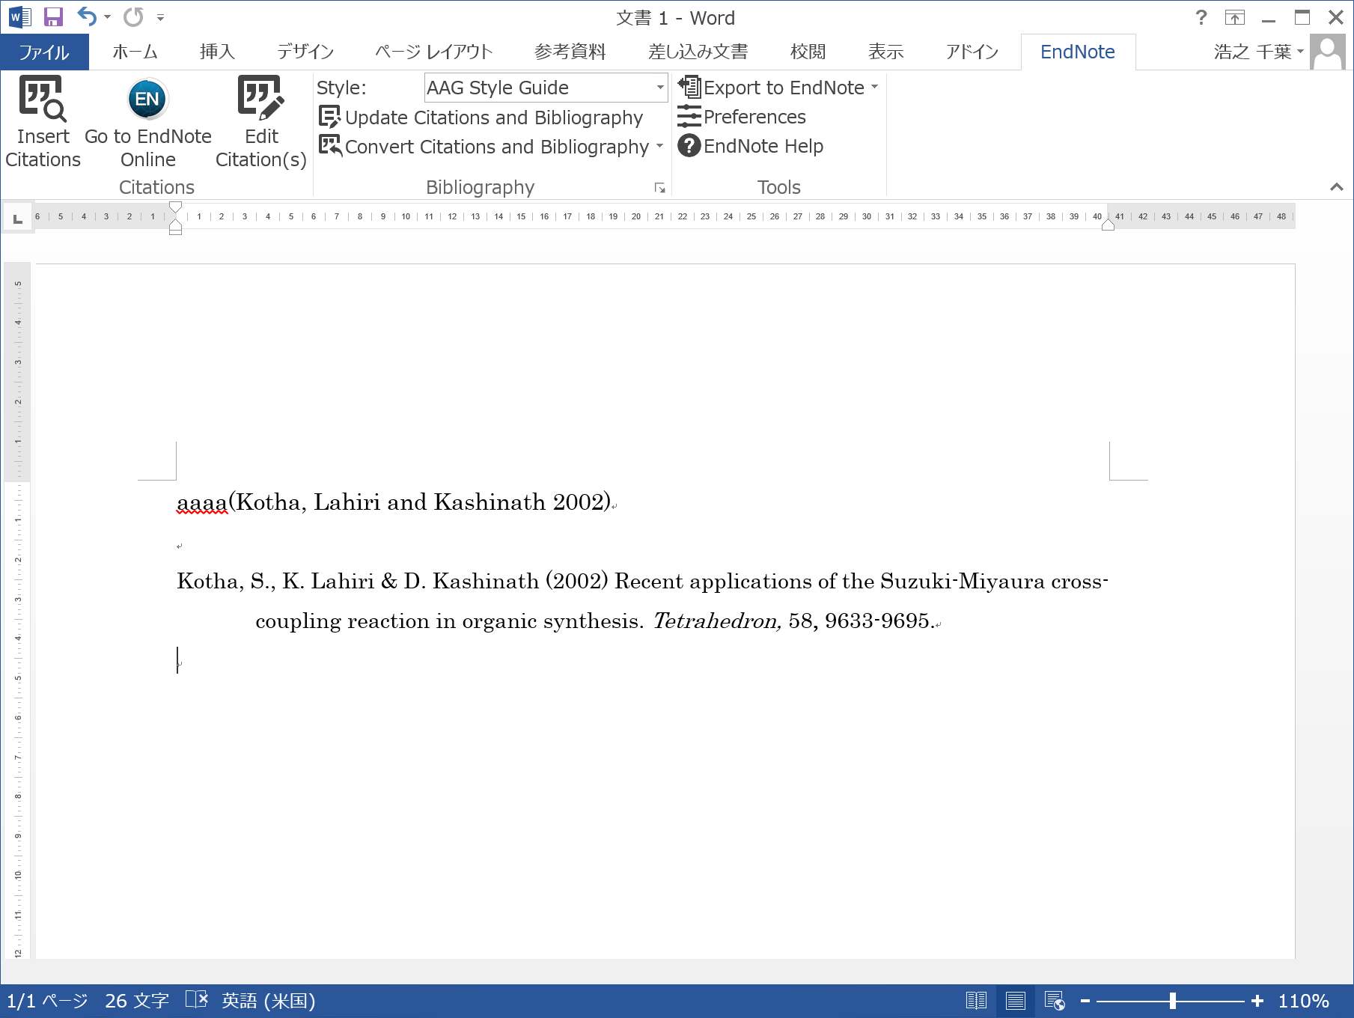
Generate citations / a reference list in Word
Screen of Word installed CWYW plug-in
A reference sign is inserted in the sentence,
and a reference is added below.
change the citation style here

Slide 14
Mendeley
Hokkaido University subscribes Mendeley Institution Edition.
* We can use this edition until March 2019 at the shortest.
We can use
100GB personal storage space 2GB
100GB shared storage space 100MB
We can make
private groups of up to 100 people unlimitedly 5 groups of up to 25 people
at the freemium edition
How to use these additional functions
You need only to log in from campus network.
Each time you log in from campus network
you can use them off-campus for one year.
I recommend this to those who:
have already quite a few PDF files of articles
* You can import references (and PDF files) to Mendeley
by dragging and dropping PDF files
want to not only save but also annotate PDF files

Slide 15

Resister with Mendeley
https://www.mendeley.com

Slide 16
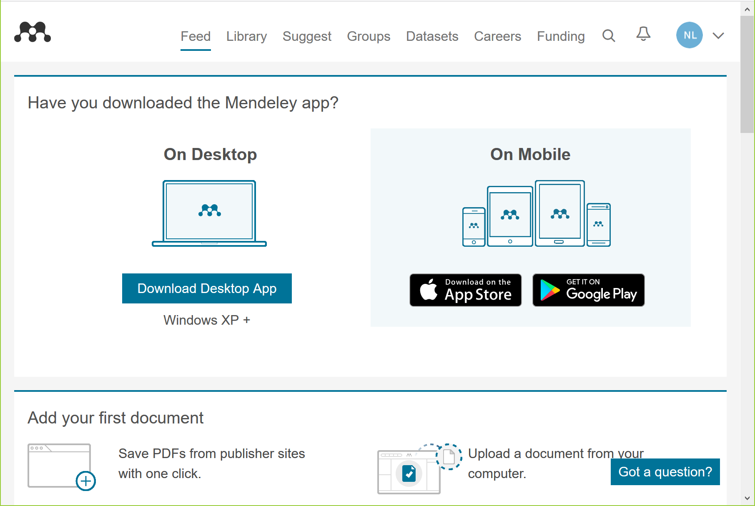
Useful tools of Mendeley
https://www.mendeley.com

Slide 17
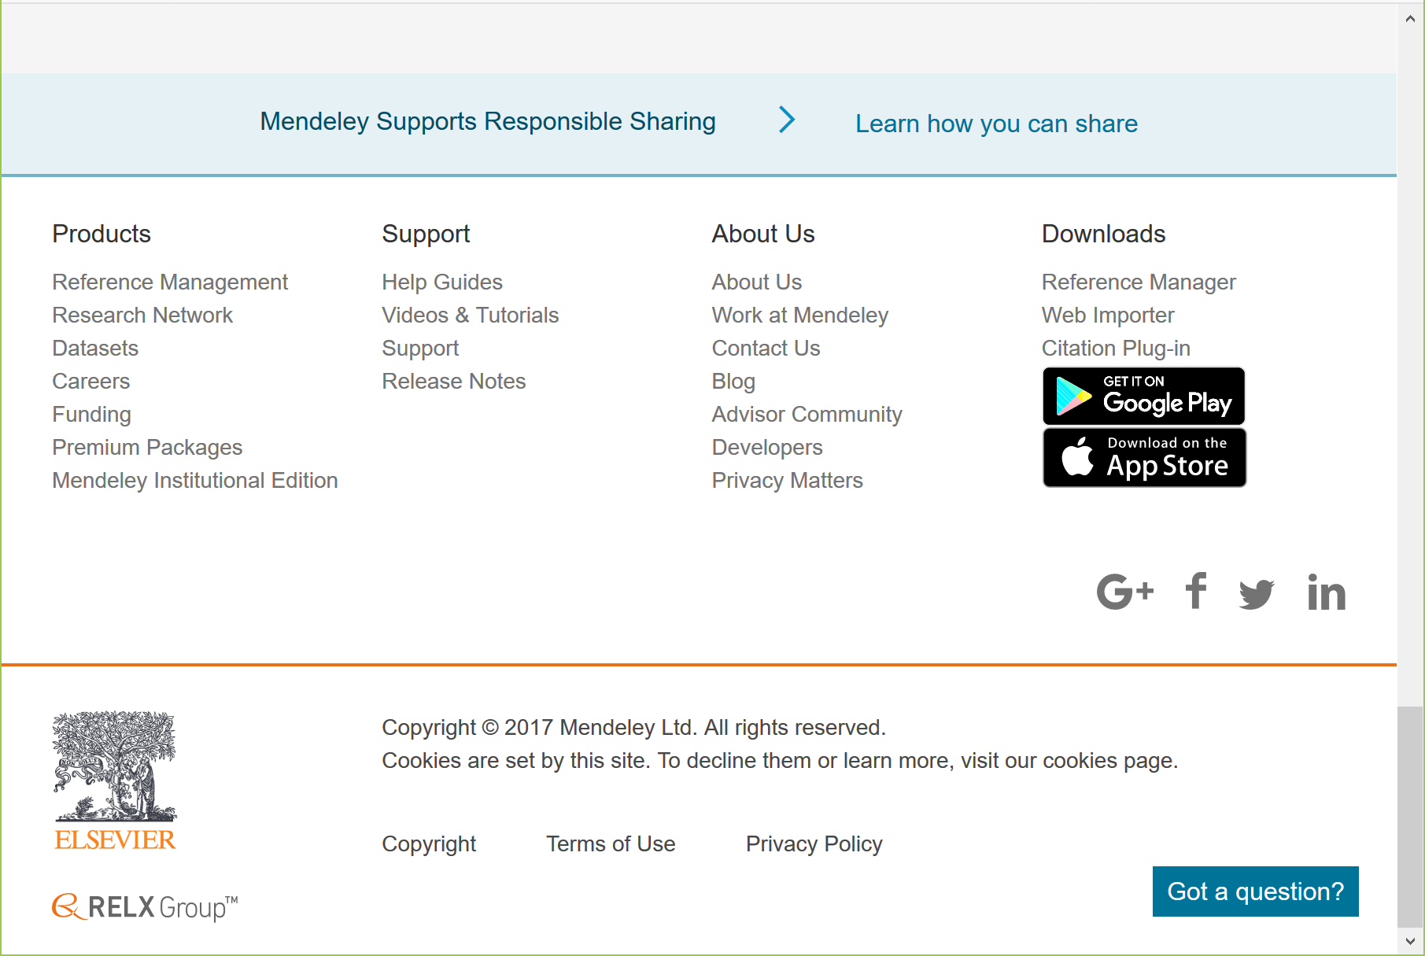
Useful tools of Mendeley
Download free Reference Manager, Web Importer, and Citation Plug-in
“Reference Manager” is the desktop version of Mendeley.
“Web Importer” is the tool which import references from a web page to Mendeley in the blowser.
“Citation Plug-in” makes you insert references while writing a paper in Word.

Slide 18
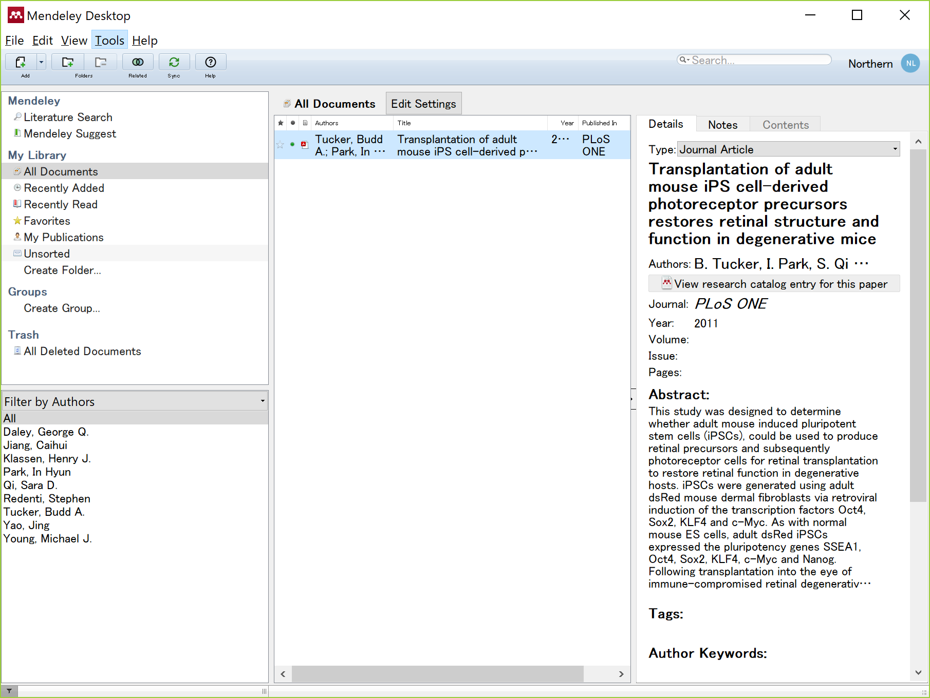

Import references to Mendeley
Drag and drop a PDF file or an entire folder of PDF files directly
Desktop version
By dragging and dropping a PDF file of an article,
you can import a reference and a PDF file
to Mendeley in both versions (desktop and web (browser)).

Slide 19
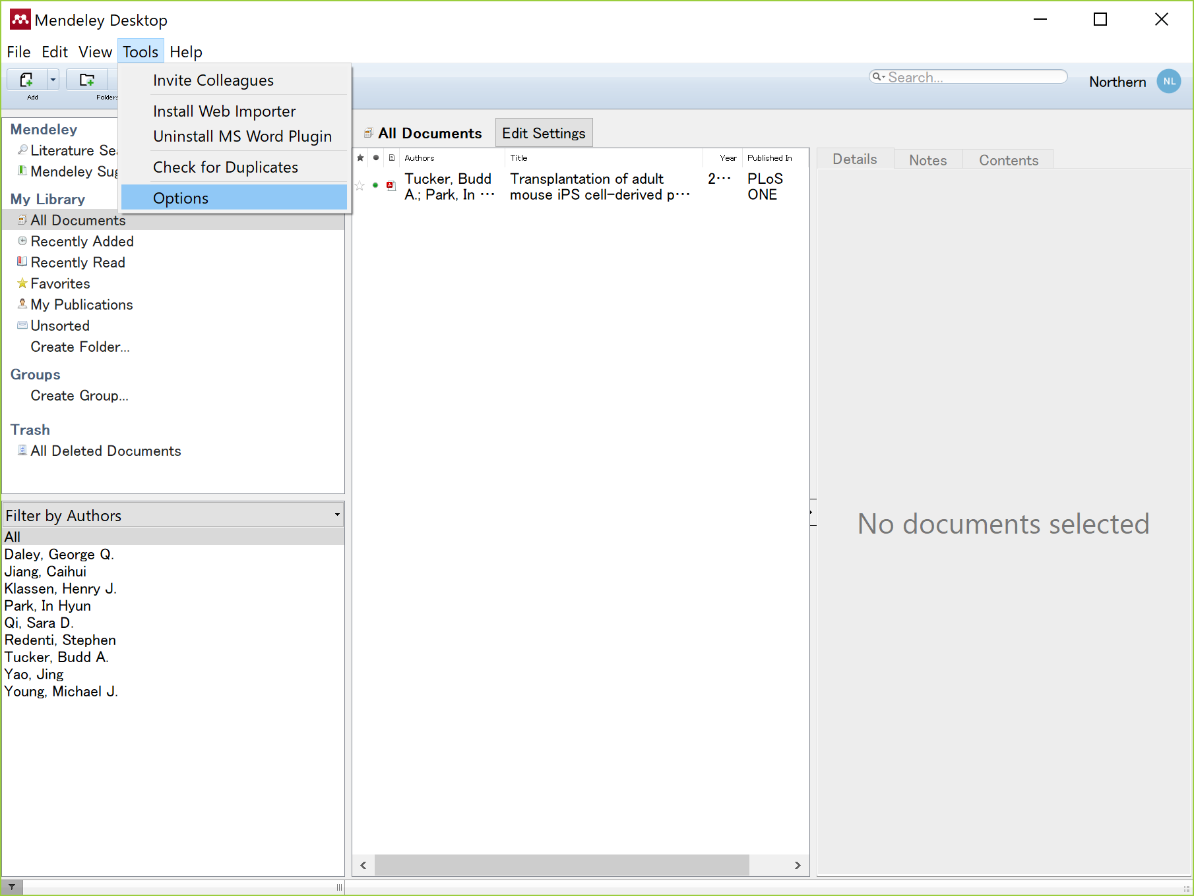
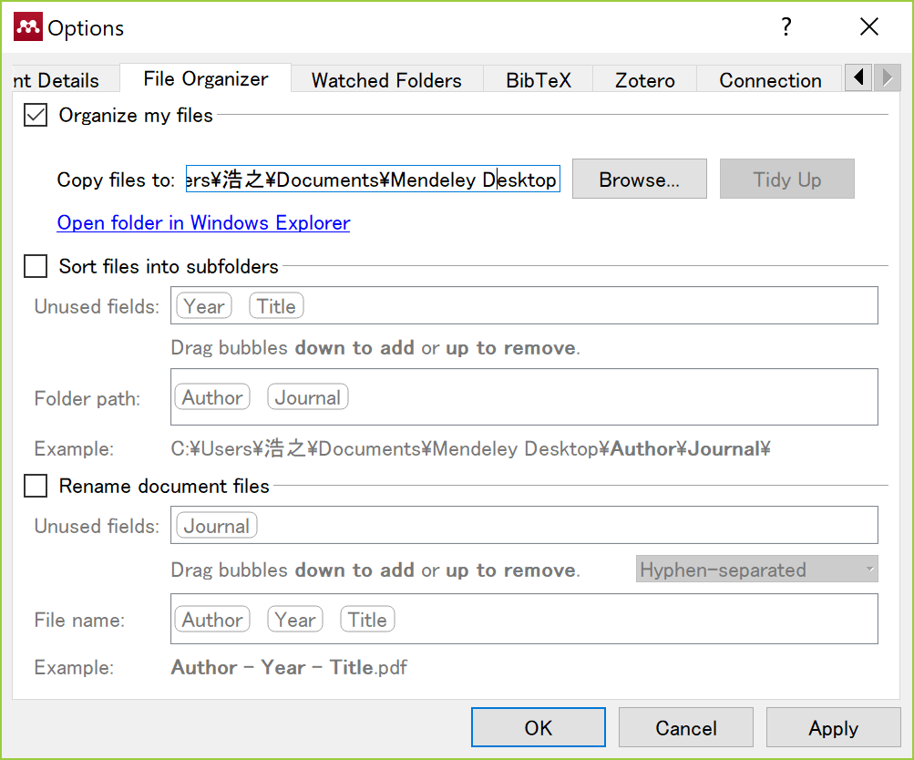
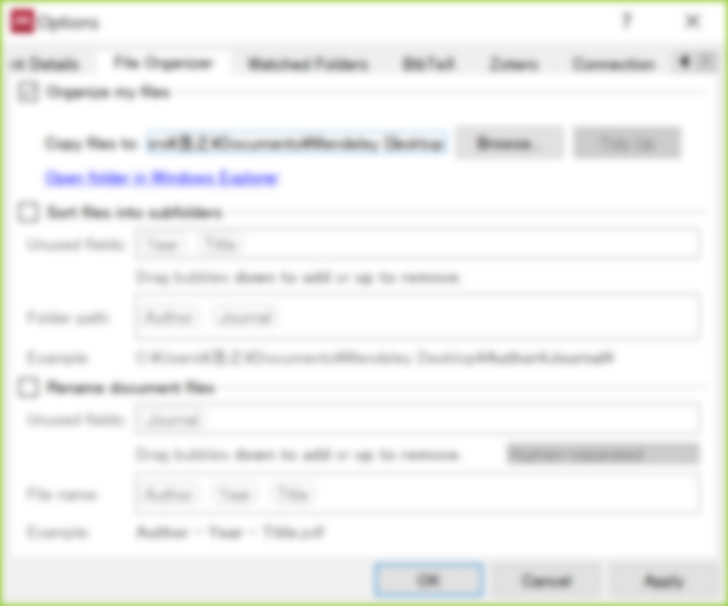
Import references to Mendeley
How to save the PDF files in your computer
Desktop version
When you delete a reference in Mendeley,
its uploaded PDF file is also deleted!
So I recommend copying PDF files in your computer.

Slide 20
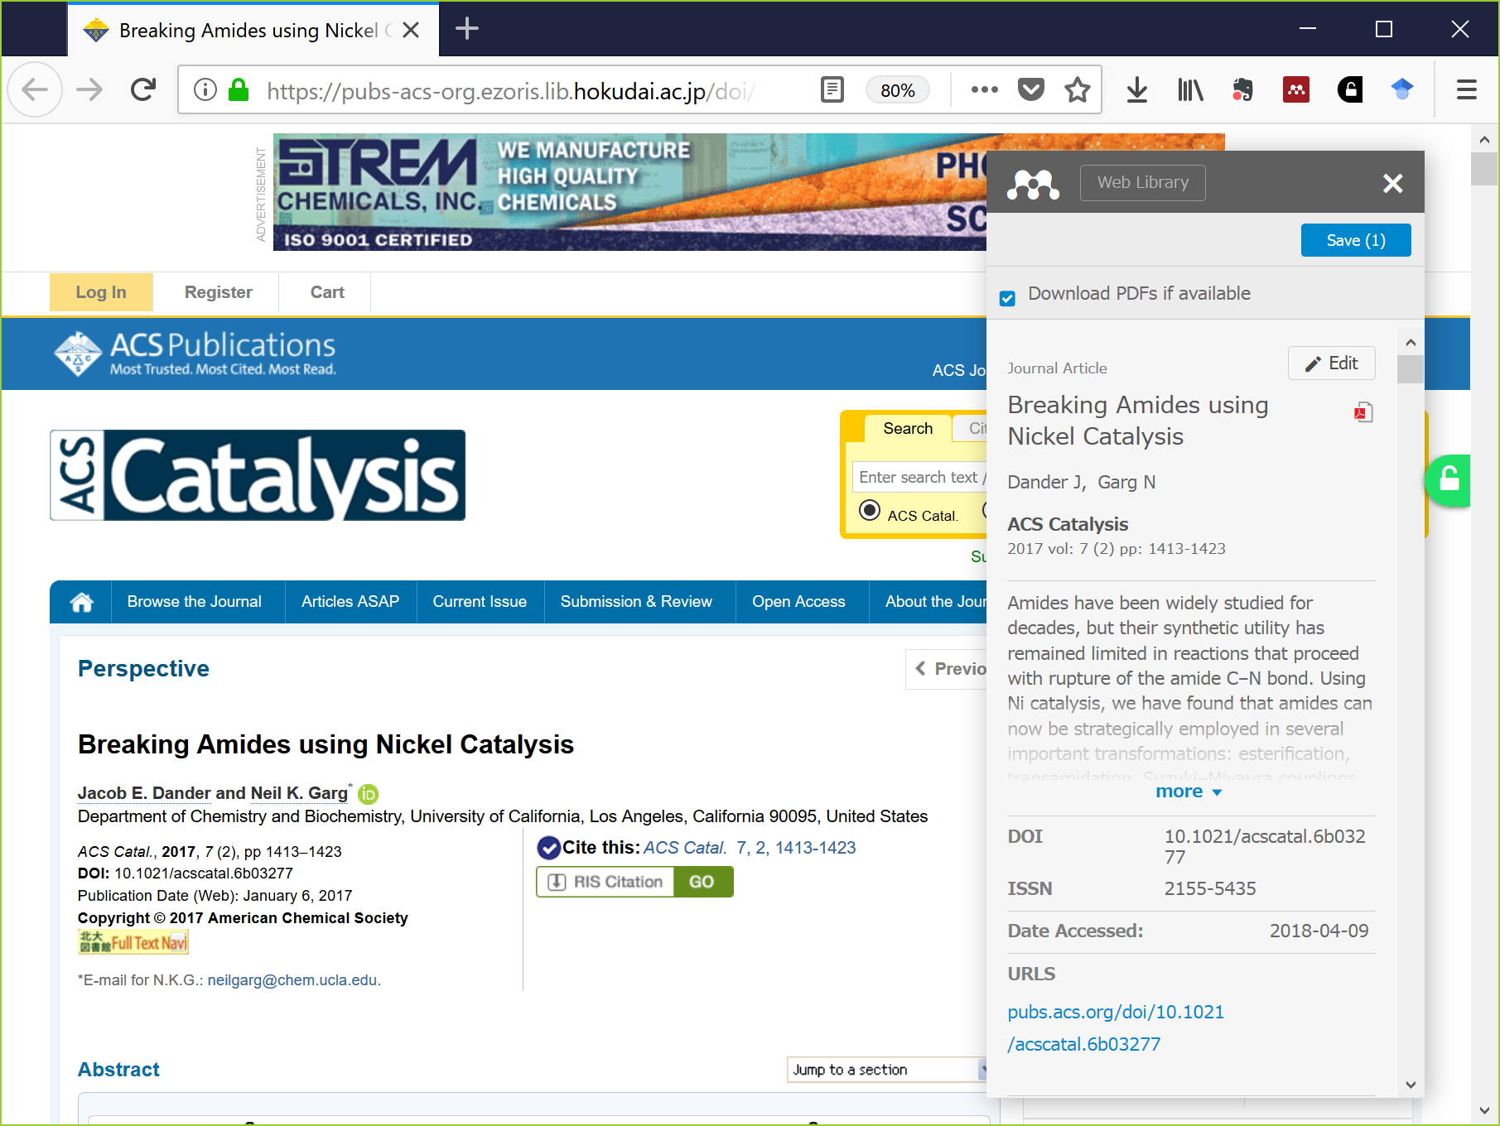
Import references to Mendeley
From Web importer in your browser directly
Just click “Web importer” button on your browser and you import references from a web page to Mendeley.

Slide 21
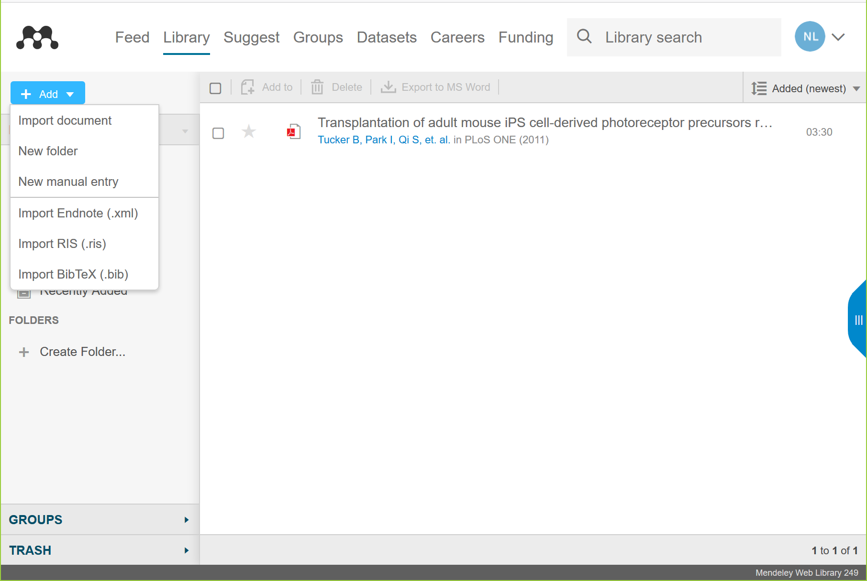
Import references to Mendeley
Upload files (such as RIS files) from “+ Add” button
Web (browser) version

Slide 22
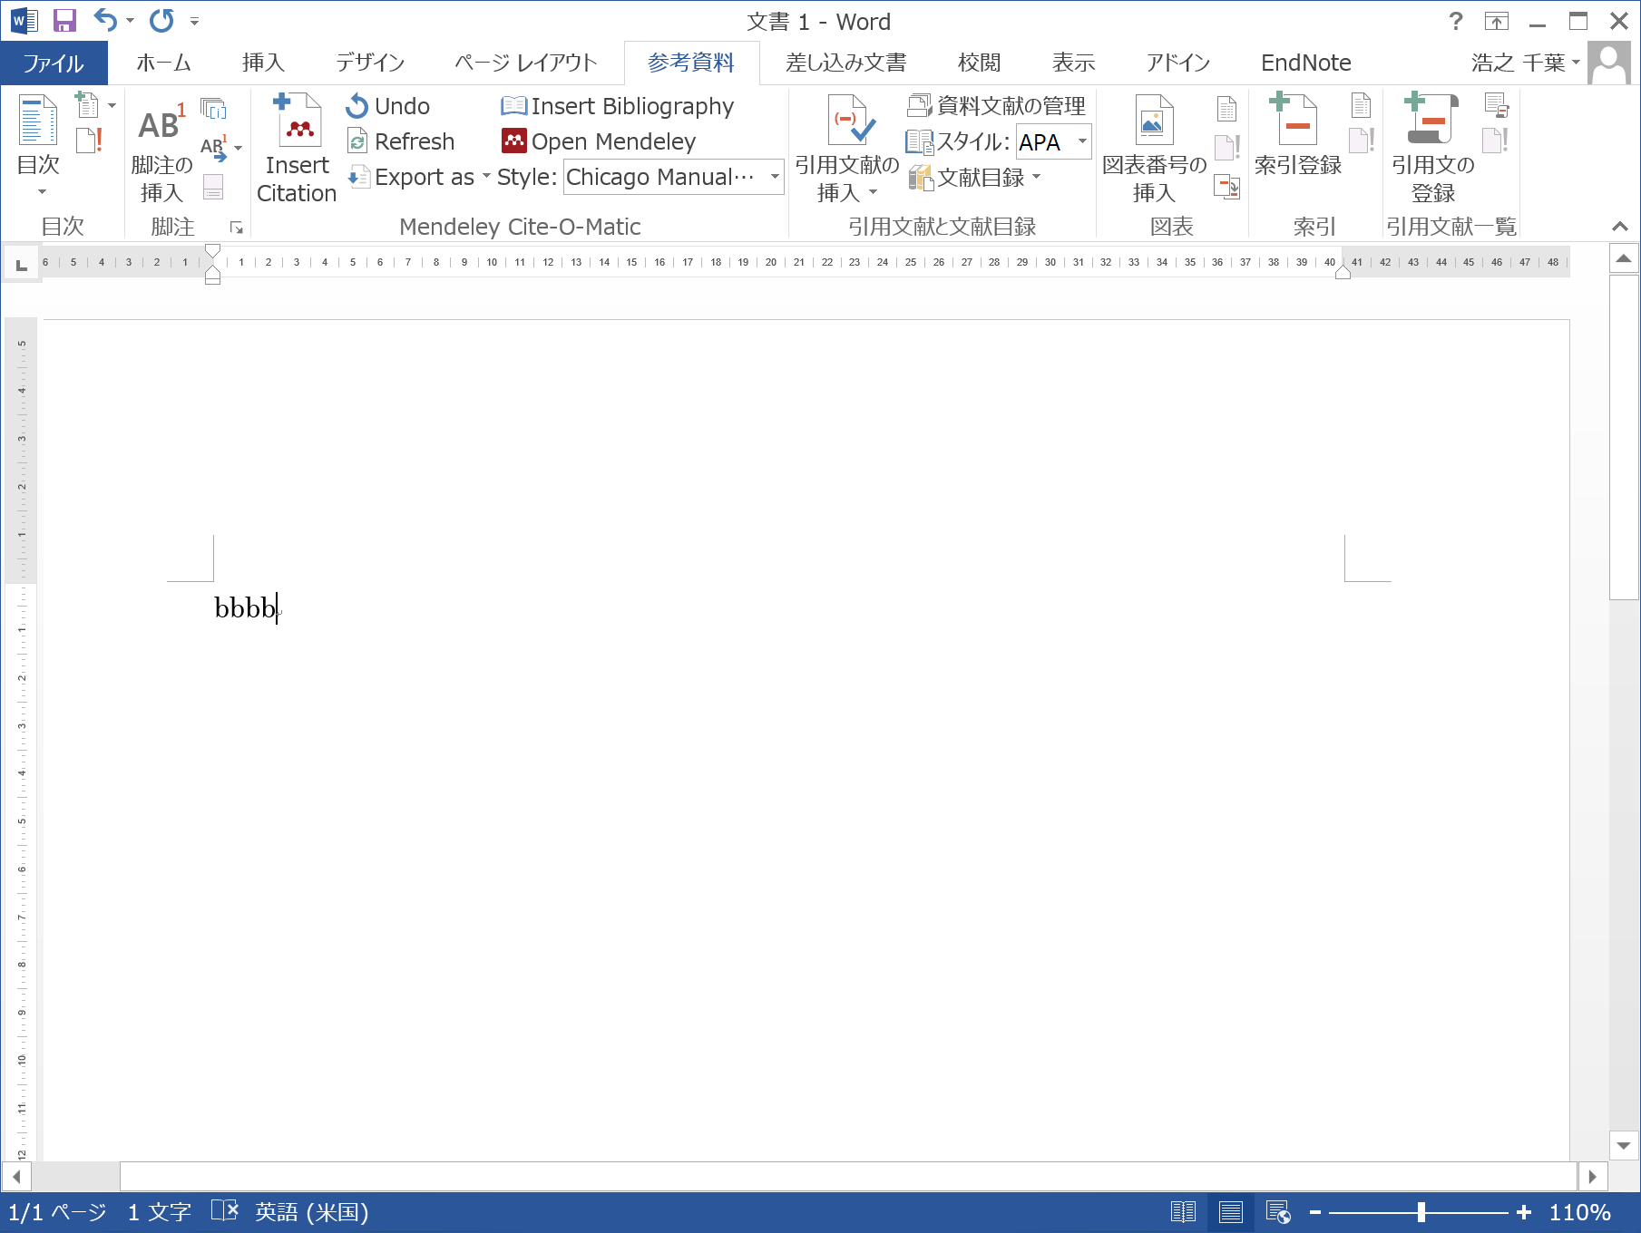
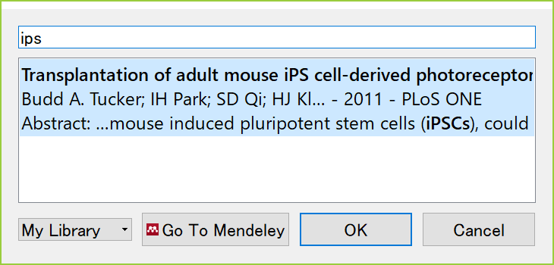
Generate citations / a reference list in Word
Screen of Word installed Citation Plug-in

Slide 23
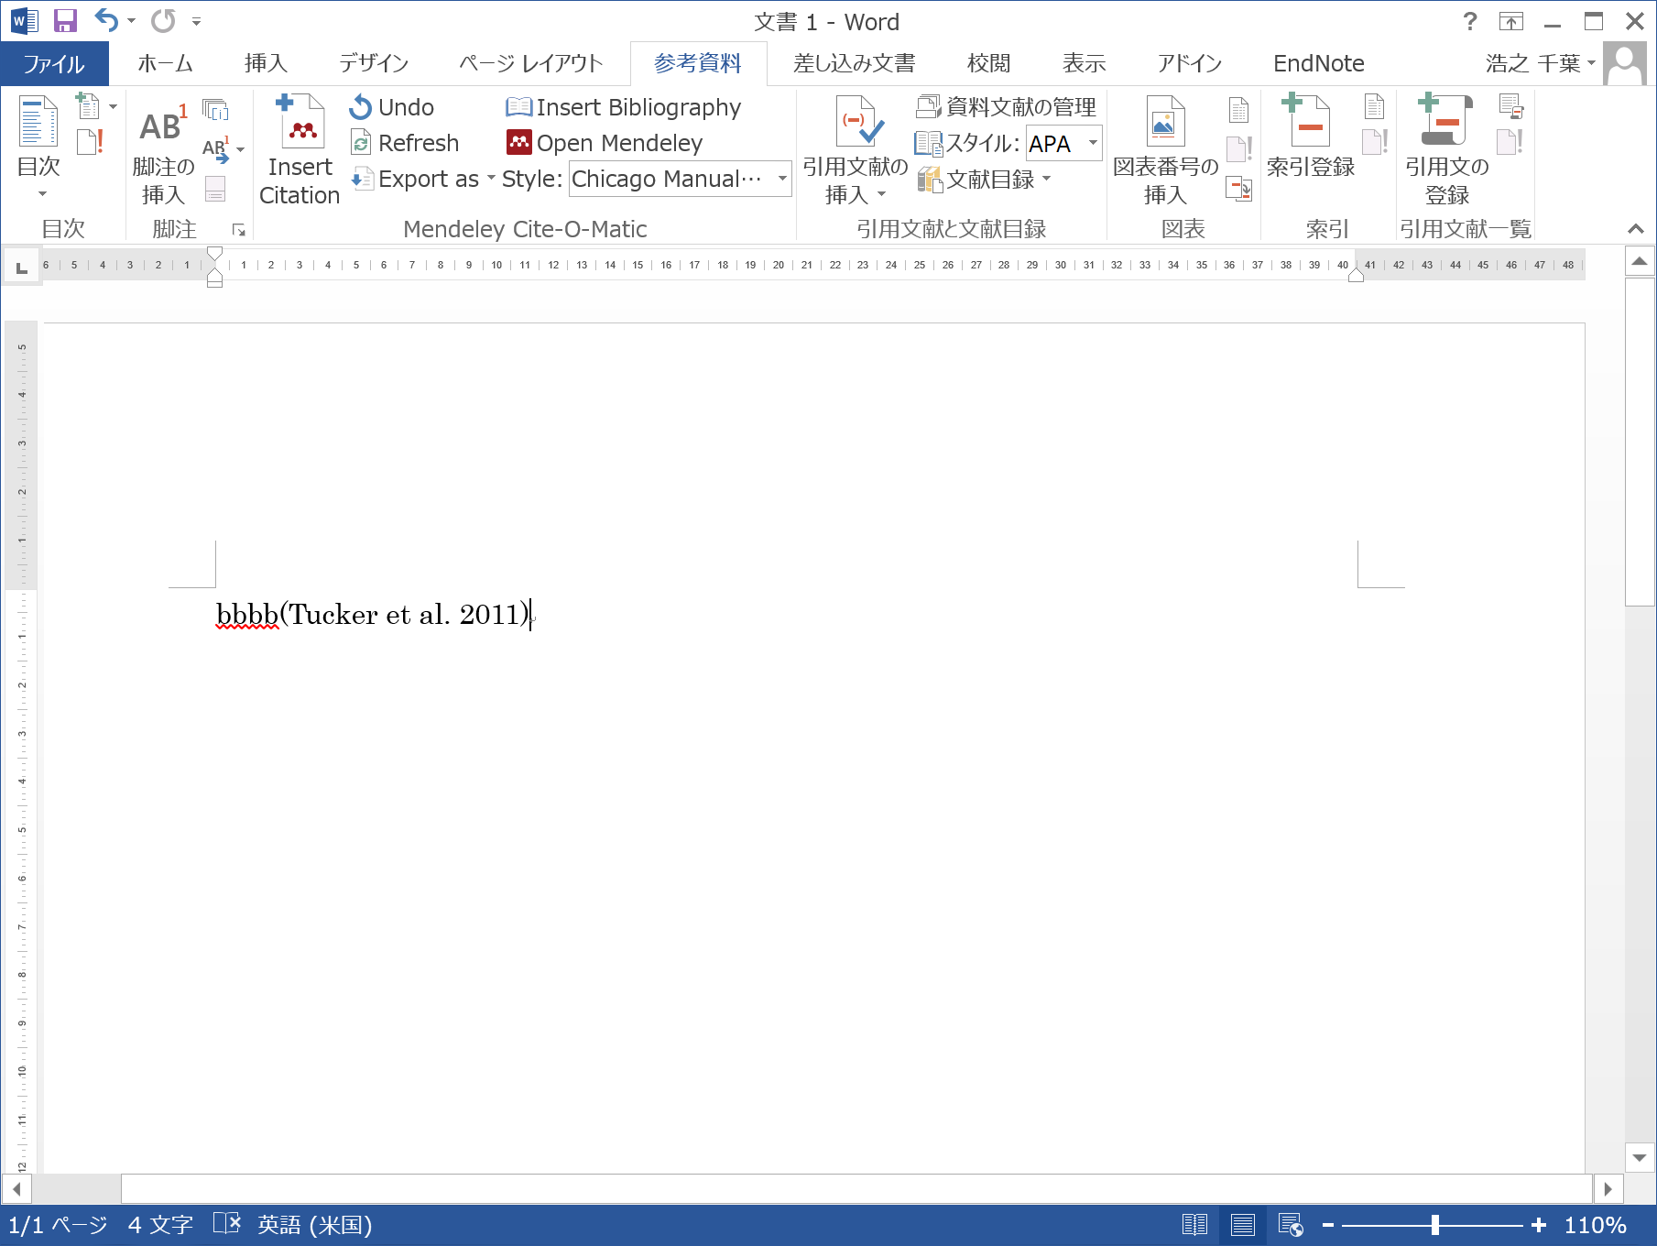
Generate citations / a reference list in Word
Screen of Word installed Citation Plug-in
A reference sign is inserted in the sentence,
but a reference is not added yet.

Slide 24
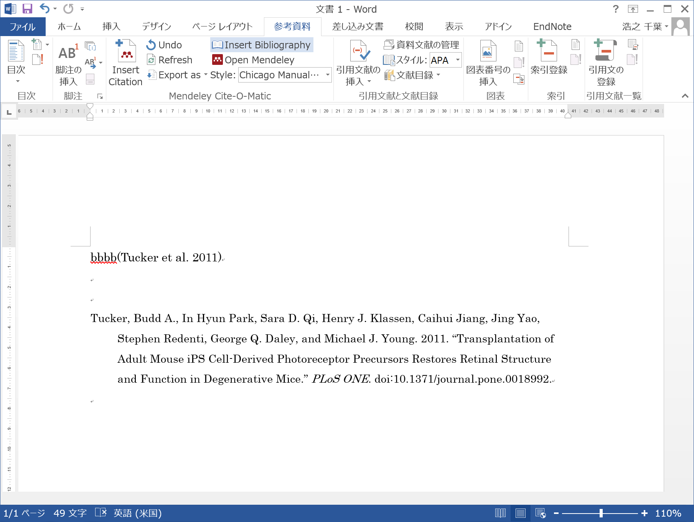
Generate citations / a reference list in Word
Screen of Word installed Citation Plug-in
Click “Insert Bibliography”
and a reference is added below.
change the citation style here

Slide 25
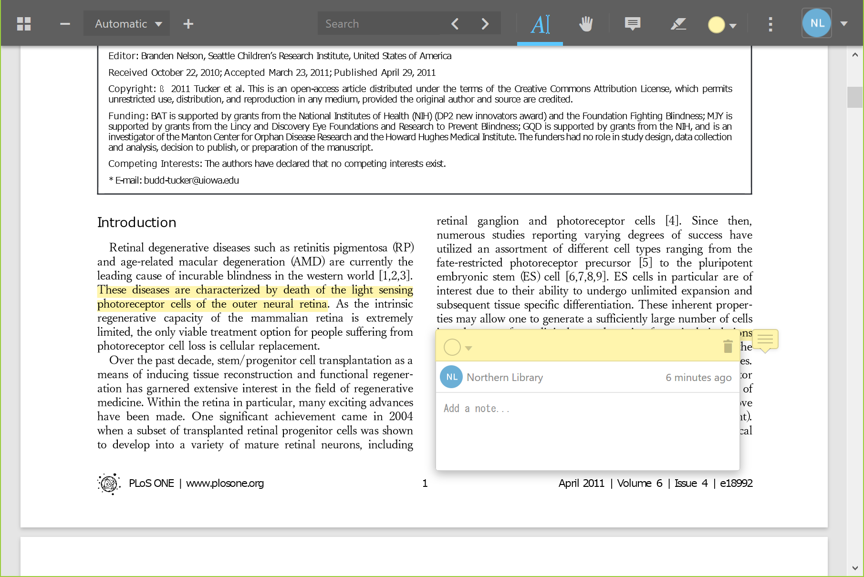
Other functions of Mendeley
Read and Annotate a PDF file in Mendeley
Web (browser) version
You can read and annotate a PDF file in Mendeley
in all versions (desktop, web (browser), and mobile).

Slide 26
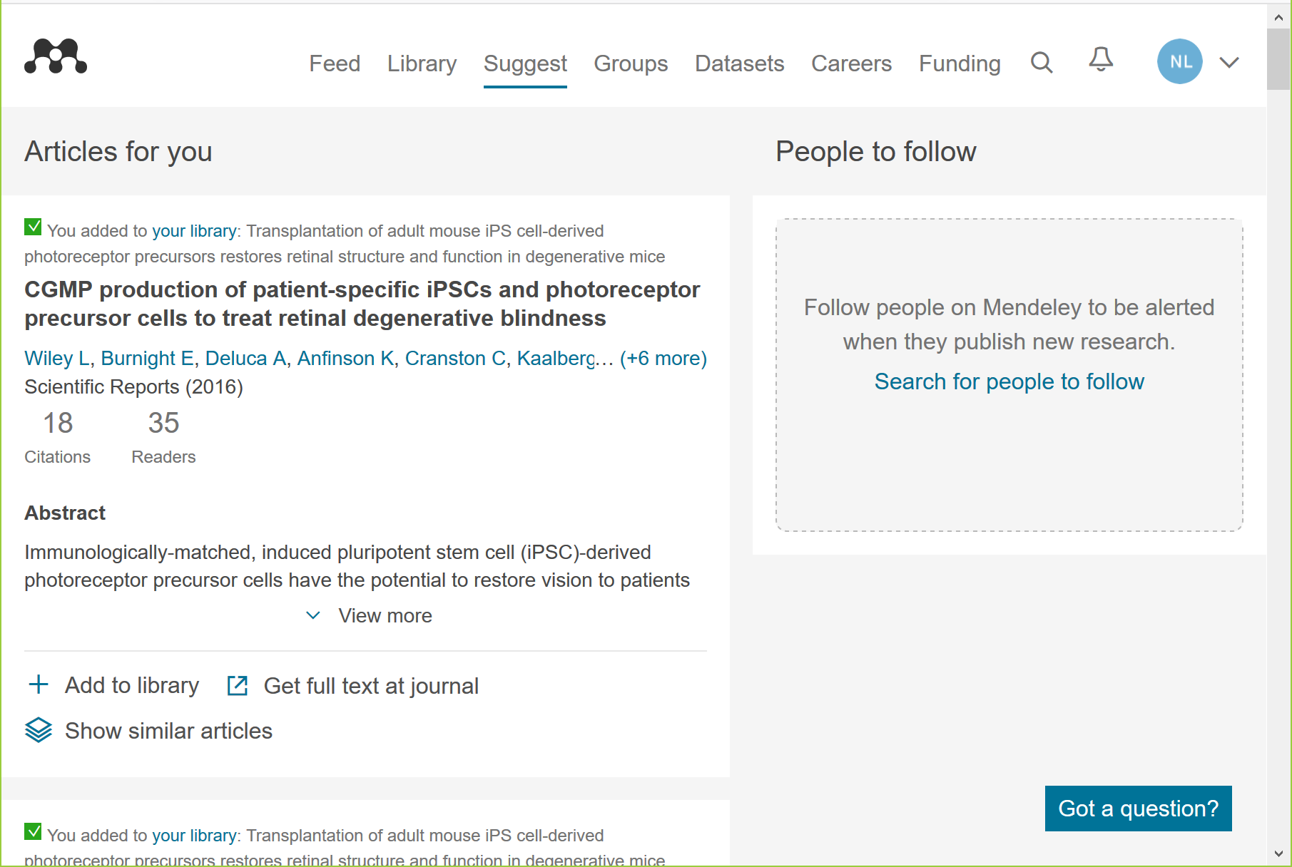
Other functions of Mendeley
Receive recommended articles, follow other users, and so on
Web (browser) version
Mendeley suggests related articles according to your collected references.
You can also follow other users.

Slide 27
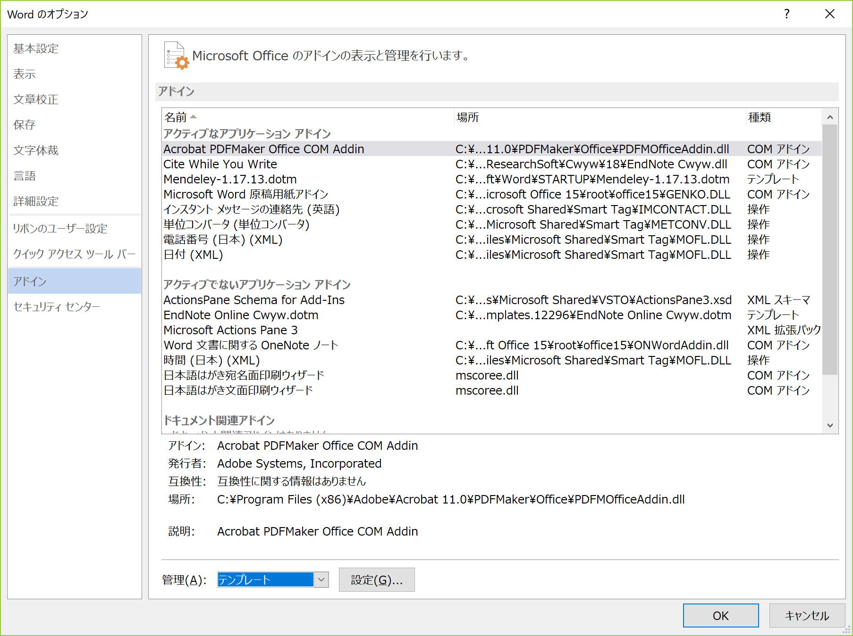
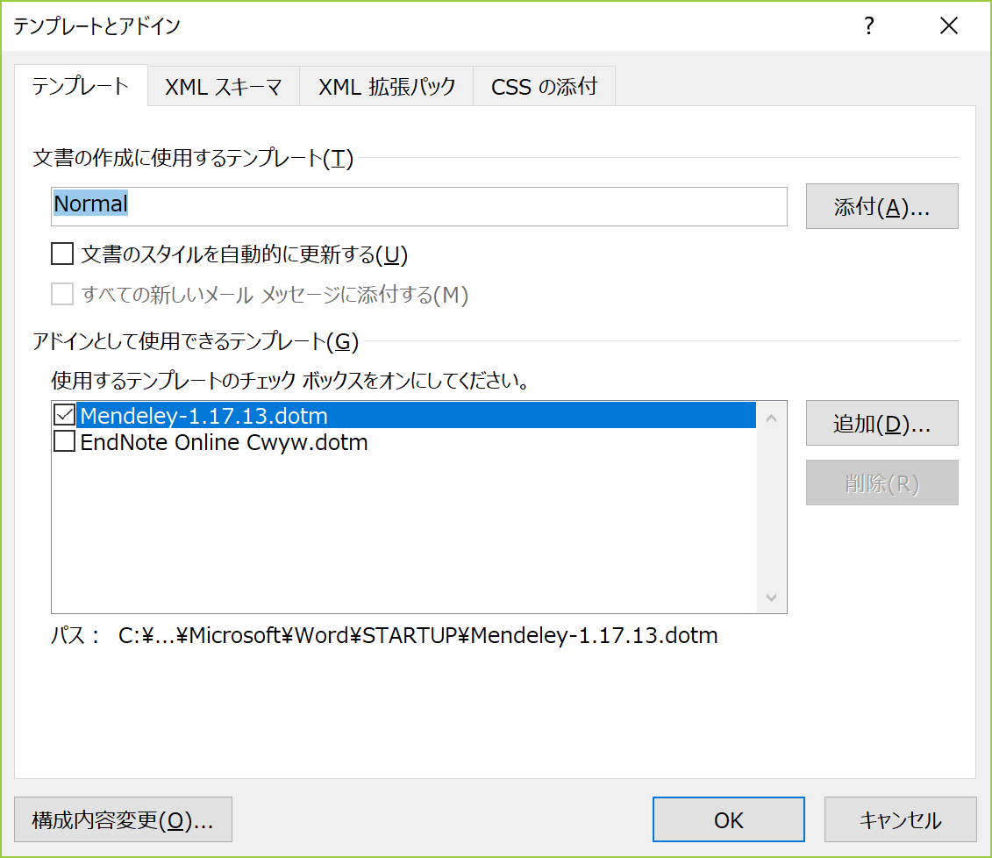
Resolve the conflict between the plug-ins
(if you try the both software’s plug-ins)
Word Options > Add-Ins > Manage: Template
If you try the both software’s plug-ins,
I recommend activating only one
to avoid the conflict between them.

Slide 28
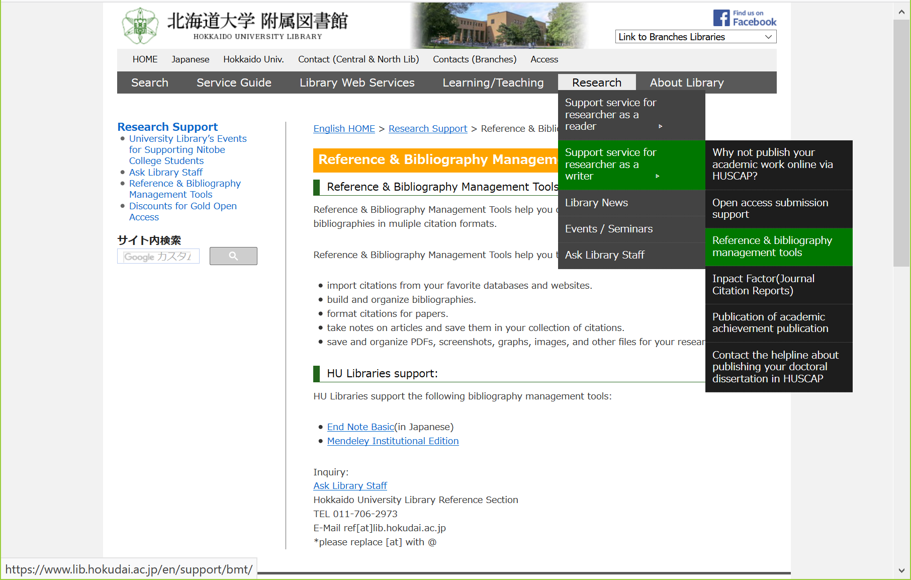
Detailed Information
on Hokkaido University Library’s website
https://www.lib.hokudai.ac.jp/en/support/bmt/

Slide 29
TRY
LATER
AND
ASK
ME
ANYTIME:
kitacam@lib.hokudai.ac.jp

