Slide 1
Northern Campus Library
Afternoon Talk
Impact Factor and Improved Access to Papers
July 2018

Slide 2
Afternoon Talk on
Impact Factor and Improved Access to Papers
■ Impact Factor (Journal Impact Factor : JIF)
Definition and Calculation Method
How to find out JIF of a journal
How to compare journals by JIF
■ Improved Access to Papers
1) Improved Access to the Papers you wrote
- Library services for publishing open access
2) Improved Access to the Papers you refer to
- Useful browser plugins to expedite your access to papers
* I will explain the above based on access to papers from the campus (HINES).

Slide 3
What is Journal Impact Factor (JIF)?
One of the metrics on journals based on citations,
that deals with the journals within “Science Citation Index Expanded”
and “Social Science Citation Index” of Web of Science
×a metric on papers
×a metric on researchers
×a metric on humanities journals
Clarivate Analytics calculates JIF for each year,
and announces its latest version as "update of JCR" in the following June or July.
JIF is displayed in Web of Science (WoS),
and its detailed information is found in Journal Citation Reports (JCR).
The latest version (2017 JIF : released in June 2018)
covers 11655 Journals
classifies journals in 234 research fields
newly includes citations from books
  https://clarivate.com/blog/news/clarivate-analytics-releases-JCR-2018

Slide 4


How to calculate Journal Impact Factor
The Journal Impact Factor of a journal in a certain year is
the average number of the citations
that the papers published in the previous 2 years received in the year.
* JIF is granted after three and a half years since its first issue.
600 times cited
650 times cited
400 times cited
150 papers
published
140 papers
published
160 papers
published
2014
2015
2016
2017
2018
(650+400)/(140+160)
=1050/300
=3.5 ← this journal’s 2017 JIF
released
in June or July

Slide 5
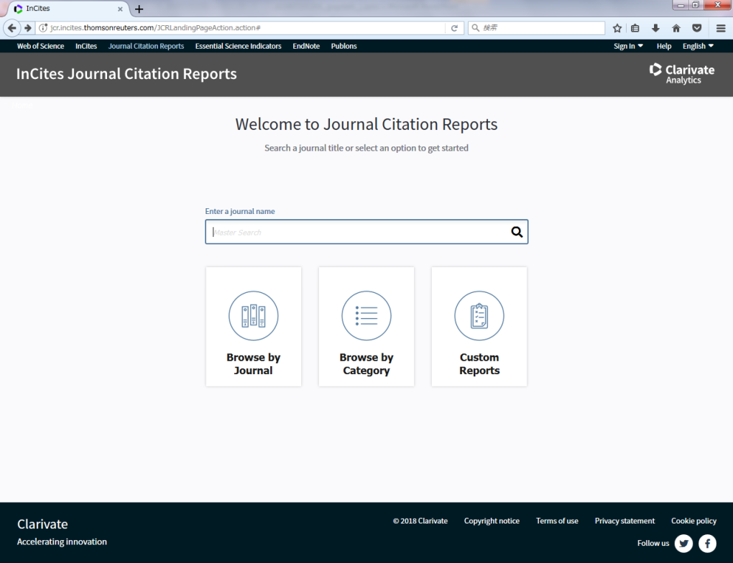
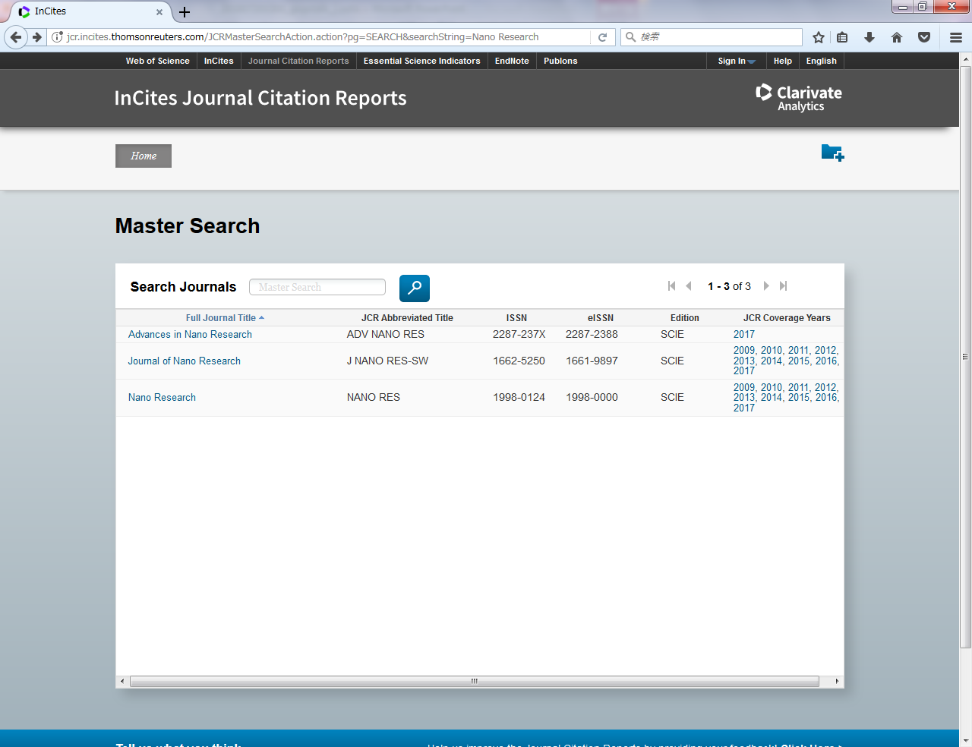
Find out Journal Impact Factor (1)
Directly by JCR (When you have the journal's name to know)
https://jcr.incites.thomsonreuters.com
Search Google with
“journal citation reports”
Search by entering journal title or ISSN
To Journal Profile (Current year)

Slide 6
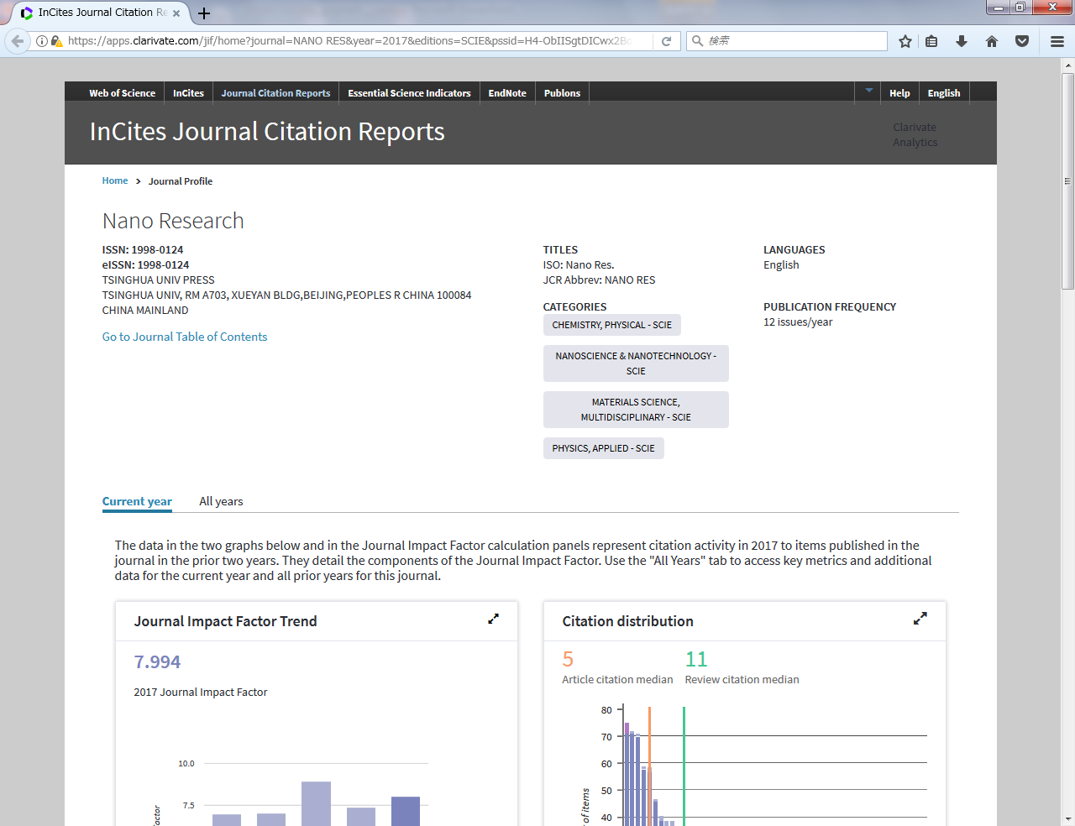
Find out Journal Impact Factor (1)
Directly by JCR (When you have the journal's name to know)
Journal Profile (Current year)
Journal Impact Factor
To Journal Profile (All years)

Slide 7
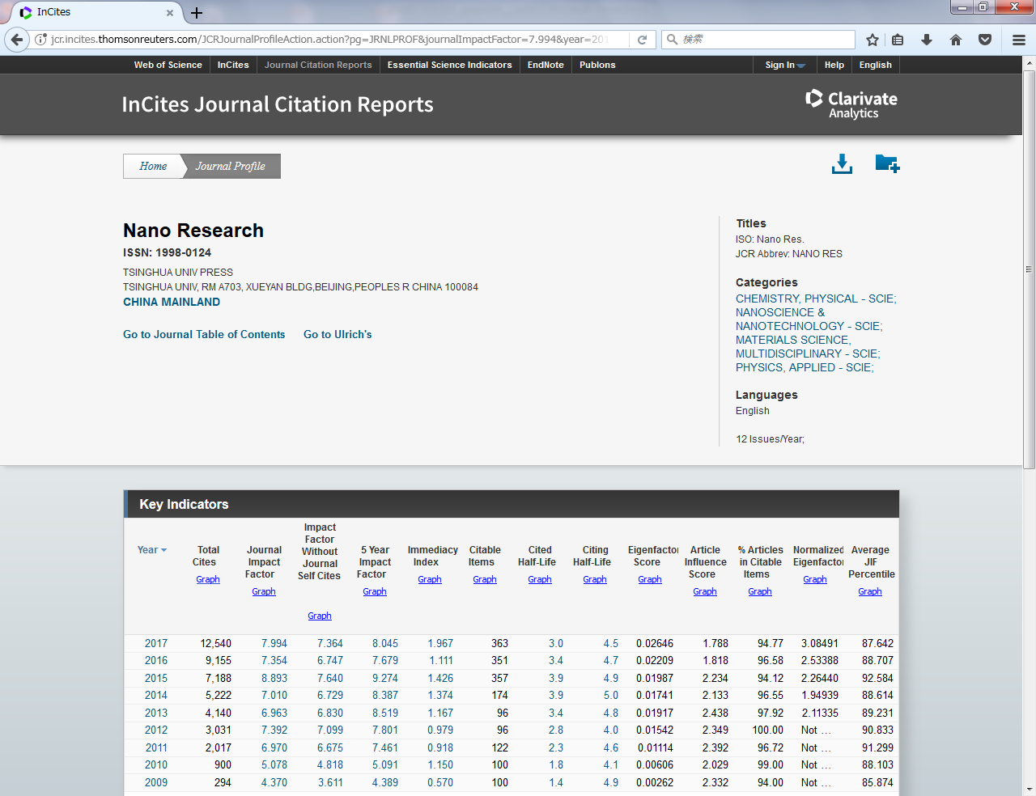
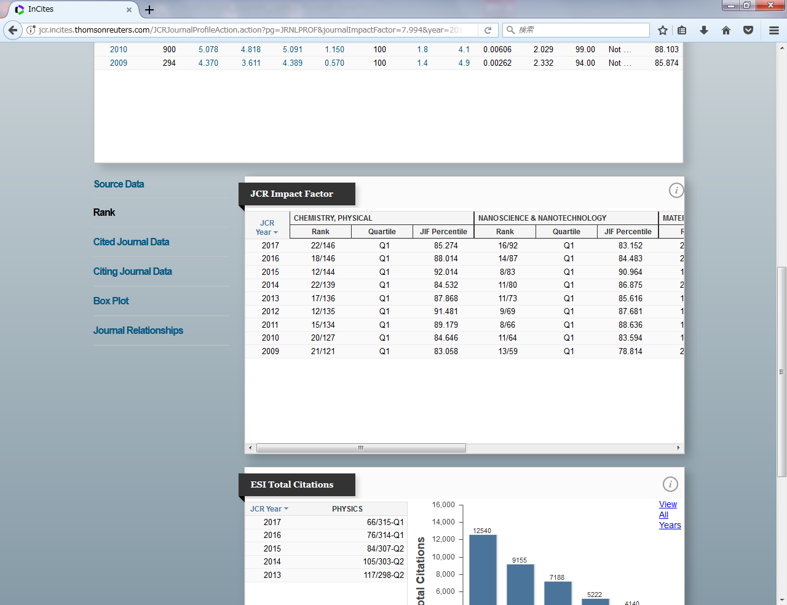
Find out Journal Impact Factor (1)
Directly by JCR (When you have the journal's name to know)
Journal Profile (All years)
“Rank” shows the position of this journal within the research field(s).
Q1 : in the top 25 %
Q2 : in the top 50 % (not included in the top 25 %)
Q3 : in the top 75 % (not included in the top 50 %)
Q4 : not include in the top 75%
This column shows the JIFs of this journal.

Slide 8
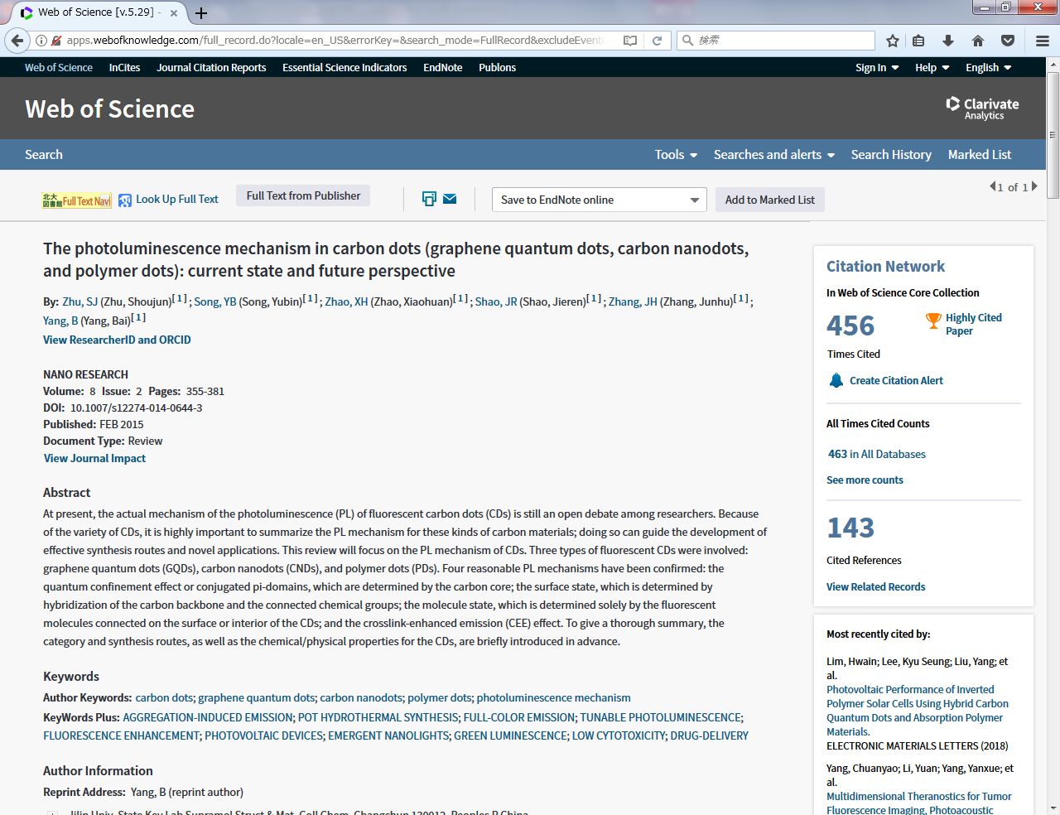
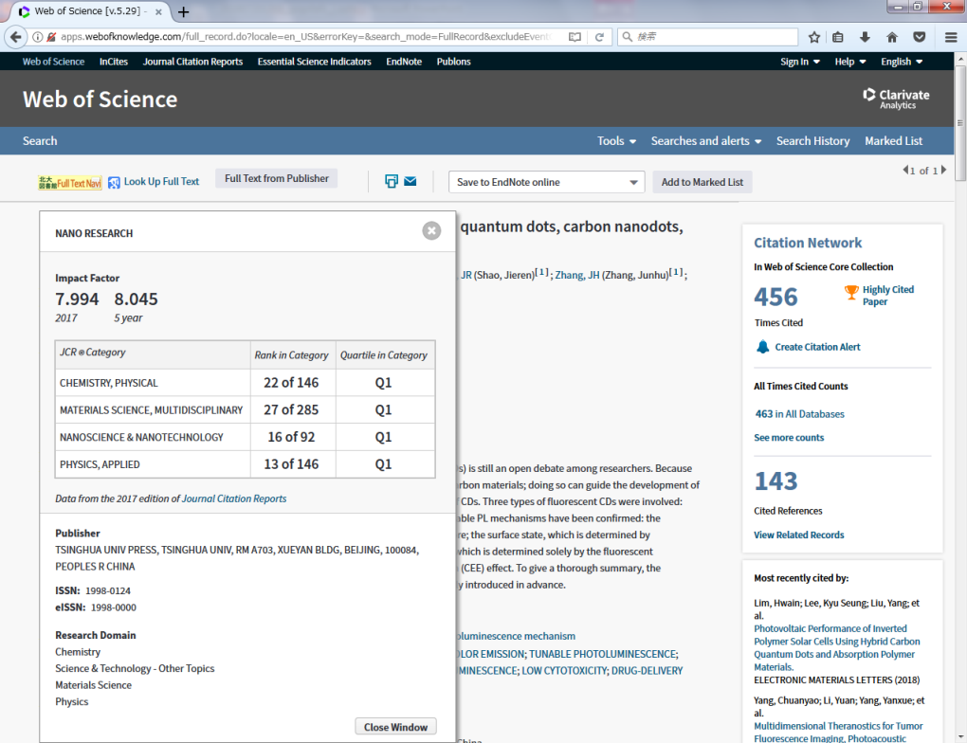
Find out Journal Impact Factor (2)
From the paper that you found in Web of Science
http://webofknowledge.com/WOS
Search Google with “web of science”
Journal Impact Factor
To Journal Profile (All years)

Slide 9
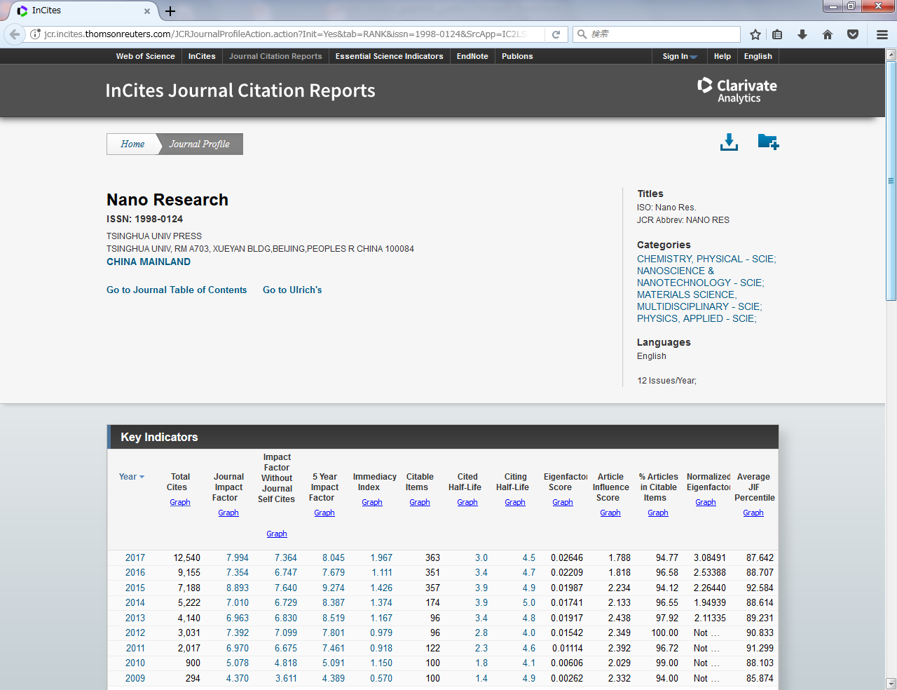
Compare journals by Journal Impact Factor
Journal Profile (All years)
In the latest version (2017 JIF),
JCR categorizes journals
into 234 research fields.
* There are also journals that are classified into multiple research fields.
When you click on one that matches your research field from "Categories",
its ranking will be displayed.

Slide 10
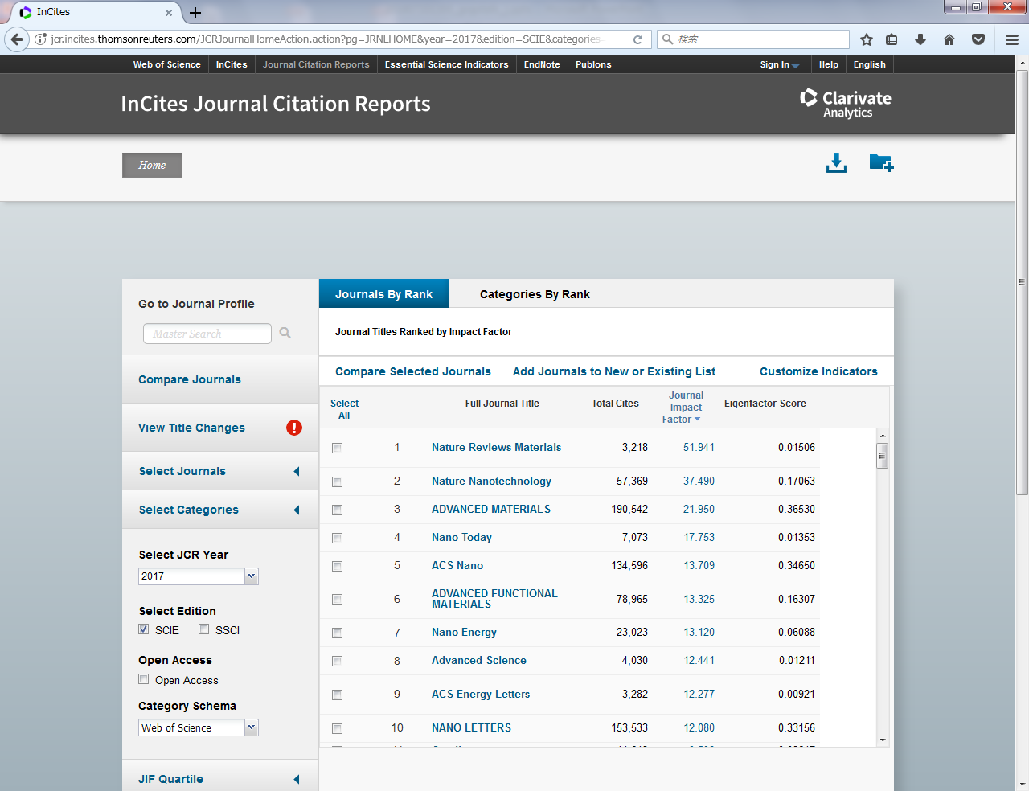
Compare journals by Journal Impact Factor
Journals By Rank
The screen displays the ranking by 2017 JIF
of the journals of "NANOSCIENCE & NANOTECHNOLOGY - SCIE”.

Slide 11
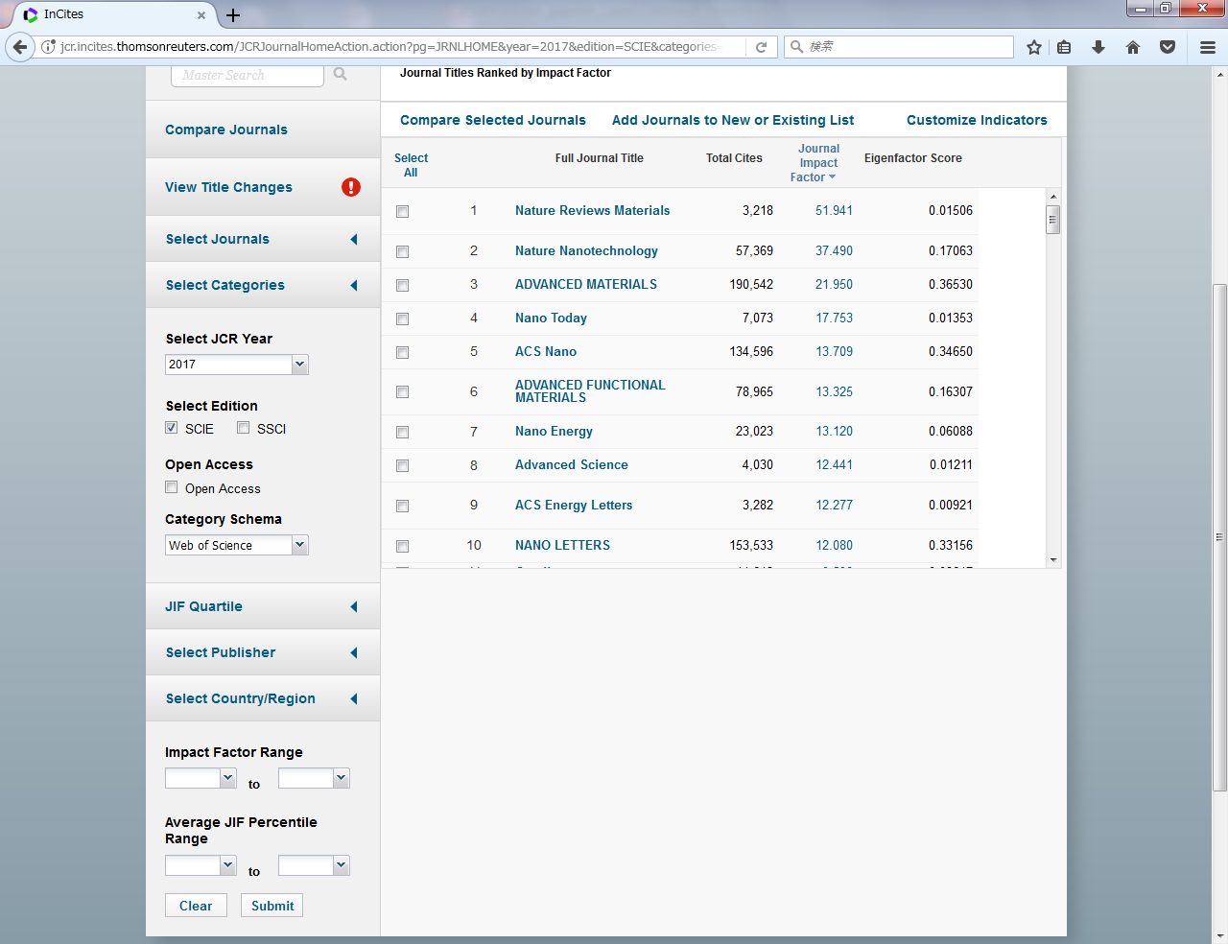
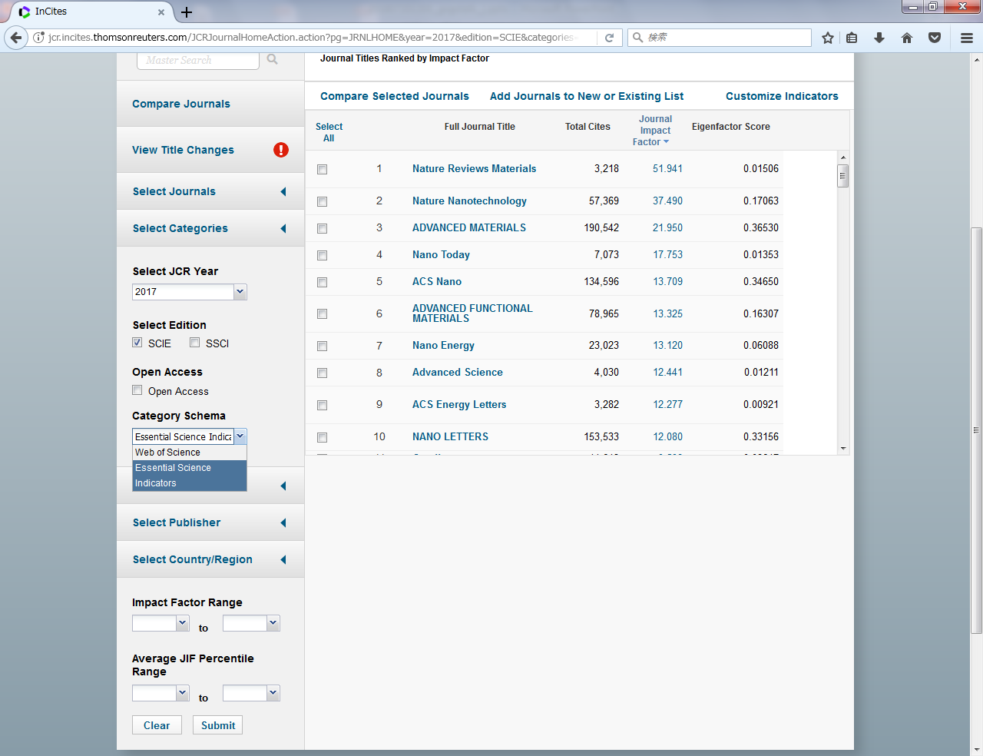
Compare journals by Journal Impact Factor
Refine journals by the range of JIFs / Expand them by 22 Research Fields of ESI
To compare in a wider range than the category of JCR,
select "Essential Science Indicators" in "Category Schema“
and select one from 22 categories in "Select Categories".
Refine
※22 Research Fields of ESI
・AGRICULTURAL SCIENCES
・BIOLOGY & BIOCHEMISTRY
・CHEMISTRY
・CLINICAL MEDICINE
・COMPUTER SCIENCE
・ECONOMICS & BUSINESS
・ENGINEERING
・ENVIRONMENT/ECOLOGY
・GEOSCIENCES
・IMMUNOLOGY
・MATERIALS SCIENCE
・MATHEMATICS
・MICROBIOLOGY
・MOLECULAR BIOLOGY & GENETICS
・MULTIDISCIPLINARY
・NEUROSCIENCE & BEHAVIOR
・PHARMACOLOGY & TOXICOLOGY
・PHYSICS
・PLANT & ANIMAL SCIENCE
・PSYCHIATRY/PSYCHOLOGY
・SOCIAL SCIENCES, GENERAL
・SPACE SCIENCE
Expand

Slide 12
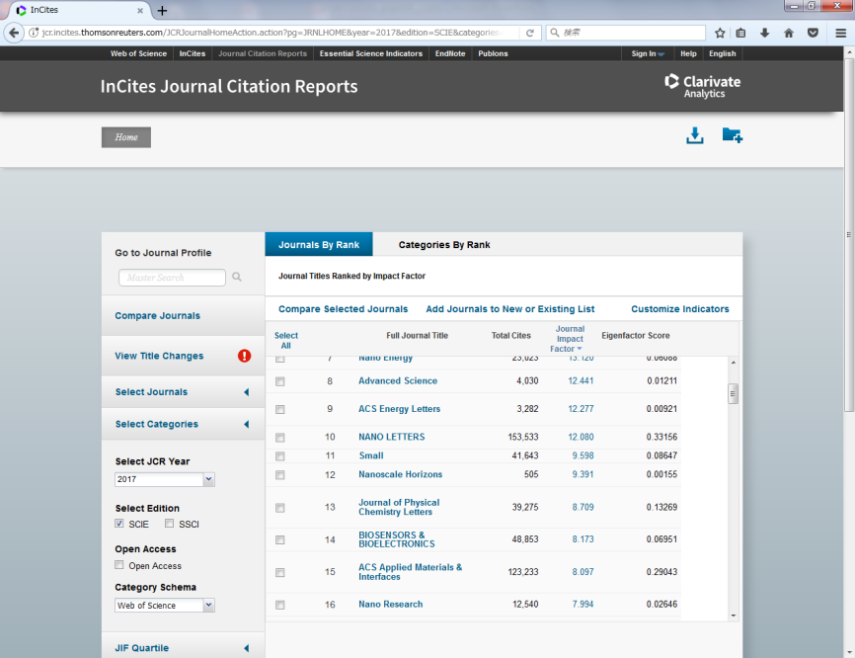
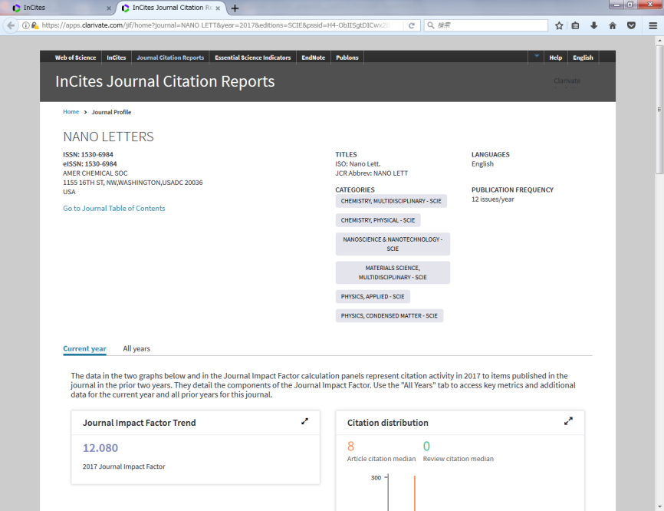
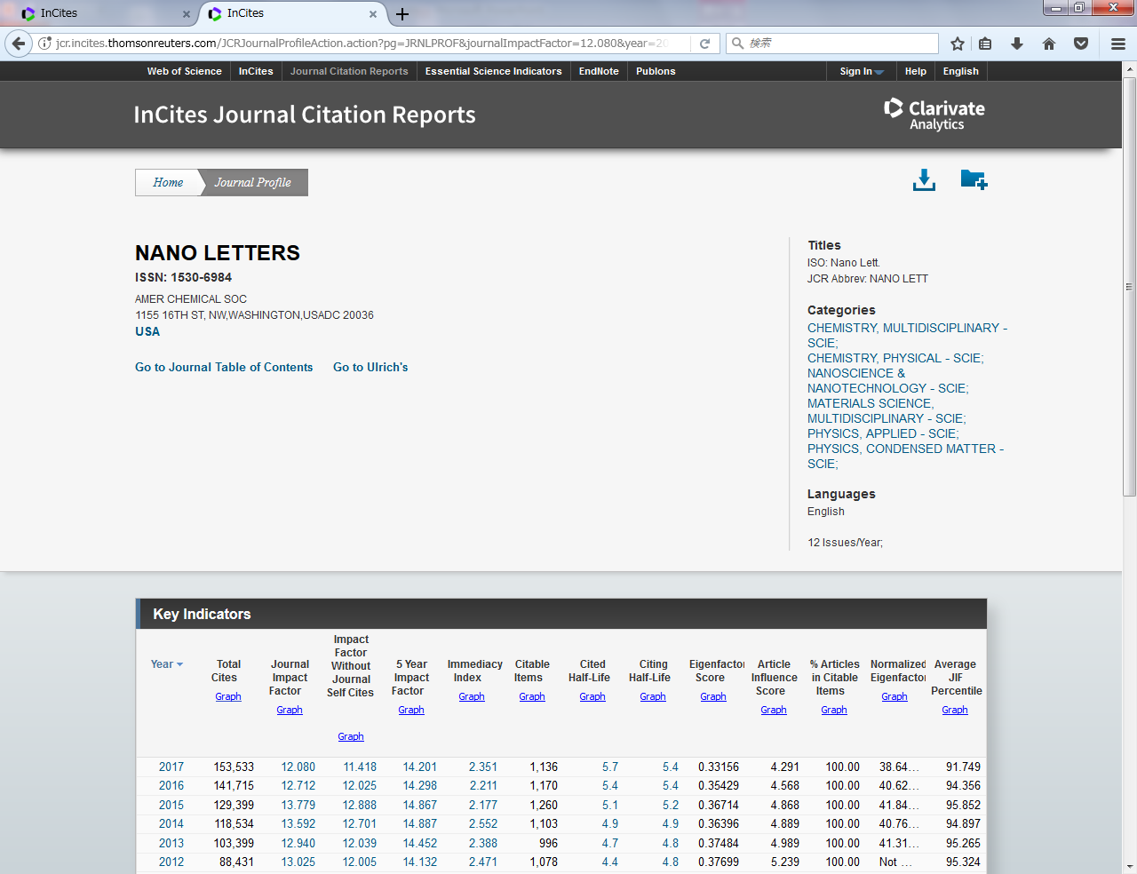
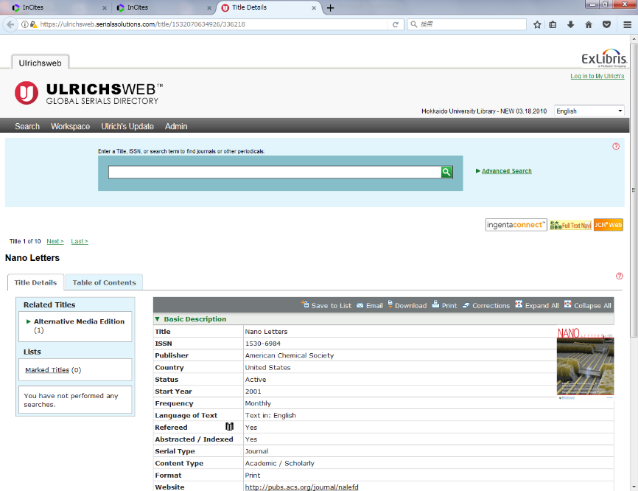
When you find an interesting journal in the ranking
You can refer to its detailed information in Ulrichsweb

Slide 13
Improved Access to Papers
1) Improved Access to Papers you wrote
Making your paper open access (OA) will increase the possibility of citing...
Library services for publishing open access
2) Improved Access to Papers you refer to
Conventional way to access to papers may have been complicated?
Useful browser plugins to expedite your access to papers

Slide 14
Improved Access to Papers you wrote
Support for publishing open access
Many researches and studies support a citation advantage for OA papers.
The Open Access Citation Advantage Service (OACA)
46 of 70 researches found a citation advantage for OA papers
  http://sparceurope.org/what-we-do/open-access/sparc-europe-open-access-resources/open-access-citation-advantage-service-oaca/
Research impact of paywalled versus open access papers
“OA papers have an indisputable citation advantage”
  http://www.1science.com/1numbr/
This is a simple idea, but it is difficult to cite papers that are difficult to access...
There are 2 ways of publishing OA
Gold OA
The author bears the cost for OA (APC) and publishes the paper open access.
Green OA
The author publishes
the manuscript approved by the publisher (usually the author’s final draft) after the period set by the publisher (eg. one year after publication).

Slide 15
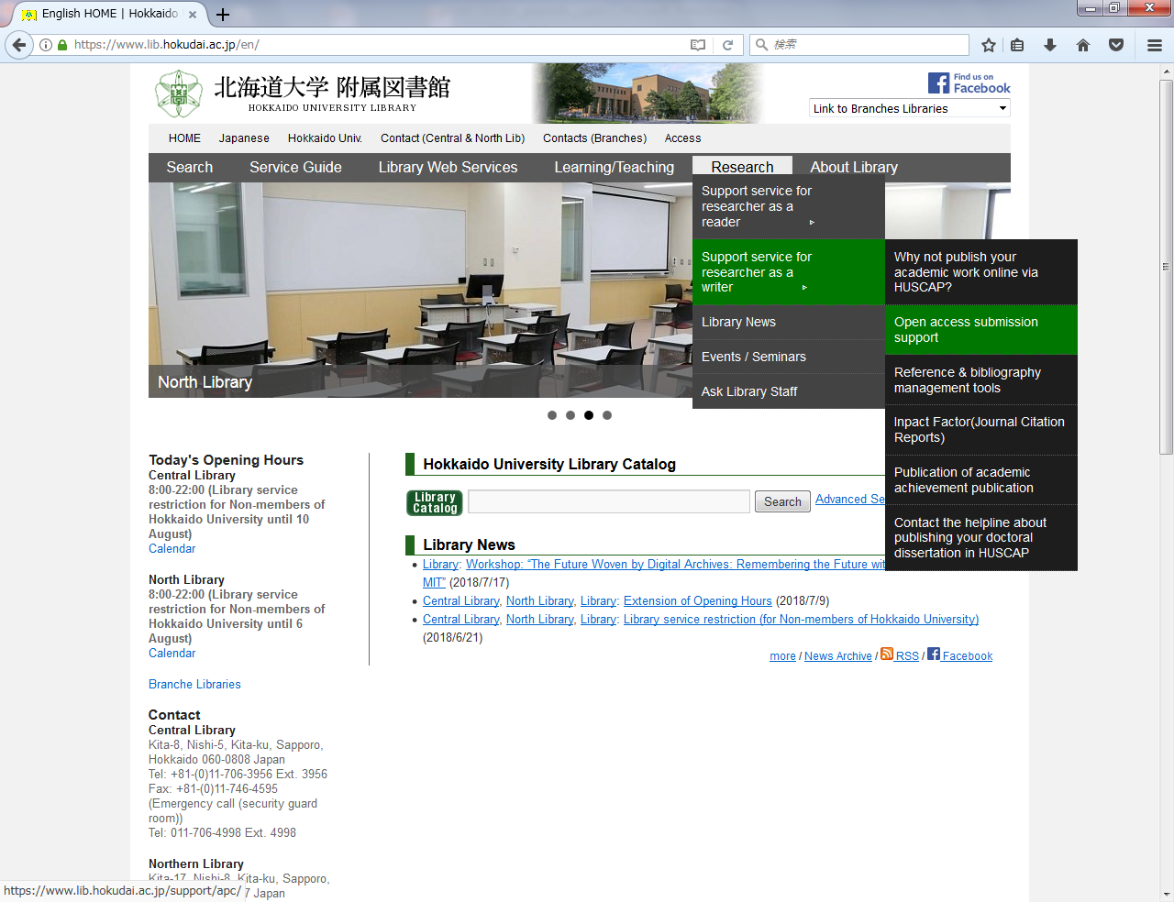
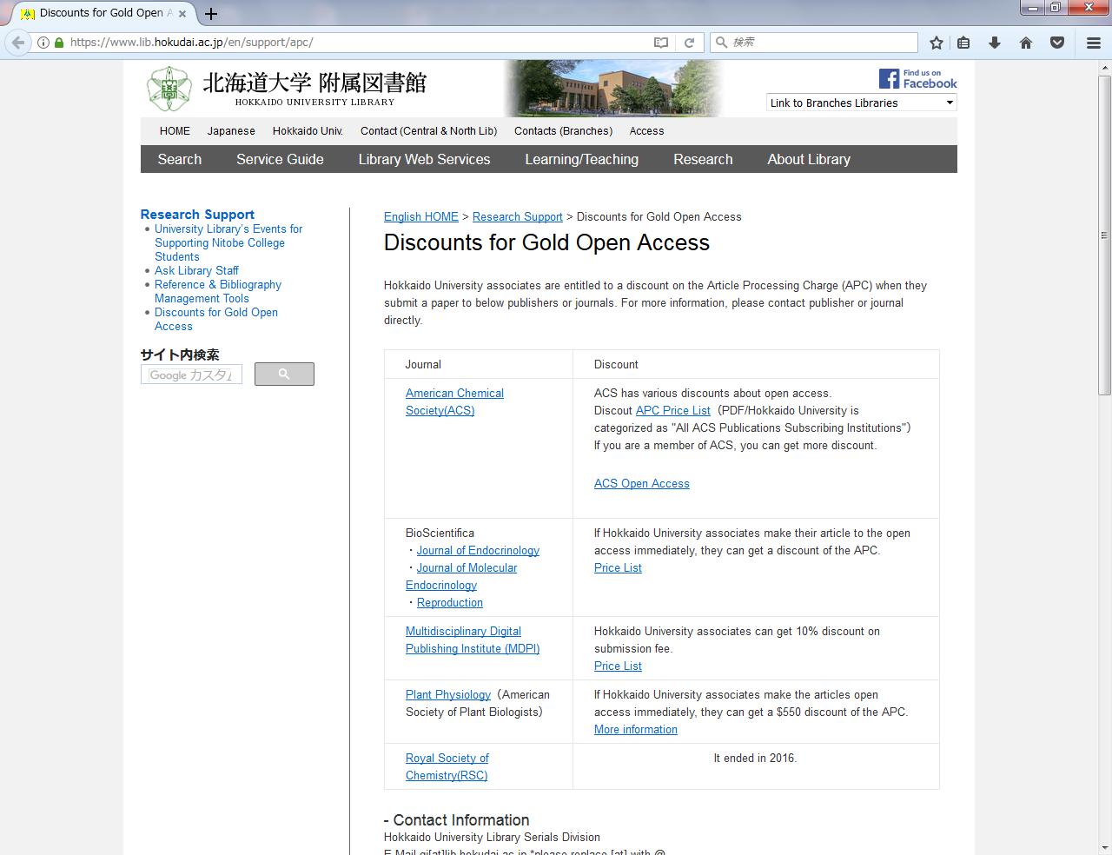
Gold OA
Information of discounts for Gold OA
https://www.lib.hokudai.ac.jp/support/apc

Slide 16
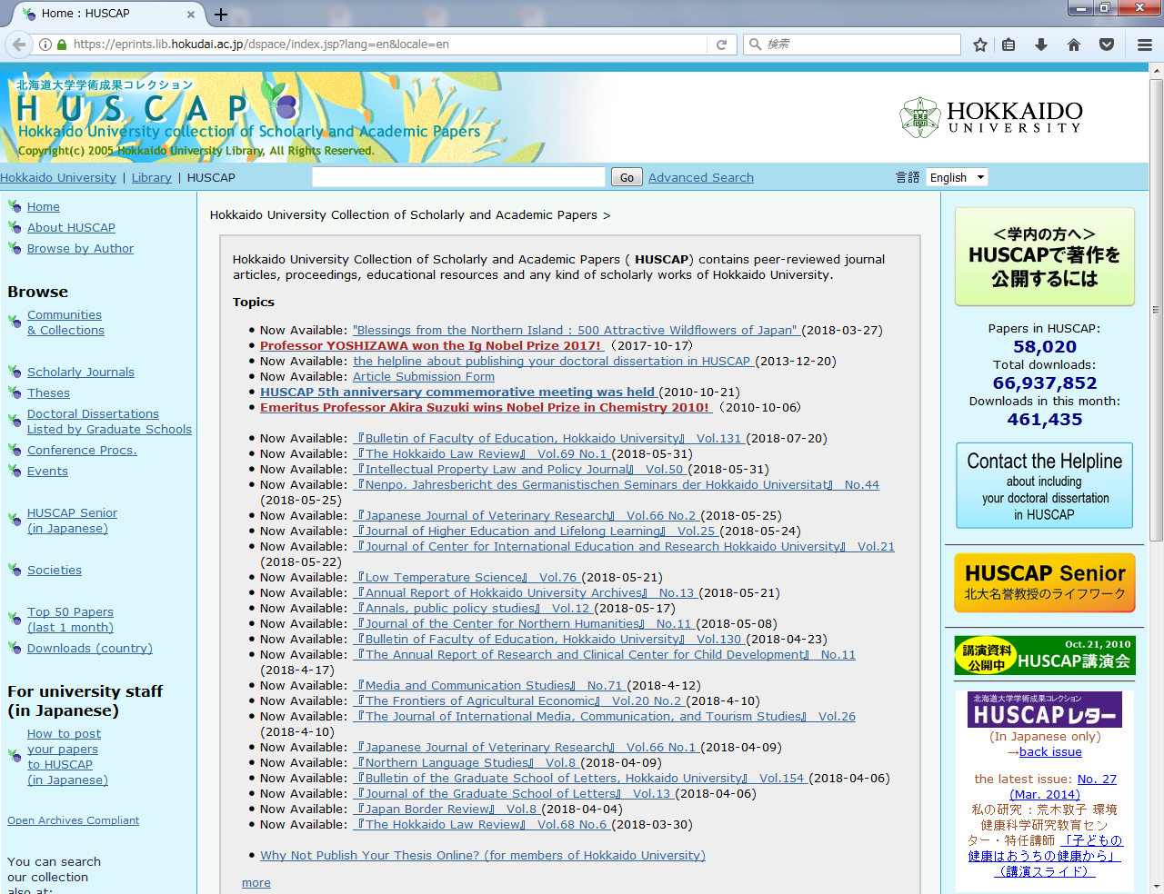
Green OA
Self-archive in HUSCAP
https://eprints.lib.hokudai.ac.jp/?locale=en&lang=en
Materials to archive are:
papers (including conference papers)
presentations (including posters)
teaching materials
made by researchers and graduate students of Hokkaido University
Key benefits are:
your papers will be discoverable from Google Scholar (also recently from Web of Science)
you receive the monthly report on the number of downloads
your works are stably and persistently archived
Library staff carries out the following archive works:
confirmation of the publisher's copyright policy
description of metadata

Slide 17
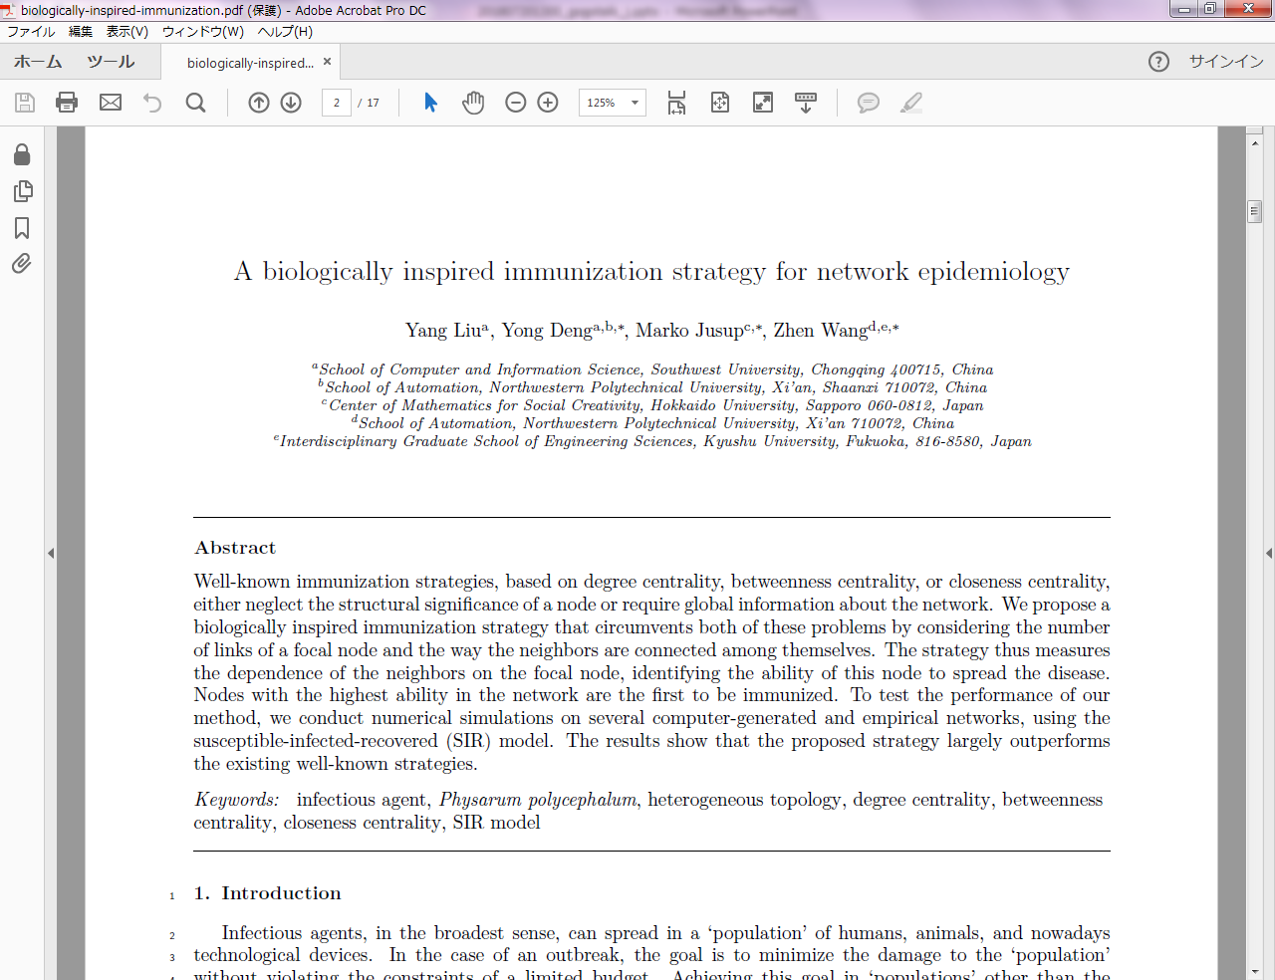
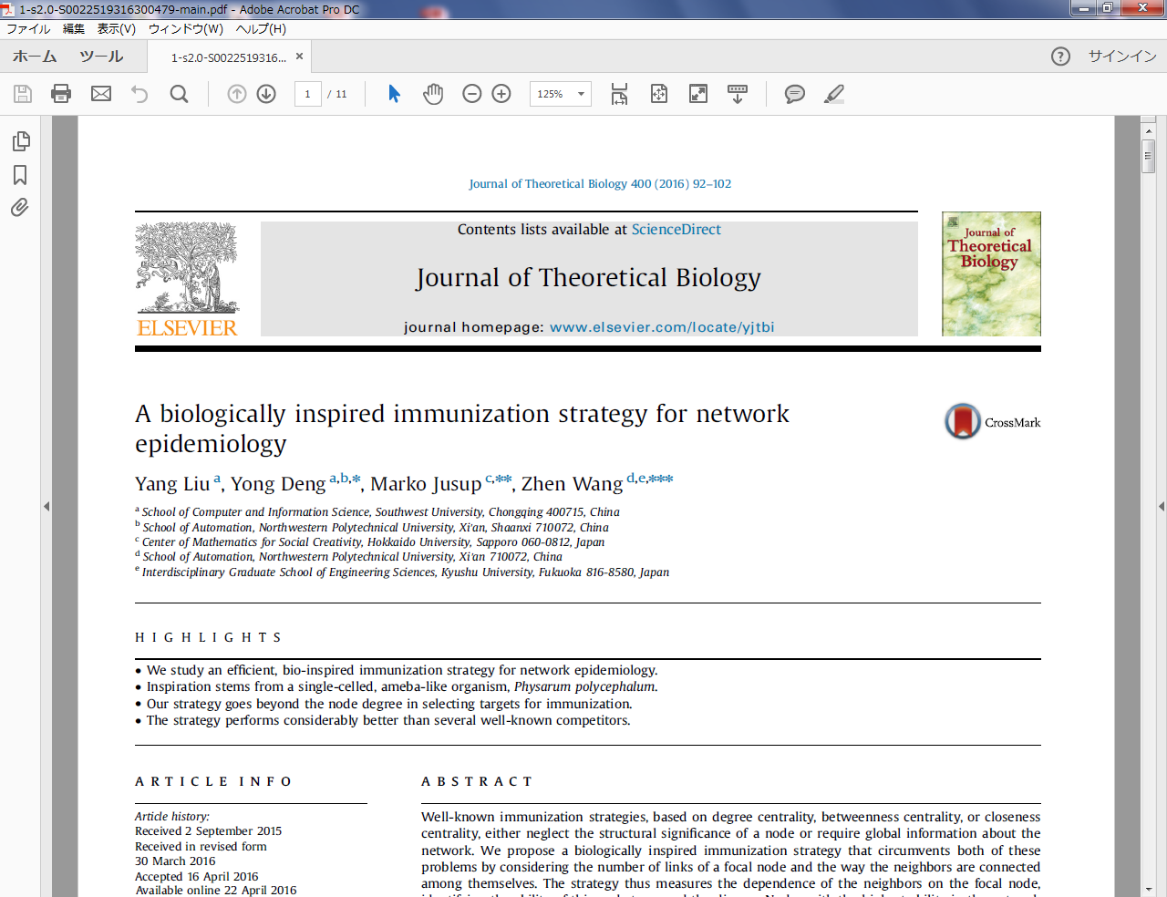
Green OA
manuscripts which can be posted in HUSCAP
○ accepted manuscript
× publisher’s version
The manuscript can be archived in the following conditions:
Word file, not PDF file
Files of texts, figures, and tables are separated
There are traces of peer review (with red letters and markers)
(Library staff arranges the appearance without changing the contents.)
* Some of the academic societies in Japan allow self-archiving of publisher version.

Slide 18
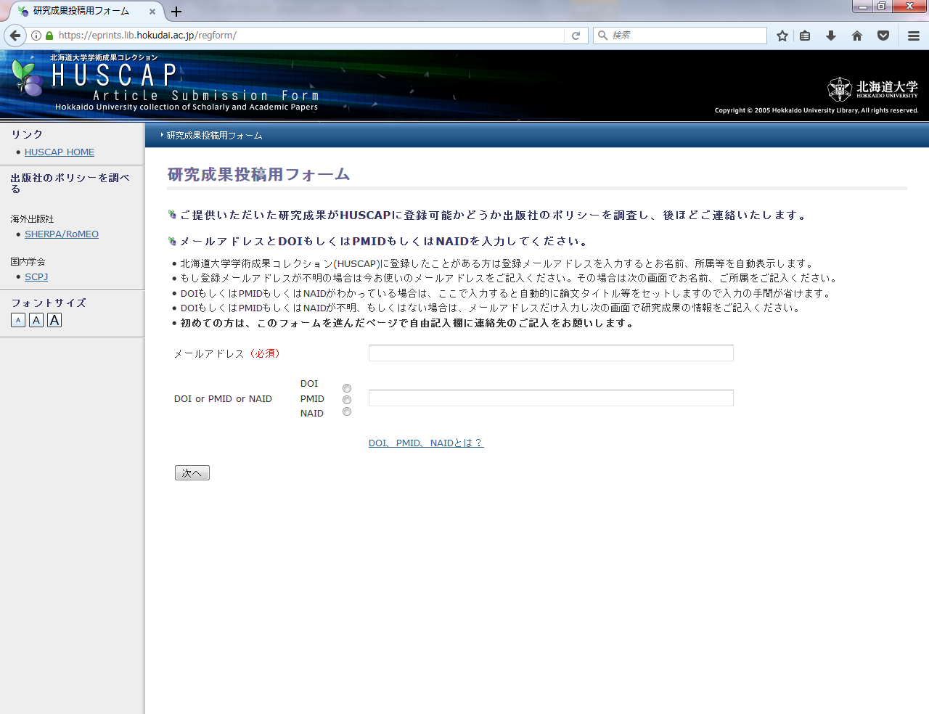
Green OA
Form for positng to HUSCAP *in Japanese only
https://eprints.lib.hokudai.ac.jp/regform *in Japanese only
Just enter
e-mail address,
name and department,
publication information
(set automatically if you enter DOI)
and attach the manuscript.

Slide 19
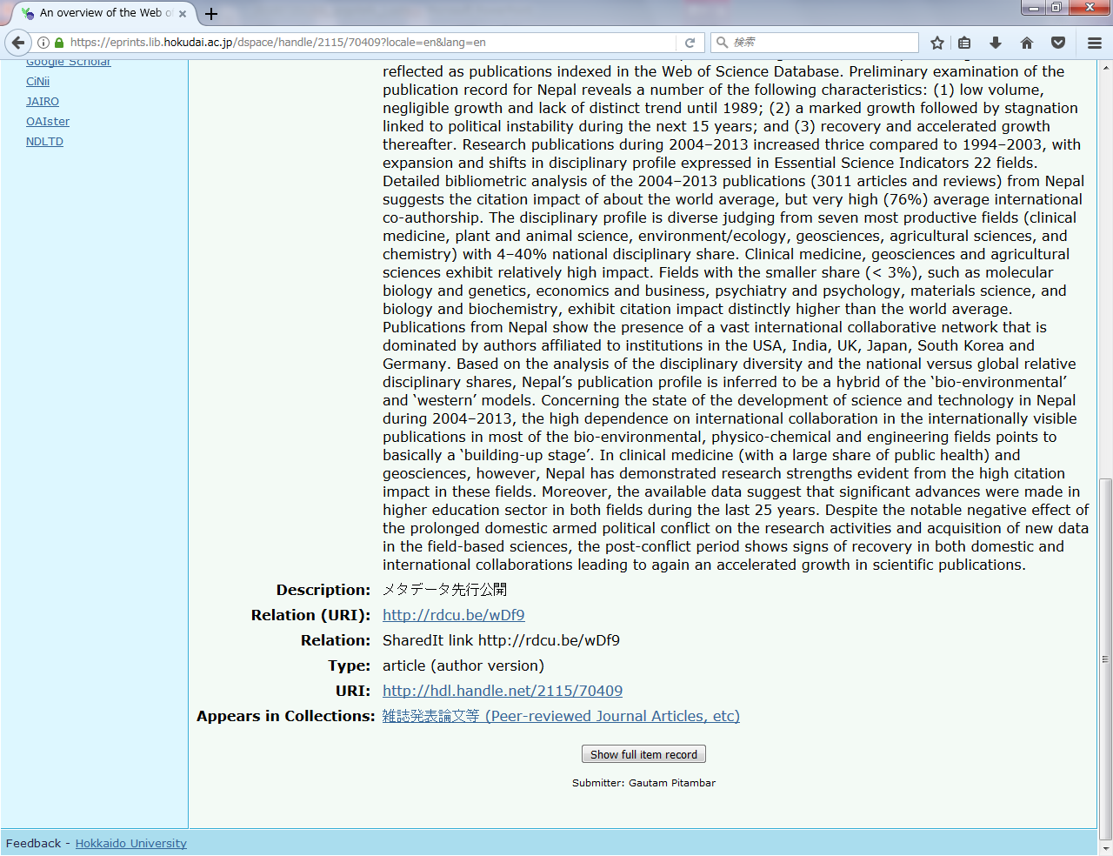
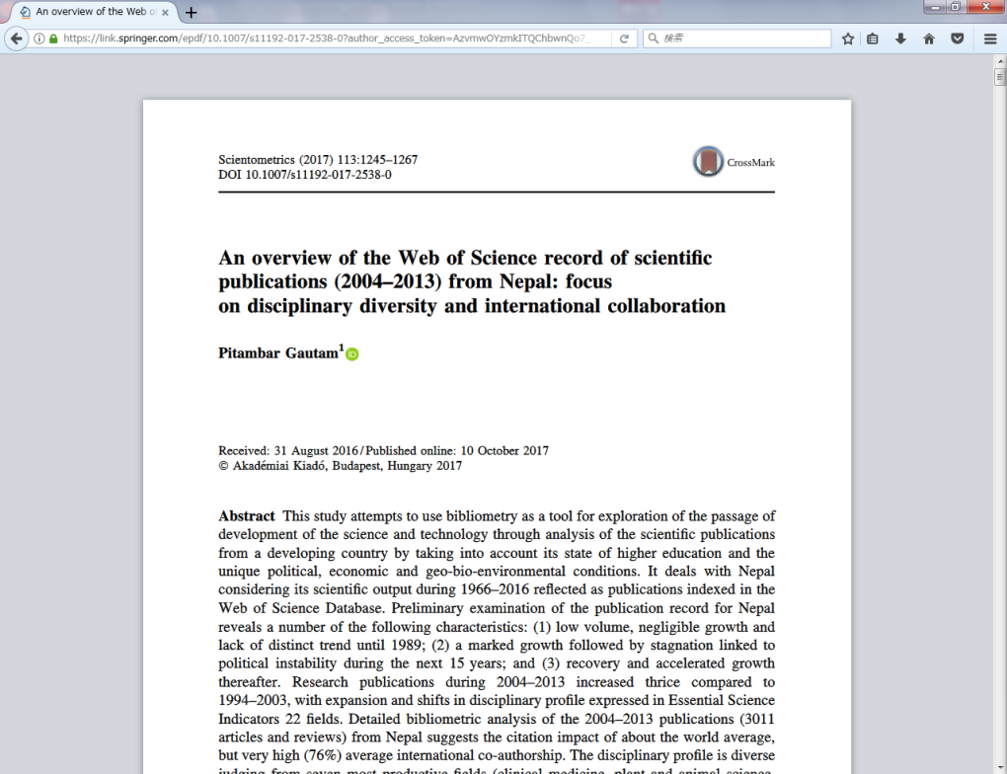
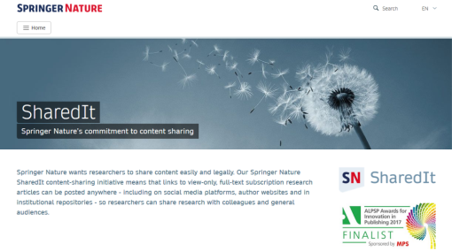
Green OA
Prior publication of metadata (from April 1, 2018)
publish only metadata before the manuscript can not be published
The link to the paper
(which can be viewed only)
acknowledged by the publisher such as "SharedIt"
can be open prior to the publication of the author's final draft.

Slide 20
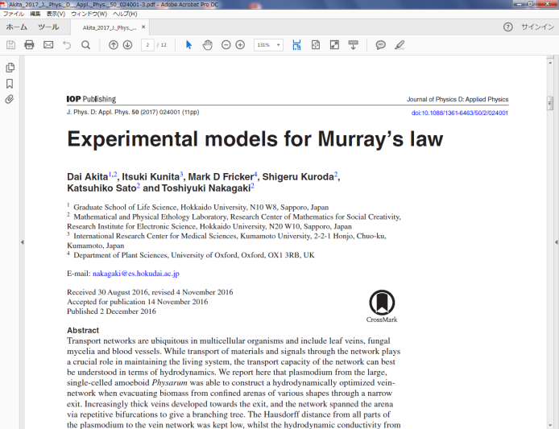
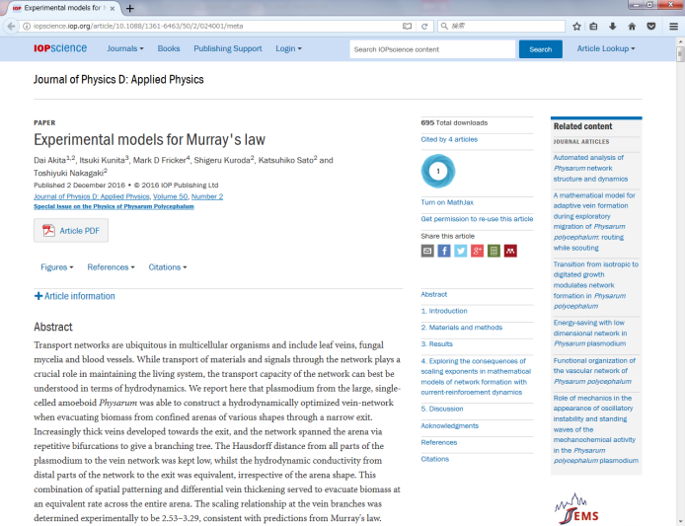
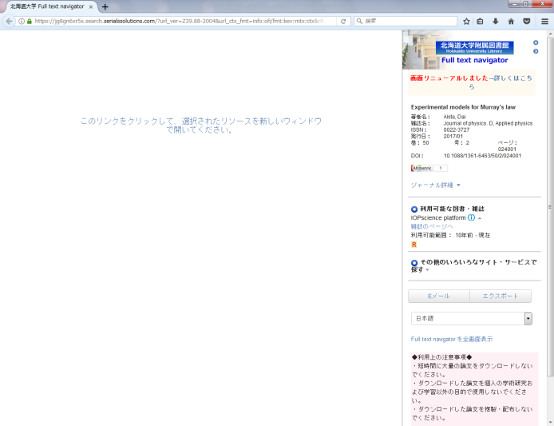
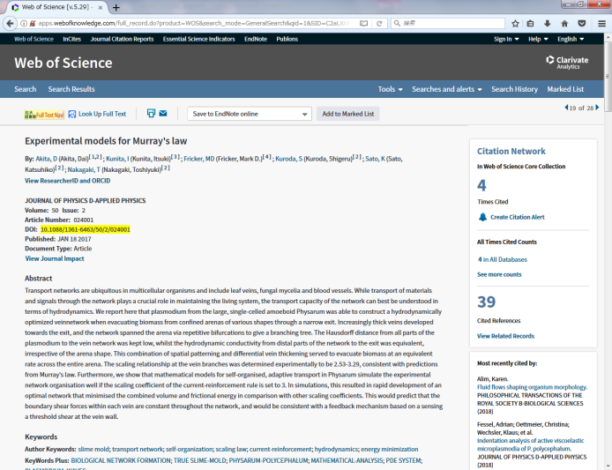
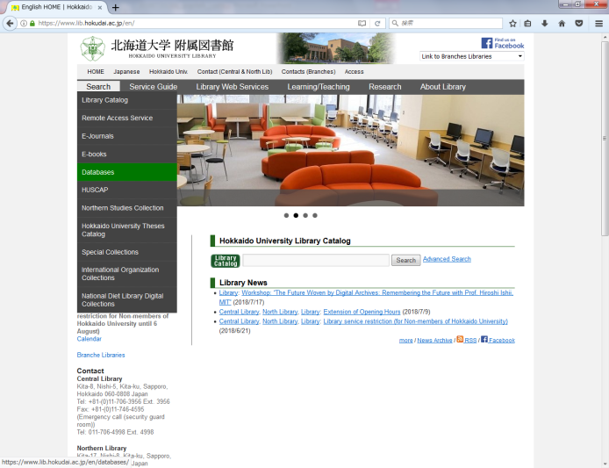
Improved Access to Papers you refer to
Too many inputs and clicks to access PDFs?
In the case of Utrecht University,
more than 75% of the papers downloaded from Sci-Hub
could have been read legally (subscribed by the university or OA ) ...
https://im2punt0.wordpress.com/2016/06/20/sci-hub-access-or-convenience-a-utrecht-case-study-part-2/
Access to the PDFs assumed by library staff
too complicated and too long?

Slide 21
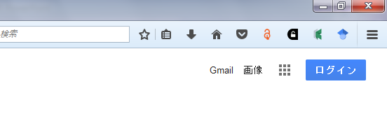
Useful browser plugins
to reduce inputs and clicks for access to PDFs
Reduce inputs
・Google Scholar Button
Reduce clicks
・Kopernio
Find the OA version when the university does not subscribe the paper
・Unpaywall
・Open Access Button
* Every plugins does not always work perfectly

Slide 22
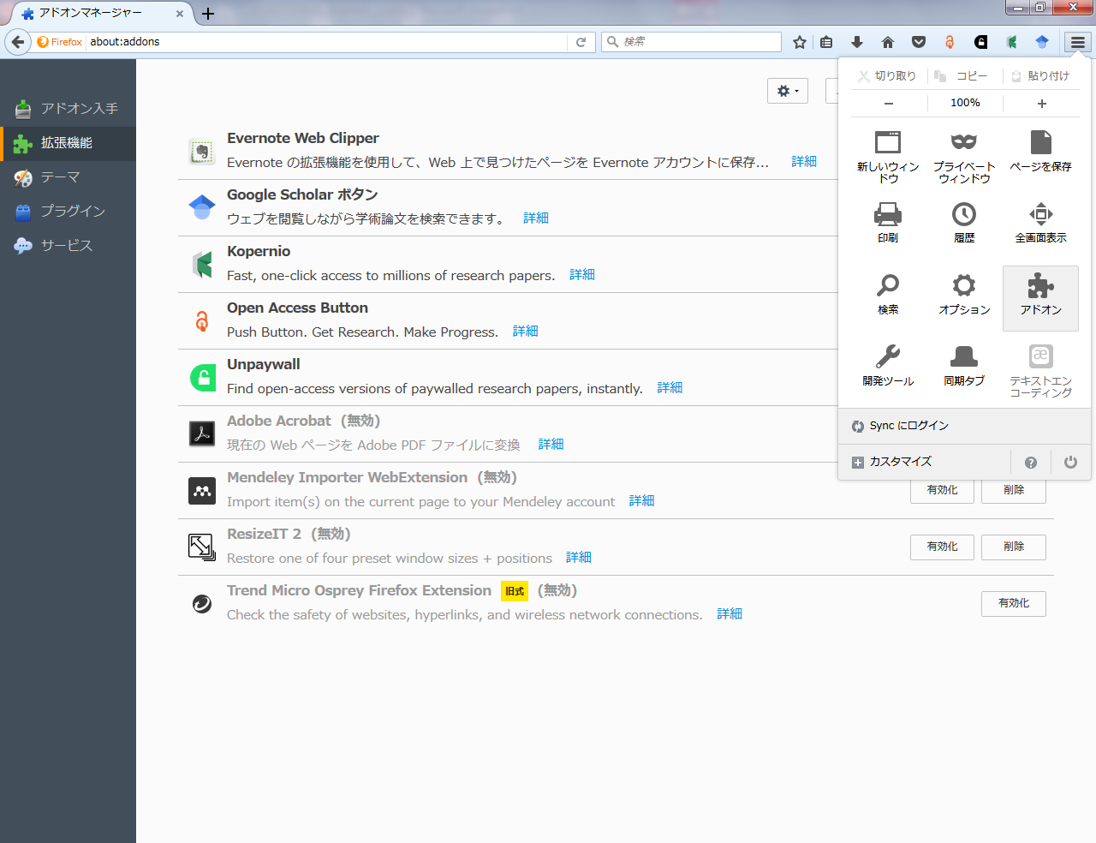
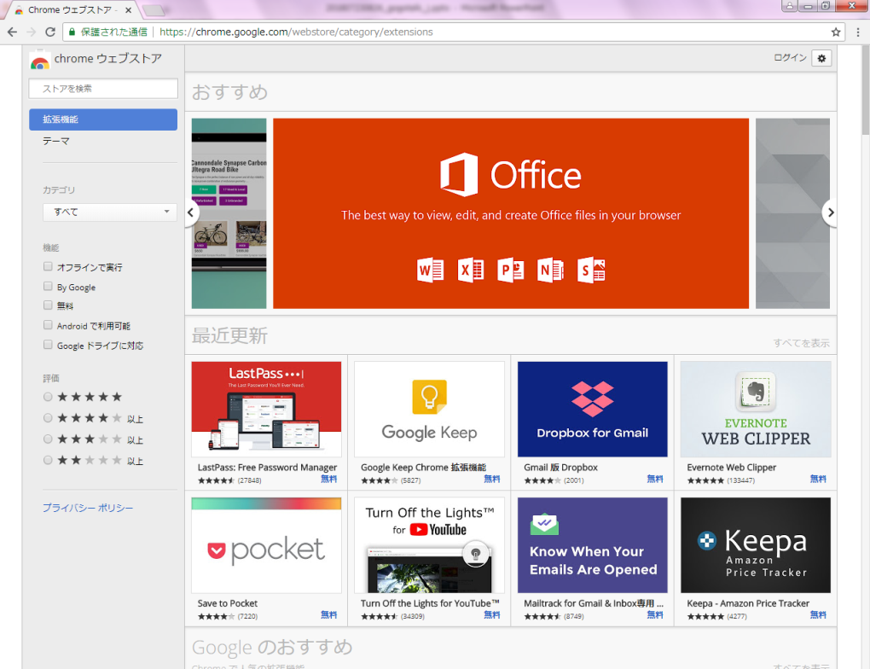
Get browser plugins (Firefox / Chrome)
Firefox
Chrome
Search here
Search here
From the button at the top right of the browser
* Only Kopernio is added from only its website:
https://kopernio.com
From https://chrome.google.com/webstore

Slide 23
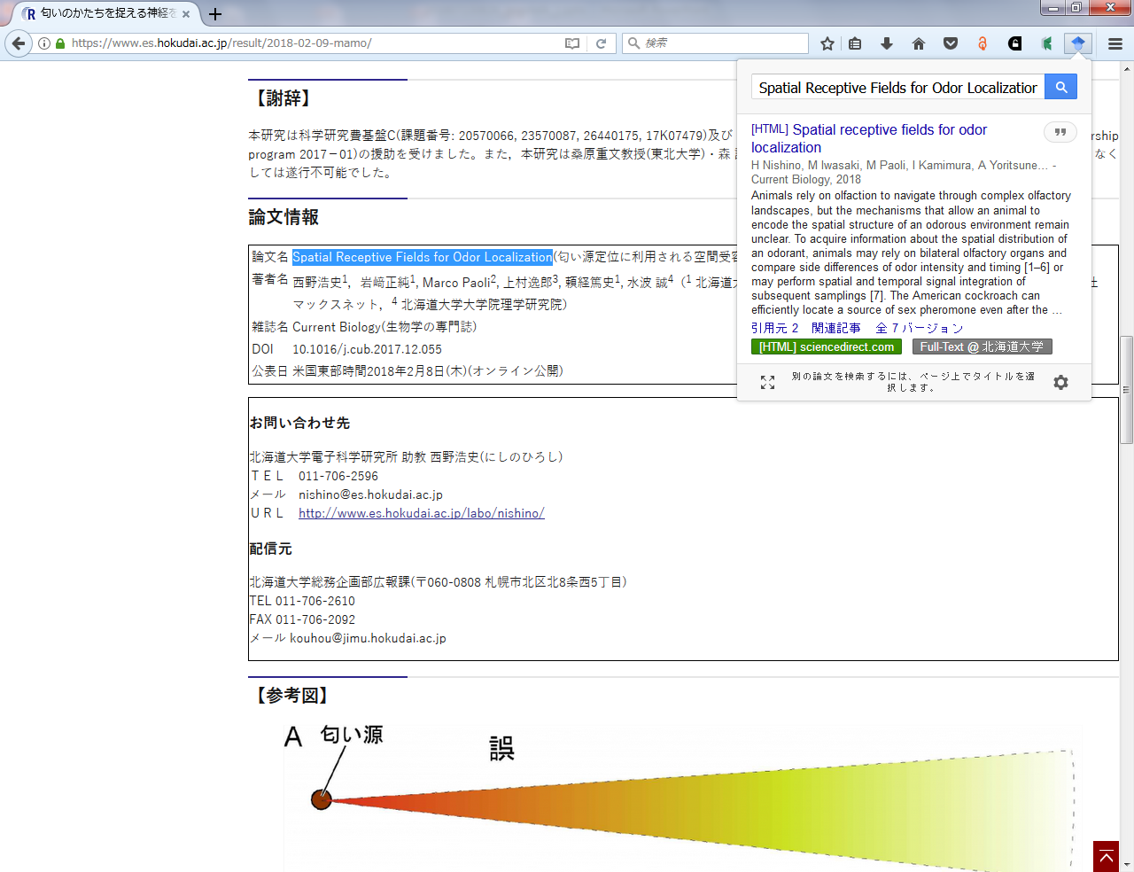
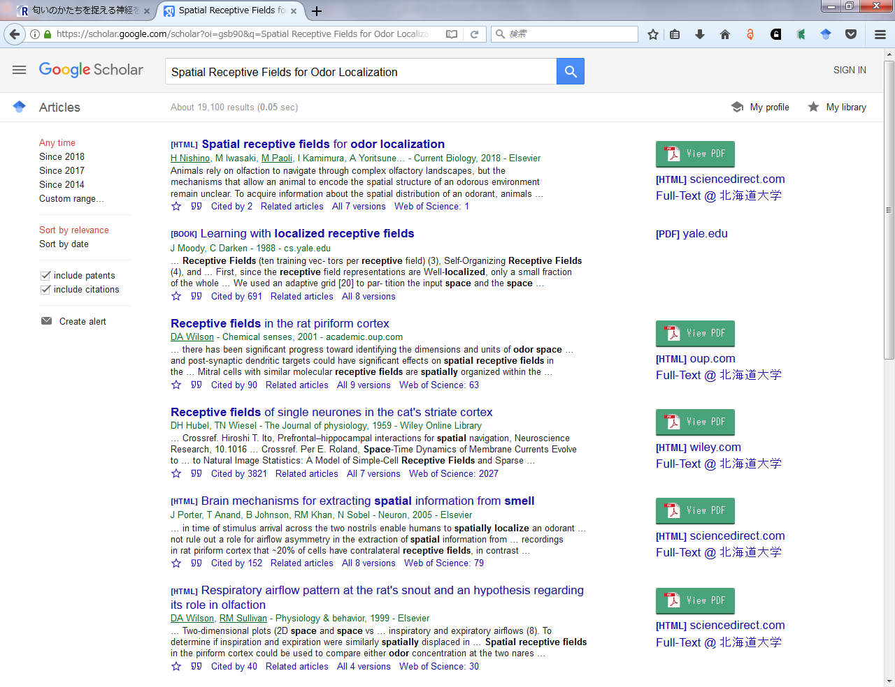
Google Scholar Button
<https://scholar.google.com>
From browsing seamlessly to search for papers
Just select some letters (eg. a title of a paper) and press the button, Google Scholar search begins.
To the paper’s website

Slide 24
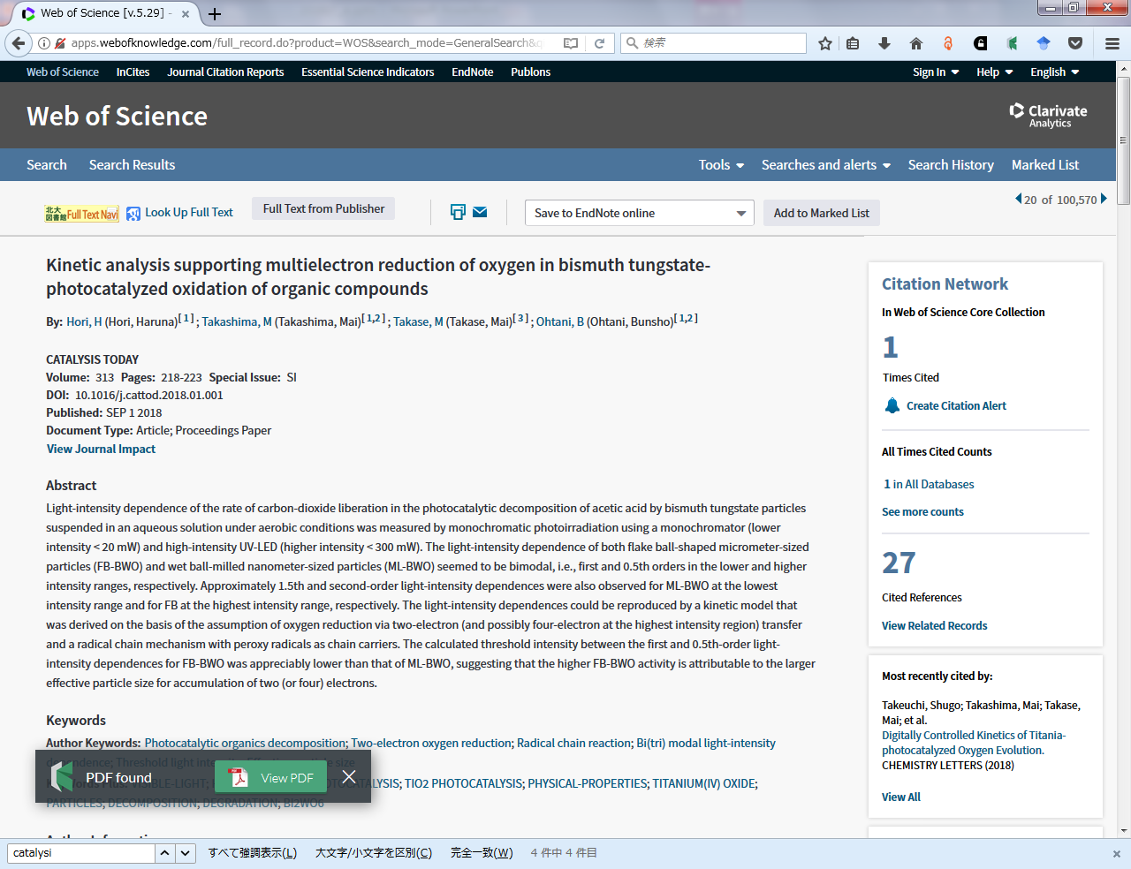
Kopernio
<https://kopernio.com>
Automatically find the subscribed paper (or OA version) during the paper search
In Google Scholar and PubMed you can see the Kopernio’s results on the search result screen.
Although the operation is sometimes unstable yet,
This plugin saves the ID / PW of “Remote Access Service” in the browser,
so you can access the papers subscribed by the university immediately from outside the campus
if you only set the above ID / PW once.
* Choose "Hokkaido University" when creating an account!

Slide 25
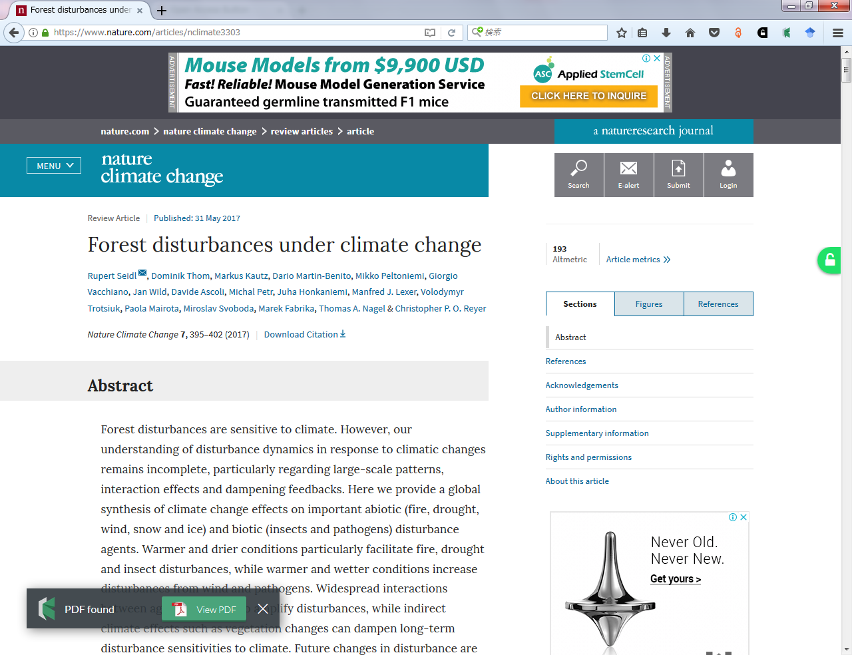
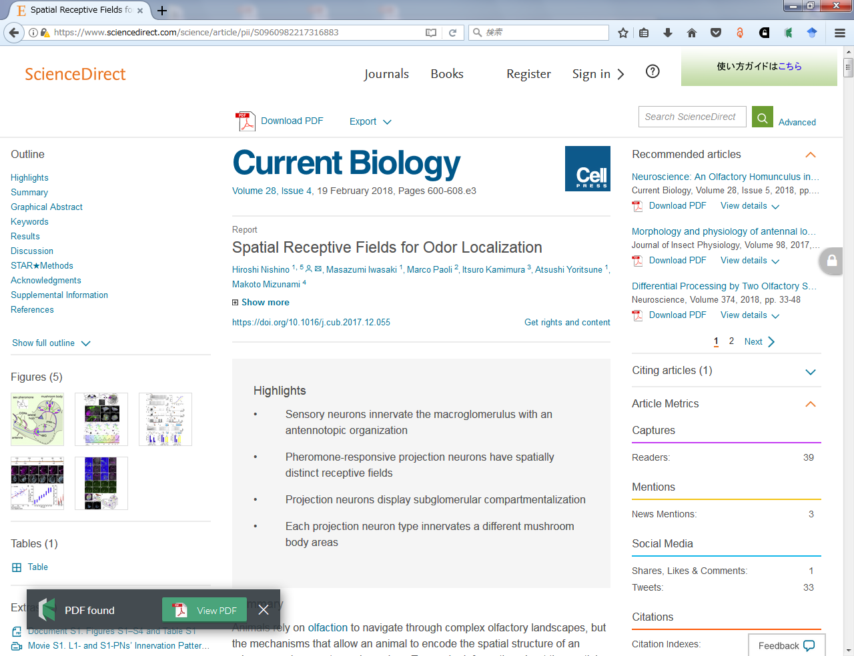
Unpaywall
<https://unpaywall.org>
Display whether you can access the OA version or not
You can download the OA version from here
You cannot access the OA version
* However, you can read the publisher’s version if the university subscribes it

Slide 26
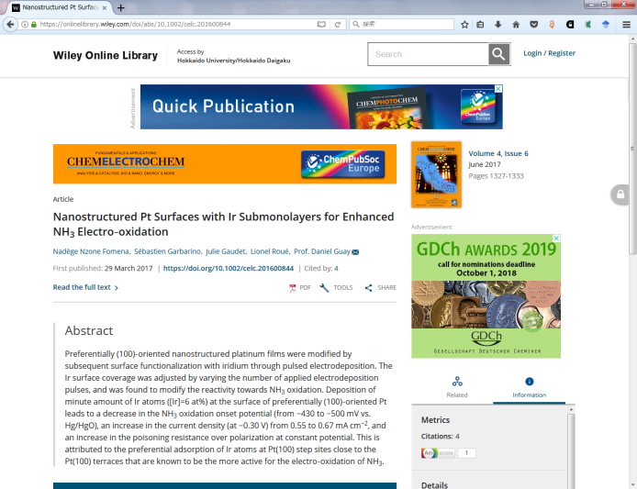
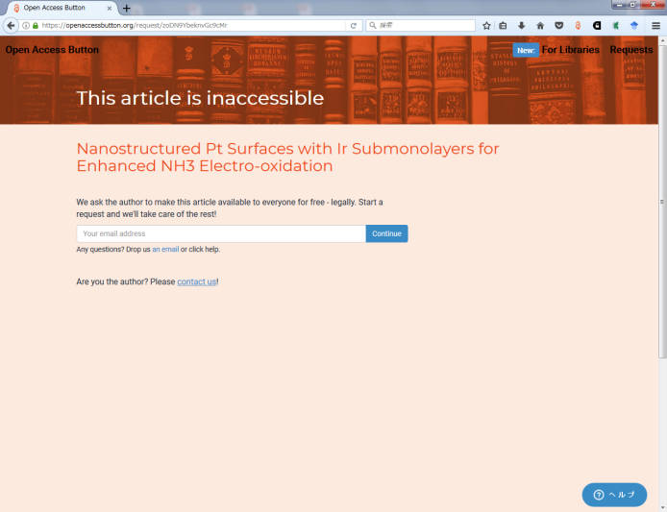
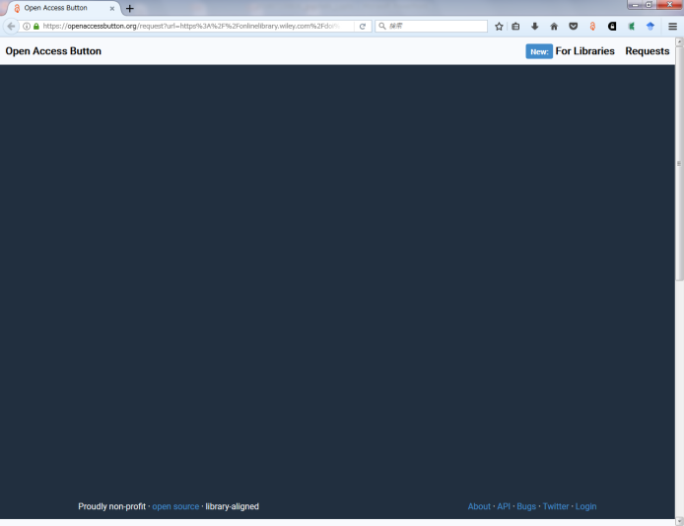
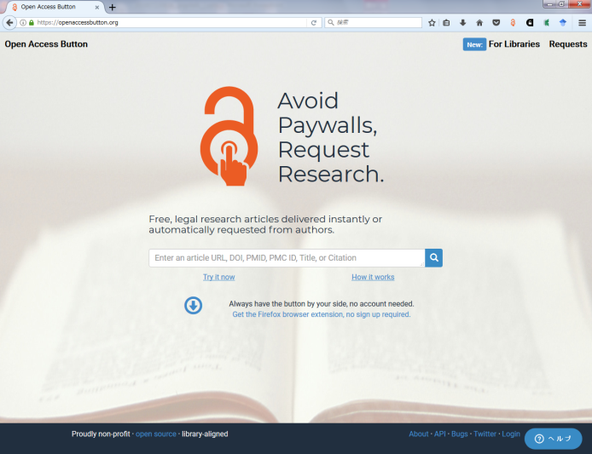
Open Access Button
<https://openaccessbutton.org>
If the OA version is available, download it / if not, request the author to self-archive
I try to verify that it immediately shifts to the request screen
like the green arrow, but it does not work well.
Go to the top page <https://openaccessbutton.org> like the red arrow
and enter the DOI etc, and you will switch to the request screen.

Slide 27

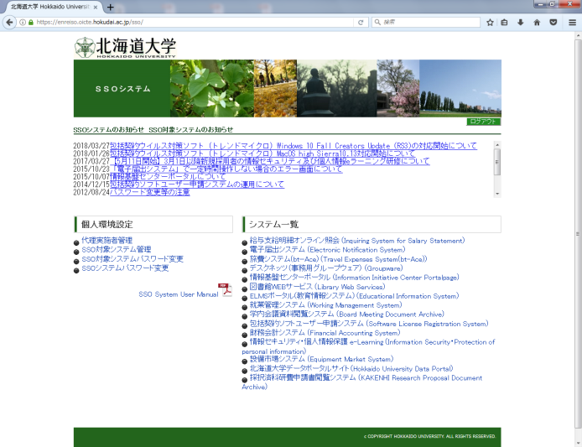


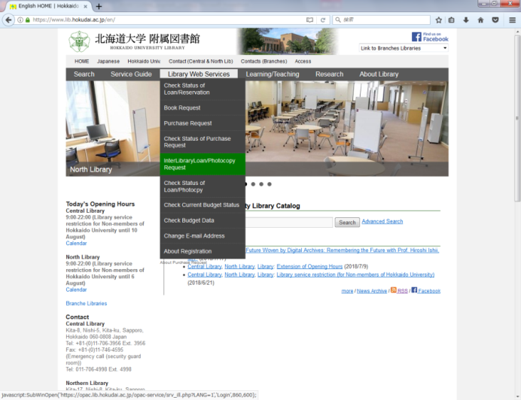

Get a photocopy of papers via Northern Campus Library
(chargeable)
If you use the public operational expenses (Ippan-Un’ei-Zaigen),
you can get a photocopy of the materials in the university libraries in PDF format (e-DDS).
In campus
laboratory
Northern Campus Library
almost all
libraries
Off campus
libraries

Slide 28
TRY
LATER
AND
ASK
ME
ANYTIME:
kitacam@lib.hokudai.ac.jp

