Slide 1


International Open Access Week 2018 Program
at Northern Campus Library, Hokkaido University, Japan
Afternoon Talk on
Open Access and Predatory Journals
                October 2018
                Hokkaido University
                Northern Campus Library

Slide 2
Afternoon Talk on Open Access and Predatory Journals
1. Predatory Journals, Open Access, and us
2. Open Access
3. Predatory Journals
4. Not to be involved in Predatory Journals
1. Know their features
2. Check the whitelists by the scholarly publishing industry
3. Check the scholarly literature databases
which have selection criteria
4. Check blacklists
5. Verify the metrics which the journals express by themselves
5. Literacy, calm, and communication are important

Slide 3
1. Predatory Journals, Open Access, and us
Predatory Journals (in Japanese : 粗悪学術誌, ハゲタカジャーナル)
- intend for only revenue from publication fee paid by authors
> abuse of the business model for Open Access Journals
- Their peer review is poor/inappropriate, or not done,
and the quality of published papers is not guaranteed
It has become a hot topic in the press of the Mainichi Shimbun in Japan
  * The red underlined parts are trial translations of the headlines
- 粗悪学術誌 : ネットで急増 査読ずさん，掲載料狙いか 2018-04-03
  Predatory Journals rapidly increase on the Internet and take away publication fee through poor peer review.
- 粗悪学術誌 : 日本から5000本 東大や阪大 論文投稿，業績水増しか 2018-09-03
  Predatory Journals published 5000 papers of Japanese institutes, such as Univ. of Tokyo and Osaka Univ, which researchers might use for padding their performance.
> Hokkaido University is the 7th largest in Japan (74 papers in nearly 15 years)
- 粗悪学術誌 : 九大が対策 国内初 投稿巡り注意喚起 2018-09-03
  Kyushu Univ. takes measures against Predatory Journals the first in Japan, or calls its researchers’ attention to posting papers.
- 粗悪学術誌 : 対策に大学本腰 聞き取り，投稿ルール 掲載上位の名大，新潟大 2018-10-10
  Universities are serious against Predatory Journals. Nagoya Univ. will interview the researchers who submitted papers to those journals. Niigata Univ. will set a rule on posting papers.
> For details, search “Maisaku (毎索)” for “粗悪学術誌”
https://dbs.g-search.or.jp/WMAI/WMAI_ipcu_login.html

Slide 4
2. Open Access
To publish research works on the Internet
and make them available for free by everyone
Open Access rate of papers of Hokkaido University
- 20% of papers published in 1998 > 40% in 2017
Although it has fallen recently at first glance, it will rise after the embargo period
(1 - 2 years) which publishers set
Publication Year
We can check whether a paper is open access on Web of Science by collaborating with ImpactStory (accessed 2018-10-18)
Search Criteria : Indexes=SCI-E, SSCI, A&HCI Document Types=Article, Review Organization-Enhanced=Hokkaido University

Slide 5







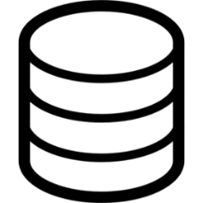

2. Open Access
Green Open Access
Publisher
Readers
Accept
Reviewer
Editor
Proofread
Author
Readers
Author’s final manuscript
Institutional
repository
HUSCAP
> Please send your final manuscript
to HUSCAP https://eprints.lib.hokudai.ac.jp
Library staff will check the copyright and register
To: repo@lib.hokudai.ac.jp
in many cases, after 1 - 2 years since publication

Slide 6
2. Open Access
Gold Open Access
Publisher
Readers
Accept
Reviewer
Editor
Proofread
Author
Readers
APC : Article Processing Charge
> Discounts for Gold Open Access
https://www.lib.hokudai.ac.jp/en/support/apc

Slide 7


3. Predatory Journals
Predatory
Publisher
Readers
Accept
Reviewer?
Editor?
poor and/or
inappropriate
peer review
Proofread?
Author
Readers
APC : Article Processing Charge
Predatory publishers urge authors to post papers for the purpose of their APC
Research works through only inappropriate or poor peer review are published

Slide 8
3. Predatory Journals
Serious concerns
Doubts on the validity of research works
- The research works are less found and less evaluated
because scholarly literature databases do not collect them
- Oversights due to poor peer review may be distributed on Google, etc.
Troubles on paying APC
- Some cases where billing is more expensive than initially presented APC
Lack of publishing process
- Some cases where predatory publishers won’t respond to withdrawal of the paper
> The paper can not be posted to another journal because it becomes “dual submission”
- Doubts about permanent storage and access of the papers
Damaging social reputation of the author and his university
- We can know whose papers are published in predatory journals
because predatory journals are open access and some blacklists are made
- The cheated APC is originally a public grant

Slide 9
4. Not to be involved in Predatory Journals
1. Know their features
2. Check the whitelists by the scholarly publishing industry
- Committee on Publication Ethics (COPE)
- Directory of Open Access Journals (DOAJ)
3. Check the scholarly literature databases
which have selection criteria
- Scopus (Elsevier’s database)
- Web of Science Core Collection (Clarivate Analytics’ database)
4. Check blacklists
- Beall’s List of Predatory Journals and Publishers, and so on
5. Verify the metrics which the journals express by themselves

Slide 10
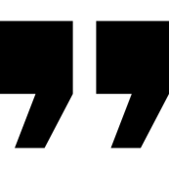
4. Not to be involved in Predatory Journals
1. Know their features
13 features of Potential Predatory Journals
Shamseer, Larissa, et al. “Potential predatory and legitimate biomedical journals: can you tell the difference? A cross-sectional comparison.” BMC medicine 15.1 (2017): 28.
https://doi.org/10.1186/s12916-017-0785-9
The scope of interest includes non-biomedical subjects alongside biomedical topics
The website contains spelling and grammar errors
Images are distorted/fuzzy, intended to look like something they are not, or which are unauthorized
The homepage language targets authors
The Index Copernicus Value is promoted on the website
Description of the manuscript handling process is lacking
Manuscripts are requested
to be submitted via email
Rapid publication is promised
There is no retraction policy
Information on whether and how journal content will be digitally preserved is absent
The Article processing/publication charge is very low (e.g., < $150 USD)
Journals claiming to be open access either retain copyright of published research or fail to mention copyright
The contact email address is non-professional and non-journal affiliated
(e.g., @gmail.com or @yahoo.com)

Slide 11
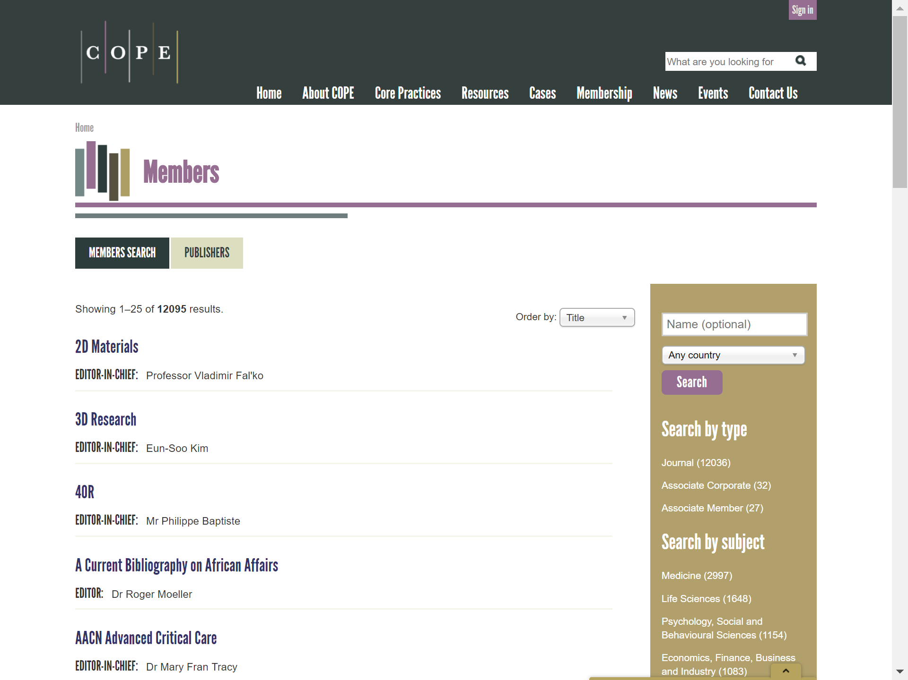
4. Not to be involved in Predatory Journals
2. Check the whitelists by the scholarly publishing industry
Committee on Publication Ethics (COPE) - Members
https://publicationethics.org/members
12,036 journals (including non-OA journals) join COPE
(accessed 2018-10-23)

Slide 12
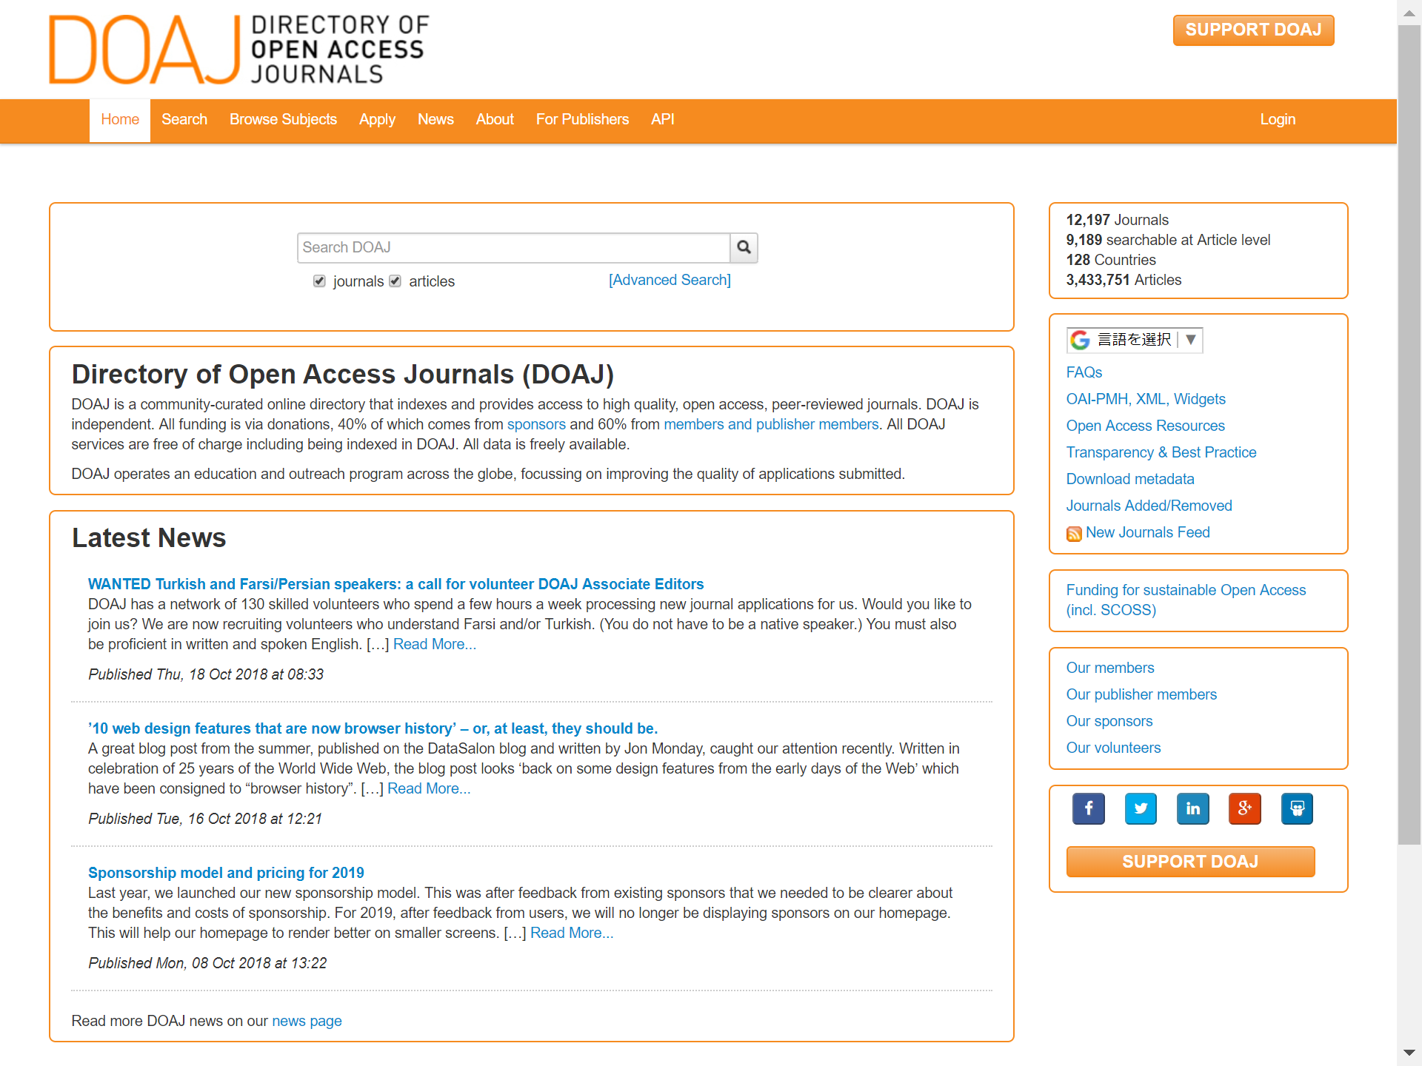
4. Not to be involved in Predatory Journals
2. Check the whitelists by the scholarly publishing industry
Directory of Open Access Journals (DOAJ)
https://doaj.org
12,917 peer-reviewed OA journals pass the rigorous screening and are registered
(accessed 2018-10-23)

Slide 13
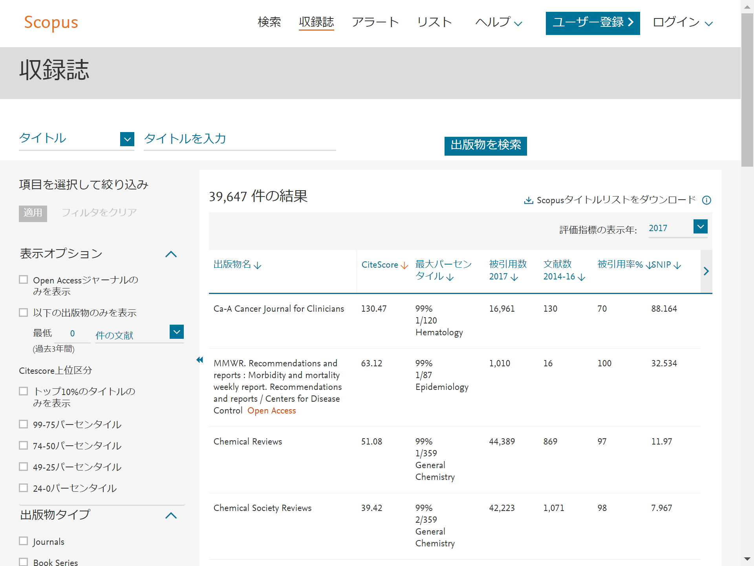
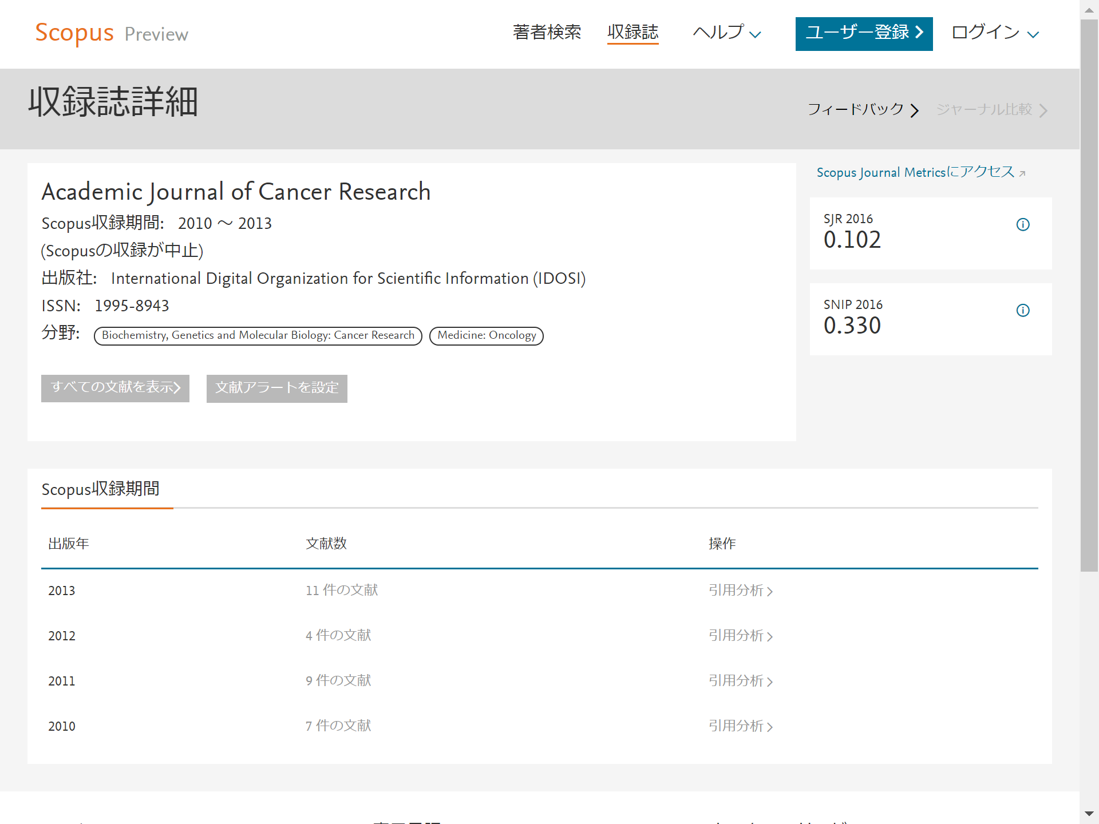
4. Not to be involved in Predatory Journals
3. Check the scholarly literature databases which have selection criteria
Scopus
https://www.scopus.com/sources
- World’s largest scholarly literature database
- selects 24,683 peer-reviewed (active) journals
- Hokkaido University does not subscribe,
but we can check its covered journals on the Internet
* The number of its journals is based
on the title list described in the next slide
(accessed 2018-10-22)
Note that inactive and/or discontinued journals also are hit here
* There are reasons for discontinuation

Slide 14
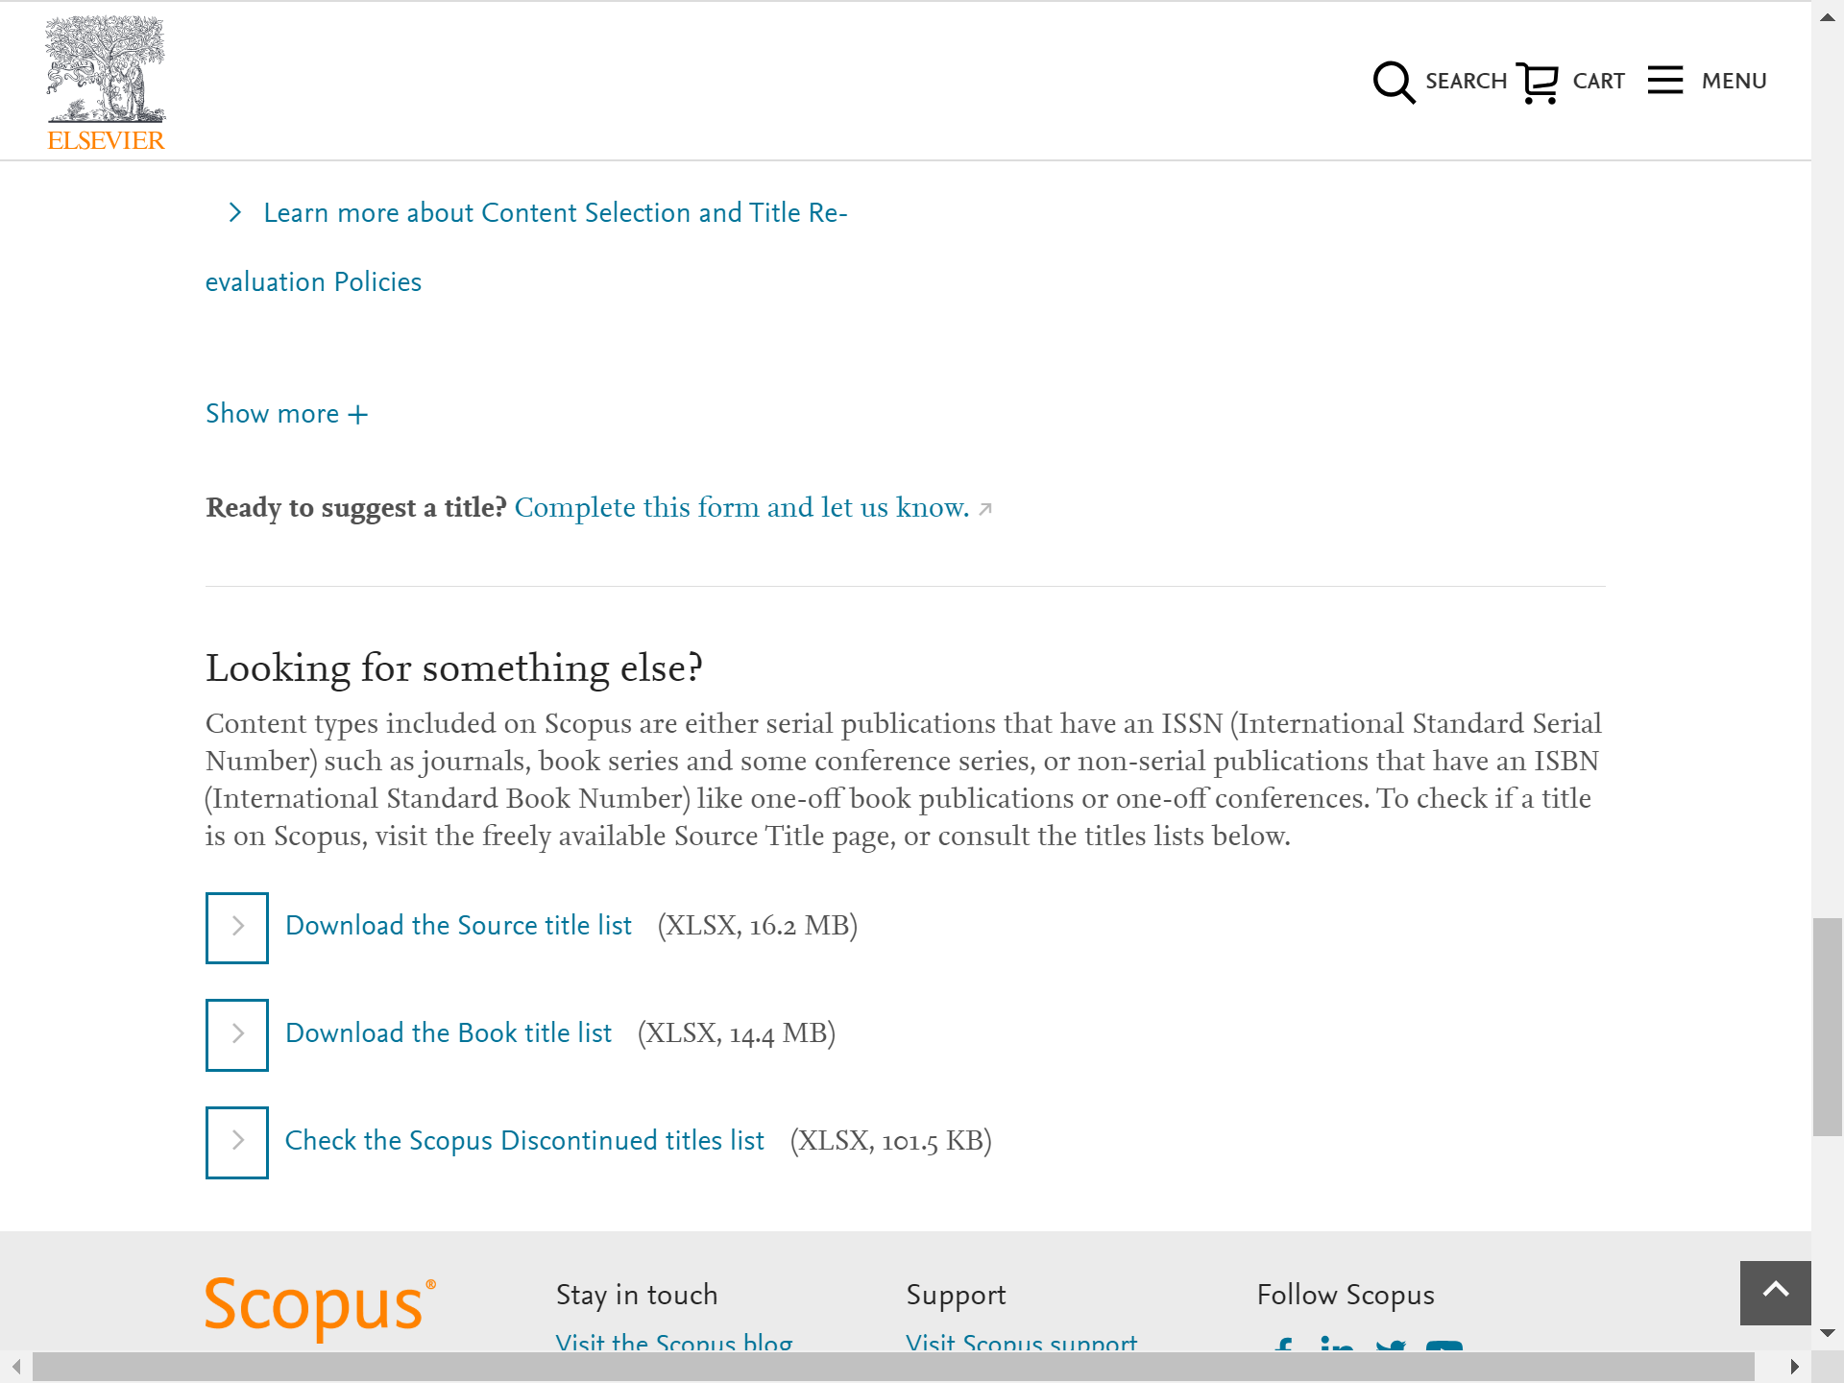
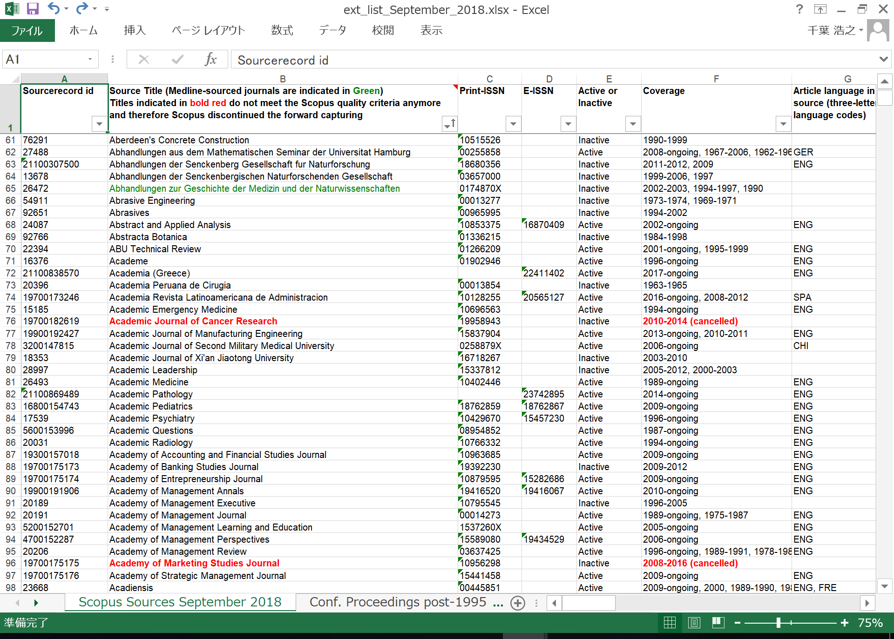
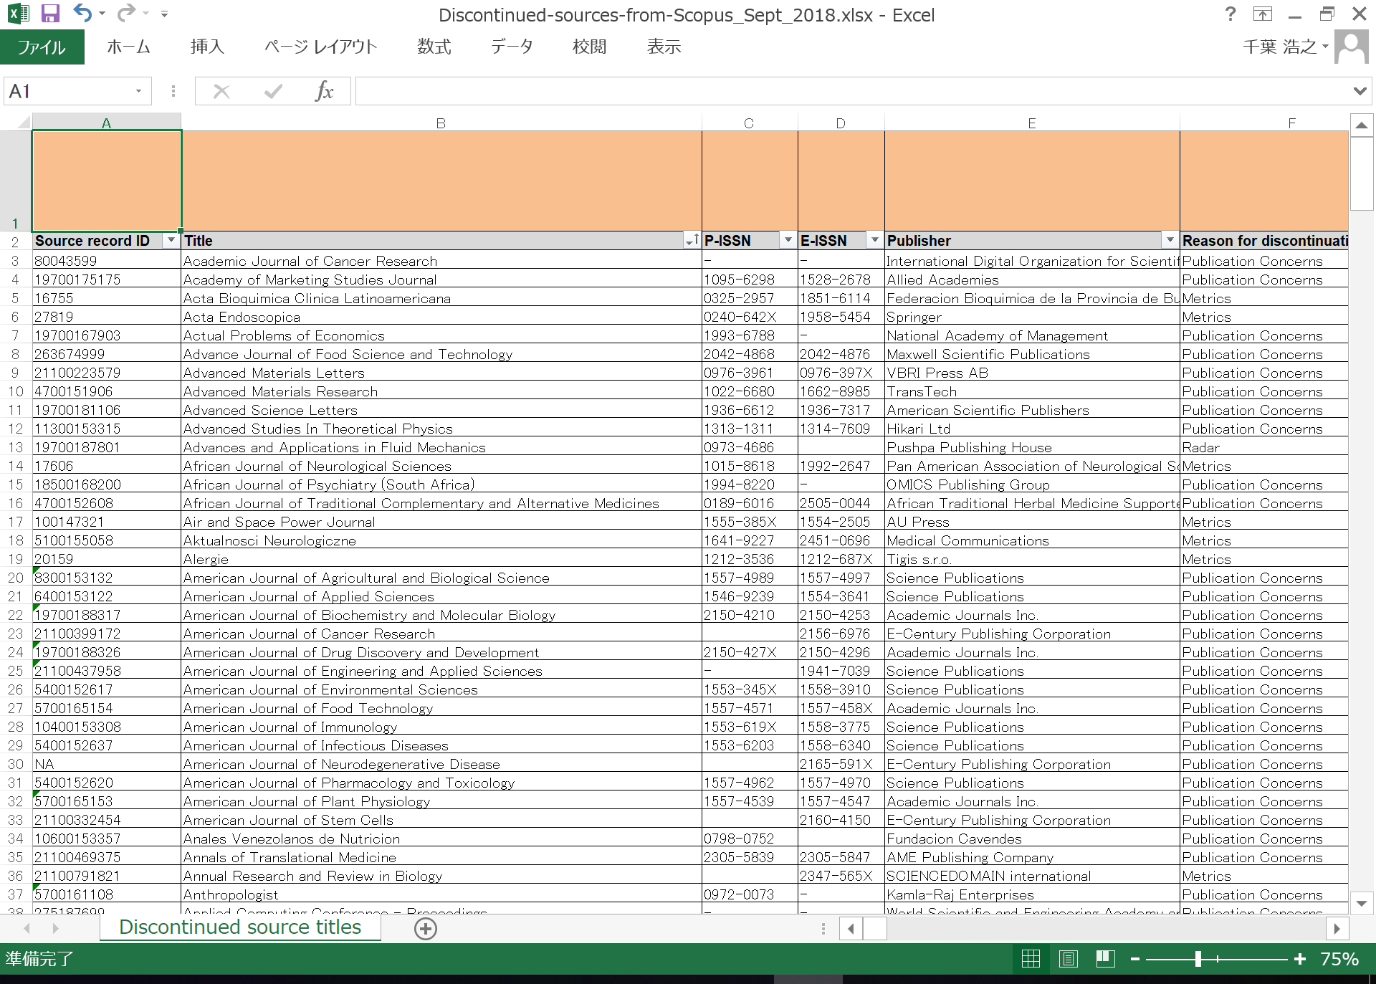
4. Not to be involved in Predatory Journals
3. Check the scholarly literature databases which have selection criteria
Scopus - the Source title list / the Scopus Discontinued titles list
https://www.elsevier.com/solutions/scopus/how-scopus-works/content
You can download the title list (including cancelled titles) and the discontinued title list
from the bottom of the link above

Slide 15
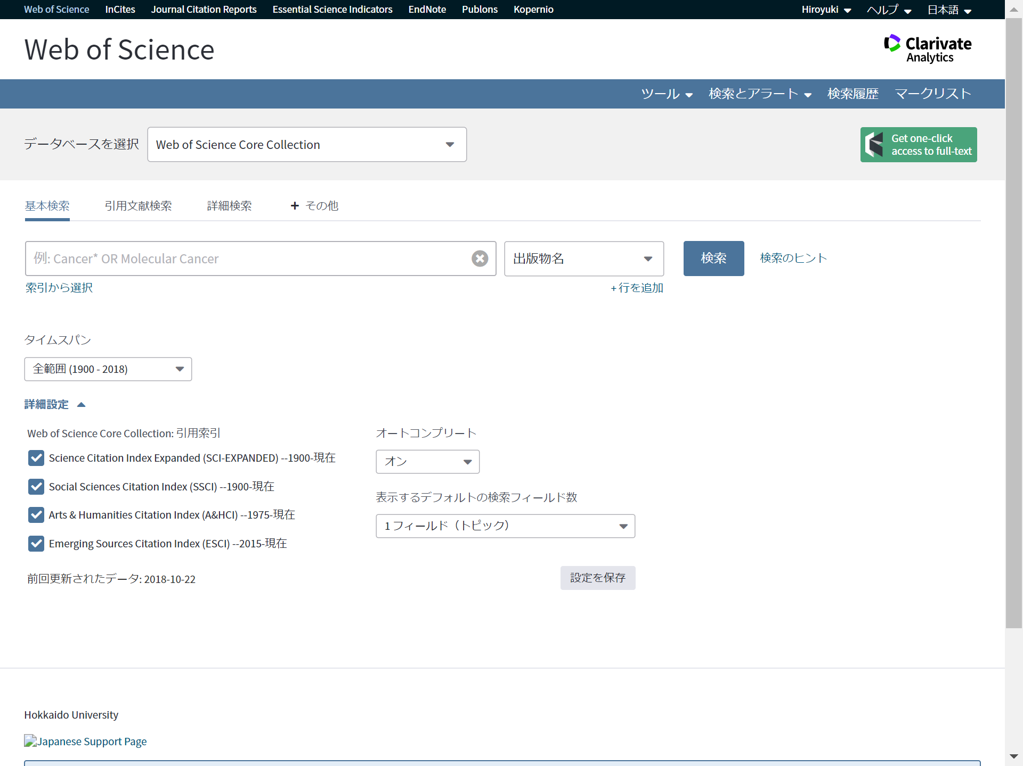
4. Not to be involved in Predatory Journals
3. Check the scholarly literature databases which have selection criteria
Web of Science Core Collection - SCI-E, SSCI, A&HCI, & ESCI
http://webofknowledge.com/wos
- World’s largest scholarly literature database
- All the index files of journals are available in Hokkaido University
- famous for its rigorous selection criteria
- The collection has covered 20,687 peer-reviewed journals
by the addition of the new index file, ESCI since 2015
* The number of the covered journals is based
on the Master Journal List described on the next slide
(accessed 2018-10-22)
Web of Science by Clarivate Analytics

Slide 16
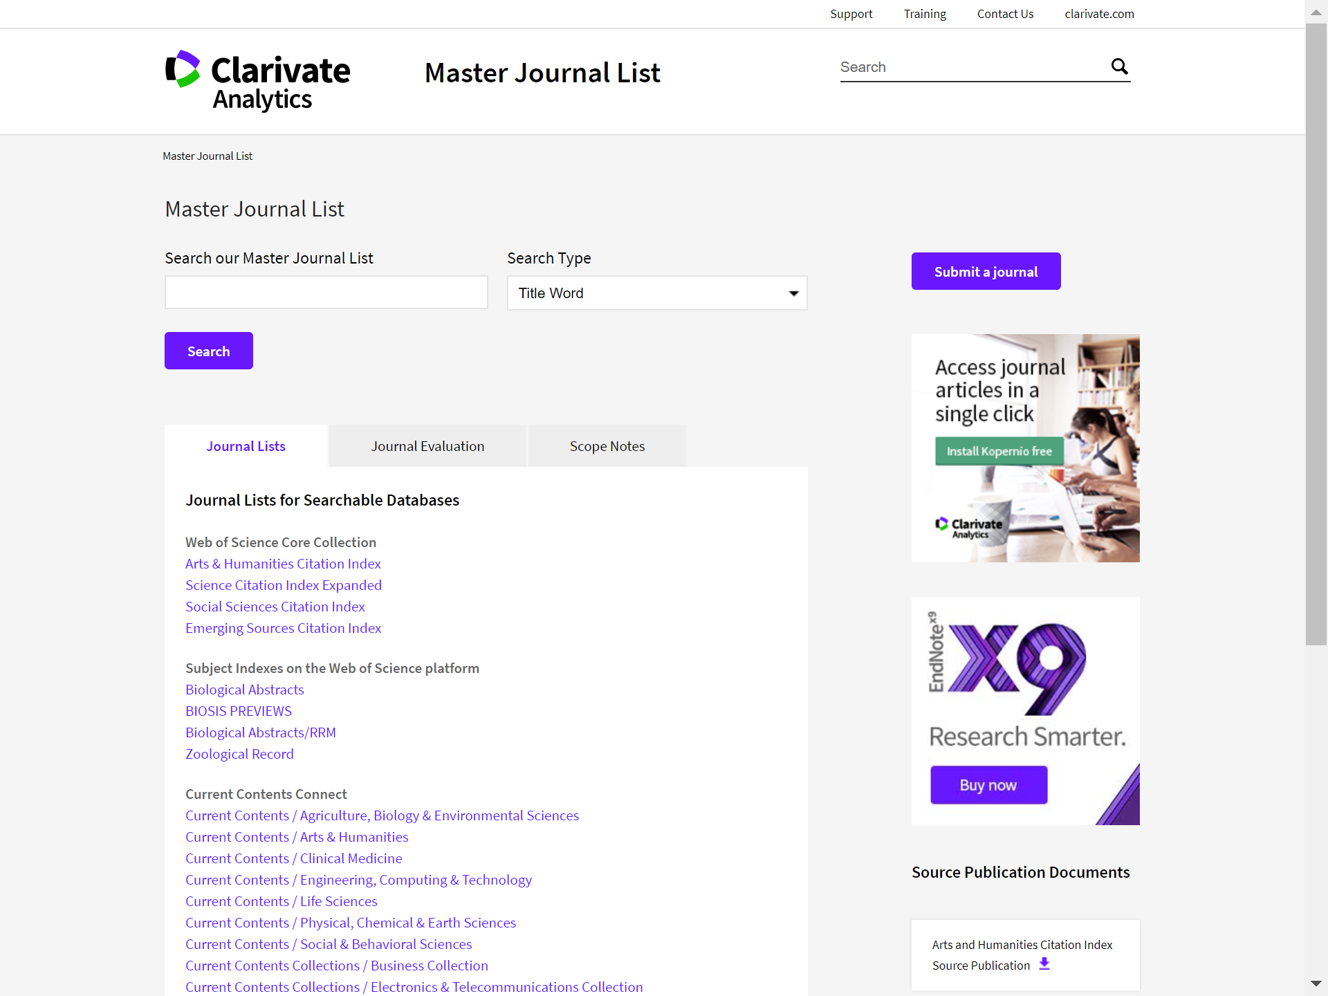
4. Not to be involved in Predatory Journals
3. Check the scholarly literature databases which have selection criteria
Web of Science - Master Journal List
http://mjl.clarivate.com
On the Internet we can check the journals covered by Web of Science Core Collection,
and also the journals of other index files,
whose criteria differ from the collection above

Slide 17
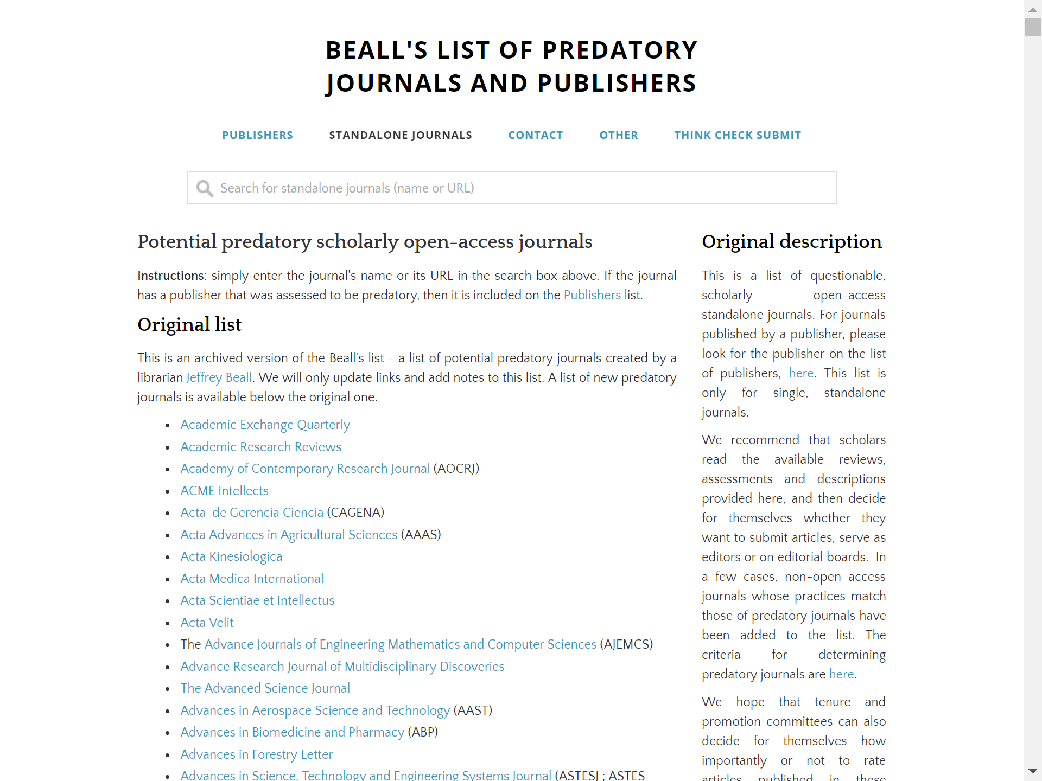
4. Not to be involved in Predatory Journals
4. Check blacklists
Beall's List of Predatory Journals and Publishers
https://beallslist.weebly.com
- An anonymous postdoctoral researcher has taken over
the list of potential predatory journals and publishers,
which had been published by Jeffrey Beall,
a university librarian and now closed.
- This consists of (Beall’s) Original list and Update

Slide 18
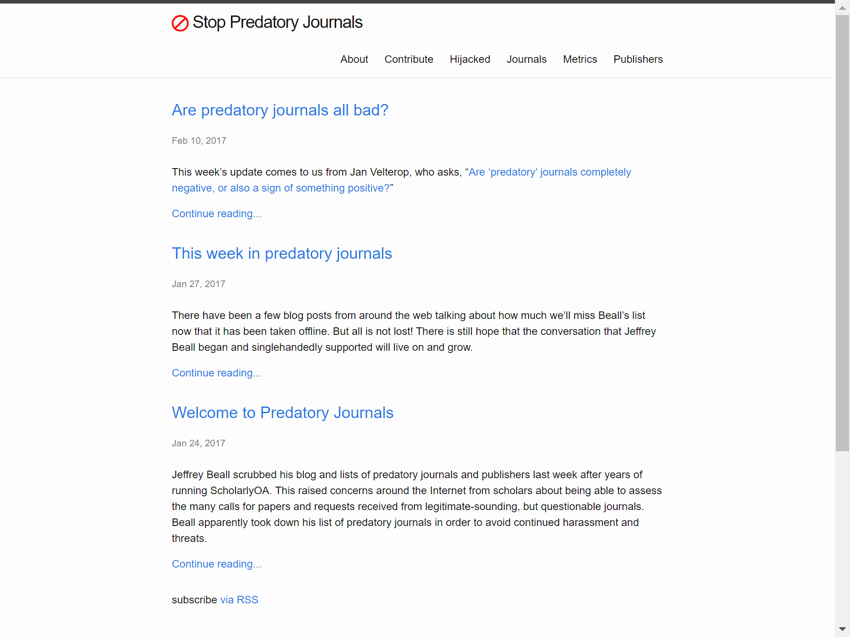
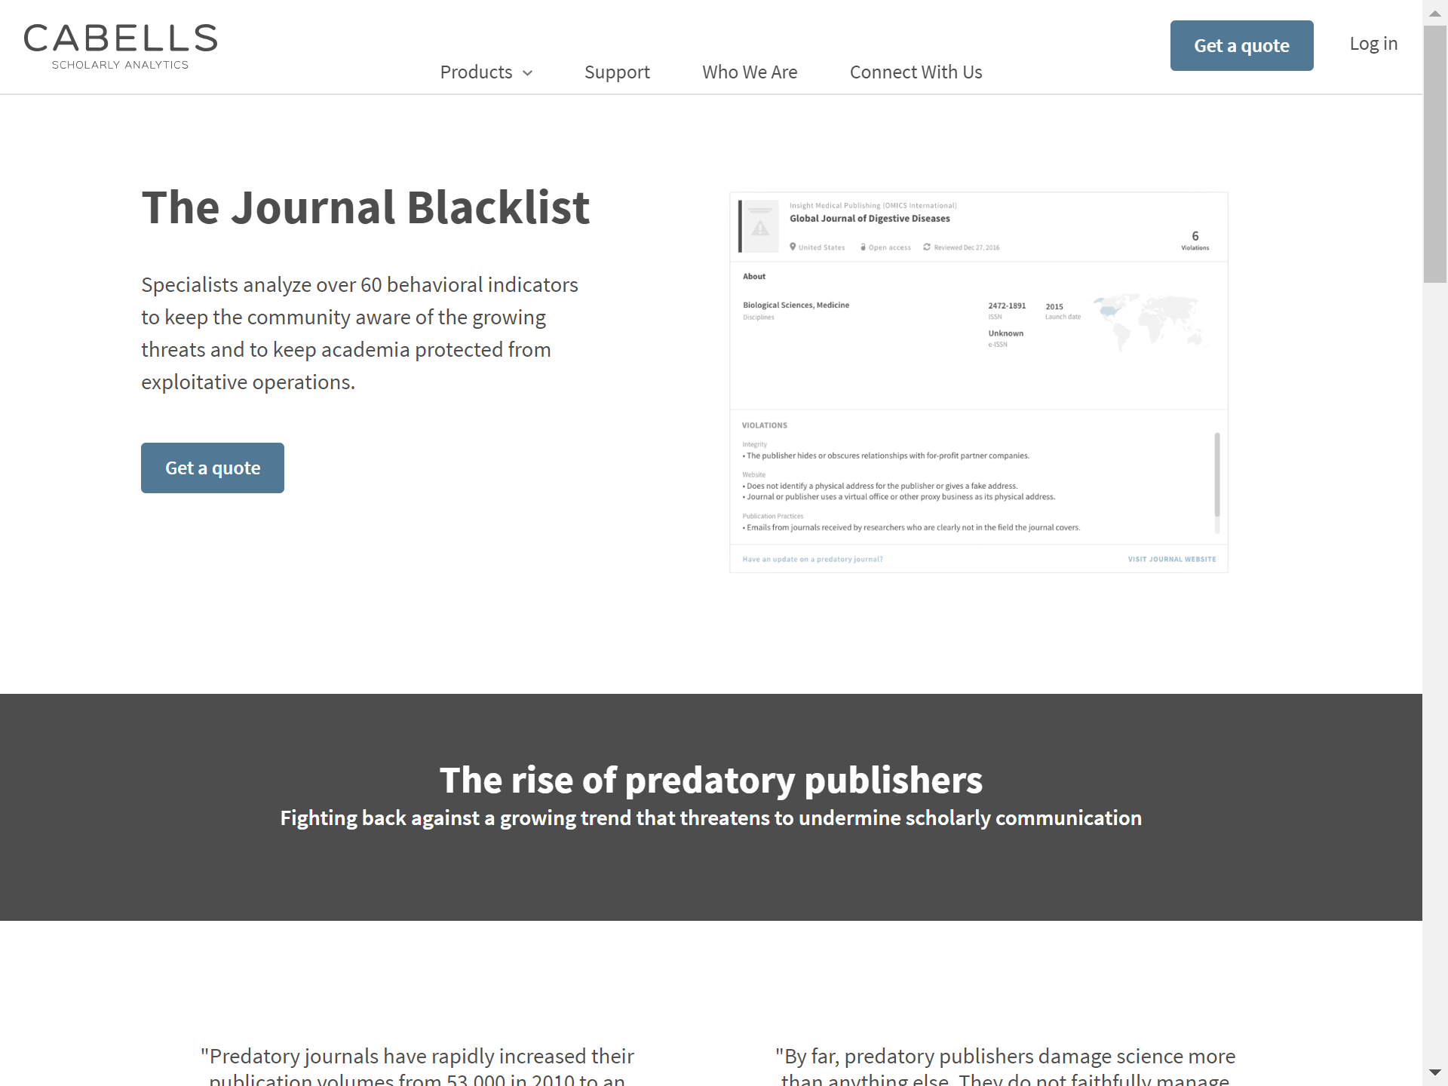
4. Not to be involved in Predatory Journals
4. Check blacklists
Other blacklists
- Stop Predatory Journals
https://predatoryjournals.com
the archive of the Beall’s list?
no update since Feb. 2017?
- Cabell’s Blacklist (& Whitelist)
https://www2.cabells.com/about-blacklist
https://www2.cabells.com/about-whitelist
charged
(only institutional subscriptions)

Slide 19
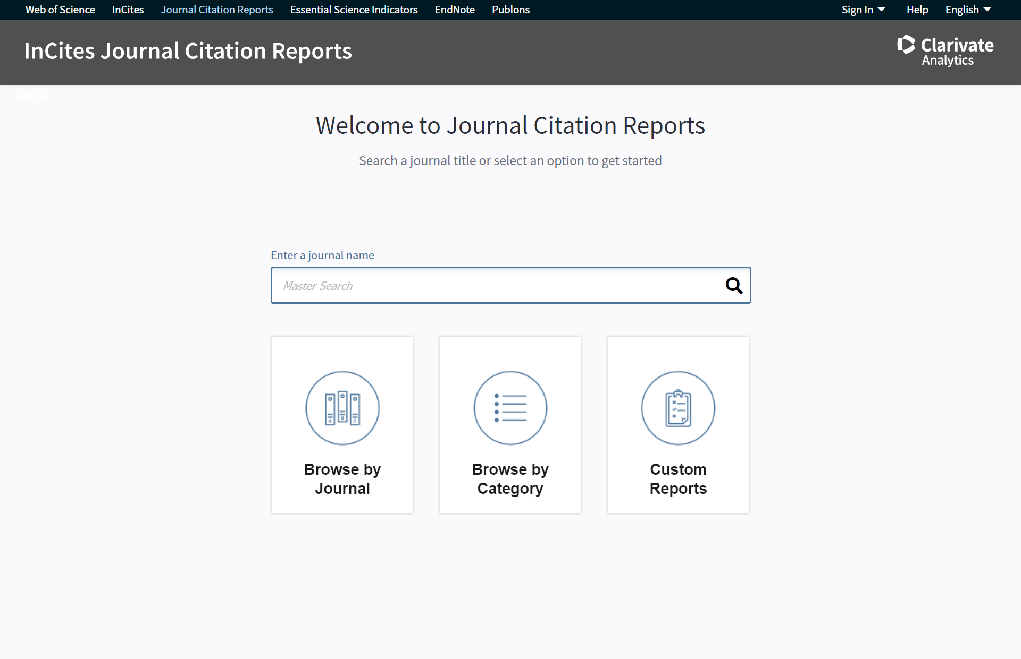
4. Not to be involved in Predatory Journals
5. Verify the metrics which the journals express by themselves
Journal Impact Factor : JIF, one of the most famous metrics
- calculated and provided by Clarivate Analytics
- for only the journals covered by SCI-E or SSCI of Web of Science Core Collection
(i.e. top journals of natural science or social sciences)
- The first JIF of a journal needs 3 years from the first issue
- We can check JIF on Journal Citation Reports (JCR)
http://jcr.incites.thomsonreuters.com
Journal Citation Reports by Clarivate Analytics

Slide 20
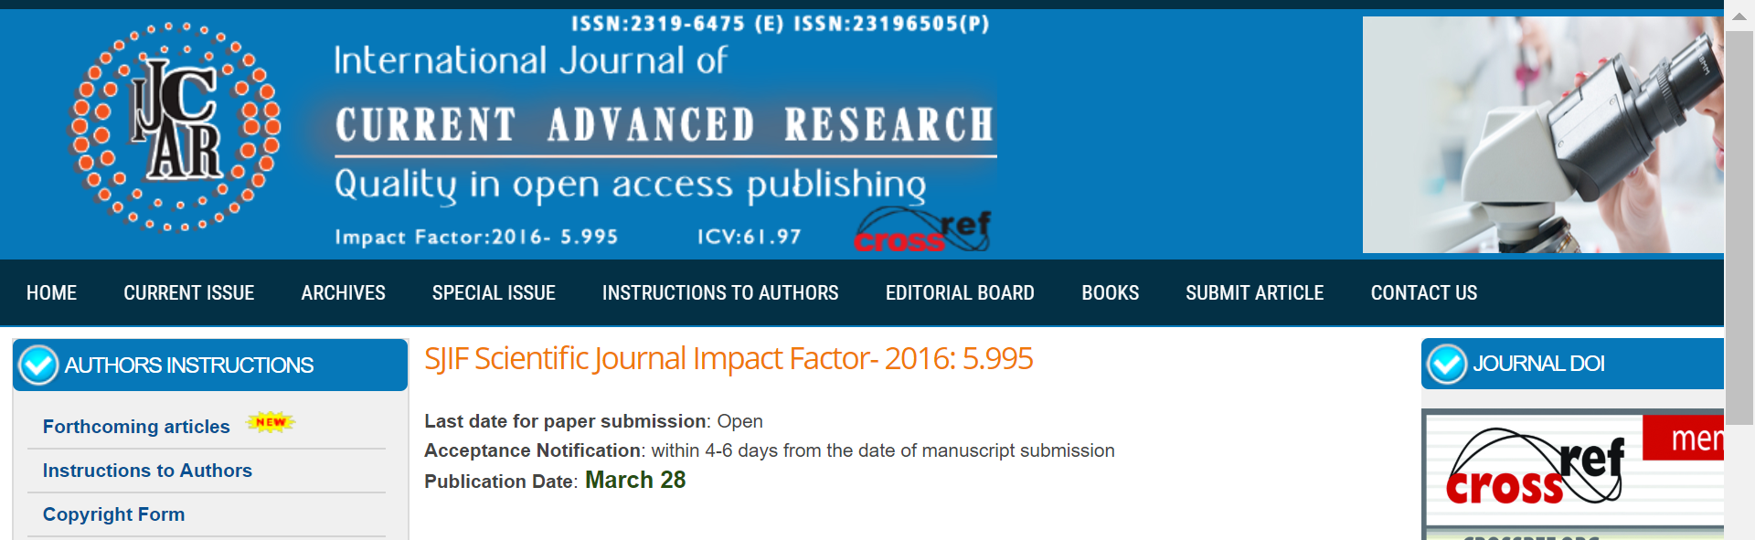
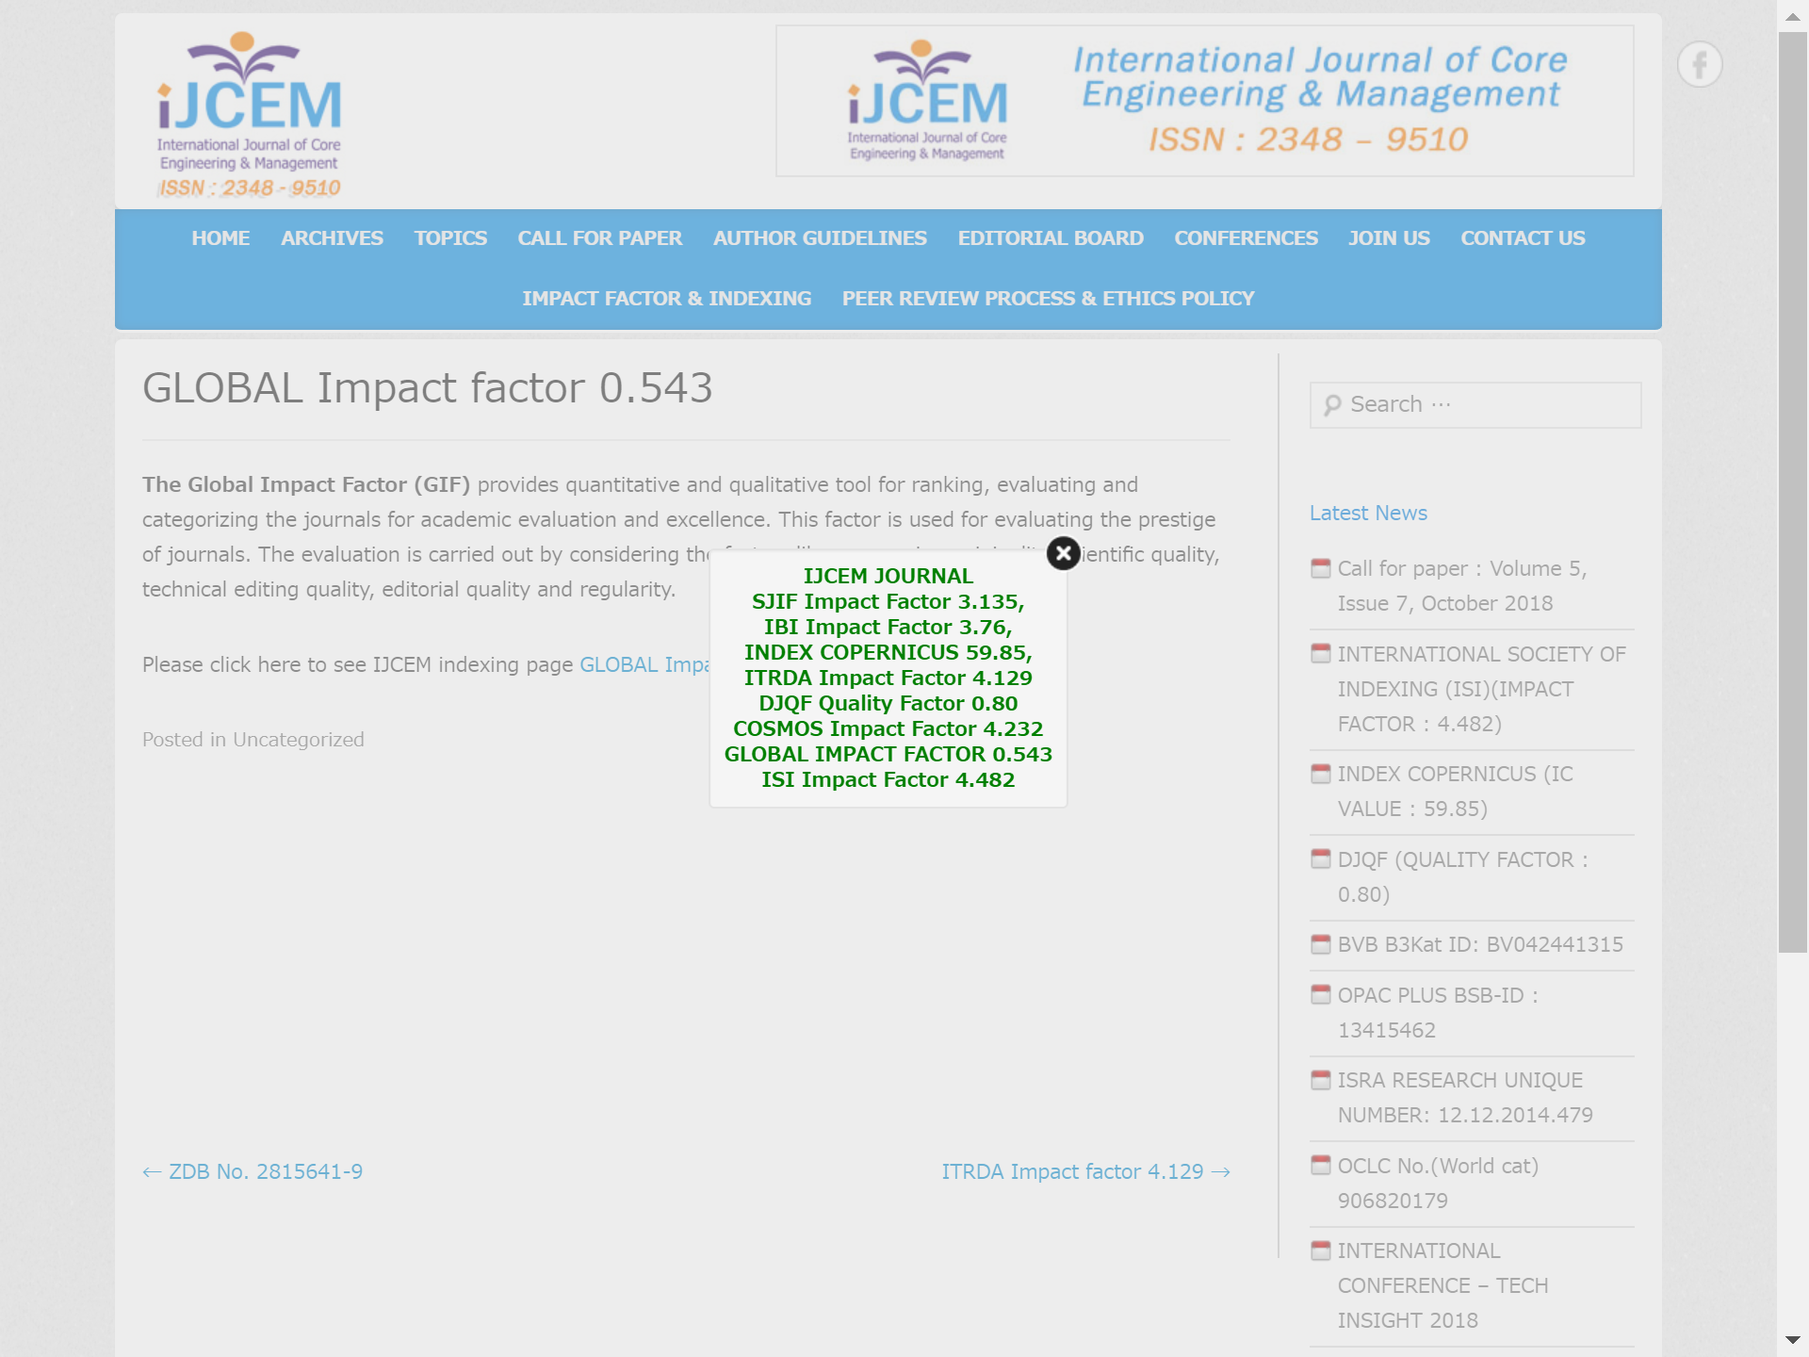
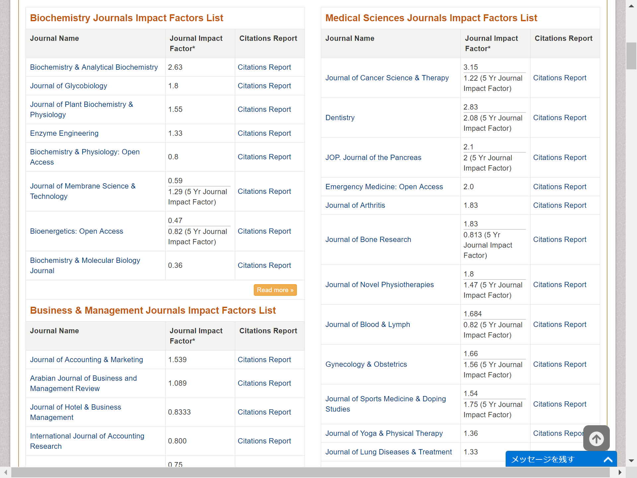
4. Not to be involved in Predatory Journals
5. Verify the metrics which the journals express by themselves
Various impact factors are mentioned,
but neither is the JIF of Clarivate Analytics at least
- “Open Access Journal Impact Factors” of the OMICS Journals
- According to the description at the bottom of the webpage,
It is based on Google Scholar Citation Index

Slide 21
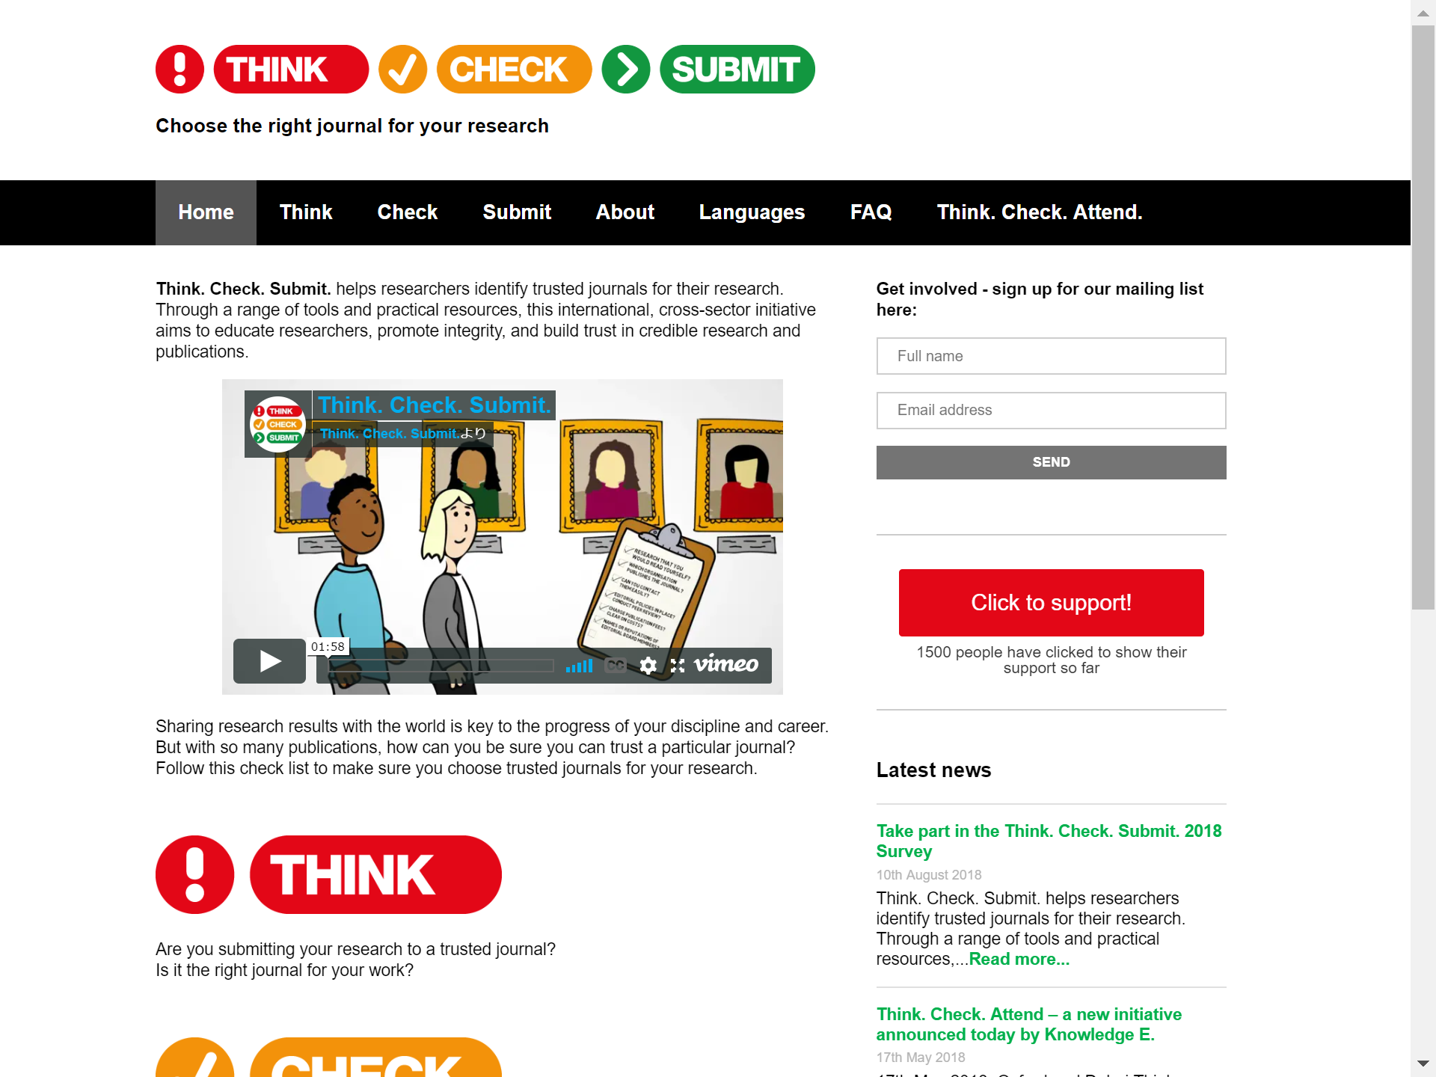
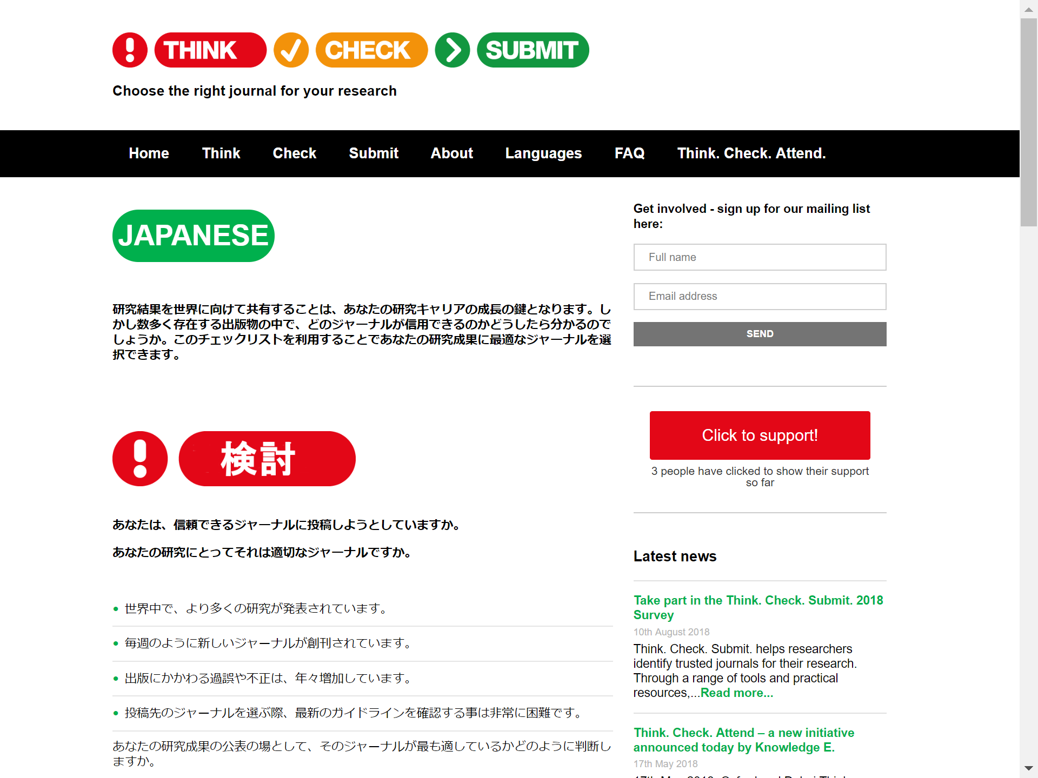
5. Literacy, calm, and communication are important
Think. Check. Submit.
https://thinkchecksubmit.org
http://thinkchecksubmit.org/translations/japanese
I think the followings are important:
- beware sweet words
(excessively flattering call for papers, too short publication process)
- do not lose to the pressure of “Publish or perish”
- consult with your boss and colleagues (and also library staff!)

Slide 22
ASK
ME
ANYTIME:
kitacam@lib.hokudai.ac.jp

