Slide 1


On-Demand Guidance on Northern Campus Library’s Service
Using Northern Campus Library’s resources and the others
Hokkaido University
Northern Campus Library
April 2019

Slide 2
Using Northern Campus Library’s resources and the others
1) Northern Campus Library’s resources
- Current journals, Japanese newspapers, and e-resources (via HINES-WLAN)
- 21,000 paper materials
- Library staff
2) The other resources
- Paper materials of the libraries of Hokkaido University
- Open Access papers and materials available on Google Books
- [Not Free] Materials of other universities
- [Not Free] Buy electronic / paper materials at public expense
- Request to corresponding authors

Slide 3
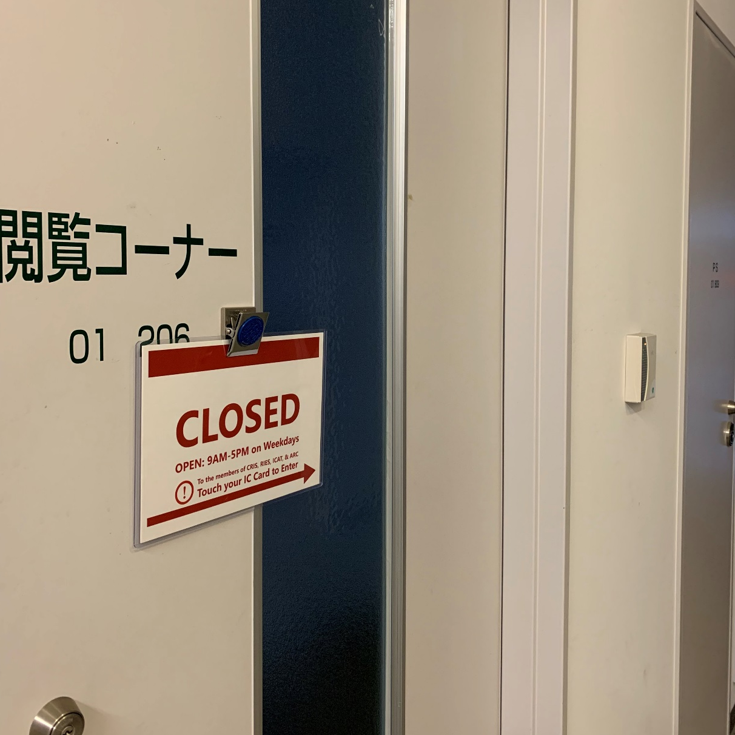
1) Northern Campus Library’s resources
* Opening hours and entering the library
Open at 9AM - 5PM on Weekdays
When staff takes day off,
the library opens at 1PM
The students and faculty of
CRIS, RIES, ICAT, and ARC
can enter the library
with their own IC card,
even when it is closed

Slide 4
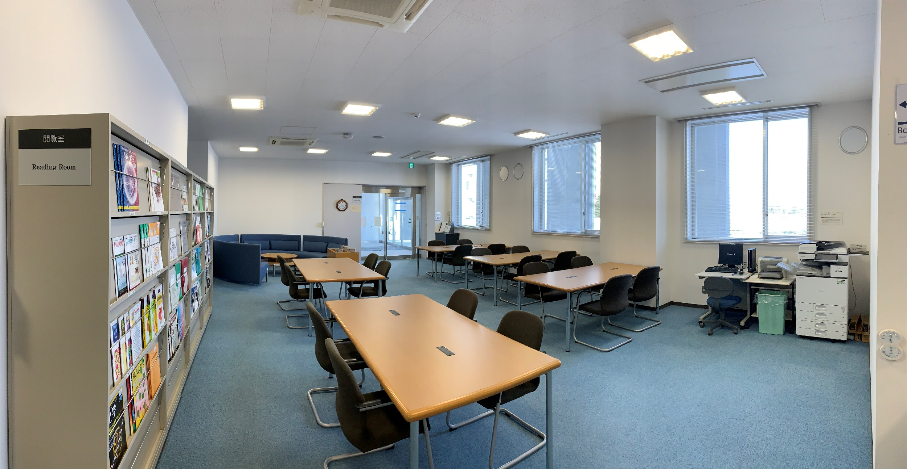
1) Northern Campus Library’s resources
- Current journals, Japanese newspapers, and e-resources (via HINES-WLAN)
HINES-WLAN
ID/PW=＿＿＿＿＿
e-journals, e-books, databases
which Hokkaido University subscribes
Pamphlets
6 Japanese newspapers
Computer for library catalog
* also Internet available
Current journals
Photocopy Machine
* a RICOH Card needed

Slide 5
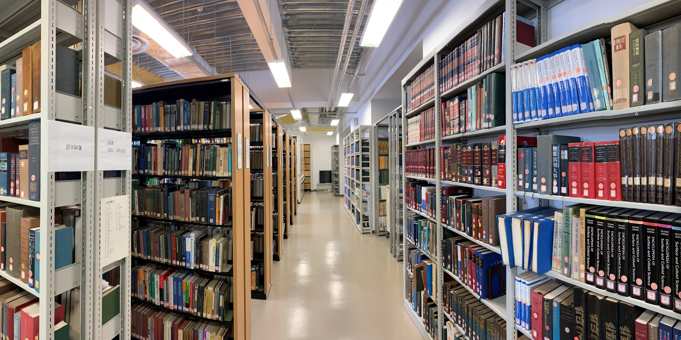
1) Northern Campus Library’s resources
- 21,000 paper materials
Russian journals
А-Я
Foreign journals
A-Z
Books
000-999
Reference
Books
Japanese journals
A-Z
Back issues of
newspapers

Slide 6
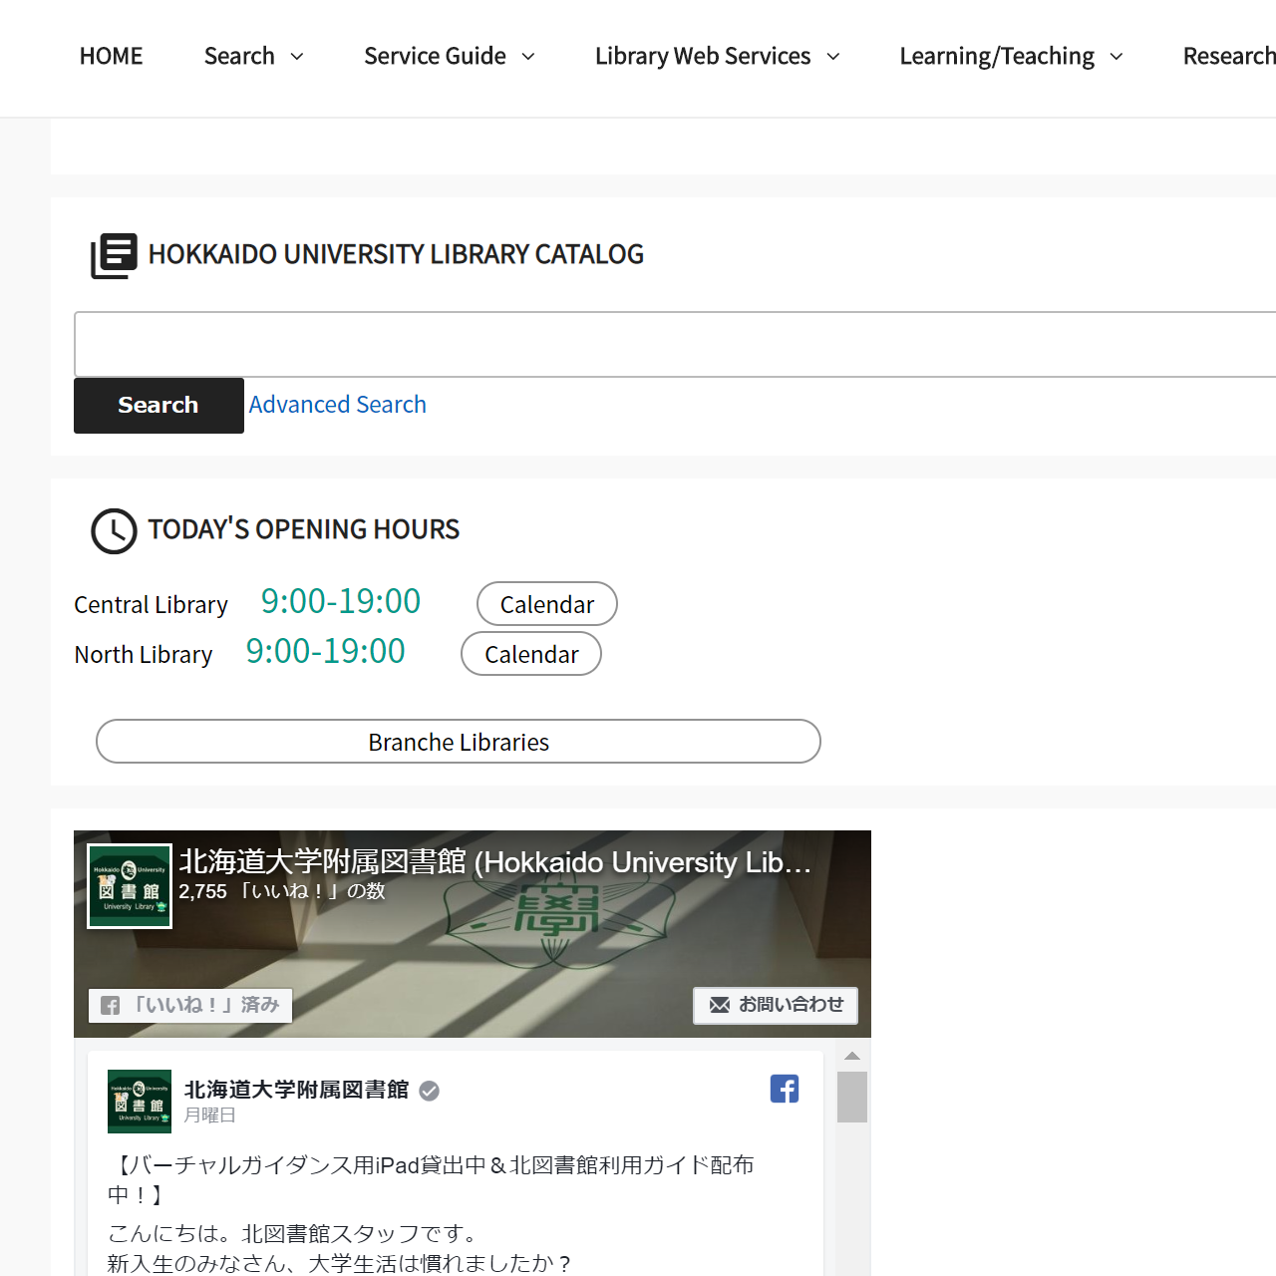
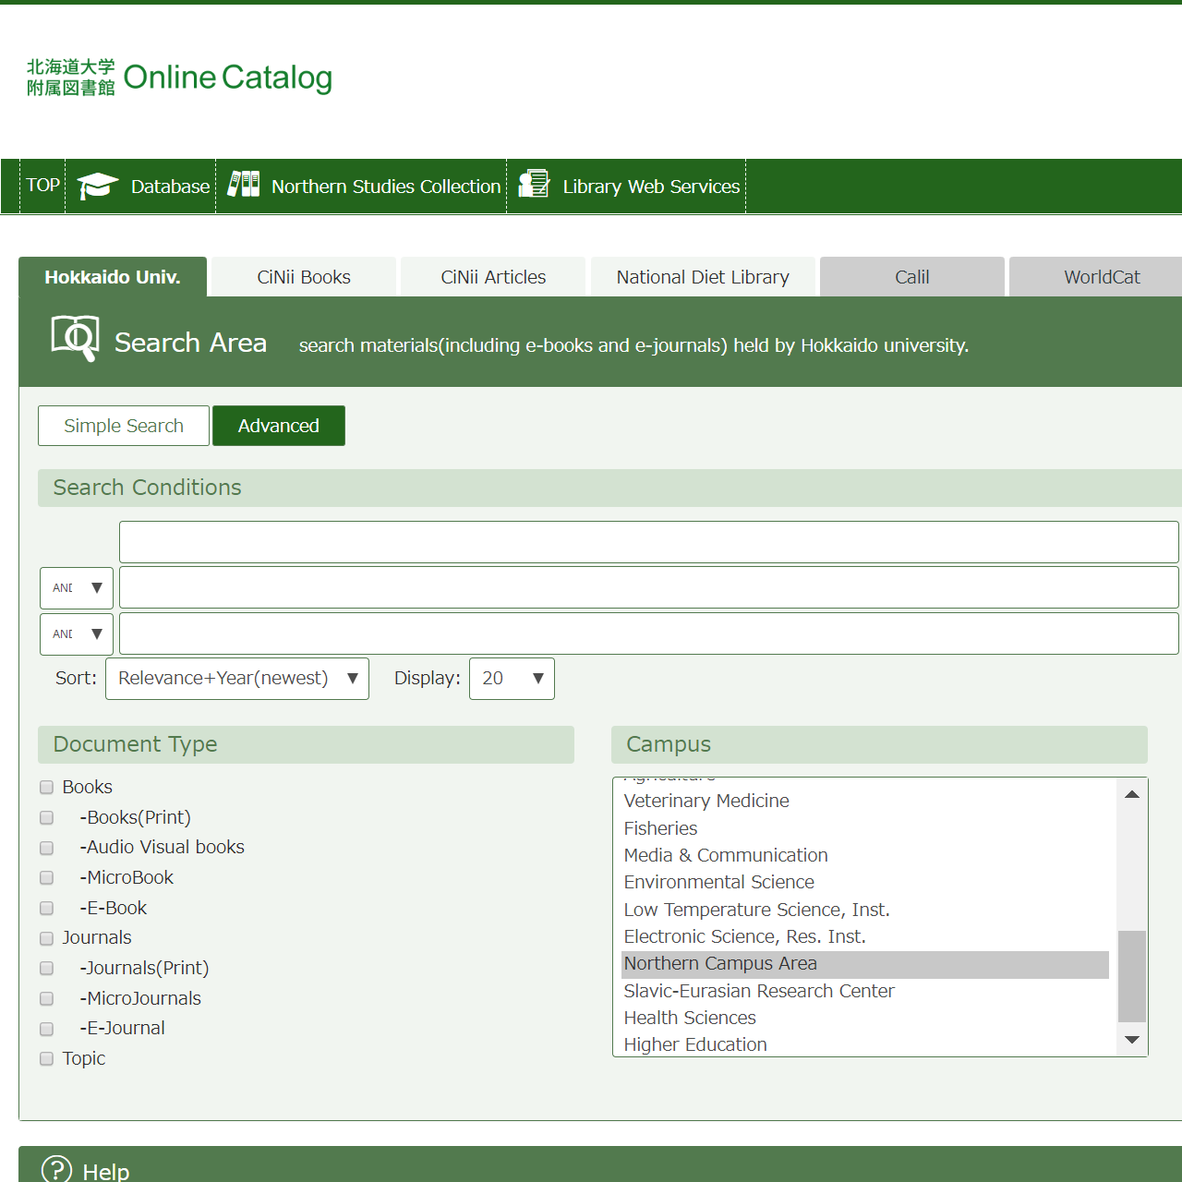
1) Northern Campus Library’s resources
* search for paper materials online
https://www.lib.hokudai.ac.jp/en

Slide 7
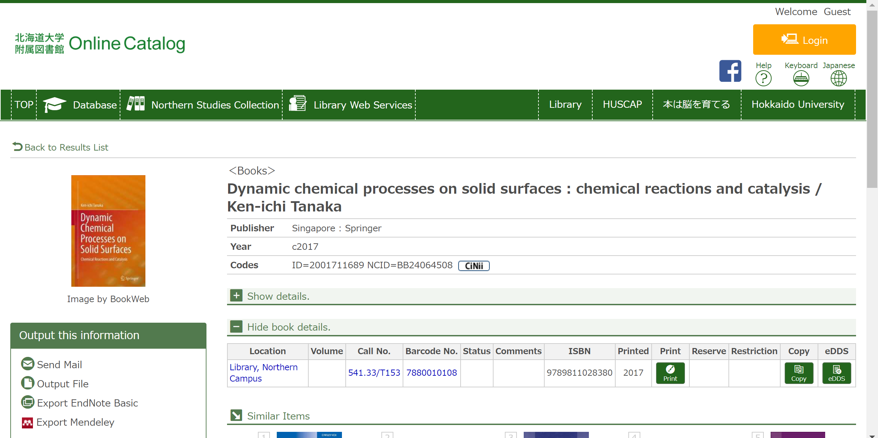
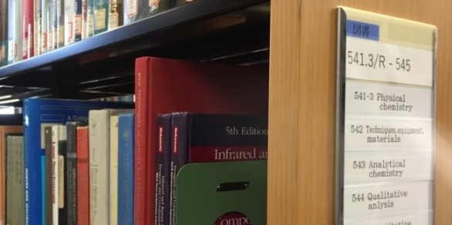
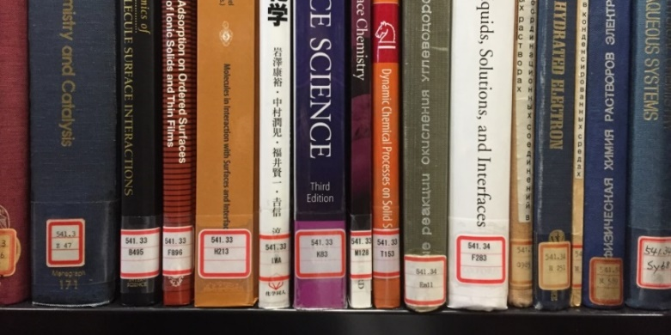
1) Northern Campus Library’s resources
* search for paper materials online

Slide 8
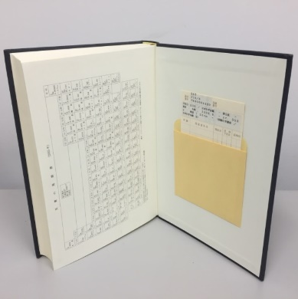
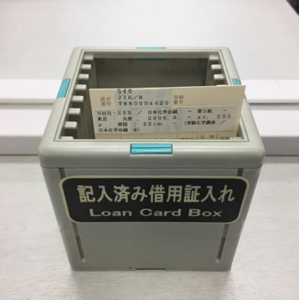
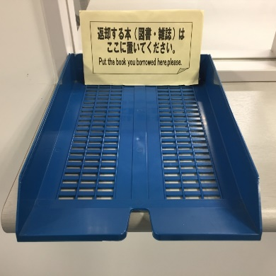
1) Northern Campus Library’s resources
* borrow (up to 3) materials (within 3 weeks) and return them
1) When staff is present, bring materials to the counter
2) When staff is absent,
borrow return
Fill in your
Department
Name
Date
Right side of
the counter
Left side of
the counter

Slide 9
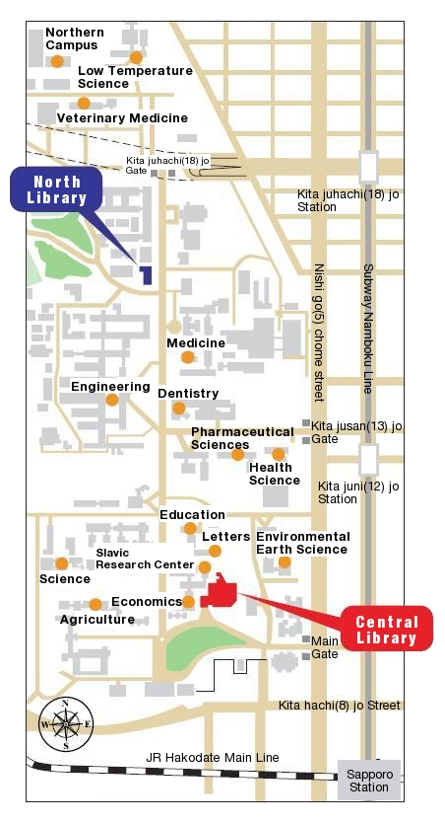

2) The other resources
- Paper materials of the libraries of Hokkaido University
The students and faculty of Hokkaido University
can use all the libraries of the university
Borrowing limits do not affect ones of other libraries
* You can borrow 3 materials at this library and
8 materials at Central Library at the same time
The materials of the other libraries
(except for the fisheries science library
at Hakodate Campus)
cannot be returned to this library

Slide 10
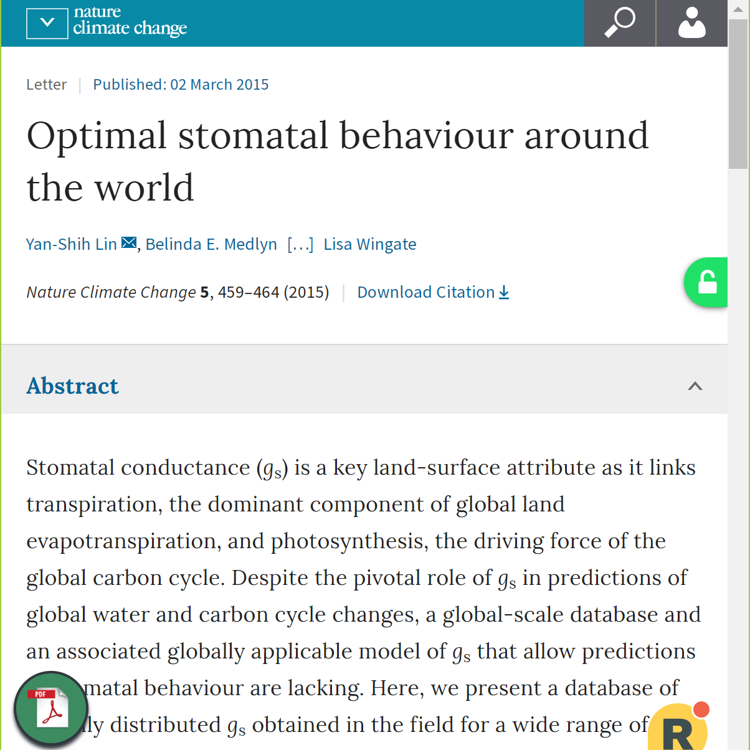
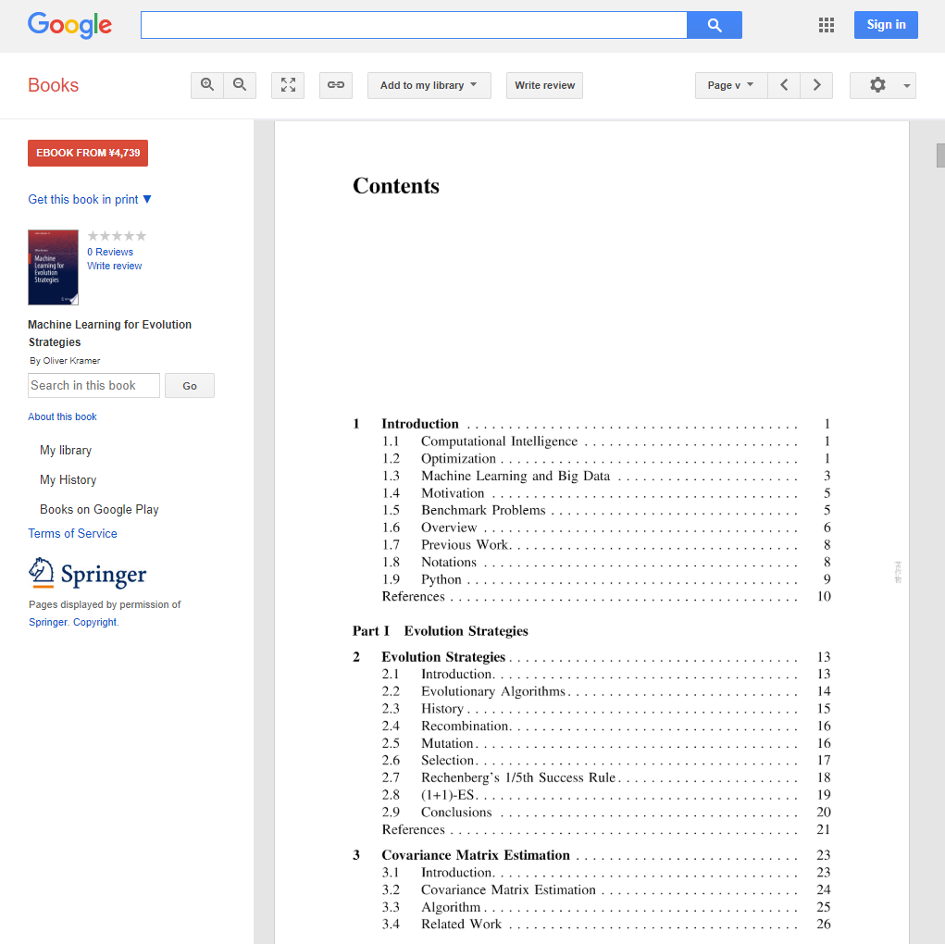
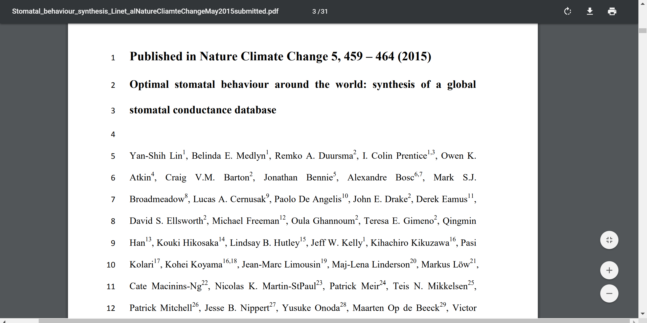
2) The other resources
- Open Access papers and materials available on Google Books
If papers / materials are unavailable
in Hokkaido University…
Some browser plug-ins (such as Unpaywall，Kopernio) navigate
you to the Open Access version
https://books.google.com

Slide 11
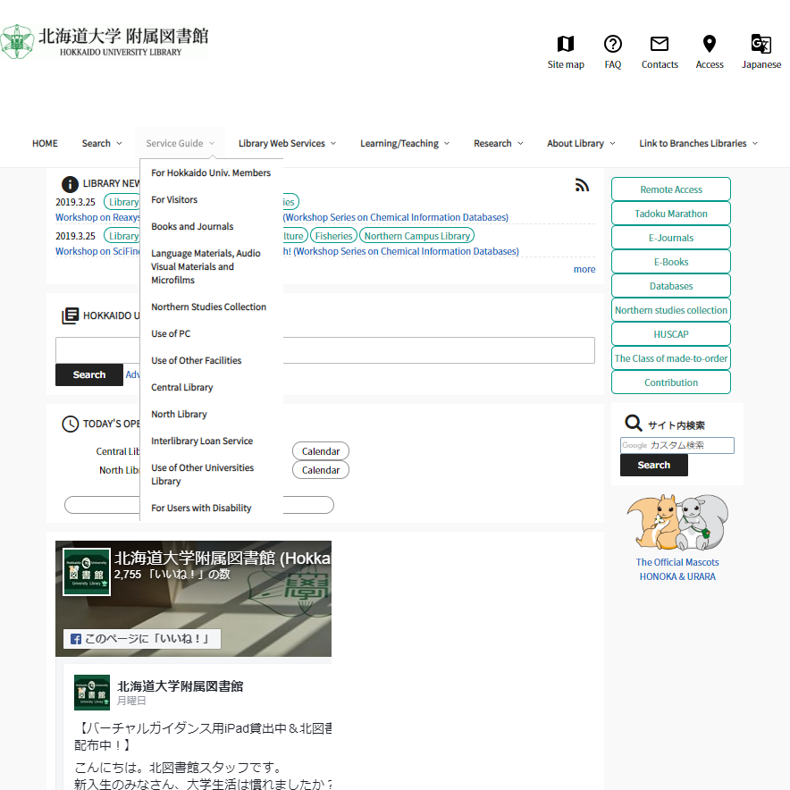
2) The other resources
- [Not Free] Materials of other universities
1) Order photocopies and materials
from other universities
Payable for private or public expense
If you use public expense (Ippan-Un’ei-Zaigen),
you can receive photocopies of the materials
of the libraries of Hokkaido University
in PDF format
2) Visit other university libraries
If necessary,
this library issues a free letter of introduction
https://www.lib.hokudai.ac.jp/en

Slide 12
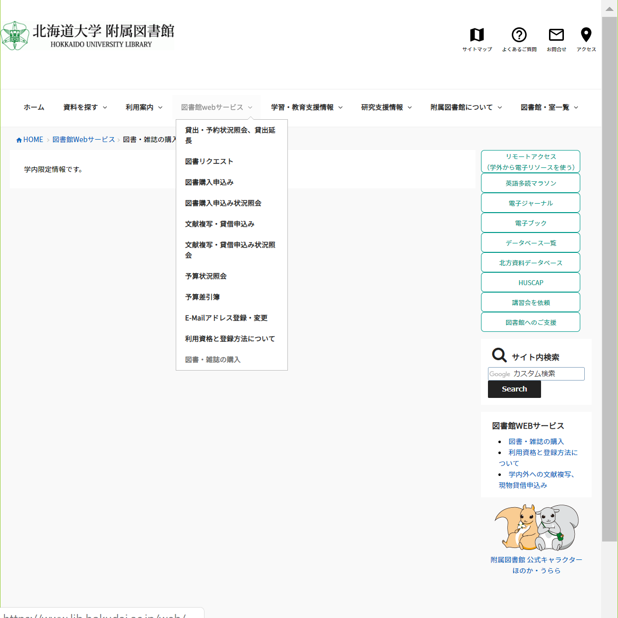
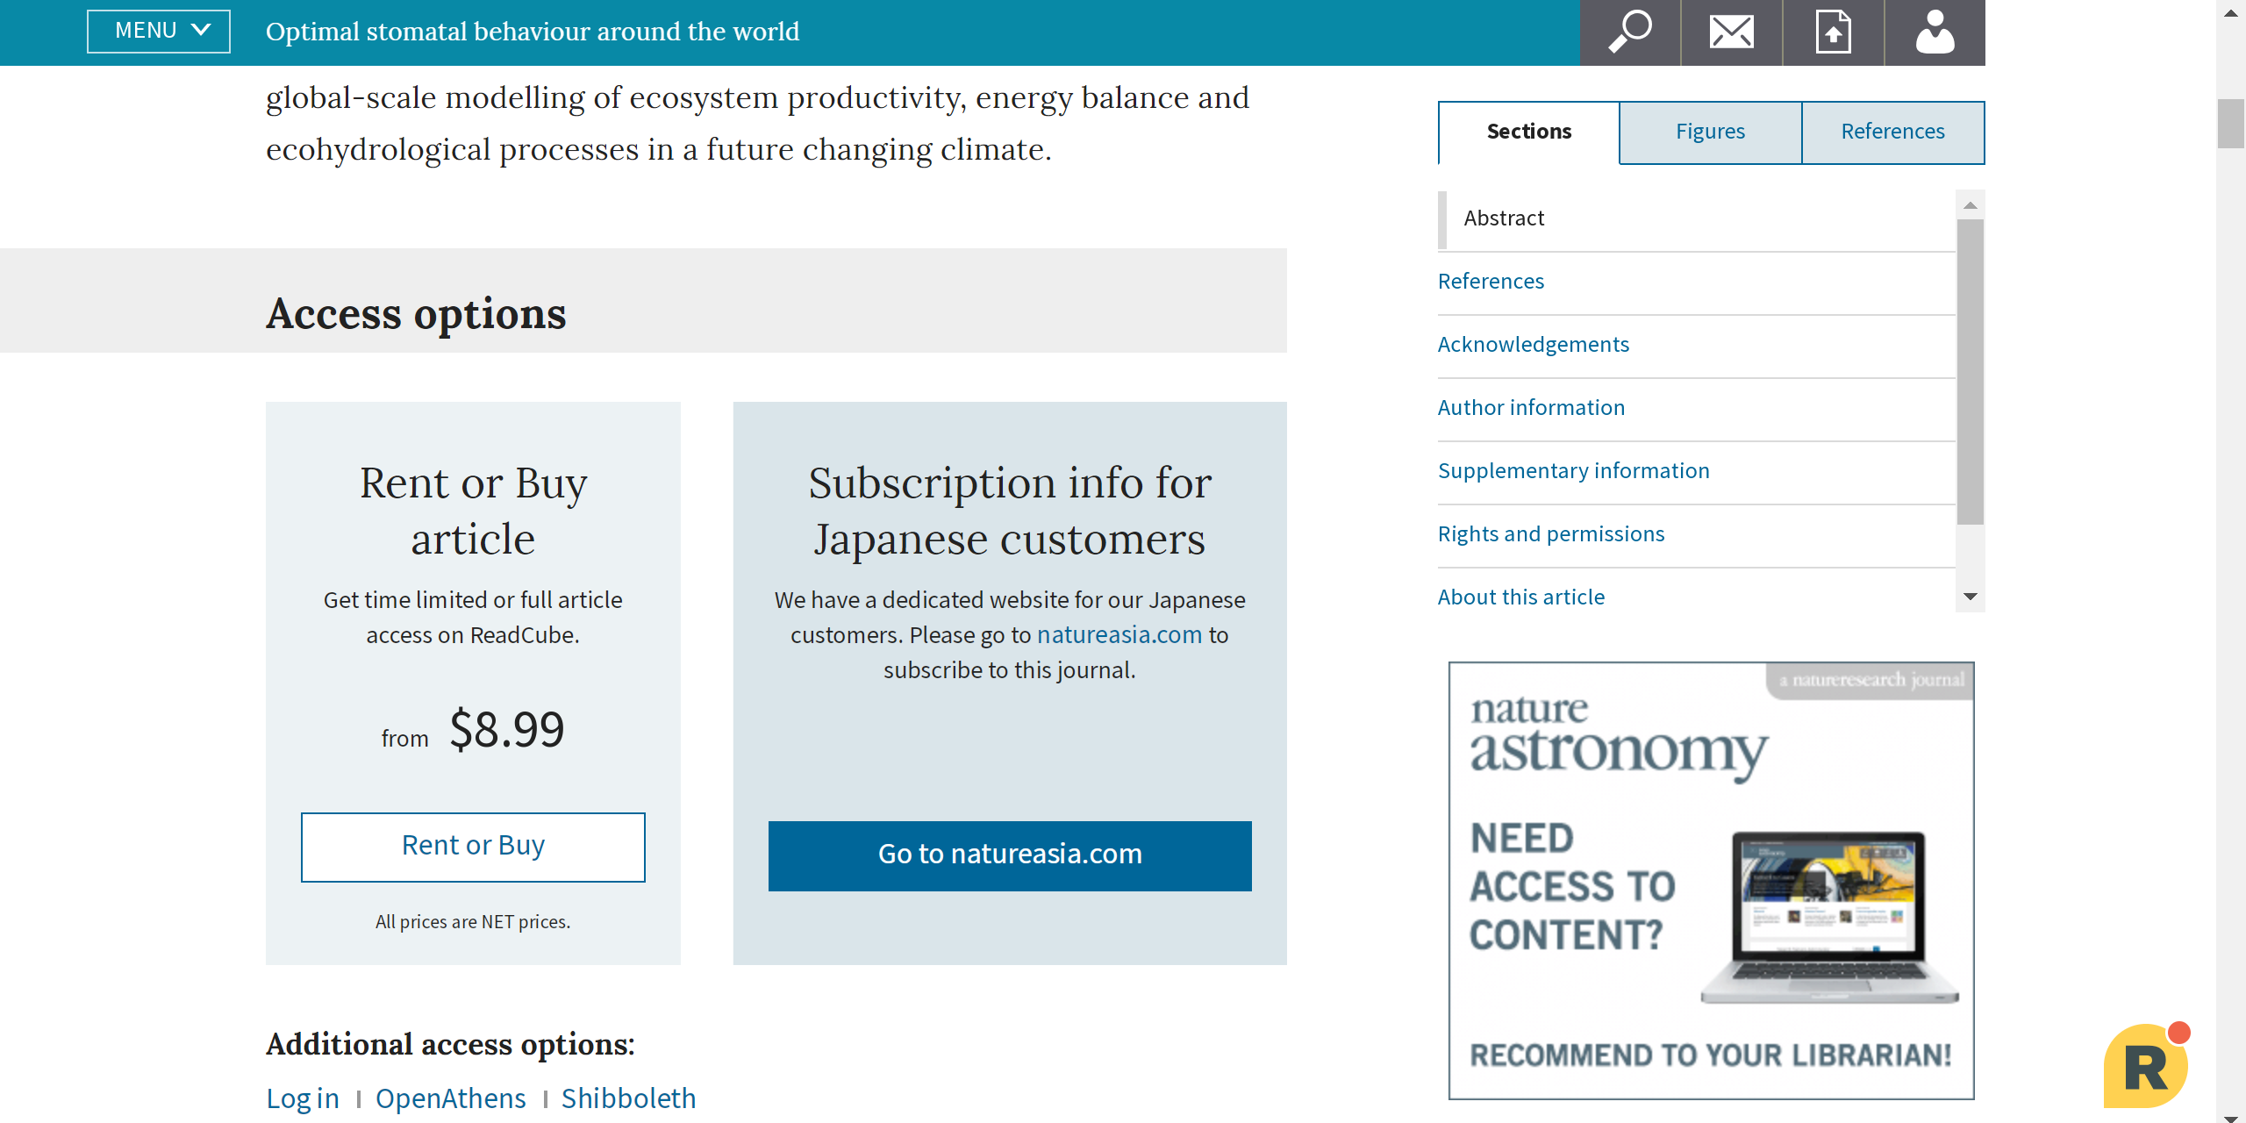
2) The other resources
- [Not Free] Buy electronic / paper materials at public expense
Buy materials at public expense
from bookshops / publishers
With the corporate card
you can buy papers in PDF format
https://www.lib.hokudai.ac.jp/web/book-order-help
* only on campus and in Japanese

Slide 13
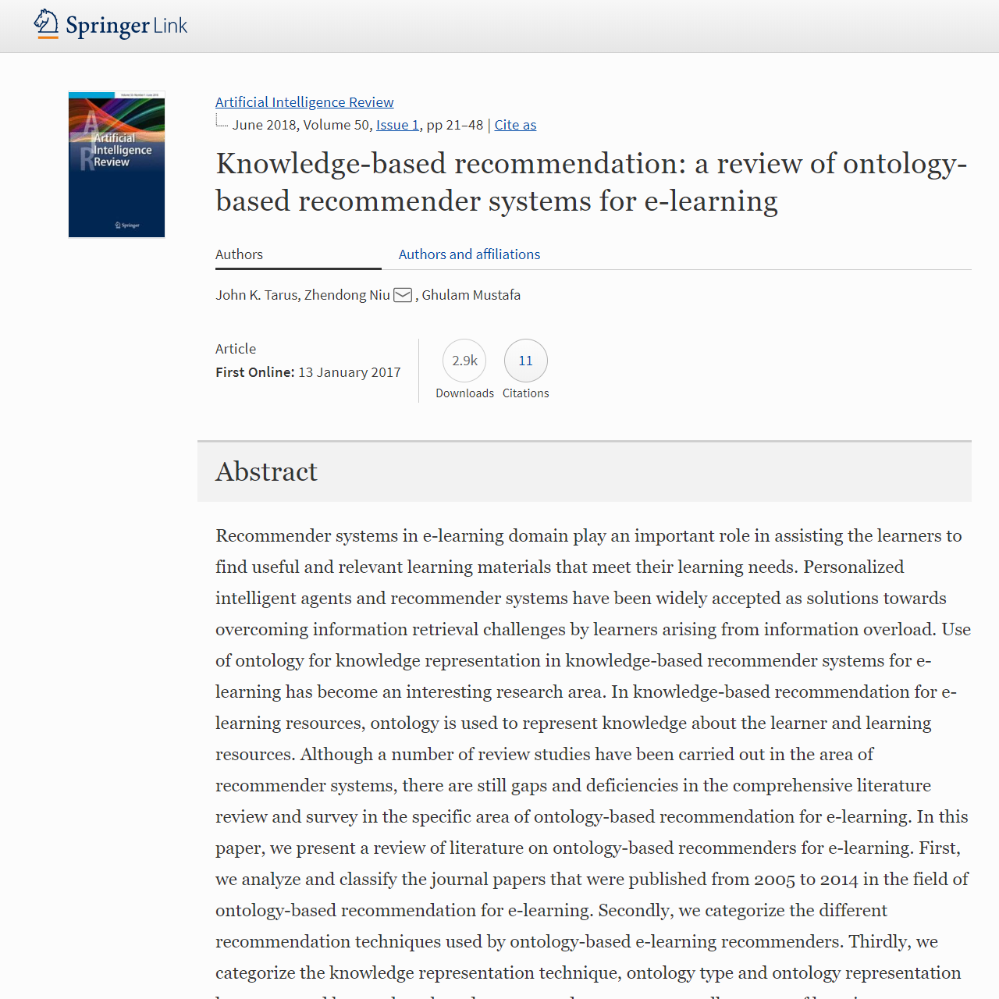
2) The other resources
- Request to corresponding authors
Request within the permission
of the publisher
Some publishers allow authors
to distribute view-only version
of their papers
- SharedIt (Springer Nature)
Besides via SNS for researchers
- ResearchGate
- Academia.edu

Slide 14
Using Northern Campus Library’s resources and the others
1) Northern Campus Library’s resources
- Current journals, Japanese newspapers, and e-resources (via HINES-WLAN)
- 21,000 paper materials
- Library staff
2) The other resources
- Paper materials of the libraries of Hokkaido University
- Open Access papers and materials available on Google Books
- [Not Free] Materials of Other universities
- [Not Free] Buy electronic / paper materials at public expense
- Request to corresponding authors

Slide 15
TRY
LATER
AND
ASK
ME
ANYTIME:
kitacam@lib.hokudai.ac.jp

