Slide 1


On-Demand Guidance on Northern Campus Library’s Service
Collecting papers : mainly Google Scholar and Web of Science
Hokkaido University
Northern Campus Library
April 2019

Slide 2
Collecting papers
1) Widely in a familiar way : Google Scholar
2) Focusing on Top Journals analytically : Web of Science
3) Periodically and Automatically : Search Alert
4) Quickly with 1 click : Kopernio, Unpaywall etc.
5) From outside the campus : Remote Access

Slide 3




1) Widely in a familiar way : Google Scholar
Surface Web
Outside of Web
Crawlable
Database
Open Access
Journal
Bibliographic
Data
Google
Full Text
Paper Material
(CiNii)
(PLOS ONE)
Paywalled Journal
unsubscribed by Univ.
Paywalled Journal
subscribed by Univ.
Google Scholar
Bibliographic
Data
Bibliographic
Data
Deep Web
Full Text
Full Text
(Nature Catalysis)
(Nature)
Stand-alone
Database
Paywalled Database
unsubscribed by Univ.
Paywalled Database
subscribed by Univ.
(Scopus)
(Web of Science)

Slide 4
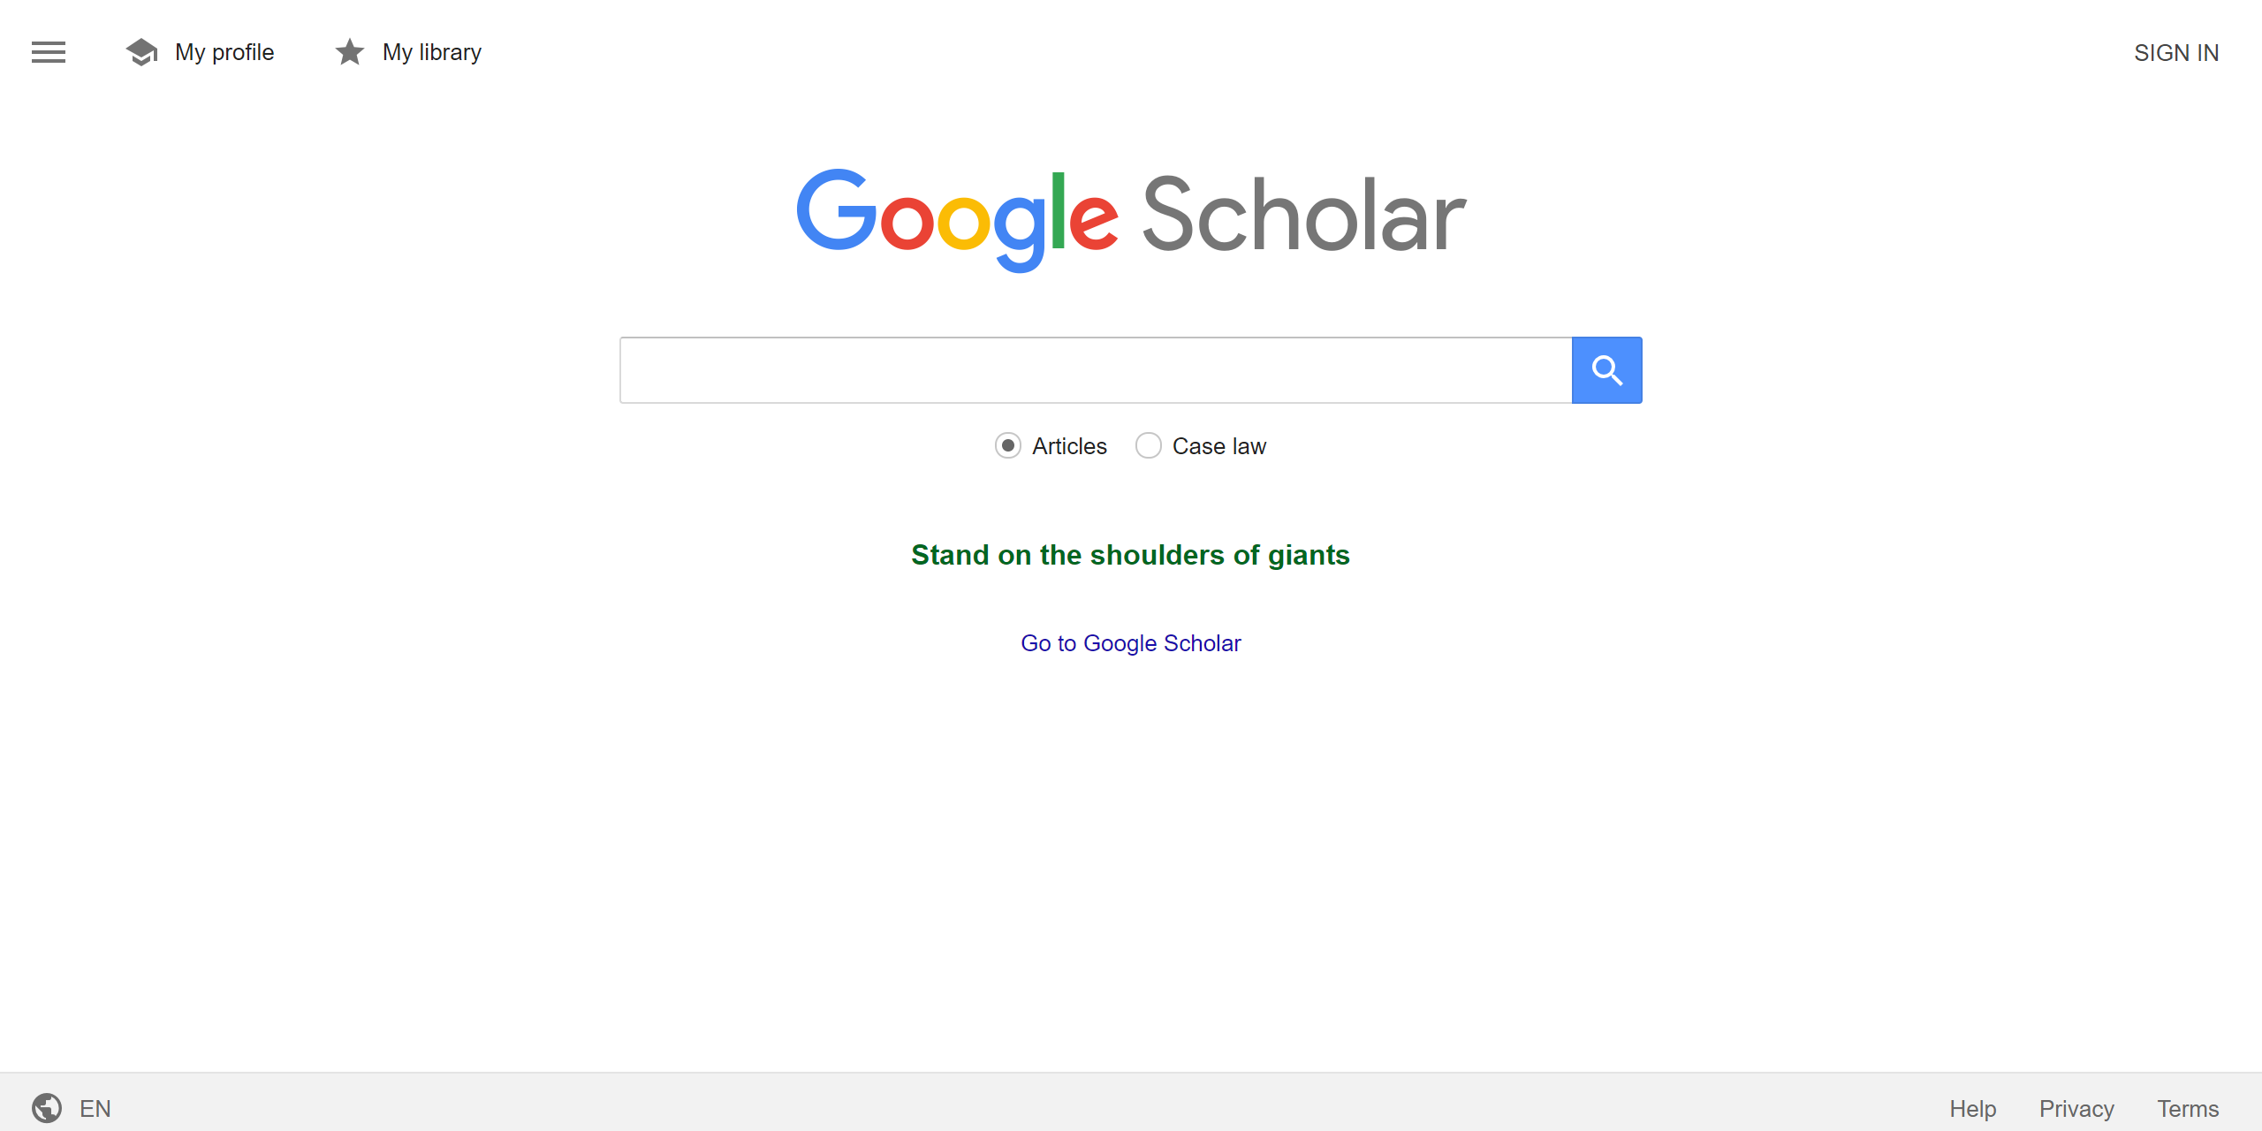
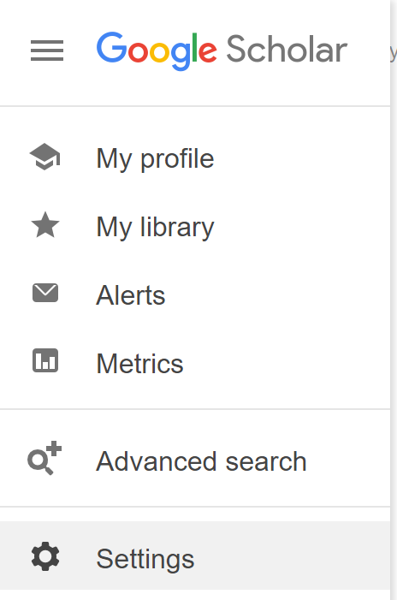
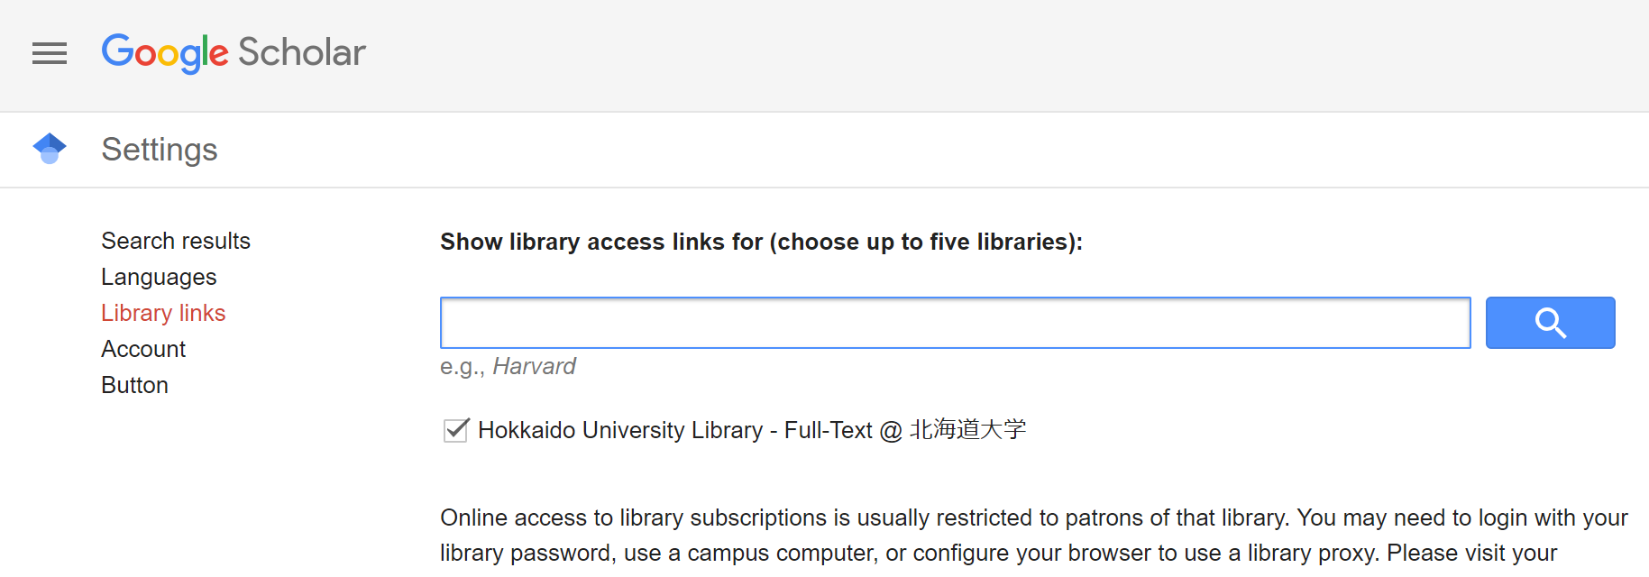
1) Widely in a familiar way : Google Scholar
If signed in to Google account
you can save the bibliographic data in ”My library”
Check where to search also!
Select “Hokkaido University Library - Full-Text @ 北海道大学” at “Library links”

Slide 5
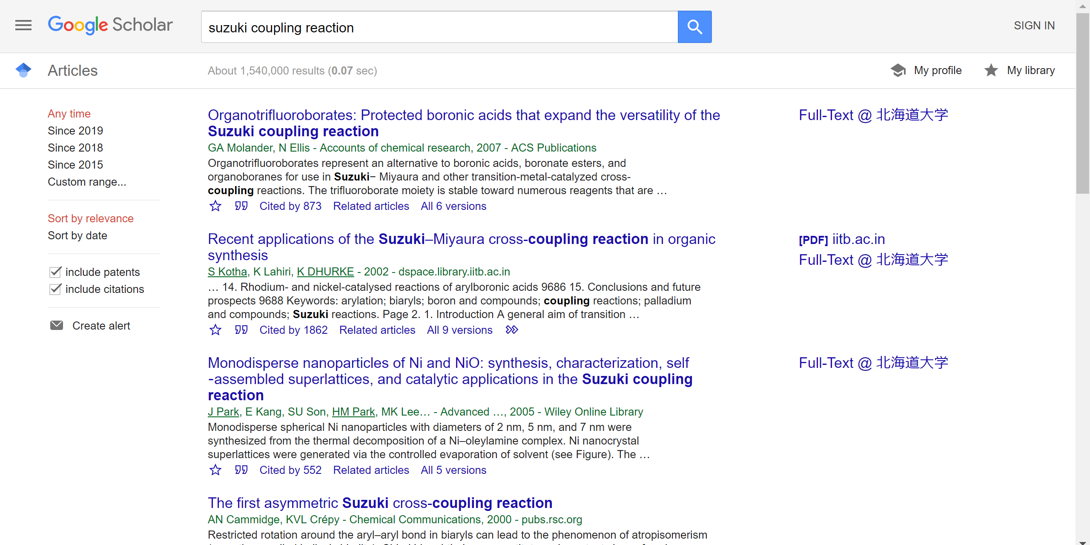
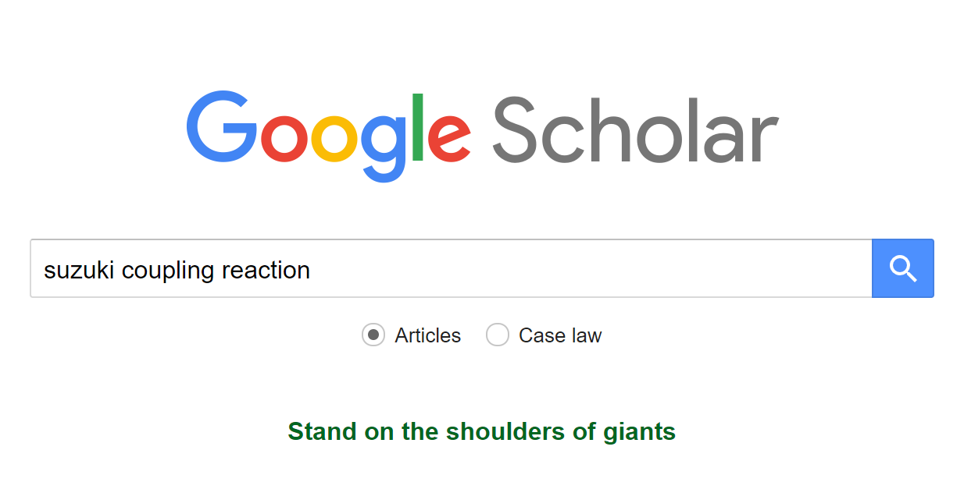
1) Widely in a familiar way : Google Scholar
Save the data to “My library”
When searching for the articles containing
AAA for the title, BBB for the author,
and CCC for the publication,
enter “allintitle:AAA author:BBB source:CCC”
Narrow the results
Refer other versions (author version etc.)

Slide 6
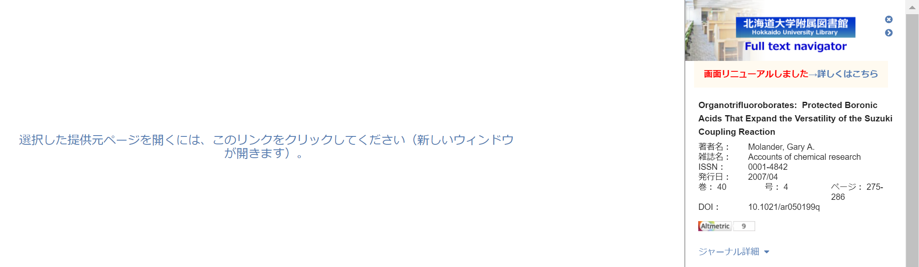
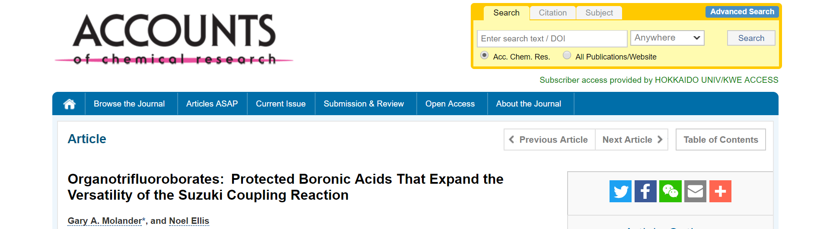
1) Widely in a familiar way : Google Scholar
Navigation to PDF of the article
by “Full-Text @ 北海道大学”

Slide 7
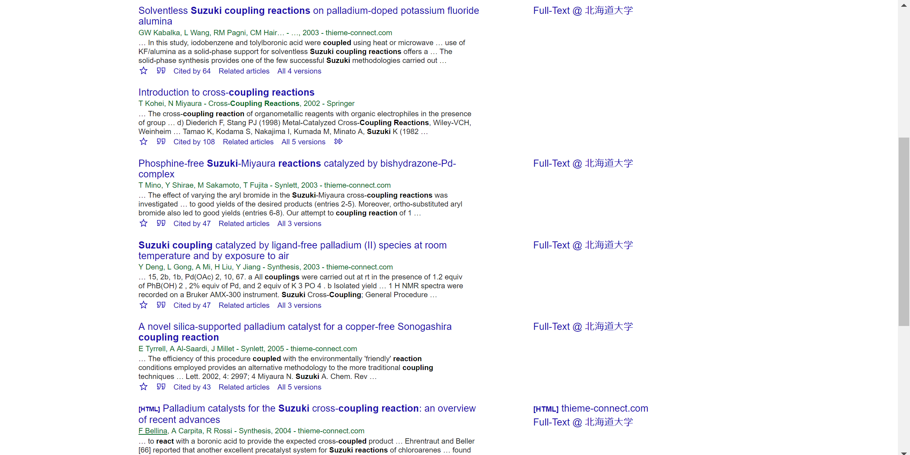
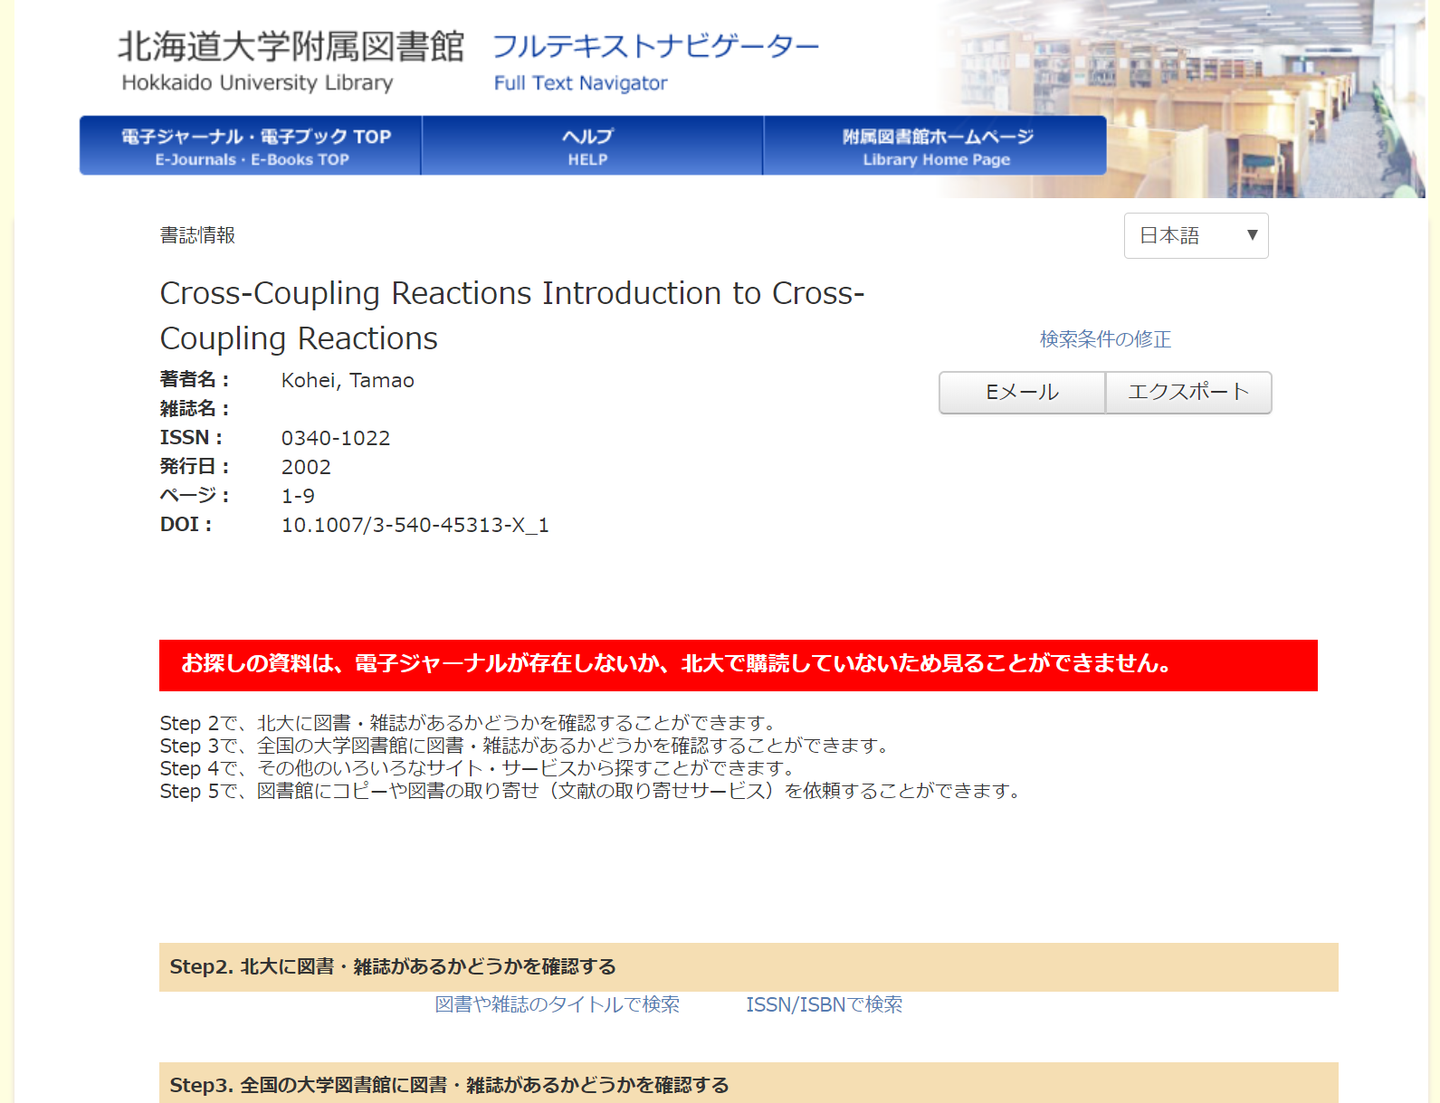
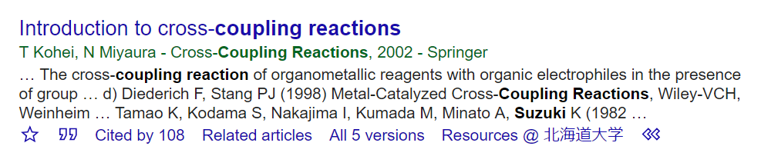
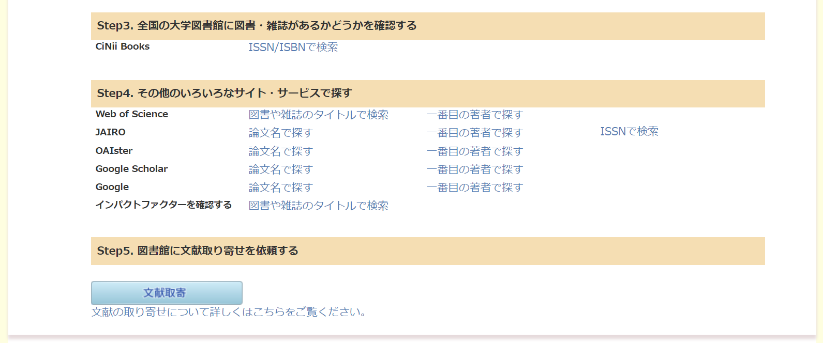
1) Widely in a familiar way : Google Scholar
When “Full-Text @ 北海道大学” does not appear,
check “Resources @ 北海道大学” for other ways to access Full-Text
Open

Slide 8
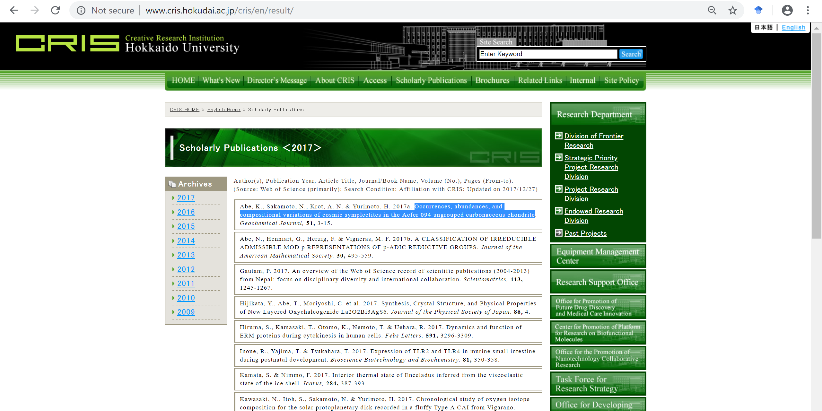
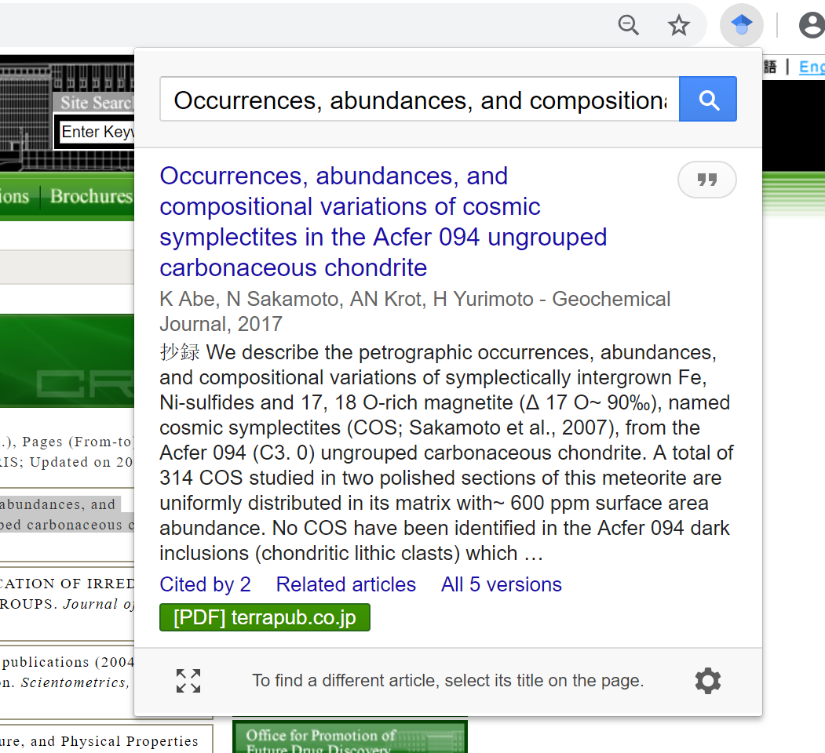
1) Widely in a familiar way : Google Scholar
The browser plug-in "Google Scholar Button“
seamlessly changes Web-browsing to scholarly search

Slide 9
2) Focusing on Top Journals analytically : Web of Science
Google Scholar
- shows us too many articles to choose
Web of Science
- focuses on papers in Top Journals (excludes “predatory journals”)
- describes detailed data of documents
- covers citations between documents
Time

Slide 10
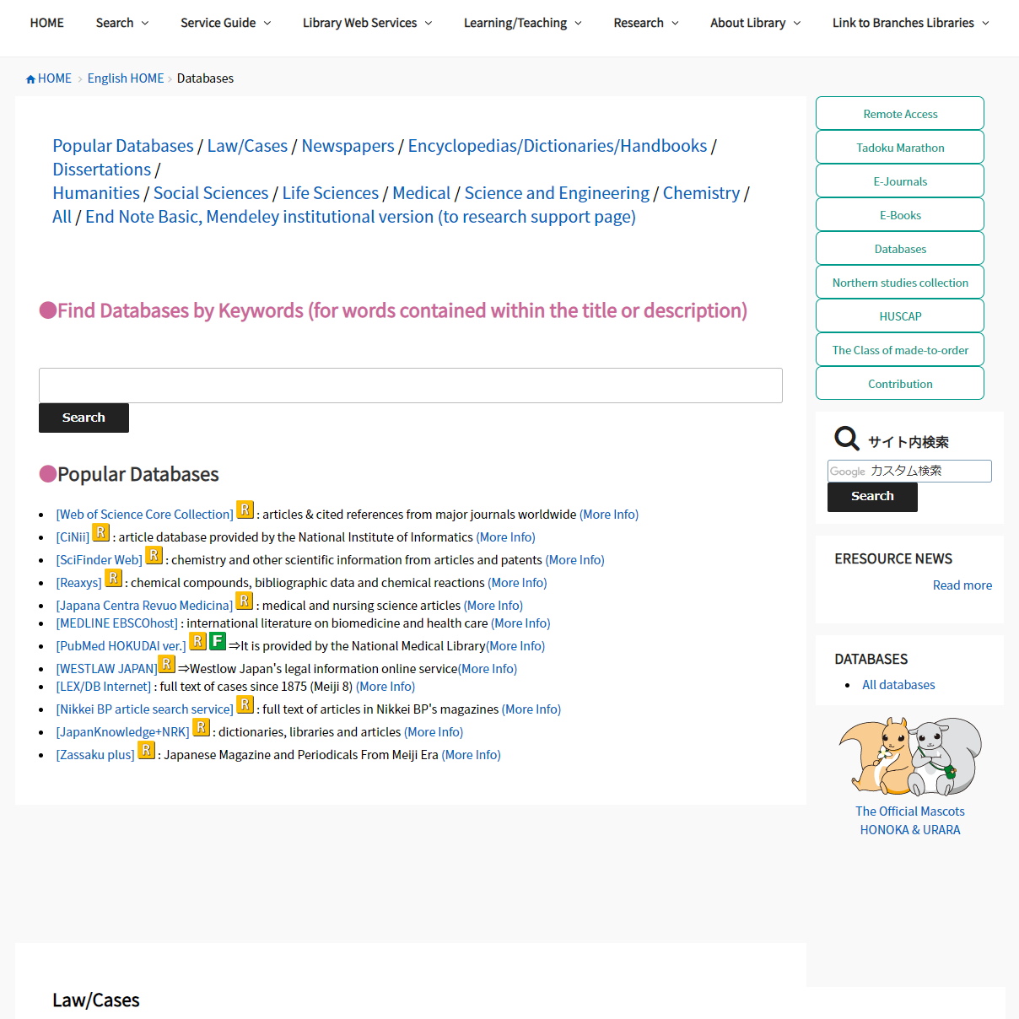
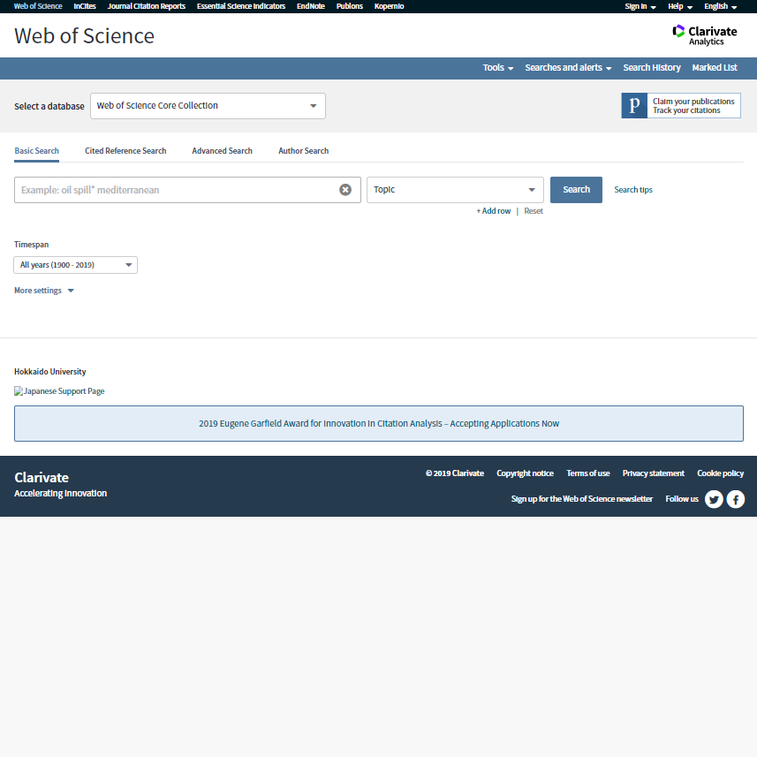
2) Focusing on Top Journals analytically : Web of Science
https://www.lib.hokudai.ac.jp/en
http://webofknowledge.com/WOS

Slide 11
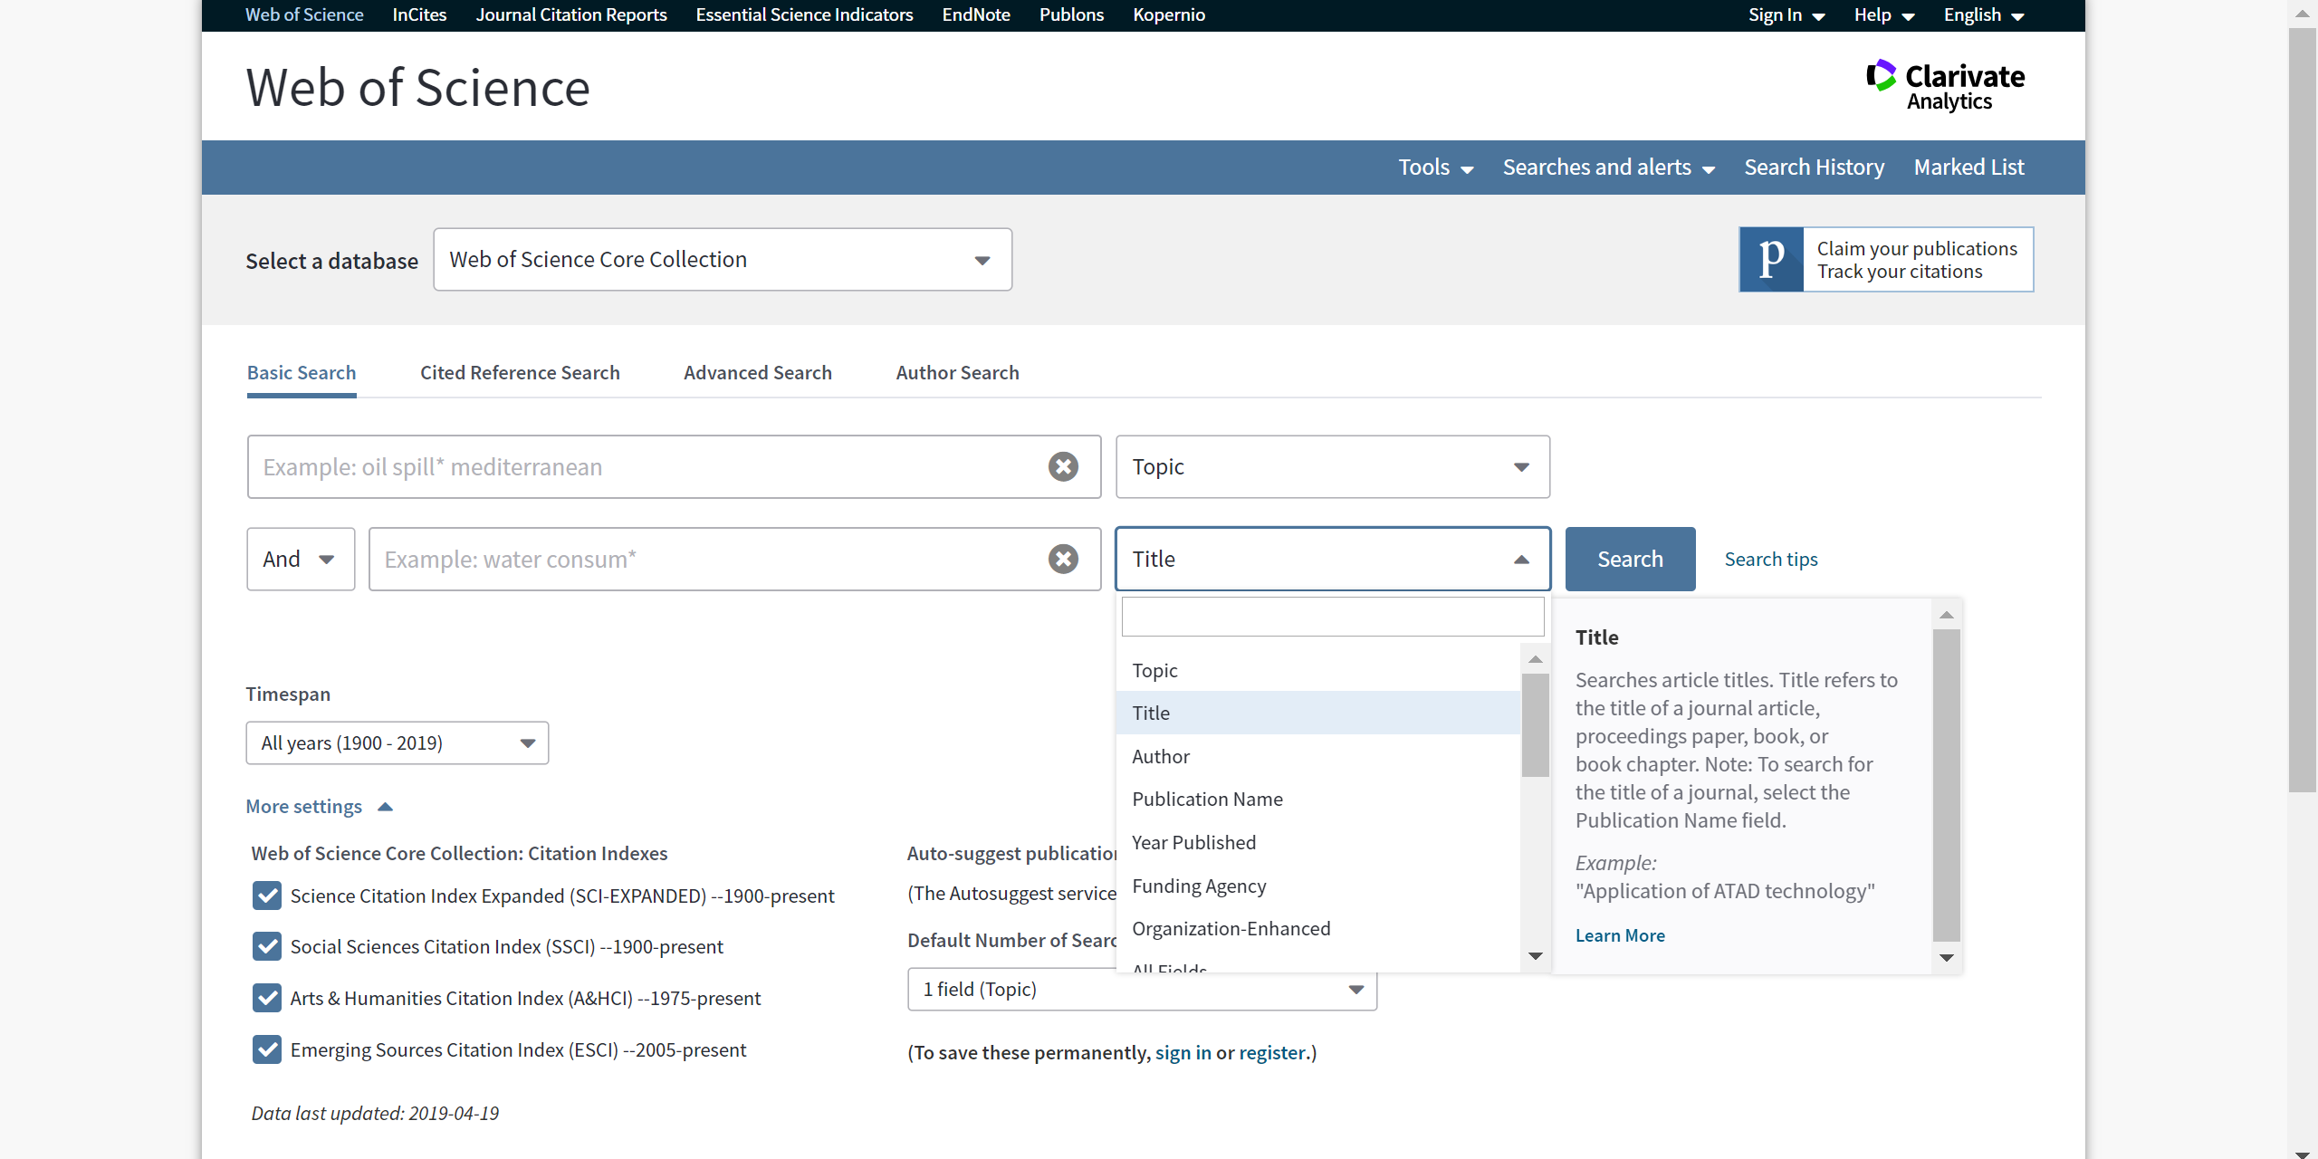
2) Focusing on Top Journals analytically : Web of Science
Complex cross search is available
Hokkaido University uses (subscribes) the indexes of journals only

Slide 12
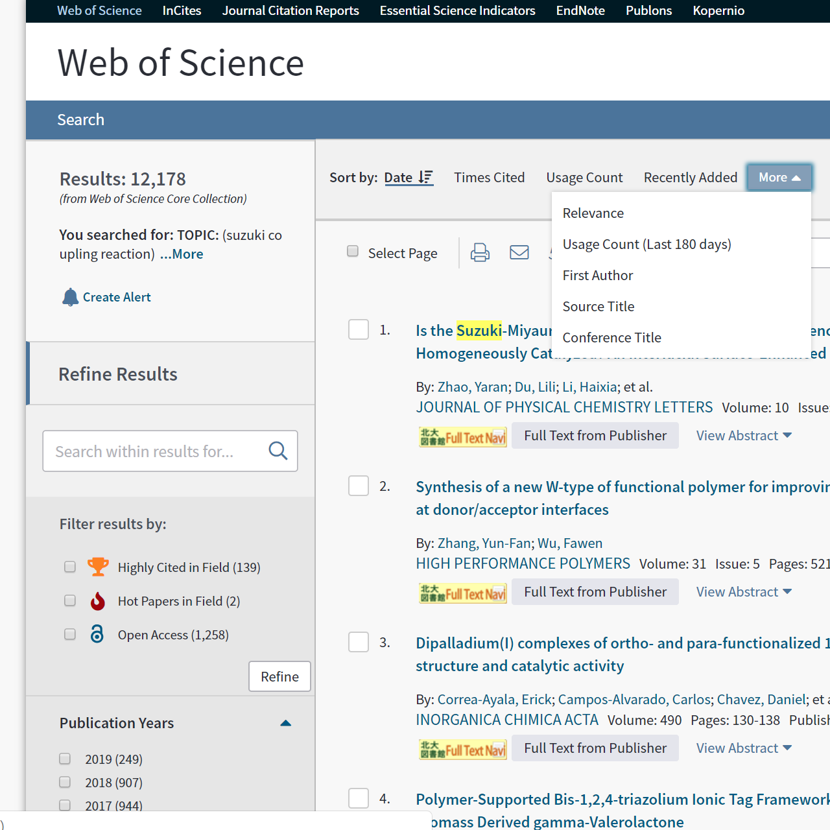
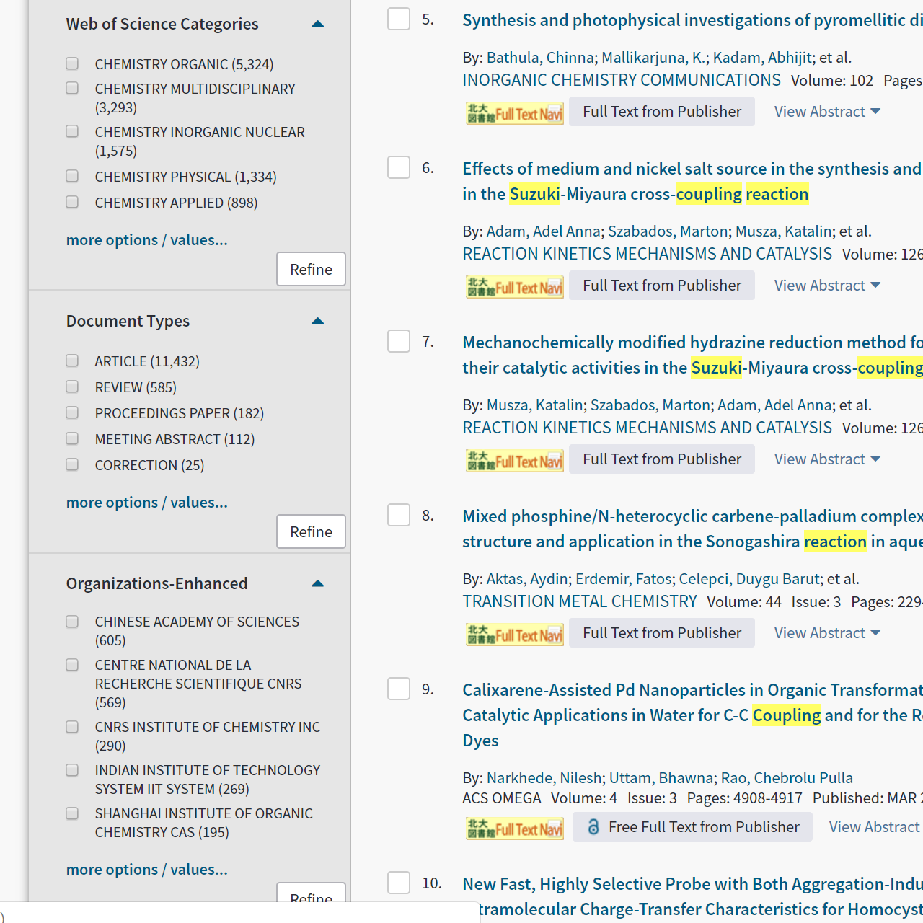
2) Focusing on Top Journals analytically : Web of Science
Sort from different perspectives
Narrow by scholarly
categories of journals
Compare abstracts
in one screen
Narrow by document types
Learn about trends
in a field with REVIEW
Narrow to top papers
cited many times

Slide 13
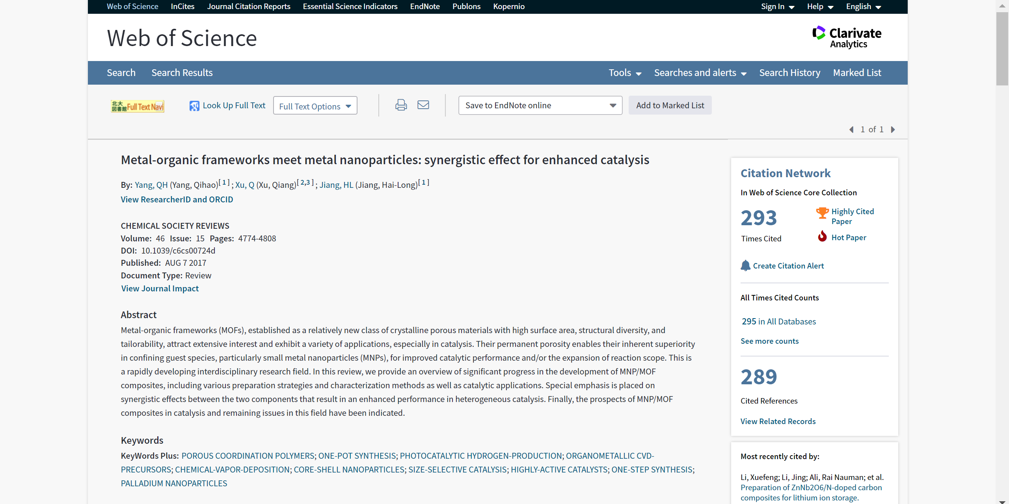
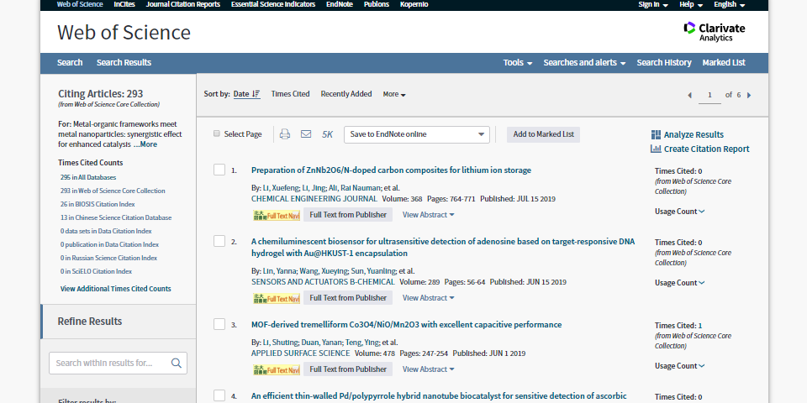

2) Focusing on Top Journals analytically : Web of Science
Navigate to PDF
* Suggest alternatives if not subscribed
Papers citing this paper

Slide 14
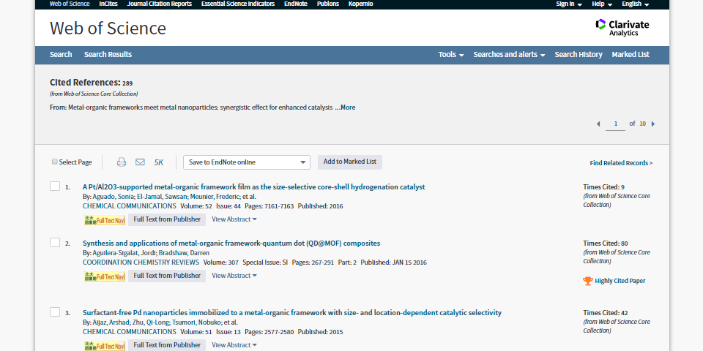
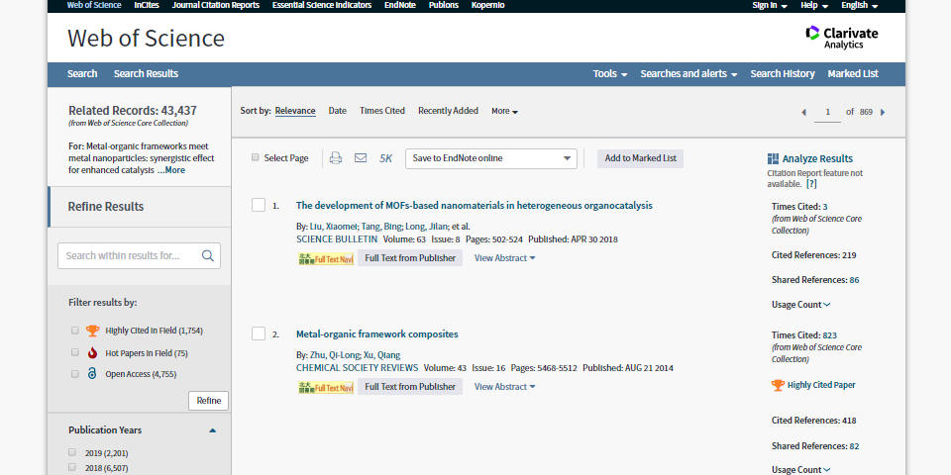
2) Focusing on Top Journals analytically : Web of Science
Papers cited by this paper
= this paper‘s references
Papers sharing references with this paper

Slide 15
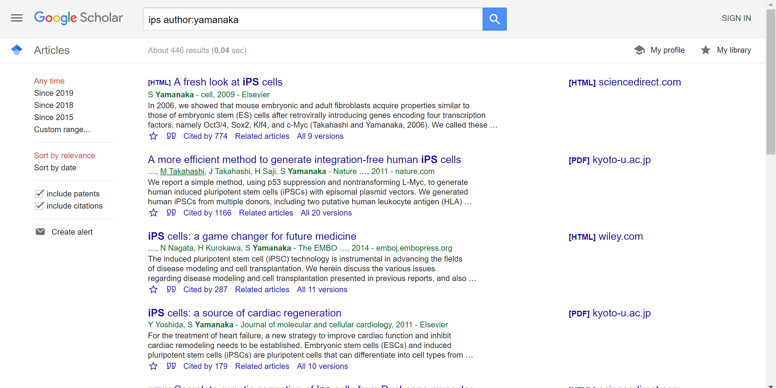
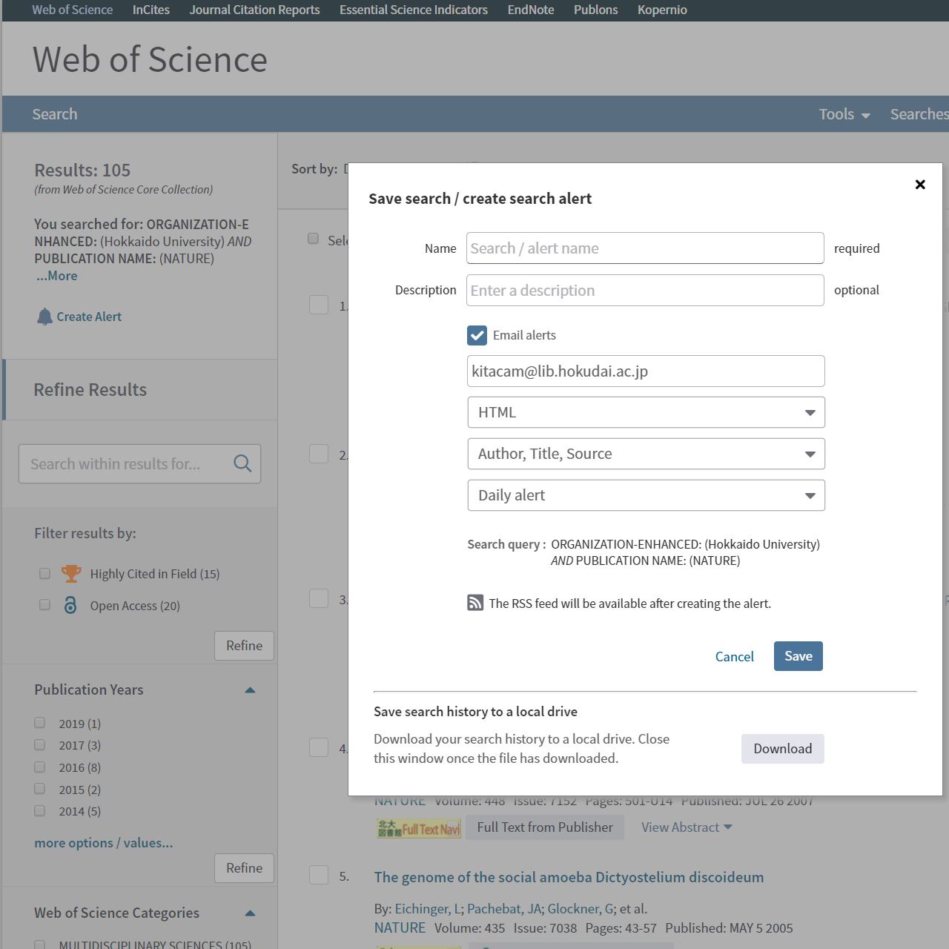
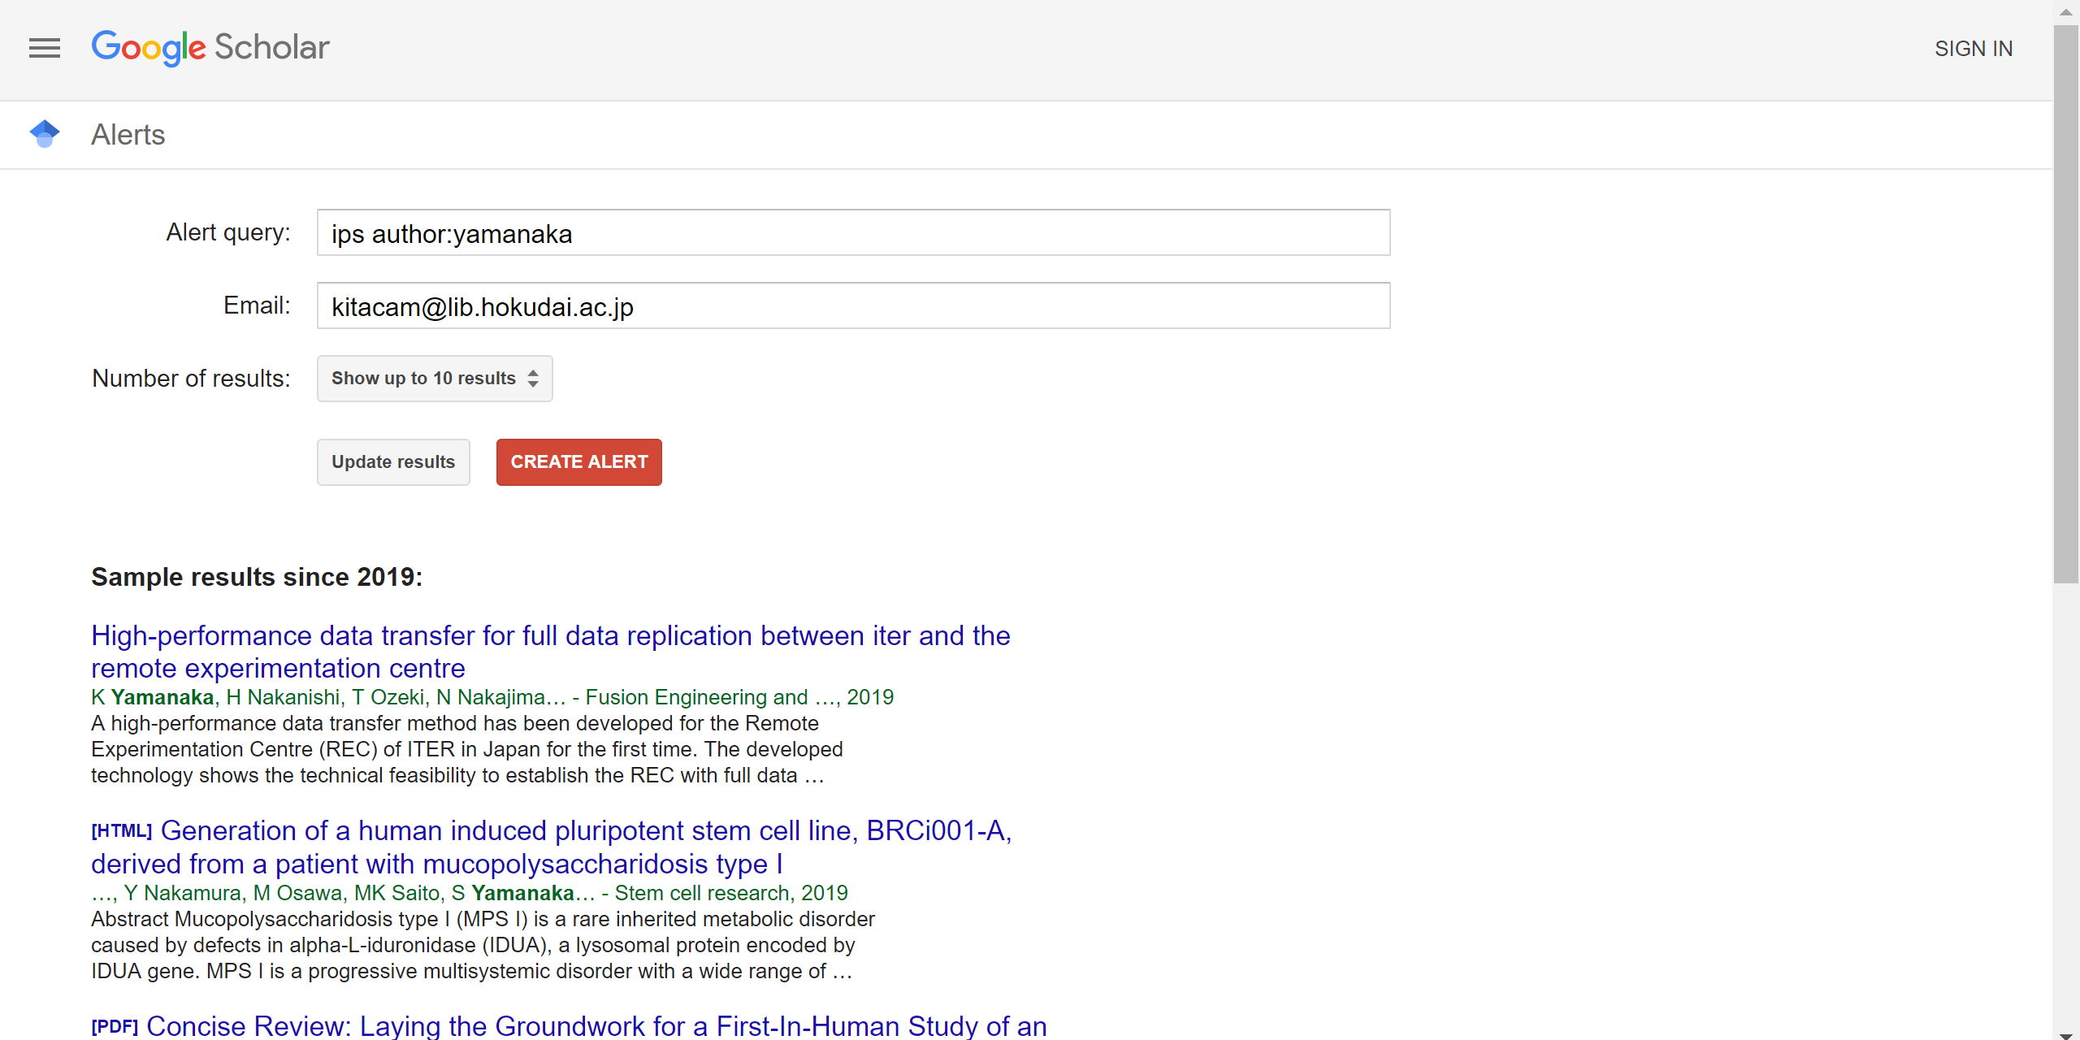
3) Periodically and Automatically : Search Alert

Slide 16
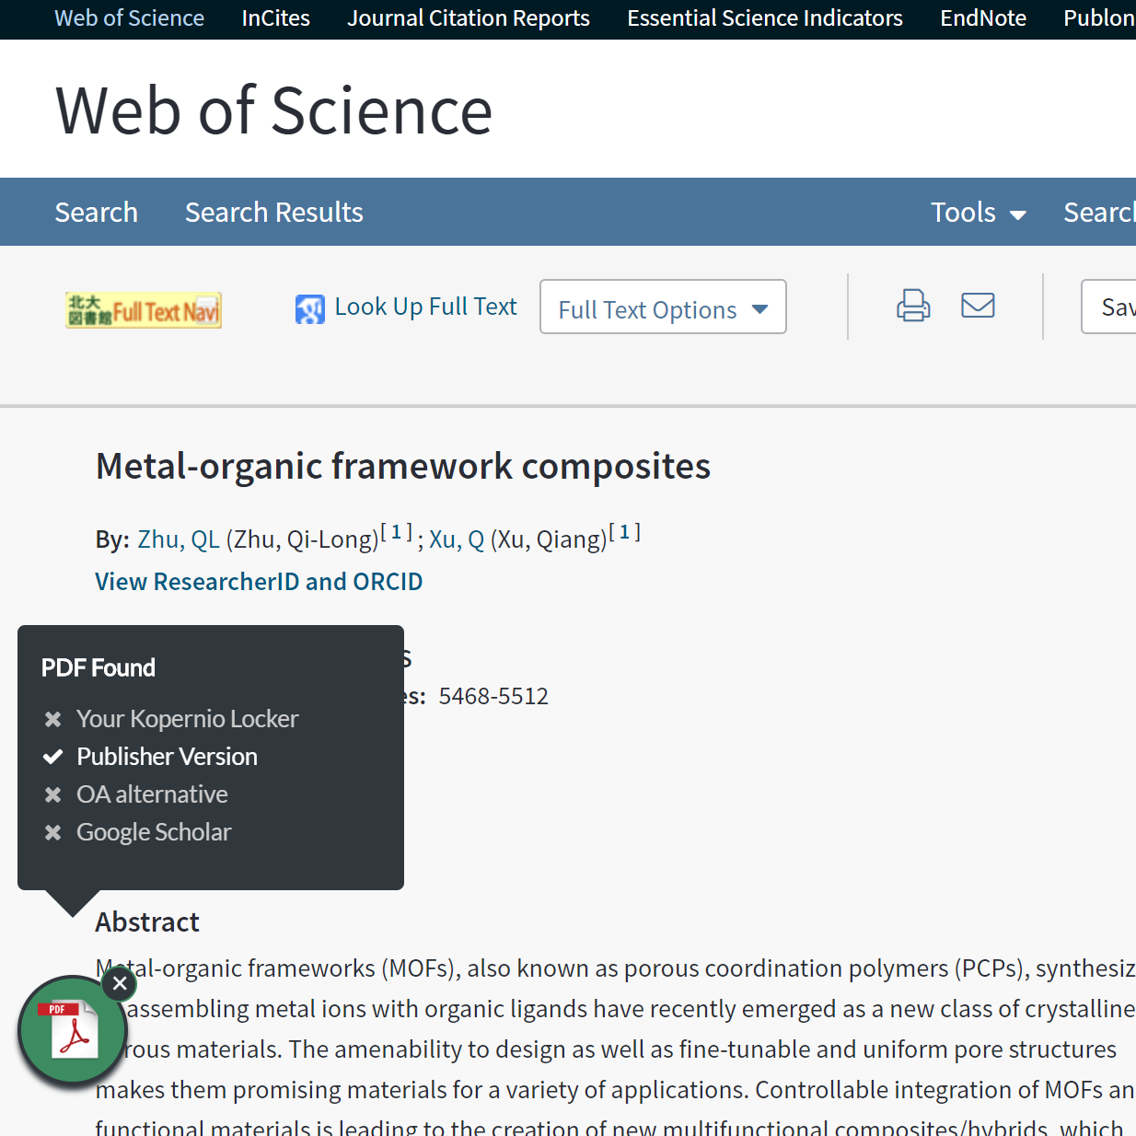
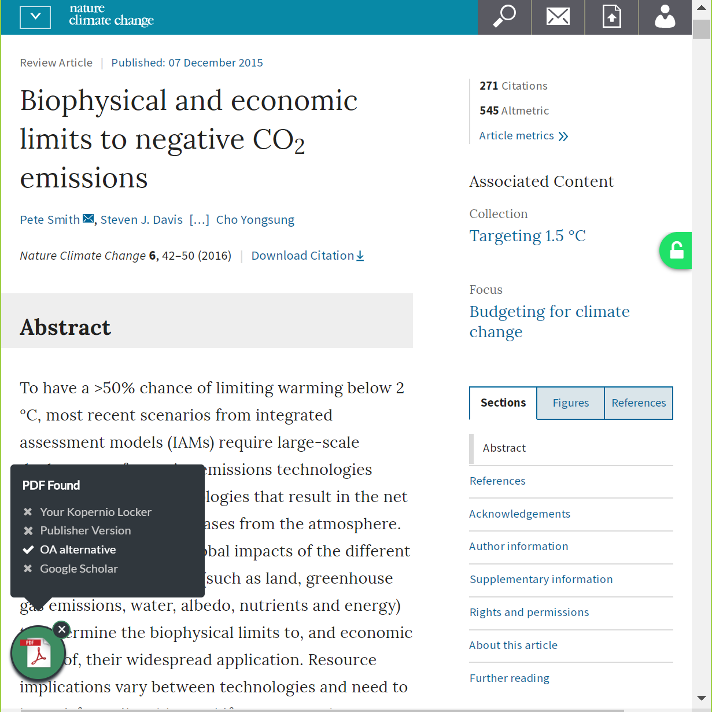
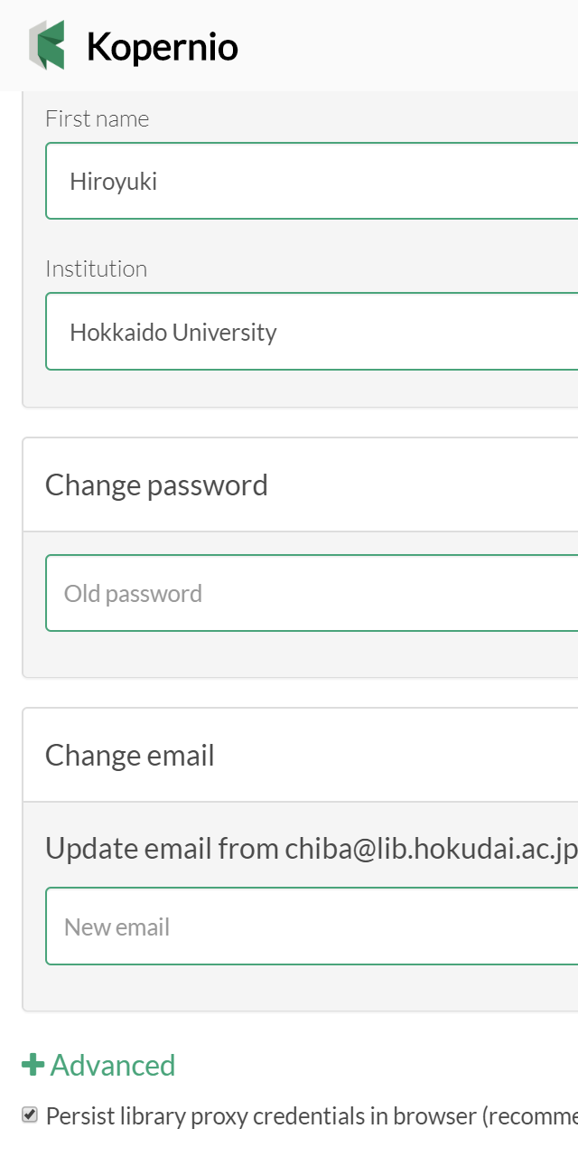
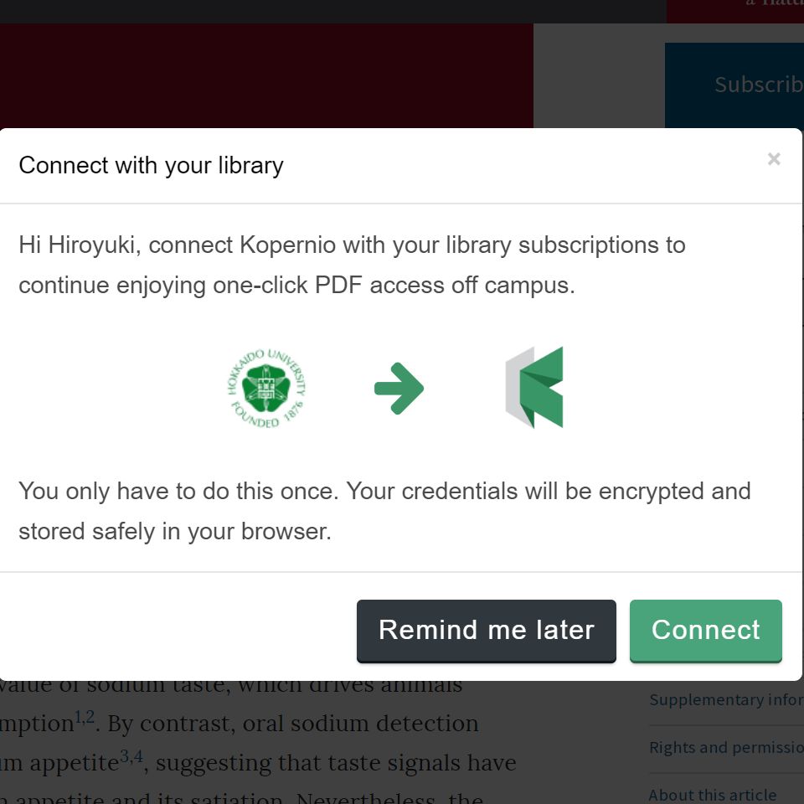
4) Quickly with 1 click : Kopernio, Unpaywall etc.
The browser plug-in “Kopernio” automatically
finds the available version of PDF
“Unpaywall” also automatically finds
the Open Access version of the paper
Access the subscribed papers
from outside the campus as well
https://unpaywall.org
https://kopernio.com

Slide 17



5) From outside the campus : Remote Access
Surface Web
Crawlable
Database
Open Access
Journal
Bibliographic
Data
Off Campus
Full Text
(CiNii)
(PLOS ONE)
Paywalled Journal
unsubscribed by Univ.
Paywalled Journal
subscribed by Univ.
Bibliographic
Data
Bibliographic
Data
Remote Access
Deep Web
Full Text
Full Text
(Nature Catalysis)
(Nature)
On Campus
Paywalled Database
unsubscribed by Univ.
Paywalled Database
subscribed by Univ.
(Scopus)
(Web of Science)

Slide 18
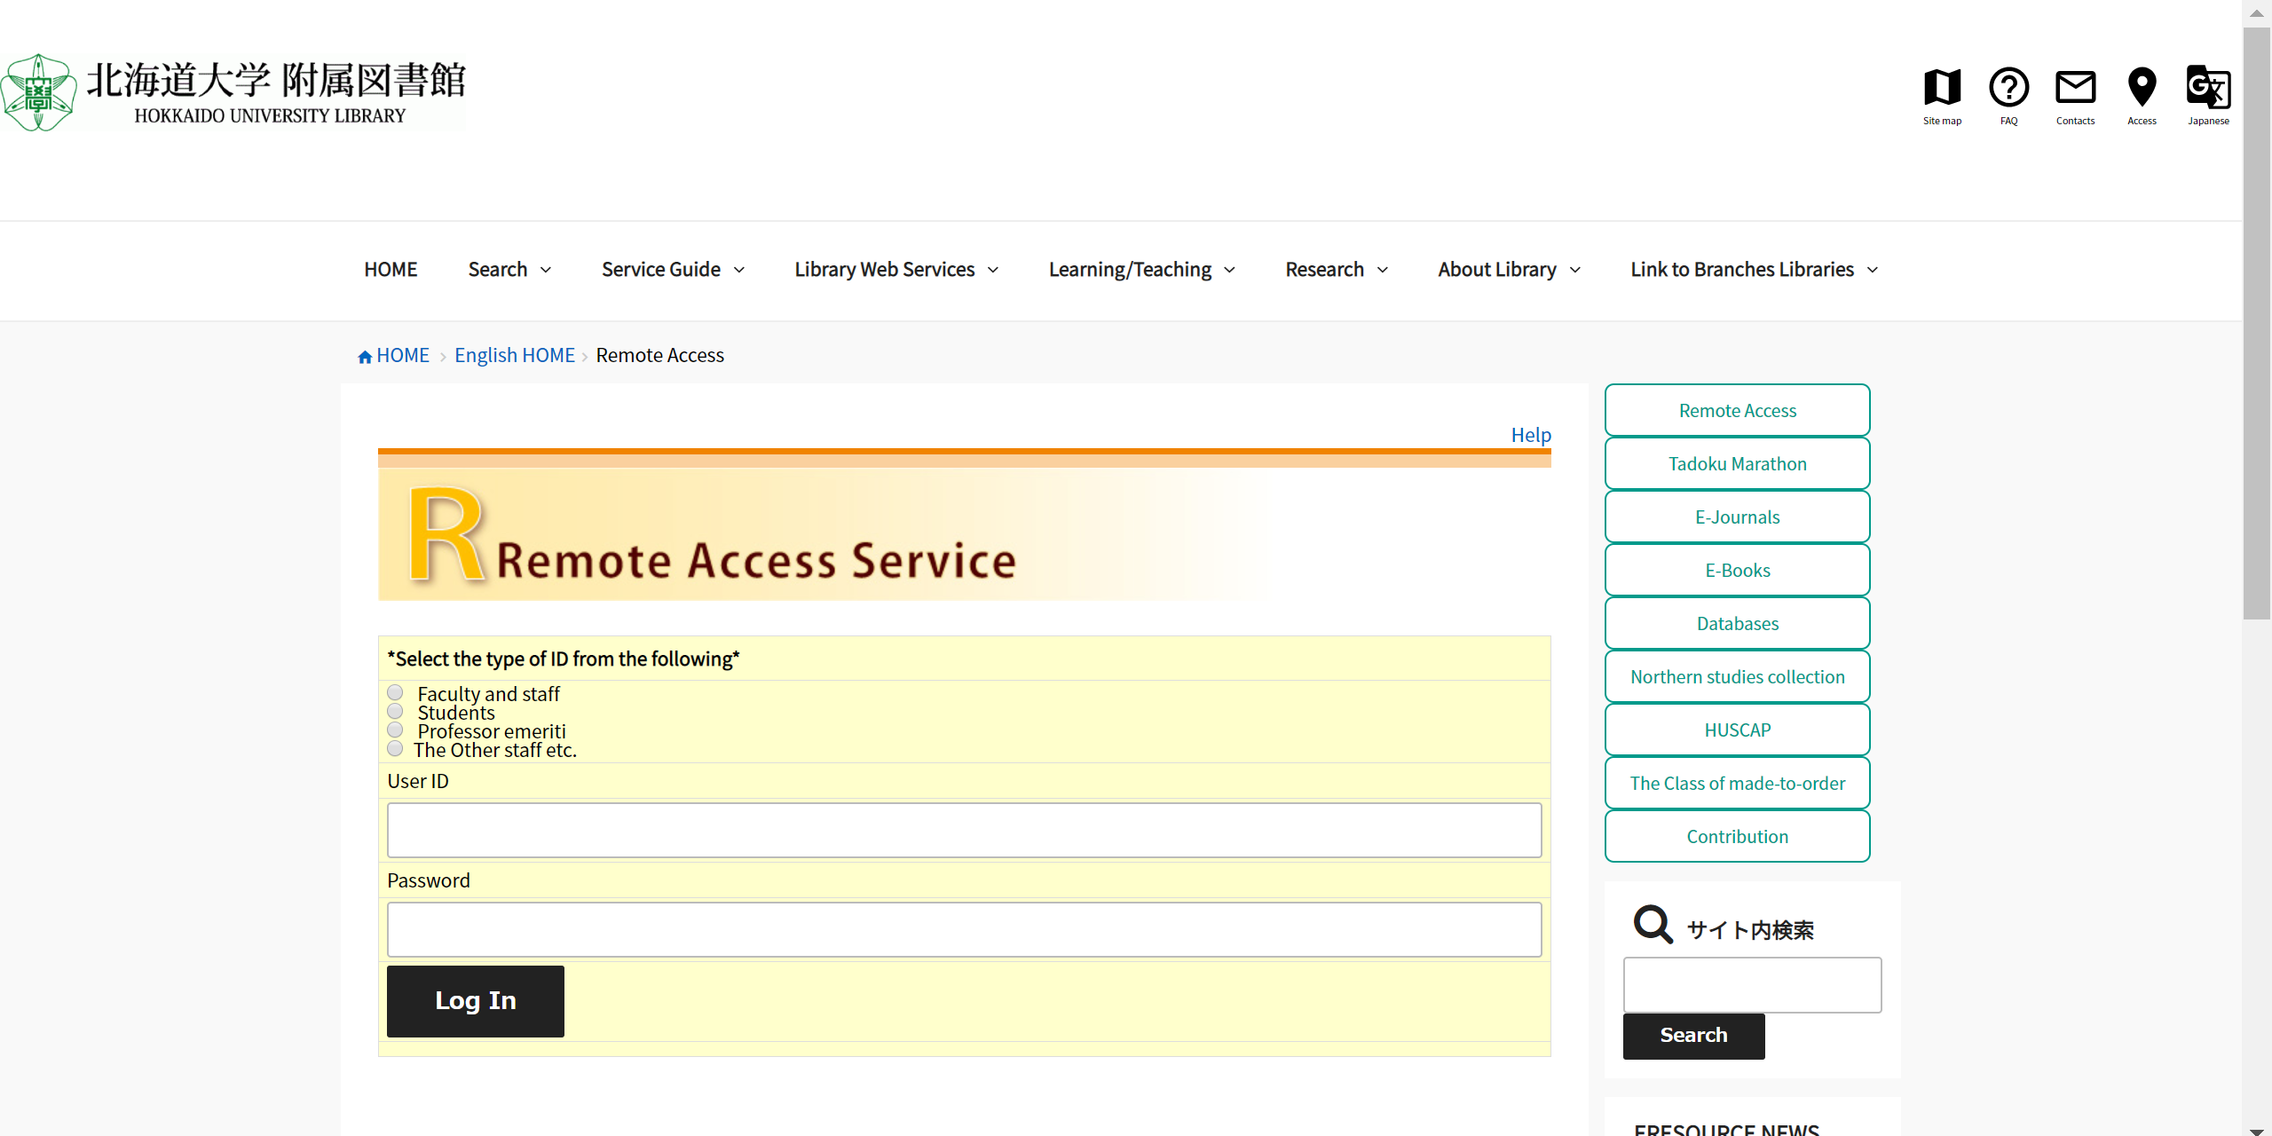
5) From outside the campus : Remote Access
ID/PW=＿＿＿＿＿
https://www.lib.hokudai.ac.jp/en/remote-access

Slide 19
TRY
LATER
AND
ASK
ME
ANYTIME:
kitacam@lib.hokudai.ac.jp

