Slide 1
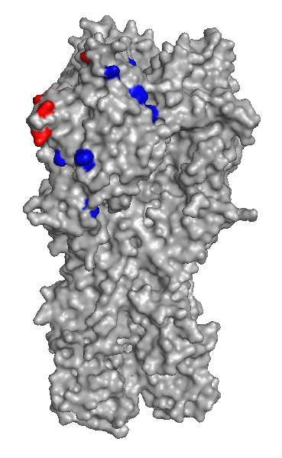
Supplementary Fig. 2.
Wang et al.,
D194N
K209N
T130S
T239S
R134T/Q
T139A
T68A
F71L
V47I
Amino acid substitutions at supposed antigenic site
(T130S, R134T/Q, N136-, T139A, K151N/E, T186V/A, K187R, T188Q/K, D194N)
Amino acid substitutions at outside of the antigenic site
(V47I, T68A, F71L, K209N, T239S)

