Slide 1

SciFinder
Start-up
Guidance
Hokkaido University
Northern Campus Library
October 2019

Slide 2
SciFinder Start-up Guidance
SciFinder
an online database provided by
CAS (Chemical Abstract Service),
a division of ACS (American Chemical Society)
provides information of
References (papers, conference papers, patents …)
Substances (containing all CAS Registry Number)
Reactions …
requires one account per person

Slide 3




SciFinder Start-up Guidance
From the perspective of a non-chemist
2. Overview
  - Reference Search
  - Substance Search
  - Reaction Search
1. Registration
  your own e-mail address of “hokudai.ac.jp” needed
SciFinder
3. Helps and Tips
  Especially
  Workshop by
  a professional instructor
  on Oct. 16th
Please use later
and join!

Slide 4
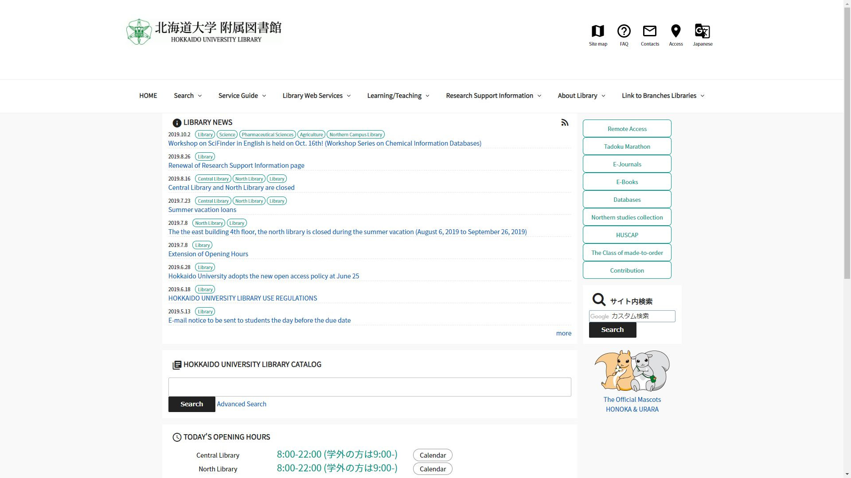
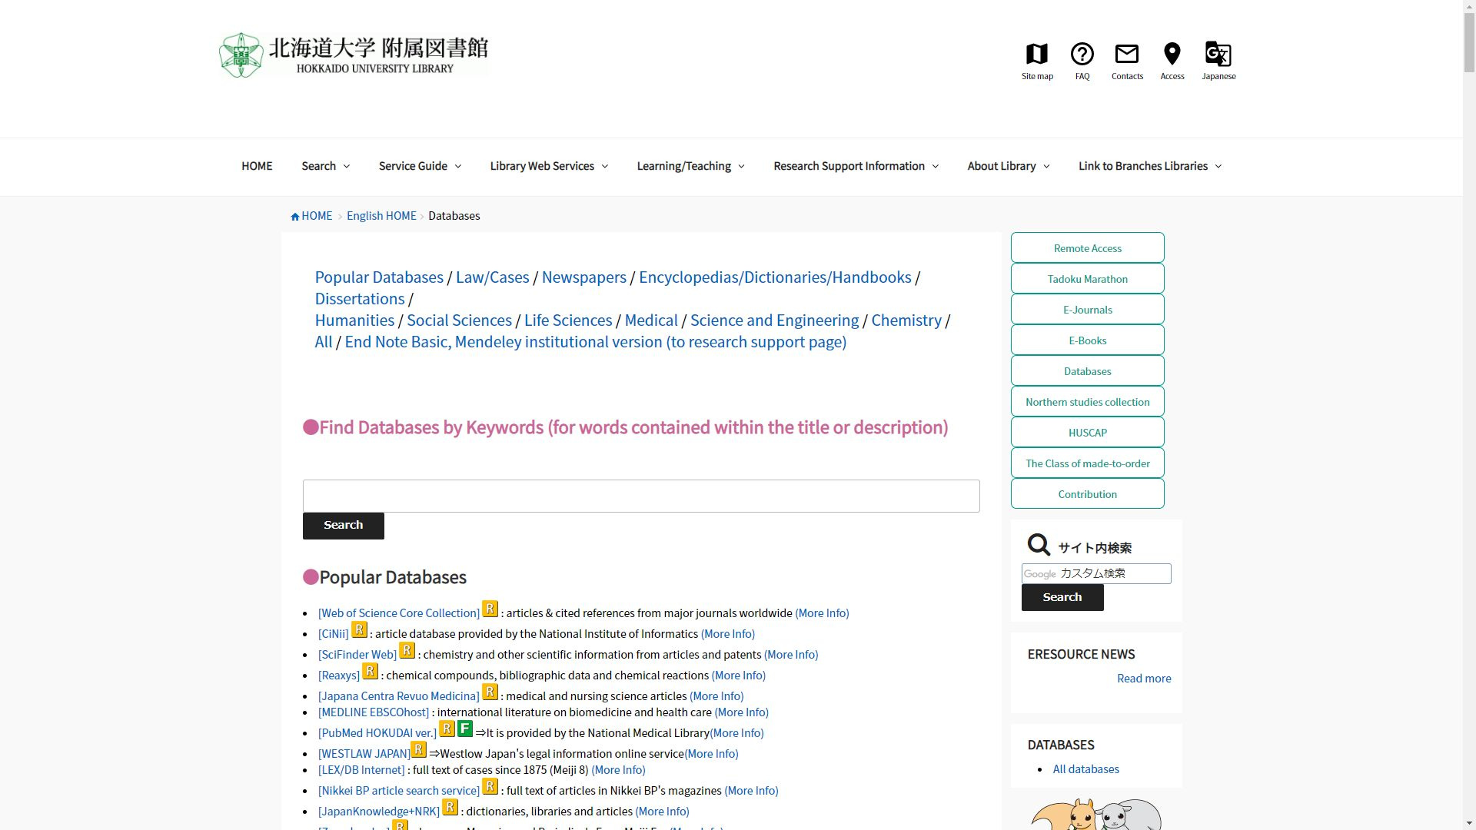
1. Registration
https://www.lib.hokudai.ac.jp/en

Slide 5
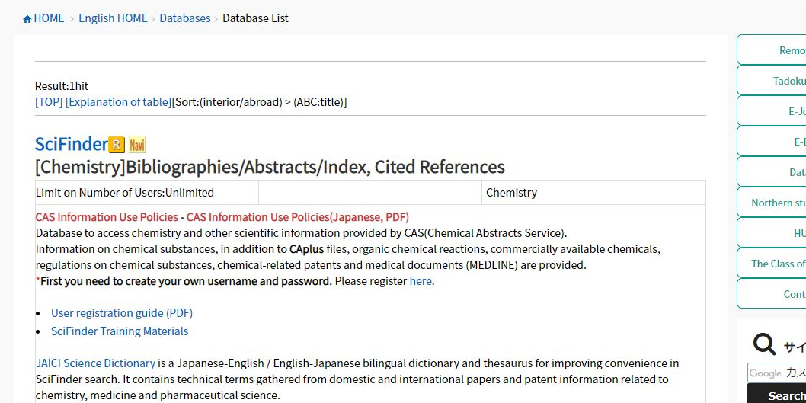
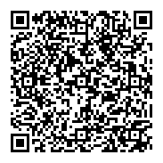
1. Registration
… or access →

Slide 6
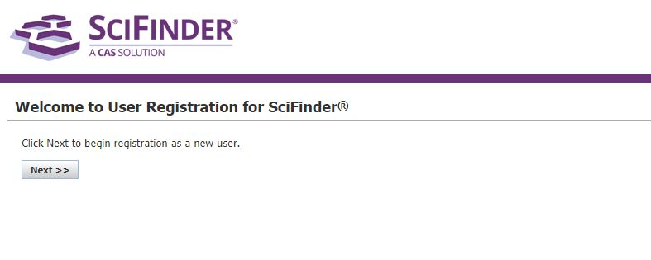
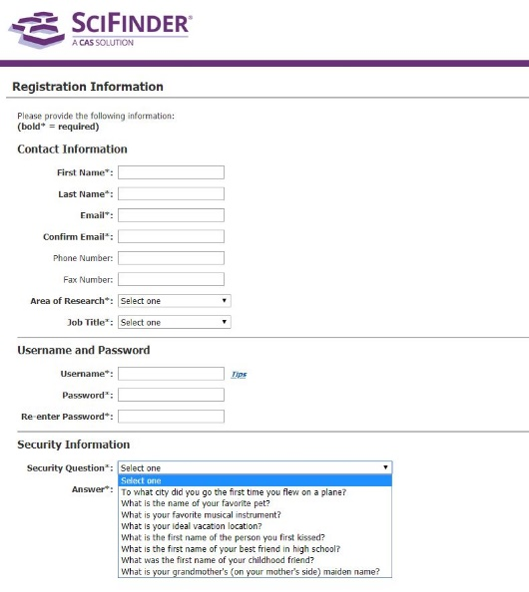
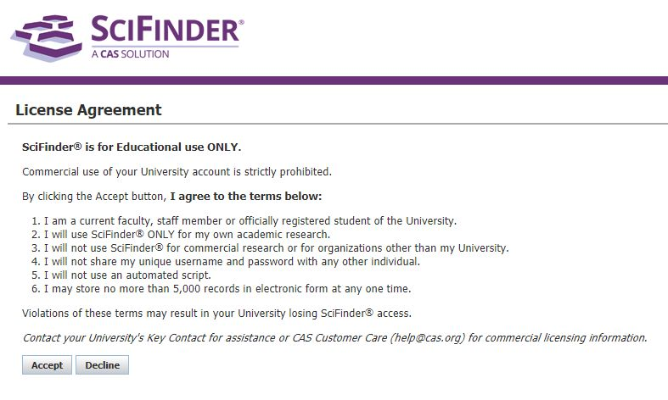
1. Registration
a
xxx@xxx.hokudai.ac.jp
* unavailable: @frontier.hokudai.ac.jp
5 - 15 half-width characters
* available: - _ . @
7 - 15 half-width characters
AND
including 3 types
of the followings:
- Uppercase letter(s)
- Lowercase letter(s)
- Number(s)
- @ # % & * …

Slide 7
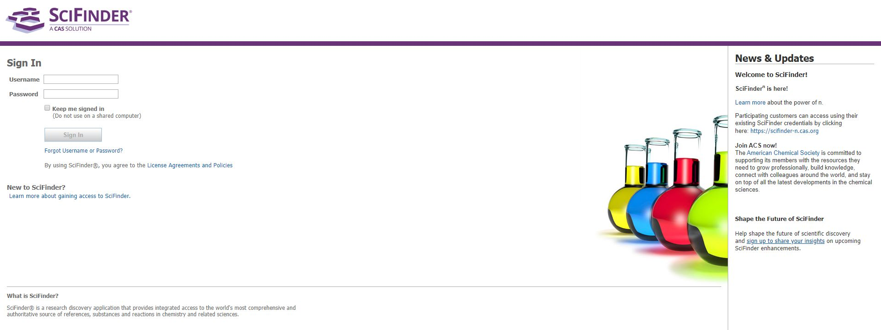
1. Registration
After clicking the link in the e-mail from CAS,
access http://scifinder.cas.org

Slide 8
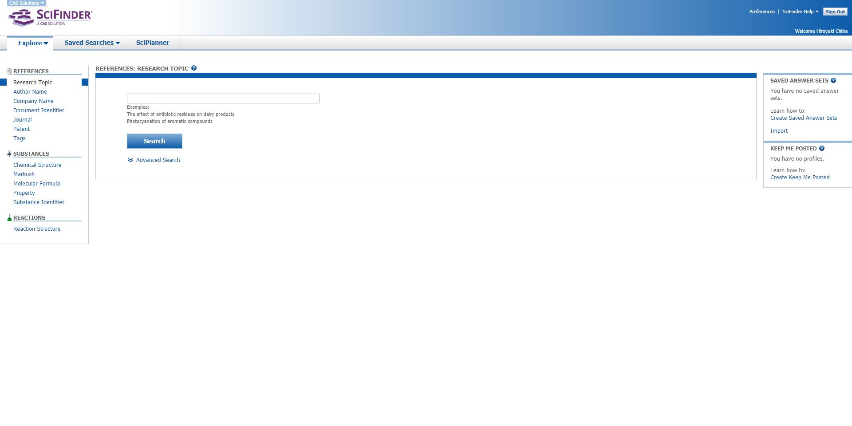
2. Overview
You can move from one search category to the others.
For example, after you find a reference,
you can also find the substances and reactions mentioned on it.

Slide 9
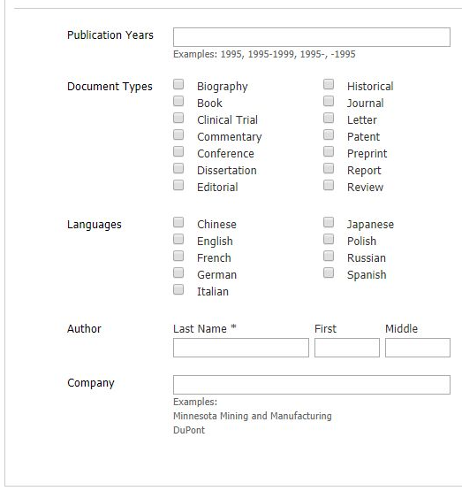
2. Overview

Slide 10

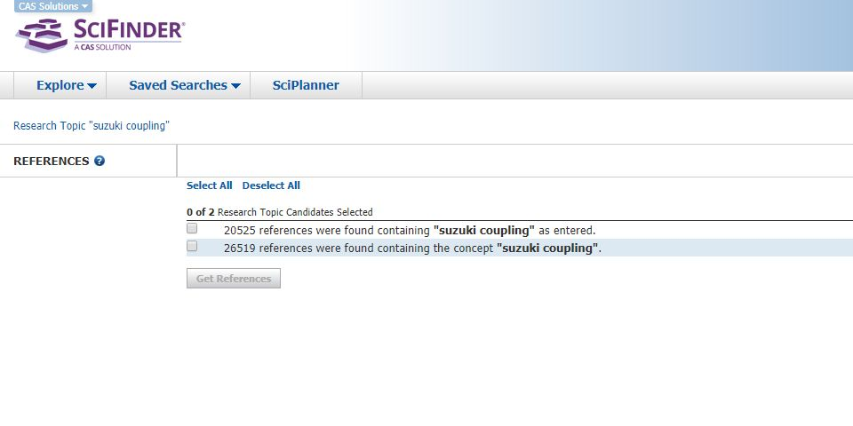
2. Overview

Slide 11
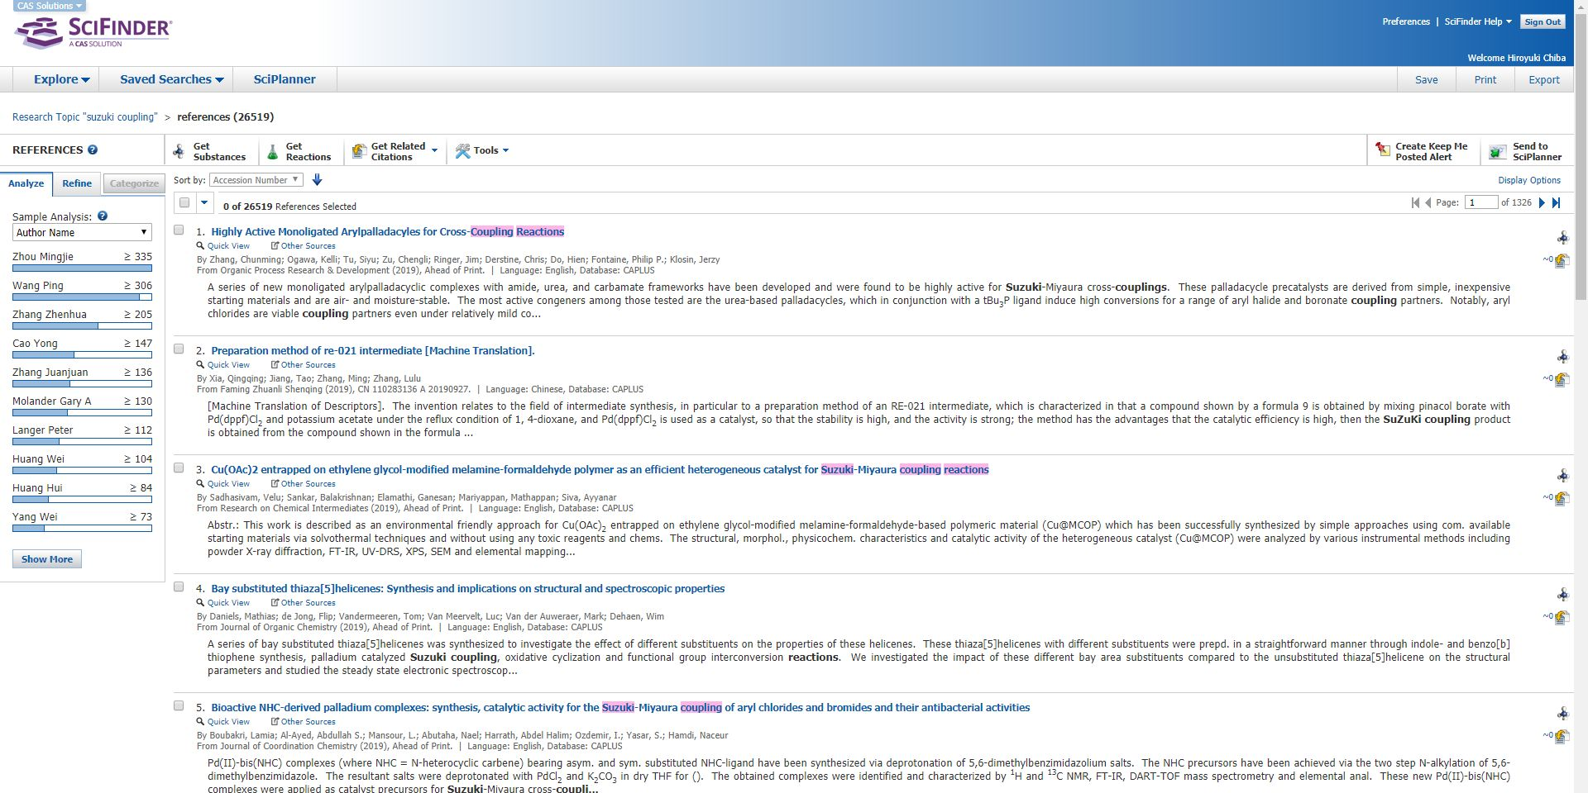
2. Overview
Sort the results by:
- Accession Number
- Author Name
- Citing References
- Publication Year
- Title
Refine the results by:
- Research Topic
- Author
- Company Name
- Publication Year
- Language
- Database

Slide 12
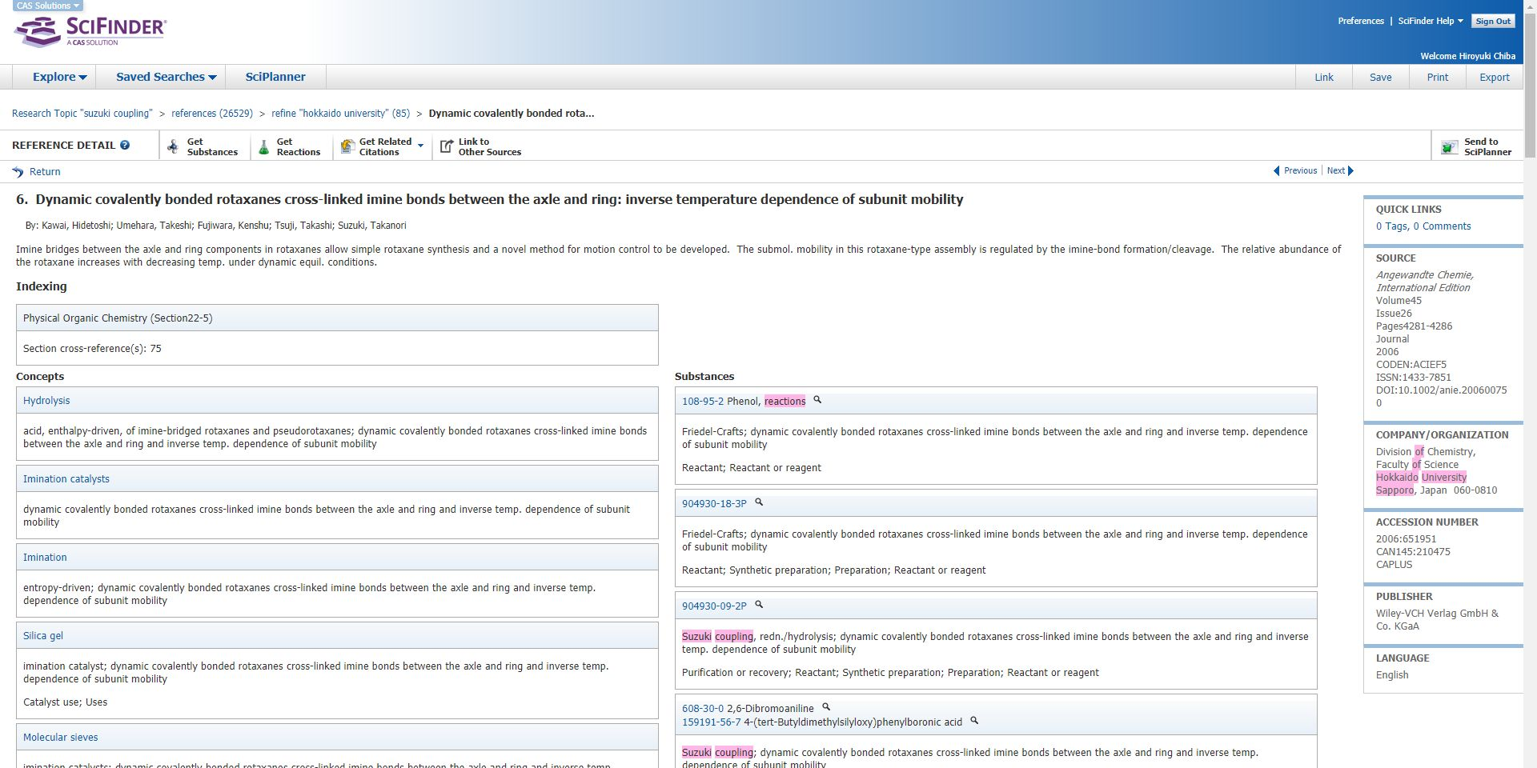
2. Overview
Title
Author(s)
Abstract
References cited by this reference below

Slide 13
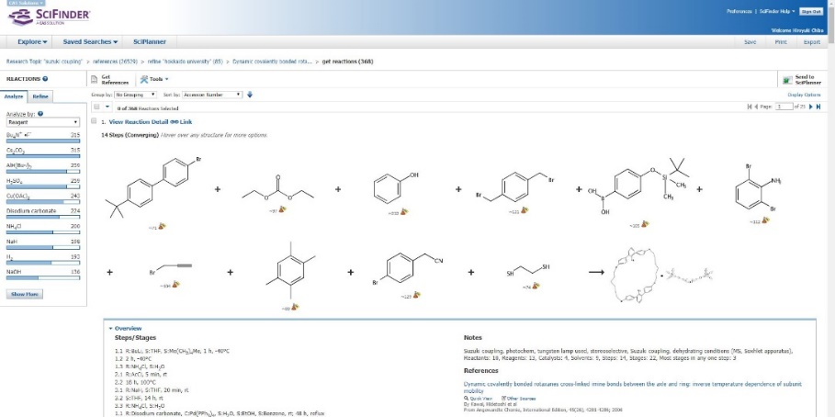
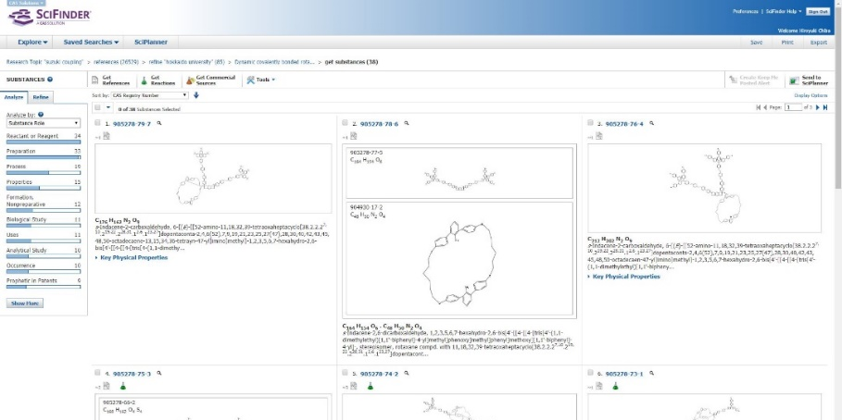
2. Overview
Citing / cited references
Link to the full-text of this reference
* The full-text Hokkaido University does not subscribe is unavailable
Reactions
Substances

Slide 14
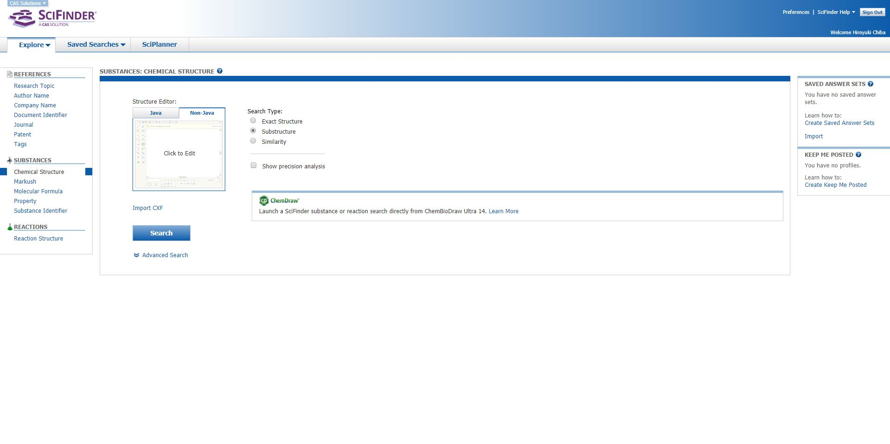
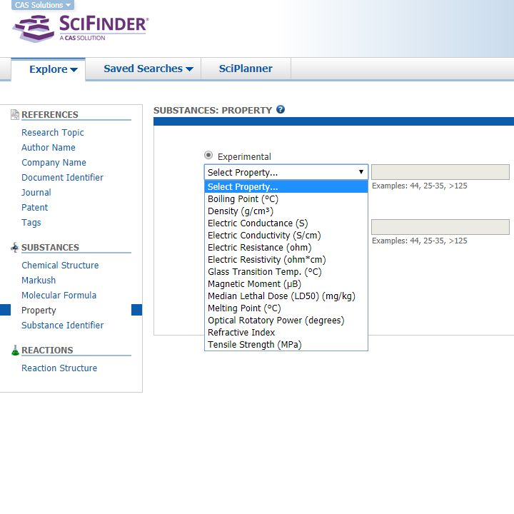
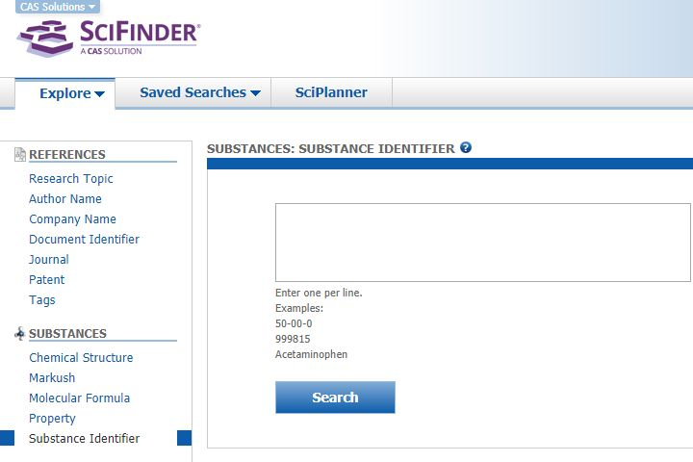
2. Overview
Search by experimental /
predicted properties
Search for multiple substances
at once by:
- CAS Registry Number
- common name
- product name ...

Slide 15
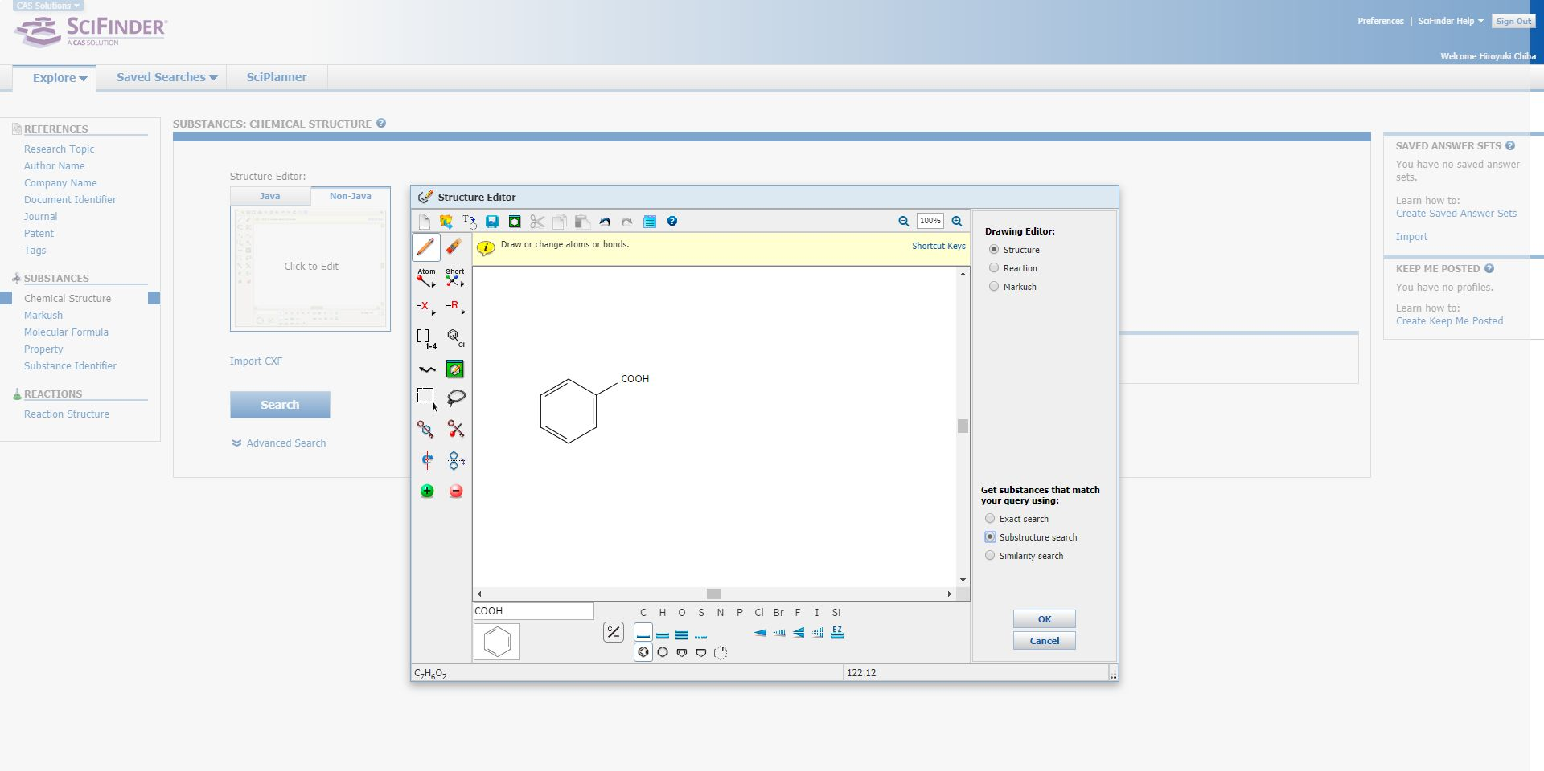
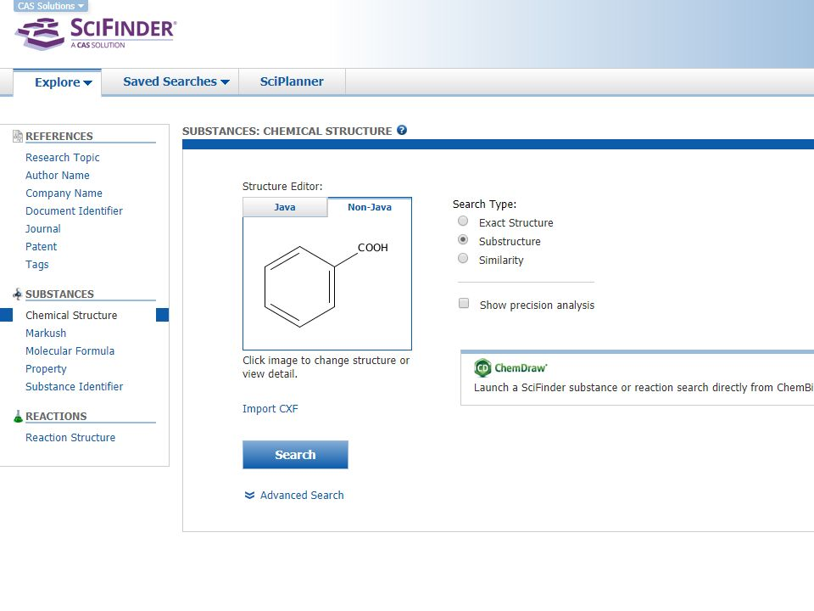
2. Overview
Draw a chemical structure
and search by it

Slide 16
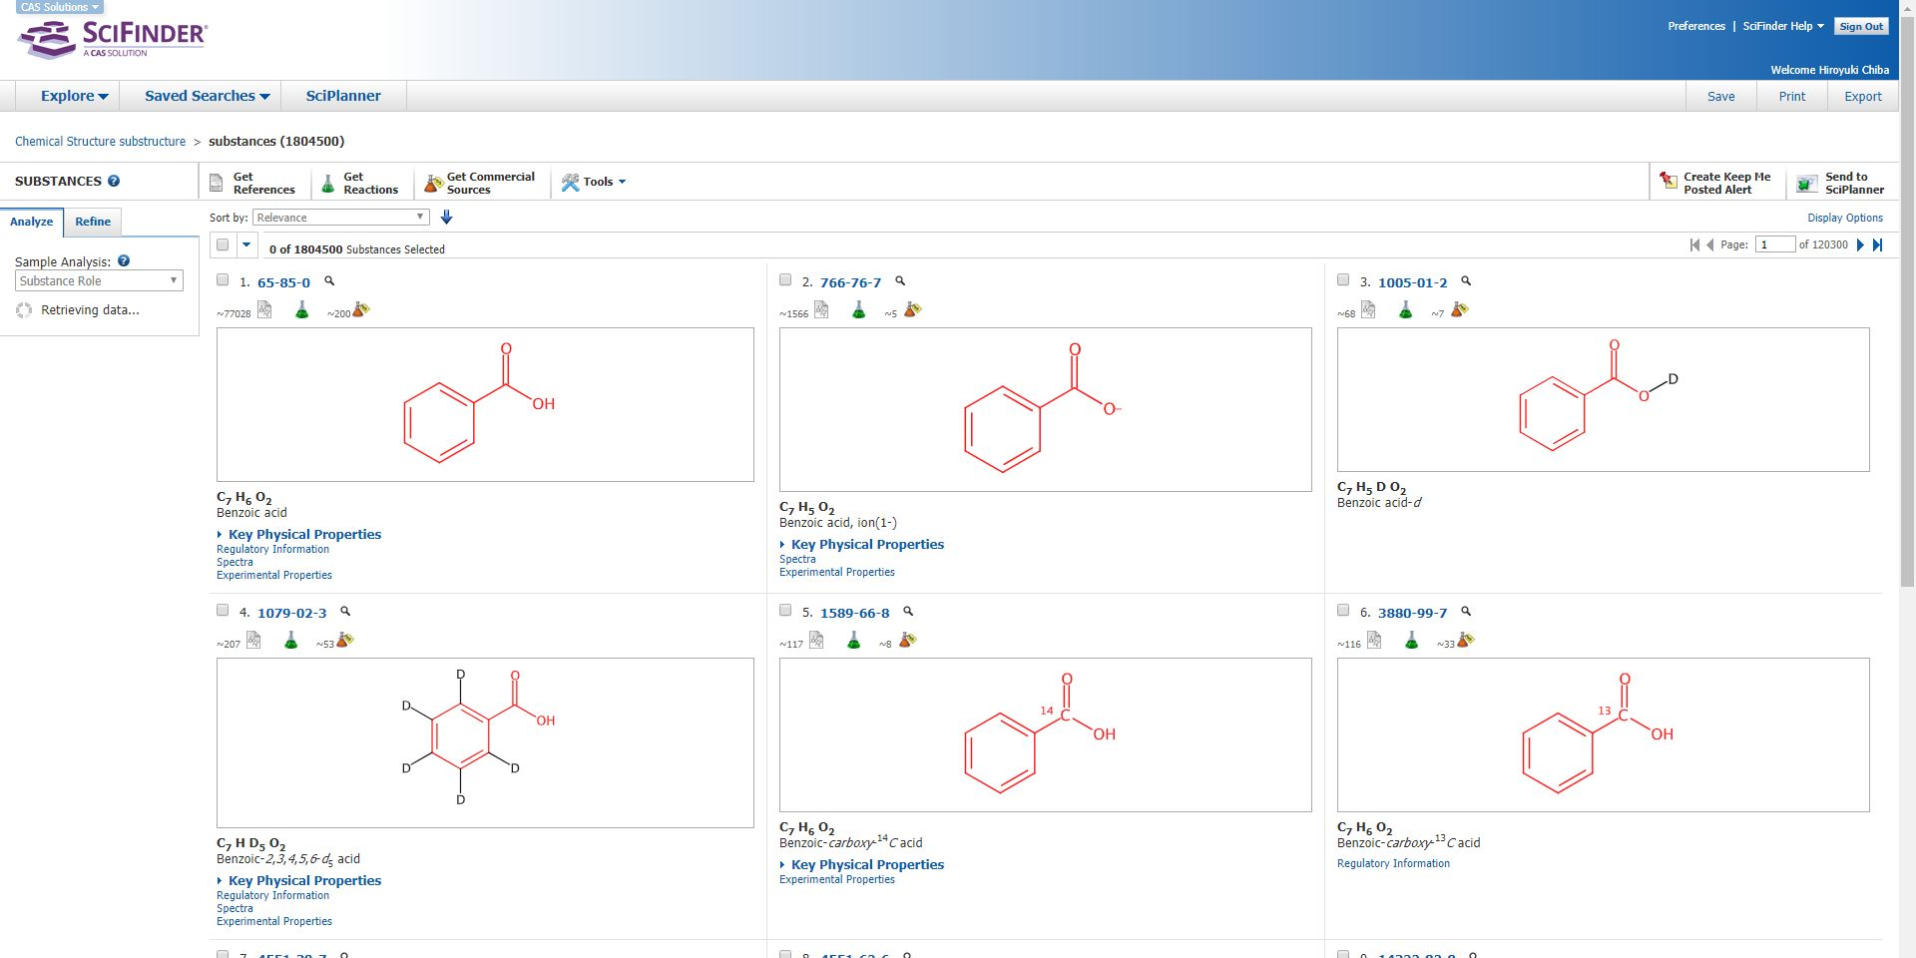
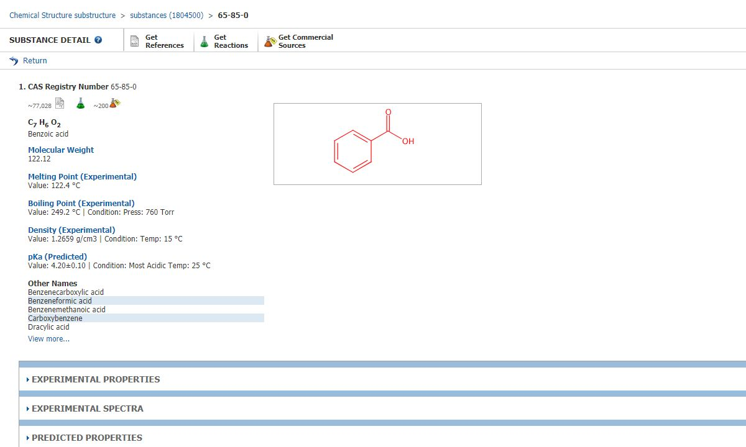
2. Overview
Detailed Data of this substance below

Slide 17
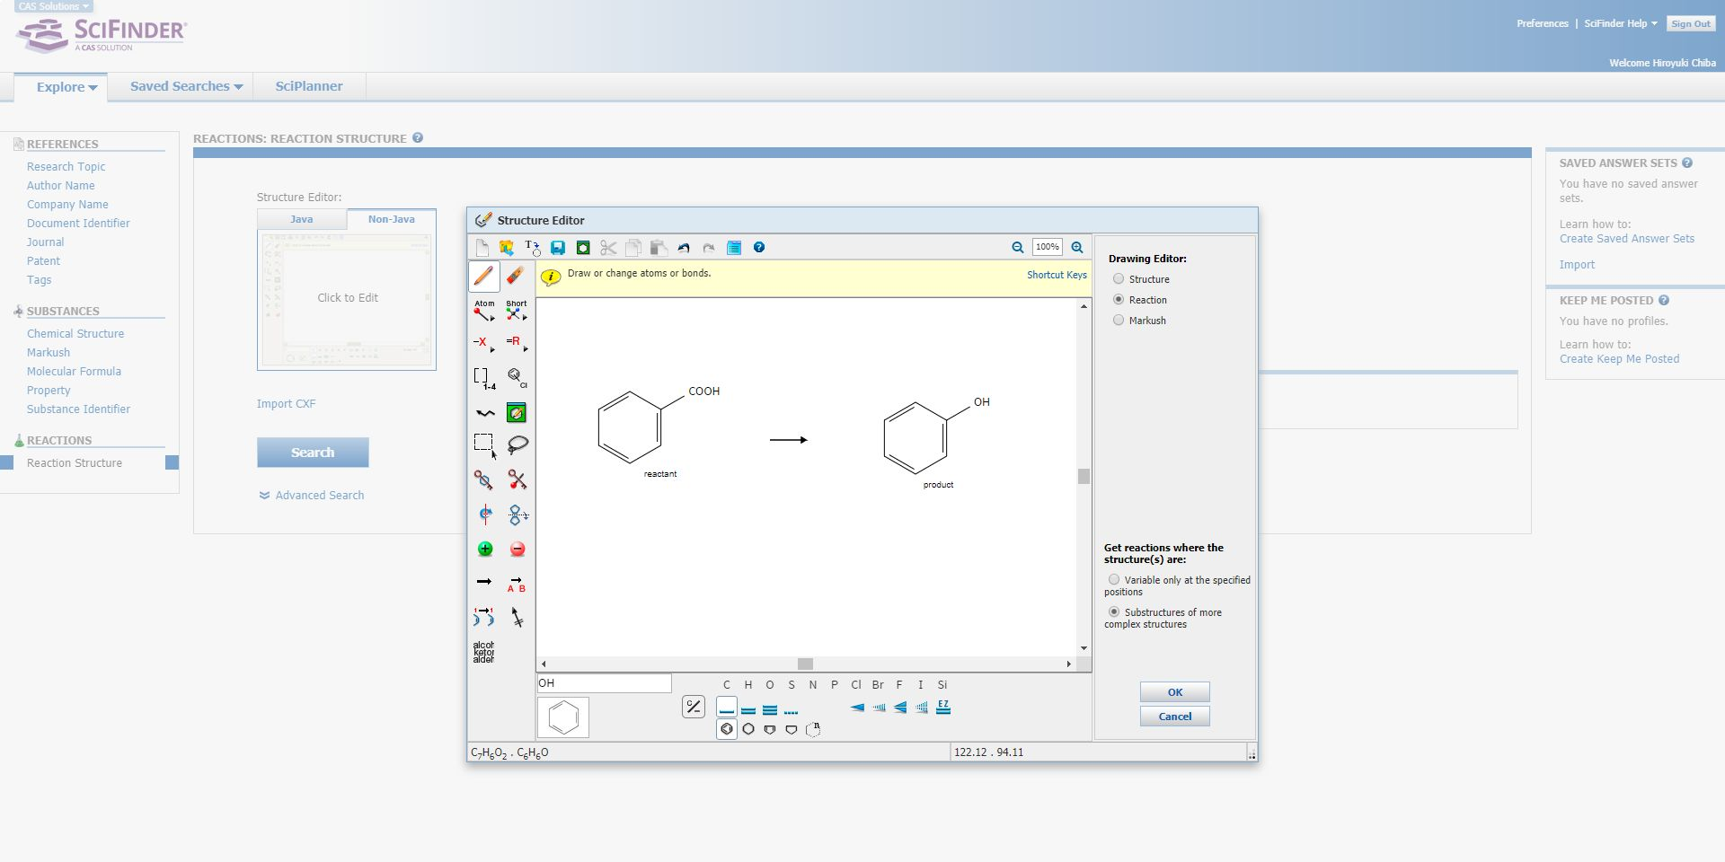
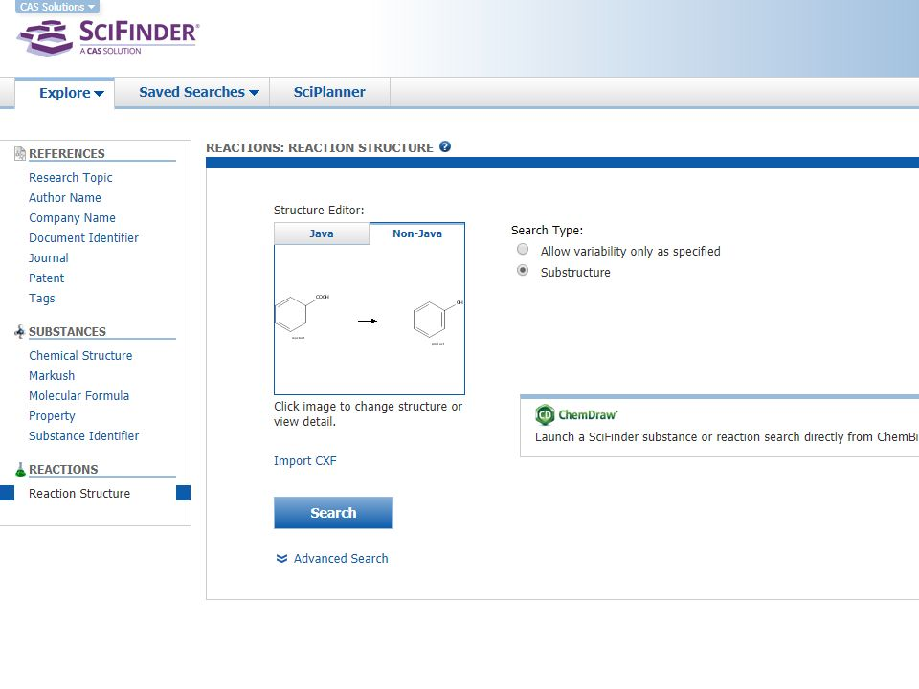
2. Overview
Draw chemical structures before / after a reaction
and search by them

Slide 18
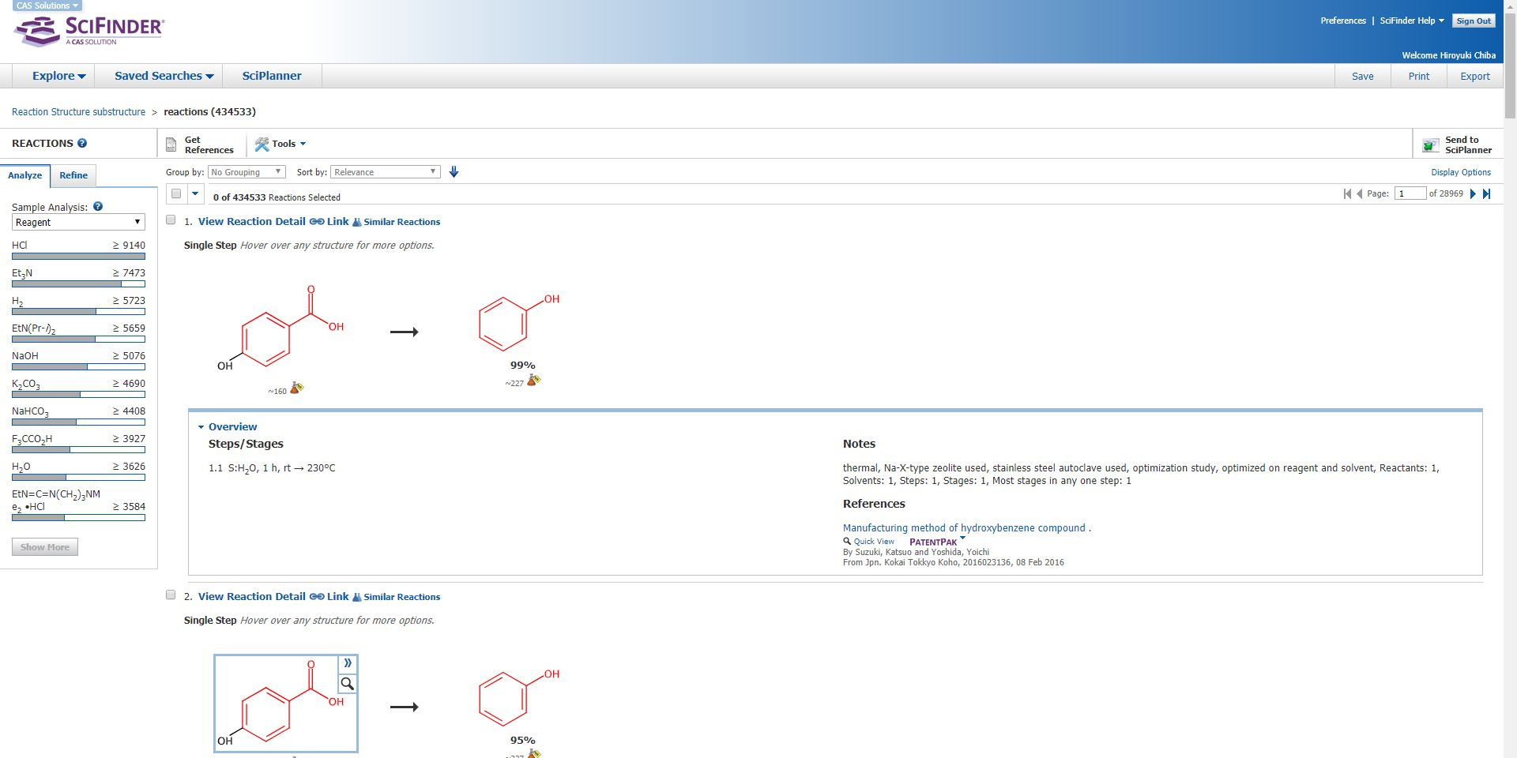
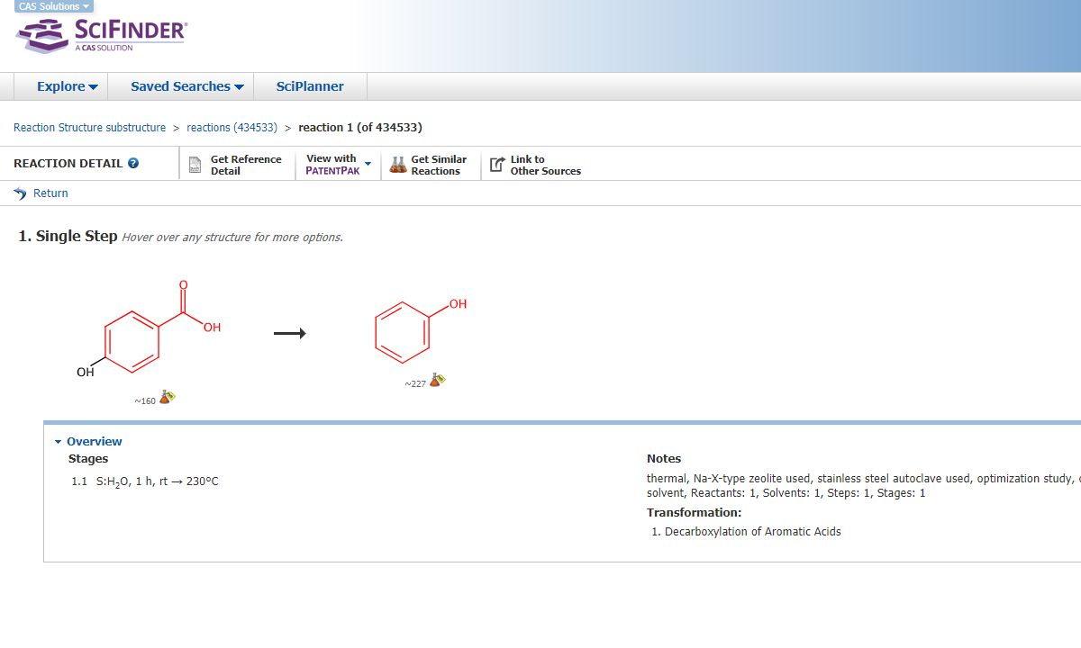
2. Overview

Slide 19
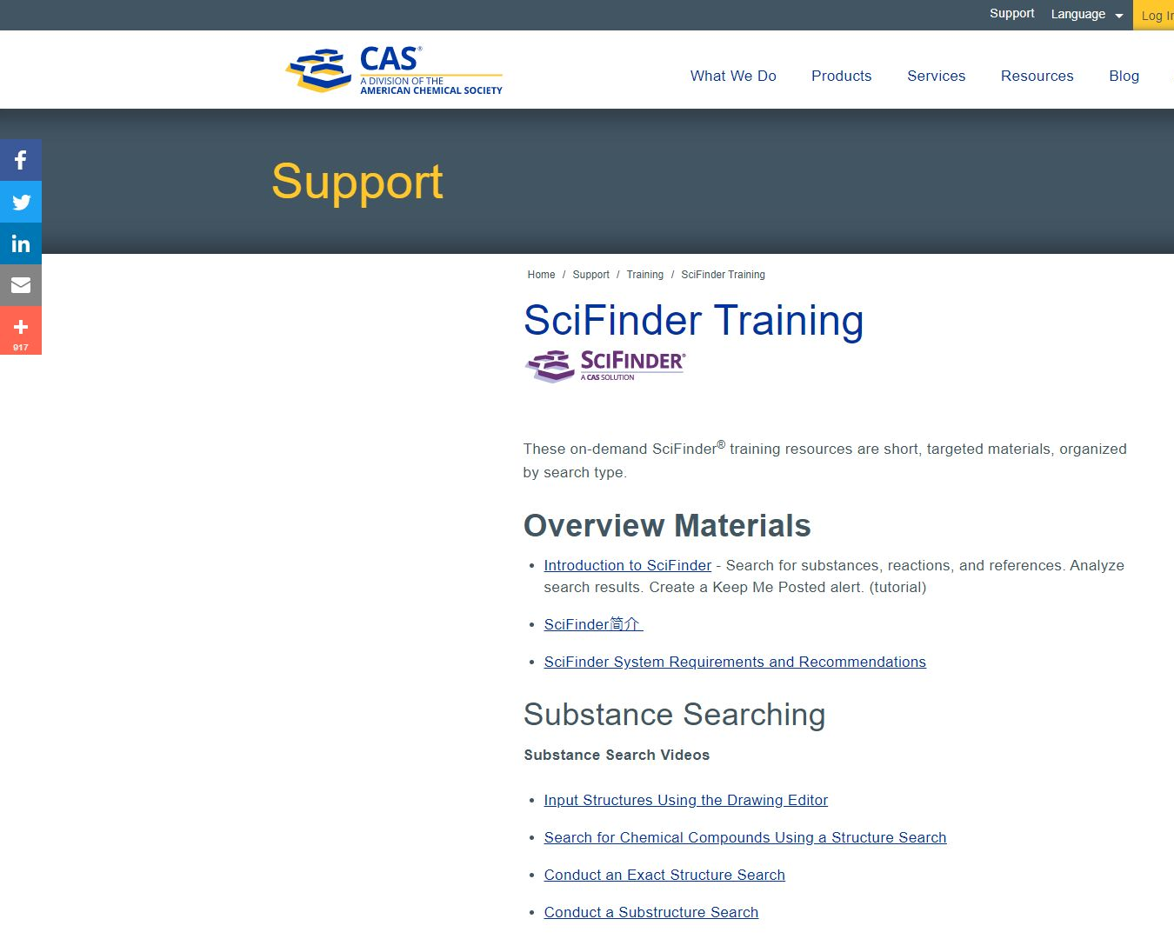
3. Helps and Tips
E-learning
Search Guides
Helpdesk
Dictionary
Using off-campus
Remote Access
SciFinder Mobile
Workshop
https://www.cas.org/support/training/scifinder

Slide 20
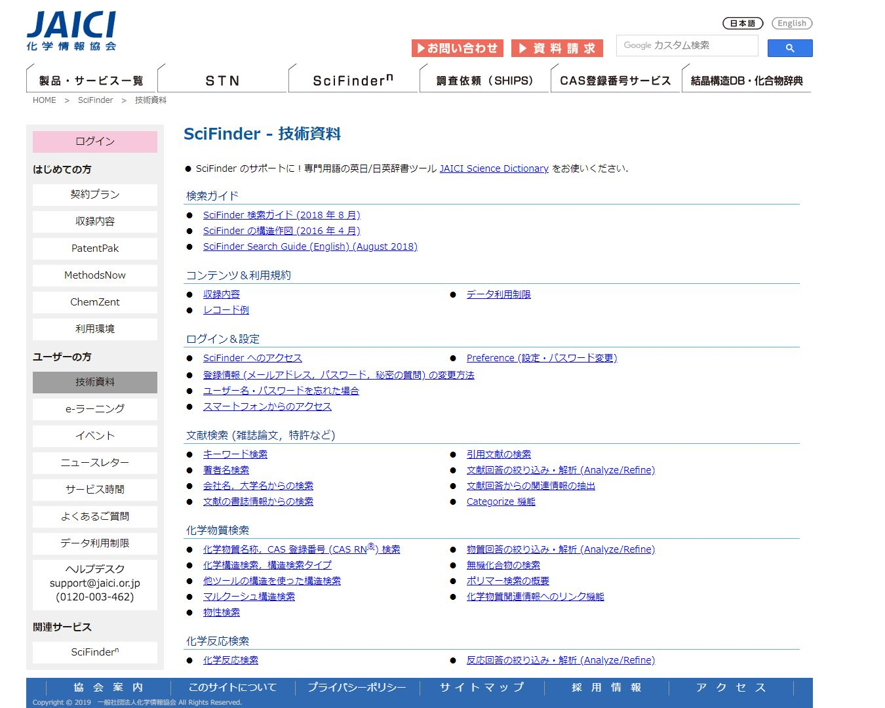
3. Helps and Tips
E-learning
Search Guides
Helpdesk
Dictionary
Using off-campus
Remote Access
SciFinder Mobile
Workshop
https://www.jaici.or.jp/SCIFINDER/sci_tecdata.html

Slide 21
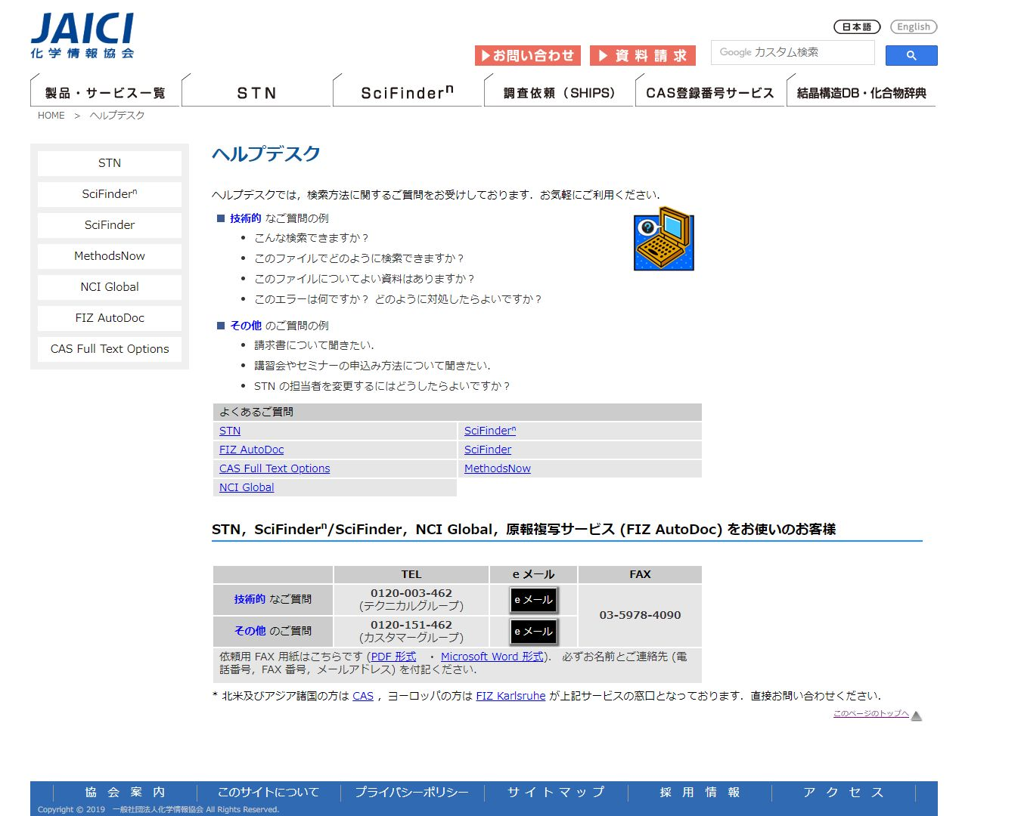
3. Helps and Tips
E-learning
Search Guides
Helpdesk
Dictionary
Using off-campus
Remote Access
SciFinder Mobile
Workshop
https://www.jaici.or.jp/helpdesk/index.htm

Slide 22
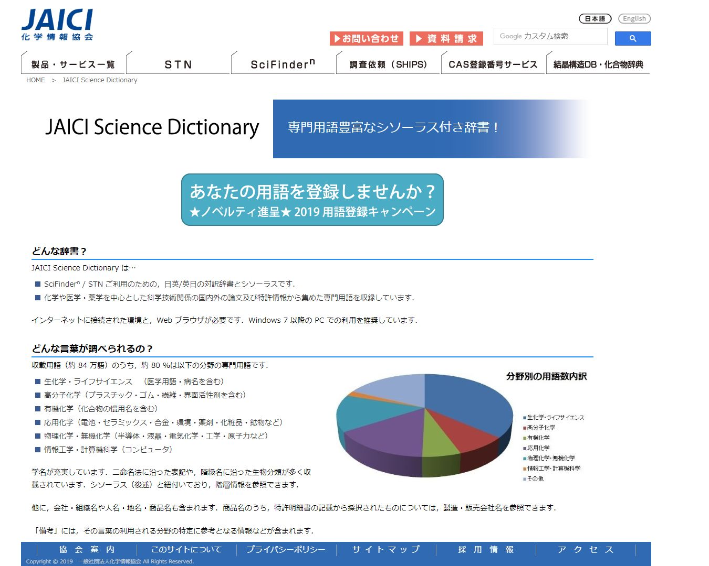
3. Helps and Tips
E-learning
Search Guides
Helpdesk
Dictionary
Using off-campus
Remote Access
SciFinder Mobile
Workshop
https://www.jaici.or.jp/jsd

Slide 23
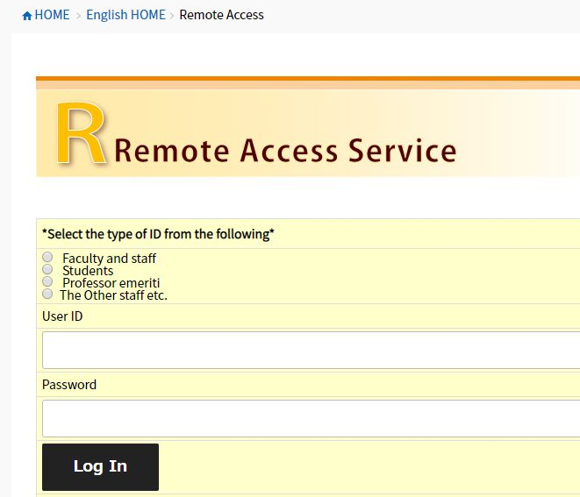
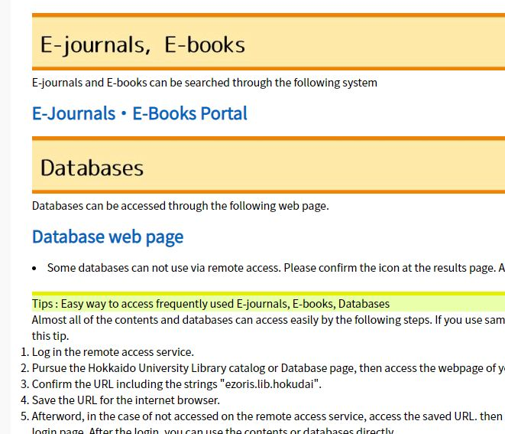
3. Helps and Tips
E-learning
Search Guides
Helpdesk
Dictionary
Using off-campus
Remote Access
SciFinder Mobile
Workshop
https://www.lib.hokudai.ac.jp/en

Slide 24
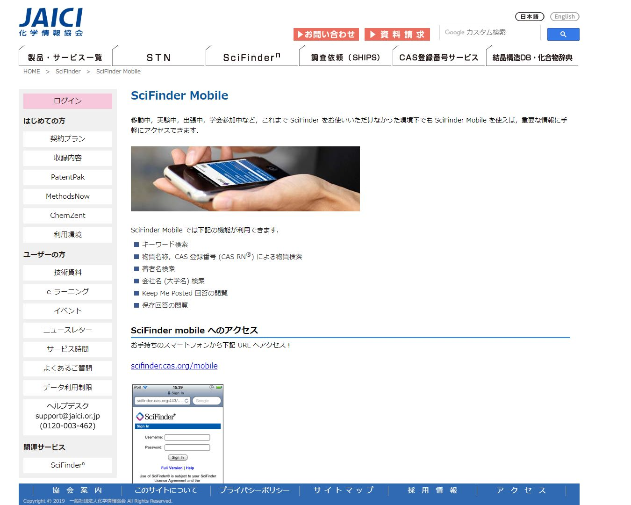
3. Helps and Tips
E-learning
Search Guides
Helpdesk
Dictionary
Using off-campus
Remote Access
SciFinder Mobile
Workshop
Although the functions of this version are limited,
you can use it on your smartphone
just by entering your SciFinder account
https://scifinder.cas.org/mobile
https://www.jaici.or.jp/SCIFINDER/sfmobile

Slide 25
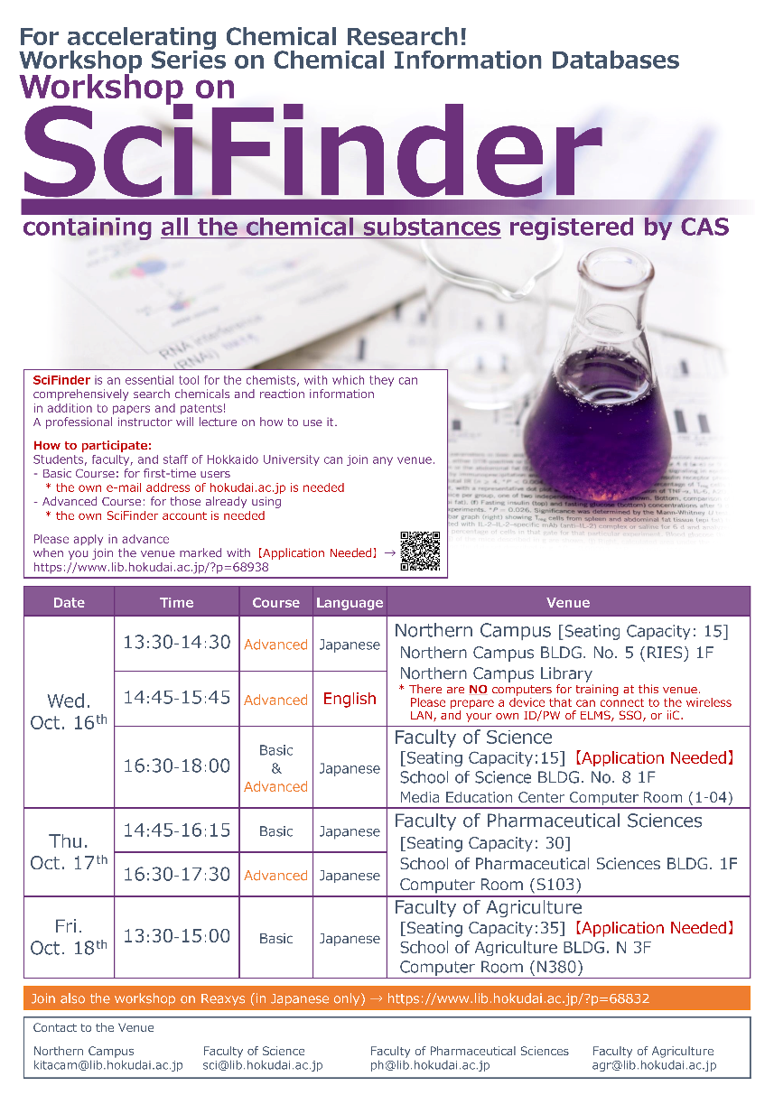
3. Helps and Tips
E-learning
Search Guides
Helpdesk
Dictionary
Using off-campus
Remote Access
SciFinder Mobile
Workshop
Hokkaido University holds the workshops
twice a year, usually in spring and fall

Slide 26
USE
SciFinder
AND
JOIN
the Workshop
on Oct. 16th

