Slide 1
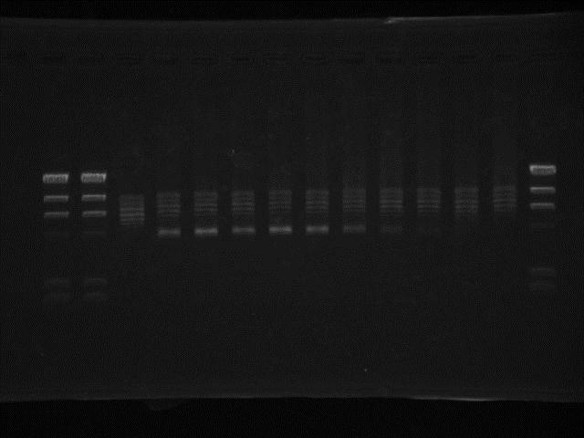
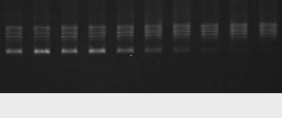
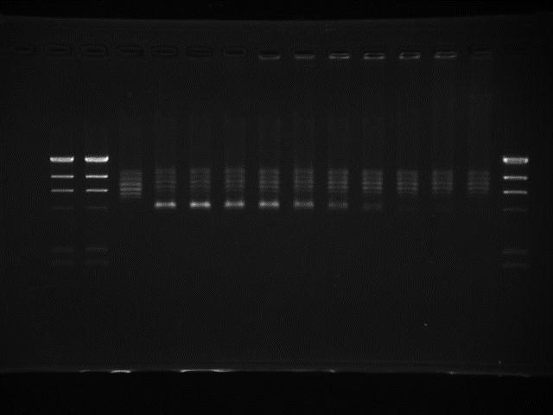
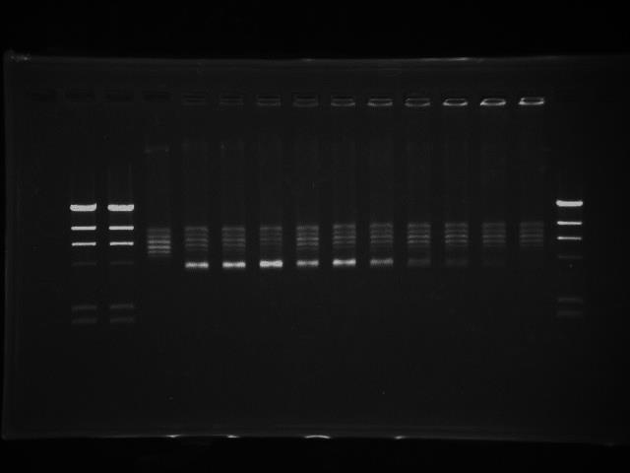
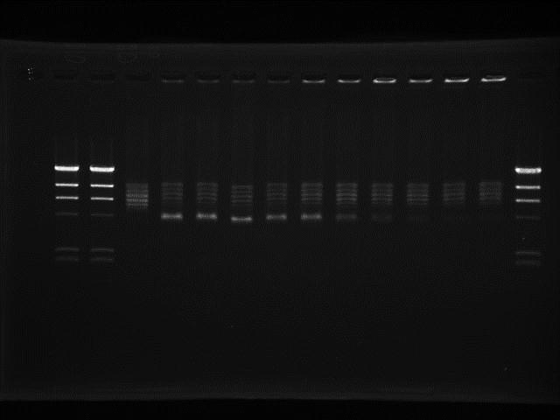
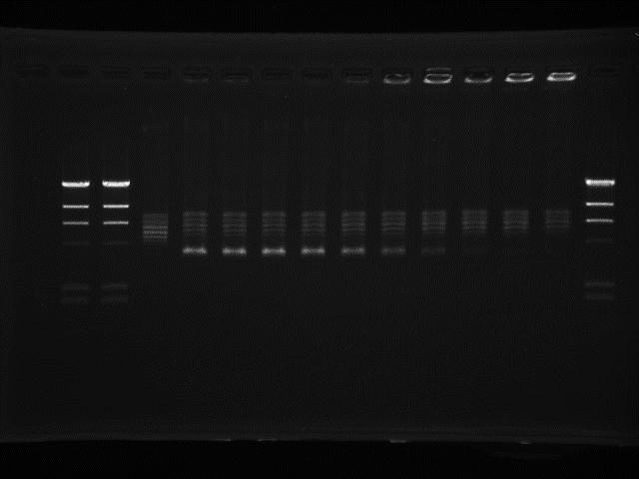
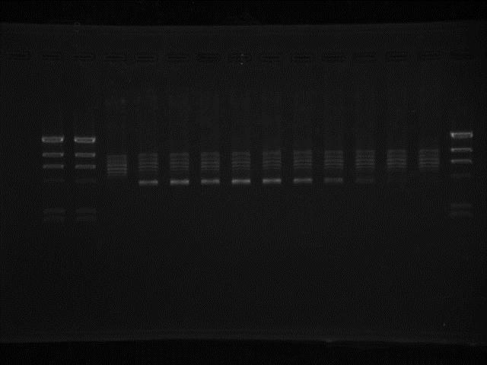
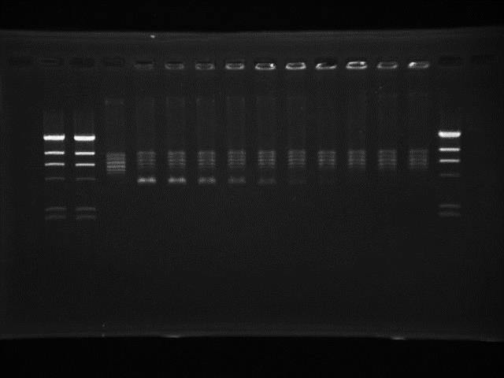
(A)
(E)
GAT conc. (µg/ml)
CIP conc. (µg/ml)
0 0.08 0.16 0.31 0.62 1.25 2.5 5 10 20
0 0.08 0.16 0.31 0.62 1.25 2.5 5 10 20
R
SC
(B)
LVX conc. (µg/ml)
(F)
ENX conc. (µg/ml)
0 0.08 0.16 0.31 0.62 1.25 2.5 5 10 20
0 0.08 0.16 0.31 0.62 1.25 2.5 5 10 20
R
SC
(C)
SPX conc. (µg/ml)
(G)
MXF conc. (µg/ml)
0 0.08 0.16 0.31 0.62 1.25 2.5 5 10 20
0 0.08 0.16 0.31 0.62 1.25 2.5 5 10 20
R
SC
(D)
OFX conc. (µg/ml)
(H)
OXO conc. (µg/ml)
0 0.08 0.16 0.31 0.62 1.25 2.5 5 10 20
0 5 10 20 40 80 160 320 640 1280
R
SC
Supplementary Fig. Inhibitory activity of (A) GAT, (B) LVX, (C) SPX, (D) OFX, (E) CIP, (F) ENX, (G) MXF and (H) OXO on the supercoiling activities of C. jejuni DNA gyrase. Relaxed pBR322 DNA (0.3 µg) was incubated with 50 ng each of GyrA and GyrB in the presence of the indicated amounts (µg/ml) of both quinolones. The reactions were stopped and the DNA products were analyzed by electrophoresis in 1% agarose gels. R and SC denote relaxed and supercoiled pBR322 DNA, respectively.

