Slide 1
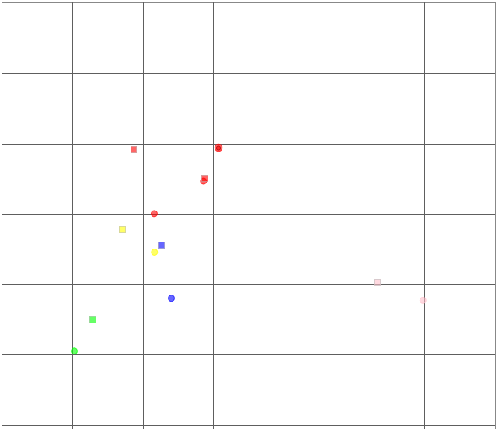
Sup. Fig 2. Antigenic cartography
6
Antiserum
Antigen
Group icA
5
Group B
Group C
Group D
Clade 2.3.4.4
Mal/HK/820/09
4
Mdk/CD/KAF17
Mdk/CD/TCH6/17
Mdk/CD/TCH6/17
Mdk/CD/KAF17
Antigenic unit
Mdk/CD/17RS882-29/17
3
Mdk/CD/NYA14/17
Dk/VTN/HU/1-1151/16
Ck/Kmm/1-7/14
Clade 2.3.4
2
Dk/VTN/HU/1-1151/16
Ck/Kmm/1-7/14
PF/HK/810/09
PF/HK/810/09
BS/Akita/1/14
1
BS/Akita/1/14
0
0
1
2
3
4
5
6
7
Antigenic unit

