Slide 1
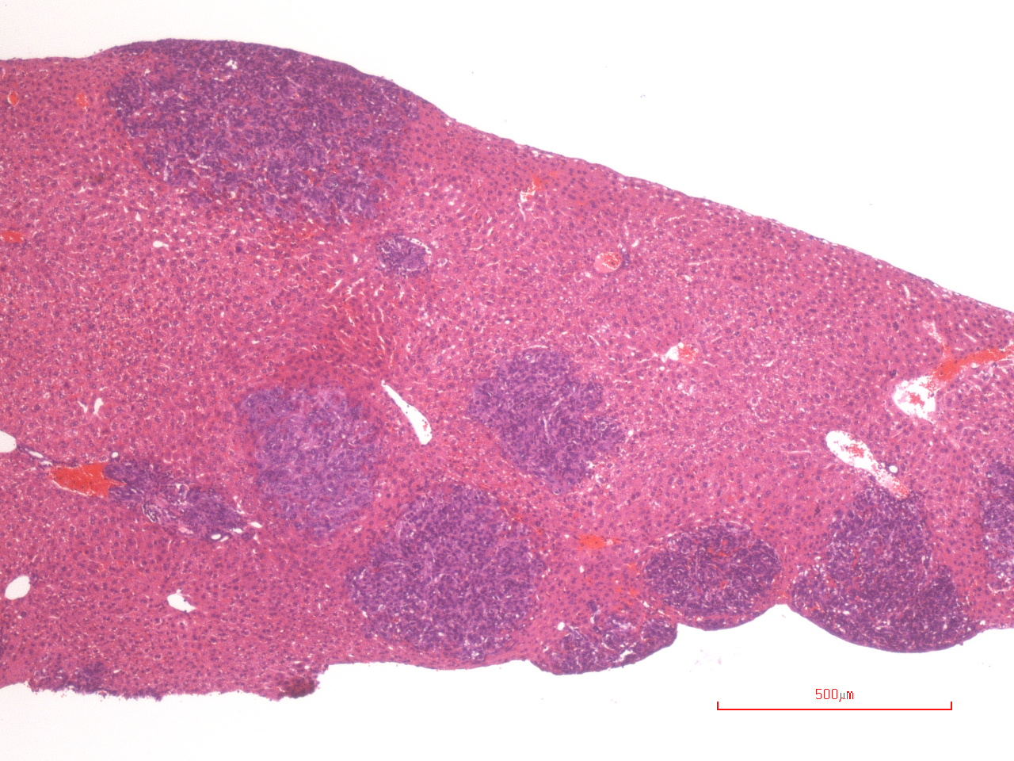
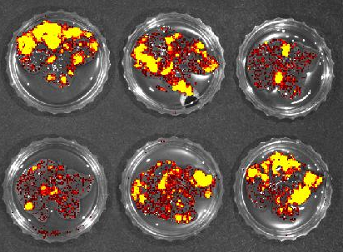
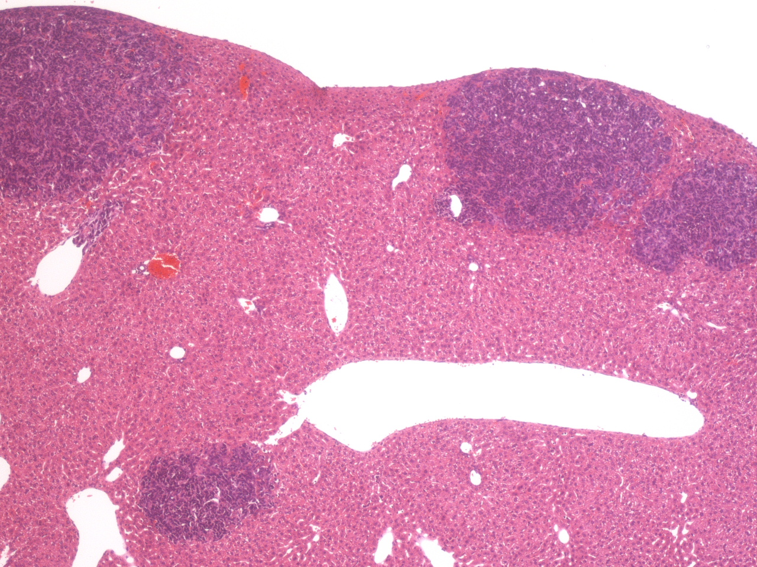
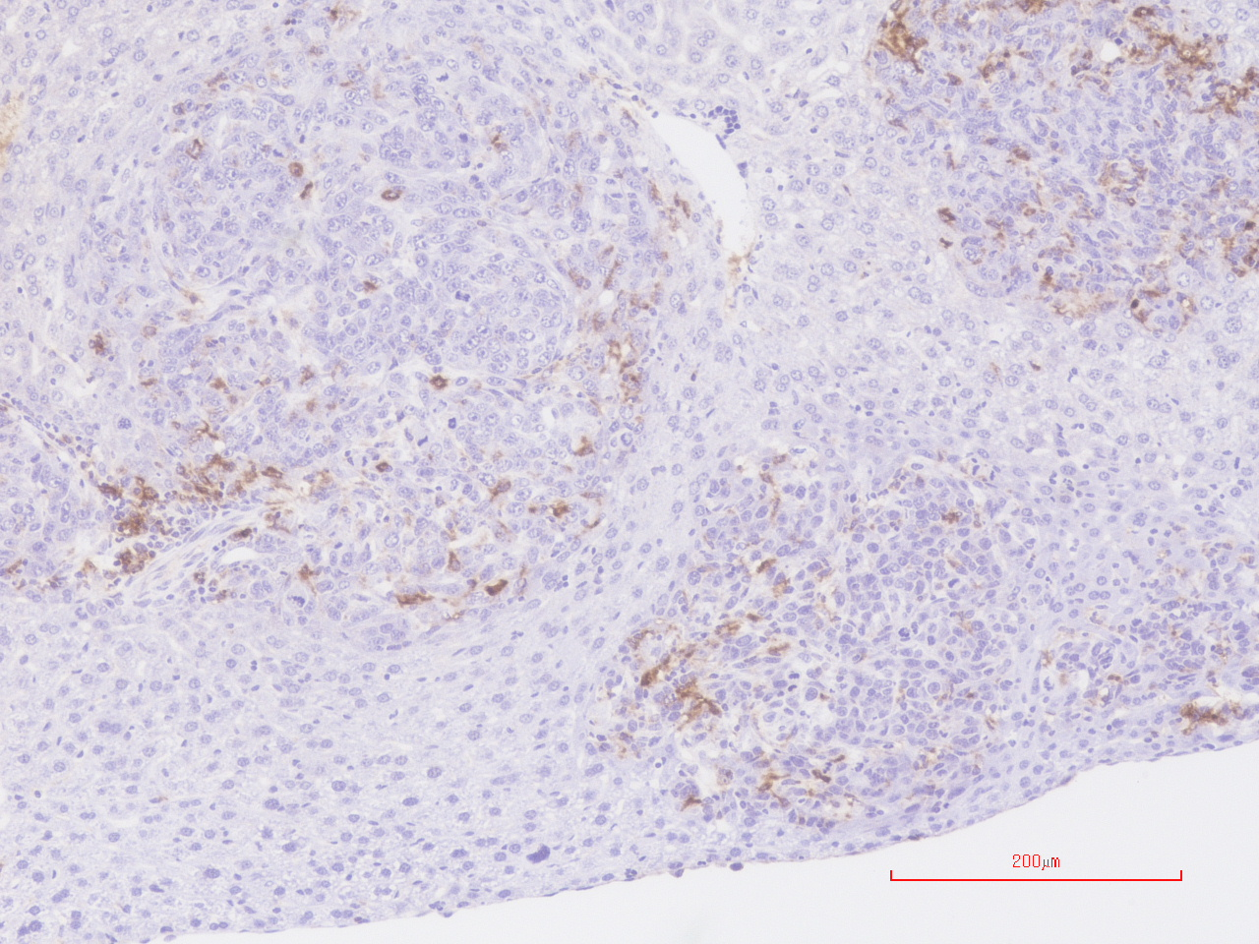
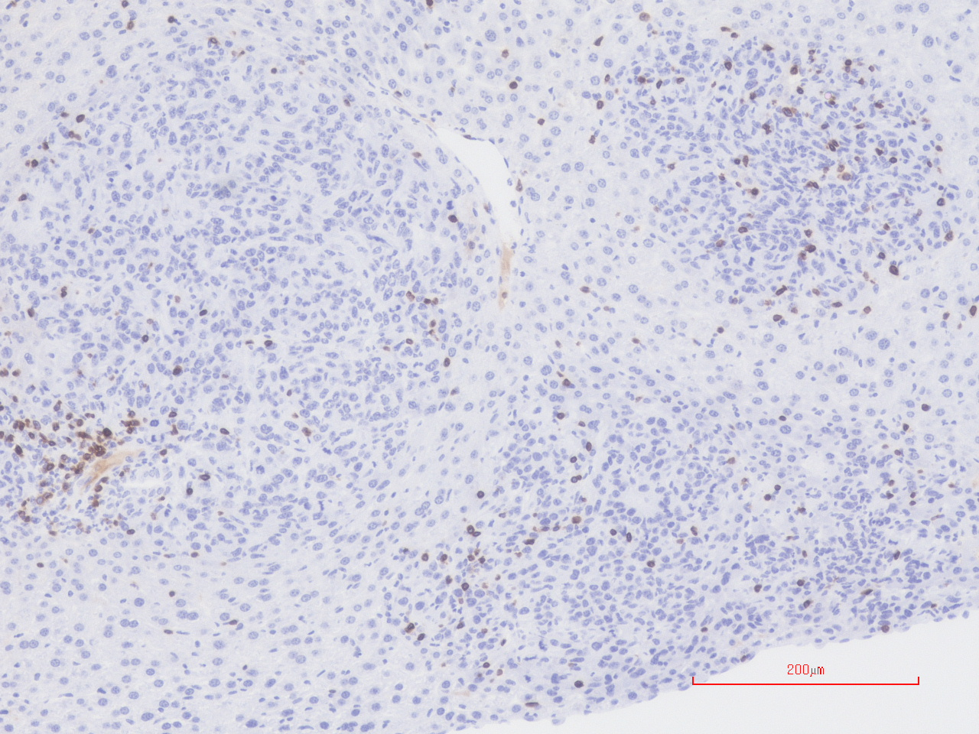
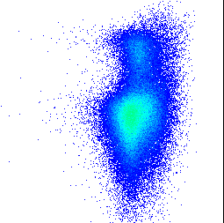
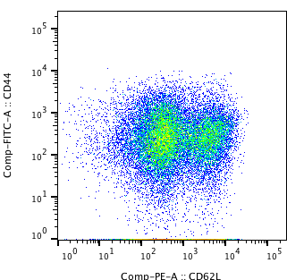
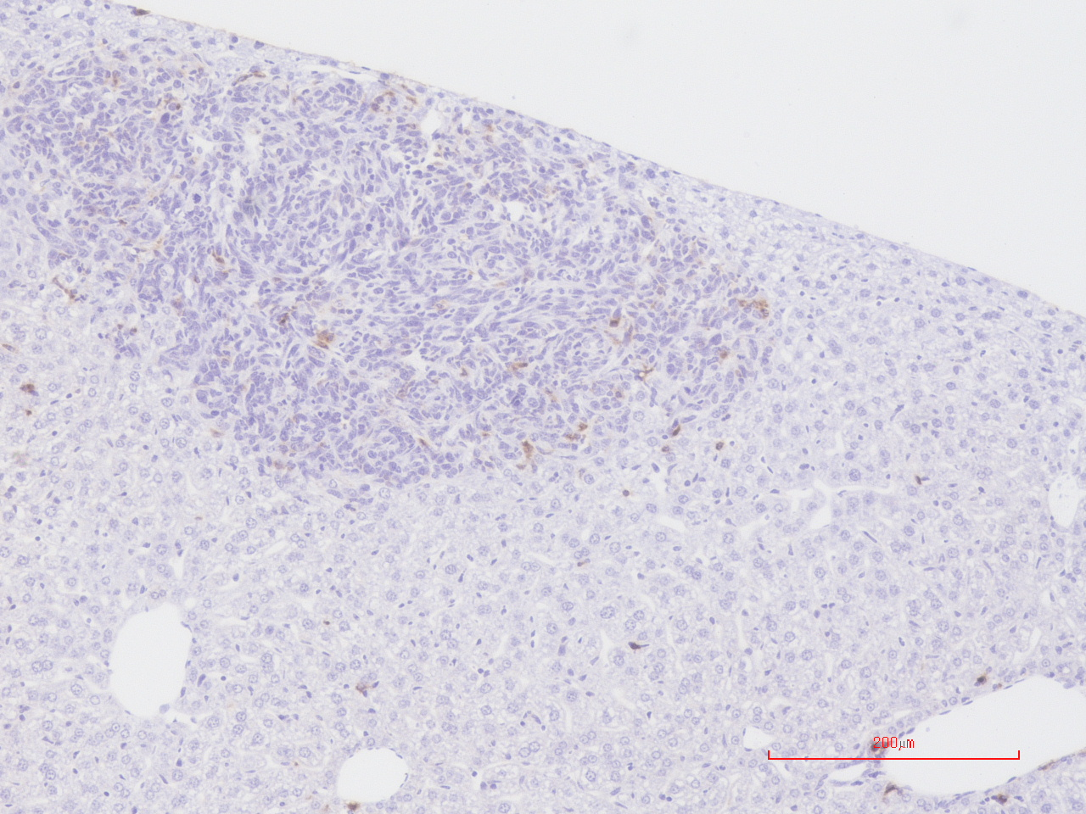
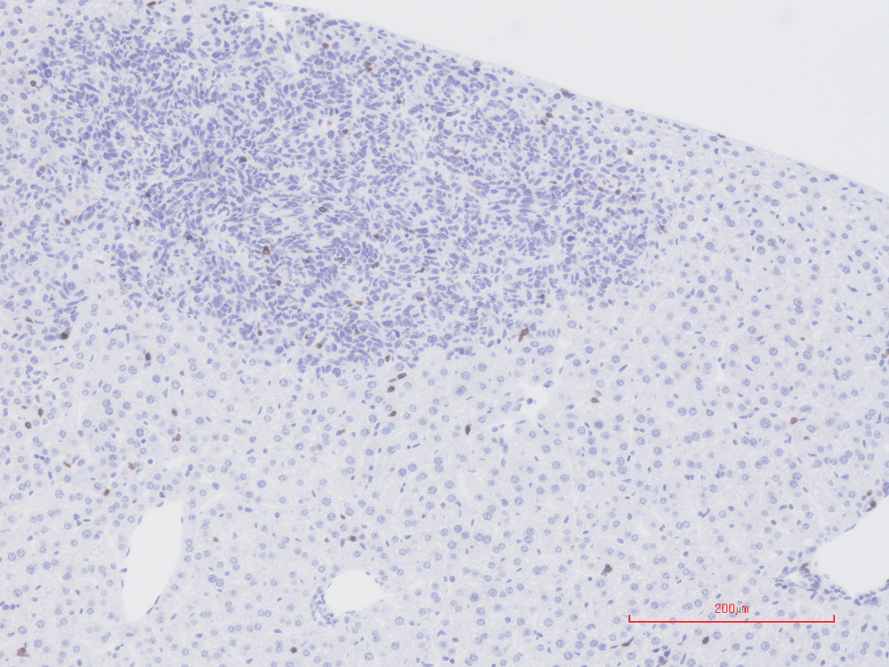
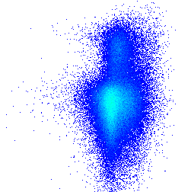
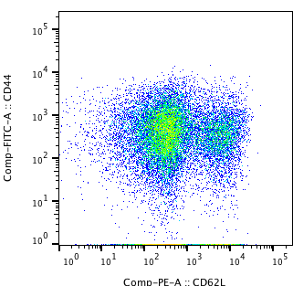
Supplementary Figure S8. Toyoshima et al.
A
IL-6^{+/+}
B
IL-6^{+/+}
C
Control IgG
Control
IgG
Photon flux ratio
Anti-PD-L1 mAb
Anti-PD-L1 mAb
Anti-PD-L1 mAb
Control IgG
D
CD11c
CD3
E
10⁵
0.22
10⁵
75.8
CD11c
CD44
Control IgG
10⁴
10⁴
10³
10³
10²
10²
10¹
I-Ad^{hi}CD11c^{hi} cells (%)
10¹
10⁰
10⁰
CD44^{hi}CD62L⁻CD8⁺ cells (%)
10⁰
10¹
10²
10³
10⁴
10⁵
10⁰
10¹
10²
10³
10⁴
0.18
78.5
10⁵
10⁵
10⁵
Anti-PD-L1 mAb
10⁴
10⁴
10³
10³
10²
10²
10¹
10¹
Anti-PD-L1 mAb
Anti-PD-L1 mAb
10⁰
Control IgG
10⁰
Control IgG
10⁰
10¹
10²
10³
10⁴
10⁰
10⁵
10¹
10²
10³
10⁴
10⁵
CD62L
I-Ad
F
IL-6^{+/+}
Log rank test P=0.9301
Survival (%)
n=24
n=23
Control IgG
Anti-PD-L1 mAb
Days after inoculation

Slide 2
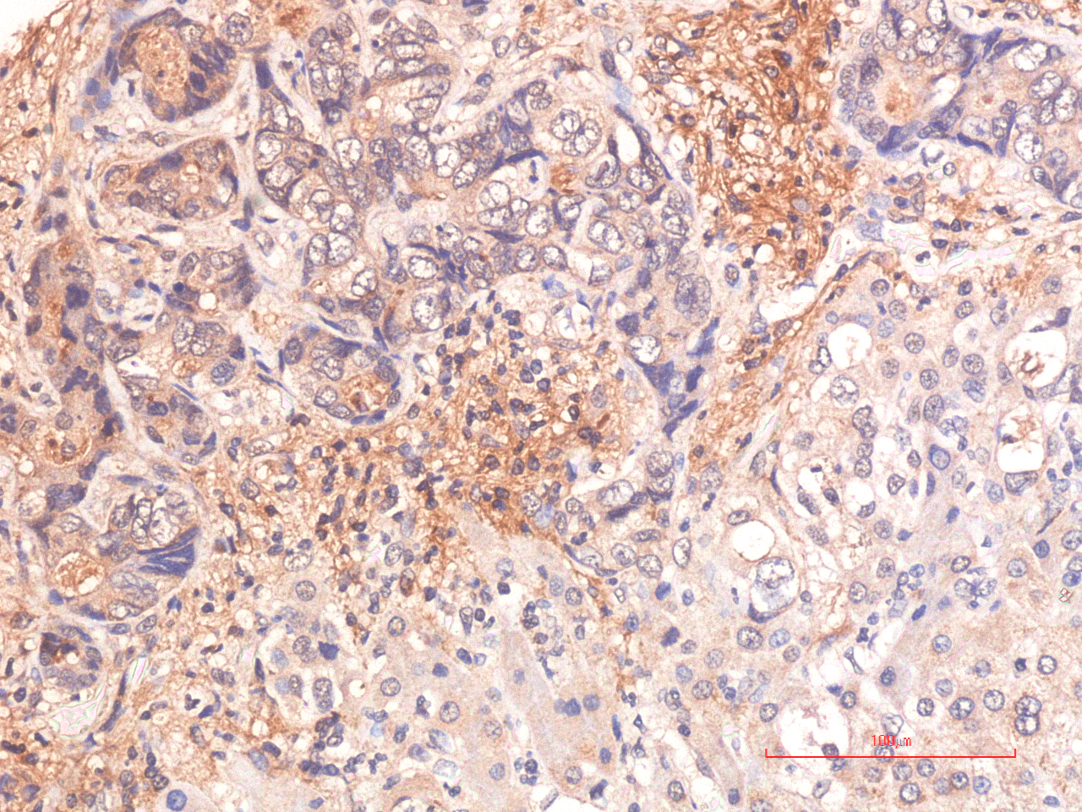
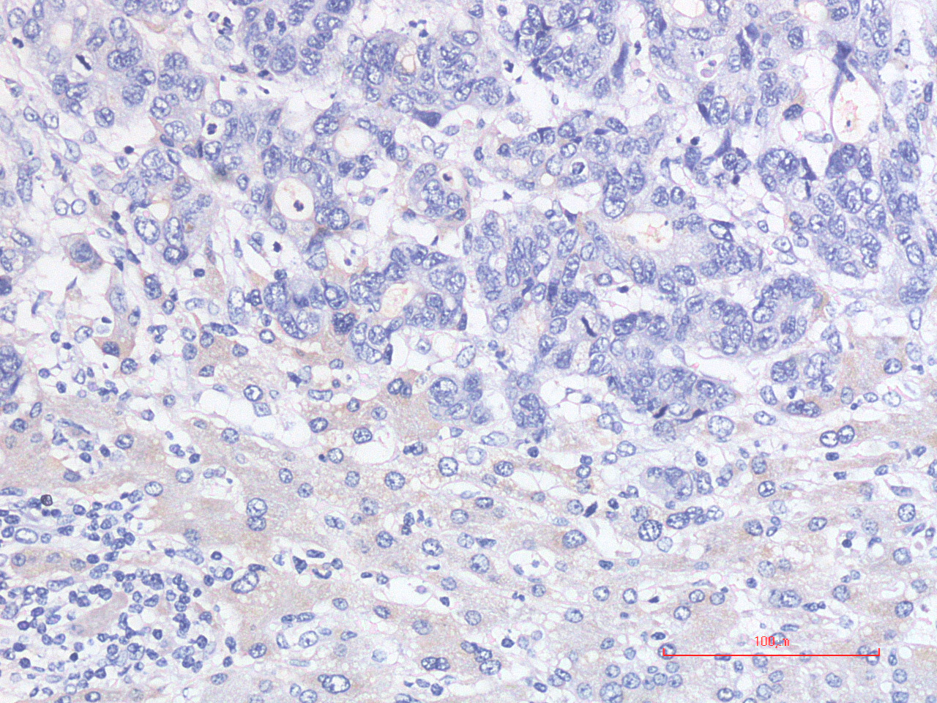
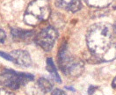
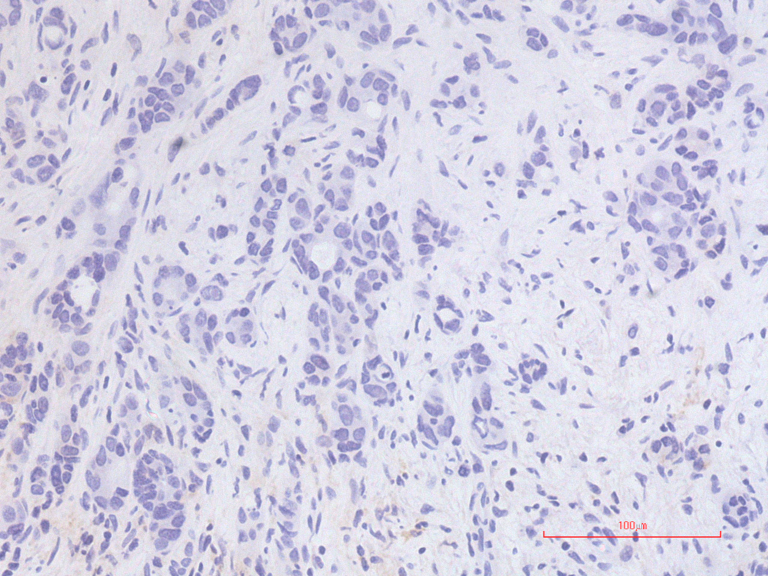
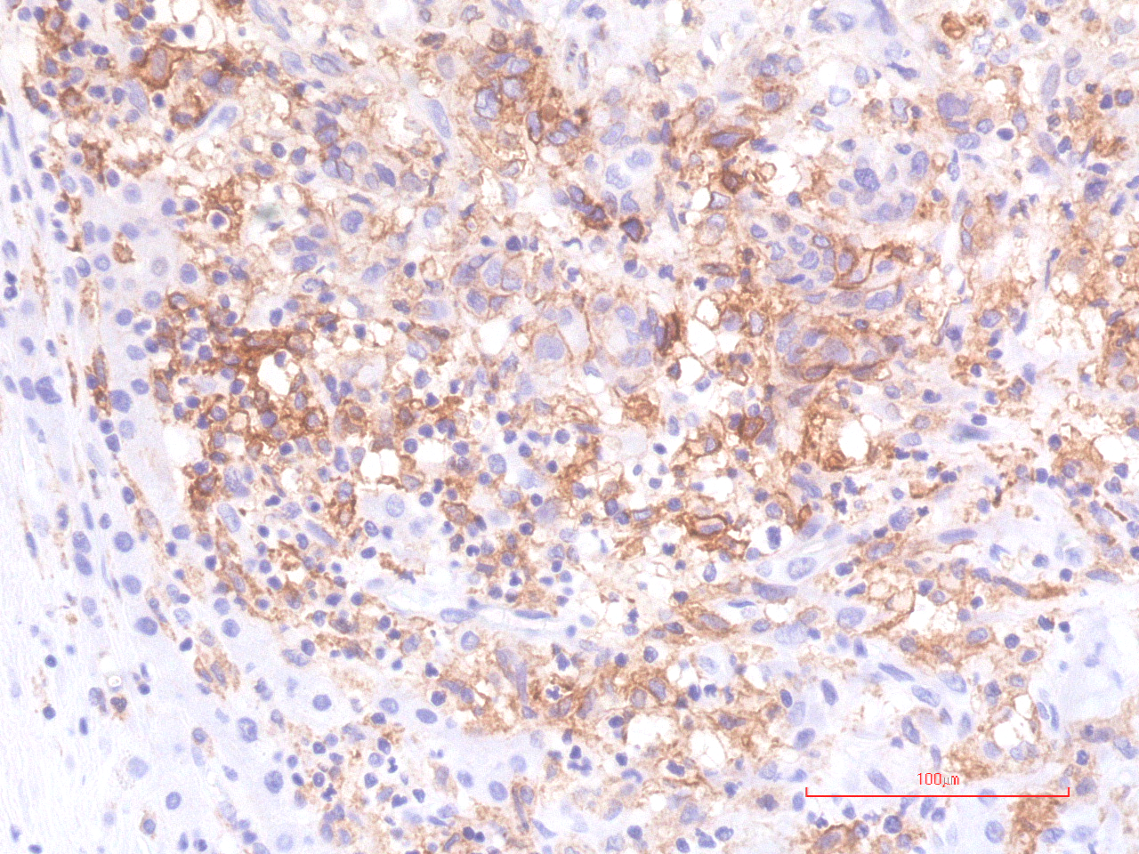
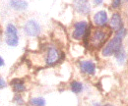
Supplementary Figure S9. Toyoshima et al.
A
Negative
Positive
IL-6
PD-L1
B
100
HR=1.03, 95% CI 0.55-1.91
P=0.929
100
HR=1.26, 95% CI 0.69-2.29
P=0.446
80
IL-6 negative (n=22)
80
PD-L1 negative (n=31)
60
IL-6 positive (n=35)
60
PD-L1 positive (n=26)
Disease free survival (%)
Disease free survival (%)
40
40
20
20
0
0
0
1000
2000
3000
4000
0
1000
2000
3000
4000
Time (days)
Time (days)

