Slide 1
Supplementary Figure 1
A
B
Notes:
(A-B) 20181120 qPCR murine primary chondrocytes

Slide 2
Supplementary Figure 2
A
B
Notes:
(A) ATDC5 Have the Inflammation Amplifier. Il-6 Expression. (qPCR: 20150711)
(B) ATDC5 Have the Inflammation Amplifier. IL-6 Production. (ELISA & MTT: 20150712)

Slide 3
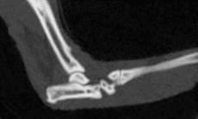
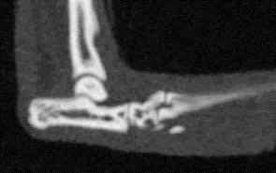
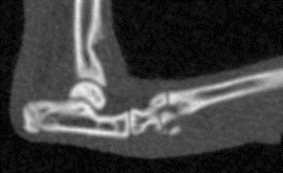
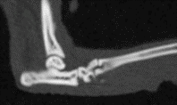
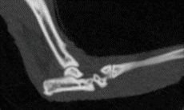
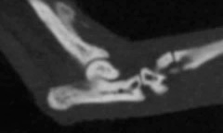
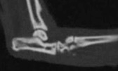
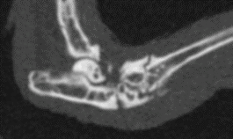
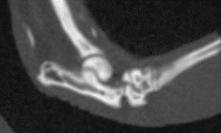
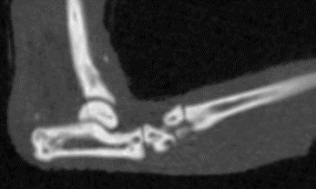
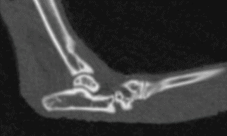
A
C57BL/6 (8 W)
Supplementary Figure 3
WT (C57BL/6)
B
Control AB
C
α-TMEM147 AB
Accelerated RA model
(F759)
D
F759 (8 W)
E
Col2a1-STAT3^{fl/fl} F759 (8W)
Accelerated RA model
(F759)
F
Mock
G
sh-TMEM147
Accelerated RA model
(F759)
H
F759 (12 M)
I
Col2a1-STAT3^{fl/fl} F759 (12 M)
Spontaneous RA model
(F759)
J
Control AB
K
α-TMEM147 AB
C57BL/6 CIA
Notes:
F759 CIA
Control: 20190802-1
anti-TMEM AB: 20190721-1
20190811
B6 CIA
Control: 20190720-1
Anti-TMEM AB: 20190720-1

Slide 4


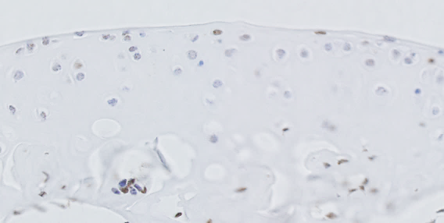



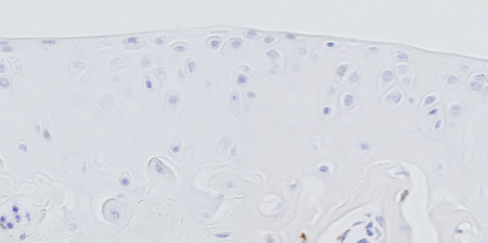



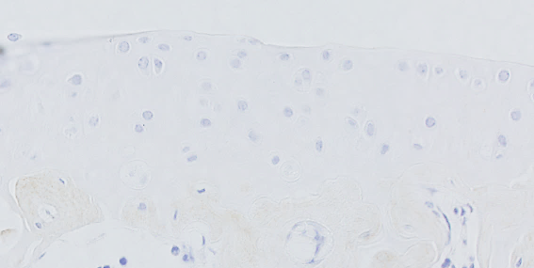





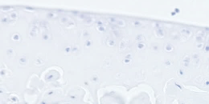

Supplementary Figure 4
A
B
Control
Spontaneous RA model
Safranin O
Knee
p-p65
C
p-STAT3
isotype
D
TMEM147
Control IgG
Notes:
20170312, 20170527
(B) % Saf-O (20190921)
(C) %: 20170719
(D)20170718,

Slide 5
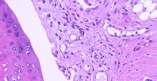
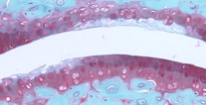
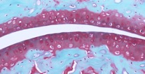
Supplementary Figure 5
A
Accelerated RA model (F759)
B
Col2Cre+ STAT3fl/fl F759
HE
Safranin O
C
p-p65
p-STAT3
isotype
D
TMEM147
Control IgG
Notes:
(A)20191002
(B)20190921
(p-p65? p-STAT3?)

Slide 6
Supplementary Figure 6
A
B
Notes:
TMEM OE HEK (20190930)

Slide 7
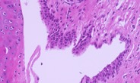
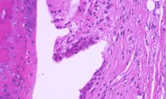
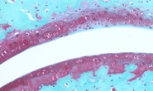
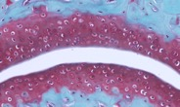
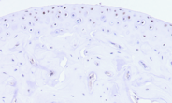
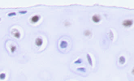
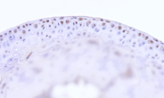
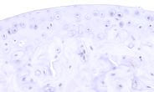
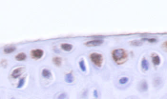

Supplementary Figure 7
A
Mock
sh TMEM147
B
HE
Safranin O
C
p-p65
p-STAT3
isotype
TMEM147
Control IgG
Notes:
(A)20191002, 20191010

Slide 8
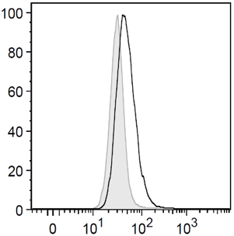
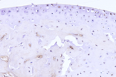
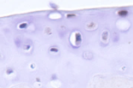
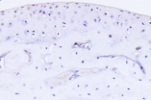
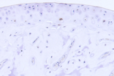
Supplementary Figure 8
A
Control
α-TMEM147
% of Max
B
FITC-TMEM147
C
p-p65
p-STAT3
isotype
TMEM147
Control IgG
Notes:
(A)

Slide 9
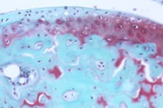
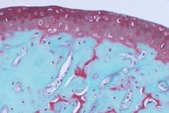
Supplementary Figure 9
A
B
Control
α-TMEM147
C
***
***
***
**
***
***
**
**
HE
Safranin O
Immunization
α-TMEM147
Notes:
anti-TMEM147 AB detects TMEM147 on ATDC5 cell surface. (FACS: 20190122)
B6 CIA: 20191002
Score: 20190429
(p-p65とp-STAT3もできれば）

Slide 10



Supplementary Figure 10
A
Control
OA model
B
Safranin O
Ankle
p-p65
C
p-STAT3
isotype
D
TMEM147
Control IgG
Notes:
Murine ankle (20190911, 20190914)
% Saf-O (20190921)

Slide 11



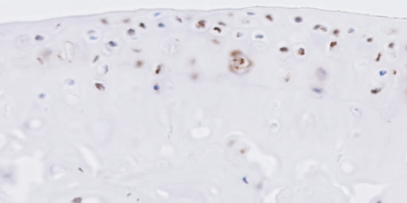



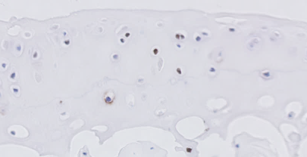






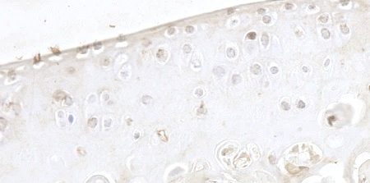

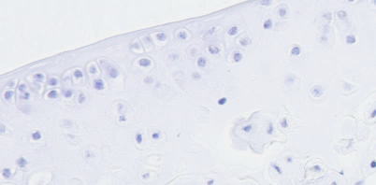
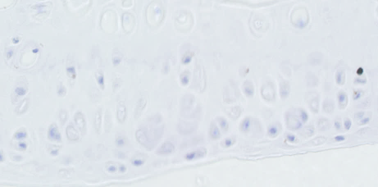
Supplementary Figure 11
A
Control
OA model
B
Safranin O
p-p65
C
p-STAT3
Knee
isotype
D
TMEM147
Control IgG
Notes:
Murine Cartilage. (IHC: 20170718, 20190212)
% Saf-O (20190921)
Murine Cartilage (%: 20170719)
TMEM147 Exists in Murine Cartilage. (IHC: 20170312, 20170527, 20190212)

Slide 12







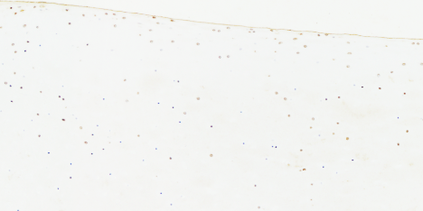
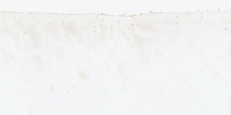


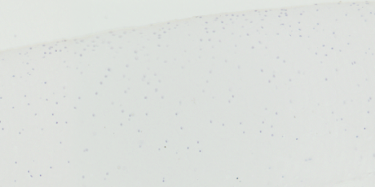



Supplementary Figure 12
A
Control
OA
B
Safranin O
p-p65
p-STAT3
isotype
C
TMEM147
Control IgG
Notes:
Murine ankle (20190911, 20190914)
% Saf-O (20190921)
Human Cartilage Has the Inflammation Amplifier. p-p65 & p-STAT3. (IHC: 20170318, 20170719, 20190212)
(%: 20170701)
TMEM147 Exists in Human Cartilage. (IHC: 20170517, 20170527, 20170624, 20170719)

