Slide 1
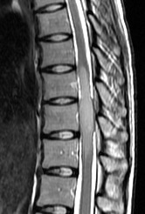
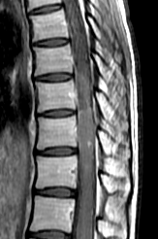
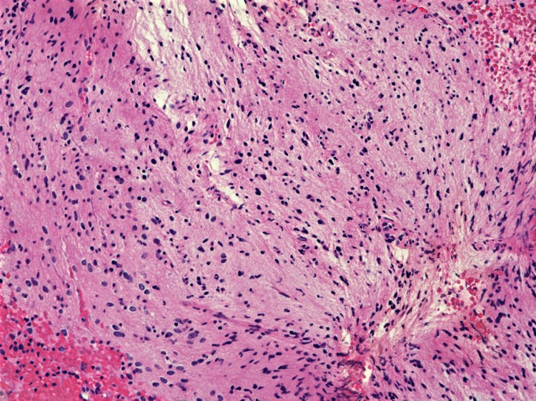
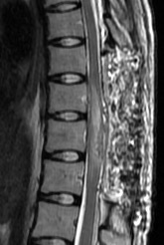
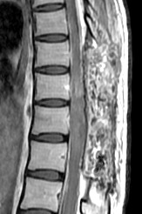
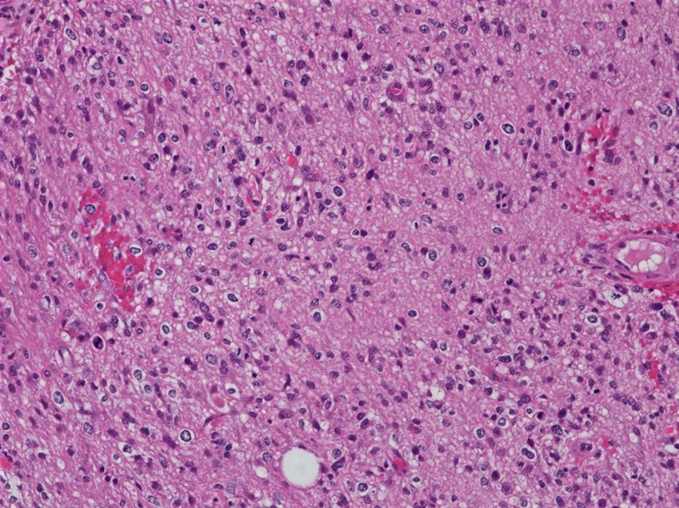
A
B
C
D
E
F

Slide 2
MGMT
Negative (N = 10)
Positive (N = 16)
OS Probability
p = 0.76
Months

Slide 3
A
B
K27M
(N = 7)
WT
(N = 7)
N.S.
1
2
3
4
5
6
7
1
2
3
4
5
6
7
8
9
10
11
12
Co
Cervical
Age at onset
Thoracic
K27M
(N = 7)
WT
(N = 7)
Conus
median
4 levels
4 levels

Slide 4
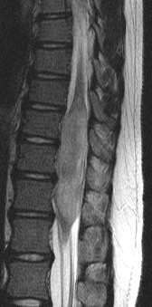
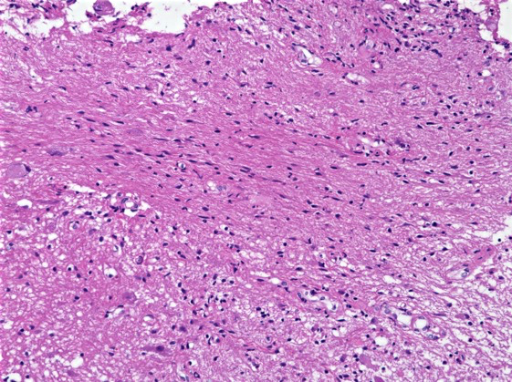
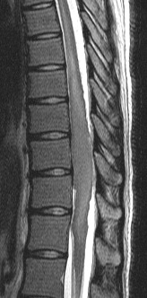
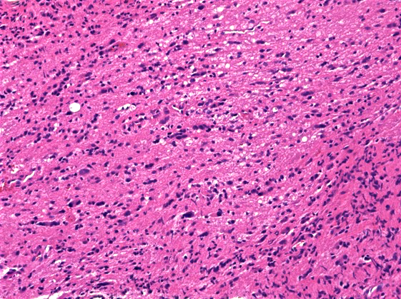
A
B
C
Grade 2 (N = 12)
OS Probability
D
E
Months
Notes:
1. 11 y.o. M
Diffuse astrocytoma (G2)
BRAF V600E mutation
Post RT
OS 16 years
Alive without recurrence
2. 23 y.o. F
Diffuse astrocytoma (G2)
No recurrent mutation
Post RT
OS 4 years
Dead after malignant transformation

Slide 5
A
B
H3K27me3
Retained (N = 8)
Loss (N = 18)
EZH2
Negative (N = 15)
Positive (N = 11)
OS Probability
OS Probability
p = 0.26
p = 0.33
Months
Months

