Slide 1
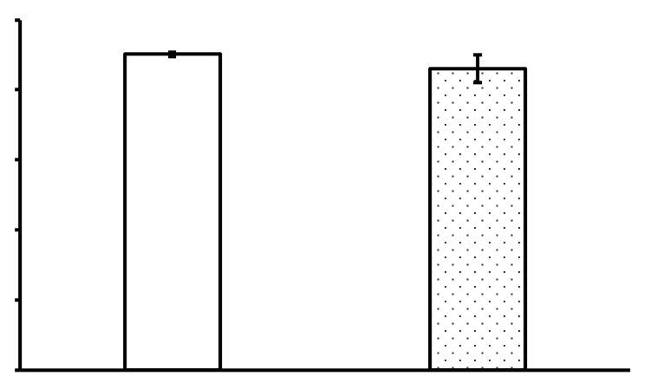
100
80
60
Sucrose preference (%)
40
20
0
noFS
3wFS

