Slide 1
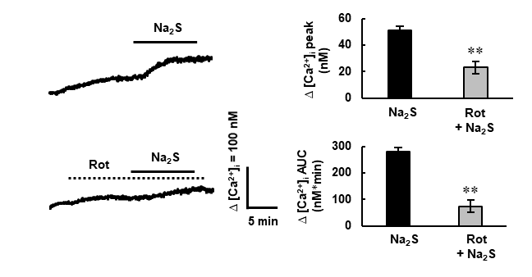
supplementary Fig. 1
Supplementary Fig. 1. The effect of pretreatment of rotenone on Na₂S-induced increases in [Ca²⁺]_{i}
Representative [Ca²⁺]_{i} response to Na₂S (150 μM) in the absence and presence of rotenone (Rot, 10 μM). Rotenone was added to cells 10 min before application of Na₂S. Peak amplitudes and AUC of the [Ca²⁺]_{i} increase by Na₂S are shown on the right. n = 58−89 cells from three cultures. Data are presented as means ± S.E.M. **P < 0.01 by unpaired Student’s t-test.

Slide 2
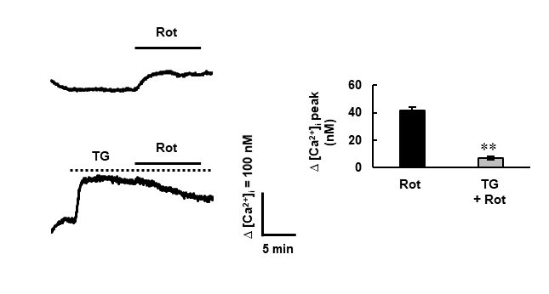
supplementary Fig. 2
Supplementary Fig. 2. Rotenone releases Ca²⁺ from the ER in spinal cord astrocytes.
Representative [Ca²⁺]_{i} response to rotenone (Rot, 10 μM) in the absence and presence of thapsigargin (TG, 1 μM). Peak amplitudes of the [Ca²⁺]_{i} increase by rotenone are shown on the right. n = 76−87 cells from three cultures. Data are presented as means ± S.E.M. **P < 0.01 by unpaired Student’s t-test.

Slide 3
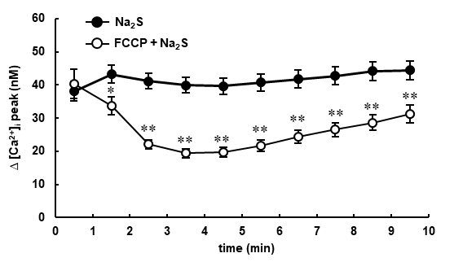
supplementary Fig. 3
Supplementary Fig. 3. Pretreatment of FCCP decreases Na₂S-induced [Ca²⁺] response in spinal cord astrocytes.
Peak amplitude of the [Ca²⁺] increase by Na₂S (150 μM) for every 1 min after the application of Na₂S in the absence or presence of FCCP (5 μM). n = 90−103 cells from three cultures. *P < 0.05 , **P < 0.01 by unpaired Student’s t-test.

Slide 4
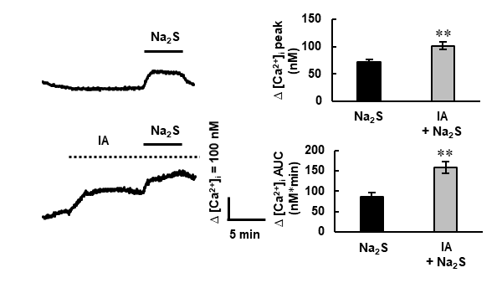
supplementary Fig. 4
Supplementary Fig. 4. Na₂S-induced [Ca²⁺]_{i} increase does not depend on glycolysis in spinal cord astrocytes.
Representative [Ca²⁺]_{i} response to Na₂S (150 μM) in the absence and presence of IA (1 mM). Peak amplitudes and AUC of the [Ca²⁺]_{i} increase by Na₂S are shown on the right. n = 95−103 cells from three cultures. **P < 0.01 by unpaired Student’s t-test.

Slide 5
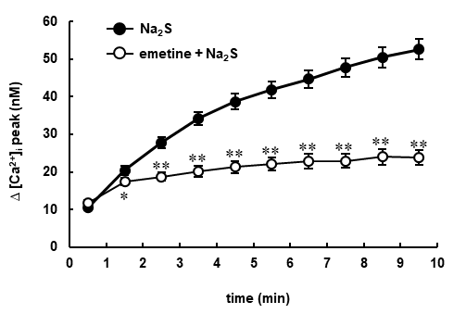
supplementary Fig. 5
Supplementary Fig. 5 Pretreatment of emethin suppressed Na₂S-induced [Ca²⁺] response in spinal cord astrocytes.
Peak amplitude of the [Ca²⁺]_{i} increase by Na₂S (150 μM) for every 1 min after the application of Na₂S in the absence or presence of emetine (5 μM). n = 93 cells from three cultures. *P < 0.05 , **P < 0.01 by unpaired Student’s t-test.

Slide 6
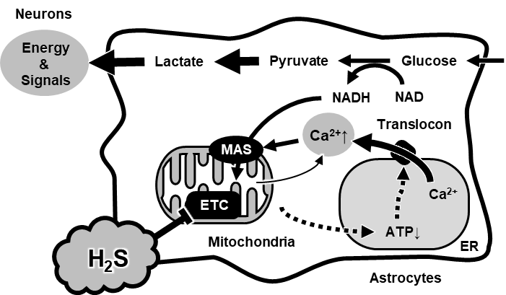
supplementary Fig. 6
Supplementary Fig. 6. Effects of H₂S on [Ca²⁺]_{i} and energy metabolism in spinal cord astrocytes.
H₂S first inhibits the ETC, which causes Ca²⁺ release from mitochondria and inhibits ATP synthesis in mitochondria. This decrease in mitochondria-derived ATP causes a decrease in the amount of ATP in the ER, which induces translocon-mediated Ca²⁺ release from the ER. Elevation of [Ca²⁺]_{i} activates NADH transport by MAS in the mitochondrial inner membrane. The activation of MAS prevents the accumulation of cytoplasmic NADH, thereby promoting the production and release of lactate. Total ATP content is maintained by an increase in compensatory lactate production. ETC; electron transport chain, ER; endoplasmic reticulum, MAS; malate-aspartate shuttle

