Slide 1
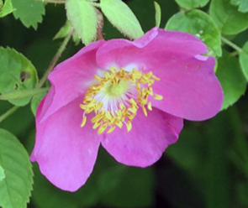
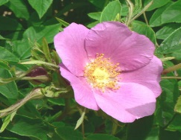
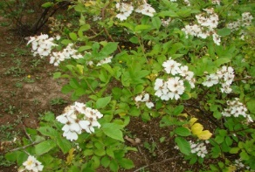
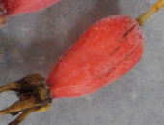
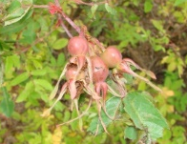
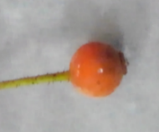
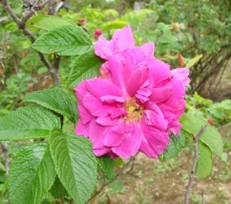
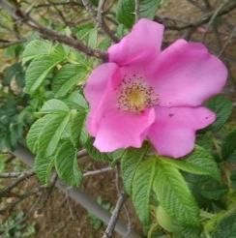
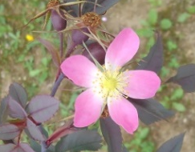
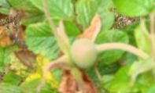
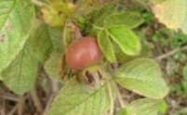
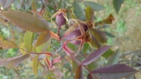
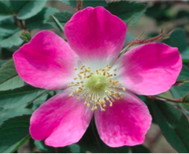
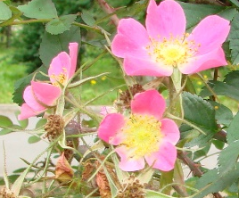
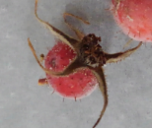
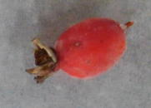
Osada et al.
R. acicularis
R. davurica
R. multiflora
R. rugosa f. plena
R. rugosa
R. glauca
‘Kitaayaka’
‘Consared’
Suppl. 1

Slide 2
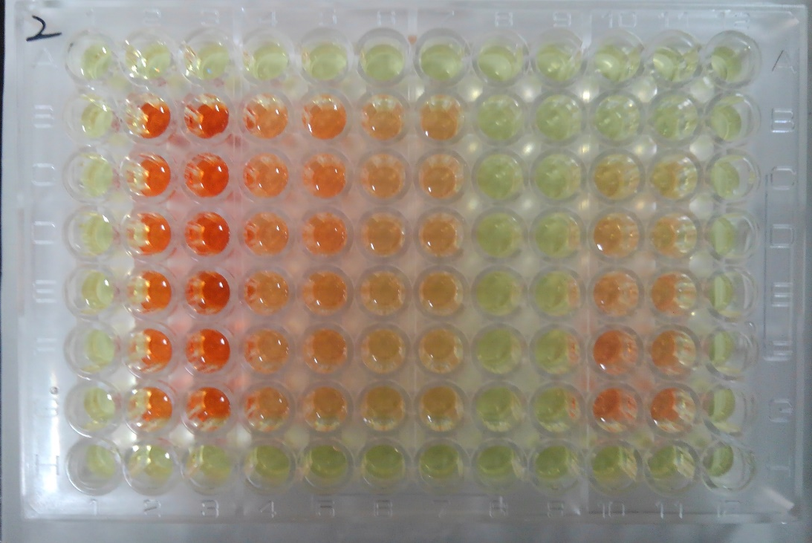
Osada et al.
ASA quantification using DNP colorimetric detection
Extract
1/1
Diluted
1/10
Diluted
1/20
ASA
Std.
5% Meta-
phosphoric acid
R. davurica
80% Ethanol
5% Metaphos.
‘Consared’
MWA
5% Metaphos.
MWA: methanol:water:acetic acid, 90:9.5:0.5 v/v/v.
Extracted directly with
5% metaphosphoric acid
Absorbance
Extracted with 80% EtOH first, evaporated, then extracted again with 5% metaphosphoric acid
Extracted with MWA first, evaporated, then extracted again with 5% metaphosphoric acid
ASA standard (mg/L)
Table. Effects of the types of solution on the content of ASA extracted.
Species/cultivar ^{z}
ASA mg/g DW (Recovery %)
Solution:
5% Metaphos.
80% EtOH
MWA
R. davurica
107.3 (100)
99.5 (93)
95.6 (89)
‘Consared’
71.7 (100)
62.7 (88)
63.5 (89)
^{z} Rose hips collected in 2013 were used.
Suppl. 2

