Slide 1

“Predatory problem” in Academia
Faculty of Media and Communication FD Training
Thursday, December 12, 2024
Research Support Division, Hokkaido University Library
Maiko Muraki

Slide 2
Table of contents
What is the “Predatory problem”? … p. 4
Encounters ... p. 10
What's the problem? … p. 16
Solution: Response? Prevention? … p. 19
The fundamental problem of the “Predatory problem” ... p. 32

Slide 3
What is the “Predatory problem”?
From first report to the present
2008
First report by the researcher
2008-
・Beall’s list
・Recognition of the problem
・Investigations
2018-
・Reports by “The Mainichi Newspapers”
・Recognition of the problem in Japan
・Alerts（Universities and Japan）
2020- (COVID19)
・Many ”Predatory Conference” were held
2022-
・Definition of ”Predatory”
・Including ambiguity, unclear
Present (2024)
・Changes in solution and recognition of problem
・Promotion of OA

Slide 4
What is the “Predatory problem”?
The so-called “Predatory”
“Predatory” translates to “Hagetaka” (vulture) in Japanese
All common names
“Predatory” journals/conferences/publishers,
“hijacked” journals/conferences/publishers, etc.
Typical characteristics
Frequent solicitation emails, poor quality sites, extremely fast or inappropriate peer review, Impact Factor-like numbers, logos and names similar to well-known journals
The purpose is the publication fee / entry fee

Slide 5

What is the “Predatory problem”?
What is the Open Access?
Anyone can freely use papers that are the results of research
Papers are available free of charge
Orange unlocked icon
Appeared with the soaring cost of journal subscriptions
Increasing and gradually becoming more common
Promoted internationally, and in Japan *
There are several ways depending on covering the cost of publication : Self-archiving (Green OA), Gold OA
English titles of Japanese documents (without English titles) are based on machine translation.
*Secretariat for Science, Technology and Innovation, Cabinet Office, Government of Japan. Open Access Policy for Academic Papers in Japan（2024.4.25, 26）(in Japanese)
https://www8.cao.go.jp/cstp/oa_houshin_setsumei.pdf

Slide 6









What is the “Predatory problem”?
Open Access：Self-archiving
Publisher
Accept
Reviewer
Editor
proofread
Author
Accepted Manuscript
Usually，after 1-2 years from the publication
Hokkaido University Northern Campus Library.
Afternoon Talk on Open Access and Predatory Journals
http://hdl.handle.net/2115/71762
Institutional Repository
HUSCAP

Slide 7
What is the “Predatory problem”?
Open Access：Gold OA
Publisher
Accept
Reviewer
Editor
Proofread
Author
APC : Article Processing Charge
Hokkaido University Northern Campus Library.
Afternoon Talk on Open Access and Predatory Journals
http://hdl.handle.net/2115/71762

Slide 8

What is the “Predatory problem”?
“Predatory journal” exploit Gold OA model
Predatory
publisher
Accept
Reviewer？
Invitation
poor and/or
inappropriate peer review
“Predatory publishers” urge authors to post papers for the purpose of their APC
↓
Research works are published through no proper peer review
Editor？
proofread？
Author
APC : Article Processing Charge
Hokkaido University Northern Campus Library.
Afternoon Talk on Open Access and Predatory Journals
http://hdl.handle.net/2115/71762

Slide 9
What is the “Predatory problem”?
Expensive APC payments
Article Processing Charge (APC): publication fee paid by authors
APC average：Approximately $2,000 (2020) *
Papers on “Predatory journals” are available for free
⇒The quality check that comes with the subscription doesn't work
Complete with the author's APC payment,
“Predatory journals”’ purpose achieved
*Yoshiro Hirata, About survey on Publication of Research Papers of Japan Alliance of University Library Consortia for E-Resources（JUSTICE）, SPARC Japan Seminar 2022
https://www.nii.ac.jp/sparc/event/2022/pdf/20230217_8.pdf (in Japanese)

Slide 10
Encounters
Isn't it a “Predatory”...?
I've never heard of a journal before?
The journal planning to submit has too short review period and seems to have been accepted for the most of submissions?
Isn't the papers on the doctoral dissertation application suspicious?
Consultee: Researcher, doctoral student's supervisor, academic affairs office, administrative office
Timing of consultation
Possibility of problems after submission (after acceptance, before APC payment, when applying for a doctoral dissertation)

Slide 11
Encounters
I've fallen for “Predatory”
Case 1: Supervisor consults to check the paper that a PhD student has submitted before APC payment…
Case 2: A journal with an IF that supervisor recommended a PhD student to submit to, actually…
Case 3: The publisher was at an unknown address, they demanded me a fine, they made threats…
Case 4: A claim from a fake publisher was made during the payment process for the proper journal
I didn't notice anything suspicious at first.
There may be other things that I didn't notice.

Slide 12
Encounters
Without permission...
One’s own paper was reprinted with a different author name and title *1
A generative AI fabrication paper was published under one’s own name *2
Hijacked Journal, Clone Journal *3
I was involved without realizing it.
There may be others that you are not aware of.
Newspaper articles can be viewed from the database (limited to Hokkaido University On‐Campus) https://www.lib.hokudai.ac.jp/databases/#shinbun
*1 Plagiarism of papers: US Predatory journal plagiarizes full text, author and title changed, Japan researchers also suffered」The Mainichi Newspapers, 2021.12.27 (in Japanese)
*2 Generative AI is used to fabricate papers by Japan researchers or published on overseas sites “Predatory Journal" for income purposes, The Yomiuri Shimbun, 2024.11.20 (in Japanese)
https://www.yomiuri.co.jp/national/20241120-OYT1T50136/
*3【Alert】About fake sites claiming to be Sapporo Medical Journals (in Japanese)
https://infonavi.sapmed.ac.jp/jpn/news/news-library/5093/

Slide 13
Encounters
I got involved even though I had doubts
Submit to increase research output *1
Participate in conferences to increase research achievements *2
Fast publication of papers was required for doctoral degree *3
Student needed papers published for employment *4
I couldn't refuse the co-author's request *5
I didn't know it at the time, I had no choice but to use it.
*1 Science Forest: Measures against Predatory journals, universities are struggling, researchers easily use it to acquire achievements,The Mainichi Newspapers, 2021.7.8 (in Japanese)
*2“Predatory" International Conference: 30 people from different fields, presented in the same room at the "Conference" in Paris, participating lecturer "Convenient“,The Mainichi Newspapers, 2019.1.19 (in Japanese)
*3 Inferior journals: Submissions, professors under pressure Associate professor testimony National University, earning achievements, The Mainichi Newspapers, 2018.9.15 (in Japanese)
*4 Inferior academic journal: Kyushu University takes measures for the first time in Japan, calls attention to submission, The Mainichi Newspapers, 2018.9.3 (in Japanese)
*5 InterAcademy Partnership, Combatting Predatory Academic Journals and Conferences (Summary Report in English), InterAcademy Partnership, 2022 https://www.interacademies.org/project/predatorypublishing

Slide 14
Encounters
Unclear…
Consultation: I've never heard of a journal before?
Solicitation e-mails to researchers, publication fees apply
It is not listed in lists. It does not meet the judgment criteria.
There are consultation cases at several universities
Mentioned in press releases at several universities
Some researchers have determined that it is a “Predatory"
Researchers have made different decisions,
and we still don't know

Slide 15
Encounters
Investigation of “Predatory" publications
Survey on the use of “Predatory" in doctoral dissertations (2017 medical): 8 out of 106 (7.5%) *1
Case Study of Universities in Japan: The Mainichi Newspapers Survey (2018) *2
⇒ This was an opportunity to raise awareness at each university
*1 Sho Sato. Some Japanese Ph.D students use Predatory publishing－7.5% of randomized samples in medicines, The Journal of Information Science and Technology Association, Vol.74 Issue 10, p.511-512（2018）(in Japanese)
https://www.jstage.jst.go.jp/article/jkg/68/10/68_511/_article/-char/ja/
*2 Inferior journals: 5,000 papers from Japan University of Tokyo and Osaka University Paper submissions, achievements inflated, The Mainichi Newspapers, 2018.9.3 (in Japanese)

Slide 16
What's the problem?
Problems for individual researchers as contributors
The publication fee is not returned, or a cancellation fee is incurred
The publisher does not respond to the withdrawal of the submission or the publication of the article
Inability to submit to other journals due to fear of double submission
Can research related to “Predatory journal" be made into an achievement?

Slide 17
What's the problem?
Issues not only individual researchers
Citation of papers ⇒ influence of research itself *
Reviews, citations in press releases ⇒ impact on the public
Degree review, performance evaluation, personnel evaluation
Care must also be taken when using papers
Time and money spent on academic results with no guarantee of value
*Sho Sato. About 40% of articles published in Predatory OA journals have been cited at least one time, The Journal of Information Science and Technology Association, Volume 69 Issue4，171-172（2019）(in Japanese) https://doi.org/10.18919/jkg.69.4_171

Slide 18
What's the problem?
Evaluation of the papers published in “Predatory journal"
Is the quality of the paper proportional to the quality of the publication? Is it different?
Case of submissions to “Predatory journal” withdrawn and on the verge of being finished peer-reviewed by appropriate journals *
It is necessary to look at the individual papers themselves and the individual situations
* Inferior academic journal: Refuses to delete papers, submissions by metropolitan hospitals, even charges fees, The Mainichi Newspapers, 2018.10.15 (in Japanese)

Slide 19
Solution: Response? Prevention?
What to do after you get involved
Can you get back the publication fee and the paper, and cut off the relationship?
Withdrawal of submission and withdrawal of publication
⇒In most cases, maybe, you don't get a reply, you don't get a response, you are charged a cancellation fee, your paper continues to be published
Case study (copyright transfer agreement is the key point) *
Consultation at Hokkaido University: Administrative work of the department to which you belong
Legal advice...? There are no court cases in Japan
It's important not to get involved in bad journals
*「Withdrawal of accepted manuscript from a predatory journal」Advice from COPE Members (2016)
https://publicationethics.org/case/withdrawal-accepted-manuscript-predatory-journal

Slide 20
Solution: Response? Prevention?
Provision of prevention information
Universities: Provision of prevention information
CAUTION: Be aware of “ Predatory Journals” （Hokkaido Univ.）
https://www.lib.hokudai.ac.jp/en/support/predatory_journals/
Japan: Concerns, recommendations
Ministry of Education, Culture, Sports, Science and Technology “Questionnaire on Response to Cases of Concern in the Distribution of Academic Information” (2021.10.26) (in Japanese)
https://www.mext.go.jp/content/20211028-mxt_jyohoka01-000018641_07.pdf
The Science Council of Japan: Reconsidering Research Misconduct
“Deliberations on Peer Review of Papers” (2023.9.25) (in Japanese)
https://www.scj.go.jp/ja/info/kohyo/pdf/kohyo-25-k353.pdf

Slide 21
Solution: Response? Prevention?
On prevention: list method
Watchlist:
list of questionable journals
Beall’s List
Predatory Reports (Cabell’s) : for profit
Safelist:
databases that are considered to be highly reliable
DOAJ（Directory of Open Access Journals）
COPE（Committee on Publication Ethics）
OASPA（Open Access Scholarly Publisher's Association）
Web of Science：Master Journal List

Slide 22
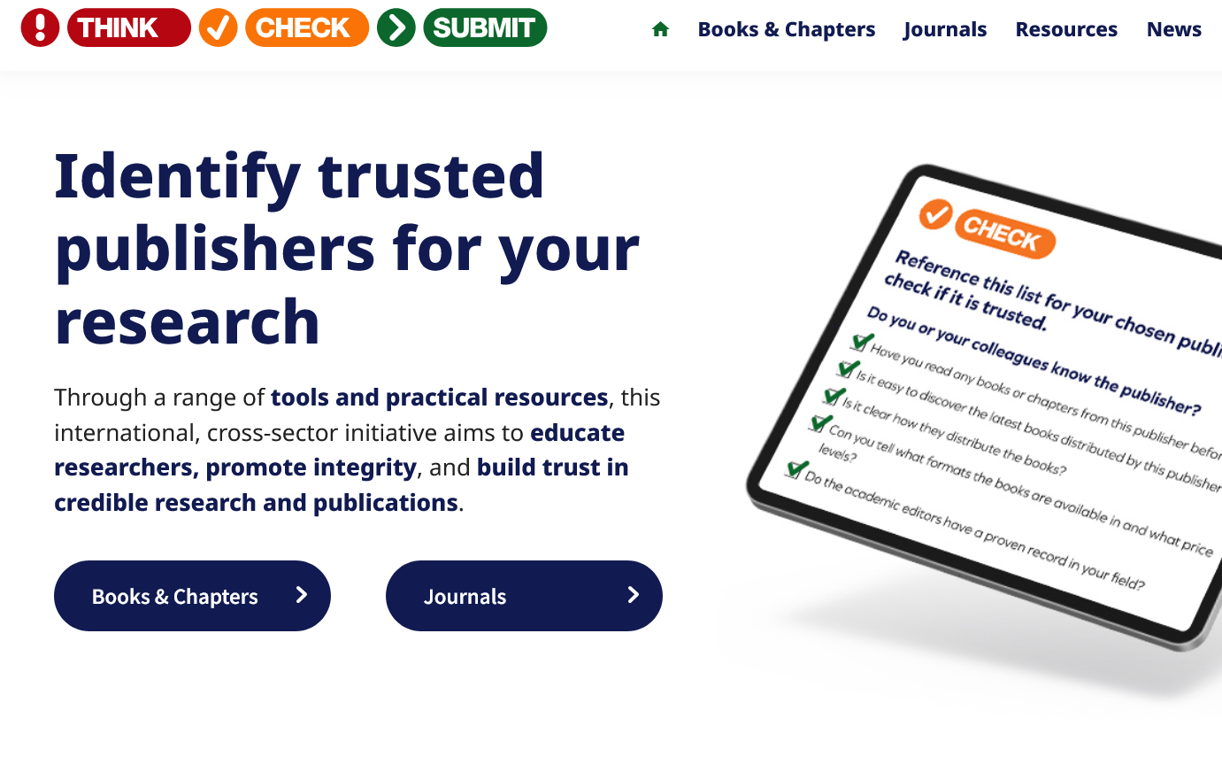
Solution: Response? Prevention?
On prevention: checklist
Think,check,submit
https://thinkchecksubmit.org/
（Multilingual support）
PDF (in Japanese) https://doi.org/10.18910/93181

Slide 23
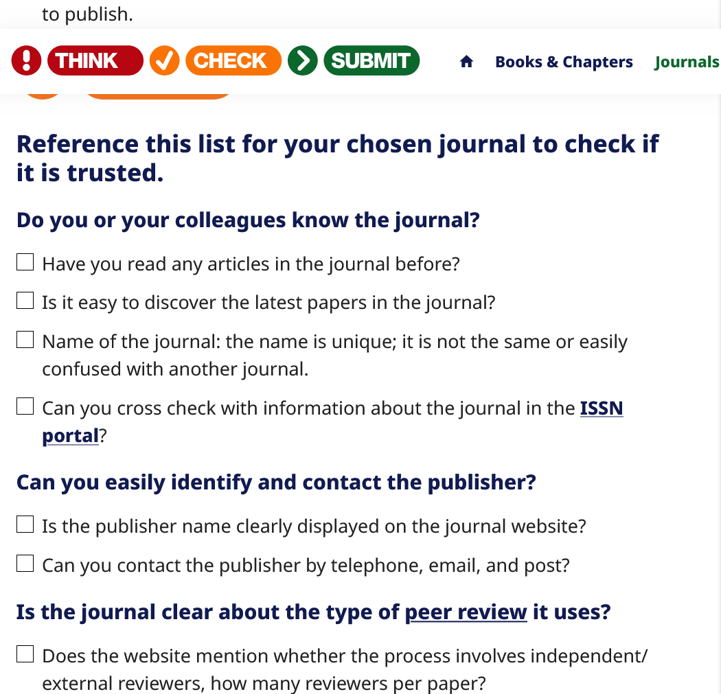
Solution: Response? Prevention?
On prevention ：Checklist Perspectives
Do you or your colleagues know the journal?
Can you easily identify and contact the publisher?
Is the journal clear about the type of peer review it uses?
Are articles indexed and/or archived in dedicated services?
Is it clear what fees will be charged?
Are guidelines provided for authors on the publisher website?
Is the publisher a current member of a recognized industry initiative?

Slide 24
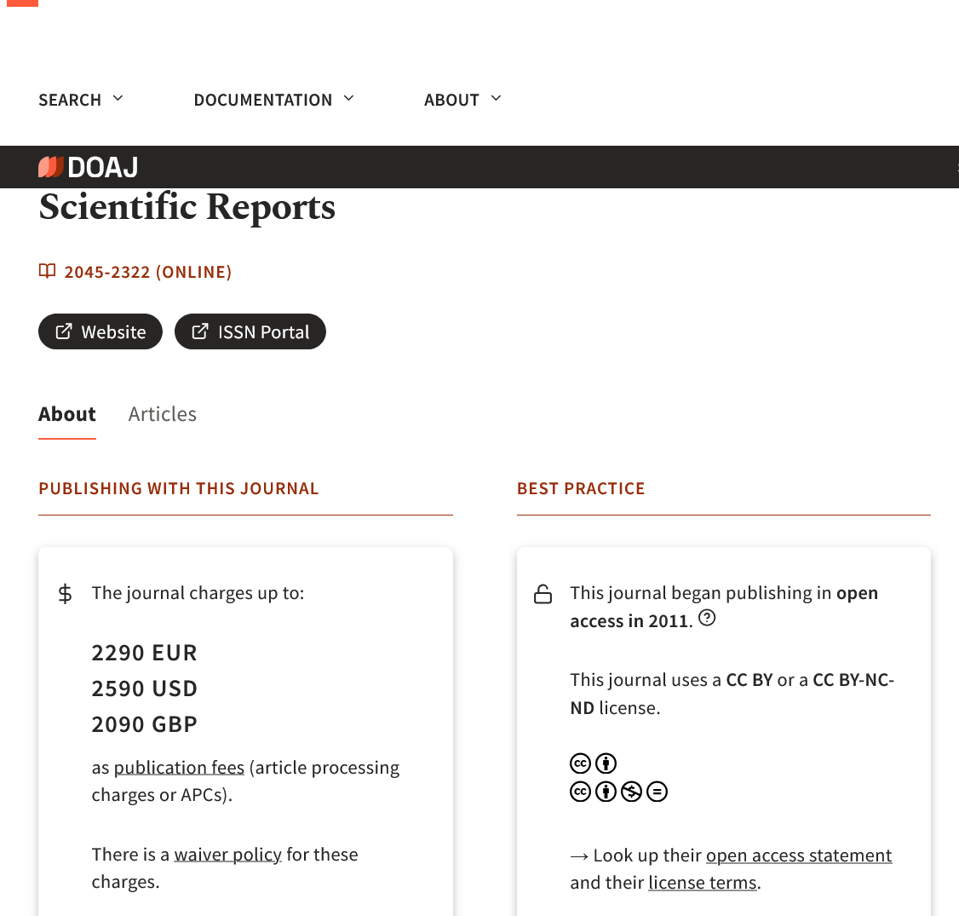
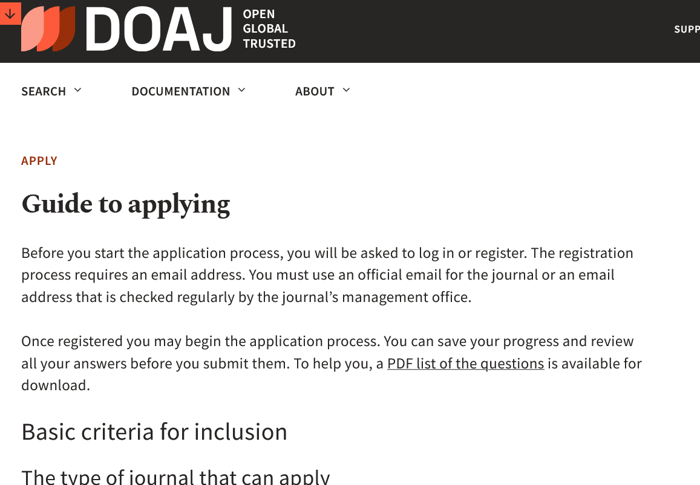
Solution: Response? Prevention?
On prevention: Safelist Perspective
DOAJ：list of Open Access Journals
https://doaj.org/
The characteristics of the journal can be listed
Strict screening criteria for inclusion ⇒ to be referenced

Slide 25
Solution: Response? Prevention?
On prevention: fluctuations in the list
Watchlists may be arbitrary in their criteria
Journals may disappear from the safelist
On both watchlists and safelists
List has no information on journals that have just been published
Fact-finding Survey of Predatory Journal Judgment List *
Reasons for judging “Predatory" and difficulties in evaluating and judging
Lack of commercial watchlist, difficulty in quality confirmation
*Kazuki Ide, Kazuhiro Hayashi, Hitoshi Koshiba. Fact-finding Survey of Predatory Journal Judgment List, NISTEP RESEARCH MATERIAL. 2023: No.326 (in Japanese)
https://doi.org/10.15108/rm326

Slide 26
Solution: Response? Prevention?
What is “Predatory" again? The quality of journals is dynamic
Peer-reviewed “Predatory journal” ？
A journal that has changed its reputation as a “Predatory”
Training low-quality journals/societies/publishers
What “Predatory” word refers to differs from person to person
The problem with the word “Predatory” : containing the judgment of “bad”
Sho Sato, Trends in Publication in the Open Science Era, Vol.2 : Definition and gradation of “Predatory journal" Turnitin blog 2022.6.1 (in Japanese) https://www.turnitin.jp/blog/the-definition-and-spectrum-of-predatory-journals

Slide 27
Solution: Response? Prevention?
Definition of “Predadory"：in Nature
Predatory journals are driven by self-interest, usually financial, at the expense of scholarship
Characteristics
False or misleading information
Deviation from best editorial and publication practices
Lack of transparency
Aggressive, indiscriminate solicitation
The difinition Keeps the word “Predatory” while noting its limitations
Agnes Grudniewicz et al. Predatory journals: no definition, no defence, Nature 576, 210-212 (2019) https://doi.org/10.1038/d41586-019-03759-y
Notes:
Natureの誌上で、有識者により打ち出された「Predatory Journal」いわゆる「ハゲタカジャーナル」の定義。
問題について、多くの人がこれは悪質、と同意できるようなラインで定義されている。
「Predatory」（ハゲタカ）の言葉には、限界に留意が必要としながらも、残す方針。

Slide 28
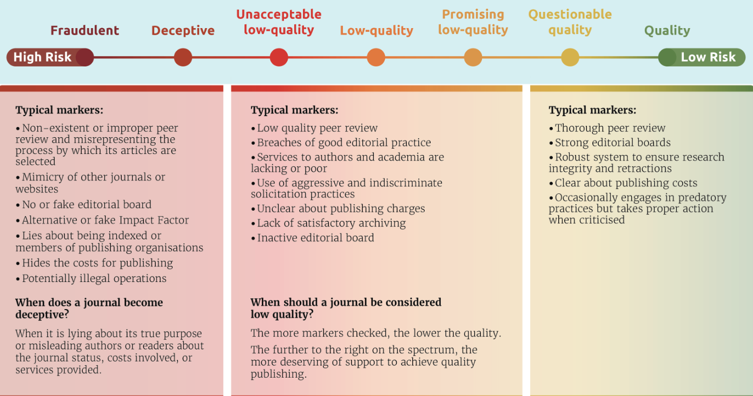
Solution: Response? Prevention?
Definition of “Predadory"：in IAP
A spectrum of predatory behaviours for journals
IAP. Summary report (in English). Combatting Predatory Academic Journals and Conferences https://www.interacademies.org/publication/predatory-practices-summary-English
This work is copyright of the InterAcademy Partnership (IAP) and is licensed under Creative Commons Attribution 4.0 International. The full report (in English) can be found at https://www.interacademies.org/publication/predatory-practices-report-English.

Slide 29
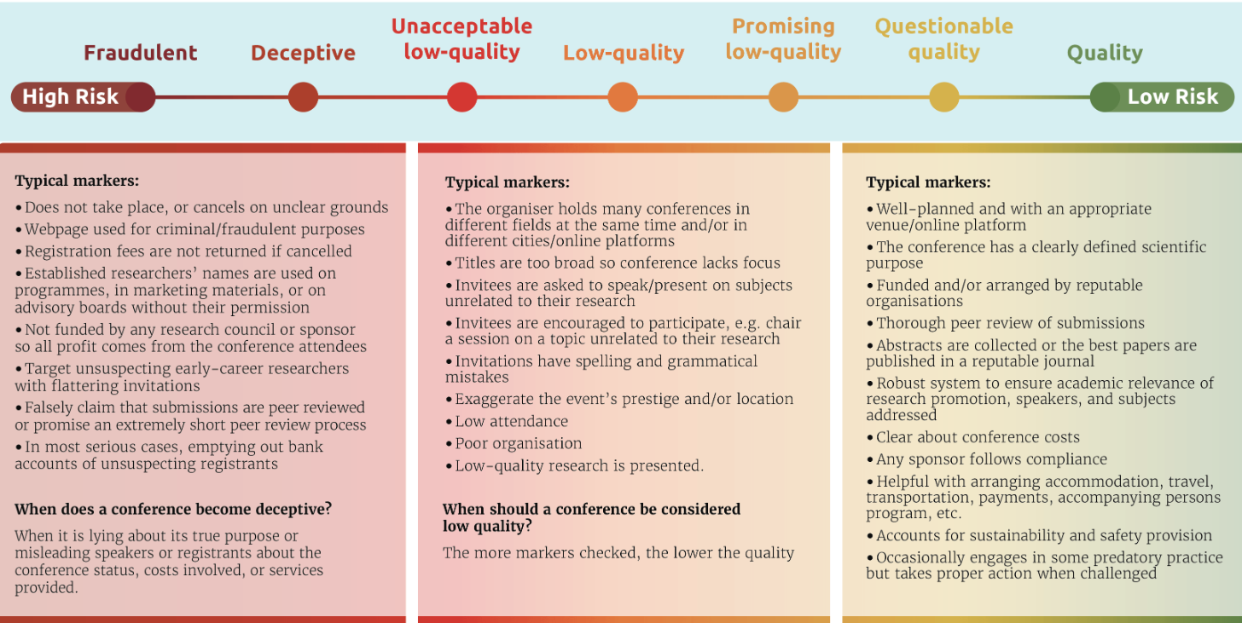
Solution: Response? Prevention?
Definition of “Predadory"：in IAP
A spectrum of predatory behaviours for conferences
IAP. Summary report (in English). Combatting Predatory Academic Journals and Conferences https://www.interacademies.org/publication/predatory-practices-summary-English
This work is copyright of the InterAcademy Partnership (IAP) and is licensed under Creative Commons Attribution 4.0 International. The full report (in English) can be found at https://www.interacademies.org/publication/predatory-practices-report-English.

Slide 30
Solution: Response? Prevention?
Definition of “Predadory” ： A spectrum of predatory behaviours for journals/conferences
You can't judge whether it's good or bad
Capture risk in a spectrum (“gradation” in Japanese)
↓ Material (in Japanese) designed and created based on “To prevent the spread of inferior academic journals and academic conferences (expanded version)” https://doi.org/10.18910/91457
Kazuki Ide, Takeo Nakayama “Is that academic journal okay?” (in Japanese)
https://doi.org/10.18910/94925

Slide 31
Solution: Response? Prevention?
Change the way you think about solution
No solution is 100% effective
Don't believe in solicitation emails, make independent decisions
Use the list to refer to the criteria, not the results of the decision
Verbalize the judgment process of each journal, conference, or publisher and what kind of problems there are
Communicate with researchers and stakeholders
Especially PhD students: choose journal to submit in consultation with supervisor
Invisibility of problems due to “Predatory”
Kazuki Ide “Openness, Quality, Inescapable Ambiguity and Practical Approach of Academic Journals and Data” 2024.11.8 Research University Consortium (RUC) Seminar (in Japanese)
https://hdl.handle.net/11094/98413

Slide 32
The fundamental problem of the “Predatory problem”
Situation Surrounding Researchers
Too busy
Fixed-term employment
Doctoral Dissertation Requirements
Excessive pressure and urgency to present results in a limited amount of time
Publish or Perish: acceleration in the modern era

Slide 33
The fundamental problem of the “Predatory problem”
Problems of Academic Publication and Research Evaluation
Overly commercialized academic journals
High subscription and publication fees
Fluctuations in trust in peer review
Is peer review working? Necessary?
Overly numerical evaluation of research
Number of papers, presentations, citations
Problems one after another
Paper Mill *1, Peer Review Mill *2
*1 The fight against fake-paper factories that churn out sham science, Nature 591, p516-519 (2021)
https://doi.org/10.1038/d41586-021-00733-5
*2 ShoSato. A New Threat "Review Mill" JPCOAR Web Magazine, 2024.9.24 (in Japanese) https://www.magazine.jpcoar.org/news/80ba13b1-ab85-4917-9040-00a47fabc330

Slide 34
The fundamental problem of the “Predatory problem”
Solution
Presentation and distribution of academic achievement
Open Peer Review, Preprint, Sharing research data,
Diamond Open Access…
Reforming the research assessment framework
Signature to “San Francisco Declaration on Research Assessment”（DORA）
https://sfdora.org/
The situation of academic results presentation and research assessment is moving

Slide 35
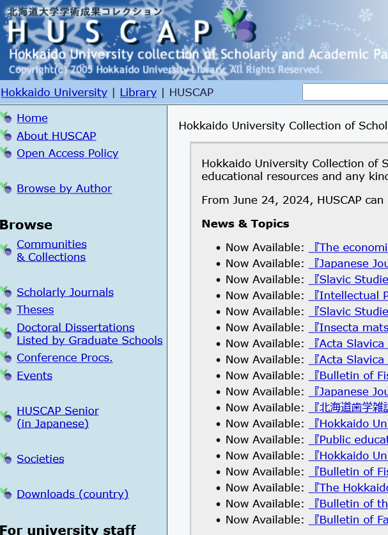
From the library
Mandatory immediate Open Access to academic papers and data in Japan
Public grants, from new applications for 2025
For details (in Japanese)
https://www.lib.hokudai.ac.jp/support/immediate_open_access
Hokkaido University's Open Access support
・Self-archiving in HUSCAP
https://eprints.lib.hokudai.ac.jp/dspace/index.jsp?&lang=en&locale=en
For inquiries
HUSCAP[at]lib.hokudai.ac.jp
・Open Access Paper submission support (in Japanese)
https://www.lib.hokudai.ac.jp/support/apc/

