Slide 1
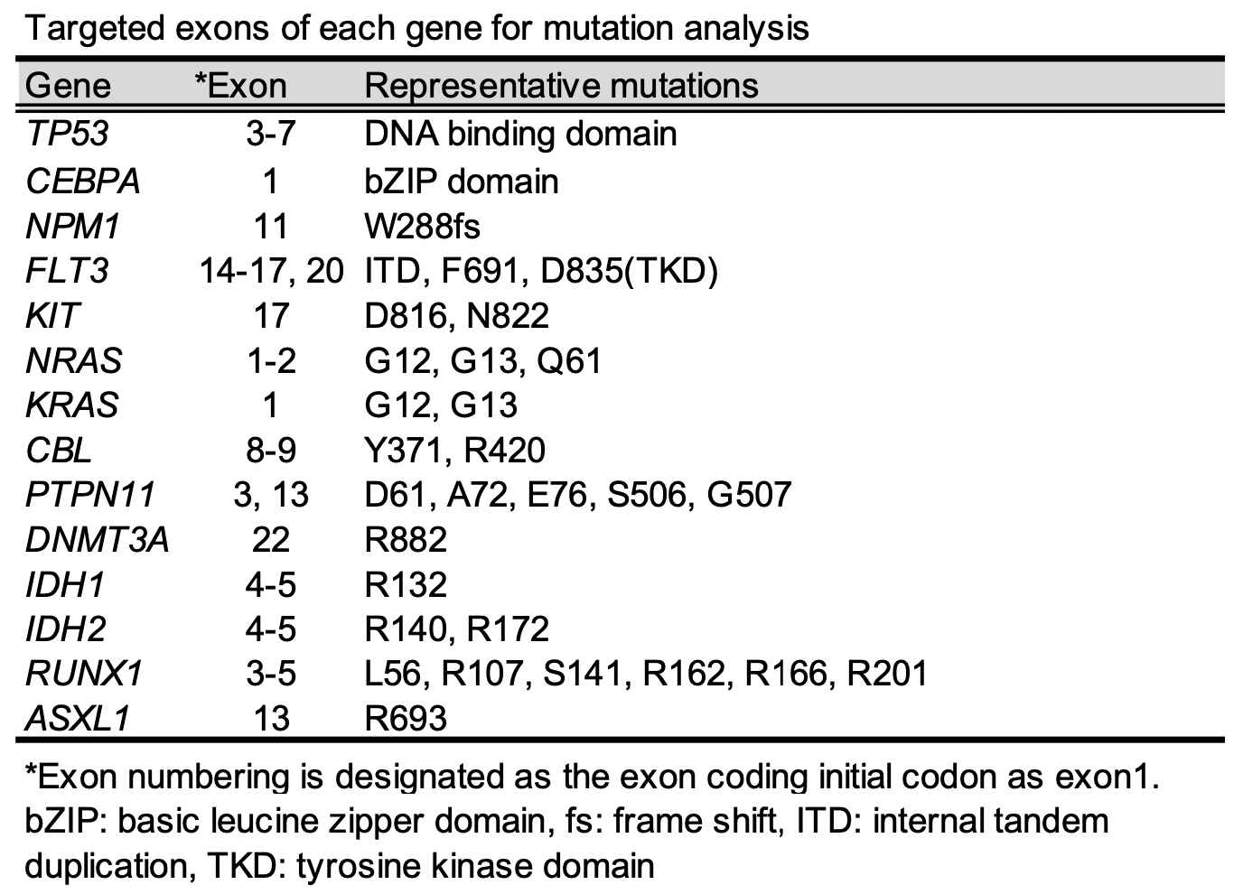
Supplementary document
Patients and Methods
Hokkaido Leukemia Net (HLN) is a multicentric prospective observational cohort study collecting acute leukemia samples from affiliated hospitals of the North Japan Hematology Study Group (NJHSG) covering all of Hokkaido and Iwate, Japan (UMIN000048611). In the HLN protocol, patients aged 16 years or older are eligible for registration without an upper age limit, reflecting a regional real-world cohort. Each patient's treatment is at the physician’s discretion. We prospectively analyzed AML cases except for cases of acute promyelocytic leukemia that were registered in HLN from May 2021 to April 2023 and that were initially treated by VEN-based therapy. This study was conducted in accordance with the Helsinki Declaration and was approved by the institutional review board of Hokkaido University Hospital (#015-0344). Written consent was obtained from all patients.
Patient samples were collected at diagnosis, and genomic DNA was extracted from bone marrow or peripheral blood. We developed a compact AML panel covering mutation hot spots of 14 genes including TP53, CEBPA, NPM1, FLT3, KIT, NRAS, KRAS, CBL, PTPN11, DNMT3A, IDH1, IDH2, RUNX1 and ASXL1. The target exons of each gene are listed in Table below. Multiplex polymerase chain reaction (PCR) products of genomic DNA were sequenced at Research Institute for Microbial Disease, Osaka University (Osaka, Japan) using Miseq (Illumina, San Diego, CA). Only variants occurring with a variant allele frequency (VAF) of more than 5% and a coverage of 100 or more were defined as mutations.
Statistical analysis
Clinical variables across groups were compared by using the 2-sided Fisher's exact test for categorial variables. The nonparametric Mann-Whitney U test and Kruskal-Wallis test were used for continuous variables. A P value < 0.05 indicated a significant difference. The log-rank test was used to evaluate overall survival (OS) and event-free survival (EFS). For multivariable analysis of prognostic factors, Cox proportional hazards regression models were used. Variables were selected based on previous studies and clinical experience. For multiple comparisons of three or more groups, p-values were adjusted using Bonferroni Holm correction. All statistical analyses were performed with EZR software ver.1.54 (Saitama Medical Center, Jichi Medical University, Saitama, Japan) .

Slide 2
Supplementary Fig. 1
A
HLN 2021.5 - 2023.4 (n=246)
B
1.0
0.8
Patients
0.6
Survival
0.4
0.2
Age
0.0
0
100
200
300
400
500
600
Days
Number at risk
89
72
43
22
7
4
1
C
D
1.0
CK/TP53 mt with
VEN-sensitive mt
0.8
0.6
2) CK/TP53 mt w/o
VEN-sensitive mt
Survival
0.4
P=0.029
0.2
0.0
0
100
200
300
400
500
Days
Number at risk
1)
6
5
4
2
0
0
2)
28
19
12
7
2
1
E
1.0
0.8
1) VEN-sensitive mt
Event-free survival
0.6
2) Others
0.4
0.2
3) CK/TP53 mt
w/o VEN-sensitive mt
P<0.001
0.0
0
100
200
300
400
500
600
Days
Number at risk
1)
24
22
13
6
3
3
0
2)
35
27
13
5
2
0
0
3)
30
20
8
5
2
1
0
Age distribution and choice of the initial therapy for our AML cohort
AZA: azacitidine monotherapy, CAG: aclacinomycin + low-dose AraC + G-CSF, HU: hydroxyurea, VEN: venetoclax, BSC: best supportive care
B. Overall survival of the patients who were initially treated by VEN-based treatment (n=89)
C. Best response by VEN-based treatment (n=89)
D. Survival of CK/TP53 mt with or without VEN-sensitive mutation
E. EFS divided by our stratification

Slide 3
Supplementary Fig. 2
A. Döhner’s stratification (ASH 2022 Abstract #602)
OS
EFS
1.0
2) TP53^{WT} and FLT3-ITD
or K/NRAS mutated
1.0
1) TP53^{WT}, No FLT3-ITD, K/NRAS^{WT}
0.8
0.8
2) TP53^{WT} and FLT3-ITD
or K/NRAS mutated
0.6
1) TP53^{WT}, No FLT3-ITD, K/NRAS^{WT}
0.6
Survival
Event-free survival
0.4
0.4
0.2
3) TP53 Mutated
0.2
3) TP53 Mutated
0.0
P=0.0030
0.0
P=0.0046
0
100
200
300
400
500
600
Days
0
100
200
300
400
500
600
Days
Number at risk
Number at risk
1)
57
50
28
14
3
1
0
1)
57
49
22
9
3
1
0
2)
8
6
4
3
2
2
1
2)
8
4
4
3
2
2
0
3)
24
16
11
5
2
1
0
3)
24
16
8
4
2
1
0
B. Mayo’s stratification (Gangat N, et al. Am J Hematol. 2023.)
Not achieve CR or CRi | +2
Adverse karyotype | +1
With TP53 mutation | +1
Without IDH2 mutation | +1
Low: 0-1, Int: 2-3, High: 4-5
OS
EFS
1.0
1) Low
1.0
0.8
0.8
1) Low
0.6
0.6
Survival
2) Int
Event-free survival
0.4
3) High
0.4
3) High
2) Int
0.2
P<0.001
0.2
P<0.001
0.0
0.0
0
100
200
300
400
500
600
Days
0
100
200
300
400
500
600
Days
Number at risk
Number at risk
1)
19
9
5
2
1
0
0
1)
19
9
5
2
1
0
0
2)
35
30
17
8
1
1
0
2)
35
27
10
5
1
1
0
3)
35
33
21
12
5
3
1
3)
35
33
19
9
5
3
0

