Slide 1
Supplementary figures and a table
Article title
Seasonal changes in pigment content in overwintering and current-year leaves of Sasa senanensis from snowmelt to before leaf-fall of canopy deciduous trees
Journal name
Journal of Plant Research
Author names
Kiyomi Ono, Megumi Hashiguchi, Ryouichi Tanaka & Toshihiko Hara
Affiliation
Institute of Low Temperature Science, Hokkaido University, Sapporo, Hokkaido, Japan
E-mail address of corresponding author
kiyomion@lowtem.hokudai.ac.jp

Slide 2
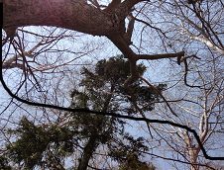
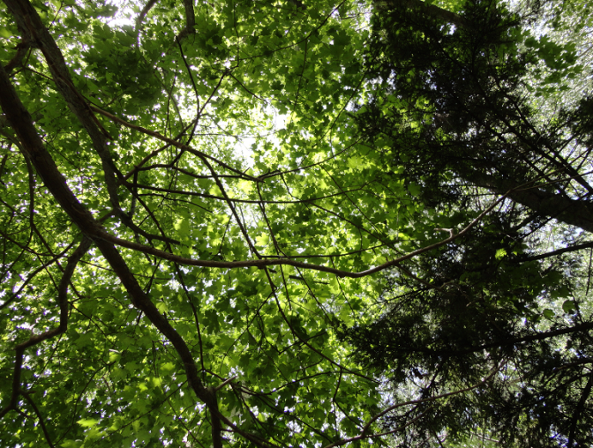
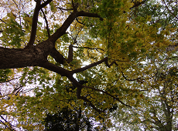
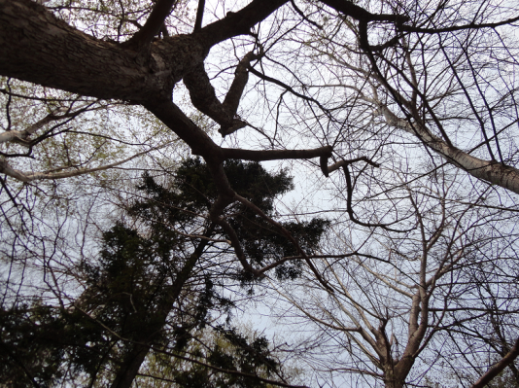
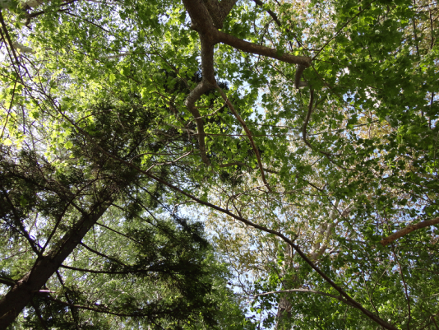
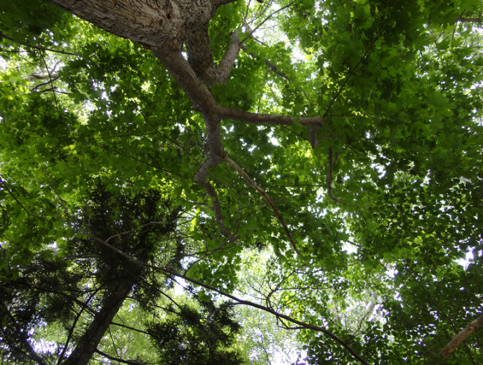
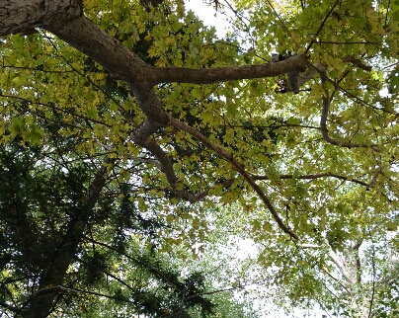
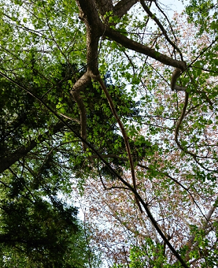
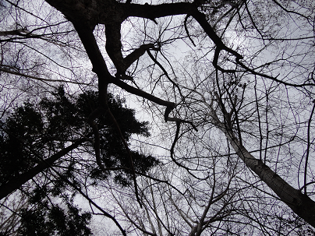
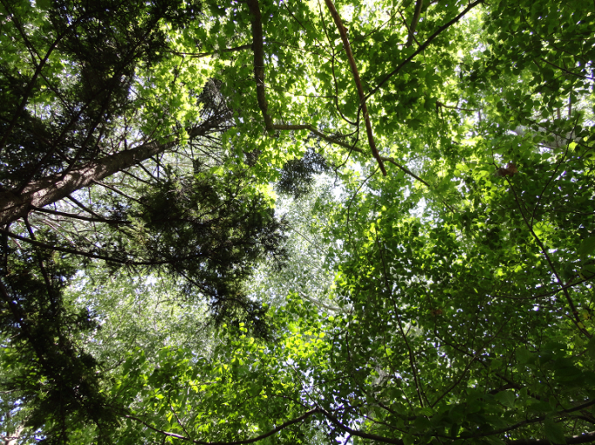
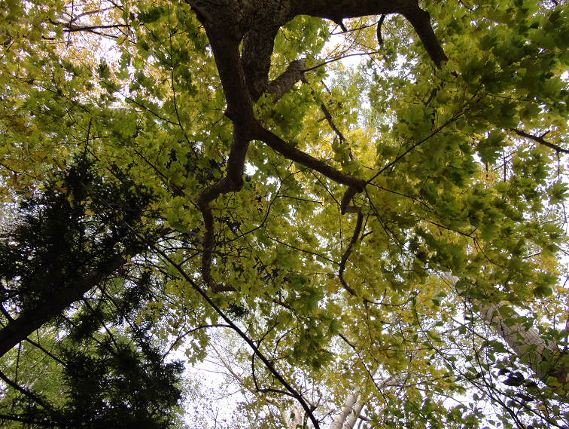
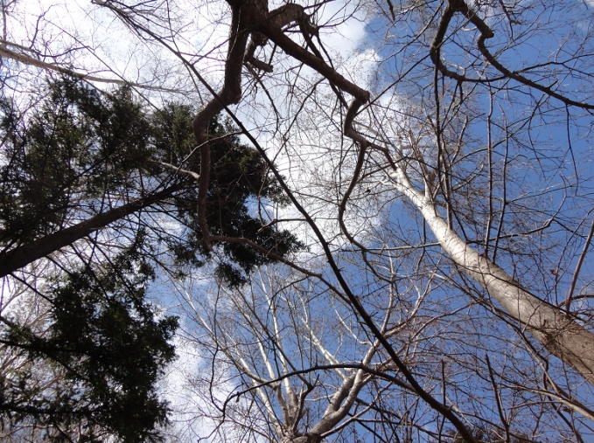
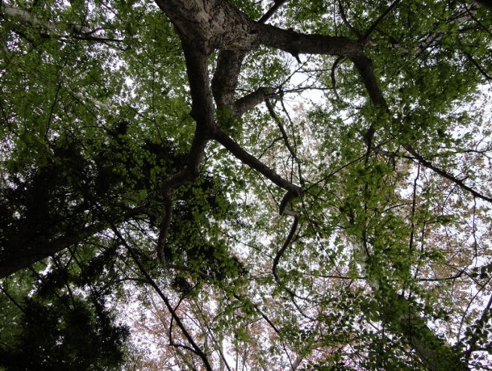
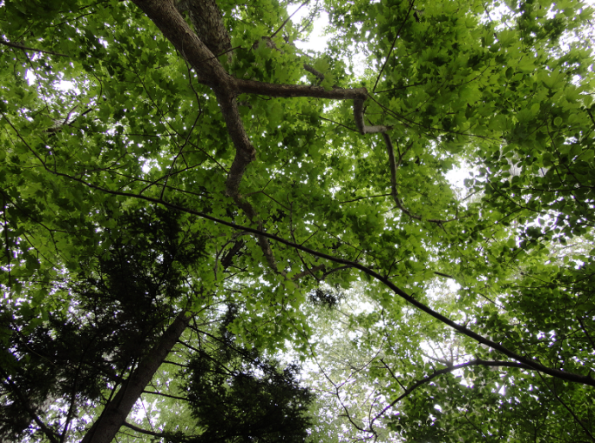
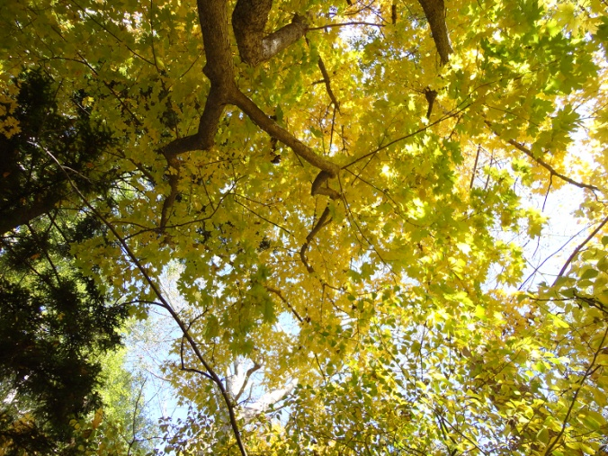
2014
April 27
May 12
May 27
October 29
2015
April 28
May 11
June 16
October 27
2016
April 28
May 13
May 30
October28
2017
April 28
May 16
May 23
October 27
Fig S1. Photographs of the upper canopy trees taken from the forest floor. Dates when the photographs taken are shown in the bottom of the photographs.

Slide 3
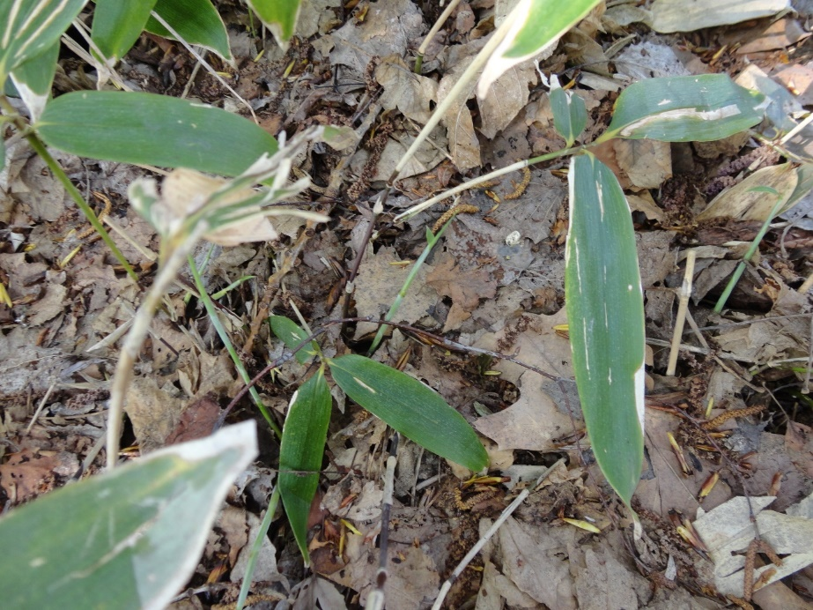
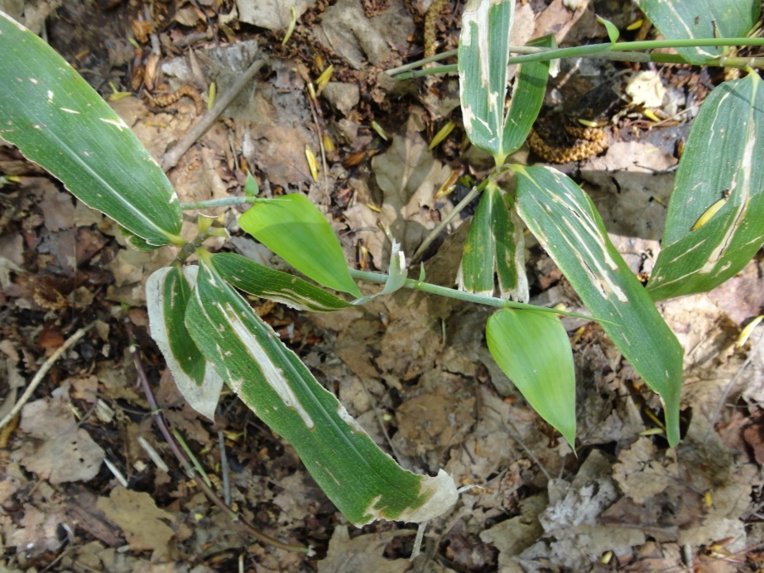
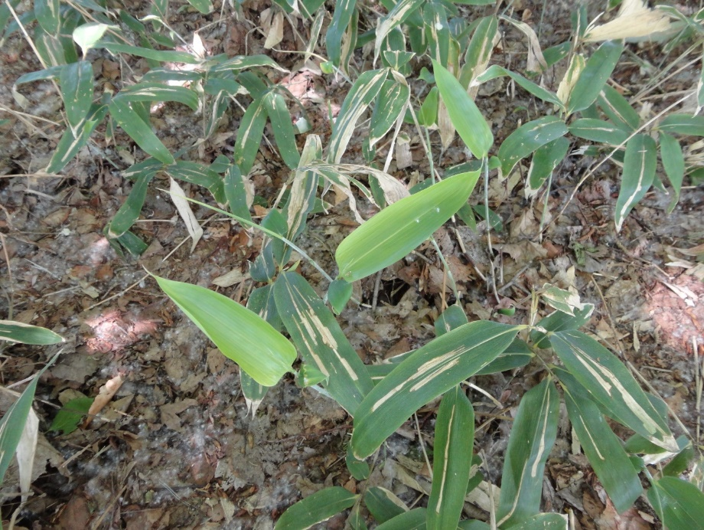
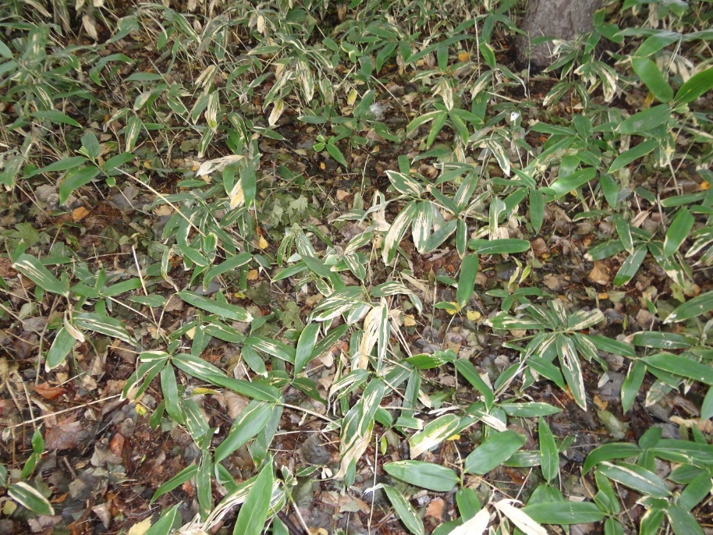
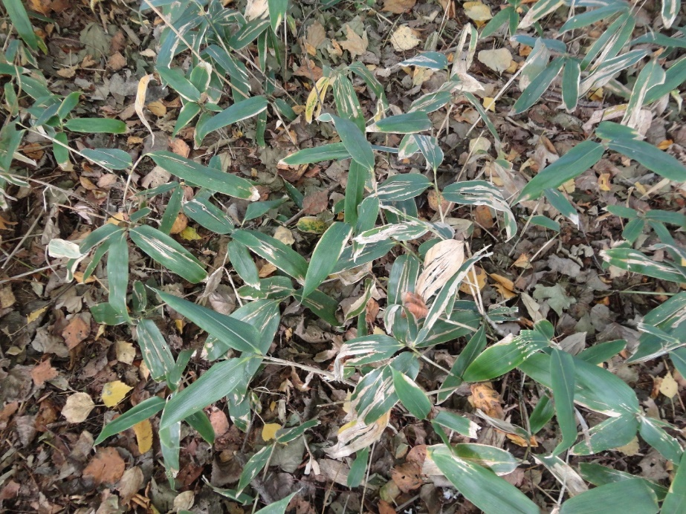
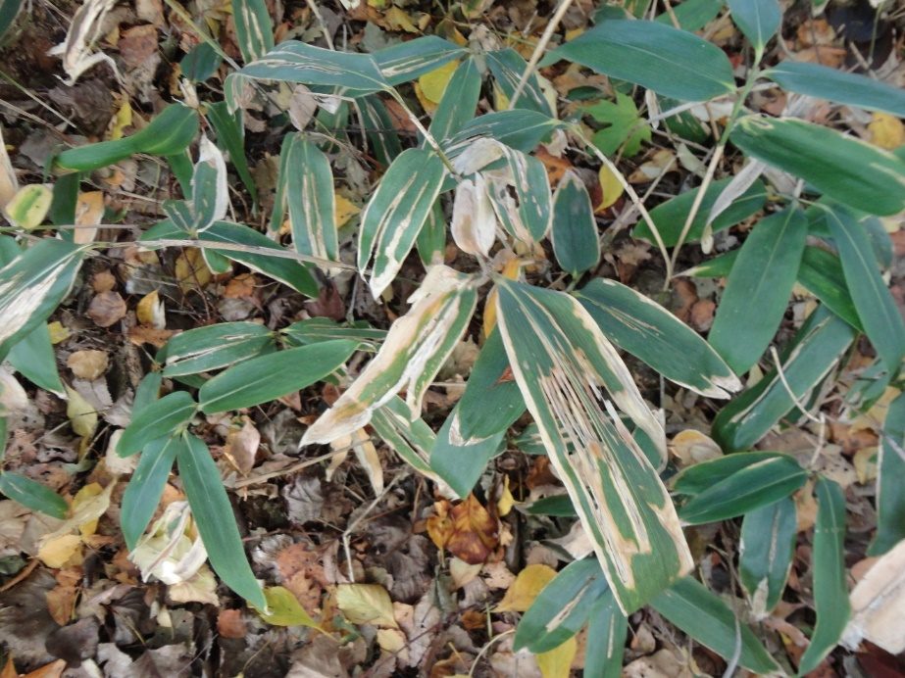
Fig. S2
May 11, 2018
May 15, 2018
May 29, 2018
Oct 2, 2018
Oct 17, 2018
Oct 25, 2018
Fig. S2 Photographs of S. senanensis. The current year leaves of S. senanensis (some examples are indicated by yellow arrows), which spread from new culms, are light green in mid-May. Some overwintering leaves have white lines in some areas and white edges.

Slide 4
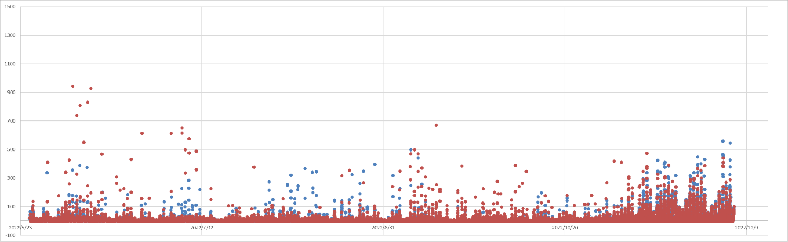
Fig.S3
PAR (μmol m⁻² s⁻¹)
Date
Fig S3 Measurements of the light environment on the forest floor from May 25 to December 5, 2022, using two PAR sensors (PAR Sensor, S-LIA-M003, ONSET, USA) connected to a data logger (HOBO USB Micro Station, ONSET, USA. The values were recorded every 10 minutes. Each measurement of each sensor was indicated by a different color. The forest floor is occasionally illuminated by strong light (sunfleck), but from late May to late October, only less than 100 μmol m⁻² s⁻¹ light reaches the forest floor.

Slide 5
Fig.S4
2014
2015
α-Carotene (mol mol Chl⁻¹)
Air temperature (ºC)
2016
2017
Fig S4. Seasonal changes in the minimum (grey lines) and maximum (black lines) temperature of the day at Sapporo as shown in Figure 1. Seasonal changes in α-carotene per chlorophyll (a + b) as shown in figure 9 are overlayed. Open and closed circles indicate data from the overwintering leaves and the current-year leaves, respectively. Each data point represents the mean of n = 3-4 leaves (± standard deviation).

Slide 6
Table S1
PPFD was measured using a light meter (LI-250, LI-COR, NE, USA) with a quantum sensor (LI-190R, LI-COR, NE, USA)
Date | 2016.04.12 | 2016.04.21 | 2016.05.10 | 2016.05.23 | 2016.08.02 | 2016.09.15 | 2016.09.30
weather | fine | fine | fine | fine | fine | fine | fine
apporx. Time of the day | 12:20 | 11:45 | 13:43 | 12:40 | 12:50 | 12:05 | 12:06
outside
numer of measuments | 3 | 4 | 5 | 5 | 5 | 4 | 5
avg | 1346.0 | 1169.3 | 756.4 | 1299.0 | 1408.4 | 1210.0 | 959.0
sd | 19.7 | 78.7 | 74.7 | 51.9 | 138.9 | 14.2 | 96.4
forest-floor(heihgt of Sasa)
number of measurements | 5 | 5 | 6 | 5 | 7 | 5 | 5
avg | 354.4 | 674.2 | 122.3 | 13.0 | 9.2 | 8.3 | 9.5
sd | 148.2 | 245.3 | 43.2 | 2.1 | 1.5 | 1.3 | 3.1
Date | 2017.04.10 | 2017.04.28 | 2017.06.30 | 2017.08.16 | 2017.09.11 | 2017.09.15 | 2017.09.22 | 2017.10.16 | 2017.10.25
weather | fine | cloudy | fine | fine | cloudy | cloudy | fine | fine | fine
apporx. Time of the day | 12:25 | 13:54 | 13:50 | 12:06 | 12:32 | 11:51 | 11:52 | 12:08 | 12:10
outside
number of measuments | 7 | 5 | 6 | 4 | 5 | 5 | 5 | 5 | 5
avg | 1310.6 | 155.4 | 1127.5 | 1528.5 | 596.8 | 368.6 | 1271.6 | 991.6 | 845.6
sd | 82.1 | 26.8 | 114.8 | 182.1 | 51.9 | 200.9 | 145.9 | 74.7 | 105.3
forest-floor(heihgt of Sasa)
number of measurements | 7 | 5 | 5 | 5 | 6 | 5 | 6 | 5 | 5
avg | 617.3 | 99.7 | 8.7 | 5.6 | 7.4 | 6.4 | 7.0 | 8.1 | 9.9
sd | 134.4 | 12.1 | 2.4 | 1.1 | 1.3 | 1.0 | 2.5 | 0.4 | 1.1

