Slide 1
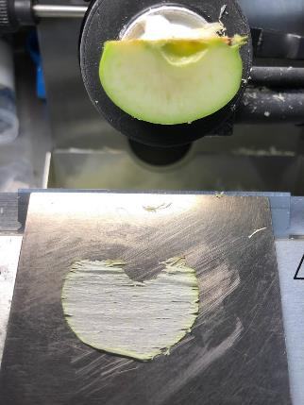
Yamashita et al.
Suppl. 1. A longitudinal specimen sliced on cryo-microtome.

Slide 2
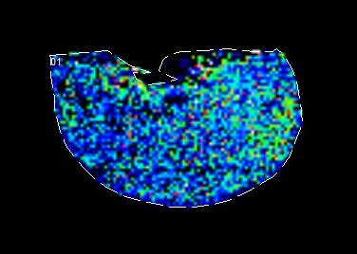
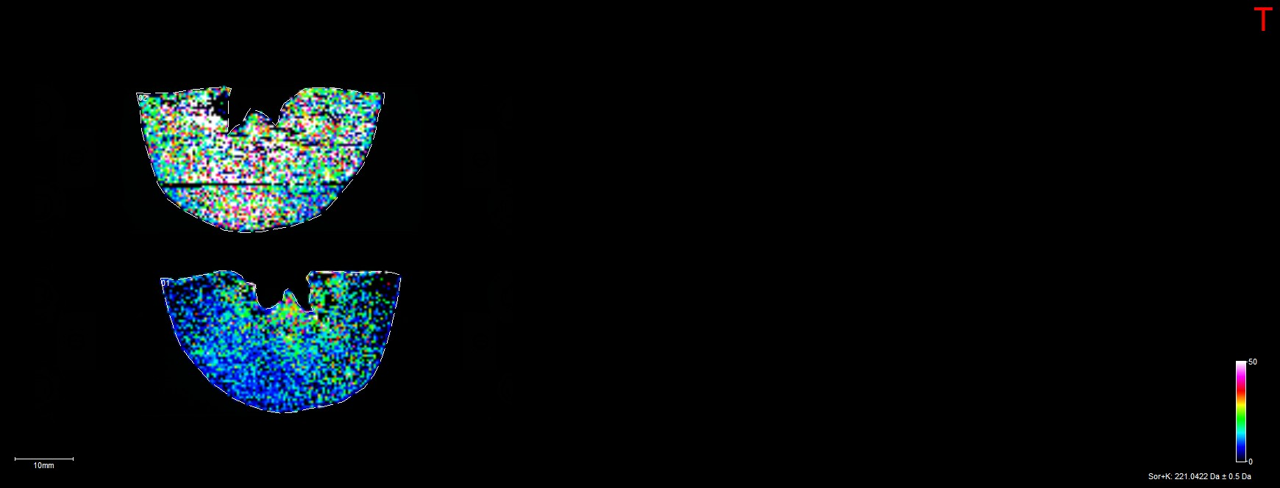
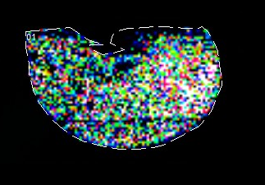
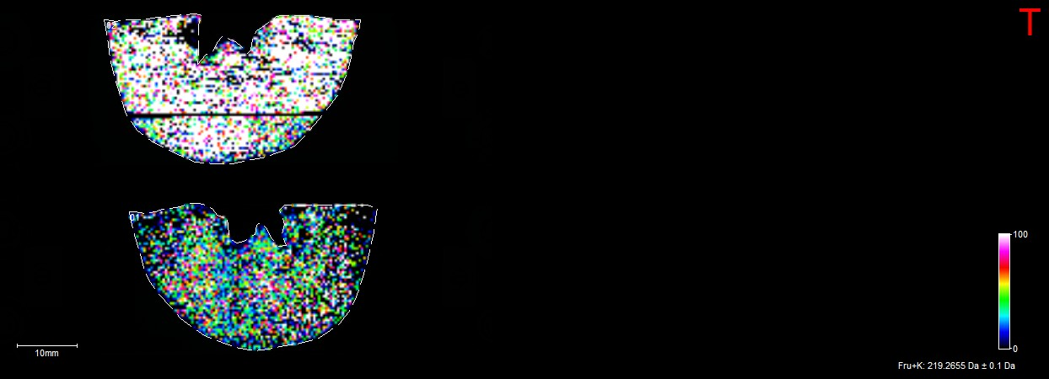
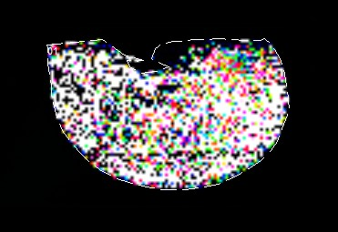
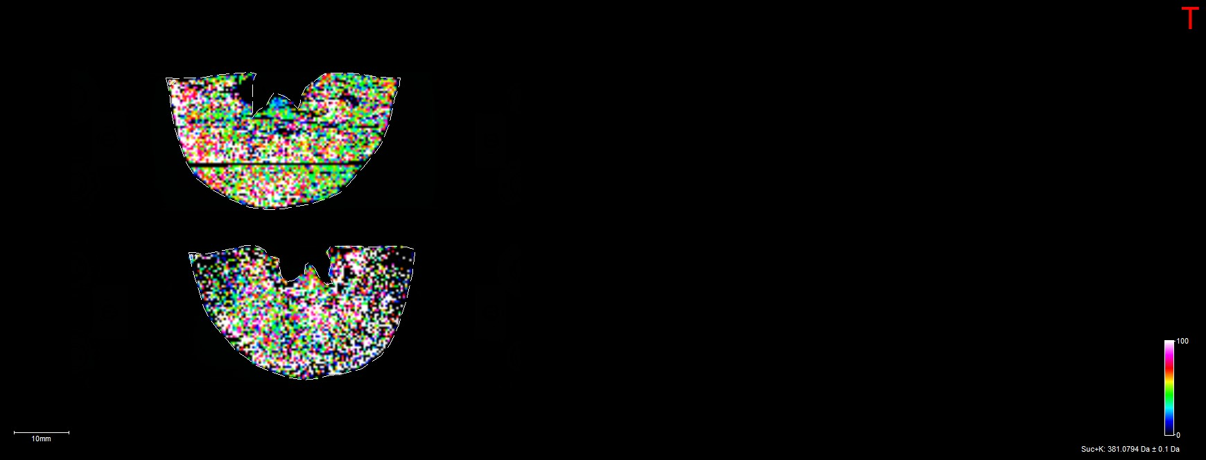
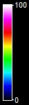
Yamashita et al.
Longitudinal
Horizontal
m/z 221.0
(¹²C sorbitol)
m/z 219.0
(¹²C hexose)
m/z 381.1
(¹²C sucrose)
Suppl. 2. Heat map images constructed by MALDI–TOF MSI on the distribution of naturally occurred (¹²C) sorbitol, hexose and sucrose in longitudinal and horizontal specimens before culturing. White bars represent 1 cm in length. On the heat map scale of 0–100%, graded color represents the peak height ratio (%) of a spot to the highest peak (100%) of each molecular ion at every MSI grid array coordinate.

