Slide 1
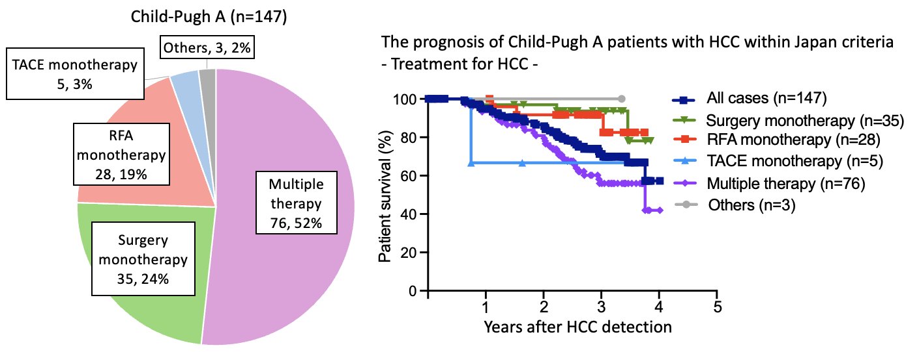
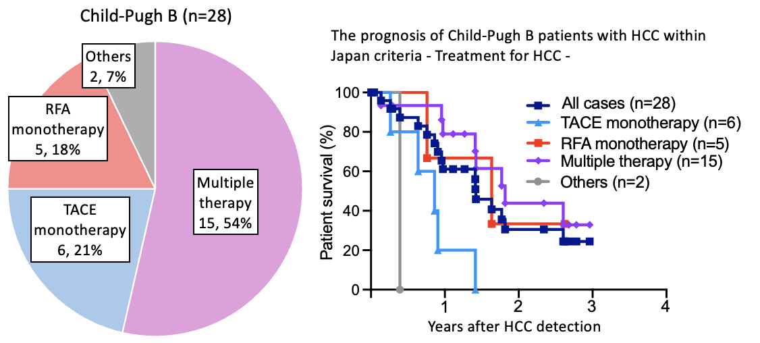
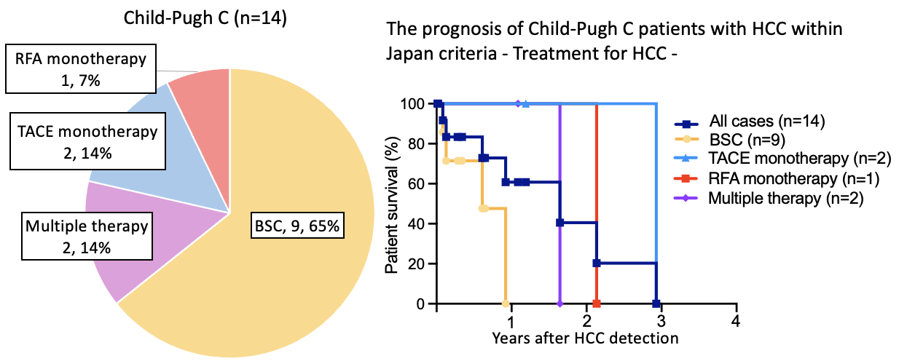
Supplemental Fig. 1
The treatment distribution for HCC patients within the Japan criteria, stratified by Child-Pugh classification, was shown in pie charts (A-C). The overall survival rates for each treatment after HCC diagnosis were presented in the corresponding figures (A-C). Four patients who underwent liver transplantation were censored at the time of transplantation.
A
B
C

