Slide 1
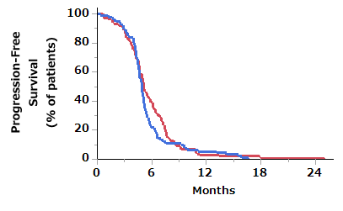
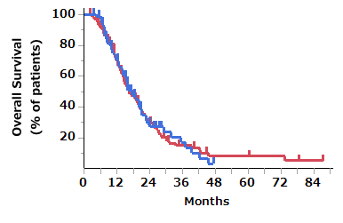
A
B
ICI-chemo
ICI-chemo
Non-ICI-chemo
Non-ICI-chemo
Number at risk
Number at risk
ICI-chemo
91
20
5
0
0
ICI-chemo
91
59
15
5
0
0
0
0
Non-ICI-chemo
133
52
4
1
1
Non-ICI-chemo
133
83
28
10
4
4
3
1
 | ICI-chemo | Non-ICI-chemo
Median PFS, months (95% CI) | 4.9 (4.6–5.1) | 5.1 (4.8–5.8)
HR (95% CI) | 1.18 (0.91 – 1.56)
P value | 0.21
 | ICI-chemo | Non-ICI-chemo
Median OS, months (95% CI) | 17.6 (14.7–20.8) | 16.5 (14.2–30.4)
HR (95% CI) | 1.00 (0.72 – 1.38)
P value | 0.99

