Slide 1
Supplementary Materials for
Peposertib prevents generation of FLT3-internal tandem duplication formed by contralateral double nicks
Document S1
Generation of cell lines with Doxycycline (Dox)-inducible Cas9 and nickases
Document S2
Generation of DNA-PKcs knock out cells
Table S1
FLT3 juxtamembrane domain alterations in clinical samples
Table S2
Clinical samples used for expression analysis of non-homologous end joining factors
Figure S1
Palindrome sequences located at the hot-spot of leukemic tandem duplications
Figure S2
Sequence pattern of FLT3-ITD joint
Figure S3
Doxycycline-induced HA-tagged Cas9 and nickases
Figure S4
Comparison of mutation frequencies and mutation rates between double nicks with 5’ overhang
and 3’ overhang
Figure S5
Artificial FLT3-ITDs in TF-1 cells
Figure S6
Murine Flt3 also has palindrome-like sequence at exon 14
Figure S7
Artificial Flt3-ITDs in murine Ba/F3 cells
Figure S8
Long term culture of artificial FLT3-ITD clones
Figure S9
Cell proliferation assays of olaparib and peposertib
Figure S10
Generation of Doxycycline-inducible wild-type FLT3 and FLT3-ITD cell lines and their sensitivity to peposertib
Figure S11
Expression of NHEJ associated factors in clinical samples

Slide 2
Document S1
Generation of cell lines with Doxycycline (Dox)-inducible Cas9 and nickases
The Cas9 nuclease is able to cleave double-stranded DNA with two nuclease domains (RuvC-like domain and HNH motif) and as a result, the Cas9 nuclease (wild type; Cas9-DSB) generates double-strand breaks (DSBs) [1]. In addition, we also used a Cas9 containing an inactivating point mutation in the catalytic residue of the RuvC-like domain (Cas9-D10A) and a Cas9 containing an inactivating point mutation in the catalytic residue of the HNH-like domain (Cas9-H840A) which act as a nickase and generates single-strand breaks (SSBs) [2]. Plasmid DNAs for the Dox-inducible expression of Cas9 were constructed as follows. cDNA of wild-type Cas9 nuclease derived from Streptococcus pyogenes was obtained by using a gene synthesis service. Sequences encoding SV40 NLS (PKKKRKV) and nucleoplasmin NLS (KRPAATKKAGQAKKKK) were added to the N- and C-termini of the Cas9 cDNA, respectively. For detection by Western blotting, a sequence encoding an HA epitope was also added to the N-terminus. D10A and H840A mutations were introduced by a PCR-based method. The resulting Cas9 cDNAs were subcloned into a piggyBac transposon vector, pPB-TRE3G-MCS-CEH-rtTA3-IP [3].
These Cas9-encoding transposon vectors were co-transfected with a plasmid DNA for the transient expression of a hyperactive piggyBac transposase into HEK293T cells using Lipofectamine 2000 (Invitrogen, Carlsbad, CA) and into K562 cells and Ba/F3 cells using electroporation with Amaxa Nucleofector 2b (Lonza, Basel, Switzerland). After the growth of live cells, the cells were given 1 µg/ml of puromycin (InvivoGen, San Diego) for selective recovery of Cas9-introduced puromycin-resistant cells. Cas9 was expressed by administering 50 ng/ml of Dox.
References
Zhang F, Wen Y, Guo X. CRISPR/Cas9 for genome editing: progress, implications and challenges. Hum Mol Genet. 2014;23(R1):R40-46.
Mali P, Aach J, Stranges PB, et al. CAS9 transcriptional activators for target specificity screening and paired nickases for cooperative genome engineering. Nat Biotechnol. 2013;31(9):833-838.
Onodera Y, Nam JM, Horikawa M, Shirato H, Sabe H. Arf6-driven cell invasion is intrinsically linked to TRAK1-mediated mitochondrial anterograde trafficking to avoid oxidative catastrophe. Nat Commun. 2018;9(1):2682.

Slide 3
Document S2
Generation of DNA-PKcs knock out cells
The tet-on-Cas9-D10A cell line established in K562 cells was electroporated TrueCut™ Cas9 Protein v2 (invitrogen) and gRNAs (5’-GCACGCGCGGGAGCGGGACT-3’ and 5’-GCGTCCTGAGCAGCAGCCCCG-3’) flanking initial codon of DNA-PKcs using Amaxa Nucleofector 4D (LONZA, Basel, Switzerland). After 48 hours, cells were diluted to 0.8 cell/well (100 µL/well) in a 96-well plate to attempt to obtain single clones. The proliferated cells were analyzed by western blotting to confirm DNA-PKcs expression, and successfully knockout cell line was obtained. Furthermore, genomic DNA was extracted, and Sanger sequencing was performed to confirm successful deletion of the target site.

Slide 4
Table S1
FLT3 juxtamembrane domain alterations in clinical samples
Case | Age | Gender | Karyotype | Sample blast (%) | Number of FLT3-ITD clones | median VAF of FLT3-ITD (%) (range) | Number of Insertion clones | median VAF of Insertion (%) | Number of Deletion clones | median VAF of Deletion (%)
1 | 83 | M | 46,XY | 98.5 | 13 | 0.0043 (0.0014-33.9) | 0 |  | 0
2 | 49 | M | 46,XY | 40 | 6 | 0.096 (0.0037-38.4) | 0 |  | 1 | 0.0037
3 | 73 | F | 46,XX | 100 | 1 | 39 | 0 |  | 1 | 0.0058
4 | 58 | F | 46,XX | 86.5 | 2 | 22.656 (0.012-45.3) | 0 |  | 1 | 0.0029
5 | 68 | F | 46,XX | 71 | 3 | 2.7 (0.026-45.7) | 0 |  | 0
6 | 44 | F | 46,XX,t(6;9)(p23;q34.1) | 82 | 2 | 15.668 (0.036-31.3) | 0 |  | 0
7 | 61 | M | 46,XY | 50.2 | 7 | 0.0546 (0.0068-14.7) | 0 |  | 0
8 | 73 | F | 46,XX | 90 | 3 | 0.066 (0.0022-14.81) | 0 |  | 1 | 0.0088
9 | 60 | F | 46,XX | 74 | 10 | 0.0236 (0.0047-18.9) | 0 |  | 1 | 0.0023
10 | 85 | M | 46,XY | 82 | 2 | 15.1758 (0.057-30.3) | 0 |  | 1 | 0.0031
11 | 49 | M | 46,XY | 99 | 7 | 0.034 (0.0048-33.2) | 1 | 0.0024 | 0
12 | 49 | M | 46,XY | 26 | 10 | 0.0067 (0.0021-38.4) | 0 |  | 0
13 | 90 | M | 46,XY | 86.5 | 2 | 17.5837 (0.0803-35.087) | 0 |  | 0
14 | 69 | M | 46,XY | 98 | 2 | 13.771 (0.012-27.53) | 0 |  | 1 | 0.0062
15 | 80 | F | 46,XX | 97.5 | 7 | 0.0201 (0.0075-9.34) | 0 |  | 0
16 | 68 | M | 47,XY,+mar[1]/46,XY[19] | 92.4 | 1 | 34.9 | 0 |  | 0
17 | 73 | M | 46,XY | 84 | 4 | 2.8595 (0.0206-20.36) | 0 |  | 0
18 | 57 | M | 46,XY | 69.5 | 6 | 0.0267 (0.01-18.6) | 0 |  | 0
19 | 34 | F | 46,XX | 34.5 | 3 | 0.032 (0.013-9.71) | 0 |  | 0
20 | 21 | F | 46,XX | 89 | 4 | 0.0948 (0.0027-44.7) | 0 |  | 1 | 0.0013
FLT3-ITD, fms-like tyrosine kinase 3-internal tandem duplication; VAF, variant allele frequency

Slide 5
Table S2
Clinical samples used for expression analysis of non-homologous end joining factors
 | All patients (N=40) | FLT3-ITD negative (N=20) |  | FLT3-ITD positive (N=20) |  | P value
 |  | NPM1 wild type (N=10) | NPM1 mutation (N=10) | NPM1 wild type (N=10) | NPM1 mutation (N=10)
Age (years) [range] | 65.5 [32-91] | 60 [39-90] | 71.5 [40-91] | 63 [32-85] | 70.5 [43-89] | 0.644
Gender
Male | 19 | 8 | 3 | 4 | 4 | 0.153
Female | 21 | 2 | 7 | 6 | 6
Karyotype
Normal karyotype | 35 | 9 | 10 | 8 | 8 | 0.726
Others | 5 | 1 | 0 | 2 | 2
Sample blast (%) | 88.8 [34.5-99] | 85 [75.5-95.5] | 86 [42-99] | 84.9 [34.5-97] | 95 [50.4-99] | 0.161

Slide 6
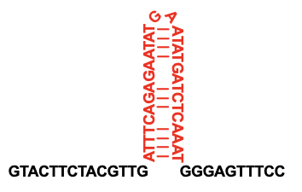
Figure S1
Palindrome sequences located at the hot-spot of leukemic tandem duplications
FLT3 exon 14
Duplication hot spot
NPM1 exon 12
AGA
TCT
GCTATTCA CTGGCAGTGGAGGAAGTCTCTTTAA
Duplication hot spot [1]
Type A mutation: NPM1 c.863_864insTCTG
UBTF exon 12
C
GCTCTC
GAGAGC
GGAGGAGCGGCCTGA GAGCTGACCCGCCTGCTGGCCCGAATGTGGAACGACC
Duplication hot spot [2]
Palindrome sequences located at the hot-spot of leukemic tandem duplications were shown. NPM1 mutation is 4 bp elongation which located 6 bp palindrome sequence (Bgl II site). The most common type of the mutation, type A, is insertion of “TCTG”, which is complete duplication of the site [1]. Recently UBTF-ITD was identified as recurrent mutation in pediatric AML. Thirteen bp palindrome sequence locates at the beginning of common duplication site [2].
References
Ivey A, Hills RK, Simpson MA, et al. Assessment of Minimal Residual Disease in Standard-Risk AML N Engl J Med. 2016;374(5):422-33.
Georgi JA, Stasik S, Eckardt JN, et al. UBTF tandem duplications are rare but recurrent alterations in adult AML and associated with younger age, myelodysplasia, and inferior outcome Blood Cancer J. 2023;13(1):88.

Slide 7
Figure S2
Sequence pattern of FLT3-ITD joint
I) ITD without filler
II) ITD with filler
NNN
NNN
III) ITD with microhomology
microhomology
CAT
CAT
CAT
MMEJ
or
NHEJ
NHEJ, non-homologous end joining; MMEJ, microhomology-mediated end joining
Sequence pattern of FLT3-ITDs was shown.
Although patterns I and II were considered to be the result of repair by non-homologous end joining (NHEJ), pattern III may have been repaired by NHEJ or microhomology-mediated end joining (MMEJ) following DNA slippage.

Slide 8



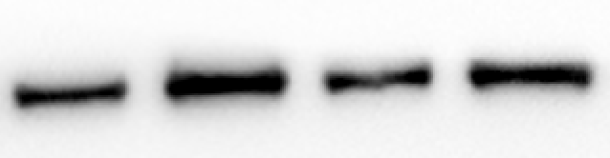



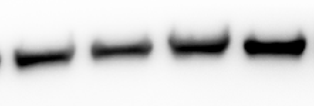


Figure S3
Doxycycline-induced HA-tagged Cas9 and nickases
Doxycycline
Cas9-DSB
Cas9-D10A
Doxycycline
Cas9-D10A
Cas9-H840A
-
+
-
+
HEK293T
-
+
-
+
HEK293T
HA
HA
K562
β-actin
K562
β-actin
HA
HA
TF-1
β-actin
β-actin
HA
Ba/F3
β-actin
CV
HA
β-actin
Western blotting of anti-HA-tag monoclonal antibody confirmed the expression of HA-tagged Cas9-nuclease, Cas9-D10A, and Cas9-H840A 24 hours after administration of Doxycycline.
TF-1 cells (human erythroleukemic cell) were cultured in RPMI1640 medium with 10% FCS and 1% PS, and 2 ng/ml of GM-CSF (Wako Pure Chemicals, Osaka, Japan.)

Slide 9

Figure S4
Comparison of mutation frequencies and mutation rates between double nicks with 5’ overhang and 3’ overhang
A
double nicks by Cas9-H840A
double nicks by Cas9-D10A
D10A
H840A
D10A
H840A
5’
3’
5’
3’
DSB with 5’ protruding ends
DSB with 3’ protruding ends
B
HEK293T
K562
P=0.037
P=0.009
ITD
P=0.046
P=0.149
ITD
30
25
20
15
10
5
0
100
90
80
70
60
50
40
30
20
10
0
Ins
5
4
3
2
1
0
100
90
80
70
60
50
40
30
20
10
0
Ins
Del
Del
Mutation frequency (%)
Mutation rate (%)
Mutation frequency (%)
Mutation rate (%)
gRNA
S+AS | S+AS
S+AS | S+AS
gRNA
S+AS | S+AS
S+AS | S+AS
Cas9
D10A
H840A
D10A
H840A
Cas9
D10A
H840A
D10A
H840A
5’overhang
3’overhang
5’overhang
3’overhang
5’overhang
3’overhang
5’overhang
3’overhang
Comparison of mutation frequencies and mutation rates between double nicks with 5’ overhang and 3’ overhang was shown. Using the same gRNA pair, Cas9-D10A and H840A creates double nicks with 5’ or 3’ overhang, which results in 5’ or 3’ protruding DSB respectively. Independent experiments were performed three times. Data for mutation frequency are shown as means ± SD. DSB, double-strand break
Difference of mutation frequency might represent different efficacy inducing nicks by each Cas9 nickase. Among the mutation events in each cell line, more than half events were ITDs in Cas9-H840A. Because mutation frequency of Cas9-D10A was higher than Cas9-H840A, we used Cas9-D10A for further analysis.

Slide 10
Figure S5
Artificial FLT3-ITDs in TF-1 cells
A
ITD
Ins
0.5
0.45
0.4
0.35
0.3
0.25
0.2
0.15
0.1
0.05
0
100
90
80
70
60
50
40
30
20
10
0
Del
Mutation frequency (%)
Mutation rate (%)
gRNA
S | AS | S | AS
S+AS
S | AS | S+AS
Cas9
nuclease
D10A
nuclease
D10A
DSB
(blunt)
SSB
DSB
(protruding)
DSB
(blunt)
DSB
(protruding)
B
D
80
70
60
50
40
30
20
10
0
3N bp
3N+1 bp
26
27
3N+2 bp
Accumulation of FLT3-ITD clones
Exon14
＊
32
C
(＊) palindrome-like sequence
E
30
25
20
15
10
5
0
10
ITD without filler
Median of 24 bp (3-44)
N=85
9
Number of FLT3-ITD clones
66
3-10 | 11-20 | 21-30 | 31-40 | 41-50 | 51-60 | 61-70 | 71-80 | 81-90
ITD length (bp)
Human erythroleukemic cell line, TF-1, was used to create artificial FLT3-ITDs.
A. Comparison of mutation frequencies and mutation rates by different modes of DNA repair.
Because the mutation frequency of single SSB was very low, the mutation rate is not
shown.
B. Area of FLT3-ITDs is shown. Orange lines show positions of gRNAs.
C. Distribution of ITD lengths for each cell line.
D. Percentages of length categories of artificial FLT3-ITDs. FLT3-ITD lengths were equally
distributed among 3N, 3N+1, and 3N+2 bp.
E. Percentages of joint characteristics of artificial FLT3-ITDs.

Slide 11
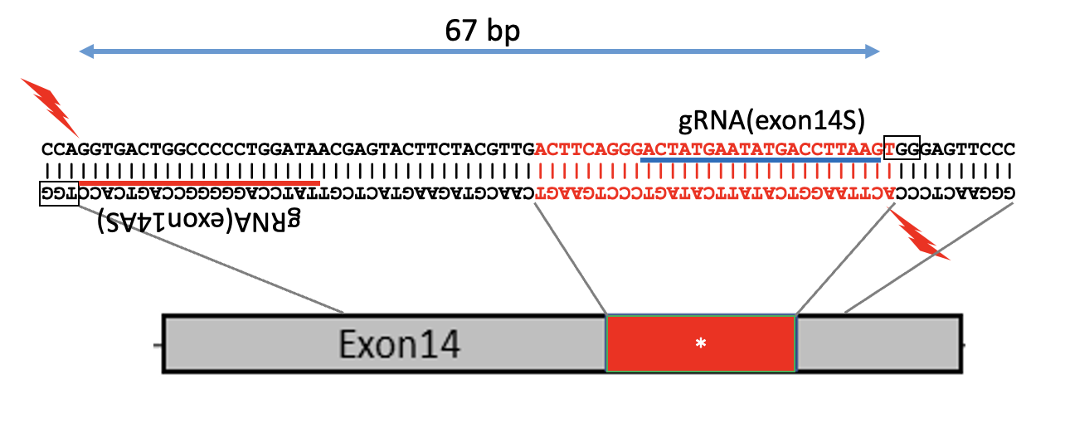
Figure S6
Murine Flt3 also has palindrome-like sequence at exon 14
A
mouse Flt3
＊
Two gRNAs were designed to target flanking the palindrome-like sequence at mouse Flt3 exon 14. S, Sense strand; AS, Antisense strand
B
mFlt3 exon 14
G
A
ACTTCAGGGACTAT
||| ||| ||||
ATATGACCTTAAGT
GTACTTCTACGTTG GGGAGTTCCC
||||||||||||||
||||||||||
GGGAACTCCC CAACGTAGAAGTAC
ATAGTCCCTGAAGT
|||| ||| |||
ACTTAAGGTCATAT
T
C
Palindrome-like sequence consisting 10 paired match within 30 bp stretch, possibly forming cruciform structure.

Slide 12
Figure S7
Artificial Flt3-ITDs in murine Ba/F3 cells
A
ITD
Ins
100
90
80
70
60
50
40
30
20
10
0
Del
8
7
6
5
4
3
2
1
0
Mutation frequency (%)
Mutation rate (%)
gRNA
S | AS | S+AS | S | AS | S+AS
S | AS | S+AS | S+AS
Cas9
WT
D10A
WT
D10A
DSB
(protruding)
DSB
(blunt)
DSB
(protruding)
DSB
(blunt)
SSB
B
30
25
20
15
10
5
0
Accumulation of Flt3-ITD clones
Exon14
＊
C
(＊) palindrome-like sequence
90
80
70
60
50
40
30
20
10
0
median of 24 bp (3-74)
N=250
Numbers of Flt3-ITD clones
3-10 | 11-20 | 21-30 | 31-40 | 41-50 | 51-60 | 61-70 | 71-80 | 81-90
ITD length (bp)
D
E
48
88
89
28
174
73
ITD without filler
3N bp
ITD with filler
3N+1 bp
ITD with microhomology
3N+2 bp
A. Comparison of mutation frequencies and mutation rates by different modes of DNA repair.
B. Area of ITDs with VAF of more than 0.01%. Orange lines show positions of gRNAs.
“＊” represents the palindrome-like sequence.
C. Distribution of Flt3-ITD lengths.
D. Percentages of length categories of artificial Flt3-ITDs. Flt3-ITD lengths were equally distributed among 3N,
3N+1, and 3N+2 bp.
E. Percentages of joint characteristics of artificial Flt3-ITDs.

Slide 13


Figure S8
Long term culture of artificial FLT3-ITD clones
A
1.2
1
0.8
0.6
0.4
0.2
0
100
90
80
70
60
50
40
30
20
10
0
ITD
Ins
Del
Mutation frequency (%)
Mutation rate (%)
day2
day28
day56
day2
day28
day56
B
3N bp ITD
Others
day2
day28
day56
C
HEK293T
K562
TF-1
THP-1
500bp→
FLT3 exon 12F x 16R
500bp→
β-actin
The mutation frequency and mutation rate are shown for the K562/tet-on CRISPR nickase (D10A), induced contralateral double nicked at day 2, day 28 and day 56 after gRNA transfection.
Percentages of length categories of artificial FLT3-ITDs are shown at day 2, day 28
and day 56.
Expression of endogenous FLT3 were verified by RT-PCR with following primers.
FLT3 exon 12F：5’-CTTGGCACATCTTGTGAGACG-3’
FLT3 exon 16R：5’-AGGTTCACAATATTCTCGTGGC-3’
β-actin F: 5’-AGGCCGGCTTCGCGGGCGAC-3’
β-actin R: 5’-CTCGGGAGCCACACGCAGCTC-3’
All cells were found not to express endogenous FLT3 protein. We attempted to establish inducible Cas9 cell lines using FLT3-expressing cells, such as THP-1, OCI-AML3, and HL60 several times. However, these cells exhibited extremely low transfection efficiency, making it difficult to generate stable cell CRISPR lines.

Slide 14
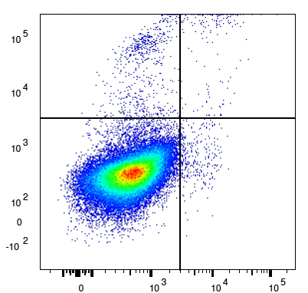
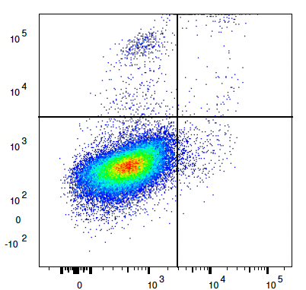
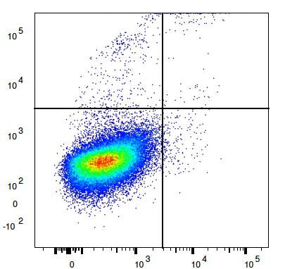
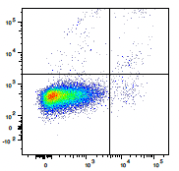
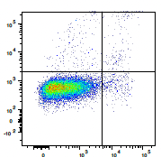
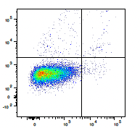
Figure S9
Cell proliferation assays of olaparib and peposertib
A
Olaparib
Peposertib
0-1000 µM
0-50 µM
0-1000 µM
0-5 µM
HEK293T
1.2
1.0
0.8
0.6
0.4
0.2
0
1.2
1.0
0.8
0.6
0.4
0.2
0
1.2
1.0
0.8
0.6
0.4
0.2
0
1.2
1.0
0.8
0.6
0.4
0.2
0
K562
Relative live cell count
Relative live cell count
Relative live cell count
Relative live cell count
0 | 0.01 | 0.1 | 1 | 10 | 100 | 1000
0 | 10 | 20 | 30 | 40 | 50
0 | 0.01 | 0.1 | 1 | 10 | 100 | 1000
0 | 1 | 2 | 3 | 4 | 5
B
(µM)
(µM)
(µM)
(µM)
HEK293T
untreated cells
Olaparib 20 µM
Peposertib 2 µM
0.85
0.25
1.19
0.48
0.63
0.21
PI
98.4
0.48
97.4
0.93
98.8
0.35
Annexin V
K562
untreated cells
Olaparib 20 µM
Peposertib 2 µM
0.69
0.73
1.08
1.08
1.05
0.71
PI
97.6
0.99
95.7
2.12
97.4
0.79
Annexin V
C
K562
HEK293T
Olaparib
Peposertib
Olaparib
Olaparib
Peposertib
(µM)
0 | 20 | 0 | 2 | 0 | 20 | 0 | 2 | 40
Cleaved caspase-3
β-actin
A. Cell proliferation assays for olaparib and peposertib in HEK293T/tet-on Cas9 D10A and K562/tet-on Cas9 D10A cells are shown. HEK293T or K562 cell suspensions were prepared at a concentration of 5.0 × 10⁵ cells/mL and seeded in 96-well plates at 90 µL per well. After 96 hours of treatment with 10 µL of Olaparib and 48 hours of treatment with 10 µL of peposertib, 10 µL of Cell Counting Kit-8 (Dojindo, Kumamoto, Japan) was added to each well, followed by incubation at 37ºC for 2 hours. The absorbance of each well was then measured using a Promega GloMax-Multi Detection System (Promega, Madison, WI). Olaparib was initially tested at concentrations ranging from 0 to 1000 µM and subsequently at 0 to 50 µM, while peposertib was tested at 0 to 1000 µM and then at 0 to 5 µM. The highest concentrations at which more than 90% of cells remained viable were determined to be 20 µM for Olaparib and 2 µM for peposertib, and these concentrations were used in our study. Since HEK293T and K562 cells do not carry BRCA mutations, the IC50 of Olaparib was significantly higher compared to BRCA-mutated, Olaparib-sensitive cells. Relative live cell data are presented as means ± SD.
B. The percentages of apoptotic cells in HEK293T and K562 cells treated with or without 20 µM Olaparib or 2 µM peposertib were assessed using flow cytometry (BD FACSCanto II) by analyzing APC Annexin V (BD Biosciences, San Jose, CA) and propidium iodide (PI) (Dojindo). In both HEK293T and K562 cells, no significant increase in apoptotic cells was observed following treatment with 20 µM Olaparib or 2 µM peposertib.
C. To further evaluate the effect of drug treatment on apoptosis, Western blotting was performed using an antibody against cleaved caspase-3 (Asp175) (Cell Signaling Technology, Danvers, MA). K562 cells treated with 40 µM olaparib served as a positive control. In both HEK293T and K562 cells, no increase in cleaved caspase-3 expression was detected at 20 µM Olaparib or 2 µM peposertib.

Slide 15






Figure S10
Generation of Doxycycline-inducible wild-type FLT3 and FLT3-ITD cell lines and their sensitivity to peposertib
A
HEK293T
K562
wild-type FLT3
FLT3-ITD
wild-type FLT3
FLT3-ITD
Dox
– | ＋ | – | ＋
– | ＋ | – | ＋
HA
γ-H2AX
β-actin
B
14
12
10
8
6
4
2
0
FLT3-ITD
Wild-type FLT3
Number of live cells (x10⁵ cells)
0 | 24 | 48
Culture time (h)
Plasmid DNAs for the Doxycycline (Dox)-inducible expression of wild-type FLT3 and FLT3-ITD were constructed as follows. The cDNA of wild-type FLT3 and FLT3-ITD was derived from MOLM-14 cells. To enable detection by Western blotting, a sequence encoding an HA epitope was added to the N-terminus. These cDNAs were then subcloned into the piggyBac transposon vector pPB-TRE3G-MCS-CEH-rtTA3-IP. For stable integration, these transposon vectors were co-transfected with a plasmid encoding a hyperactive piggyBac transposase. Transfection was performed using Lipofectamine 2000 (Invitrogen) for HEK293T cells and electroporation with Amaxa Nucleofector 2b (Lonza) for K562 cells. After allowing the cells to recover and proliferate, 1 µg/ml of puromycin (InvivoGen) was added to selectively enrich for cells expressing wild-type FLT3 or FLT3-ITD. The expression of wild-type FLT3 and FLT3-ITD was induced by administering 50 ng/ml of Dox. To assess differences in baseline DNA double-strand break (DSB) accumulation, Western blotting was performed to compare γH2AX expression between cells expressing wild-type FLT3 and FLT3-ITD after Dox administration. The results showed that cells expressing FLT3-ITD did not exhibit increased γH2AX expression at baseline compared to those expressing wild-type FLT3.
Using these cell lines, 5×10⁵ cells/mL of wild-type FLT3 and FLT3-ITD were treated with 2 µM of peposertib, and cell culture was initiated. The number of viable cells was counted at 24 and 48 hours, and cell viability was compared to that before peposertib administration. As a result, no significant difference in peposertib sensitivity was observed between wild-type FLT3 and FLT3-ITD. Additionally, the possibility that artificially introduced FLT3-ITD was markedly reduced by peposertib treatment was ruled out.

Slide 16
Figure S11
Expression of NHEJ associated factors in clinical samples
For the analysis of the expression of non-homologous end joining (NHEJ)-associated factors such as DNA-PKcs, Ku80, Ku70, and LIG4, 10 cases each of AML with or without FLT3-ITD and/or NPM1 mutations were randomly selected from cases registered in the Hokkaido Leukemia Net. Total RNA was extracted from 1×10⁶ cells of each clinical sample using TRIzol Reagent (Thermo Fisher Scientific, Waltham, MA). One microgram of total RNA was used for cDNA synthesis with the SuperScript™ III First-Strand Synthesis System (Thermo Fisher Scientific). Quantitative PCR analysis was performed using a CFX96 Real-Time System (Bio-Rad Laboratories, Hercules, CA) with the following primers.
Primer name | Oligo
DNA-PKcs forward | GCGCCATATCTGTCATCTGCTG
DNA-PKcs reverse | TTATAGCGGCGCTTCAGGTCGA
Ku80 forward | GTTCTAAAGGTCTTTGCAGCAAGA
Ku80 reverse | AAAAGCCACGCCGACTTGAGGA
Ku70 forward | GGTTTCAAGCCGTTGGTACTGC
Ku70 reverse | CTCCAGACACTTGATGAGCAGAG
LIG4 forward | CAGCAGAGATCGTACCCAGTGA
LIG4 reverse | TGCGAGCTTACCAGATGCCTTC
β-actin forward | AGGCCGGCTTCGCGGGCGAC
β-actin reverse | CTCGGGAGCCACACGCAGCTC
A
DNA-PKcs
Ku80
Ku70
LIG4
4
3
2
1
0
P=0.006
3.5
3
2.5
2
1.5
1
0.5
0
P=0.016
2.5
2
1.5
1
0.5
0
P=0.405
4
3
2
1
0
P=0.092
Relative expression (2^{-ΔΔCt})
Relative expression (2^{-ΔΔCt})
Relative expression (2^{-ΔΔCt})
Relative expression (2^{-ΔΔCt})
FLT3-ITD
– N=20 | + N=20
– N=20 | + N=20
– N=20 | + N=20
– N=20 | + N=20
B
C
DNA-PKcs
DNA-PKcs
Ku80
Ku70
LIG4
**P<0.001, *P<0.05
P=0.026
3
2.5
2
1.5
1
0.5
0
P=0.06
P=0.011
P=0.323
7
6
5
4
3
2
1
0
**
*
*
3
2
1
0
4
3
2
1
0
3
2
1
0
Relative expression (2^{-ΔΔCt})
Relative expression (2^{-ΔΔCt})
Relative expression (2^{-ΔΔCt})
Relative expression (2^{-ΔΔCt})
Relative expression (2^{-ΔΔCt})
NPM1 MT
– N=20 | + N=20
FLT3-ITD
– | – | + | +
– N=10 | + N=10 | – N=10 | + N=10
– N=20 | + N=20
– N=20 | + N=20
– N=20 | + N=20
NPM1 MT
Comparison of the expression of DNA-PKcs, Ku80, Ku70 and LIG4 in clinical samples with or without FLT3-ITD. Data of relative expression are shown as means ± SD.
Comparison of the expression of DNA-PKcs, Ku80, Ku70 and LIG4 in clinical samples with or without NPM1 mutation. Data of relative expression are shown as means ± SD.
Comparison of the expression of DNA-PKcs among the 4 groups with or without FLT3-ITD and NPM1 mutation. Data of relative expression are shown as means ± SD.

